Slide 1




Functional Programming
Introduction

Slide 2
What is Functional Programming?
“Functional programming is a paradigm that treats computer programs as mathematical functions”

Slide 3
What is Functional Programming?
Functions instead of Classes
Pure functions
Combining and composing
Immutability
Focus on what the computer should do
Code is similar to reasoning

Slide 4
F#

Slide 5
List
type List<T> =
| Empty
| Node of T * List<T>

Slide 6
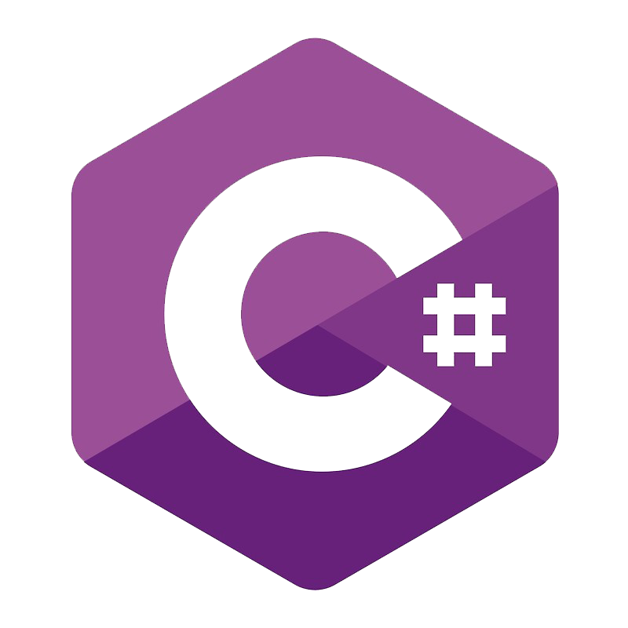
List
(Linked)
public class List<T>
{
private Node<T>? head;
public static List<T> Empty() {
return new List<T>();
}
public void Add(T value) {
var newNode = new Node<T>(value);
newNode.next = head;
head = newNode;
}
}
public sealed class Node<T>
{
internal T item;
internal Node<T>? next;
public Node(T value) {
item = value;
}
}

Slide 7
List
type List<T> =
| ([]): T list
| (::): Head: T * Tail: T list -> T list

Slide 8
List.contains
let rec contains x lst =
match lst with
| Empty -> false
| Node(y, ys) ->
if x = y then true
else contains x ys

Slide 9
List.contains
Linked
public bool Contains(T value)
{
Node<T>? node = head;
EqualityComparer<T> c = EqualityComparer<T>.Default;
if (node != null) {
if (value != null) {
do {
if (c.Equals(node!.item, value)) {
return true;
}
node = node.next;
} while (node != head);
}
else
{
do {
if (node!.item == null) {
return true;
}
node = node.next;
} while (node != head);
}
}
return false;
}

Slide 10
Summary
Concise
Elegant
Less bugs
Polymorphism by default
Slower
Different

Slide 11
Advanced topics
Folds
Active Patterns
Trees
Monads
(Monadic) Parser Combinators
Regular expressions
Tail recursion
Continuations

