Slide 1














Thanks to our Sponsors!
Partners
Premier
Marquee:
Prize:

Slide 2
Starting with R from Scratch
Mark Nielsen
nielsen.markus11@gmail.com
github.com/nielsenmarkus11/allergy-report

Slide 3
R Learning Resources
Stack Overflow
RStudio Cheat Sheets
tryr.codeschool.com
Rseek.org
CRAN Task Views

Slide 4
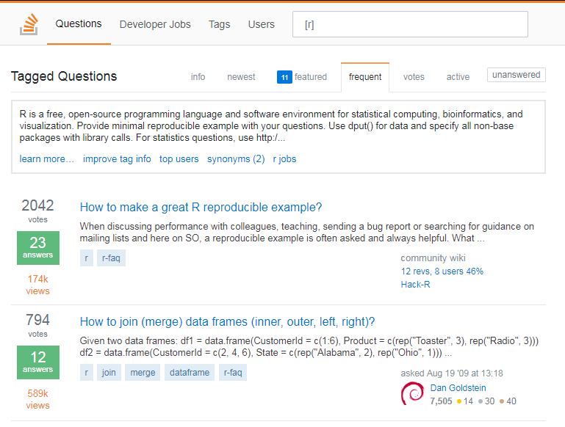
Stack Overflow
https://stackoverflow.com/questions
Can easily search with [r] tag.

Slide 5
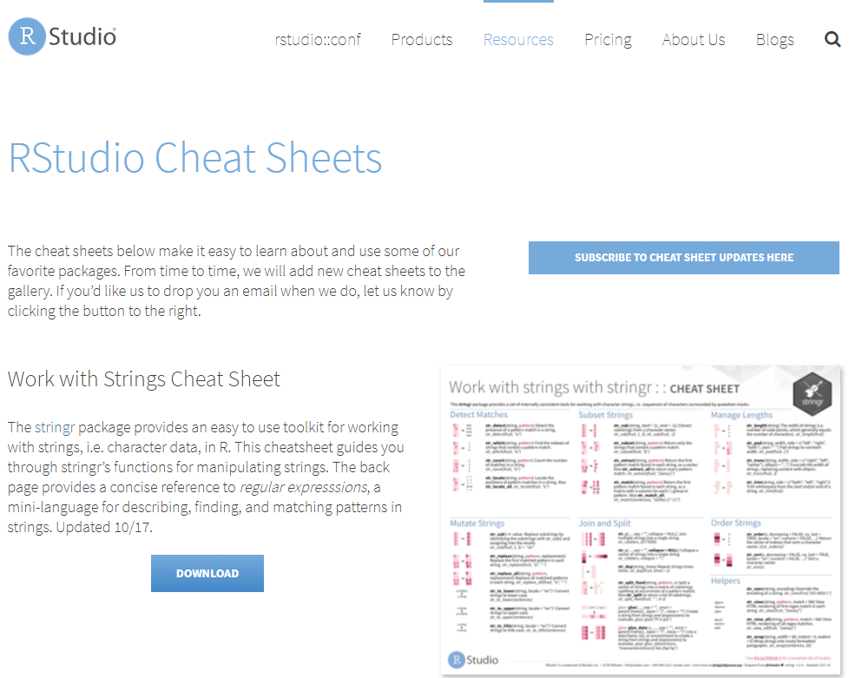
Rstudio Cheatsheets
https://www.rstudio.com/resources/cheatsheets/
Can also access from RStudio help menu.

Slide 6
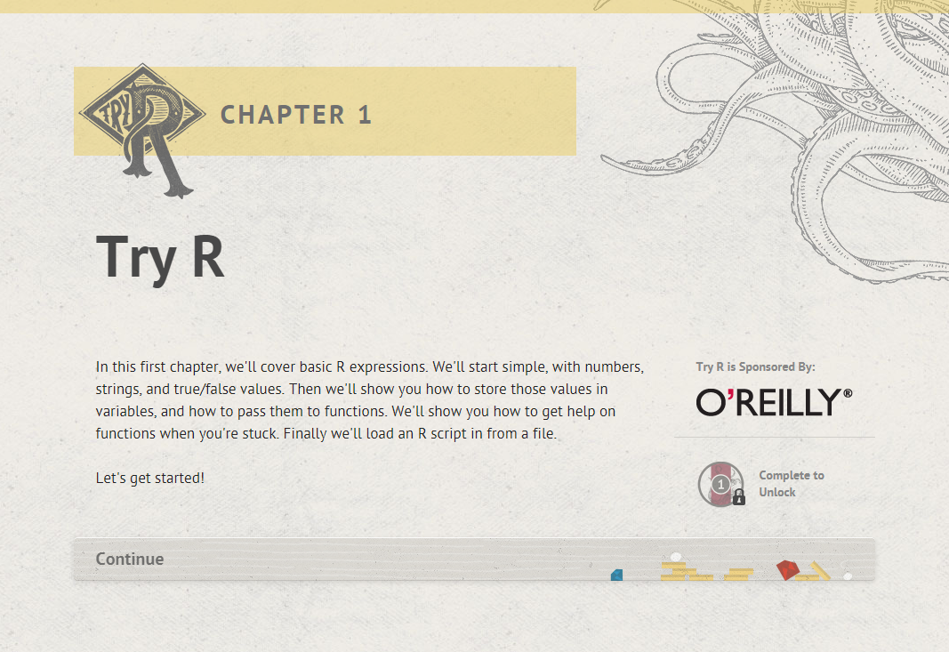
Try R
http://tryr.codeschool.com/
Hands-on training with no R installation required.

Slide 7
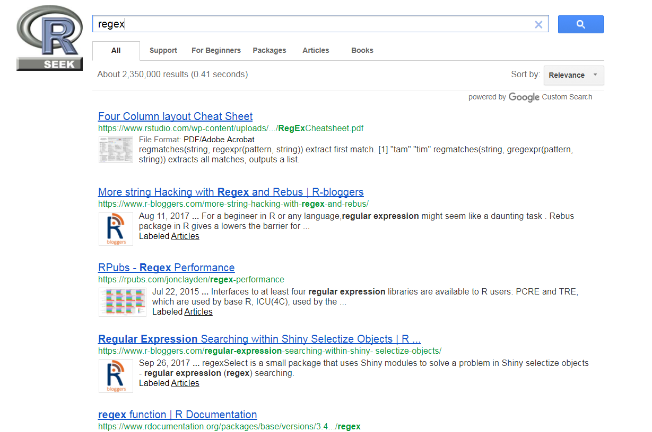
Rseek.org
http://rseek.org/
Google search limited to known R forums, blogs and websites.

Slide 8
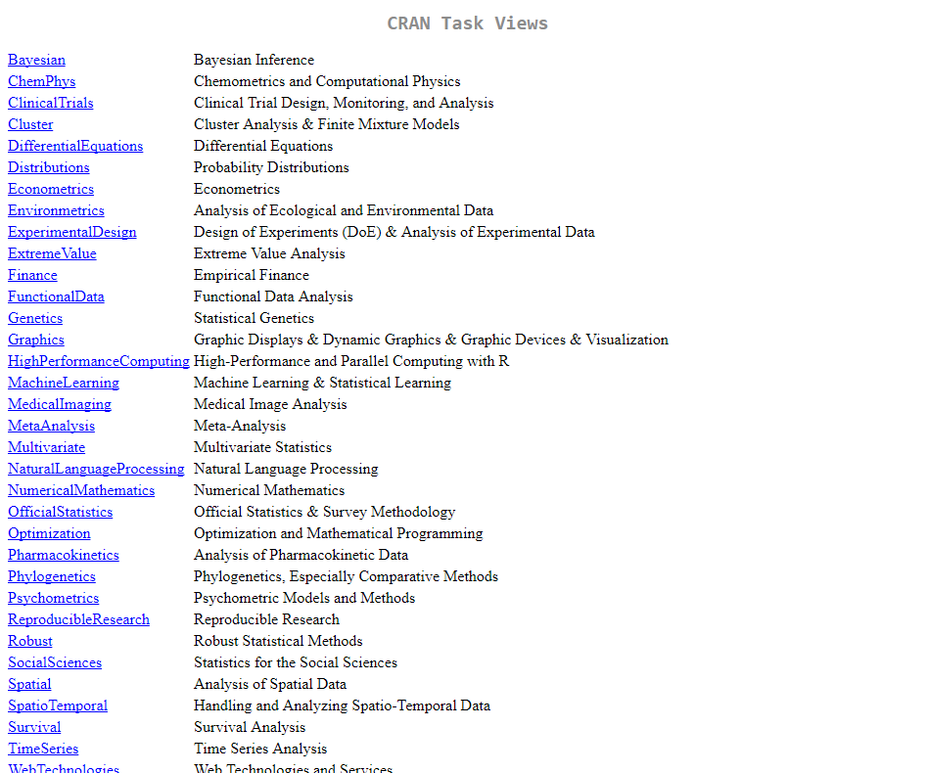
CRAN Task Views
https://cran.r-project.org/web/views/
R packages grouped by task.

Slide 9
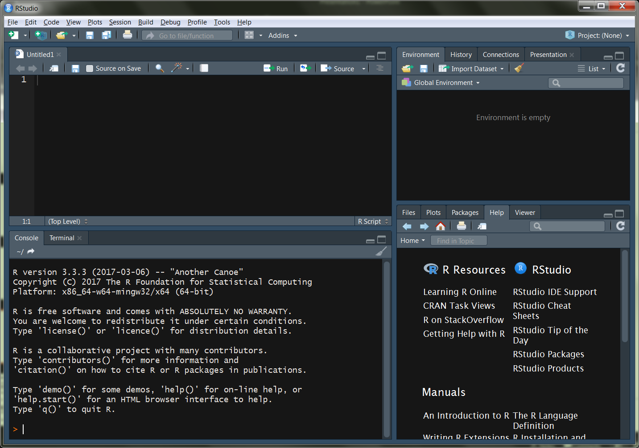
Demo
Allergy Counts from Facebook
Extract Features from Comments
Group Pollen Types
Plot Pollen Peak Seasons
Shiny App
Data sourced from Intermountain Allergy & Asthma

Slide 10
Thanks to our Sponsors!
Partners
Premier
Marquee:
Prize:

