Slide 1
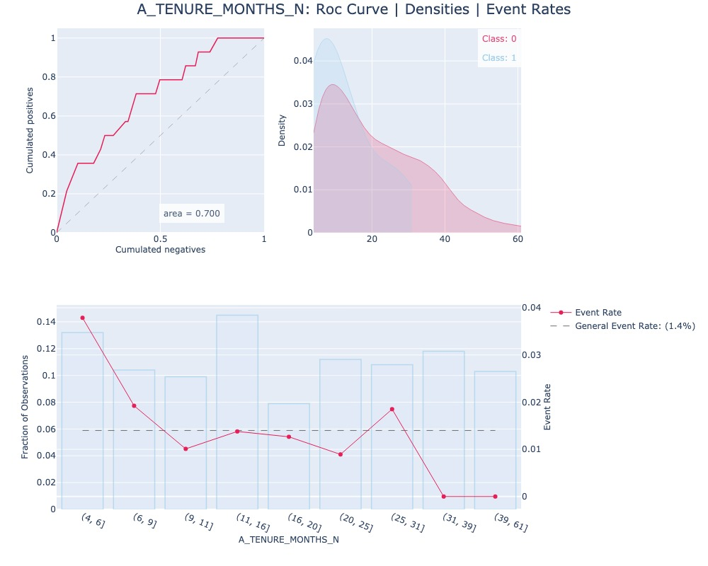
0 Univariate analysis for A_TENURE_MONTHS_N

Slide 2
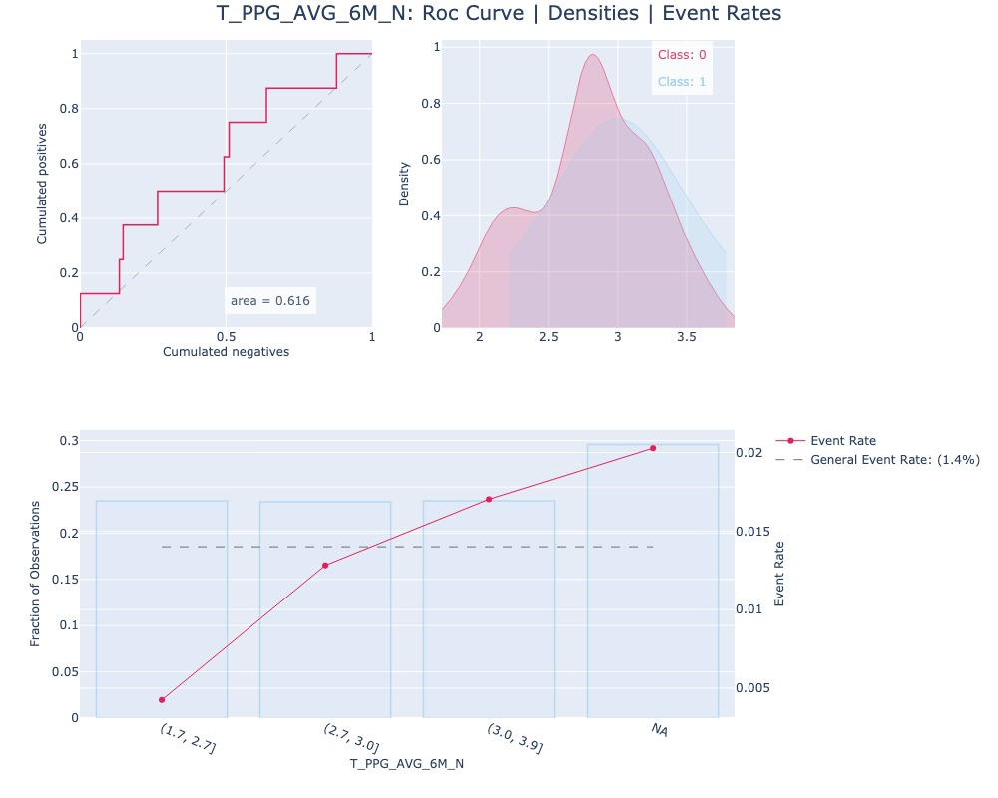
1 Univariate analysis for T_PPG_AVG_6M_N

Slide 3
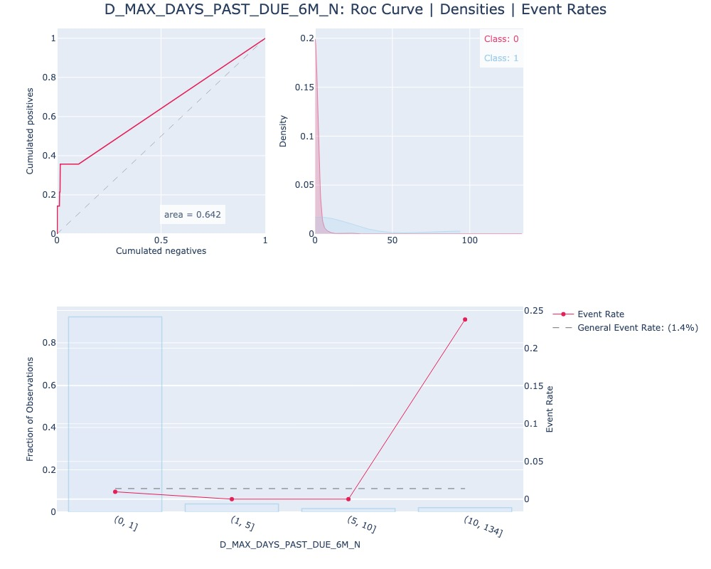
2 Univariate analysis for D_MAX_DAYS_PAST_DUE_6M_N

Slide 4
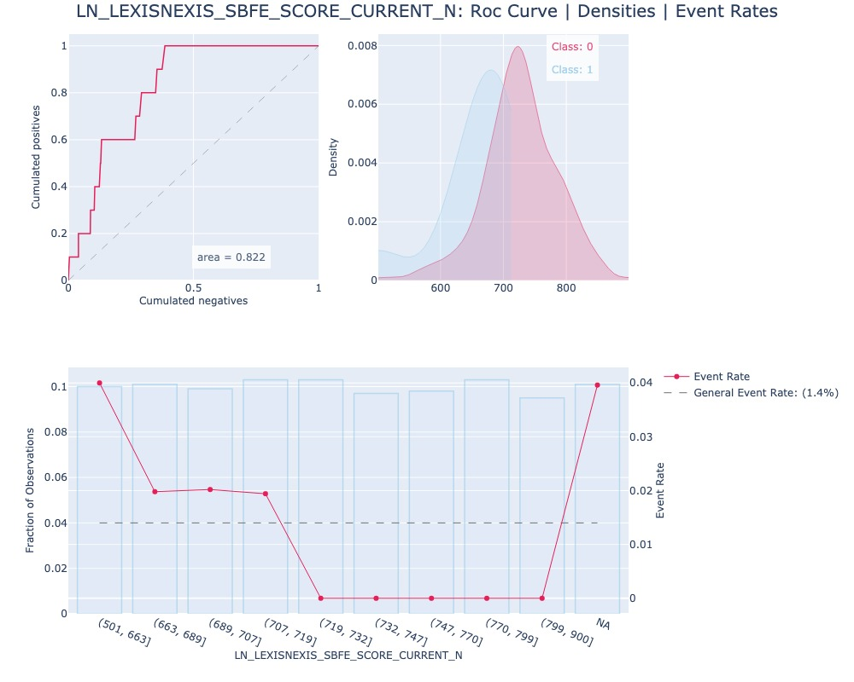
3 Univariate analysis for LN_LEXISNEXIS_SBFE_SCORE_CURRENT_N

Slide 5
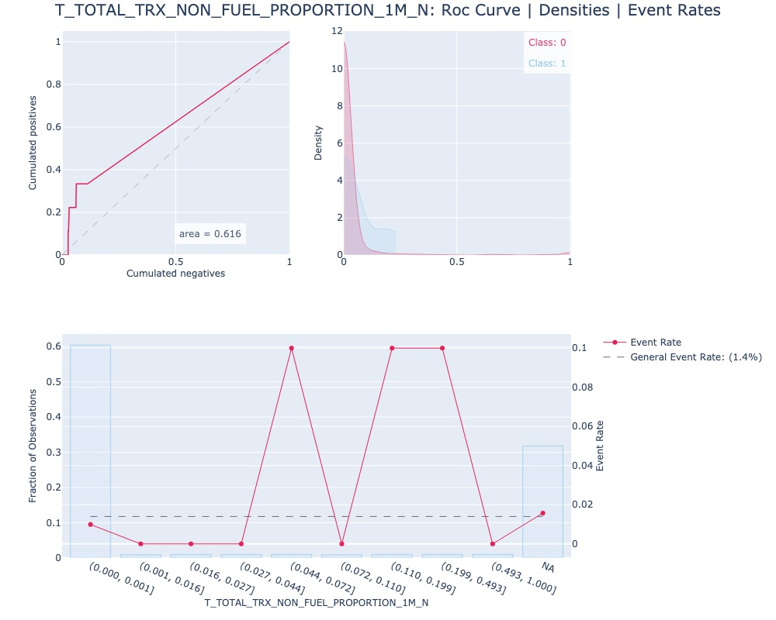
4 Univariate analysis for T_TOTAL_TRX_NON_FUEL_PROPORTION_1M_N

Slide 6
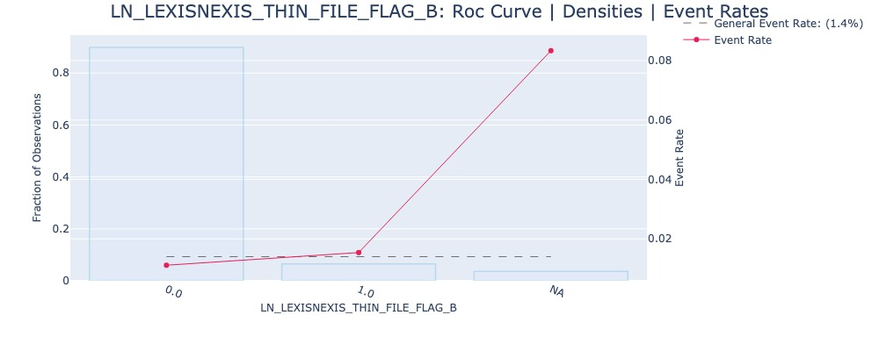
5 Univariate analysis for LN_LEXISNEXIS_THIN_FILE_FLAG_B

