Slide 1
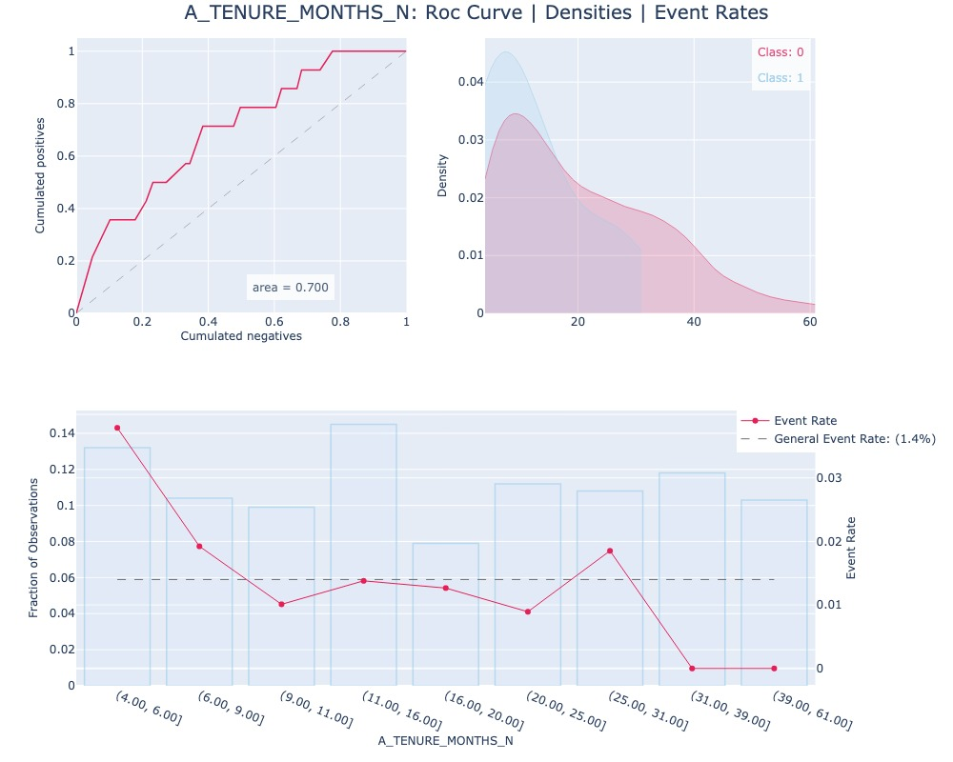
Univariate analysis for A_TENURE_MONTHS_N

Slide 2
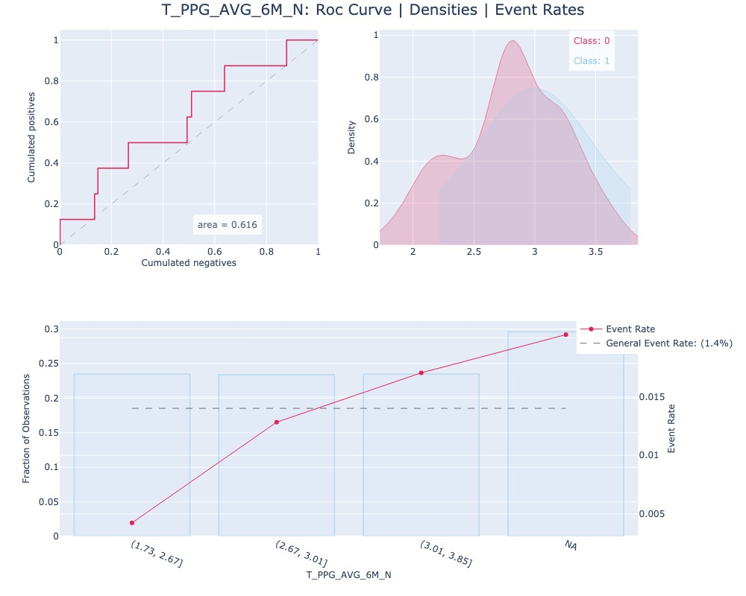
Univariate analysis for T_PPG_AVG_6M_N

Slide 3
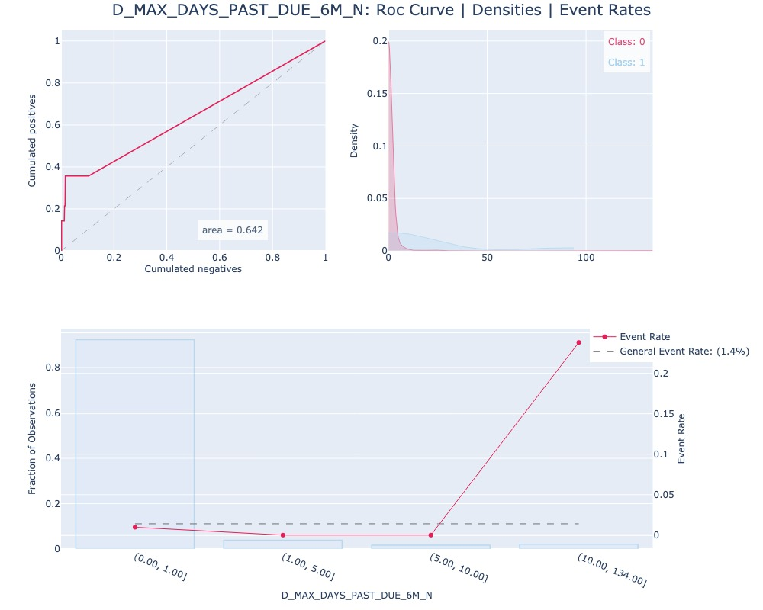
Univariate analysis for D_MAX_DAYS_PAST_DUE_6M_N

Slide 4
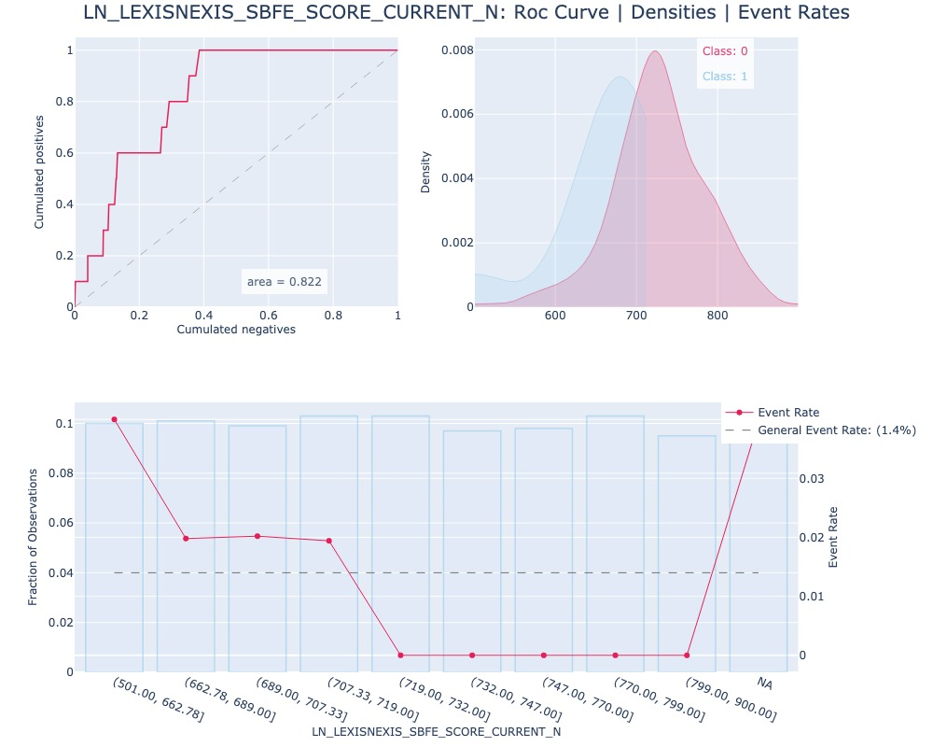
Univariate analysis for LN_LEXISNEXIS_SBFE_SCORE_CURRENT_N

Slide 5
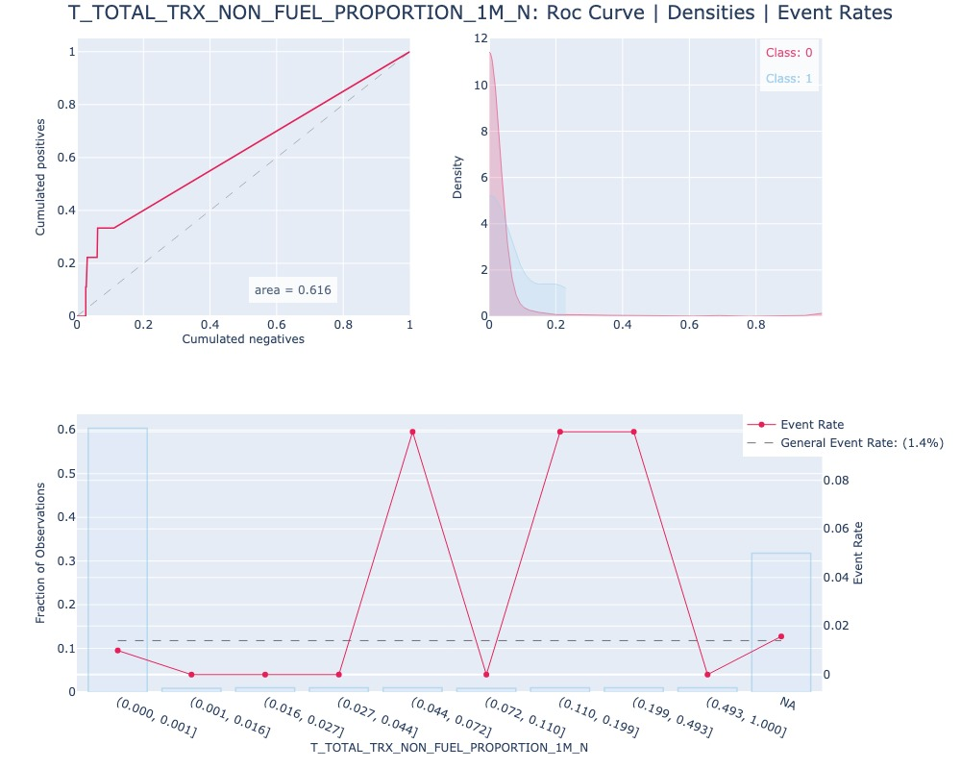
Univariate analysis for T_TOTAL_TRX_NON_FUEL_PROPORTION_1M_N

Slide 6
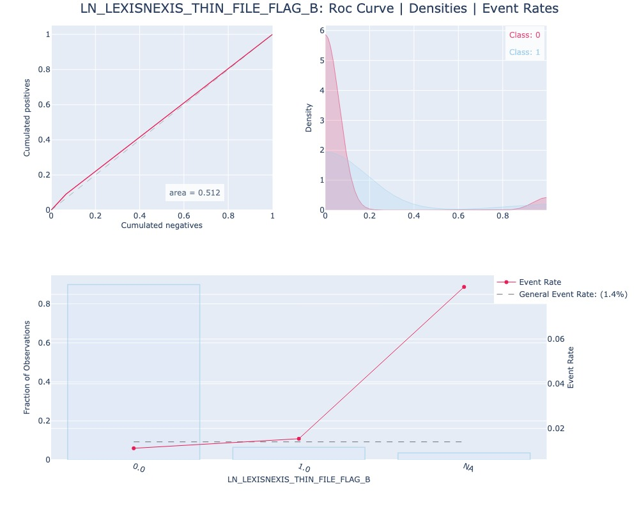
Univariate analysis for LN_LEXISNEXIS_THIN_FILE_FLAG_B

