Slide 1
A 7-point bedside score for rescue surgery
after middle meningeal artery embolization for cSDH
Single-center derivation and internal validation, n = 214
Pacheco-Barrios N, Gonzales-Salidos J, et al.
Department of Neurosurgery · 2026
nielspac177.github.io/mmae-rescue-score

Slide 2
Background
Three randomized trials in 2024–2025 cemented MMA embolization as standard adjunct for cSDH.
• EMBOLISE (N=400): 4.1% vs 11.3% reoperation at 90 days (Kan 2024)
• MAGIC-MT (N=722): same direction of effect (Tian 2024)
• EMPROTECT (N=342): significant 6-month recurrence reduction (Kerleroux 2024)
But 5–20% of embolized patients still need rescue surgery.
• No bedside-usable, externally validated score exists
• Existing cSDH grades (Markwalder, Stanišić) predict recurrence after burr-hole, not after embolization
• Decision-relevant question: who needs tighter post-procedure surveillance?
MMA Embolization Rescue Score · Pacheco et al., 2026
2 / 10

Slide 3
Methods — two-tier prediction-model strategy
Cohort
Sensitivity models
• 214 consecutive adults, MMA embolization for cSDH
• 36 rescue events (16.8%); single center, retrospective
• TRIPOD-AI compliant; IRB approved with consent waiver
• Model 3 — alternative age-stratification (age >85, plt, antiplatelet)
• Model 4 — lasso, EPV-5 cap, 3 imbalance modes
• Model 5 — splines + interactions + tuned EN + stacking + Bayesian + MICE
• Focal-deficit-included variants of M1–M3
Primary models — knowledge-driven
Validation
• Model 1 (max 7): age, SDH ≥100 mL, anticoag, plt <150, antiplatelet, ant+post
• Model 2 (max 4): age, SDH ≥100 mL, anticoag
• Capped at EPV-5 (≤7 predictors per Peduzzi 1996)
• Apparent + Harrell optimism-corrected AUC (1000 bootstrap)
• Hosmer–Lemeshow calibration
• Decision curve analysis (Vickers net-benefit)
• 5×10 stratified CV for ML/data-driven models
MMA Embolization Rescue Score · Pacheco et al., 2026
3 / 10

Slide 4
Cohort characteristics
Variable
Cohort (n=214)
Age, mean (SD), years
73.4 (13.1)
Age >80 years
31.8%
Anticoagulation
25.7%
Antiplatelet therapy
36.4%
SDH volume ≥100 mL
29.0%
Platelets <150 ×10⁹/L
20.6%
Anterior + posterior embolization
53.7%
Focal deficit at presentation
59.8%
Rescue surgery (primary outcome)
36 (16.8%)
MMA Embolization Rescue Score · Pacheco et al., 2026
4 / 10

Slide 5
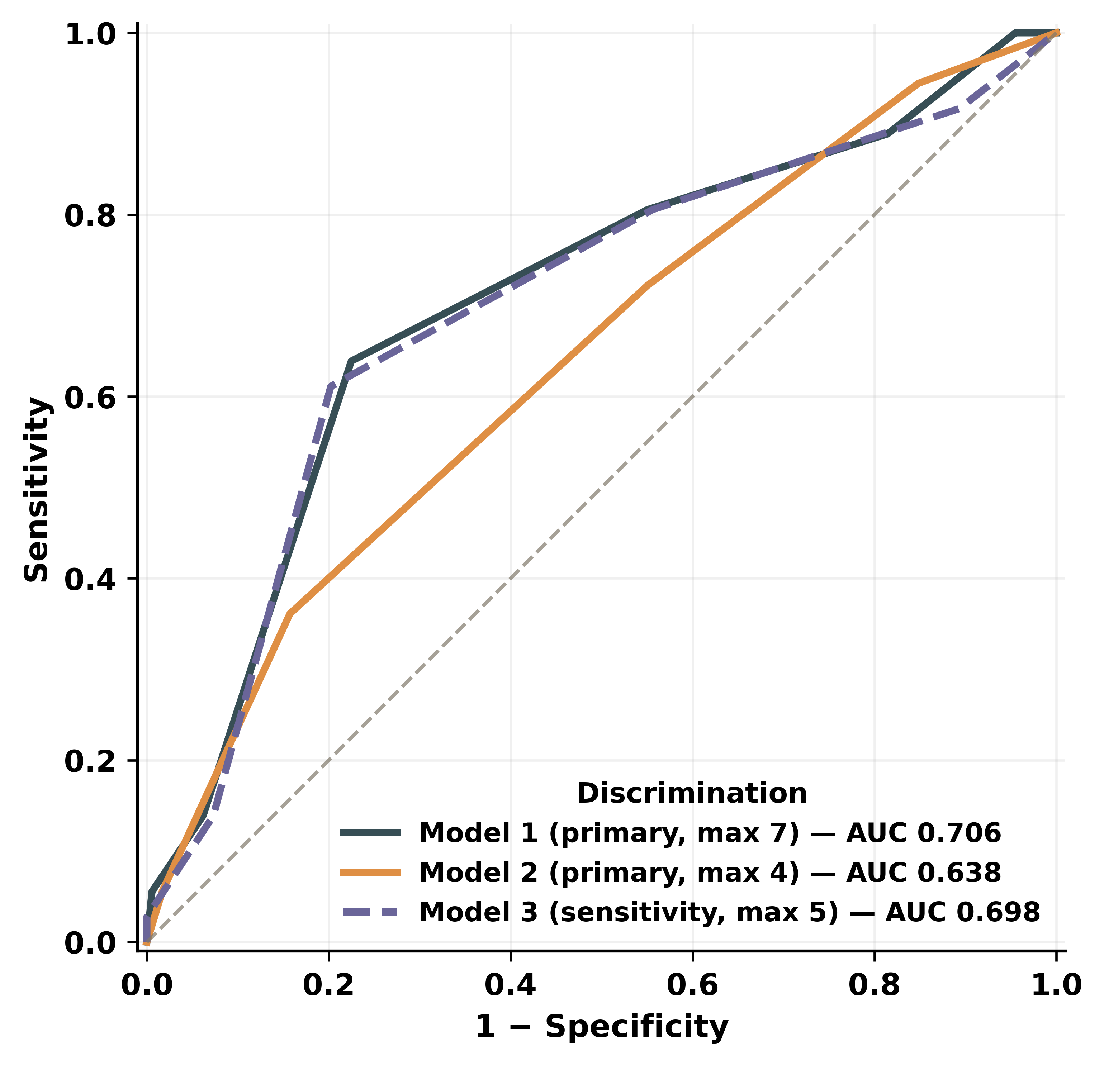
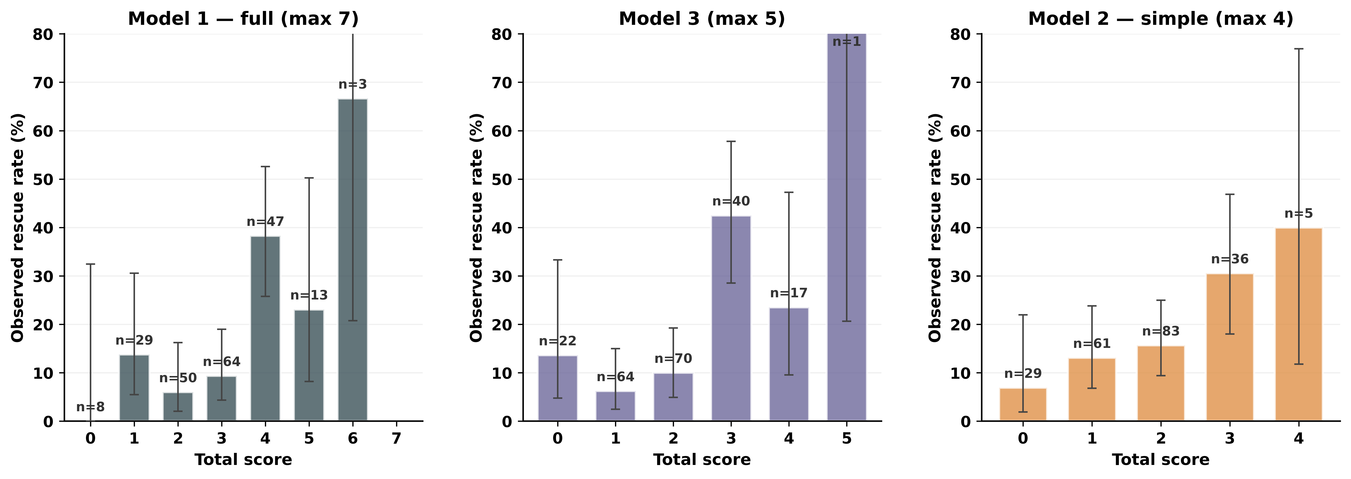
Primary result — Model 1 (knowledge-driven, 7 pts)
AUC 0.706 (Harrell optimism-corrected 0.704)
Hosmer–Lemeshow P > 0.5 · Brier 0.13 · TRIPOD-AI compliant
Stepwise rise in observed rescue rate across the 0–6 score range
MMA Embolization Rescue Score · Pacheco et al., 2026
5 / 10

Slide 6
A single bedside cutoff: score ≥ 4
Low risk
High risk
Score 0–3
Score ≥ 4
8.6%
36.5%
4.2×
13 of 151 patients
rescue gradient
23 of 63 patients
Operating point
• Sensitivity 64% (95% CI 48–78) · Specificity 78% (71–83)
• Positive predictive value 37% · Negative predictive value 91%
• Decision-curve analysis: positive net benefit across 10–40% threshold range
• Bedside use: PDF score card and browser calculator (no PHI leaves device)
MMA Embolization Rescue Score · Pacheco et al., 2026
6 / 10

Slide 7
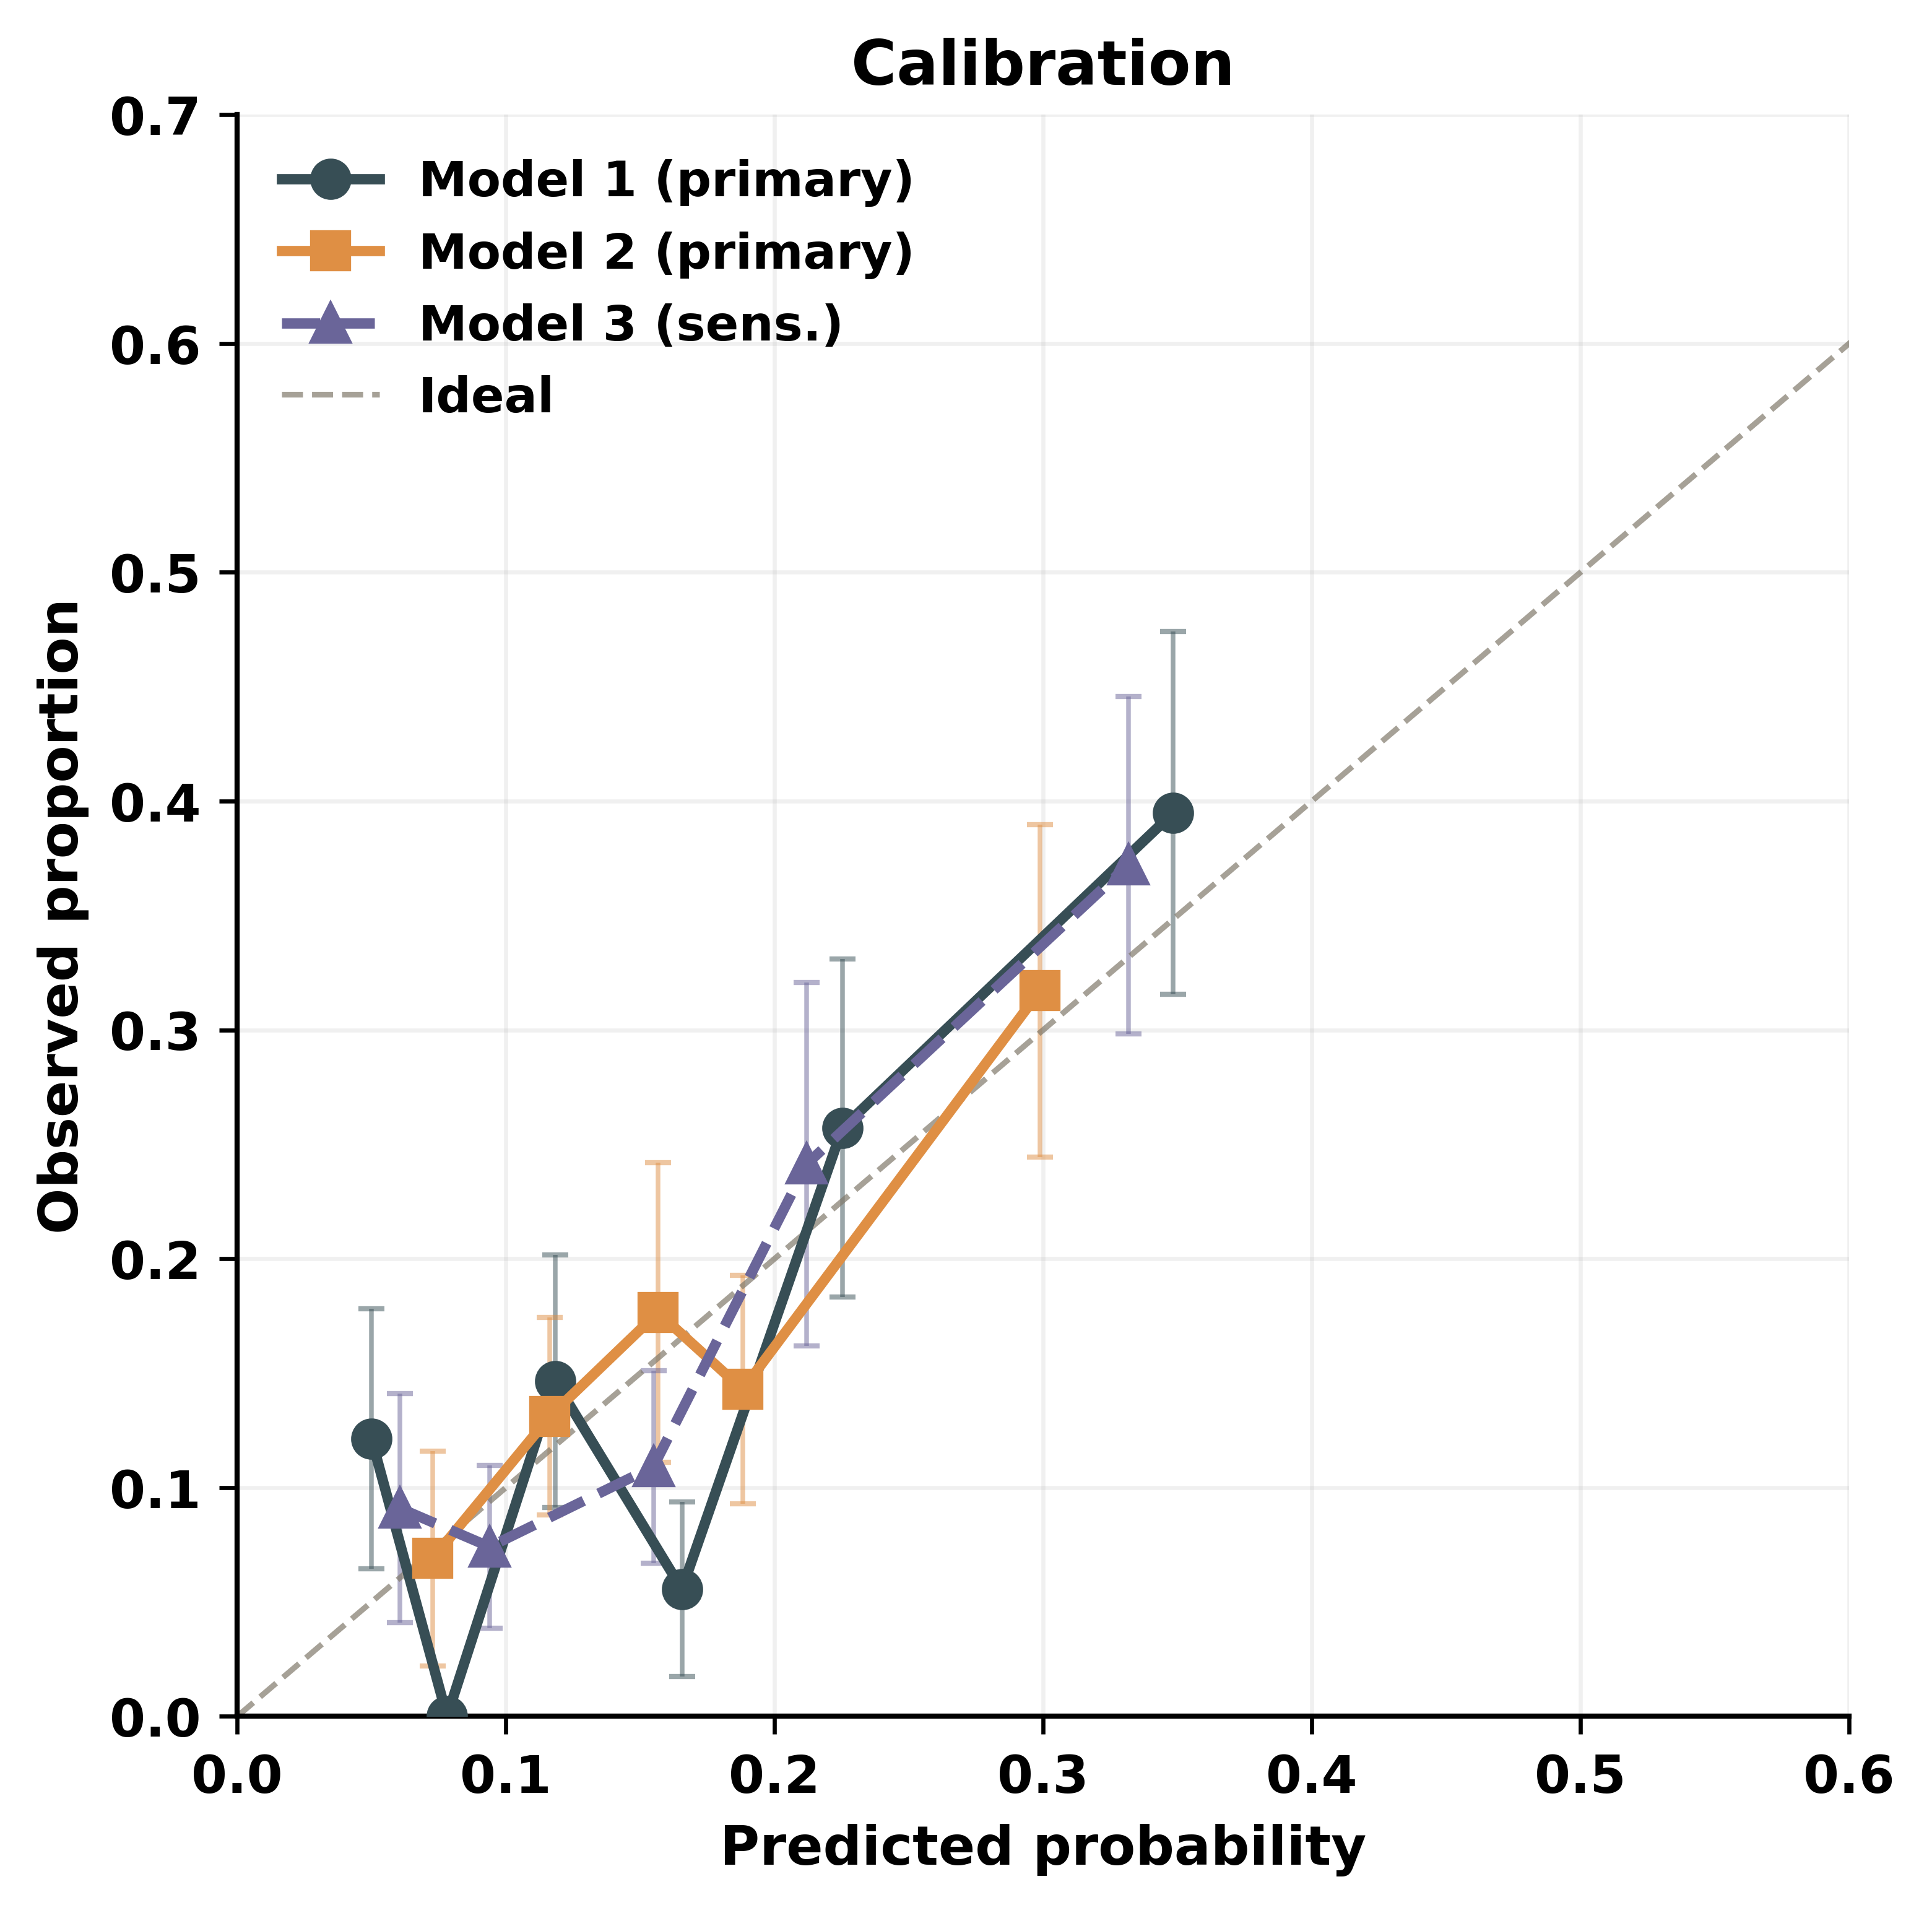
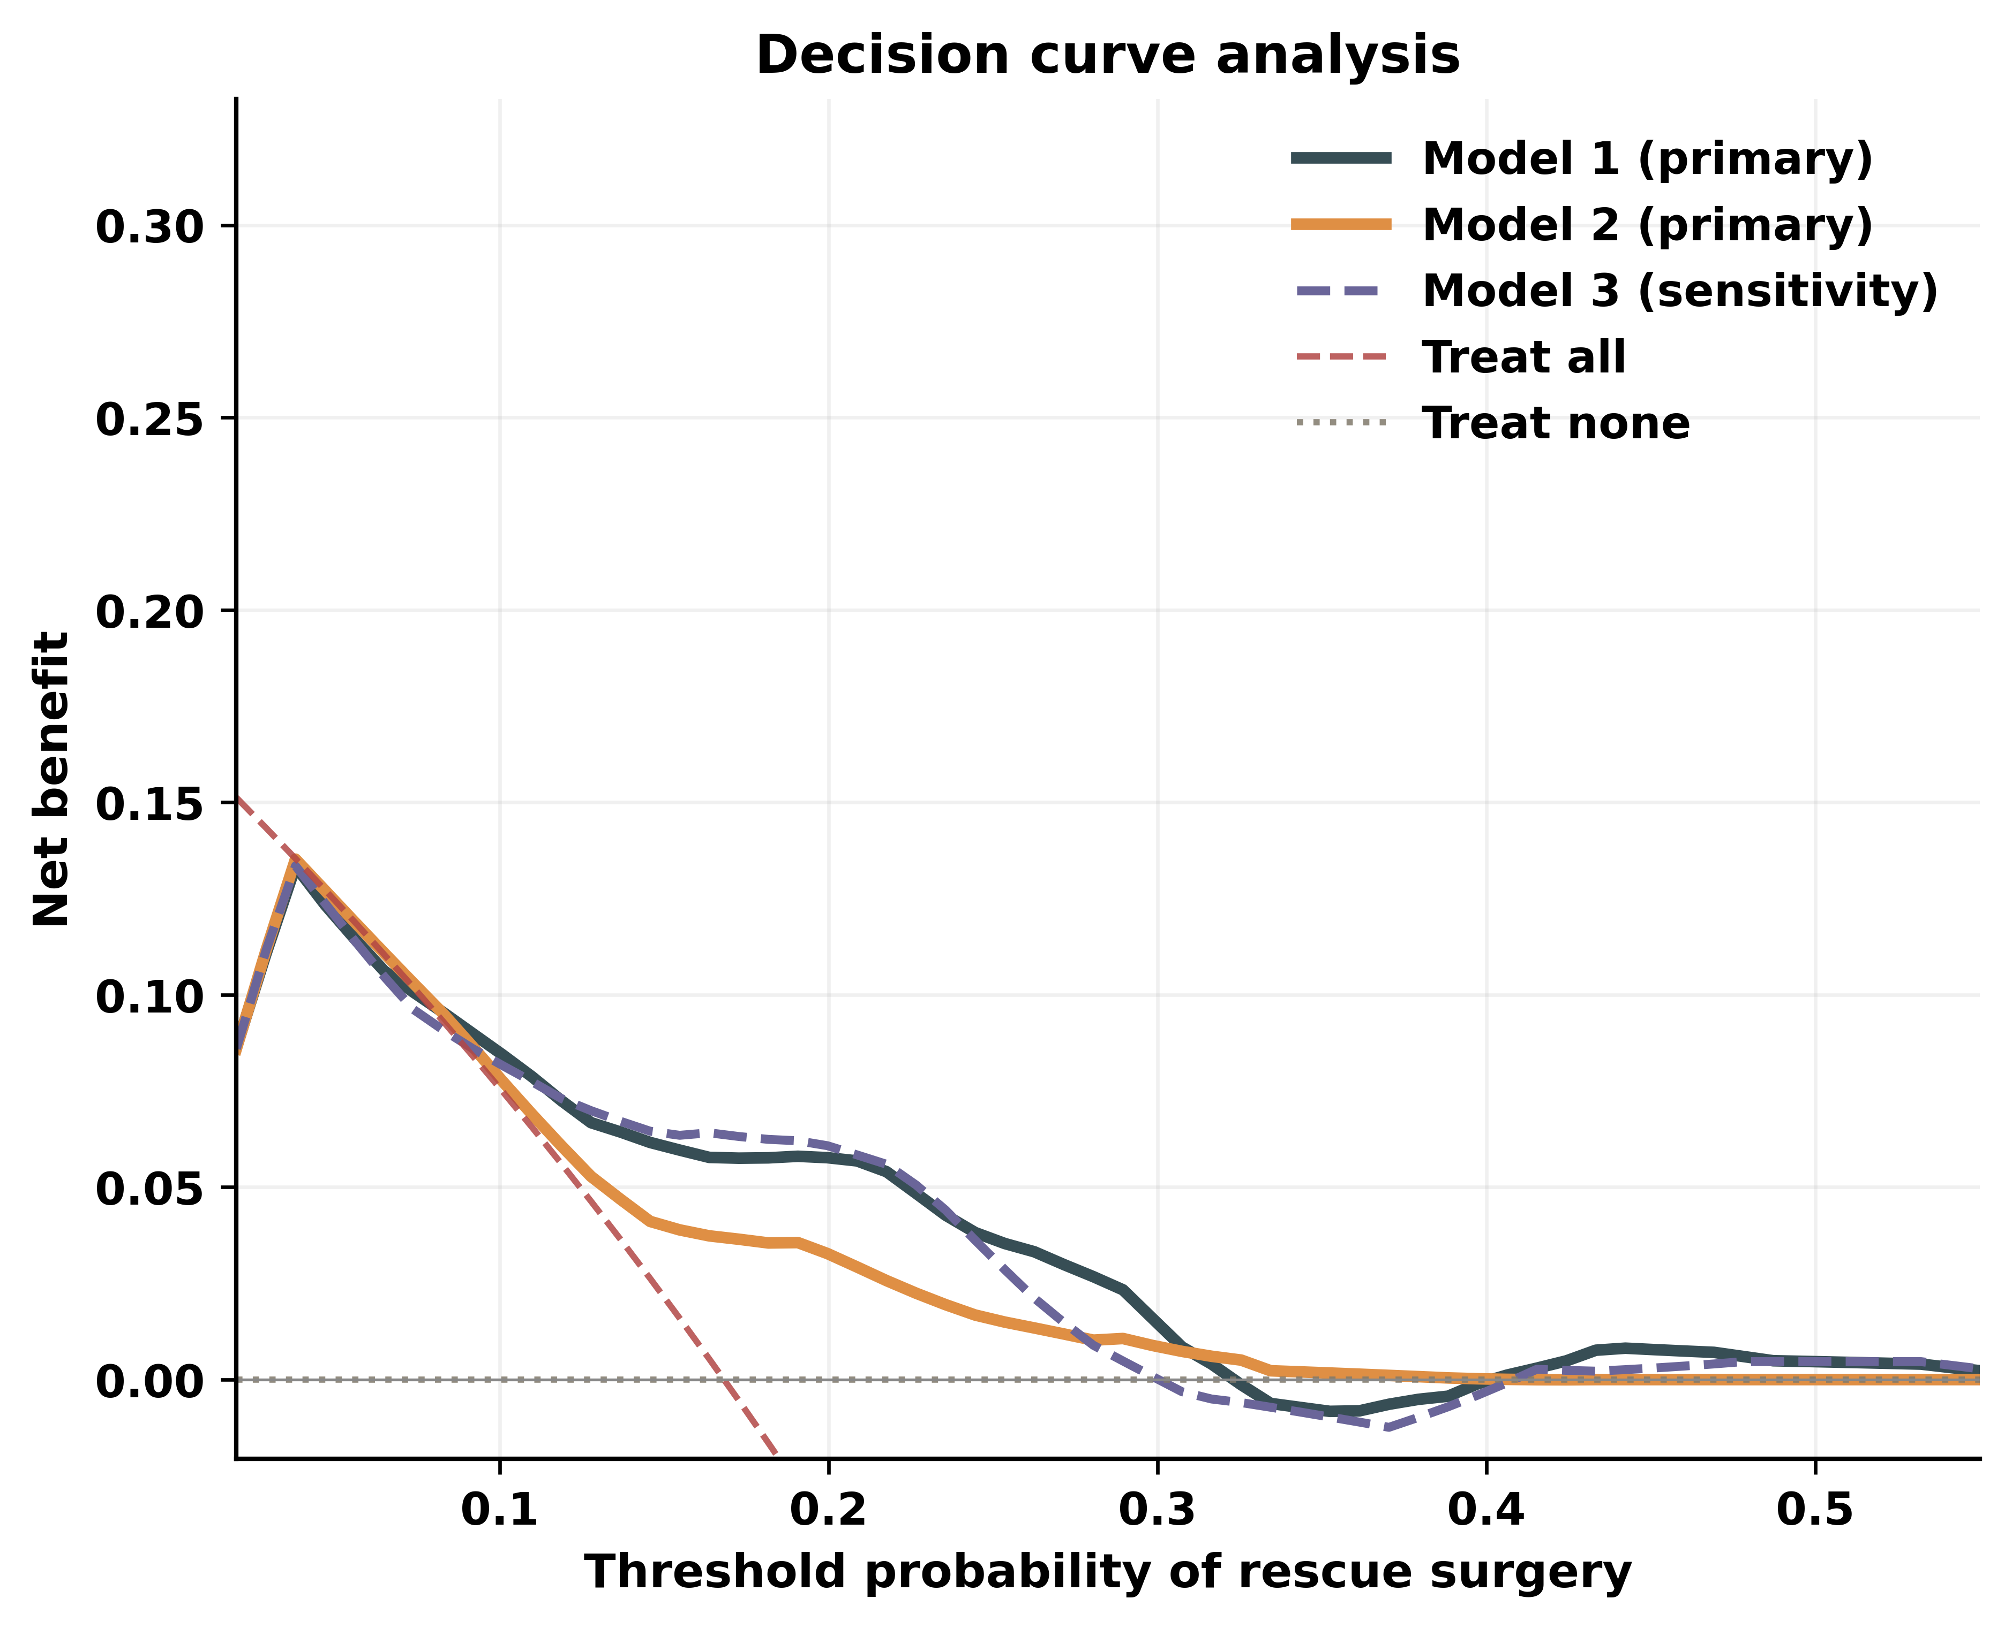
Calibration and decision-curve analysis
Predicted-vs-observed across deciles · HL P > 0.5
Net benefit > treat-all and treat-none across 10–40% threshold range
MMA Embolization Rescue Score · Pacheco et al., 2026
7 / 10

Slide 8
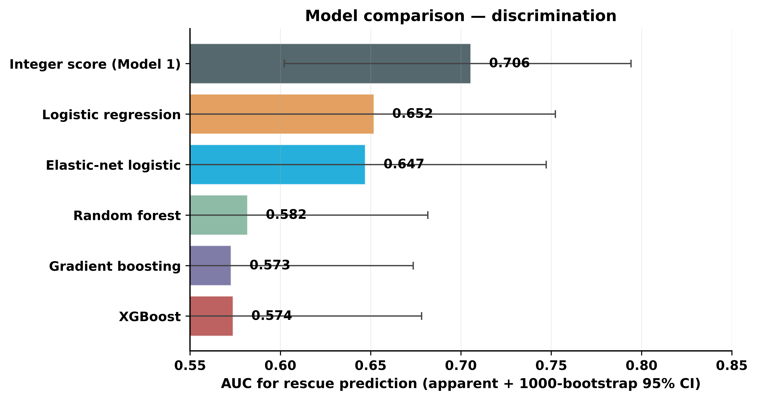
Sensitivity analyses — discrimination preserved
AUCs across all five model families overlap the Model 1 95% CI
Sensitivity AUC summary
• Model 2 (simple, 4 pts) AUC 0.64
• Model 3 (age cutoff >85, 5 pts) AUC 0.70
• Model 4 (lasso, 5 pts) CV-AUC 0.66
• Model 5 (Bayesian + priors) CV-AUC 0.67
• Composite enhanced bundle CV-AUC 0.63
• Random forest / GBM / XGB CV-AUC 0.57–0.58
36 events bound the AUC ceiling — flexibility costs more than it gains.
MMA Embolization Rescue Score · Pacheco et al., 2026
8 / 10

Slide 9
Limitations and roadmap
Limitations
Validation roadmap
• Single-center retrospective design
• 36 events — wide CIs on individual coefficients
• Rescue ascertained at last follow-up, not fixed time point
• 15% of SDH volumes imputed (sensitivity supports primary)
• Embolic agent and access route captured but not in score
• Pre-registration of external-validation analysis plan
• Pooled validation across active MMA registries
• Embed scoring within next-generation RCTs (EMBOLISE+, EMPROTECT-2)
• Update calibration with hierarchical Bayesian recalibration
• Add prospective surveillance time-to-rescue endpoint
MMA Embolization Rescue Score · Pacheco et al., 2026
9 / 10

Slide 10
Take-home
A 7-point pre-procedural score, derived from six routinely available variables, discriminates rescue surgery after MMA embolization for cSDH with AUC 0.70 and stratifies the cohort into a 4.2-fold rescue-rate gradient at a single cutoff.
Clinical use
Methodology
Open science
Pre-procedural triage of post-embolization surveillance intensity
Knowledge-driven primary, lasso + Bayesian + ML as sensitivity
Code, calculator, bedside card, and supplementary tables freely available
Live calculator + printable bedside card
nielspac177.github.io/mmae-rescue-score
Pacheco-Barrios N, Gonzales-Salidos J, et al. · TRIPOD-AI compliant · Pending external validation

