Slide 1
A Verified Imperative Implementation of B-Trees
Niels Mündler
TU Munich, Department of Informatics
Chair for Logic and Verification
3 March 2021

Slide 2
Overview
Introduction
Abstract specification
Imperative implementation
Conclusion

Slide 3
What is this about?
Verification of functional correctness of B-Tree operations
(membership, insertion, deletion)
Obtain a functional specification, refine to an imperative implementation
Extraction of executable binary code
… and all of it in Isabelle/HOL
Sets
refines
B-Trees
refines
Imperative
B-Trees

Slide 4
Motivation
B-Trees are the precursor to B⁺-Trees
Basis of virtually all modern database systems
Incorrect implementations exist, cause trouble
Provide new insights for efficient verification

Slide 5
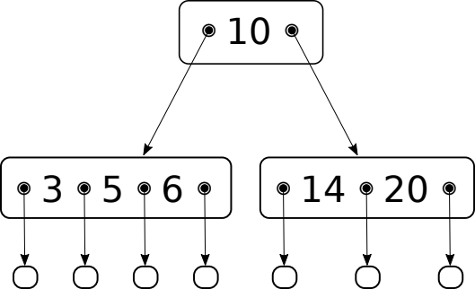
What is a B-Tree?
Bayer and McCreight [BM72]
Nodes contain subtrees and separators, interleaved
Multiway search tree:
Balanced
Order k
Sorted

Slide 6
Previous Work
Pen and paper proofs by Fielding [Fie80] and Sexton [ST08]
- more abstract reasoning but contain informal parts
Mechanized proofs by Ernst (KIV+TVLA) [ESR15] and Malecha (Coq) [Mal+10]
- direct analysis of imperative implementation
Here: Mechanized proof by refining abstract specification

Slide 7
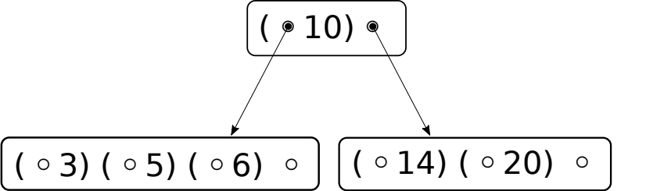
Abstract specification

Slide 8
Membership test
Find element x in the tree:
Find the corresponding pair (sub,sep)
If sep = x then True
Otherwise: Recurse into the corresponding subtree

Slide 9
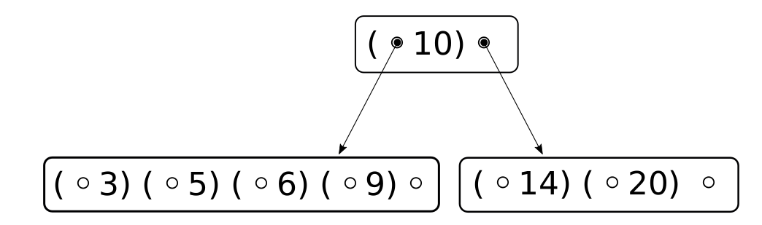
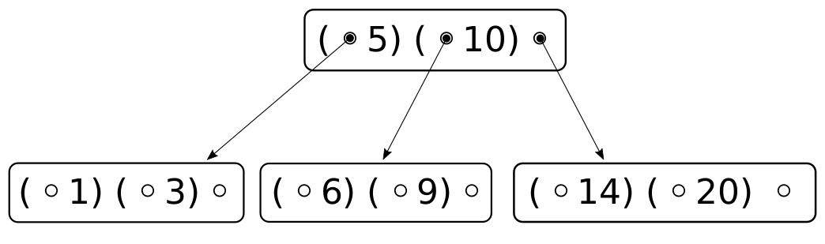
Insertion
Insert x into the tree:
Find the corresponding pair (sub,sep)
If sep = x then do nothing
Otherwise:
  Recurse, obtaining sub’
  Integrate sub’ into the current node
Return current node

Slide 10
Deletion
Often omitted, variations exist
Inverse of the previous operation
Abstract specification implemented and verified

Slide 11
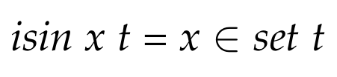
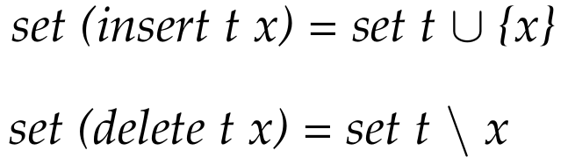
Concretization of Abstract sets
The specification refines abstract sets
Operations preserve invariants
Operations refine set operations

Slide 12
Concretization of Abstract sets: Lessons learnt
Operations preserve invariants (except for sortedness)
- straightforward
Operations act similar to set operations,
preserve sortedness
- tideous
Notes:
Invariants: require lemmas for helper functions, algebra, straightforward
sortedness/set: hard! Need to relate changed elements to all elements to the right and to all elements to the left
Intuitively: range justifies position in tree, but formal proof was difficult (2000 LoC)
Remedy: next slide

Slide 13
Concretization of Abstract sets: Lessons learnt
Operations preserve invariants (except for sortedness)
- straightforward
Operations act similar to set operations,
preserve sortedness
- tideous straightforward
Remedy: Inorder approach by Nipkow [Nip16]
1 | 3 | 5 | 6 | 9 | 10 | 14 | 20
Notes:
Remedy: looked into the literature
- consider only inorder view on the tree
Relate insertion to insertion into list
Sorted –> only argue that resulting inorder is sorted
By arguing that
- inorder did not change
- element inserted at correct position in inorder
–> position suggested by the split function

Slide 14
Imperative Refinement
So far algebraic datatypes
Changes propagate through the data structure
Memory usage difficult to control
→ Introduce a heap and pointers

Slide 15
Imperative Refinement
2
0x1234
5
0x123F
10
0x1240
2
0
1
0
...
Refine abstract datatypes
Nodes → Heap pointer option
Lists → Arrays
Relate the abstract datatype and refined datatype: btree_assn k t ti

Slide 16
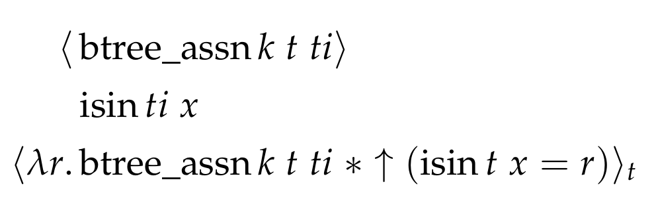
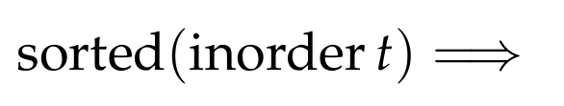
Refinement of abstract specifications
Obtain Hoare Triples relating imperative and abstract functions

Slide 17
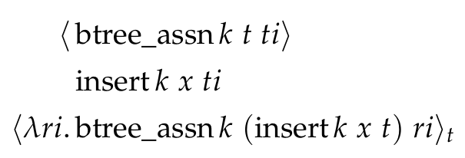

Refinement of abstract specifications
Insertion changes the tree

Slide 18
Concretization of Abstract sets
Transitively, the imperative refinement refines abstract sets!
Last step: finding the corresponding pair
In the thesis: Provide and verify
Linear search
Binary search

Slide 19
Refinement: Lessons Learnt
Refining the functional specification using Refinement Framework [Lam19]
straightforward
Providing search operations
- finding a correct binary search
- providing suitable loop invariants

Slide 20
Conclusions
Verified B-Trees on an abstract level
Refined down to imperative, exectuable code (SML, Scala), features binary search
Effort compares well to other approaches
 | [Mal+10] | [ESR15] | This thesis
Code | 870 | 1862 | 500
Proof steps | 5190 | 3800 | 2753
Time (months) | - | 6+ | 4

Slide 21
Future Work
Finalize Refinement of the imperative deletion operation
Refine the abstract Map specification
Refine B⁺-Trees

Slide 22
Conclusions
Verified B-Trees on an abstract level
Refined down to imperative, exectuable code (SML, Scala), features binary search
Effort compares well to other approaches
Thank you for your attention! Questions?

Slide 23
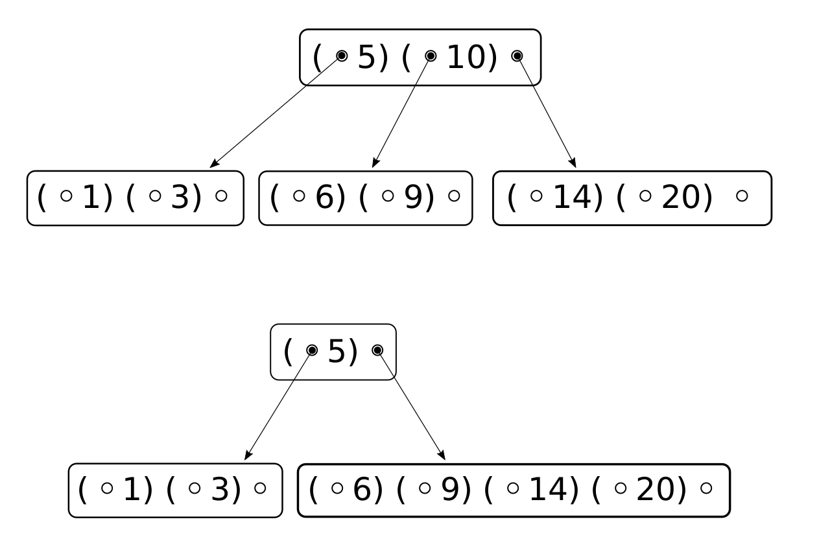
Bonus: Deletion
Delete x from the tree:
Find the corresponding pair (sub, sep)
If sep = x then delete greatest lower element, obtain sub’
Otherwise: Recurse, obtain sub’
Integrate sub’ into the current node

Slide 24
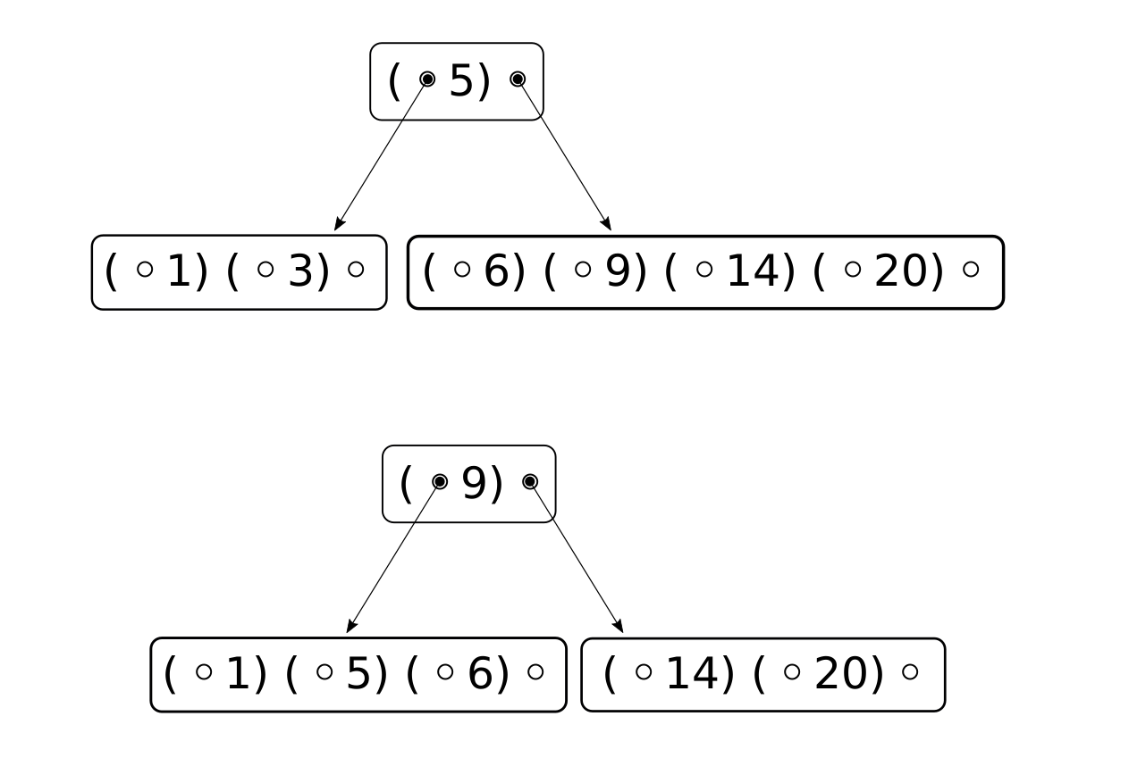
Bonus: Deletion
Delete „3“

Slide 25
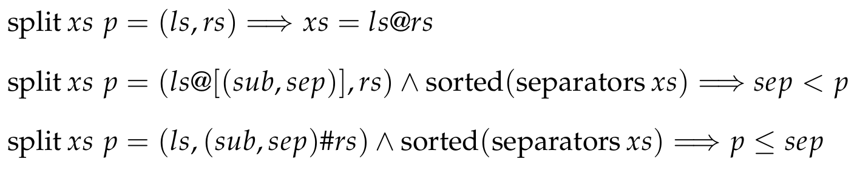
Bonus: Abstract split function

Slide 26
Bonus: Finding the corresponding pair
Linear search: iterate through all elements, return the first suitable
Easy to prove correct, usually implemented
Binary search: bisect the range of suitable elements in each step
Efficient, more difficult to prove correct
Notes:
Example: looking for 6

Slide 27
Proving refinement of the abstract search
Imperative search functions based on while loops
→ Relate final results manually
Approach:
Derive Hoare Triple A for Linear Search with some basic loop invariant
Show „A ⟶ Search refines result of some abstract search“
Derive Hoare Triple A’ for Binary Search
Adjust 2) to obtain the correct result
Notes:
Example: looking for 6

Slide 28

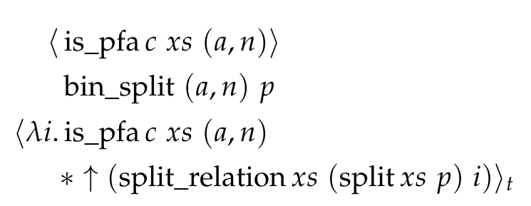
Binary search
In the end...

Slide 29
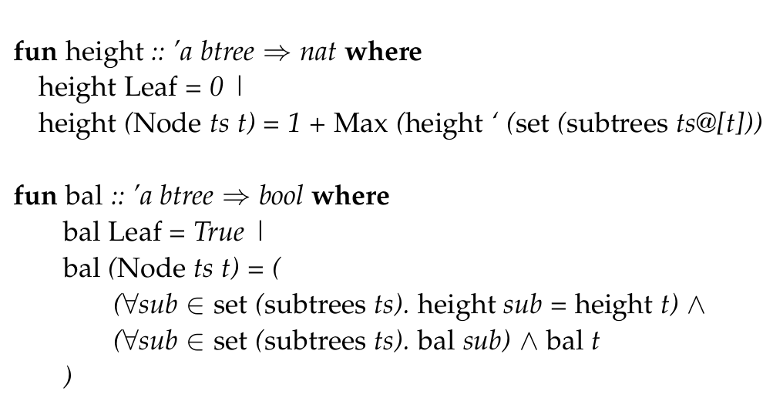
Abstract specification: Balancedness

Slide 30
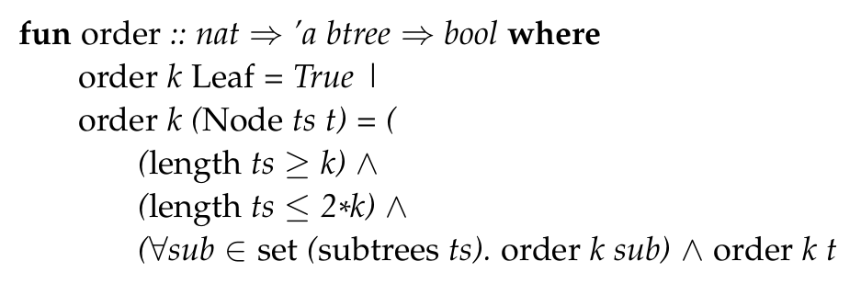
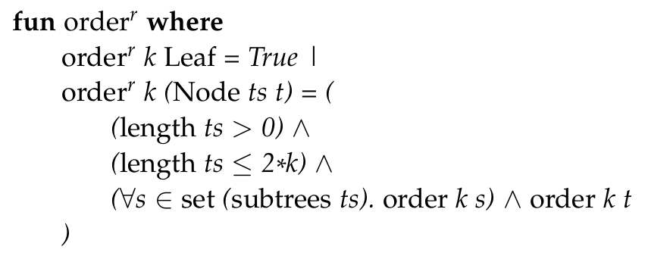
Abstract specification: Order

Slide 31
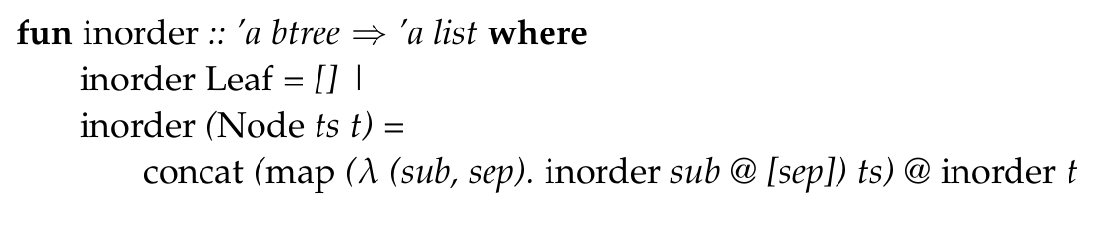
Abstract specification: Sortedness

