Slide 1
LinkGuard Ethiopia
Scan suspicious links before you click
A cybersecurity platform that protects people from social-engineering scams: fake stores, phishing pages and malicious websites.
Kali Linux | Python + Flask | VirusTotal | urlscan.io | Google Safe Browsing

Slide 2
The problem and the idea
The problem
Scan links
Risk score
Fake online stores and phishing pages spread through messages and social media.
A scam link looks almost the same as a real one.
One click can cost someone money or an account.
Check a URL before opening it
0-100 score with plain-language reasons
Report
Shared database
Users flag suspicious links
A moderated list warns others

Slide 3
What it is built with
Part | Technology
Safe lab | Kali Linux in VirtualBox: NAT network, clean-baseline snapshot, clipboard off
Language | Python 3 with a virtual environment
Web app | Flask, with HTML and CSS written in templates
Web requests | The requests library
Database | SQLite, the whole database in one file
Security helpers | Werkzeug, hashlib, hmac and secrets
Threat sources | VirusTotal, urlscan.io and Google Safe Browsing APIs
Code storage | Git and GitHub

Slide 4
Where the answers come from
VirusTotal
urlscan.io
Dozens of security engines vote on the link. The free plan allows 4 requests per minute.
Opens the page in a sandbox and returns a verdict and score. Free scans are public.
Google Safe Browsing
The community
Google's list of known dangerous sites. A match adds 35 points.
Reports from users: one per visitor per link, approved by a moderator.

Slide 5
How I built it, step by step
1
Safe lab
2
API access
3
Test data
Kali Linux in VirtualBox, NAT network, clean-baseline snapshot, clipboard and drag-and-drop off.
VirusTotal, urlscan.io and Google Safe Browsing keys, kept in a private keys file.
27 URLs: 15 confirmed phishing links and 12 known-good sites.
4
Python checkers
5
Scoring + web app
6
Community layer
vt_check.py, urlscan_check.py and batch_test.py, with rate-limit handling.
A Flask page merges the sources into one score with reasons.
SQLite reports, a moderated public list and a protected admin page.

Slide 6
How a scan works
VirusTotal
Safe
urlscan.io (live scan)
User pastes a link
Clean and validate the URL
Weighted risk score + reasons
Suspicious
Google Safe Browsing
Dangerous
Community reports (SQLite)
If a source fails or times out, it reports "no data" instead of crashing. A result that would be Safe is then shown as Unverified.

Slide 7
The risk scoring engine
Signal | Points
VirusTotal: engines flagging malicious | 4 each, max 40
VirusTotal: engines flagging suspicious | 3 each, max 10
Google Safe Browsing match | +35
urlscan.io malicious verdict | +30
urlscan.io risk score | 20% of it, max 20
Community reports | 5 each, max 25
Total is capped at 100
0-30 Safe
31-60 Suspicious
61-100 Dangerous
Every point has a written reason, so the user sees why a link scored what it did.

Slide 8
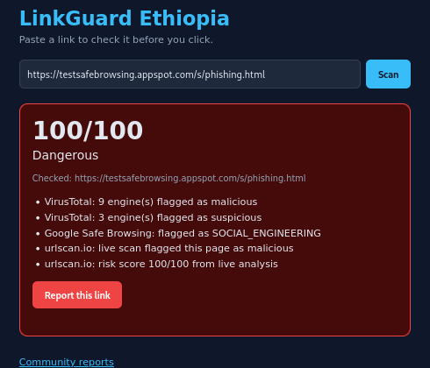
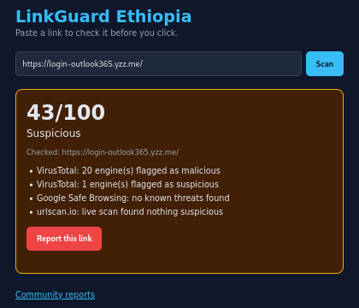
Dangerous and suspicious results
100/100 Dangerous: all three sources agree
43/100 Suspicious: a fake Outlook login page

Slide 9
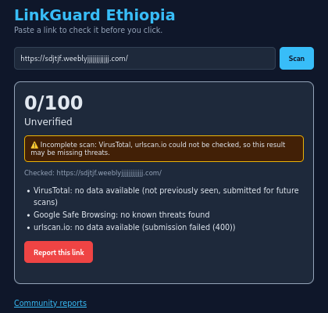
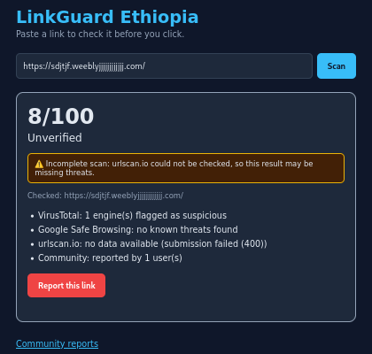
Unverified results when a source fails
No data from two sources, so not shown as Safe
After one community report, 8/100 and still Unverified

Slide 10
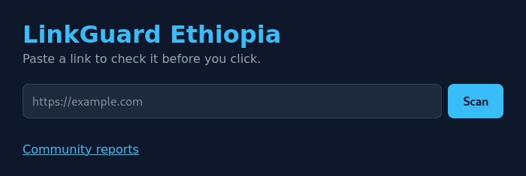
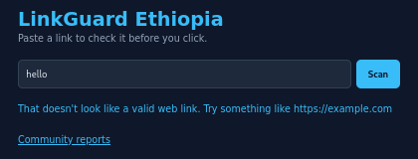
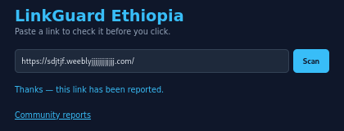
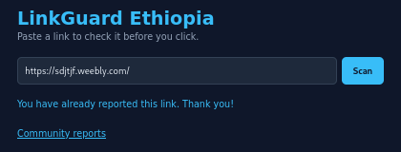
Everyday screens
Home page
Text that is not a link is rejected
A link has been reported
One report per visitor per link

Slide 11
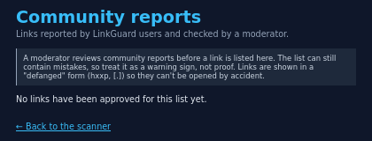
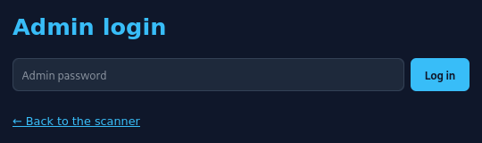
Community list and admin login
Moderators log in at /admin
Public list: empty until a moderator approves a link

Slide 12
Testing found gaps, so I hardened it
Problem found in testing | Fix
One person could report the same link again and again to raise its score | One report per visitor per link: salted hash of the IP plus a unique database index
http://example.com and http://example.com/ counted as two links | normalize_url(): lowercase host, no default port or #fragment, "/" path; non-URLs are rejected
A failed source (dead domain, network error) still showed a green Safe | "Incomplete scan" warning; Safe becomes Unverified when any source has no data
Public list could be spammed or unfairly name a real business | Moderator approval before listing; reports on rejected links are not counted
Behind a proxy, a forged X-Forwarded-For could dodge the report limit | ProxyFix with TRUSTED_PROXIES, default 0 so the header is ignored locally
The admin and moderation code passed 34 of 34 test checks.

Slide 13
Community reporting, moderation and security
Reporting
Moderation
Admin security
Anyone can report a link.
One report per visitor per link.
Visitor ID is a salted hash; the raw IP is never stored.
Parameterised SQL queries block injection.
An admin approves or rejects each reported link.
Only approved links appear on the public list.
Reports on rejected links no longer raise the score.
Links are shown defanged: hxxp, [.]
Password stored only as a hash; no default password.
CSRF token on every admin button.
5 wrong passwords lock a visitor out for 15 minutes.
HttpOnly cookie, 30-minute session, security headers.

Slide 14
Getting ready to deploy
Reading the visitor IP behind a proxy
Ready for hosting
Setup | Visitor sends | App sees
No proxy (default 0) | A fake header | Real connection address; fake ignored
1 trusted proxy | Nothing; proxy adds the real IP | Real visitor IP
1 trusted proxy | Fake header, then proxy adds the real IP | Real visitor IP; fake ignored
Secrets come from environment variables first, then the keys file.
The database creates its own tables at start.
Security headers on every page; secure cookie flag for HTTPS.
Lockout counter is in memory and resets on restart.
Still to do: turn off debug=True and use a production server.
The proxy count must match your real setup: too few shows the proxy address, too many trusts forged entries.

Slide 15
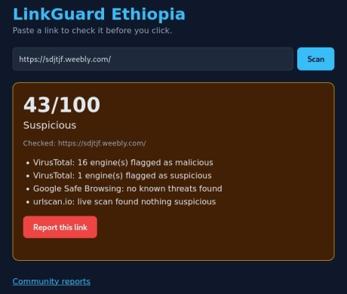
Results and next steps
15/15
0/12
43/100
phishing URLs detected
good sites falsely flagged
example phishing page
Limits and next steps
The good-URL test set was only famous sites (VirusTotal alone); add small, obscure legitimate sites.
Add domain age, SSL, redirect and typosquatting checks from the riskScorer.js design.
Deploy with debug off and a production server.
A real scan in the web app

Slide 16
Key terms in plain words
Phishing: a fake site or message that imitates a trusted one to steal data.
Social engineering: tricking people instead of hacking computers.
API key: a private code that identifies you to an online service.
Sandbox: an isolated space where a page can be opened safely.
Hash: a one-way scrambled version of data that cannot be read back.
Salt: a secret extra string mixed in before hashing.
CSRF: an attack where another site tricks your logged-in browser; a secret token stops it.
Defang: rewrite a link (hxxp, [.]) so it cannot be clicked by accident.
Reverse proxy: a server in front of an app that passes visitors' requests to it.
Typosquatting: a website name almost identical to a famous brand.

