Slide 1



Slide 2
NIEM MilOps CJCSI

Slide 3
Outline
Bottom Line Up Front
Issues
Options
Proposed / Recommendations

Slide 4
BOTTOM LINE UP FRONT
Currently
DODI 8320.07 states to consider NIEM for all new XML information exchanges.
Actual Implementation
DOD CIO never implemented the waiver program.
DOD CIO does not enforce this policy.
Result
Services, CCMDS, agencies simply state they considered NIEM, without any evidence.
NIEM is not being utilized by many DOD organizations.
Proposed Solution
Establish a CJCSI for NIEM Open sponsored and managed by MILOPS Domain

Slide 5
Issues
DODI 8320.07 “consider NIEM”
Referenced in many different documents as consider but it’s not authoritative or enforced.
DOD CIO does not enforce NIEM.
Referenced in JADC2 Standard V-2 but will be with OASIS as the authority and managed by NTAC.
Notes:
NIEM gets mentioned in many different documents and referenced as “consider first” per the DODI policy which CIO does not enforce.
Writing a DODI for NIEM where we could say that organizations “will use NIEM first” would continue to be managed by CIO so we are trusting that they would manage this policy. We could rewrite DODI 8320.07 but we will be dealing with CIO and again relying on them to enforce it.
Writing a CJCSI is easier in regards to the process since its internal to our organization and we (CJCS) have authority of these types of documents. With the transition to OASIS, CIO will no longer be the executive agent. With this document we (J6) continue to have some control over NIEM and MILOPS domain can manage this document since J6 will be the lead for MILOPS Domain. This CJCSI also ensures that MILOPS Domain will continue to be a DOD entity or a JS entity.

Slide 6
Options
Collaborate with DOD CIO to implement a ‘waiver program for NIEM.
Rewrite the language on the DODI 8320.07.
Write a DODI only for NIEM.
Write a CJCSI for NIEM.

Slide 7
Proposed / Recommendation
Write a CJCSI for NIEM
Stating “will use NIEM standards-based approach when developing XML information exchanges.
MILOPS Domain sponsors and manages the CJCSI
JS will continue to have authority over MILOPS Domain.
Annual review after the first 2 years.
Republish after 5 years.
This would be CJCSI #6243.01 which will align with the interoperability CJCSIs 6200 series.
Notes:
JADC2 / STDV-2 Data Fabric / JADC2 Standards /
will help enforce the standard for JADC2 by referencing the CJCSI which will state that the organization “will use NIEM standards-based approach first when developing XML information exchanges.

Slide 8
BACK UP
Notes:
Why a CJCIS for MILOPS? How does it benefit NIEM?
How is it aligning with the Organization’s goals?
DODD, DODI, DODM or Directive-type memorandum
in order to inform doctrine and affect real change for MilOps; you probably need a DoDI, a CJCSI and a CJCSM. A DoDI mandates NIEM, A CJSCI tasks the services and a CJCSM will show how to implement. The bottom line question is who is the target audience. The DODI states to consider NIEM. Mentions in the FMN spiral.

Slide 9
Benefits
Marketing purposes
JADC2 Standard V-2
Bold Quest
Promote adoption
Notes:
Bold Quest – CJCSI provides more authority for NIEM to be demonstrated in BQ.

Slide 10
DODI
Mandates NIEM
Establish policy
Approved by OSD component head
Need OSD sponsorship
Have to coordinate with DA&OP OCMO (the DOD issuances program)
Need DepSecDef approval

Slide 11
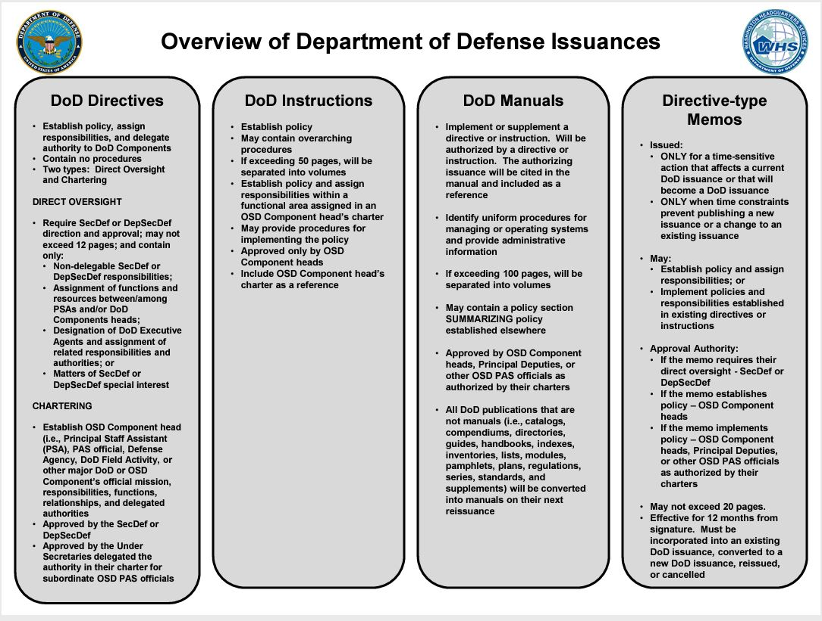
Notes:
Unable to create a DOD issuance without coordinating with a sponsoring office in OSD. Need OSD to sponsor.

