Slide 1
Tools Support
16 April 2025
Ms. Shunda Louis & Mr. Aubrey Beach
NIEMOpen NMO-TSC Support

Slide 2
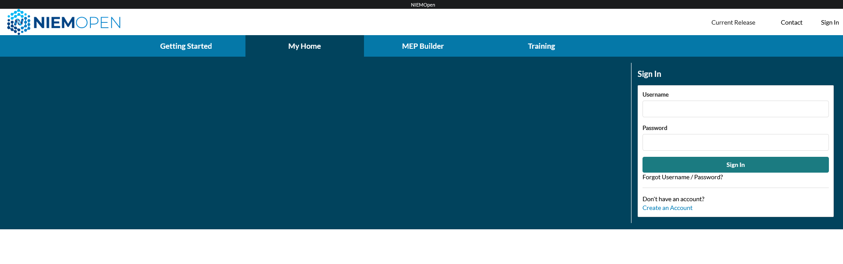
MEP Tool
Located at https://mep.niemopen.org/MyHome
To get a new account, Click Create an Account
Account will be assigned in 1-2 business days

Slide 3
MEP Tool
Open Source
Can also be installed locally
Currently supports NIEM 3.0 -5.2
Leverage a fork from the NIEM API 2.0
Christina working on updating changes to the API
Will require some changes for 6.0
Supports various stages of the lifecycle

Slide 4
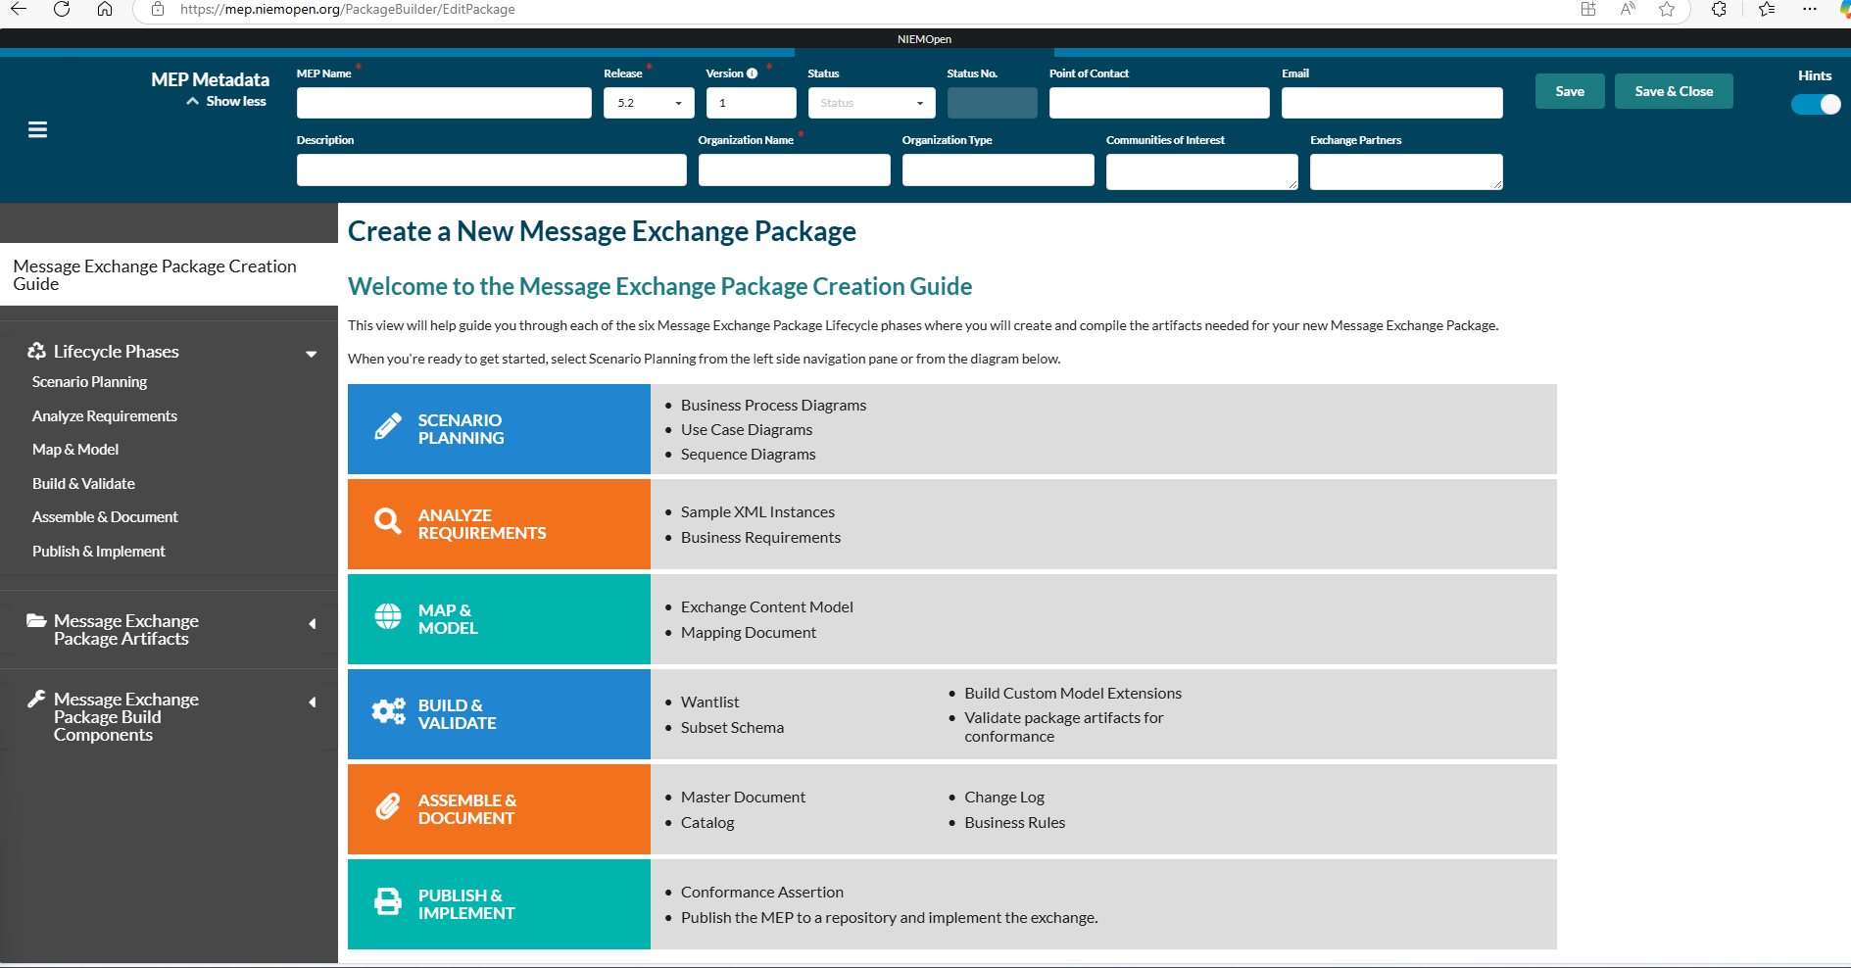
MEP Tool

Slide 5

AWS Hosting Supports MEP Builder
https://mep.niemopen.org/
User Documentation: NIEM User Guide
Can also migrate the NIEM API 2.0 to the AWS Resource

Slide 6

LearnPress LEARNING MANAGEMENT SYSTEM (LMS)
Status: Building & testing NIEMOpen Release 6.0
Expect 30 - 40 Modules
Modules 10 - 20 minutes
2 Major Tracks Executive/ Project Manager level
Developer/Implementor
XML + JSON content
Hosting on NIEMOpen.org
Features Video + Knowledge Checks
Notes:
Training signups will be on Eventbrite

Slide 7
LearnPress LEARNING MANAGEMENT SYSTEM (LMS)
Status:
Initial Signup will be on Eventbrite
May 6-8 Q & A from 3:00- 3:30
Future training will be available 24/7 @niemopen.org

