Slide 1
userRoles
abstract
producer
Information requirement
(the facts that must be conveyed
abstract
consumer
defines
defines
Business
Analyst
Message
Designer
Subject
Matter
Expert
creates
Message
Developers
Message
type
understand
understand
Message
Developers
specifies
implement
System /
Application
interface
System /
Application
System /
Application
Message
(XML,
JSON, etc.)
System /
Application
System /
Application
System /
Application
Producers
Consumers

Slide 2
m2mShare
Information requirement
Message
Designer
creates
Message type
Message format
Message
Developers
understand
understand
Message
Developers
specifies
implement
System /
Application
interface
System /
Application
System /
Application
Message
(XML,
JSON, etc.)
System /
Application
System /
Application
System /
Application
Producers
Consumers

Slide 3
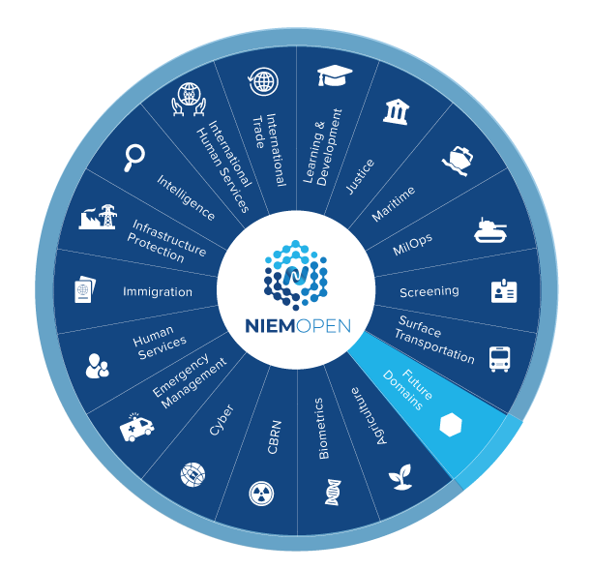
community
Domain models
NIEM
Core
Domain communities: analysts, SMEs, developers with shared subject interests
Business architecture committee (NBAC): representatives from all communities, creating a common core
NIEM data model
design
design

Slide 4
messageSpec
message specification
messages
message type
defines content of
message format
defines syntax of
<my:Request
xmlns:msg="http://example.com/M
xmlns:nc="https://docs.oasis-op
<msg:RequestID>RQ001</msg:Requ
<msg:RequestedItem>
Request
Request.XML
same information
message format
defines syntax of
{
"@context": "http://example.com
"msg:Request": {
"msg:RequestID": "RQ001",
"msg:RequestedItem": {
Request.JSON
message type
defines content of
message format
defines syntax of
<msg:Response
xmlns:msg="http://example.com/M
xmlns:nc="https://docs.oasis-op
<msg:RequestID>RQ001</msg:Reque
<msg:RequestedItem>
Response
Response.XML
same information
message format
defines syntax of
{
"@context": "http://example.com
"msg:Response": {
"msg:RequestID": "RQ001",
"msg:RequestedItem": {
Response.JSON

Slide 5
msg+meta
specified-by
instance-of
Message (runtime instance data)
Message model
Metamodel
request object
is-a
msg:RequestType
is-a
Class
has-a
has-a
msg:requestedItem
defined-by
nc:requestedItem
is-a
Object Property
is-a
item object
is-a
nc:ItemType
is-a
Class
has-a
has-a
nc:ItemName
defined-by
nc:ItemName
is-a
Data Property
is-a
literal
Wrench
is-a
xs:string
is-a
Datatype

Slide 6
kgraph
msg:RequestType
nc:ItemType
nc:TextType
rdf:type
rdf:type
rdf:type
_:b0
msg:RequestedItem
_:b1
nc:ItemName
Wrench
msg:RequestID
RQ001
nc:ItemQuantity
10

Slide 7
xml-meaning
nc:PersonType
nc:PersonNameType
rdf:type
rdf:type
_:n0
nc:Person
_:n1
nc:PersonName
_:n2
nc:PersonFullName
“Clark Kent”

Slide 8
relProp
my:isSecret
true
_:n1
nc:PersonName
_:n2
nc:PersonFullName
Superman
nc:PersonName
_:n3
nc:PersonFullName
Clark Kent

