Slide 1
A guide to activate trajectory projector and laser LEDs on the Innok Robot

Slide 2
Connect this laptop to “tumheros” wifi
You can find the details in HowTo Innok document

Slide 3
Connect pin 11 (GPIO 17) on RPi to the MOSFET Trigger/PWM
Connect the beamer to the HDMI port (@Nicolas bitte befuellen welche Port) on the Rpi
Turn the raspberry pi on
Check connection to the RPi by opening the terminal on the Luigi PC and running "ping ubuntu@10.21.20.15". Wait until you get a respond from the Rpi. It should look like this:
“64 bytes from 10.21.20.15: …...”
If after 5 Minutes you dont get any response, restart the pi.
If this still does not work, contact Nicolas

Slide 4
At the luigi PC, visit the github repository for the code:
Go to https://github.com/niessenTUM/Innok_students (if not working use https://github.com/tungkaG/Innok_students)

Slide 5
Create a project:
Open the terminal (shift+alt+T) and type
“mkdir Innok”

Slide 6
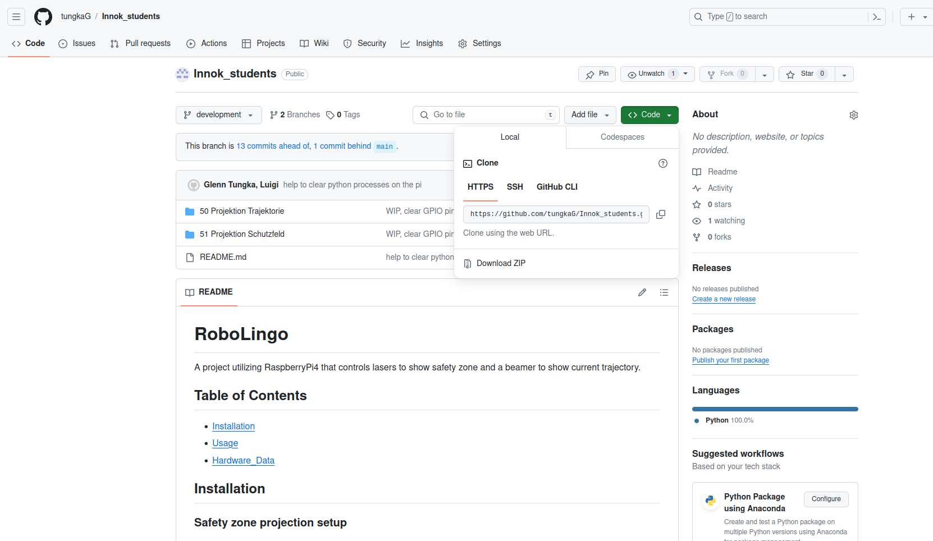
Copy this link

Slide 7
Go back to the terminal and type
“cd Innok”
And enter
Then type
“git clone <paste the link here>”
Then type
“code Innok_students/51\ Projektion\ Schutzfeld/projection_management.py”
Visual studio code should be opened

Slide 8
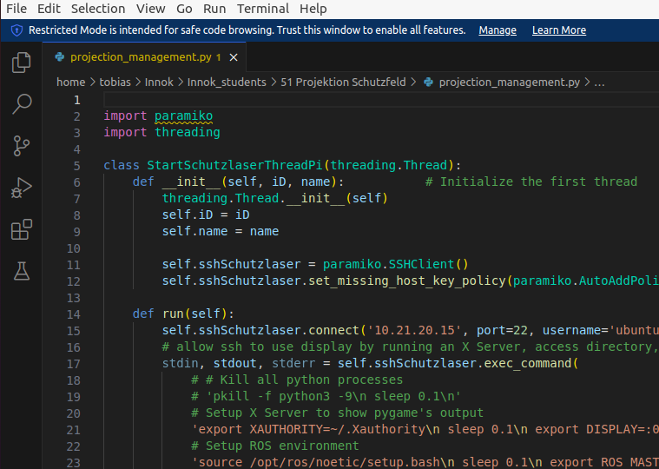
Click manage

Slide 9
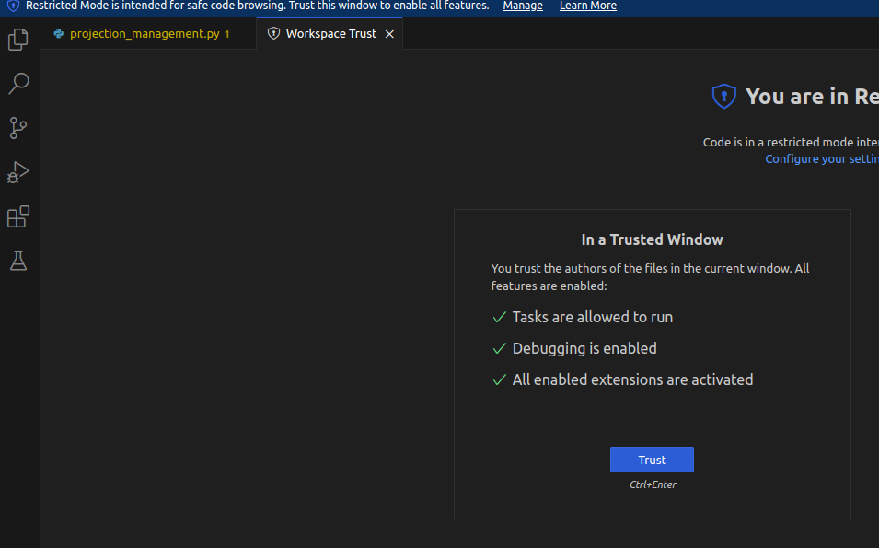
Click trust

Slide 10
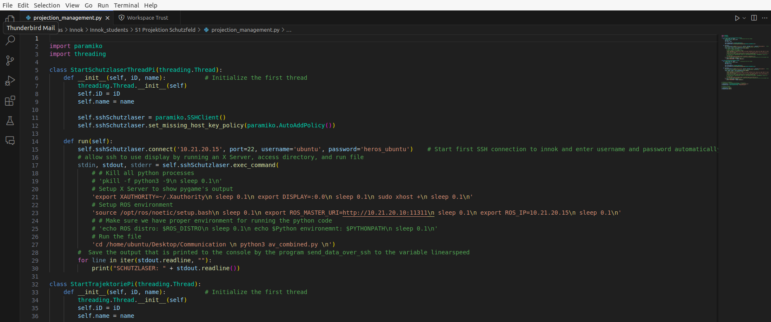
Run the file

Slide 11
Wait until you see a response on the terminal of VS code, normally takes maximum 3 minutes

Slide 12
Switch button configuration
To activate only the safety zone projection, toggle the C switch on the Innok Robot RC upwards
To activate only the trajectory projection, toggle the C switch on the Innok Robot RC downwards
To activate both projections, toggle the D switch on the Innok Robot RC upwards
To deactivate both projections, toggle the D switch on the Innok Robot RC downwards

Slide 13
If anything is doubtful in this document, refer to the READme files on the repository

