Slide 1
Q-learning in a grid world
Learning a route around obstacles
Python project presentation
01
Notes:
Introduce the project as a demonstration of reinforcement learning. The agent learns action values by trial and error. This presentation takes about 8 to 10 minutes. Source: gridworld.py and results/summary.json.

Slide 2
Problem and project objective
Navigate from the start cell to the goal
Avoid blocked cells and grid boundaries
Learn action values through repeated episodes
Evaluate the learned route against a shortest-path baseline
02
Notes:
Explain that the grid contains fixed walls and deterministic actions. The agent begins at S and receives rewards after each move. The goal is a successful short route without entering obstacles. Source: GridWorld in gridworld.py.

Slide 3
Environment and rewards
6 × 6 grid with four actions
Event | Reward | Outcome
Open-cell move | −1 | Move to next cell
Wall or obstacle | −5 | Stay in current cell
Goal reached | +100 | End episode
Actions: up, right, down, left. Each episode allows 200 actions.
03
Notes:
The default map has 36 cells, including 8 blocked cells and 28 traversable states. Row and column indices begin at zero. S is at (0,0), G at (5,5). A collision leaves the agent in its current cell. Source: DEFAULT_MAP and GridWorld.step in gridworld.py.

Slide 4
How Q-learning updates action values
Q(s,a) ← Q(s,a) + α [target − Q(s,a)]
Ordinary move: target = r + γ max Q(s′, a′)
Goal reached: target = r
α controls learning speed. γ discounts future rewards.
04
Notes:
Q(s,a) estimates discounted future reward after taking action a in state s. For nonterminal moves, combine the observed reward and best next-state value. At the goal, the target equals the reward. The time limit truncates the trajectory and does not remove bootstrapping. Source: update_q and train in gridworld.py.

Slide 5
Exploration and training settings
Setting | Default
Training episodes | 3,000
Learning rate α / discount γ | 0.10 / 0.95
Epsilon schedule | max(0.05, 1.0 × 0.997^episode)
Random seed / episode limit | 42 / 200 actions
05
Notes:
Epsilon-greedy exploration initially chooses random actions frequently. Over episodes epsilon falls to a floor of 0.05, preserving some exploration. Random ties are seeded during training. The evaluation policy uses a deterministic tie order and no exploration. Source: train and greedy_action in gridworld.py.

Slide 6
Training workflow
1. Initialize Q-values and reset to the start
2. Select an action using the epsilon-greedy policy
3. Observe the next state and reward
4. Update Q and repeat until the goal or time limit
The trainer saves reward, action count, success, and epsilon per episode.
06
Notes:
Describe the loop: initialize a table with four zeros per traversable state, reset to S each episode, choose an epsilon-greedy action, step the environment, update the selected Q-value, and repeat until the goal or time limit. CSV history records episode-level observations. Source: train in gridworld.py.

Slide 7
Project structure and live demonstration
gridworld.py: environment, training, evaluation, and CLI
test_gridworld.py: six automated tests
results/: CSV history, Q-table, summary, and route
docs/ and presentation/: report and presentation
py gridworld.py
py -m unittest -v
07
Notes:
In the project folder, run py gridworld.py, then py -m unittest -v. Open results/learned_path.svg in a browser. Explain that GridWorld handles movement, train learns the table, rollout evaluates it, and the CLI writes results. Source: project README and gridworld.py.

Slide 8
Training rewards improve as exploration falls
100
500
1000
1500
2000
2500
3000
Mean total reward by episode, averaged in blocks of 100. Seed 42.
08
Notes:
Each point is the mean total reward in a consecutive block of 100 training episodes, computed directly from training.csv. These are exploratory training rewards, not greedy evaluation scores. Negative early returns reflect long episodes and collisions. Source: results/training.csv, seed 42, 3000 episodes.

Slide 9
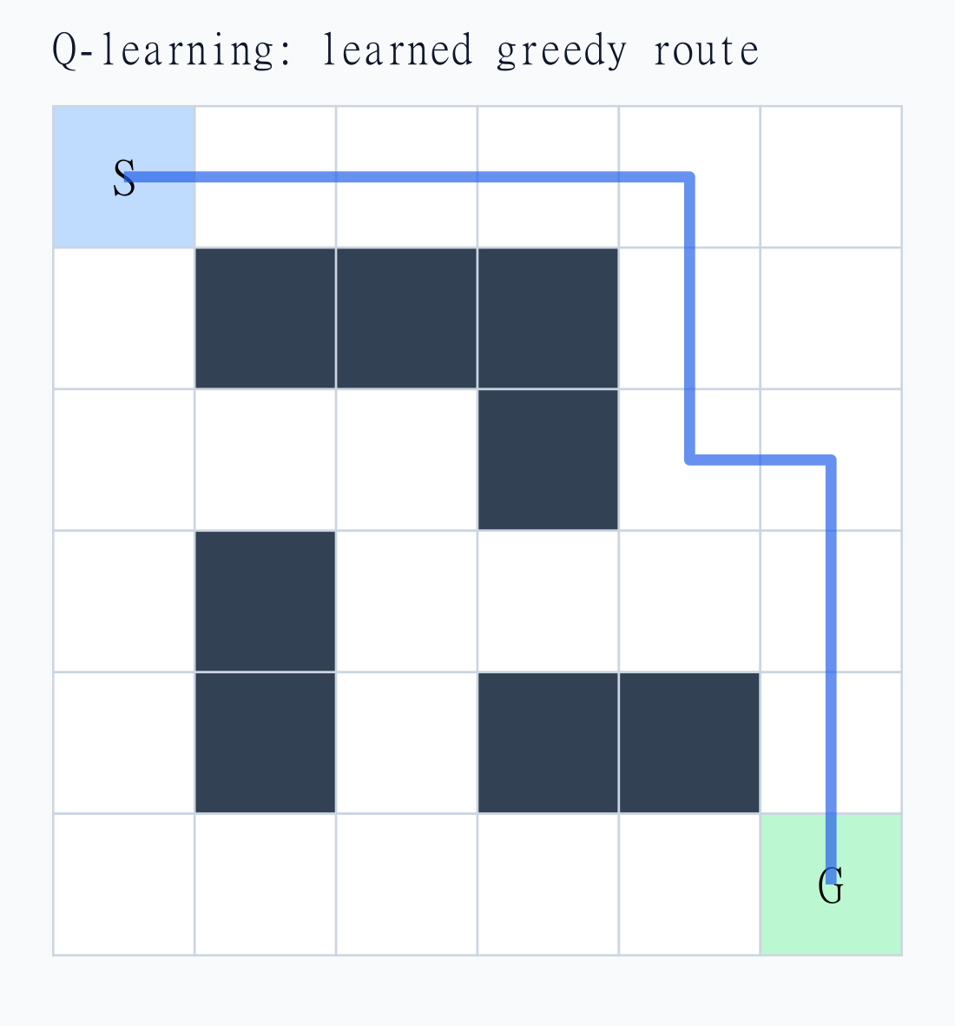
The learned route reaches the goal in 10 moves
10 moves
Shortest-path baseline: 10
Greedy return: +91
Goal reached: yes
S = start G = goal
Blue line = learned route
09
Notes:
The image is the saved route visualization from the executed project. The greedy evaluation uses no random exploration. The route contains 9 ordinary moves and one goal move, for a return of 9 times -1 plus 100 = 91. BFS independently finds the same path length, but does not supply actions to training. Source: results/summary.json and results/learned_path.svg.

Slide 10
Validation and test evidence
6 automated tests pass
Seeds 0, 7, and 42 each learn a 10-move route
Tests verify collisions and terminal Q updates
The final 100 training episodes all reach the goal
10
Notes:
Six unittest methods pass. The learning test trains three seeds: 0, 7, and 42. Each greedy policy reaches the goal in 10 valid adjacent moves. Reproducibility uses a separate small grid. All claims are limited to the tested deterministic maps and settings. Source: test_gridworld.py and executed unittest output.

Slide 11
GitHub publication workflow
Empty GitHub repository + local project folder
git init
git add .
git commit -m "Add Q-learning grid world project"
git branch -M main
git remote add origin YOUR_REPOSITORY_URL
git push -u origin main
11
Notes:
Use docs/GITHUB_GUIDE.md for the complete Windows PowerShell instructions. Create an empty GitHub repository, initialize the local folder, commit, add origin, and push main. Complete authentication if prompted. Source: https://docs.github.com/en/migrations/importing-source-code/using-the-command-line-to-import-source-code/adding-locally-hosted-code-to-github

Slide 12
Conclusions and future improvements
Q-learning learned an optimal route
on the tested grid
Current scope: small, static, deterministic maps
Future work: larger maps and stochastic transitions
Questions
12
Notes:
The project demonstrates tabular Q-learning on a small fixed environment. BFS supplies only a reachability and shortest-length baseline. Fixed learning rate and finite exploration do not prove convergence for every map. Future work could add larger maps, moving obstacles, or comparisons with SARSA. Finish by inviting questions.

