Slide 1


GLOBAL NATURE CARE SANGATHAN’S GROUP OF INSTITUTIONS
Department Of Information Technology Engineering
Session 2021-22
PROJECT NAME:
BlurDetection
TEAM LEADER :
PRANAV DARWAI
SUBMITTED To :
Prof. Sandeep Rao

Slide 2
PROBLEM
STATEMENT
Many digital images contain blurred regions which are caused by motion or defocus. Automatic detection and classification of blurred image regions are very important for different multimedia analyzing tasks. This paper presents a simple and effective automatic image blurred region detection and classification technique. In the proposed technique, blurred image regions are first detected by examining singular value information for each image pixels. The blur types (i.e. motion blur or defocus blur) are then determined based on certain alpha channel constraint that requires neither image deblurring nor blur kernel estimation. Extensive experiments have been conducted over a dataset that consists of 200 blurred image regions and 200 image regions with no blur that are extracted from 100 digital images. Experimental results show that the proposed technique detects and classifies the two types of image blurs accurately. The proposed technique can be used in many different multimedia analysis applications such as image segmentation, depth estimation and information retrieval.

Slide 3
SOLUTION
The quality of images is essential in computer vision, image processing, and other related fields. Image restoration is one of the categories in image processing, where the quality of an image plays a vital role in the process. Blur detection is a pre-processing stage in image restoration. Using different blur detection techniques, the quality of an image can identify if blurry or not. This study aims to provide a comparative performance of the available state-of-the-art blur measure operators or blur detection techniques. Python 6.3 was used for testing and evaluating the blur detection techniques. Providing the confusion matrix, precision, recall, f-measure, accuracy, and execution time were used to compare blur detection techniques. In testing, the Gaussian kernel and threshold value were set to measure the performance of each technique. Provided on the evaluation results, in terms of accuracy rate, HWT leads the best result. Based on the computed scores, FFT got the highest precision score, while LAP got the highest recall score, and HWT got the highest f-measure score. In terms of the execution time, MLAP performs the fastest processing time among them all. Likewise, results of this study can use as resources before performing the image restoration.

Slide 4
Administrator
1. The head is provided with login and password .Only administrator can login into the main server .
2. The administrator can view the availability of food delivery boys and change the cost of food items and other details .
3. Administrator can manage new added customers and can also remove anyone from the system and at the same time.
MODULE
Customer
1. Every customer will be given an I'd .
2. The client will register with his name , mobile no ,email, password and their residence address.
3. The customer will choose from the provided meal plans and the number of meals to be provided in a day along with the timings .
Manager
1. Manager will inform the kitchen about the orders.
2. Manager will forward the Name, Address and phone number to the delivery boy for delivery
3. Manger will make the management report
Delivery Boy
1. View pending order and delivery details .
2. Tiffin will be delivered to the customers by the delivery boy.
3 .We will have all details of tiffin provider and the delivery boy.

Slide 5





F
E
1- Simply choose from various meal plans (weekly, monthly)and set there preference.
A
Doorstep delivery
T
2- Our tiffin management service manages the dates when tier subscription expire.
U
Easy availability
Low cost
R
3- Customer have to pay online and enter their address and the most convenient time they want their tiffin to be delivered.
E
Advantages
S
4- Food is prepared, packed and delivered hygienically.
5- Tiffin can be delivered to most of the locations in the city.
Delivered in food grade disposable boxes
Hygienic & good quality
6-The meal is packed and delivered to your doorstep.

Slide 6
Proposed System
O
Existing System
ur main objective is to deliver homemade and hygienic food to the people living away from there home. Our service let's people order homemade tiffin just like they order food from restaurants . They can easily select a suitable meal plan from a variety of meal plans on our site according to their need and time . The food will be delivered at their doorstep which saves their time Our system supports vocal for local as all the kitchens and home cooks from who we deliver the food are locals. Small home grown kitchens and Women's can easily cook comfort food and can get it delivered through our service which can help them earn in the comfort of their homes.
In existing system there are very less tiffin services and thus homemade tiffin's are not available to everyone, which leads to ordering and consumption of fast food on a regularly basis and thus disturbing the proper diet .

Slide 7



System Requirements
Operating System
Browser
Connectivity
Any operating system
Any web browser
Internet connection
Technology Used
HTML5
CSS3
JavaScript
Bootstrap
PHP
MySQL
XAMPP
Ver.3.2.4
Front-end development
Front-end development
Front-end development
Front-end development
Back-end development
Database
Server

Slide 8
Approx Tentative Rates
Cost Estimation
Designing Cost = Rs. 5000/-
Web Server LINUX = Rs. 2500/-
Domain Name = Rs. 1200/-
Miscellaneous Cost = Rs. 2000/-
Our Project costing would be approx Rs.11000/- with
05 Modules.

Slide 9
MODULES
ADMIN
Details about admin module
2. RESTAURANT MANAGER
Details about other modules
3. DELIVERY BOY
Details about other modules
4. CUSTOMER
Details about other modules

Slide 10
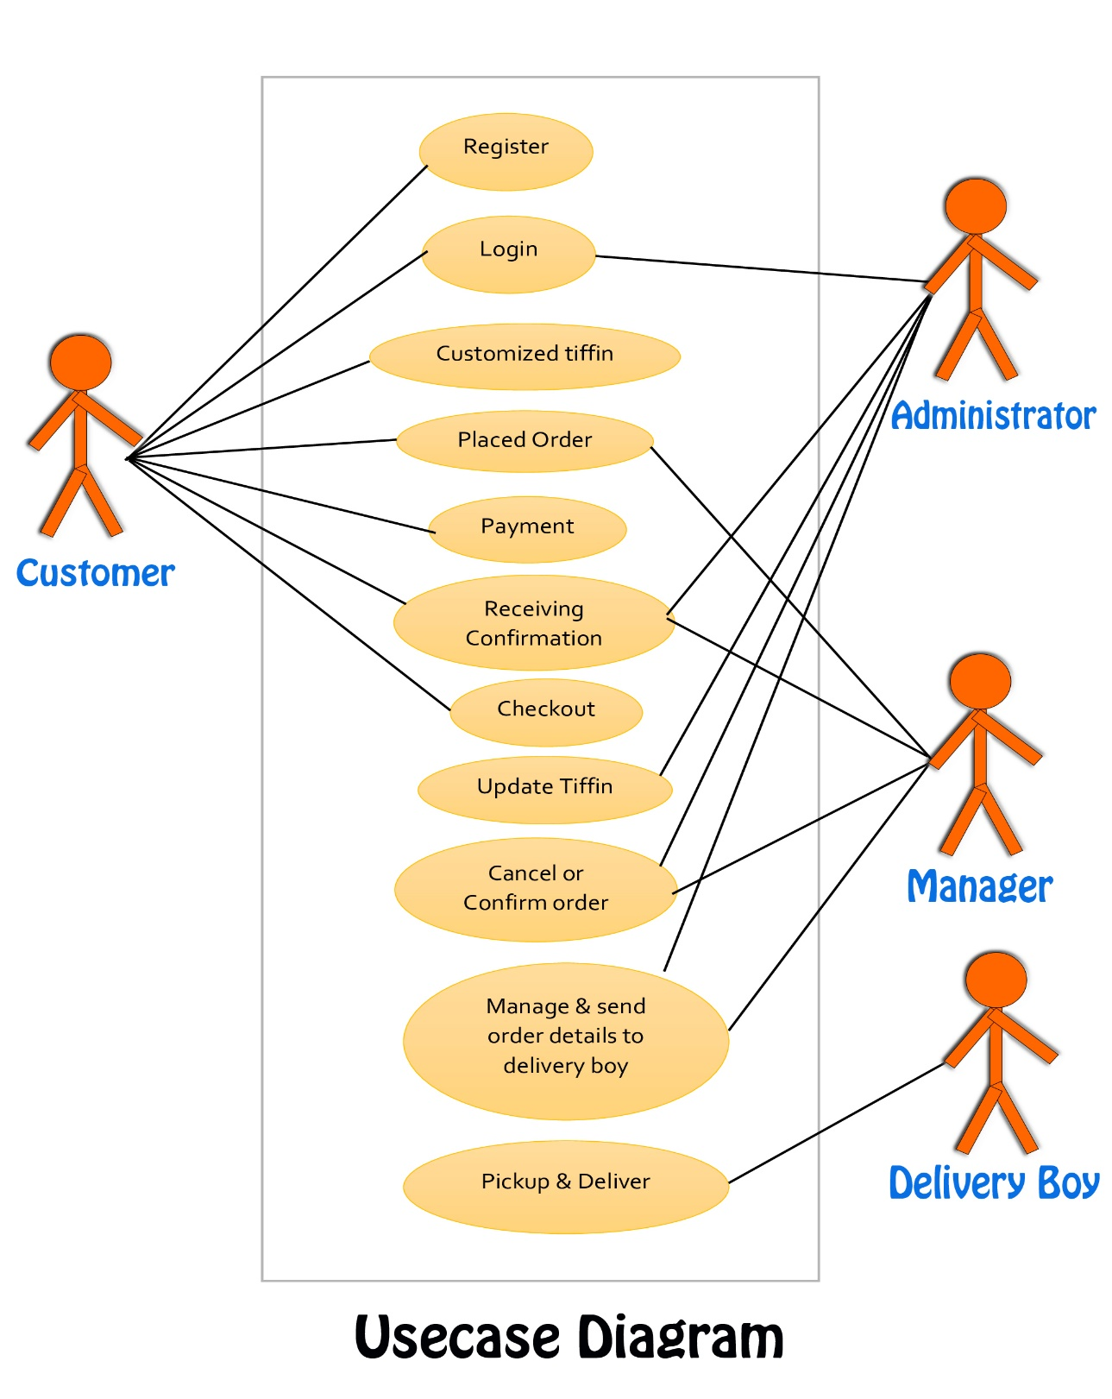
Use Case Diagram

Slide 11
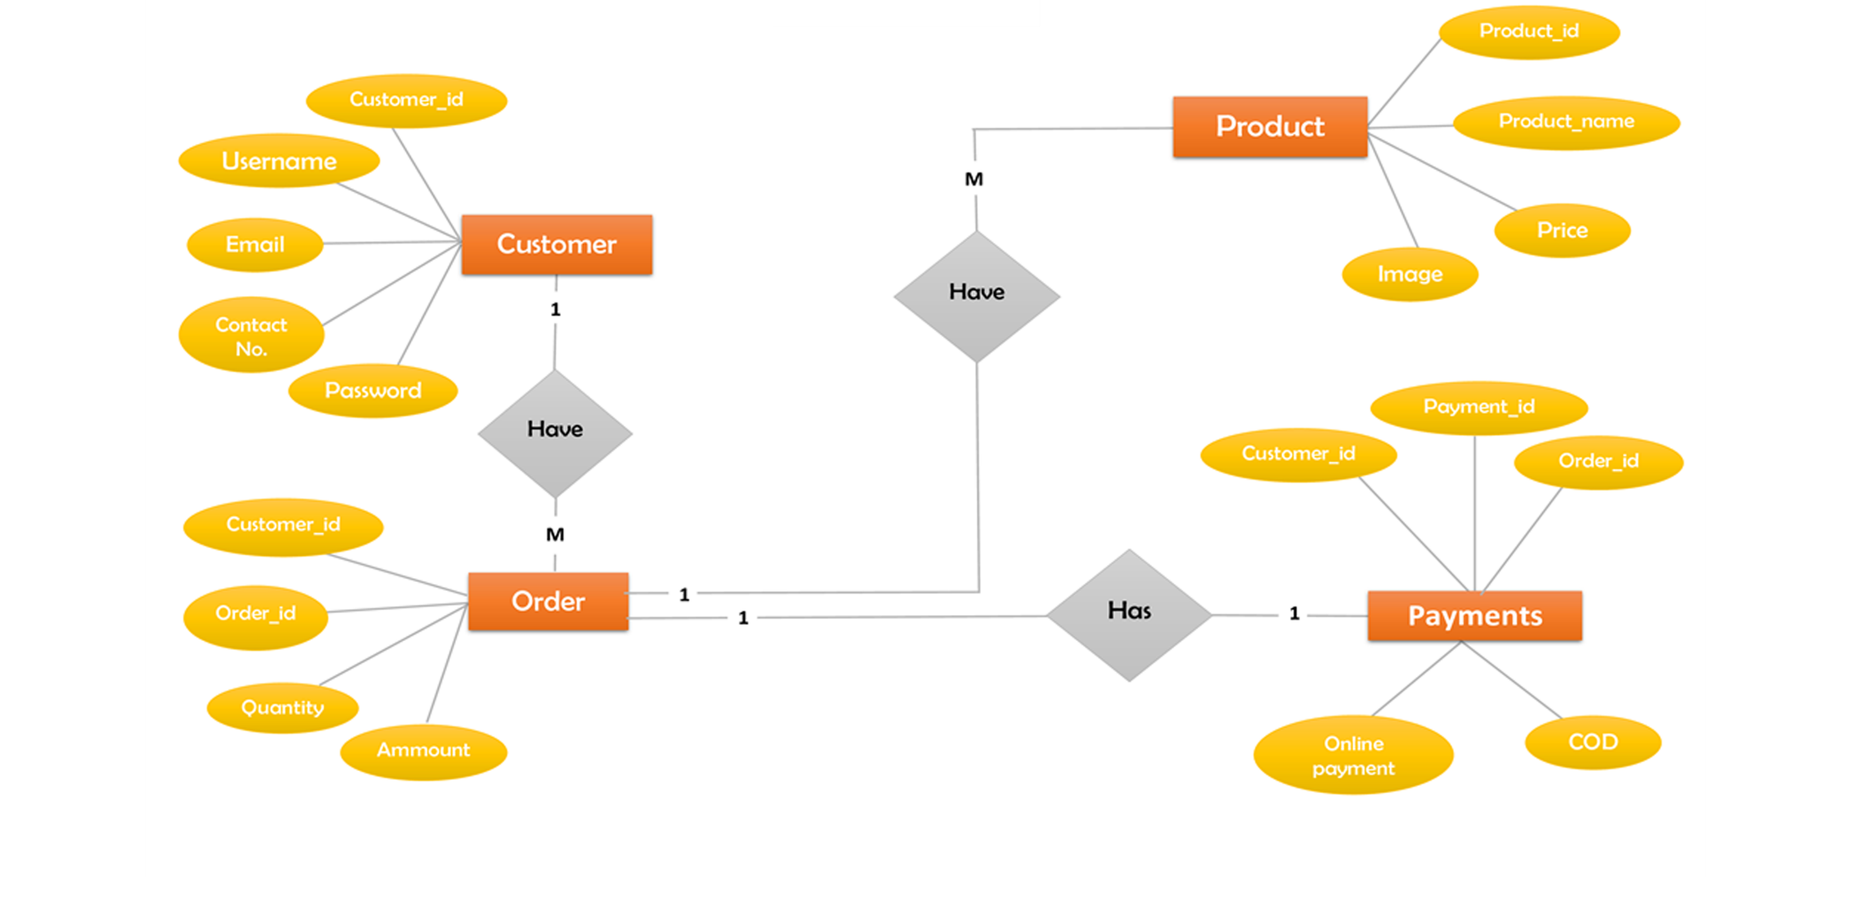
ER Diagram

Slide 12
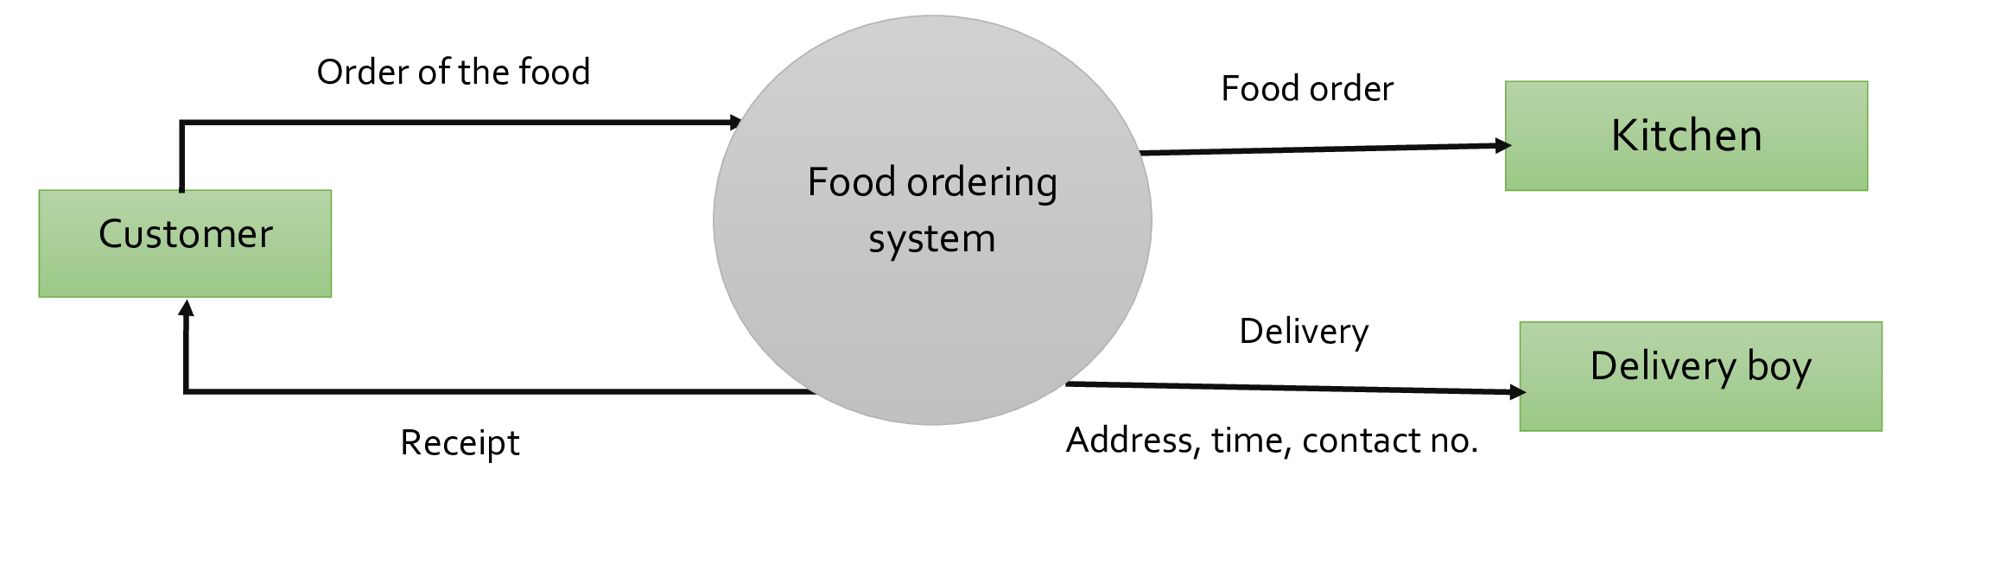
Level-0 DFD Diagram

Slide 13
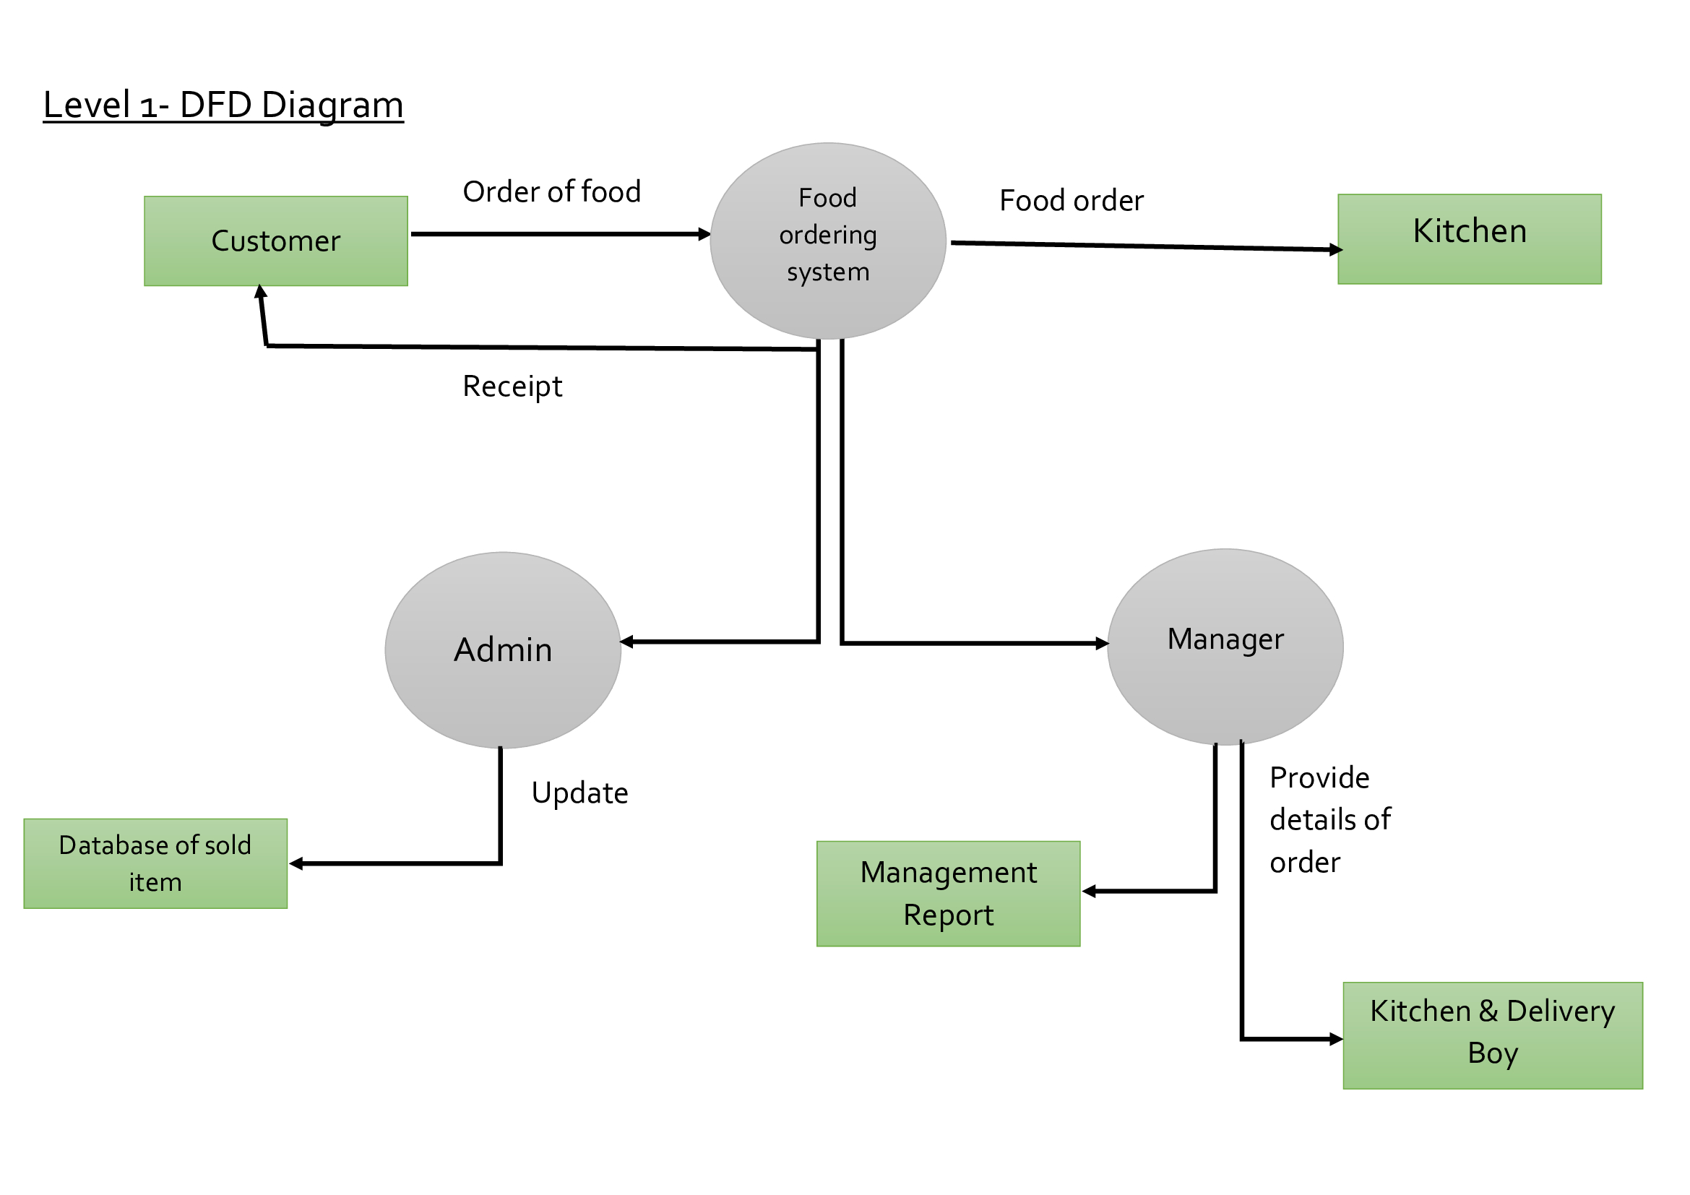
Level-1 DFD Diagram

Slide 14
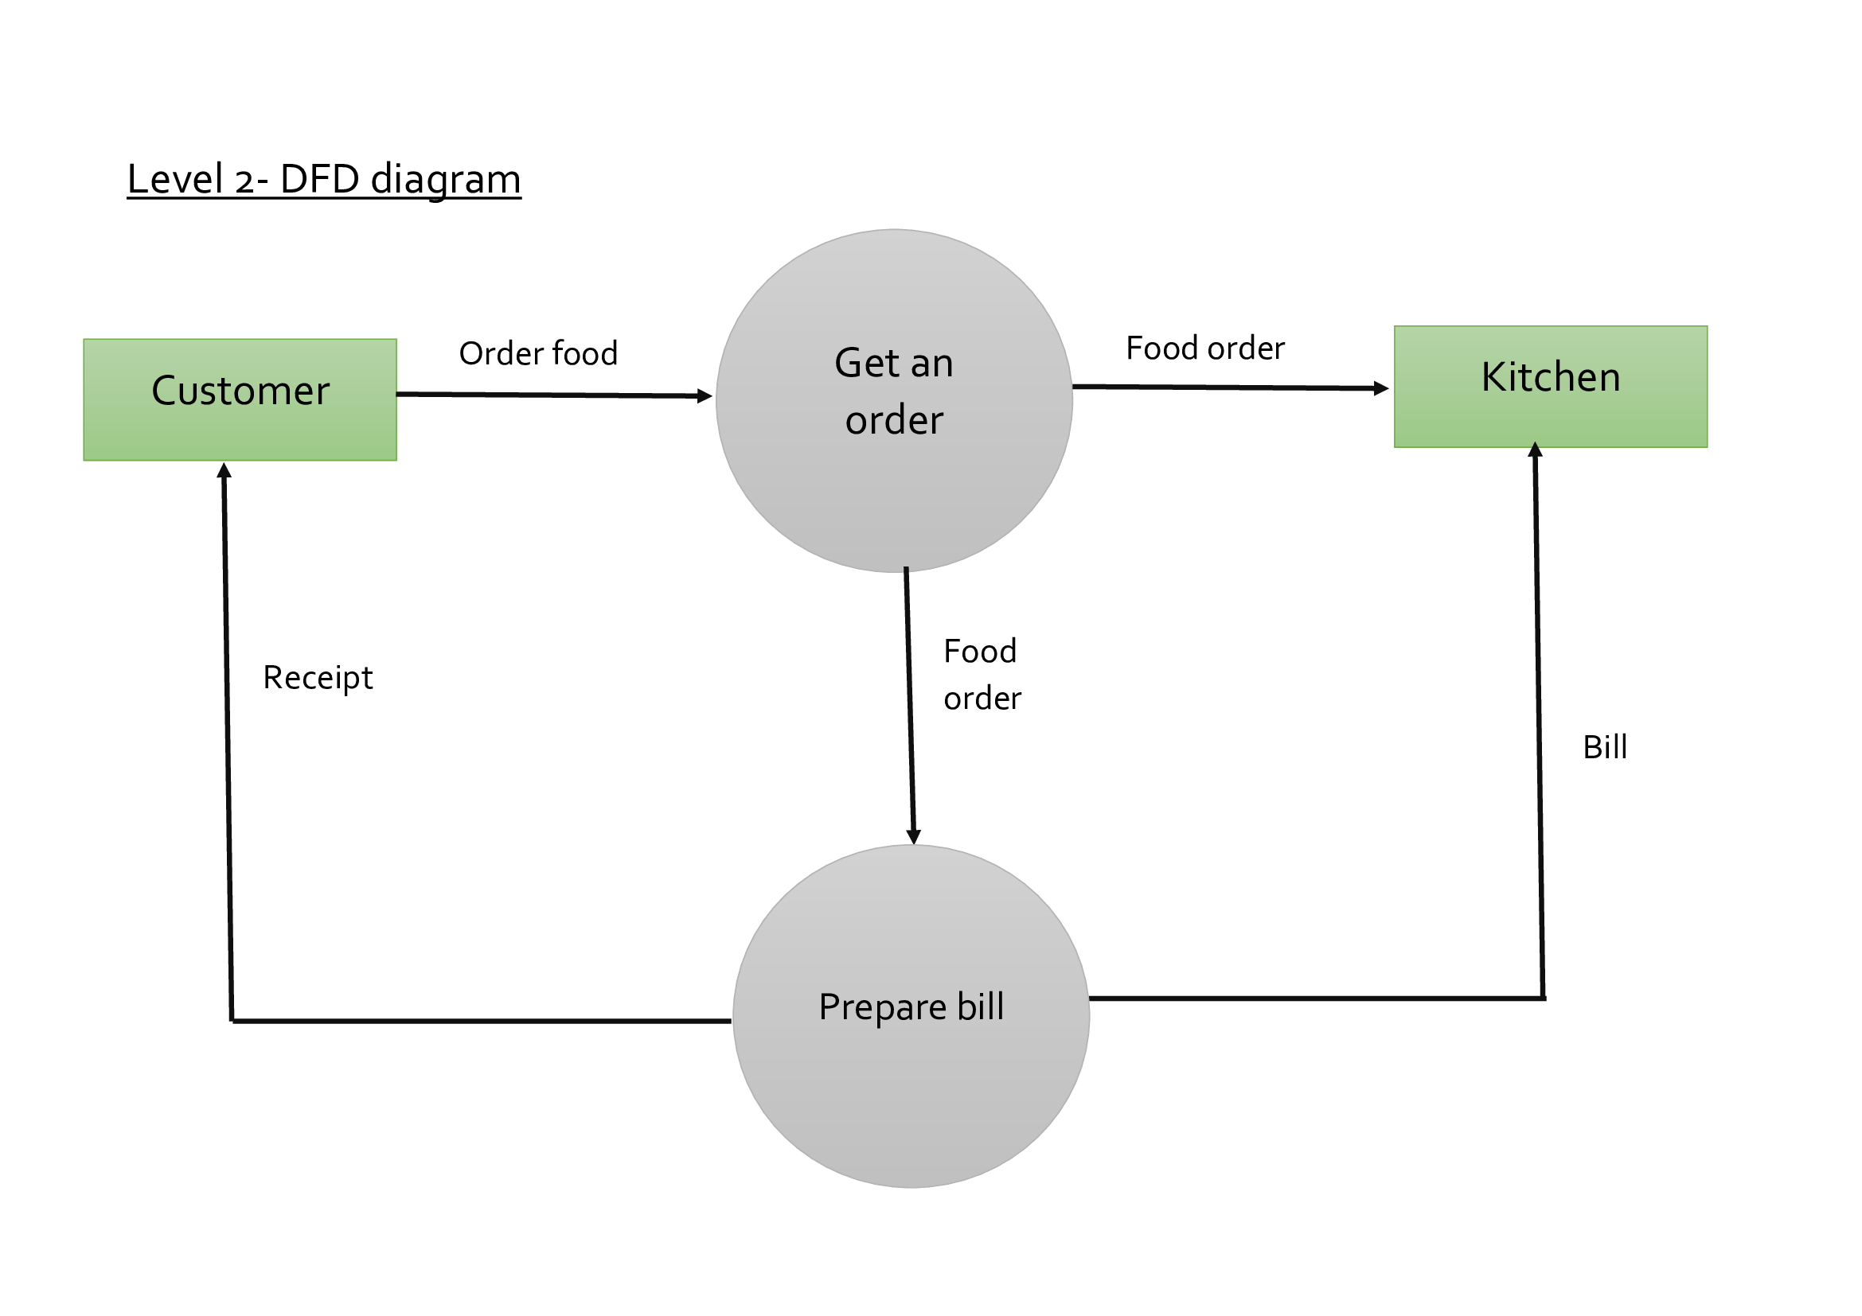
Level-2 DFD Diagram

Slide 15
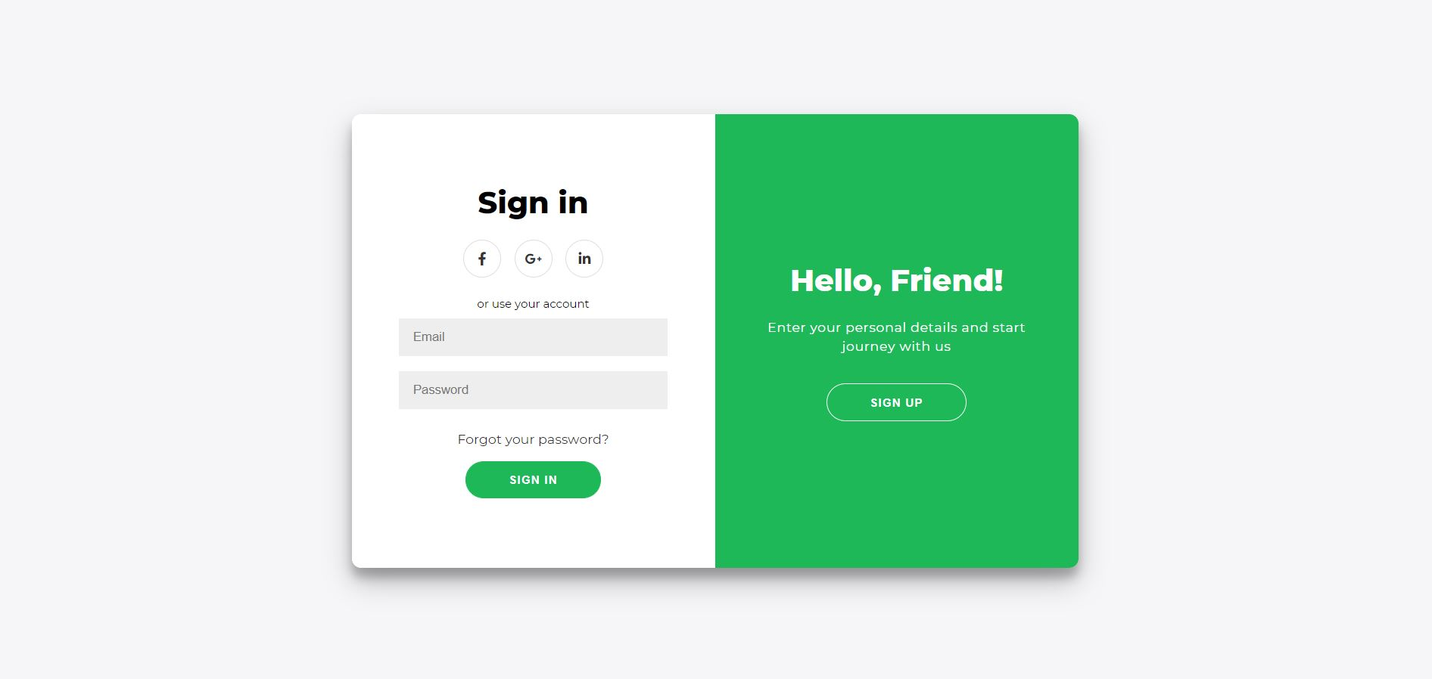

Login Page

Slide 16
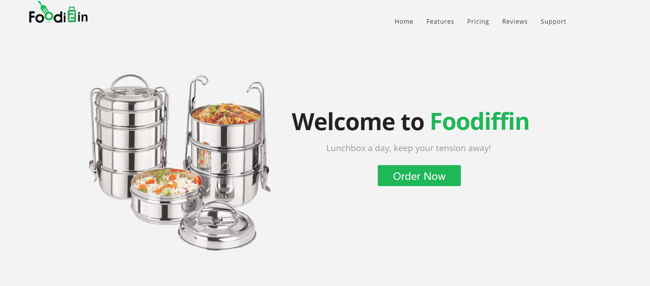

Homepage

Slide 17
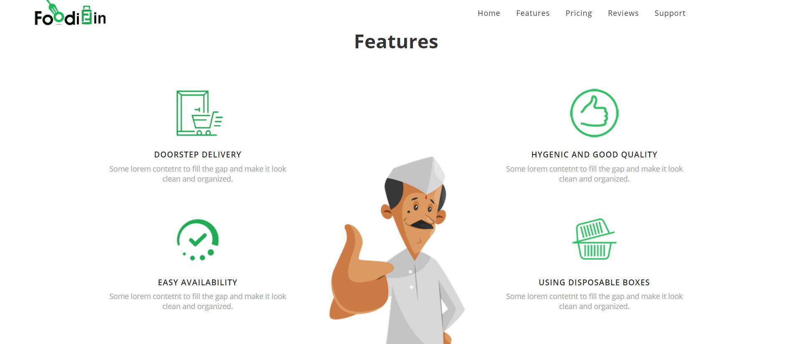

Slide 18
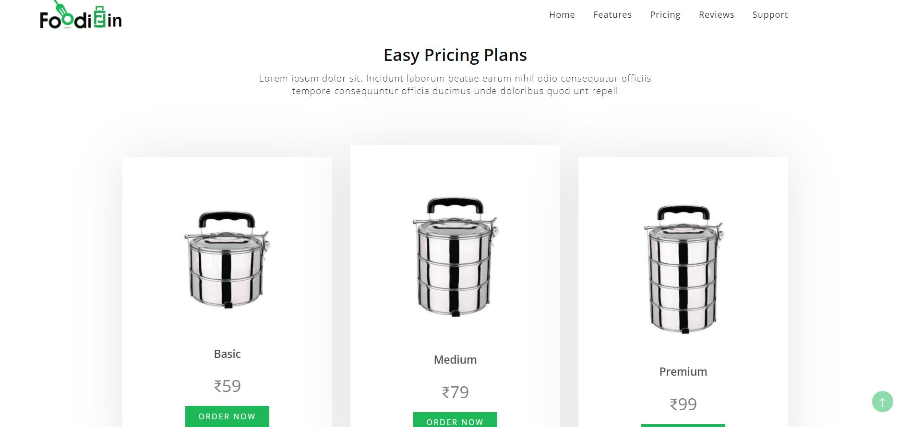
Pricing Page

Slide 19
CONCLUSION
In this project we have implemented a role based online tiffin management system which efficiently manages the entire functionality of admin and customer. The admin can manage customer records and preference easily where the customer can register and enjoy tiffin service based on personal preference. Food wastage is reduced as customer orders only that food which he/she prefer to order from range of available menu items. The admin can prepare less food in case the customer’s decides to skip tiffin for a particular day. This will help reduce food wastage. The tiffin delivery can be done at given address correctly. The website can be further expanded by following the future Enhancements mentioned above.

Slide 20

THANKS
We, are thankful to our beloved HODs for their fruitful guidance.
We are also thankful to Prof. Sandeep Rao for wonderful guidance and help.

