Slide 1
Ethereum : Decentralized Application Design & Development
Presenter: Jack Szulc

Slide 2
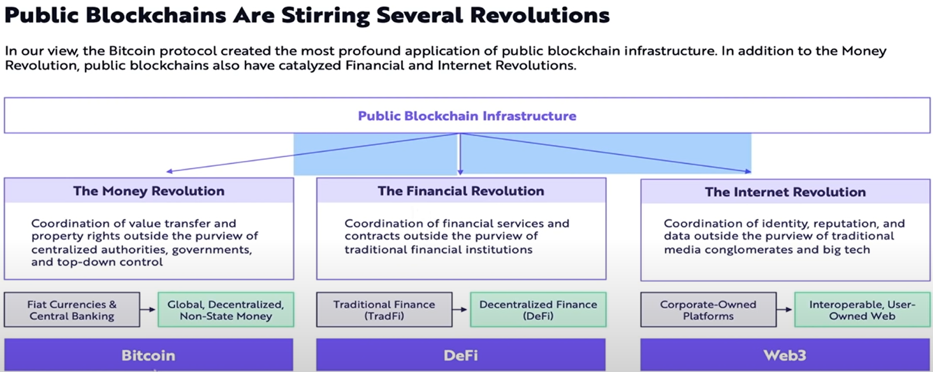

Slide 3

Satoshi Nakamoto
Born: Unknown
Creator of Bitcoin Cryptocurrency
Authored the Bitcoin whitepaper (2008)
Designed first blockchain database
https://bitcoin.org/bitcoin.pdf

Slide 4



Ethereum Blockchain
Vitalik Buterin
Gavin Wood

Slide 5
Glossary of terms
Blockchain – is a decentralized ledger of all transactions across a peer-to-peer network.
Bitcoin is a form of digital money
Ethereum is cryptocurrency and a platform
Gas is a unit of measurement that calculates the computational effort required by each transaction on the Ethereum network
1 GWEI = 0.000000001 ETH
Gwei gas is the fee paid to the network and transaction validators for the computational work of verifying a transaction

Slide 6
Consensus mechanisms
Proof of Work (PoW)
Proof of Stake (PoS)
Proof of burn
Raft consensus
Federated consensus
Proof of activity
Proof of elapsed time
Proof of capacity
Proof of importance
*Ethereum has shifted from PoW to PoS consensus

Slide 7
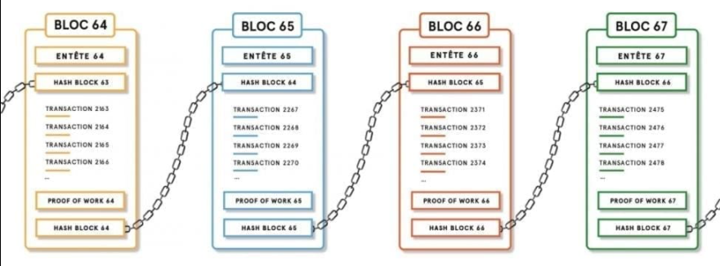
Blockchain

Slide 8


Slide 9




Web2
Users are able to utilize free services in exchange for their personal data
Web3
Users pay protocols to work for them in exchange for self-sovereignty and privacy

Slide 10
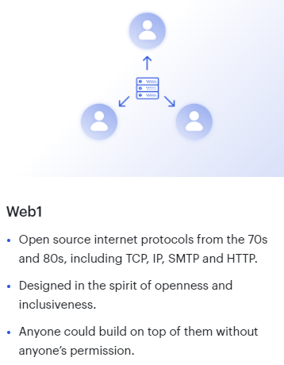
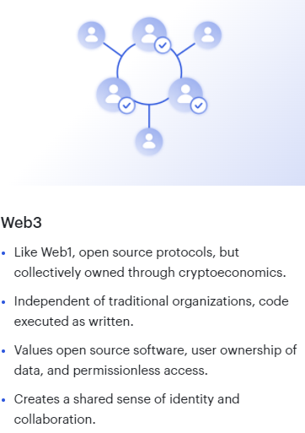
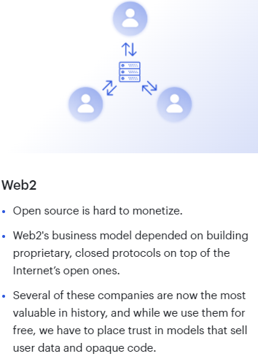
History of the Web

Slide 11








Development Toolset

Slide 12
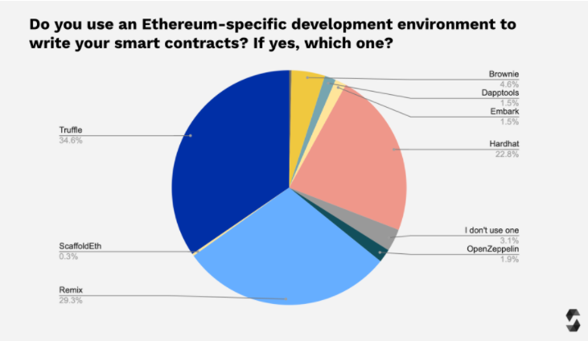
IDEs / Tooling

Slide 13
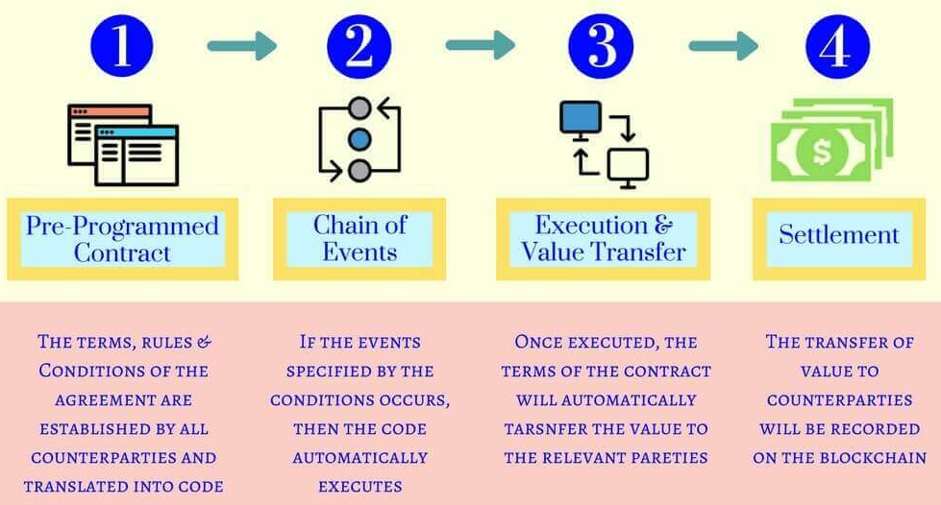
Smart Contracts -- How it works

Slide 14


LIMITATIONS
Smart contracts alone cannot get information about "real-world" events because they can't send HTTP requests. This is by design. Relying on external information could jeopardize consensus, which is important for security and decentralization.
There are ways to get around this using oracles.

Slide 15



Slide 16
Ethereum Virtual Machine (EVM)
The Ethereum Virtual Machine has three areas where it can store items.
The first is “storage”, where all the contract state variables reside. Every contract has its own storage and it is persistent between function calls and quite expensive to use.
The second is “memory”, this is used to hold temporary values. It is erased between (external) function calls and is cheaper to use.
The third one is the stack, which is used to hold small local variables. It is almost free to use, but can only hold a limited amount of values.
For almost all types, you cannot specify where they should be stored, because they are copied everytime they are used.
The types where the so-called storage location is important are structs and arrays. If you e.g. pass such variables in function calls, their data is not copied if it can stay in memory or stay in storage. This means that you can modify their content in the called function and these modifications will still be visible in the caller.

Slide 17
Defaults for the storage location depending on which type of variable it concerns:
state variables are always in storage
function arguments are always in memory
local variables of struct, array or mapping type reference storage by default
local variables of value type (i.e. neither array, nor struct nor mapping) are stored in the stack

Slide 18

Demo…..

Slide 19
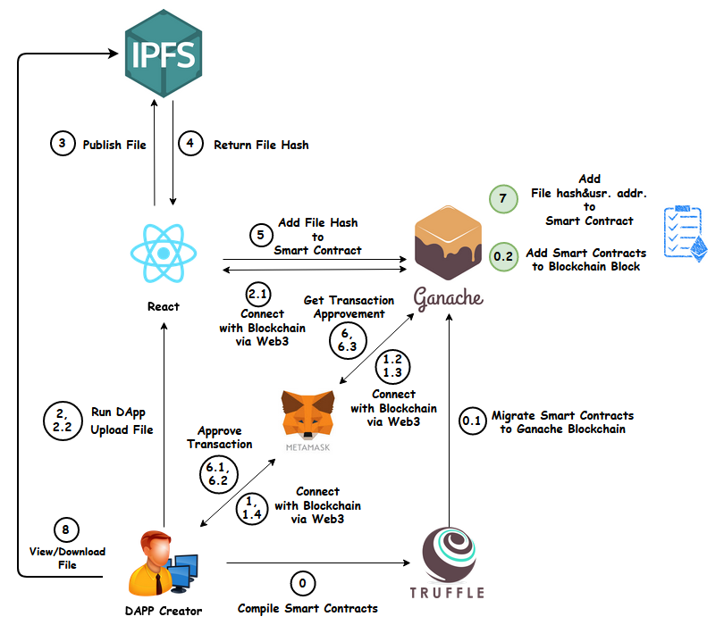
What we will build….

Slide 20
Truffle commands
truffle compile
truffle migrate
truffle test
truffle console
truffle(development)> let accounts = await web3.eth.getAccounts()
truffle(development)> instance
truffle(development)> HouseContract.deployed().then(function(i) {app = i;})
truffle(development)> app.get().then(function(value) {houseHash = value });
truffle(development)> houseHash

Slide 21
References:
https://www.coinbase.com/learn/crypto-basics/what-is-proof-of-work-or-proof-of-stake
https://blockworks.co/proof-of-work-vs-proof-of-stake-whats-the-difference/
https://www.geeksforgeeks.org/consensus-algorithms-in-blockchain

