Slide 1
264 SCREENS | 20 CITIES | 29L+ IMPRESSIONS

Slide 2
TOTAL SCREENS - 264
SR.NO.
CITY NAME
QTY(55 UNIT INCH)
SR.NO.
CITY NAME
QTY(55 UNIT INCH)
01
ANAND
20
11
BOTAD
10
02
KHEDA
10
12
BHAVNAGAR
15
03
GANDHINAGAR
20
13
VERAVAL
10
04
HIMMATNAGAR
20
14
JUNAGADH
15
05
DAHOD
10
15
PORBANDAR
20
06
GODHRA
10
16
DWARKA
10
07
ANKLESHWAR
10
17
JAMNAGAR
10
08
SURAT
20
18
MORBI
15
09
VALSAD
14
19
BHACHAU
10
10
CHIKHLI
10
20
SURENDRANAGAR
15

Slide 3
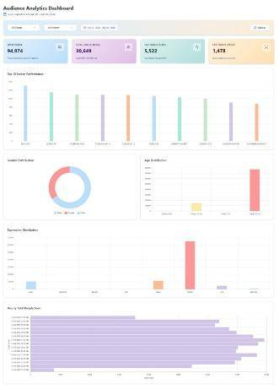
DATA DRIVEN ADVERTISING
DATA DRIVEN ADVERTISING
29L+ Monthly
95k+ Per Day
TOTAL UNIQUE PEOPLE
30k+ Per Day
Gender Distribution, Age Distribution
& Many More.
*Sample AI Analytics Report

Slide 4
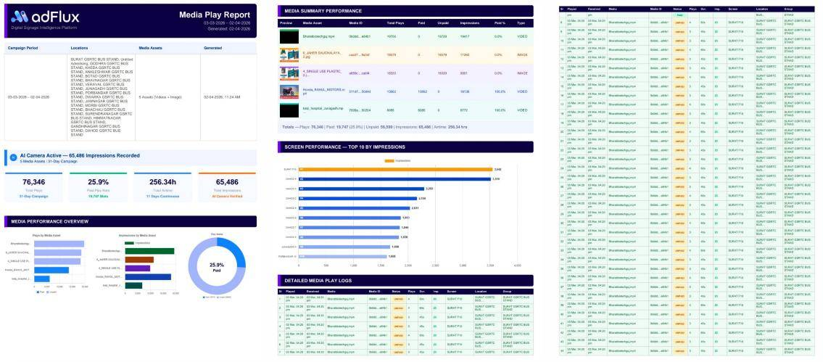
MEDIA DATA REPORT
*Sample Media Data Report

Slide 5
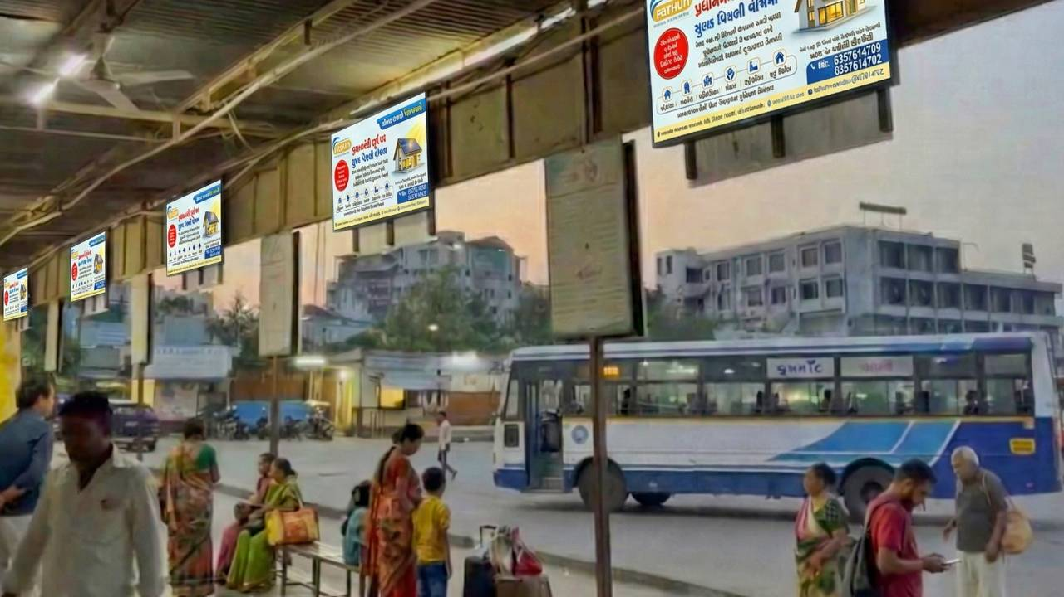
ANAND
20 SCREENS- 55” SIZE

Slide 6
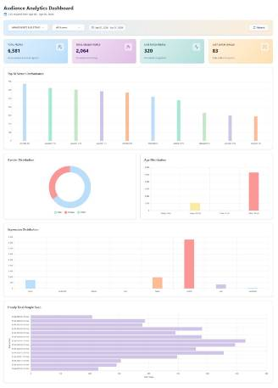
ANAND 20 SCREENS- 55” SIZE
TOTAL IMPRESSION
2L+ Monthly
6.5k+ Per Day
TOTAL UNIQUE PEOPLE
2k+ Per Day
Gender Distribution, Age Distribution
& Many More.
*Sample AI Analytics Report

Slide 7
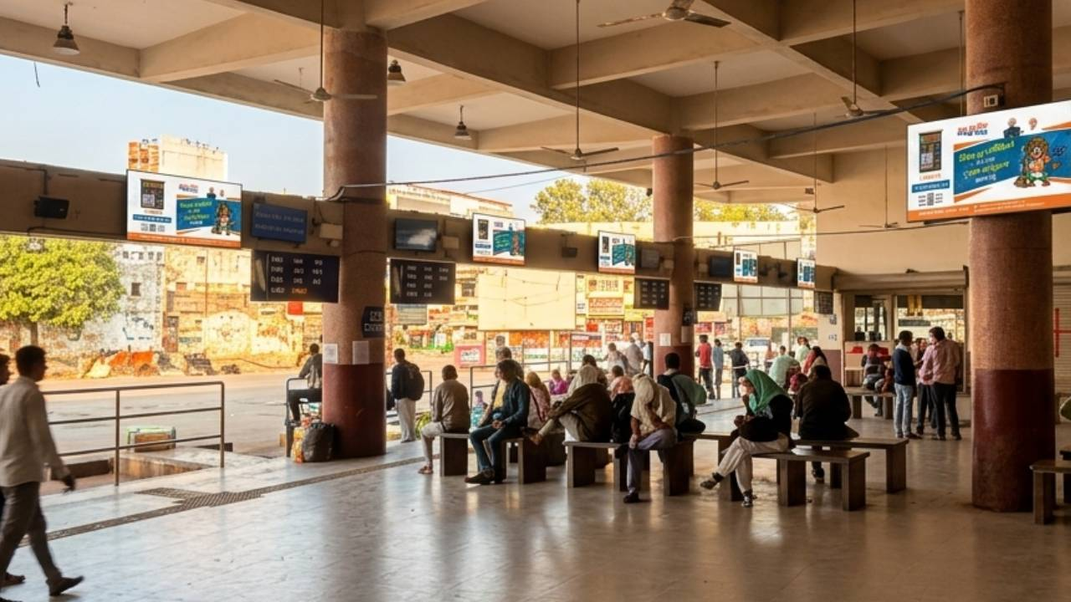
KHEDA
10 SCREENS- 55” SIZE

Slide 8
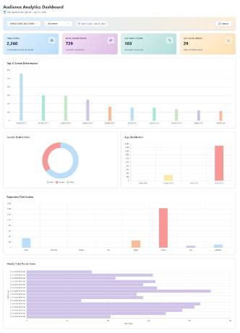
KHEDA 10 SCREENS - 55” SIZE
TOTAL IMPRESSION
65K+ Monthly
2.2k+ Per Day
TOTAL UNIQUE PEOPLE
700+ Per Day
Gender Distribution, Age Distribution
& Many More.
*Sample AI Analytics Report

Slide 9
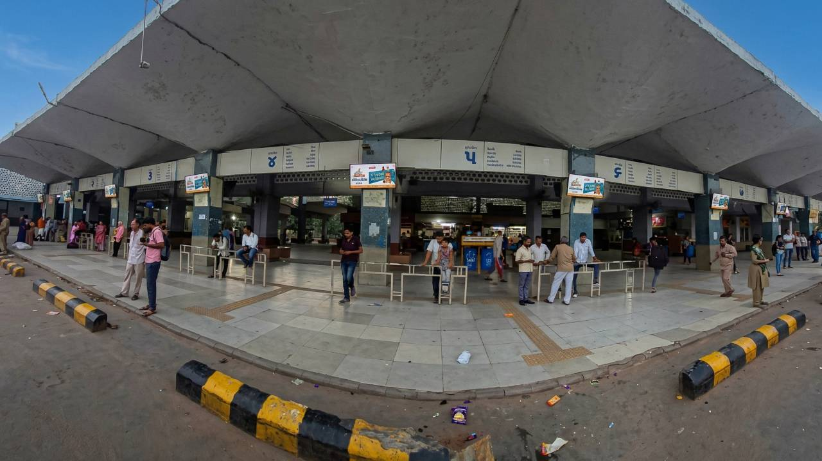
GANDHINAGAR
20 SCREENS- 55” SIZE

Slide 10
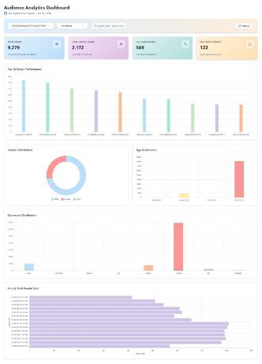
GANDHINAGAR 20 SCREENS- 55” SIZE
TOTAL IMPRESSION
2.7L+ Monthly
9k+ Per Day
TOTAL UNIQUE PEOPLE
2k+ Per Day
Gender Distribution, Age Distribution
& Many More.
*Sample AI Analytics Report

Slide 11
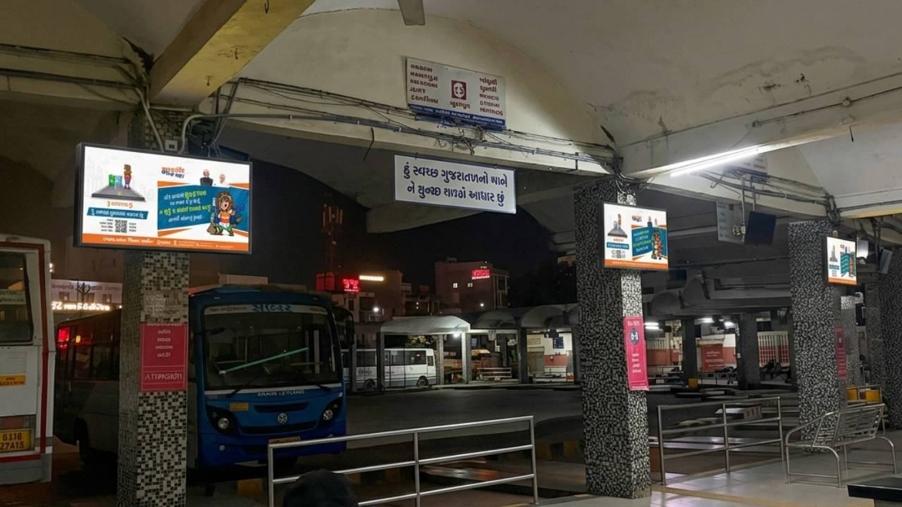
HIMMATNAGAR
20 SCREENS- 55” SIZE

Slide 12
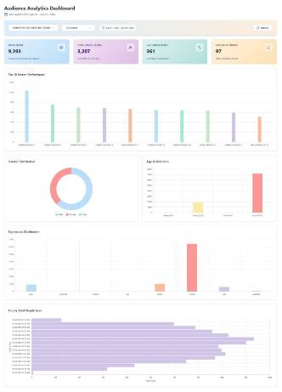
HIMMATNAGAR 20 SCREENS- 55” SIZE
TOTAL IMPRESSION
2.7L+ Monthly
9k+ Per Day
TOTAL UNIQUE PEOPLE
3k+ Per Day
Gender Distribution, Age Distribution
& Many More.
*Sample AI Analytics Report

Slide 13
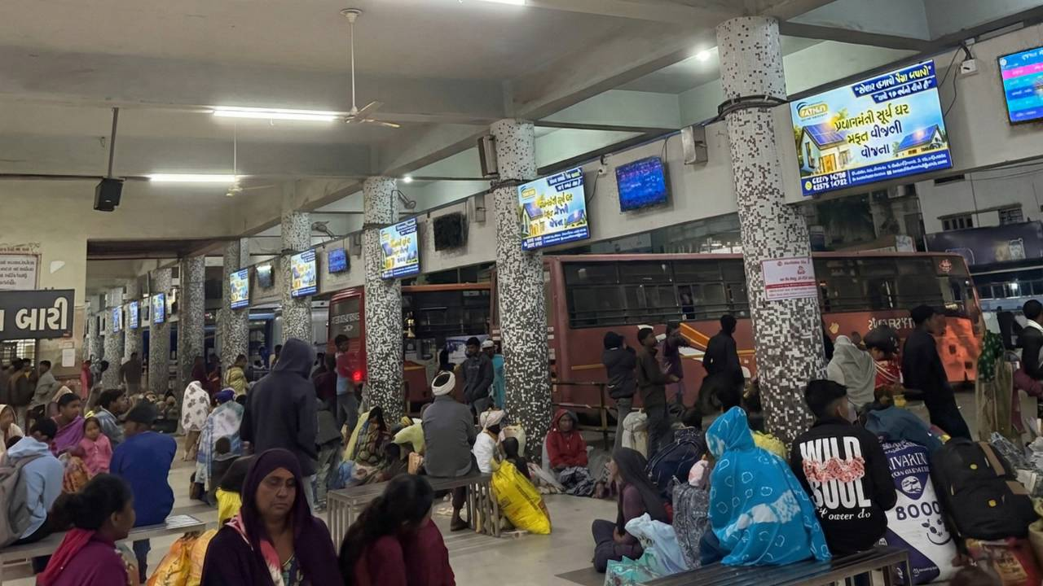
DAHOD
DAHOD
10 SCREENS- 55” SIZE

Slide 14
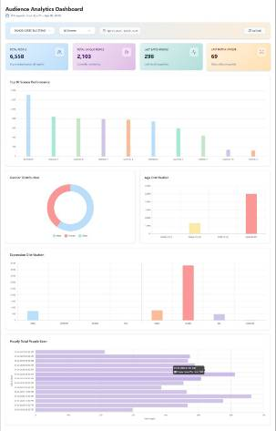
DAHOD 10 SCREENS- 55” SIZE
TOTAL IMPRESSION
2L+ Monthly
6.5k+ Per Day
TOTAL UNIQUE PEOPLE
2k+ Per Day
Gender Distribution, Age Distribution
& Many More.
*Sample AI Analytics Report

Slide 15
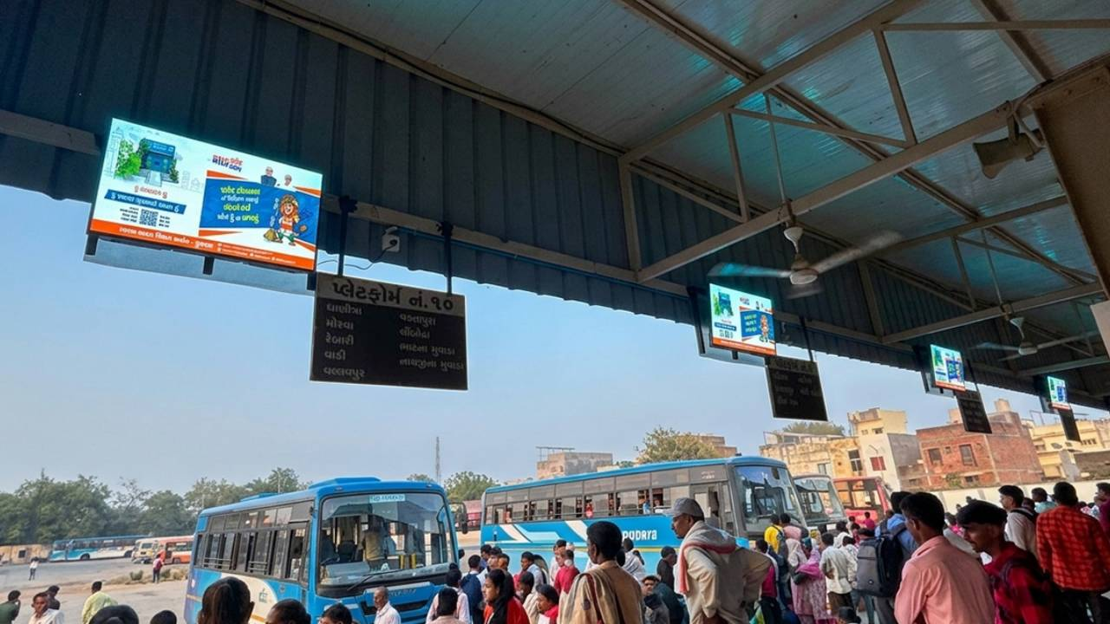
GODHRA
10 SCREENS- 55” SIZE

Slide 16
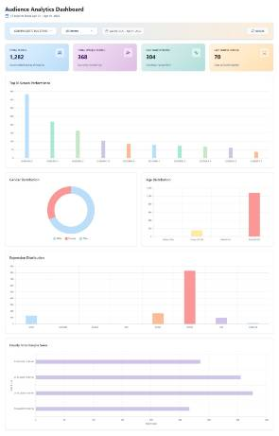
GODHRA 10 SCREENS- 55” SIZE
TOTAL IMPRESSION
38k+ Monthly
1.2k+ Per Day
TOTAL UNIQUE PEOPLE
368+ Per Day
Gender Distribution, Age Distribution
& Many More.
*Sample AI Analytics Report

Slide 17
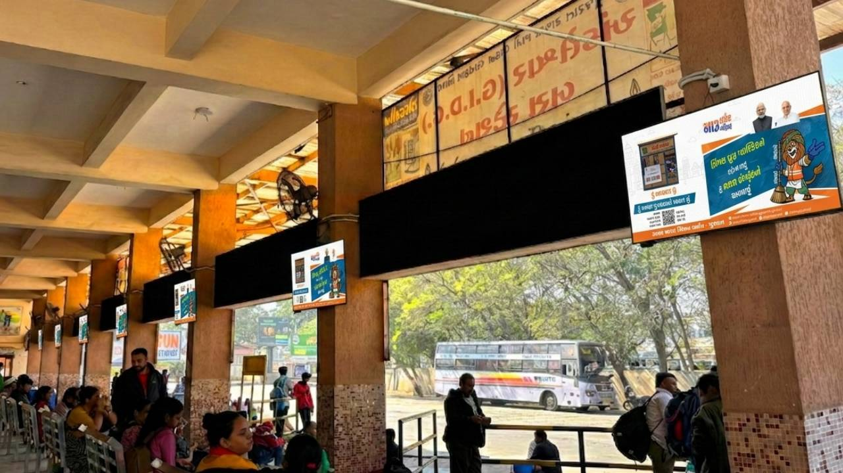
ANKLESHWAR
10 SCREENS- 55” SIZE

Slide 18
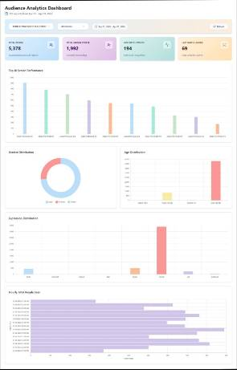
ANKLESHWAR 10 SCREENS- 55” SIZE
TOTAL IMPRESSION
1.6L+ Monthly
5.3k+ Per Day
TOTAL UNIQUE PEOPLE
2k+ Per Day
Gender Distribution, Age Distribution
& Many More.
*Sample AI Analytics Report

Slide 19
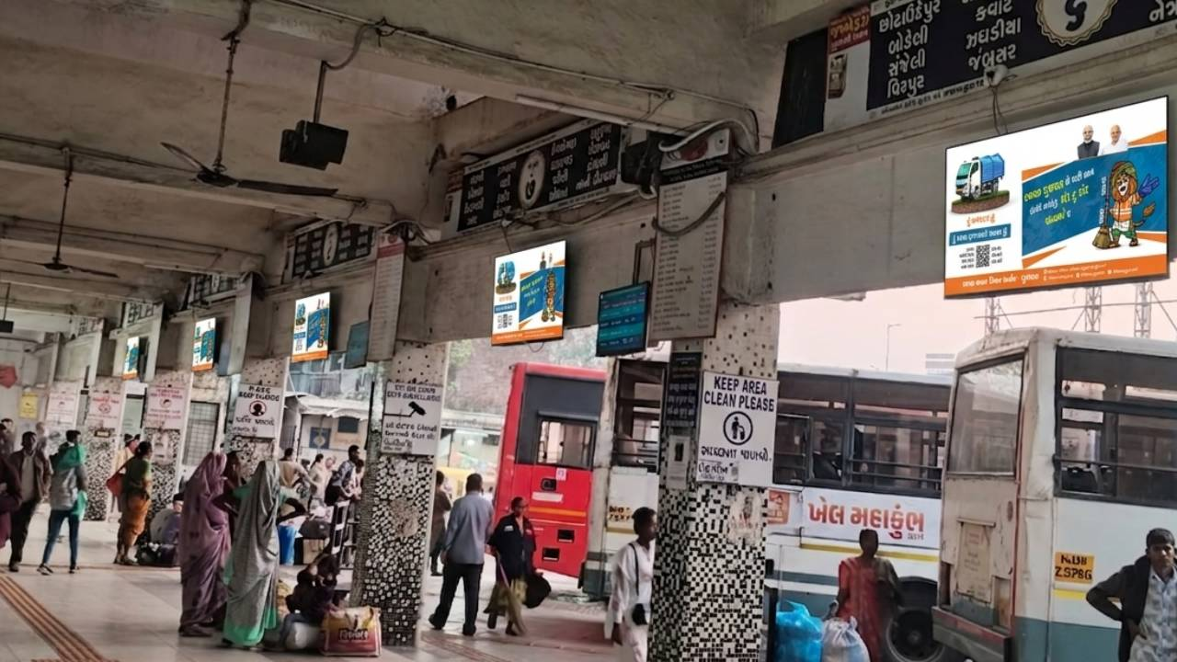
SURAT
20 SCREENS- 55” SIZE

Slide 20
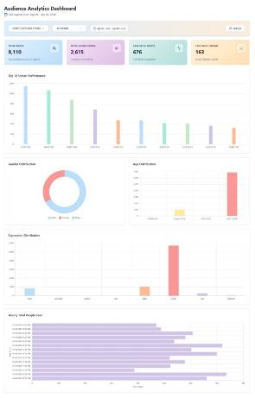
SURAT 20 SCREENS- 55” SIZE
TOTAL IMPRESSION
2.4L+ Monthly
8k+ Per Day
TOTAL UNIQUE PEOPLE
2.5k+ Per Day
Gender Distribution, Age Distribution
& Many More.
*Sample AI Analytics Report

Slide 21
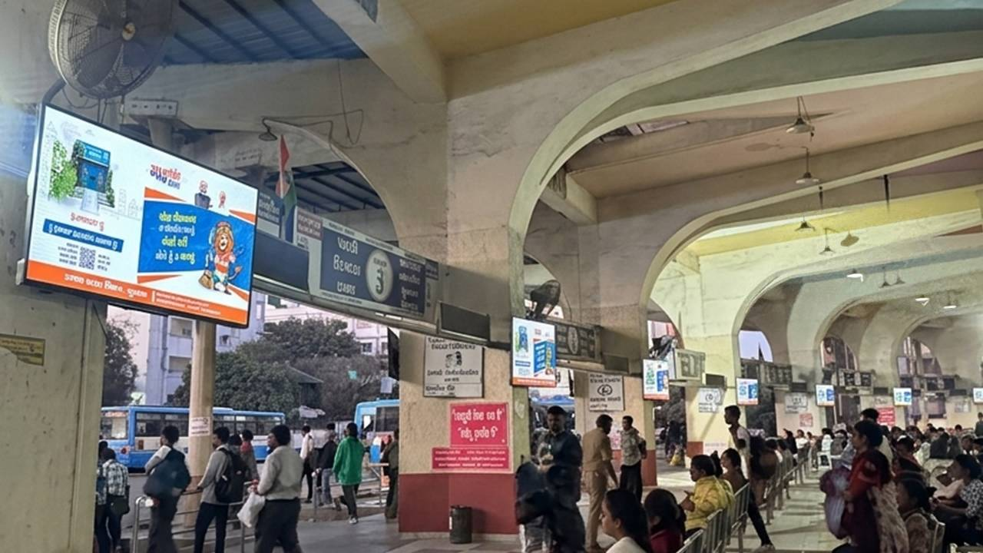
VALSAD
14 SCREENS- 55” SIZE

Slide 22
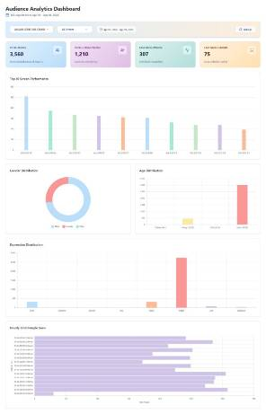
VALSAD 14 SCREENS- 55” SIZE
TOTAL IMPRESSION
1L+ Monthly
3.5k+ Per Day
TOTAL UNIQUE PEOPLE
1.2k+ Per Day
Gender Distribution, Age Distribution
& Many More.
*Sample AI Analytics Report

Slide 23
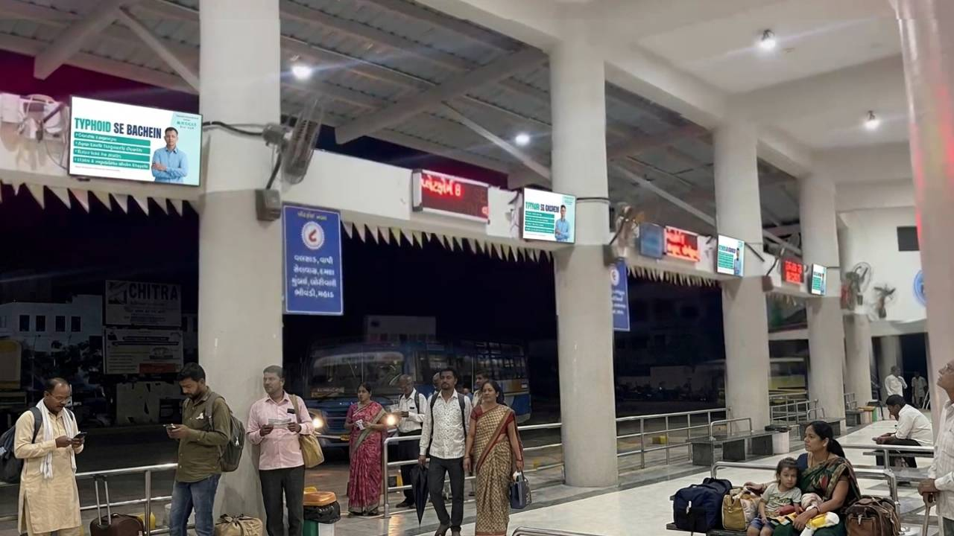
CHIKHLI
10 SCREENS- 55” SIZE

Slide 24
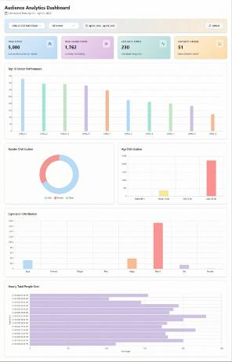
CHIKHLI 10 SCREENS- 55” SIZE
TOTAL IMPRESSION
1.5L+ Monthly
5k+ Per Day
TOTAL UNIQUE PEOPLE
1.7K+ Per Day
Gender Distribution, Age Distribution
& Many More.
*Sample AI Analytics Report

Slide 25
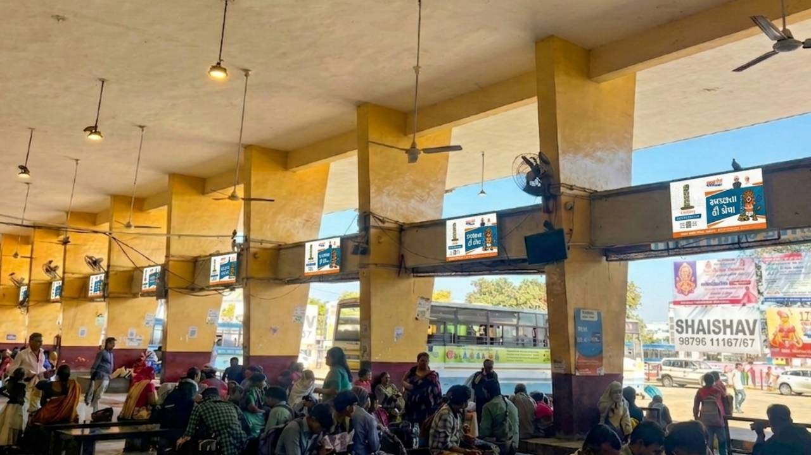
BOTAD
10 SCREENS- 55” SIZE

Slide 26
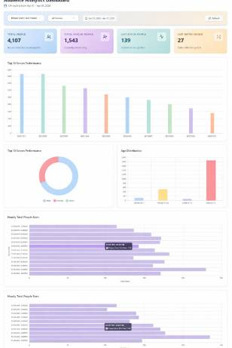
BOTAD 10 SCREENS- 55” SIZE
TOTAL IMPRESSION
1L+ Monthly
4K+ Per Day
TOTAL UNIQUE PEOPLE
1.5K+ Per Day
Gender Distribution, Age Distribution
& Many More.
*Sample AI Analytics Report

Slide 27
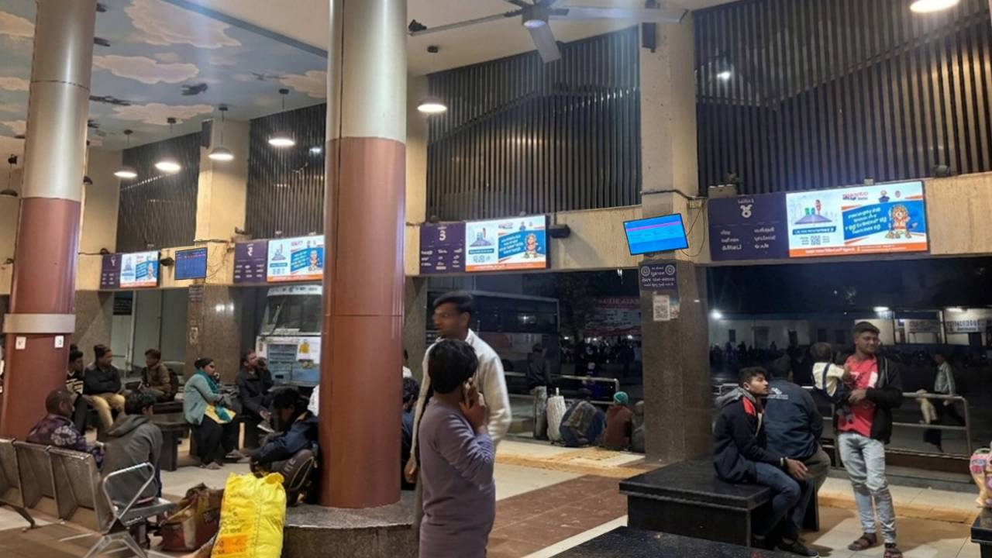
BHAVNAGAR
15 SCREENS- 55” SIZE

Slide 28
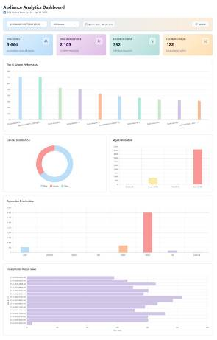
BHAVNAGAR 15 SCREENS- 55” SIZE
TOTAL IMPRESSION
1L+ Monthly
4K+ Per Day
TOTAL UNIQUE PEOPLE
1.5K+ Per Day
Gender Distribution, Age Distribution
& Many More.
*Sample AI Analytics Report

Slide 29
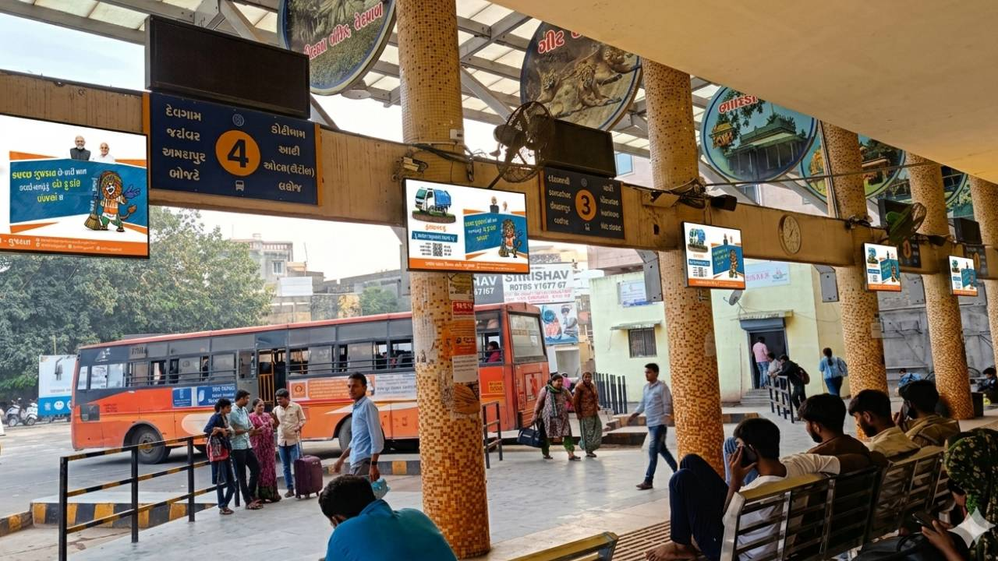
VERAVAL
10 SCREENS- 55” SIZE

Slide 30
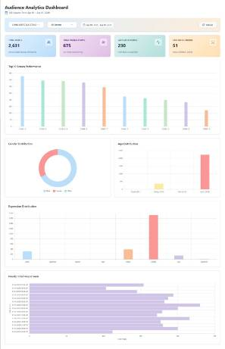
VERAVAL 10 SCREENS- 55” SIZE
TOTAL IMPRESSION
78k+ Monthly
2.6k+ Per Day
TOTAL UNIQUE PEOPLE
675+ Per Day
Gender Distribution, Age Distribution
& Many More.
*Sample AI Analytics Report

Slide 31
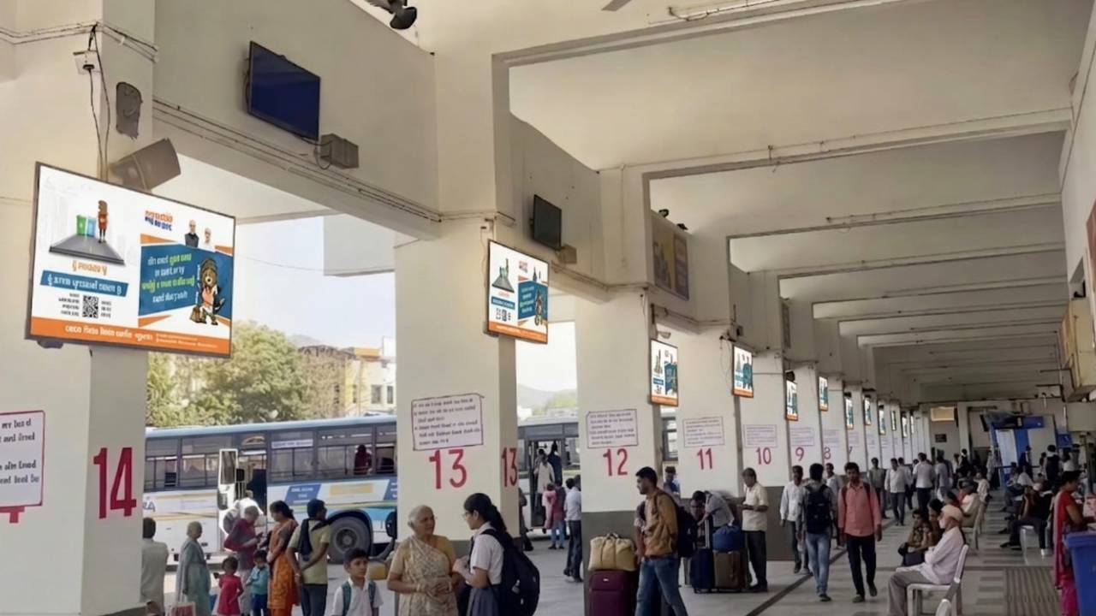
JUNAGHAD
15 SCREENS- 55” SIZE

Slide 32
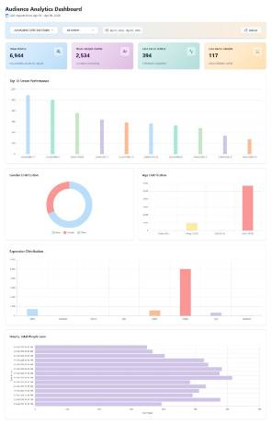
JUNAGADH 15 SCREENS- 55” SIZE
TOTAL IMPRESSION
2L+ Monthly
7k+ Per Day
TOTAL UNIQUE PEOPLE
2.4K+ Per Day
Gender Distribution, Age Distribution
& Many More.
*Sample AI Analytics Report

Slide 33
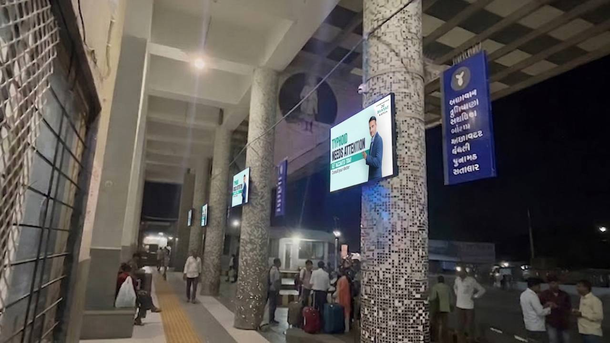
PORBANDAR
10 SCREENS- 55” SIZE

Slide 34
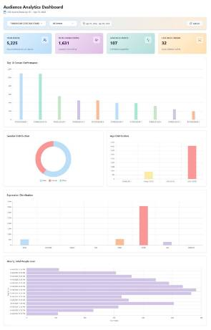
PORBANDAR 10 SCREENS- 55” SIZE
TOTAL IMPRESSION
1.5L+ Monthly
5k+ Per Day
TOTAL UNIQUE PEOPLE
1.5K+ Per Day
Gender Distribution, Age Distribution
& Many More.
*Sample AI Analytics Report

Slide 35
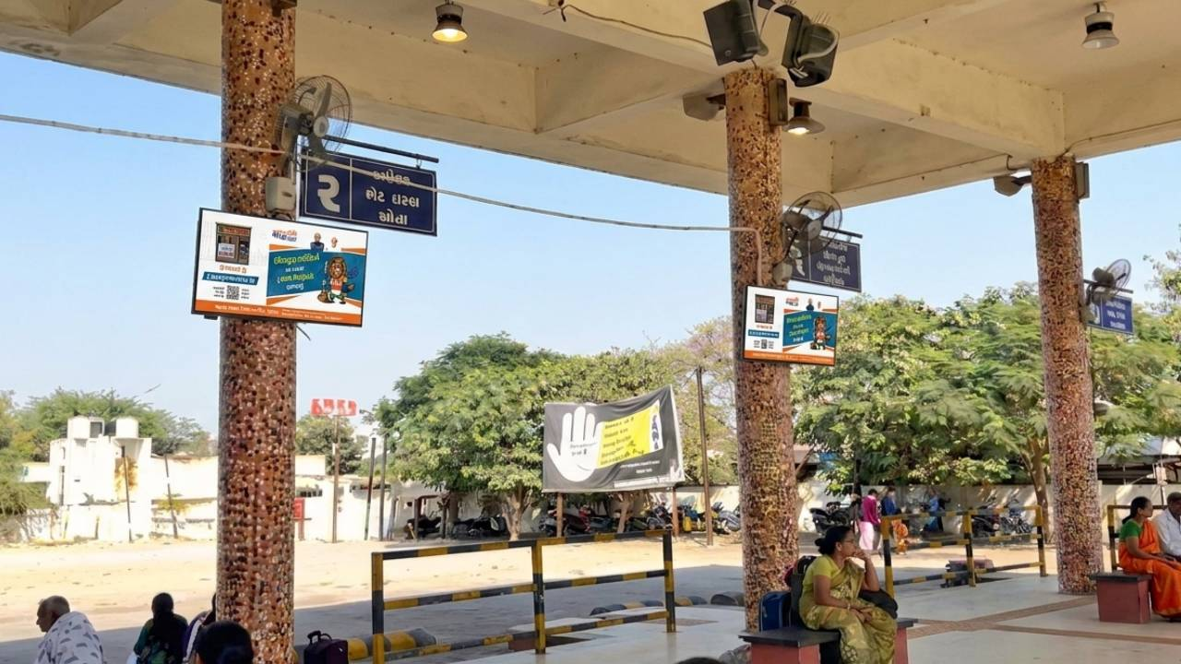
DWARKA
10 SCREENS- 55” SIZE

Slide 36
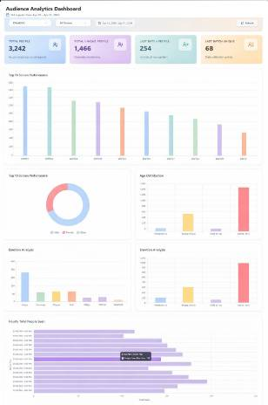
DWARKA 10 SCREENS- 55” SIZE
TOTAL IMPRESSION
1L+ Monthly
3k+ Per Day
TOTAL UNIQUE PEOPLE
1.4k+ Per Day
Gender Distribution, Age Distribution
& Many More.
*Sample AI Analytics Report

Slide 37
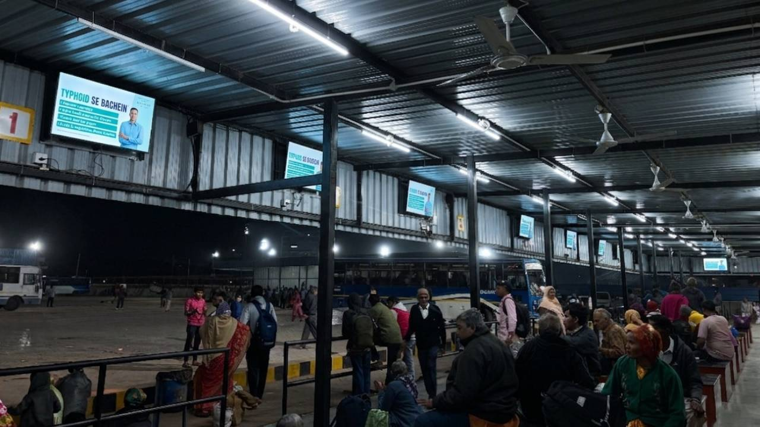
JAMNAGAR
10 SCREENS- 55” SIZE

Slide 38
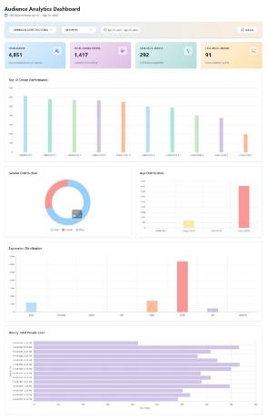
JAMNAGAR 10 SCREENS- 55” SIZE
TOTAL IMPRESSION
1.4L+ Monthly
4.7k+ Per Day
TOTAL UNIQUE PEOPLE
1.3K+ Per Day
Gender Distribution, Age Distribution
& Many More.
*Sample AI Analytics Report

Slide 39
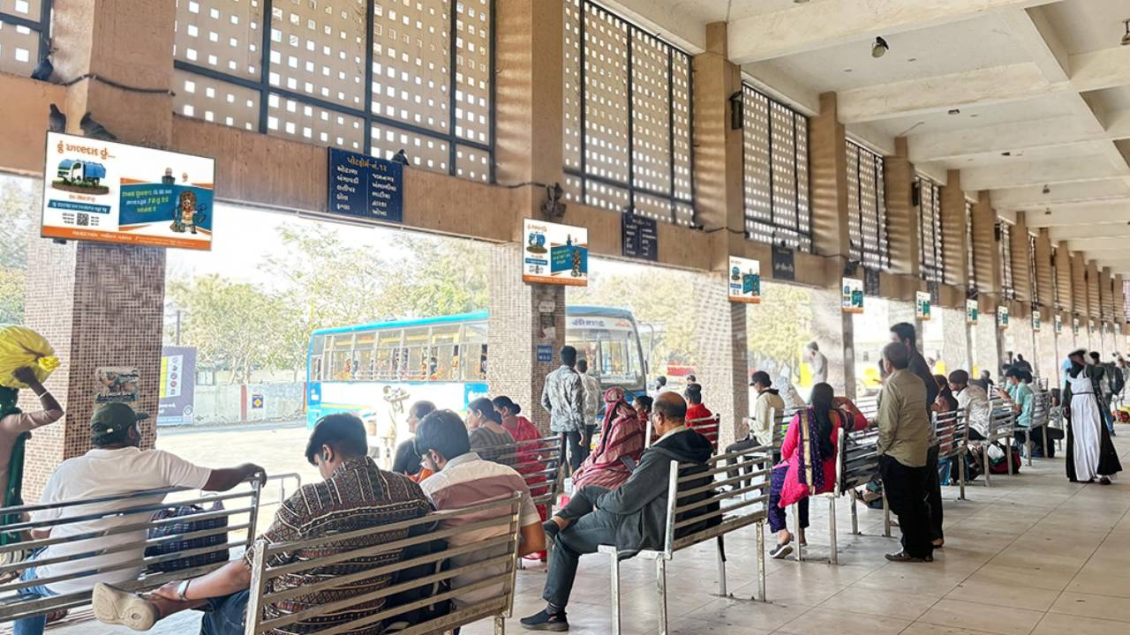
MORBI
15 SCREENS- 55” SIZE

Slide 40
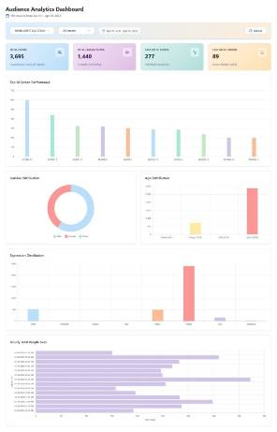
MORBI 15 SCREENS- 55” SIZE
TOTAL IMPRESSION
1L+ Monthly
3.5k+ Per Day
TOTAL UNIQUE PEOPLE
1.3K+ Per Day
Gender Distribution, Age Distribution
& Many More.
*Sample AI Analytics Report

Slide 41
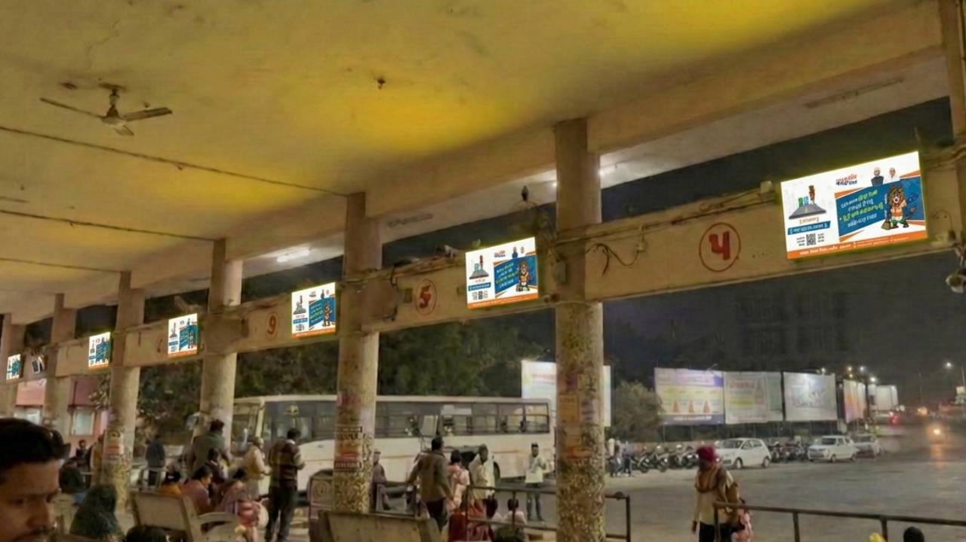
BHACHAU
10 SCREENS- 55” SIZE

Slide 42
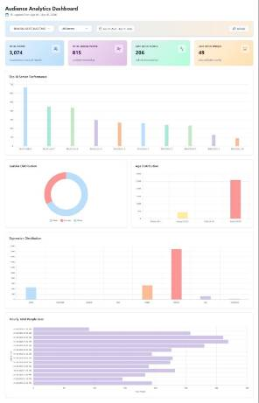
BHACHAU 10 SCREENS- 55” SIZE
TOTAL IMPRESSION
90K+ Monthly
3k+ Per Day
TOTAL UNIQUE PEOPLE
815+ Per Day
Gender Distribution, Age Distribution
& Many More.
*Sample AI Analytics Report

Slide 43
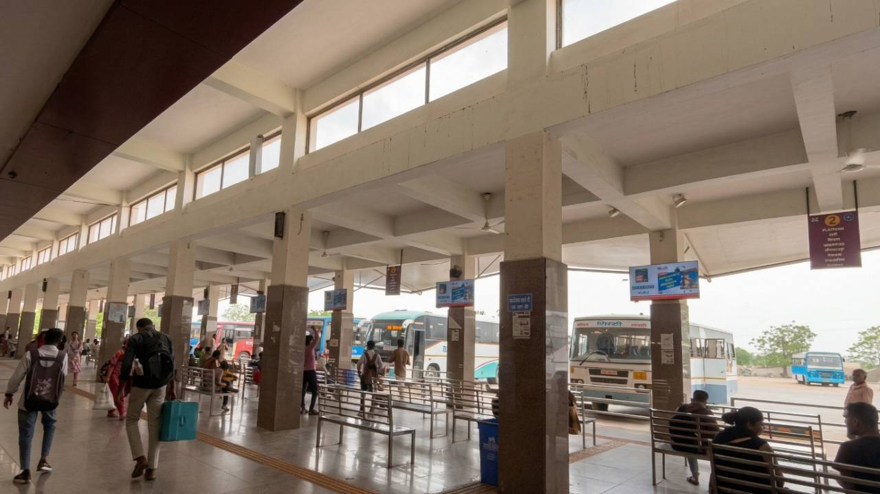
SURENDRANAGAR
15 SCREENS- 55” SIZE

Slide 44
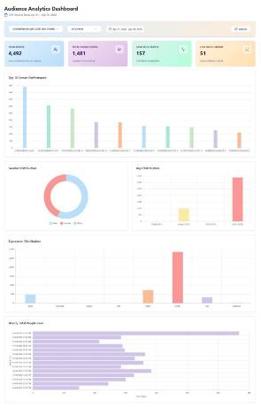
SURENDRANAGAR 15 SCREENS- 55” SIZE
TOTAL IMPRESSION
1.3L+ Monthly
4k+ Per Day
TOTAL UNIQUE PEOPLE
1.5K+ Per Day
Gender Distribution, Age Distribution
& Many More.
*Sample AI Analytics Report

Slide 45







BENEFITS
Massive Reach : 264 screens in 20+ cities, Reach thousands daily.
High Frequency & Strong Brand Recall : Daily repeat ads for brand recall
Captive Audience Advantage : Waiting passengers = attentive audience
Data-Driven Precision with AI Analytics : AI insights for smarter campaigns
Measurable ROI & Transparency : Transparent reporting, measurable ROI
Flexible & Dynamic Campaigns : Flexible scheduling & updates
Credibility & Trust : 700+ clients, 2400+ campaigns, Trusted govt-approved agency

Slide 46

Terms & Conditions
What We Do : We show your approved ads on LED screens for at least 30 days. Each screen plays your ad
100 times a day (10 seconds each, in a 5-minute loop). We give AI reports on views and audience info. If a
screen breakdown due to technical error, we move your ads to working screens to keep the same
number of views.
What You Do : Send us your ad files 7 days before start. Make sure ads follow laws and rules (no religion,
or bad stuff). Check our previews in 2 days.
Payment : Pay 50% up front to book. Pay the rest 15 days after campaign ends. Prices in INR with 18% GST.
Late payments add 1.5% per month fee. Refunds only if we mess up big (more than 20% downtime).
Your Ad Rights : You own your ad, but let us use it for the campaign and our promo. We own our AI tools
and reports.
Ending the Deal : Give 15 days notice to stop. If you stop early, no refund. We can stop right away.
Our Responsibility : We only owe up to what you paid. Not for extra losses.
Rules & Fights : Follows India laws.

