Slide 1
Add One
Kayla Colletti and Ryan Neives

Slide 2
About Our Code:
User enters only length of array:
User enters length of array they would like.
Worst case scenario of all 9’s- it adds another index position, makes current value 0 and add 1 to previous value.
For best case of the whole array being 1’s, the last index position value is increased by 1.
User enters each index value:
User enters length of array they would like
User enters each value per index
If the last index is a 9 then it adds 1 to the previous index and changes the current value to 0.
If each index is 9 then each previous index increases by 1, the current becomes 0 and an additional index position is added.
If none of the index values are set to 9 then the last index value is increased by 1.

Slide 3
Best and Worst Case:
The best case scenario is when all index values do not include 9.
When all index values are less than 9 it just adds 1 to the last index value. Has a time complexity of O(n).
The worst case scenario is when all index values include a 9.
When all index values are 9 it has to make the current index value 0, add 1 to the previous index value and add an addition index position. Has a time complexity of O(n).

Slide 4
Theoretical Time Complexity Analysis
Entering the Whole array
The user entering the length of the array is an O(n) since n is the length of the array being inputted.
Reading the values of each index value entered is O(n), since its only one element being entered at a time.
Once all values have been entered, the array searches to see if the last index value is 9, if not then it just adds 1 to the last index value, O(c).
Then a for loop O(n) with 2 if statements O(c) within it to check to see if any other index value are 9 and if it is make that value 0 and add 1 to the previous index value, O(n).
Overall, the total time complexity of this program is O(n).
Only entering the length of the array
The user entering the length of the array is an O(n) since it is only one element being entered.
Making the array of either 1 or 9 to the length requested in an O(n), only one element is being entered into the for loop at a time.
If statement to see if the last index value is 9 O(c), since is it constant.
Then for loop if other values are 9 then makes them zero and adds 1 to previous index value O(n).
If last index value is not 9 then add 1 to the last index value O(c).
Overall, the total time complexity of this program is O(n).

Slide 5
Experimental Time Complexity on Mac OS
Best (1’s)
10: 35 milliseconds
35092083 nano
100: 39 milliseconds
38573417 nano
1000: 42 milliseconds
41709333 nano
10000: 58 milliseconds
57652500 nano
Worst (9’s)
10: 37 milliseconds
36636667 nano
100: 42 milliseconds
41700916 nano
1000: 43 milliseconds
43335750 nano
10000: 59 milliseconds
58938041 nano

Slide 6

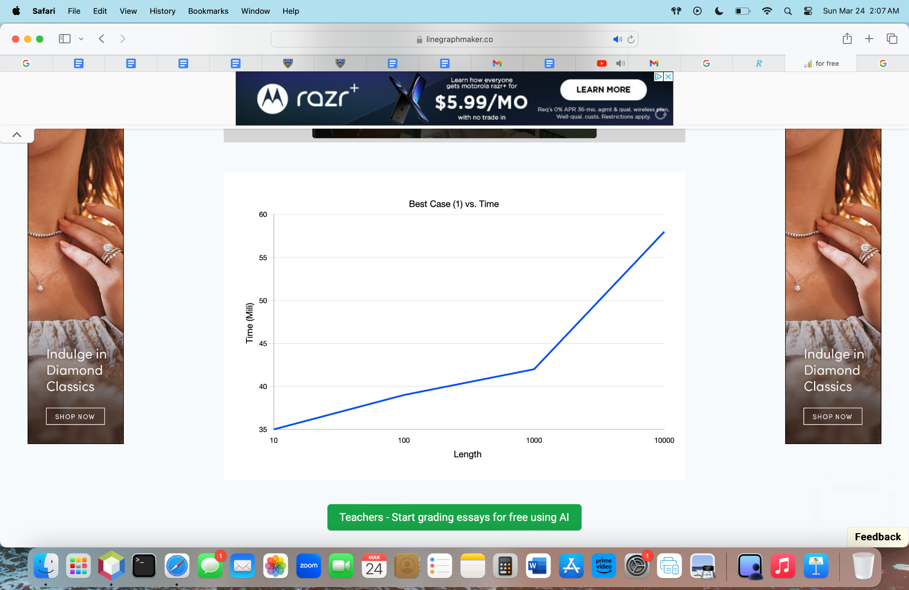
Graph and Analyzation
The best case scenario is almost a linear line O(n) however it is still slightly off from the 10000 elements increasing dramatically, making it closer to O(n^2).
The worst case scenario is not a linear line due to the fast increases, this graph is closer to O(n^2).

Slide 7
Conclusion
The experimental proved that the worst case is an array of all 9’s and the best is an array of all 1’s. Since theoretical time complexity is O(n) it does not match up with the experimental of O(n^2). This program is very efficient based on the findings from the experimental time complexity.

