Slide 1
Yahoo Finance Trading System
Kyle Gu
Shawn Shao
Zack Yu

Slide 2
Outline
Overview
Table scheme
Architecture
Technical details
Demo
Future work

Slide 3
Overview
Trading system
Watch real time market data
Buy and sell stocks
Search transaction history
Visualization

Slide 4
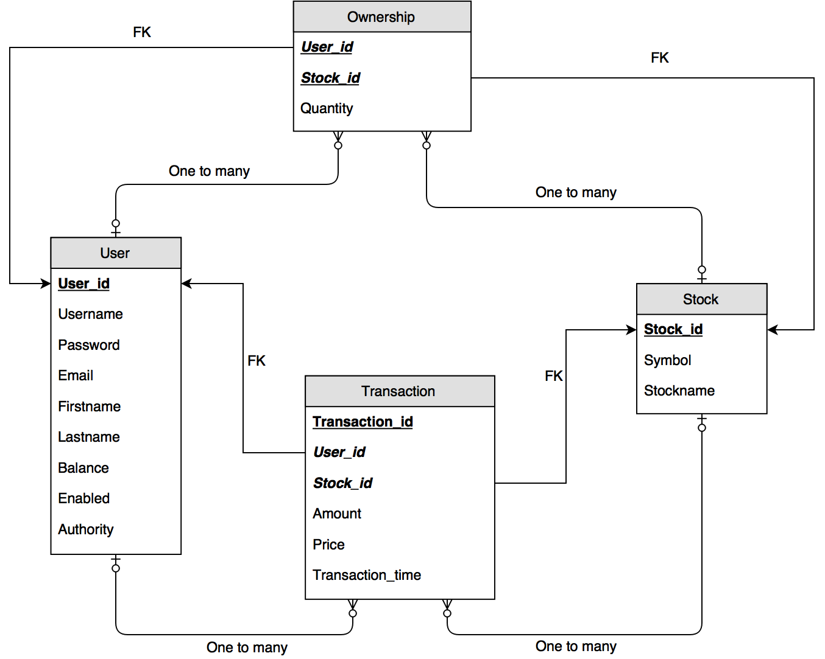
Table Scheme

Slide 5
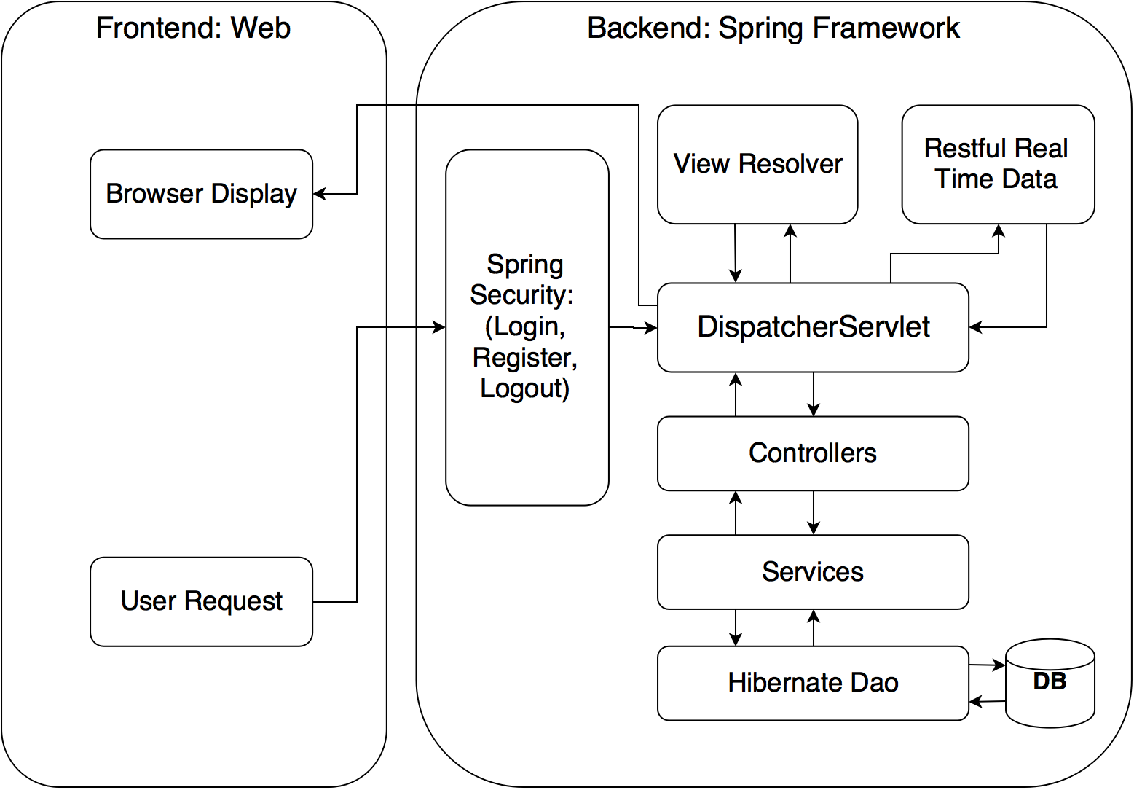
Architecture

Slide 6
Technical Details
Objective | Technique
Server | Tomcat 7.0
Framework | Spring 3.1
MVC | Spring MVC
Authentication & Authorization | Spring Security 3.1
ORM | Hibernate 4.2
Database | Oracle 10g
Web Service | REST
Webpages | HTML5, CSS3, jQuery, AngularJS, Bootstrap
Chart | Angular Chart
IDE | Eclipse Indigo
Version Control | GitHub

Slide 7
Demo
User
Login/Register/Logout
Market data
Transaction
Portfolio
History
Admin
Commit/Drop Pendings
Add/Delete Stocks

Slide 8
Future work
Let user decide interested fields
More advanced trading system

Slide 9
Thanks!
Questions?

