Slide 1

Hawkeye End驱动研究与分析
SMB交换 邱俊源

Slide 2

目的
熟悉End驱动开发流程
分析Hawkeye Bsp中End驱动的层次结构，为后续Broadcom平台机型的End驱动开发做准备

Slide 3





大纲

Slide 4
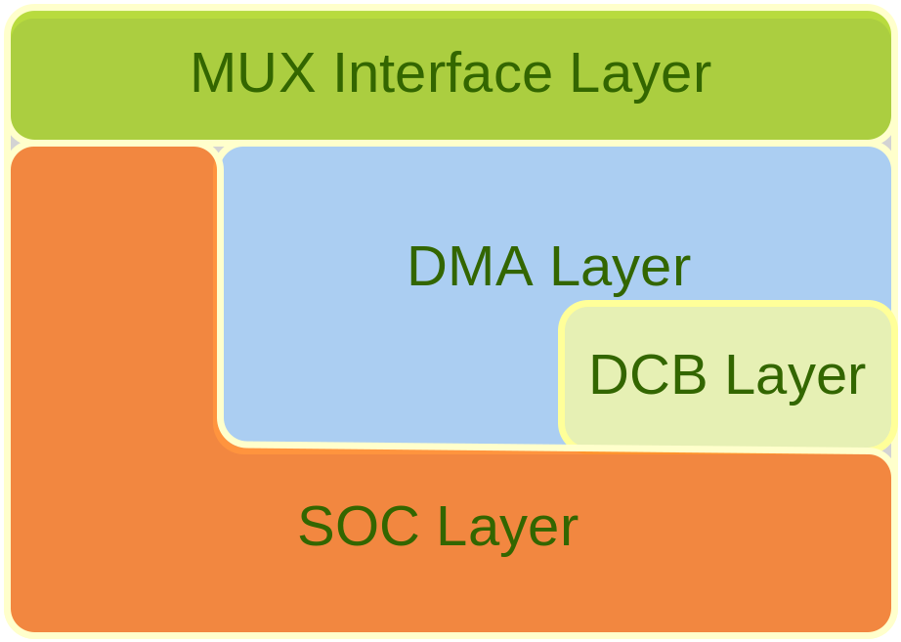
Hawkeye End层次结构
END分层
  MUX接口层
  硬件实现层
    DMA处理层
    DCB操作层
    SOC操作层（初始化、PCI、REG、MEM、MII r/w）

Slide 5

Hawkeye End层次结构

Slide 6
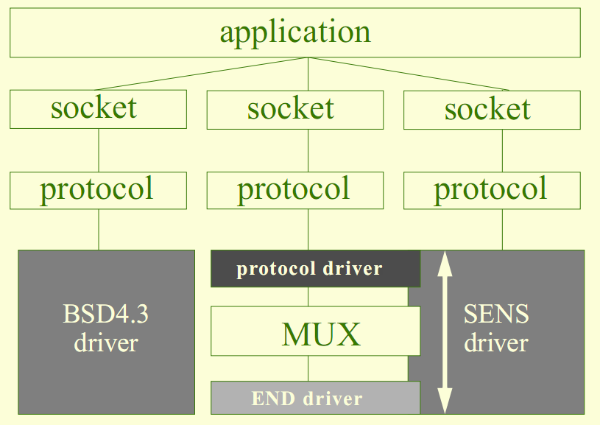
END基础
Enhanced Network Drivers

Slide 7
END基础
Scalable Enhanced Network Stack
Multiplex Layer
END
  Status and Control Registers
  Interrupts Events
  DMA Hardware

Slide 8
MUX接口层_数据结构
typedef struct end_object
{
NODE node;
DEV_OBJ devObject; /* driver object */
STATUS (*receiveRtn) (void*, M_BLK_ID);
BOOL (*outputFilter) (void*, long,M_BLK_ID, M_BLK_ID, void*);
BOOL attached; /* attachment flag. */
SEM_ID txSem; /* transmit semaphore. */
long flags; /* various flags. */
NET_FUNCS * pFuncTable; /* END functionstable */
M2_INTERFACETBL mib2Tbl; /* counters */
LIST multiList; /* address list head*/
int nMulti; /* list count */
LIST protocols; /* NET_PROTOCOL list. */
BOOL snarfProto; /* snarf flag */
NET_POOL_ID pNetPool; /* memory cookie */
} END_OBJ;

Slide 9
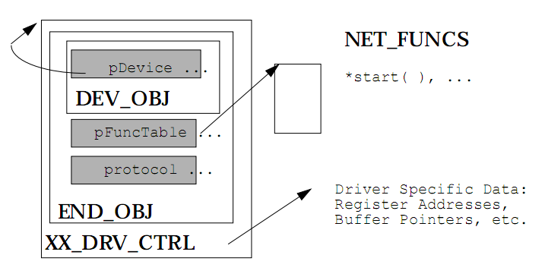
MUX接口层_数据结构

Slide 10
MUX接口层_数据结构
typedef struct net_funcs
{
STATUS (*start) (void*);
STATUS (*stop) (void*);
STATUS (*unload) (void*);
int (*ioctl) (void*, int, caddr_t);
STATUS (*send) (void*, M_BLK_ID);
STATUS (*mCastAddrAdd) (void*, char*);
STATUS (*mCastAddrDel) (void*, char*);
STATUS (*mCastAddrGet) (void*, MULTI_TABLE*);
STATUS (*pollSend) (void*, M_BLK_ID);
STATUS (*pollRcv) (void*, M_BLK_ID;
M_BLK_ID (*formAddress) (M_BLK_ID, M_BLK_ID,M_BLK_ID);
STATUS (*packetDataGet)(M_BLK_ID,LL_HDR_INFO *);
STATUS (*addrGet) (M_BLK_ID, M_BLK_ID, M_BLK_ID,M_BLK_ID, M_BLK_ID);
} NET_FUNCS;

Slide 11
MUX接口层_ END驱动加载
Driver’s load routine
  Creates END_OBJ with NET_FUNCS
  Init netpool mib etc.
  Registered in endDevTbl of configNet.h
MUX Initialization
  muxDevLoad()
  muxDevStart()
  muxBind() [ipAttach]

Slide 12
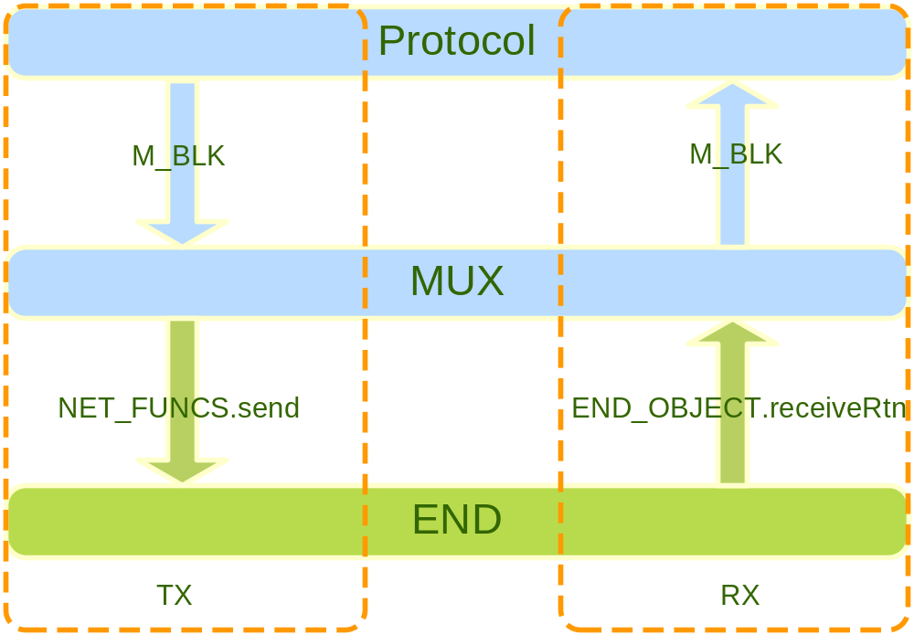
MUX接口层_PKT TX/RX

Slide 13

Hawkeye End层次结构

Slide 14
硬件实现层_基本原理
Packet DMA
  CPU <-> SWITCH
  CPU <-> MAC CORE <-> SWITCH

Slide 15
硬件实现层_基本原理
CMIC
  Cpu Management Interface Controller Block
DCB
  DMA control block (DMA Descriptor)
  The DCB contains all of the information required for a packet data transfer.

Slide 16
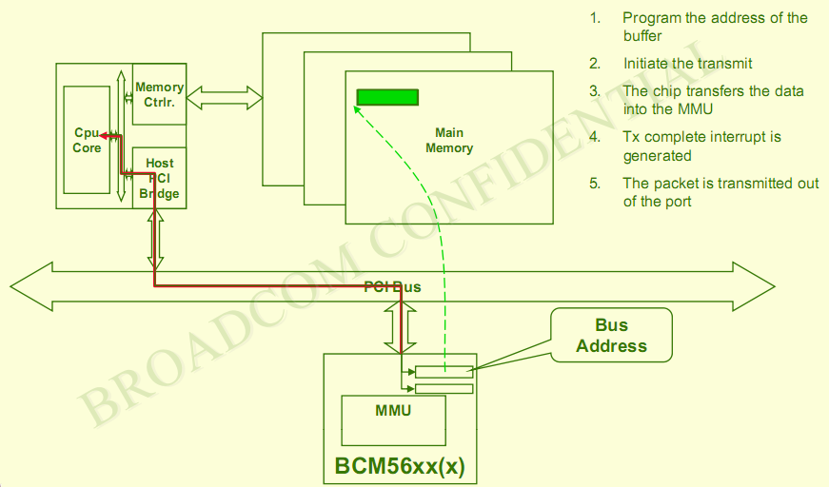
硬件实现层_DMA TX

Slide 17
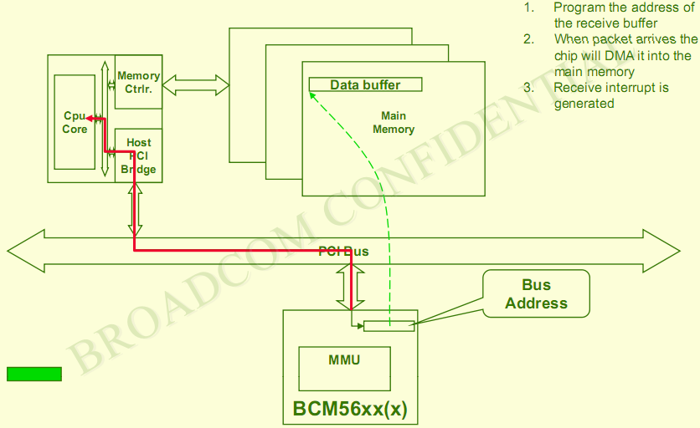
硬件实现层_DMA RX

Slide 18
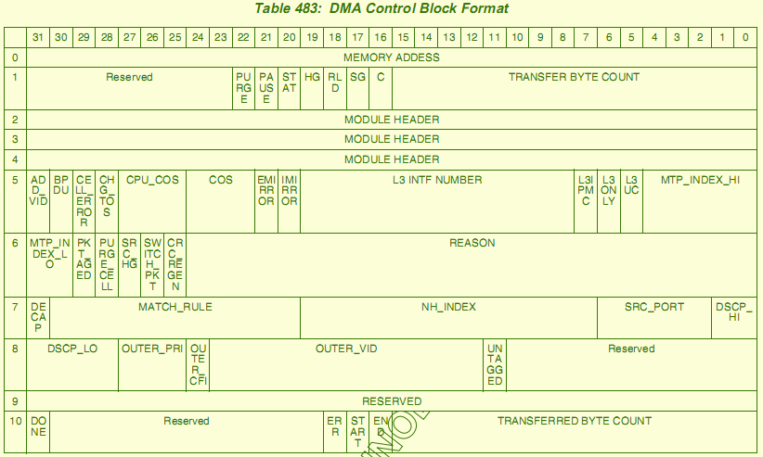
硬件实现层_DCB Format
Point to Data Buffer or DCB
Chain Control

Slide 19
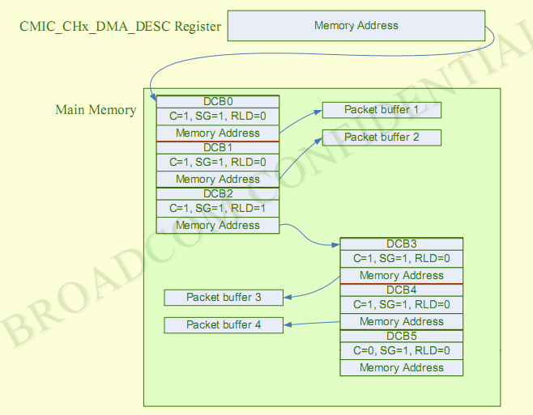
硬件实现层_DCB链

Slide 20
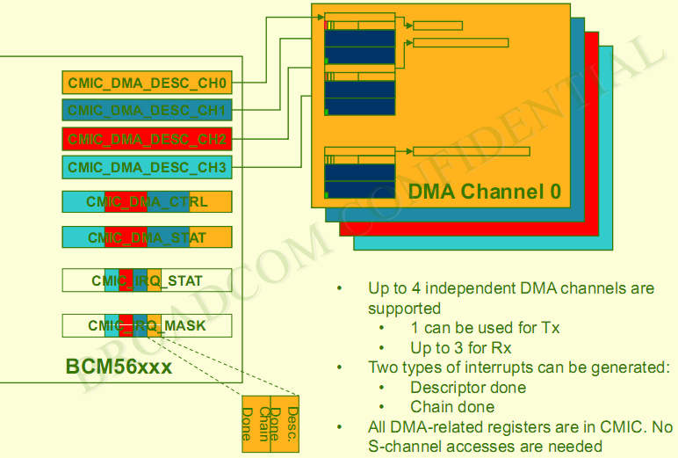
硬件实现层_DMA Channel

Slide 21
DMA处理层
与MUX接口层的数据包交互
管理DMA Channel 及相应的DCB链
数据包的实际发送及接收处理

Slide 22
DMA处理层_主要数据结构
soc_dma_manager_t
dv_t
rx_ctl_t/rx_chan_ctl_t
bcm_pkt_t
dcb_op_t

Slide 23
DMA处理层_主要数据结构
typedef struct _soc_dma_manager
{
uint32 soc_dma_lock; /* Lock for updating DMA operations etc. */
sdc_t soc_channels[N_DMA_CHAN];
int soc_max_channels; /* maximum channel count */
sdc_t *soc_dma_default_rx; /* Default RX channel */
sdc_t *soc_dma_default_tx; /* Default TX channel */
int dma_droptx; /* Any channels in drop tx mode */
dv_t *soc_dv_free; /* Available DVs */
int soc_dv_free_cnt; /* # on free list */
int soc_dv_cnt; /* # allowed on free list */
int soc_dv_size; /* Number DCBs in free list entries */
uint32 *tx_purge_pkt; /* DMA able buffer for TX Purge */
soc_stat_t stat;
dcb_op_t dcb_op; /* DCB operations */
sal_mutex_t schanMutex; /* S-Channel mutual exclusion */
sal_mutex_t miimMutex;
} soc_dma_manager_t;

Slide 24
DMA处理层_主要数据结构
typedef struct dv_s {
struct dv_s *dv_next, /* Queue pointers if required */
*dv_chain; /* Pointer to next DV in chain */
int dv_unit; /* Unit dv is allocated on */
uint32 dv_magic; /* Used to indicate valid */
dvt_t dv_op; /* Operation to be performed */
dma_chan_t dv_channel; /* Channel queued on */
int dv_flags; /* Flags for operation */
int16 dv_cnt; /* # descriptors allocated */
int16 dv_vcnt; /* # descriptors valid */
int16 dv_dcnt; /* # descriptors done */
void (*dv_done_chain)(int u, struct dv_s *dv_chain);
void (*dv_done_desc)(int u, struct dv_s *dv, dcb_t *dcb);
void (*dv_done_packet)(int u, struct dv_s *dv, dcb_t *dcb);
…
uint8 dv_dmabuf[SOC_DV_PKTS_MAX][24];
dcb_t *dv_dcb;
} dv_t;

Slide 25
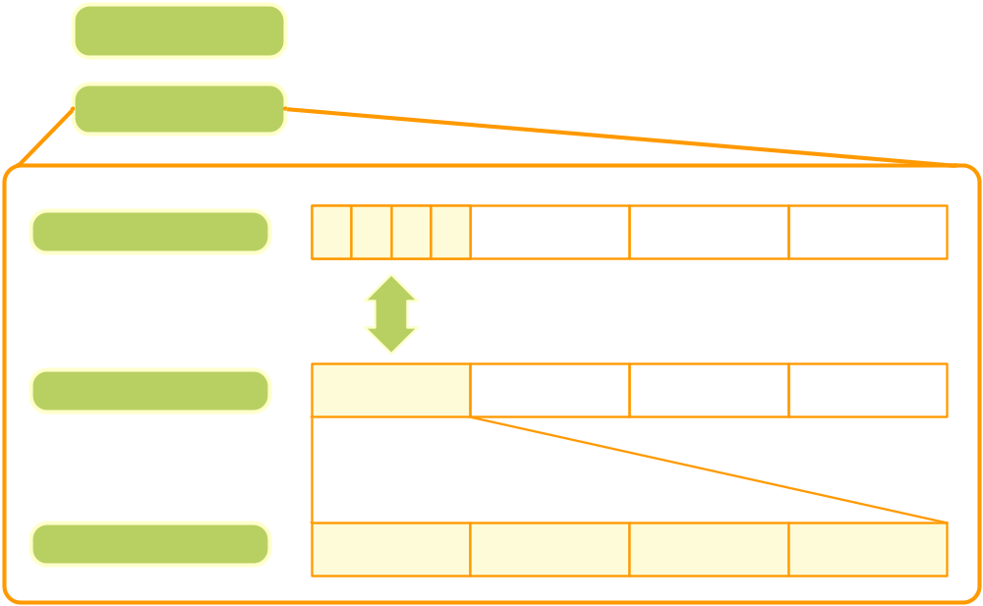
DMA处理层_数据结构关系

Slide 27
END初始化
SOC初始化
DMA相关寄存器初始化
中断使能与绑定
DMA处理层初始化

Slide 28
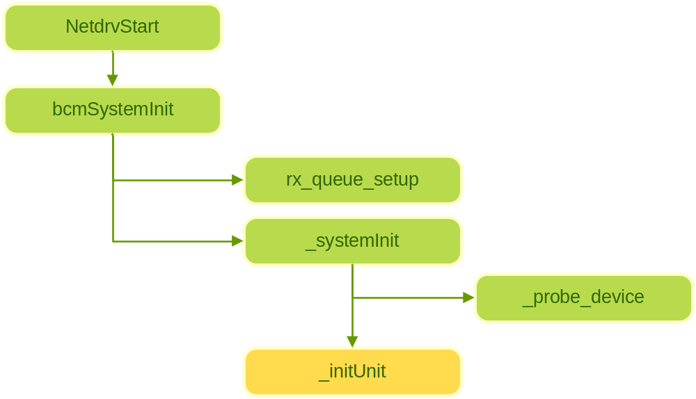
END初始化

Slide 29
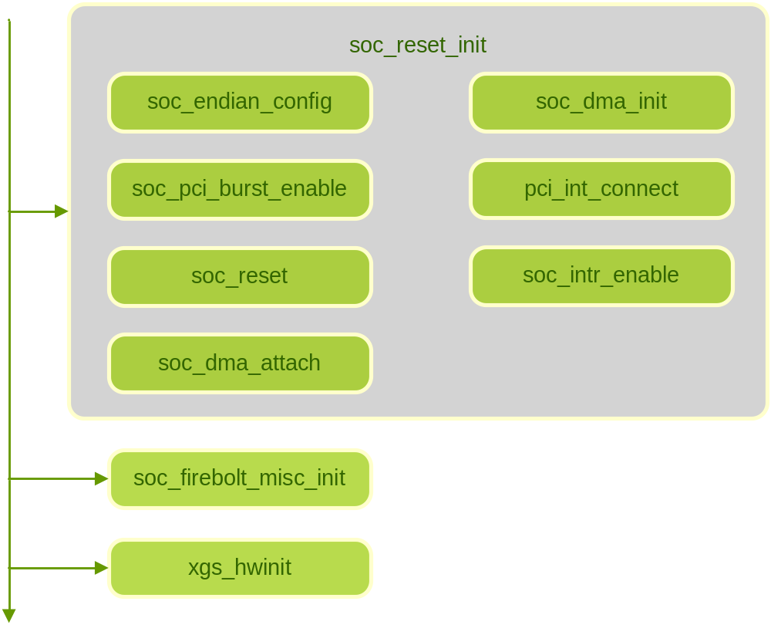
END初始化_initUnit

Slide 30
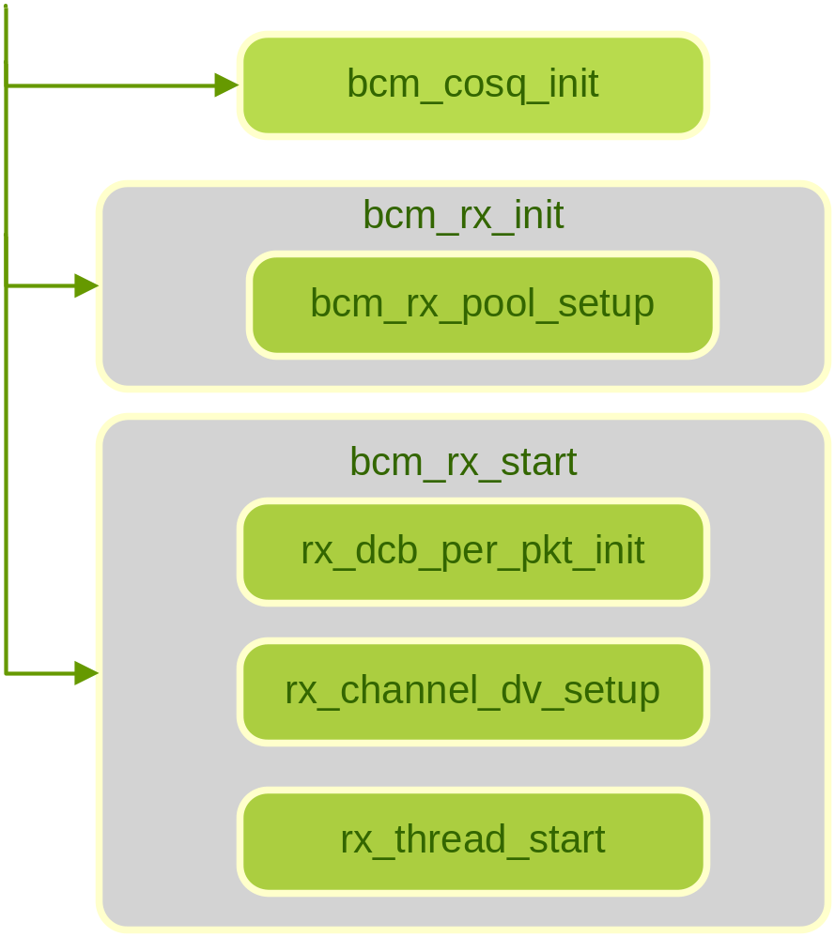
END初始化_initUnit

Slide 32
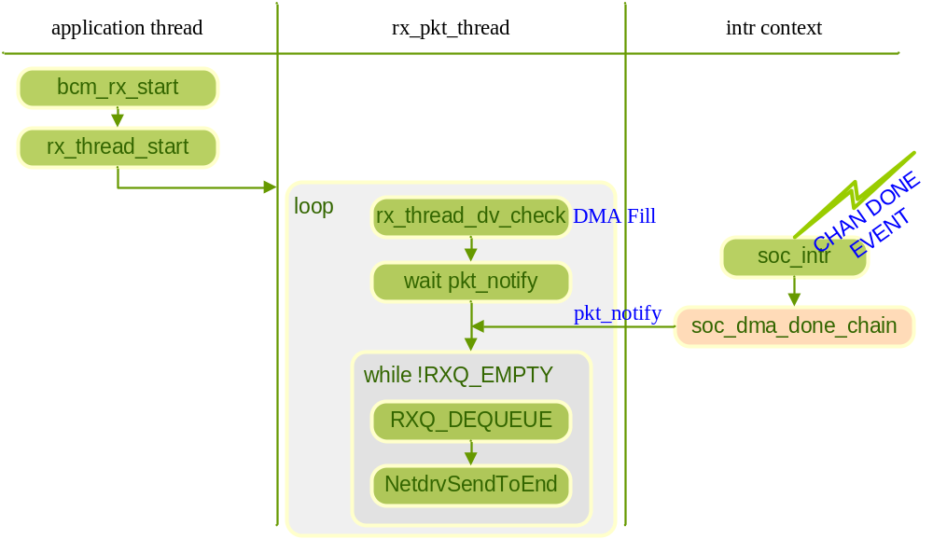
数据包接收流程

Slide 33
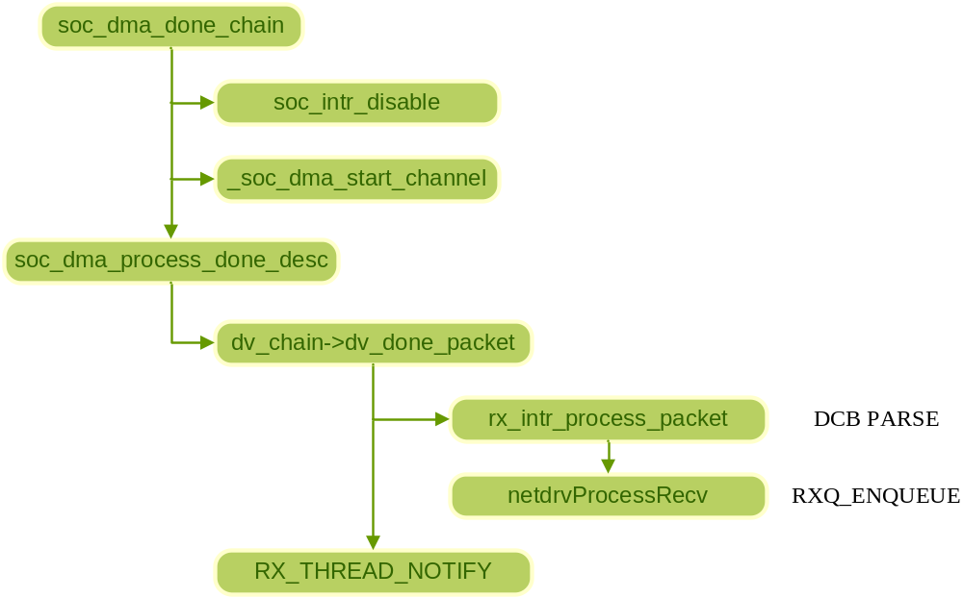
数据包接收流程

Slide 34
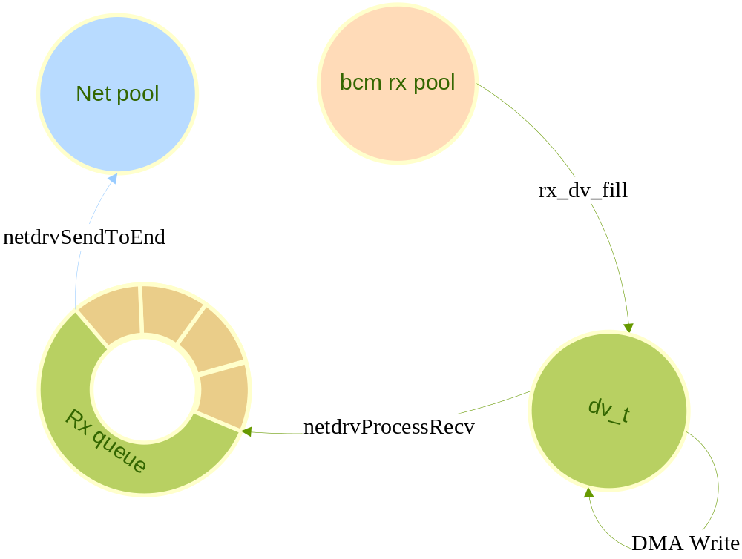

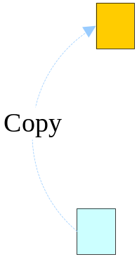

数据包接收流程

Slide 35
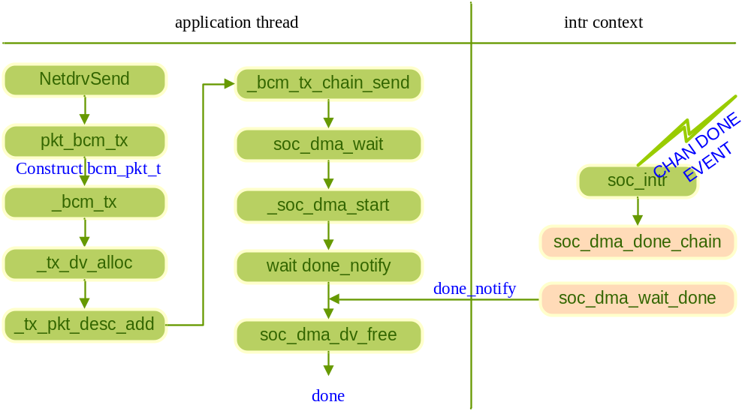
数据包发送流程

Slide 36
END性能优化
Hardware Layer
Software Layer
  Pooled Memory alloc & free
  Avoid Memory Copy
  Keep Busy
  Others

Slide 37
Hawkeye END缺陷？
不必要的DCB解析操作
Synchronized Tx

Slide 38
END移植
SOC操作函数实现
初始化流程
确定DCB格式

