Slide 1
Healthcare Analytics at Faith Specialist Hospital
How Faith Specialist Hospital Can Use Patient Data to Improve Patient Care and Hospital Management
Presented by: Faith Amuda Role: Data Analyst, Faith Specialist Hospital Date: April 18, 2025

Slide 2
OUTLINE
Introduction
Problem Statement
Business Task
Data Sources
Data Cleaning and Manipulation
SQL Queries
Visualization and Insights
Dashboard
Patient Demographics & Outcomes
Discharge Against Medical Advice (DAMA)
Chronic Illness Patterns
Lifestyle Factors
Doctor Performance Evaluation
Recommendations

Slide 3
INTRODUCTION
Faith Specialist Hospital is a dynamic healthcare facility serving a diverse and growing patient population. With years of service, the hospital has accumulated a rich repository of patient data, including demographics, admissions, diagnoses, and health outcomes.
Problem Statement:
The hospital is facing key challenges, including a rising number of patients discharged against medical advice (DAMA), an increase in chronic disease cases, and higher mortality rates in some patient groups. These issues signal the need for data driven solutions to improve both clinical and operational performance.
Business Task:
As the data analyst at Faith Specialist Hospital, my task is to explore and analyze patient data to uncover patterns, trends, and risk factors. The goal is to provide insights that will help the hospital improve patient care, reduce adverse outcomes, and enhance overall management decisions.

Slide 4
DATA SOURCES
This analysis is based on four datasets provided by Zion Tech Hub for the SQL capstone project during the Healthcare Analytics training. These datasets include:
Patients Dataset Contains demographic information such as age, gender, and location.
Admissions Dataset Includes details on patients' hospital visit, such as admission and discharge status, and the presence of chronic diseases.
Doctors Dataset Provides information on doctors, including their specialization.
Risk Factors Dataset Provides information on lifestyle risk factors for each patient, such as smoking, and alcohol use.
Together, these datasets offer a comprehensive foundation for analyzing patient outcomes, healthcare delivery, and operational efficiency.

Slide 5
DATA CLEANING AND MANIPULATION
Data Cleaning
Tool Used: Microsoft Excel
To ensure accurate analysis and reliable insights, the following steps were carried out during data preparation:
Removed Duplicates: Eliminated repeated entries across patient, admission, and doctor datasets.
Handled Missing Values: Removed records with null or incomplete fields where appropriate.
Standardized Formats: Cleaned and aligned text cases (e.g., M/m, Yes/yes) across all datasets for consistency.
These steps ensured the datasets were clean, uniform, and ready for analysis.
Data Manipulation
After cleaning the data in Excel, the following steps were taken to enable structured querying and deeper analysis:
Database Creation: A relational database was created using SQL.
Table Setup: Cleaned datasets were imported as separate tables (Patients, Admissions, Doctors, Risk Factors).
Data Relationships: Tables were linked using primary and foreign keys to ensure relational integrity.
Querying: SQL was used to explore relationships, extract insights, and perform advanced filtering and aggregation.

Slide 6
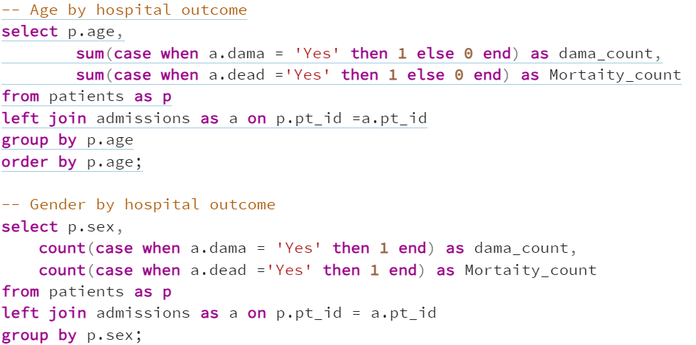
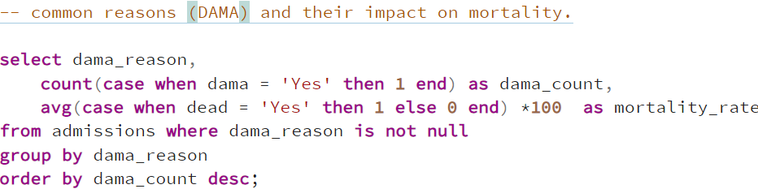
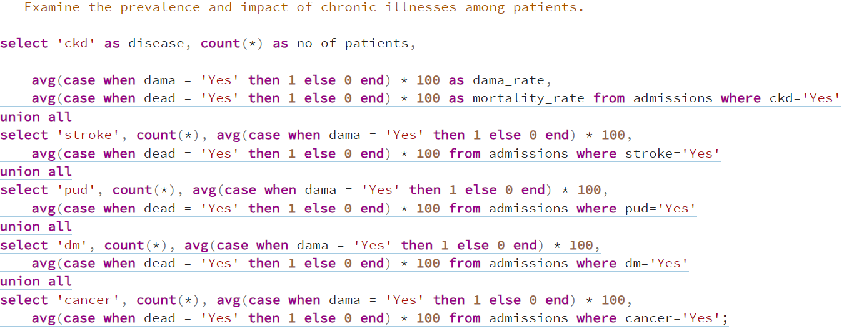
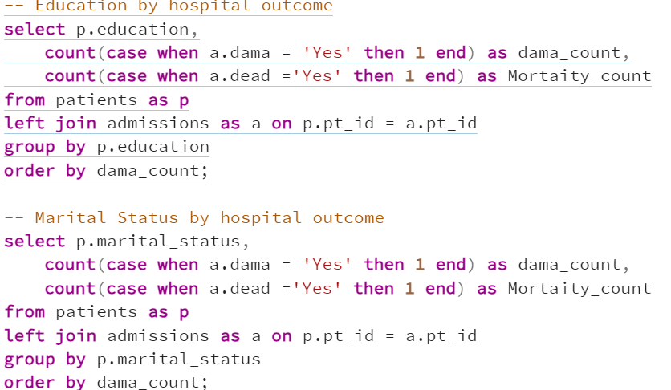
SQL QUERIES

Slide 7
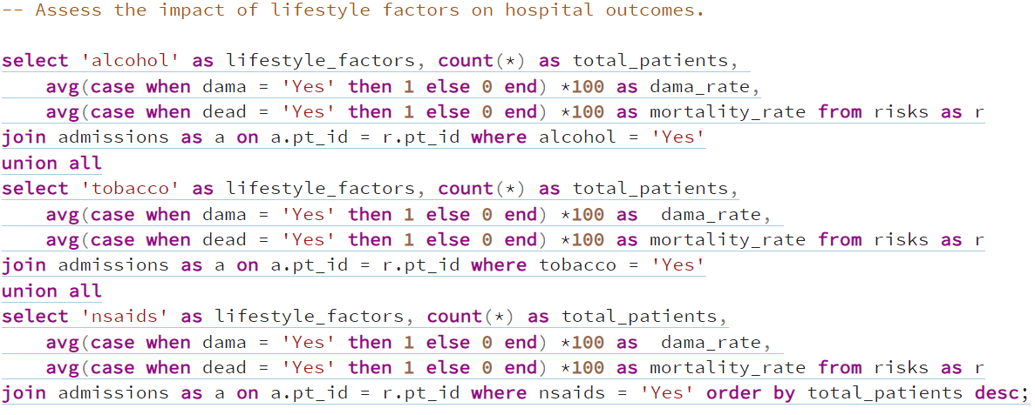
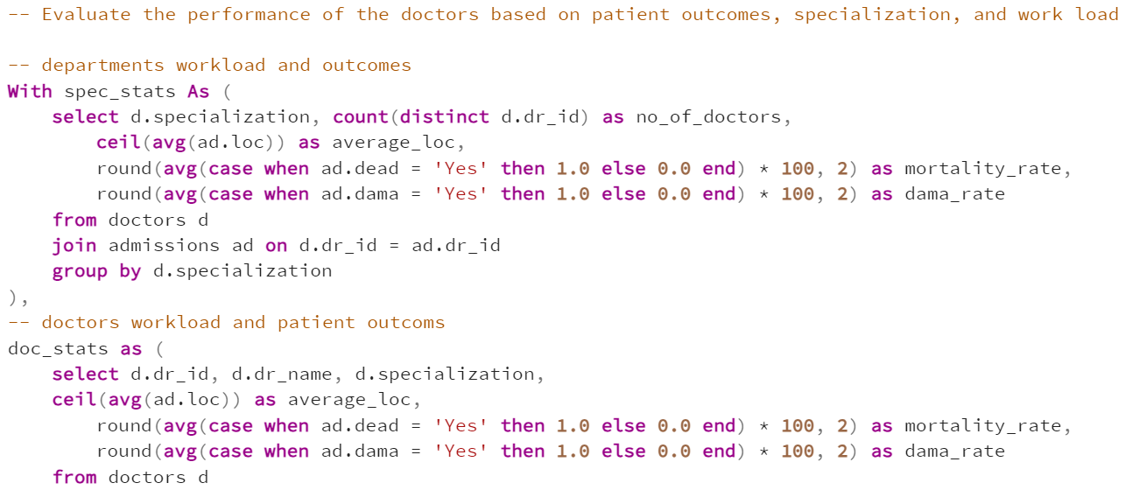
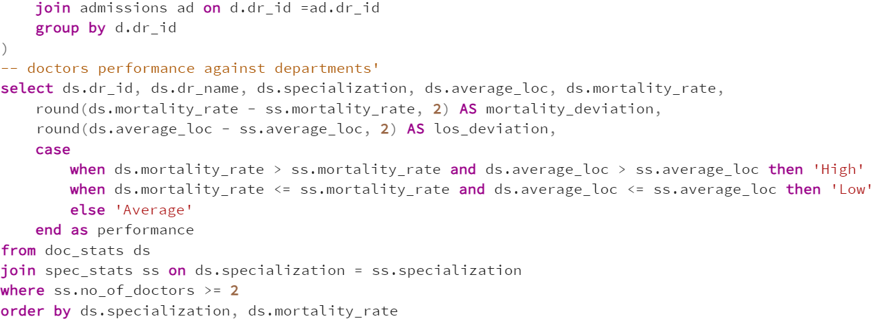
SQL QUERIES

Slide 8





VISUALIZATION AND INSIGHTS
Queried cleaned data using SQL
Loaded query results into Tableau to:
Create visual insights
Analyze key trends and patterns
Present findings to support decisions
Interact with the dashboard here

Slide 9
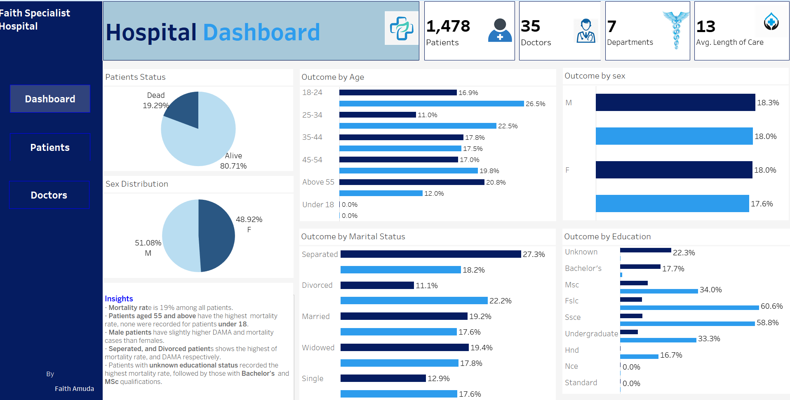

Slide 10
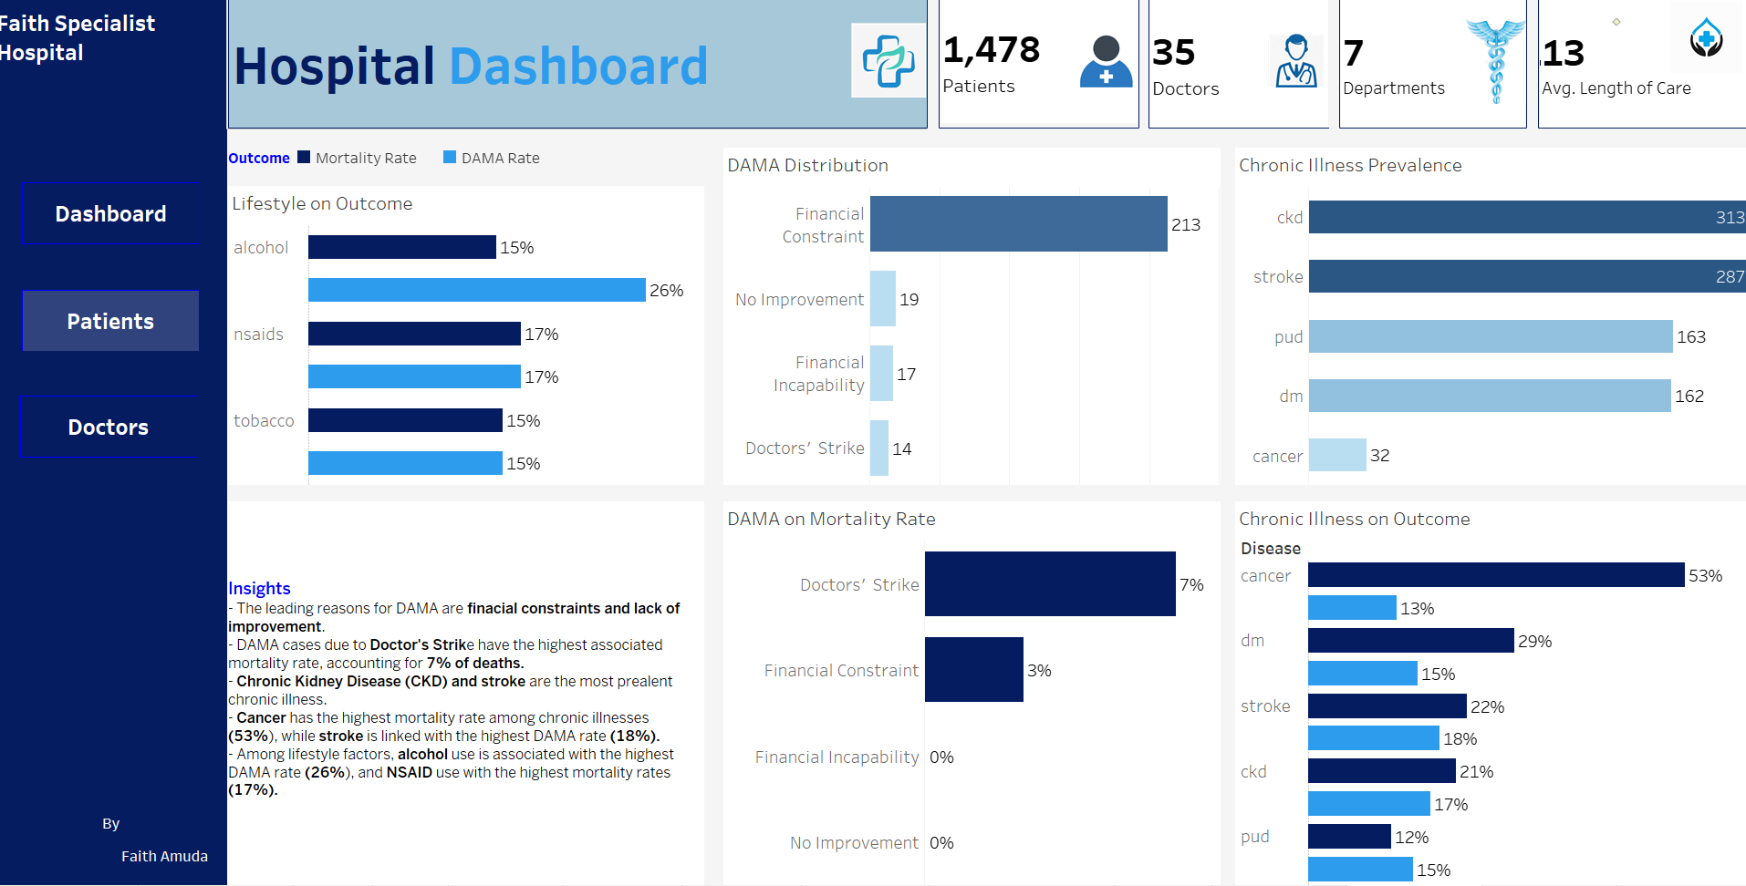

Slide 11
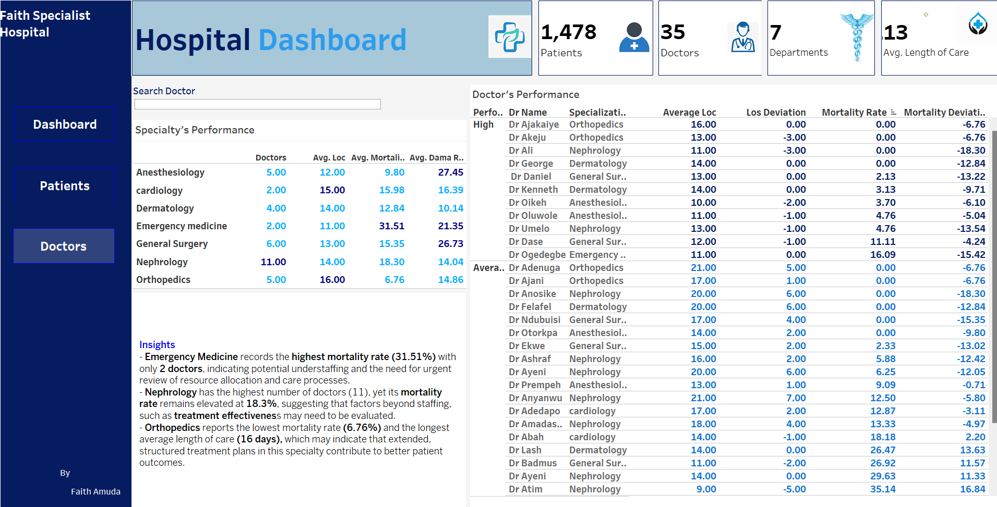

Slide 12
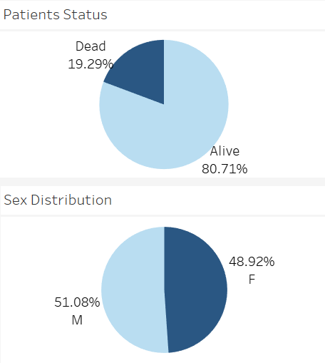
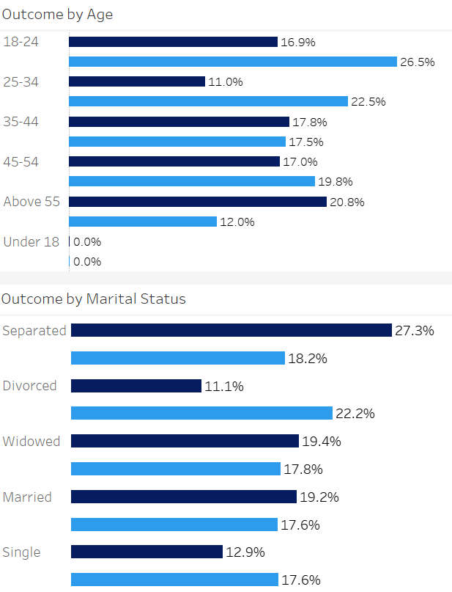
PATIENT DEMOGRAPHICS & OUTCOMES
Mortality Rate: 19% of patients are deceased.
Sex Distribution: 51.1% of patients are male; 48.9% female.
Male mortality: 18.3%
Female mortality: 18.0%
Mortality rates are slightly higher in males than females.
Patients with Unknown education status had the highest mortality rate (22.3%) followed by Bachelor’s (17.7&).
Patients aged Above 55 had the highest mortality rate (20.8%), followed by 45–54 (17.0%) and 18–24 (16.9%).
Patients under 18 recorded 0% mortality and DAMA.
Separated individuals had the highest mortality rate at 27.3%, followed by the widowed at 19.4%, and married patients at 19.2%.

Slide 13
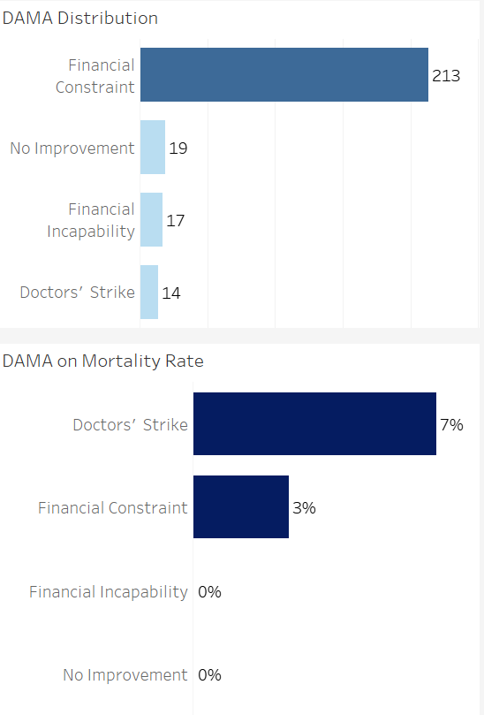
DISCHARGE AGAINST MEDICAL ADVICE
Majority of DAMA cases were attributed to Financial constraints (81%).
DAMA was highest among patients with FSLC (60.6%), and SSCE (58.8%) educational qualifications.
Highest DAMA cases occurred among 18-24 and 25–35 age groups
Slightly more males opted for DAMA than females
Although Doctors’ Strike accounted for the fewest DAMA cases, it had the highest mortality rate among all DAMA reasons.

Slide 14
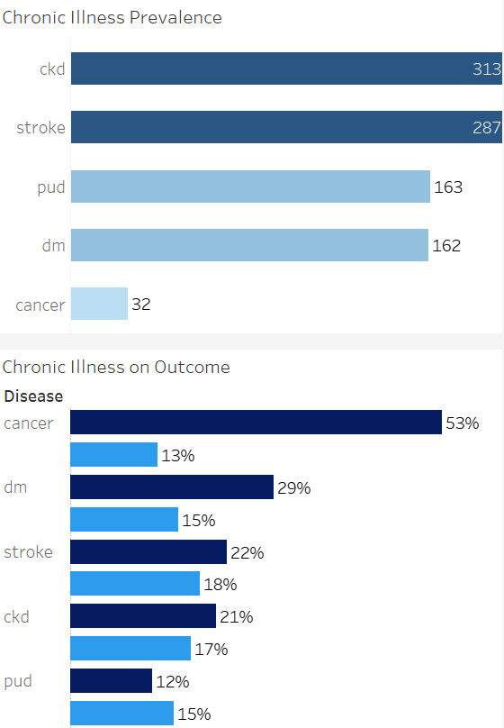
CHRONIC ILLNESS PATTERN
Chronic Kidney Disease (CKD) and Stroke are the most prevalent chronic illnesses among patients, with 313 and 287 cases respectively.
Cancer patients had the highest mortality rate (53%), despite cancer being the least common chronic illness.
Diabetes and Stroke also showed elevated mortality rates at 29% and 22% respectively.
Conditions like CKD, PUD, and Stroke contribute significantly to the hospital’s burden due to both their high frequency and impact on outcomes.

Slide 15
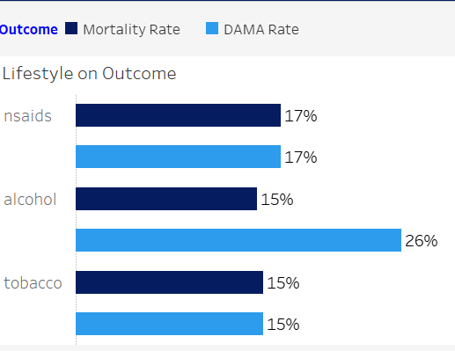
LIFESTYLE FACTORS
NSAID use is associated with both a mortality rate and DAMA rate of 17%, indicating it may be linked to complications that lead to poorer outcomes and patient dissatisfaction or discharge.
Alcohol use shows the highest DAMA rate (26%), suggesting patients with a history of alcohol use are more likely to leave against medical advice, possibly due to behavioral, financial, or compliance issues. Mortality for this group is 15%.
Tobacco use has a 15% mortality and DAMA rate, highlighting a consistent risk.

Slide 16
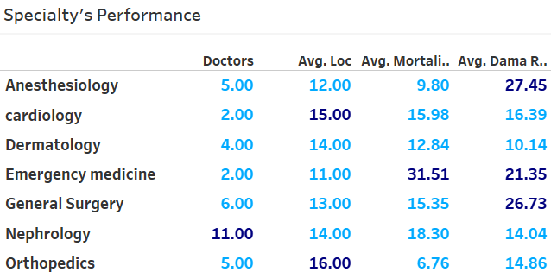
DOCTOR’S PERFORMANCE EVALUATION
Orthopedics reports the lowest mortality rate (6.76%) and the longest average length of care (16 days), which may indicate that extended, structured treatment plans in this specialty contribute to better patient outcomes.
Anesthesiology has the highest DAMA rate (27.45%) despite maintaining a low mortality rate (9.36%), suggesting that while clinical outcomes are good, non-clinical factors may be driving early discharge decisions.
Emergency Medicine has the highest mortality rate (31.51%) and the least number of doctors (2), suggesting severe understaffing despite the critical nature of cases handled in this specialty.
Nephrology has the most doctors (11) but still shows a high mortality rate (18.3%), suggesting that factors beyond staffing such as case severity, or treatment effectiveness may need to be evaluated.

Slide 17
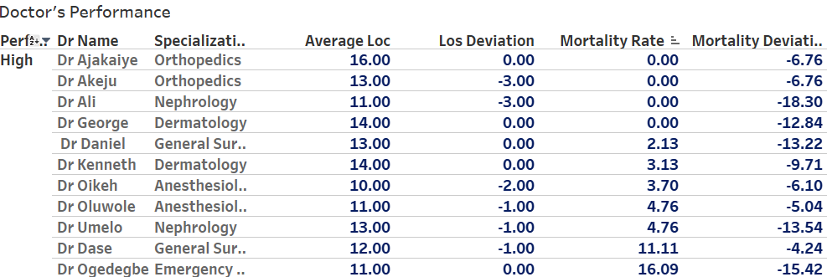
DOCTOR’S PERFORMANCE EVALUATION 2
All doctors in Orthopedics, excluding Dr. Akinola have zero mortality rate, indicating consistent and safe care delivery.
Dr. Ali (Nephrology) has the lowest mortality deviation (-18.30%), suggesting exceptional patient outcomes in a high-risk specialty.
Dr. George (Dermatology) and Dr. Daniel (General Surgery) also show strong performance with mortality deviations of -12.84% and -13.22%, respectively.
Dr. Ogedegbe has a mortality rate of 16.09%, but a low mortality deviation of -15.42 indicates better-than-expected outcomes in a high-risk, low-staffed specialty.
Dr. Salu (26.67%), Dr. Olori (31.82%), and Dr. Akinola (38.46%) recorded high mortality rates with positive deviations, performing worse than peers in the same specialties. This may point to gaps in protocol adherence, or experience level.
Dr. Mahmoud of General Surgery reports an unusually high mortality rate of 80%, this prompt a closer review to determine the cause.

Slide 18
RECOMMENDATIONS
Review staffing levels and care protocols in Emergency Medicine and Cardiology, given their high mortality rate (31.51%, 15.98% ) and limited number of doctors (2), to improve outcomes and reduce overload.
Nephrology and Orthopedic shows wide performance gaps, this suggest uneven workload distribution or a lack of accountability, with some doctors underperforming while others maintain strong outcomes. A review of task assignment, leadership oversight, and clinical audit is recommended.
Recognize and leverage best practices from high performers like Dr. Ali and Dr. George, potentially using them as mentors or case reviewers.
Conduct an in-depth review of Dr. Mahmoud’s cases in General Surgery, given the unusually high mortality rate (80%) and significant deviation, to determine whether the outcomes result from systemic issues, case severity, or data inconsistencies.
Provide refresher training and protocol alignment for doctors with positive mortality deviations (above 10), to standardize care quality across specialties.
Implement financial support programs including financial counseling and subsidized insurance schemes for low-income patients to reduce DAMA due to financial burden.

Slide 19
RECOMMENDATIONS
Launch behavioral health interventions targeting alcohol, tobacco, and NSAID misuse, and provide counseling and referral services for “at risk” patients to reduce the incidence of stroke, CKD, and related chronic conditions.
Ensure accurate and complete recording of patient education status during admission and history taking. Missing
data could mask other vulnerabilities (e.g., illiteracy, low health literacy).
Strengthen geriatric care pathways, including fall risk assessments, chronic disease management, and palliative care services for patients aged Above 55, and 45–54.
For separated and widowed patients, screen for mental health concerns like depression or social isolation, refer to counseling or support groups. If family is absent, provide volunteers or community health workers for in-hospital and post-discharge support.
Develop contingency plans with backup clinical teams or temporary staff during industrial actions.

Slide 20
Thank You

