Slide 1
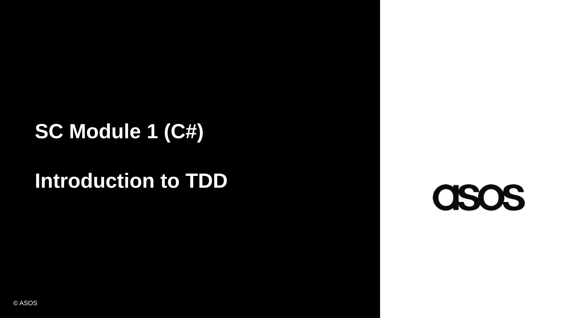

Slide 2
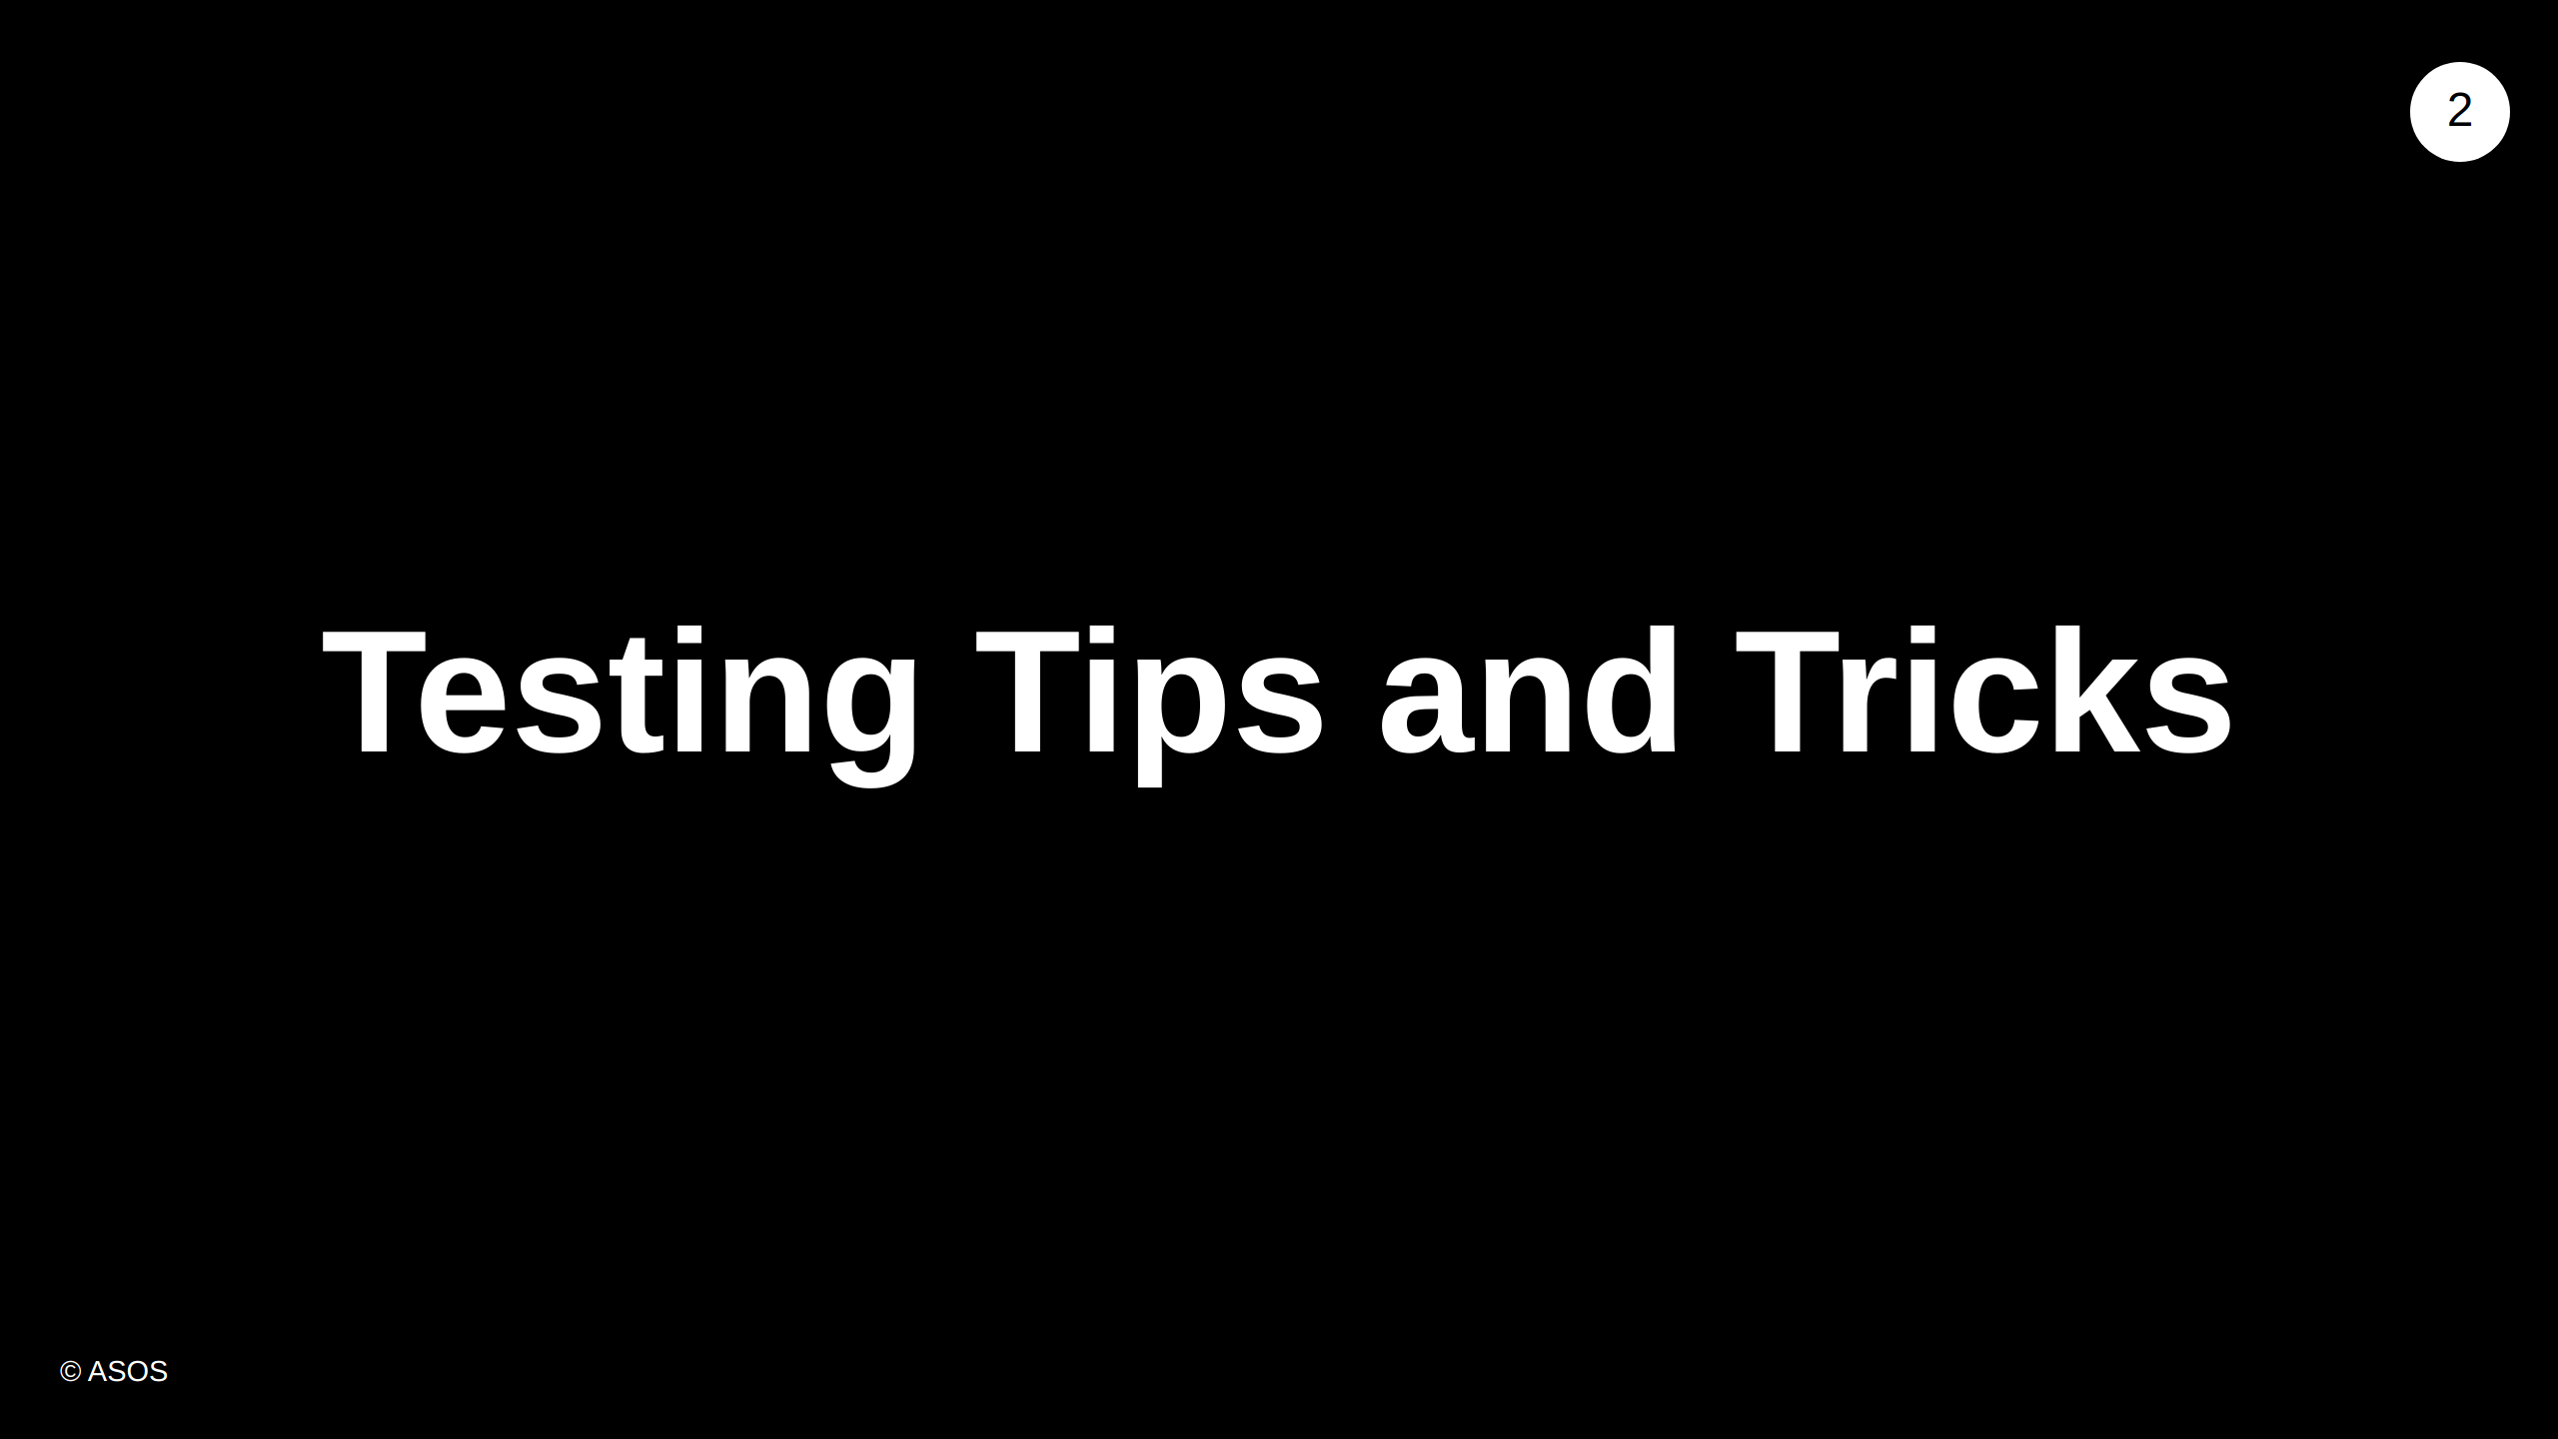
Notes:
- Miro board - ask everyone to think of any testing principles, tools - make point that it doesn't have to just be what you use now at ASOS Anything around: testing libraries (unit / bdd) asserting libraries mocking and stubbing libraries approaches

Slide 3
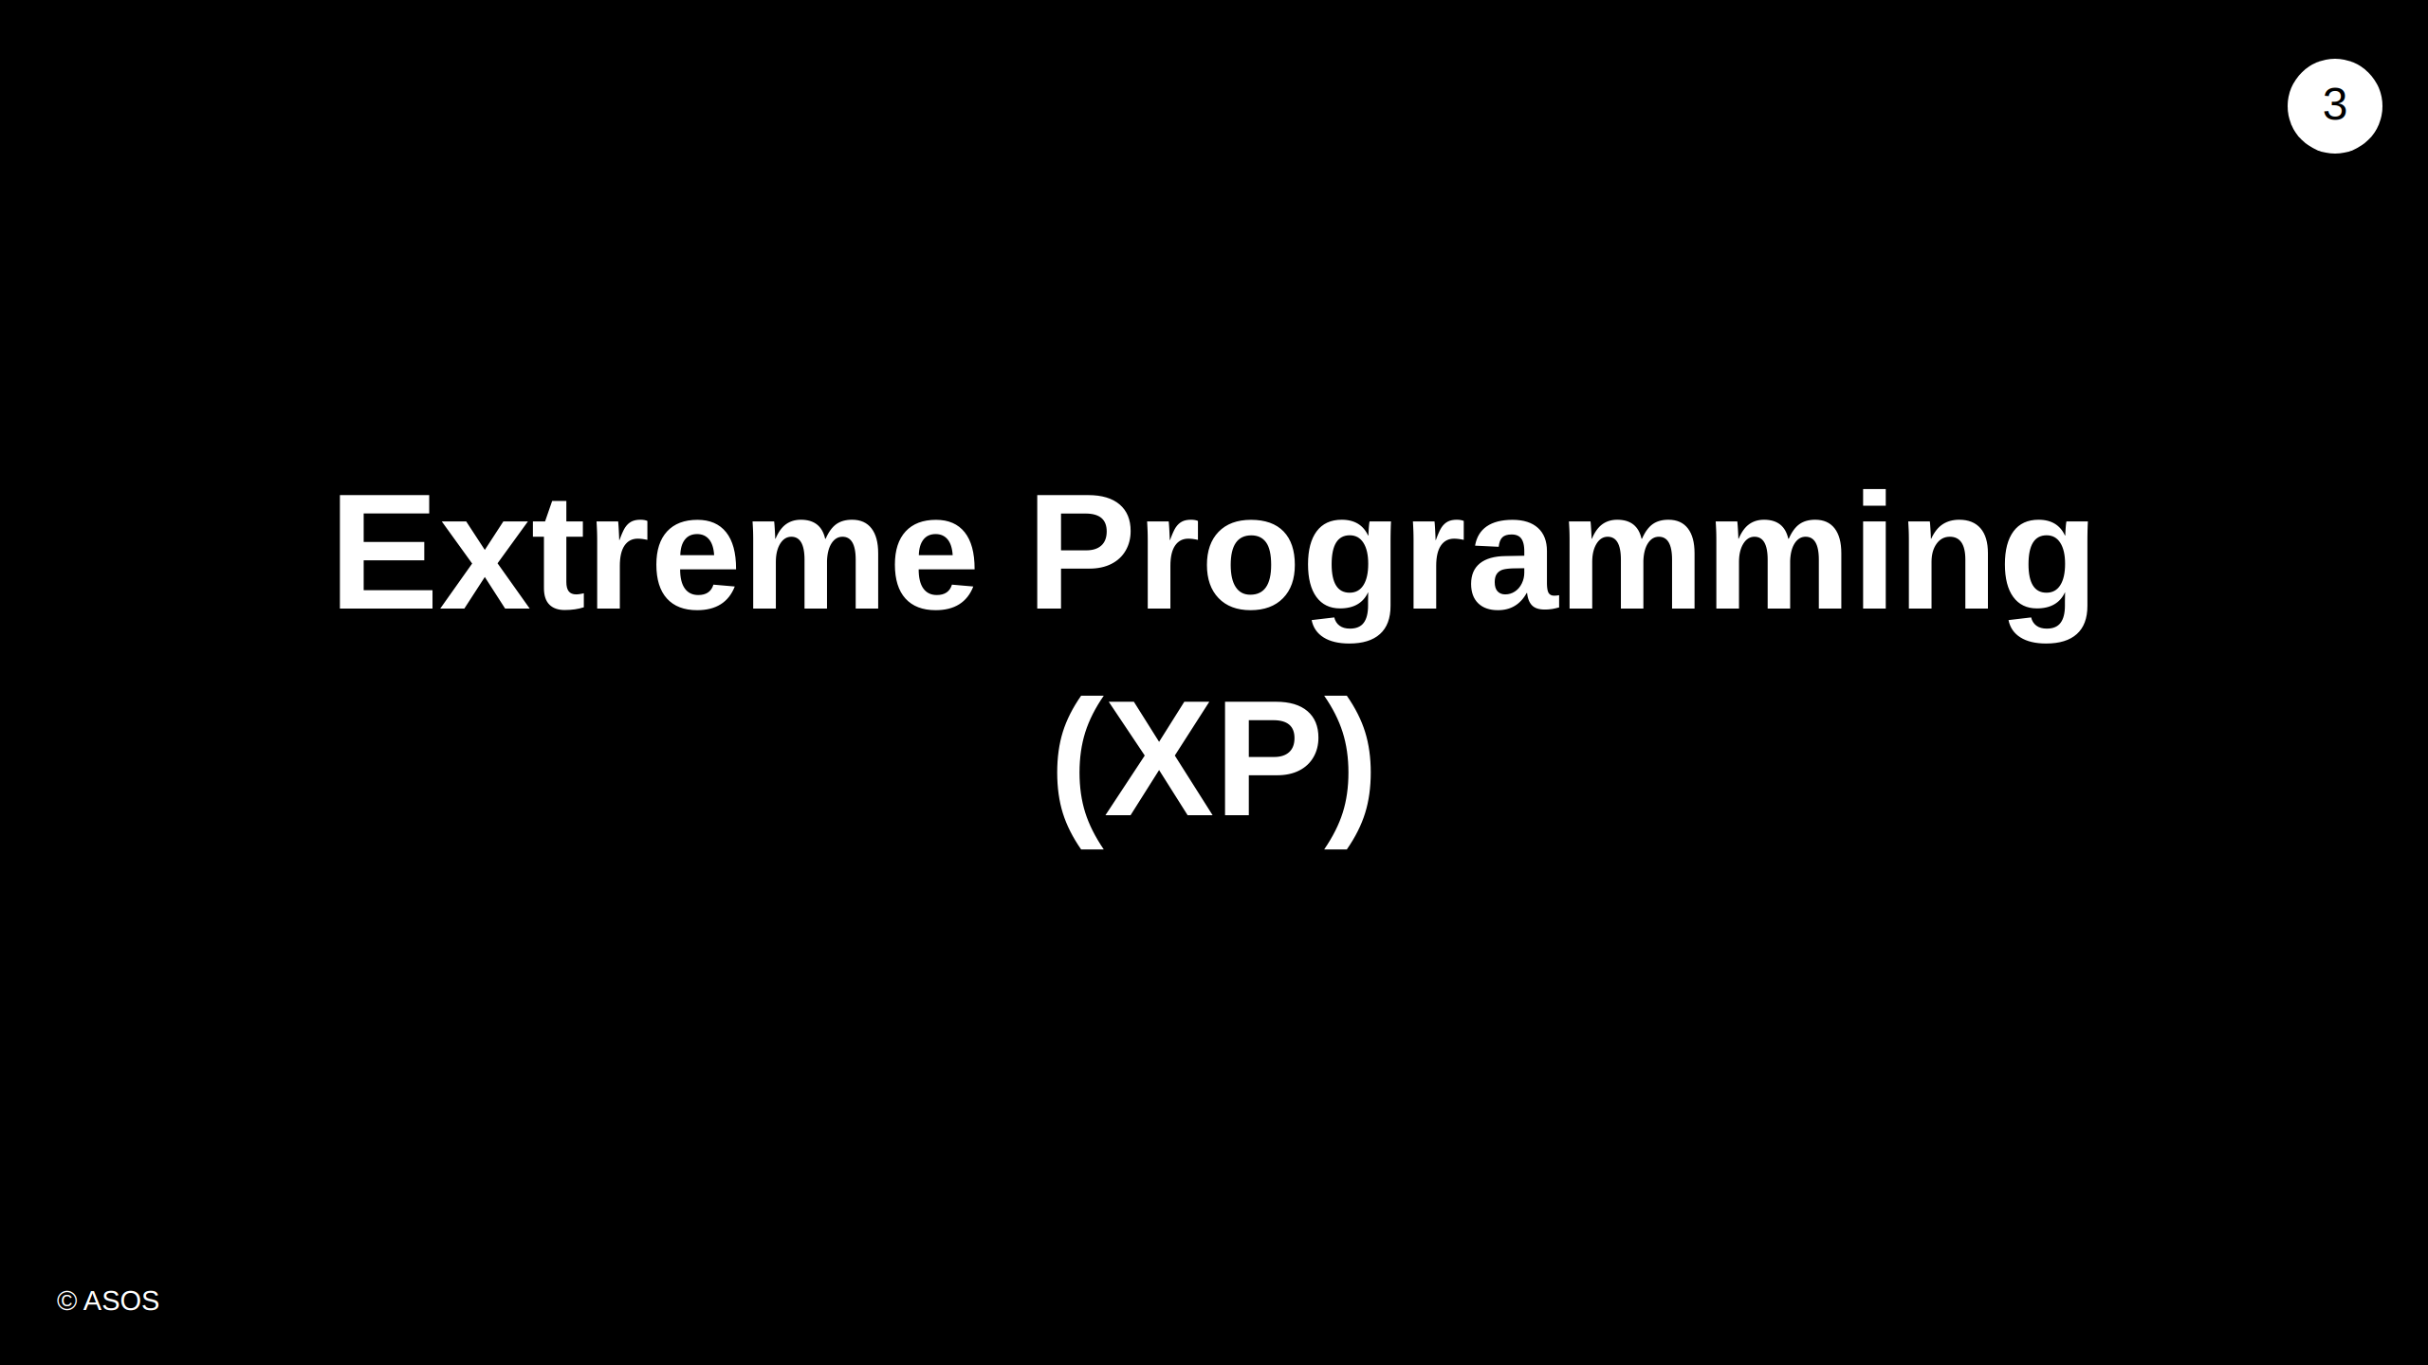
Notes:
XP is: - a software development methodology - it's another flavour of "agile" software development - Created by Kent Beck in 1996, but based on methodologies going back to Nasa in the 60s

Slide 4
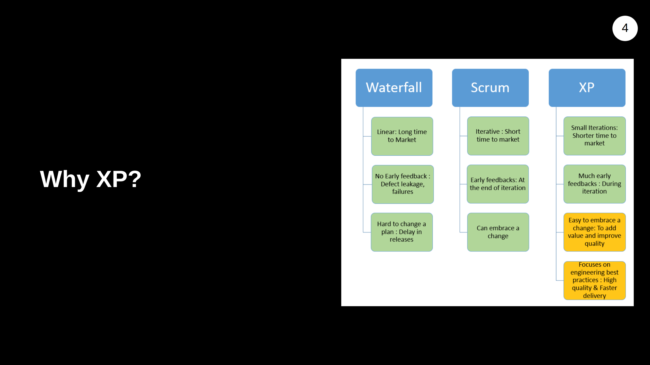
Notes:
XP CORE technical practices are: - TDD, Pair programming, Refactoring and Simple Design. - It advocates frequent releases and short development cycles. - It is intended to react to changes in customer requirements quickly.

Slide 5
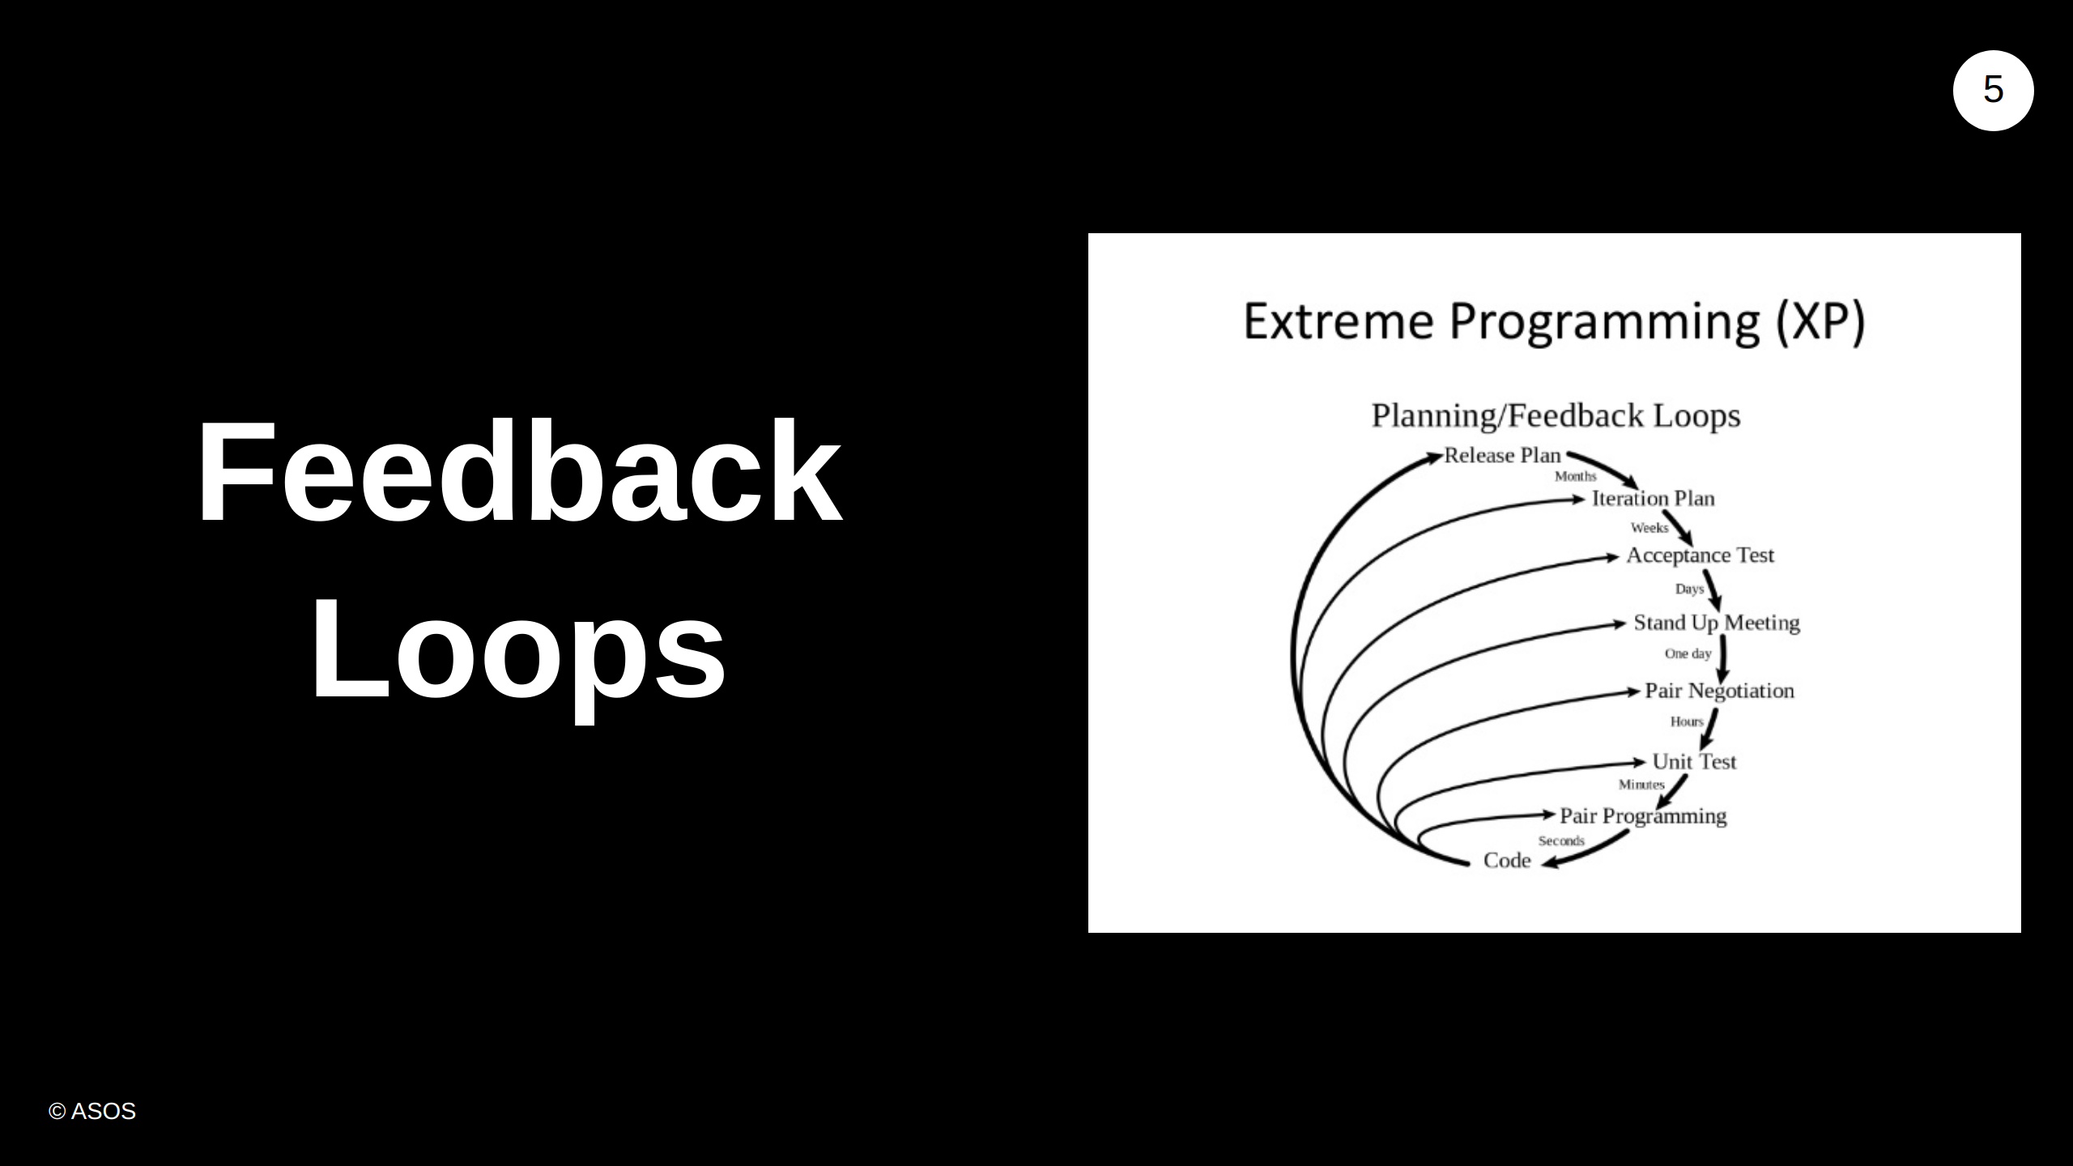
Notes:
"XP/scrum is all about the feedback loops". This image illustrates. We start at the top, with the team release plan, where the loop can take months, all the way down to pair programming, which can take just seconds for the feedback loop to occur. Pair Negotiation - Sitting with your partner and discuss solution to the immediate task. Notice how the diagram shows that the cycles spiral outward in loops.

Slide 6
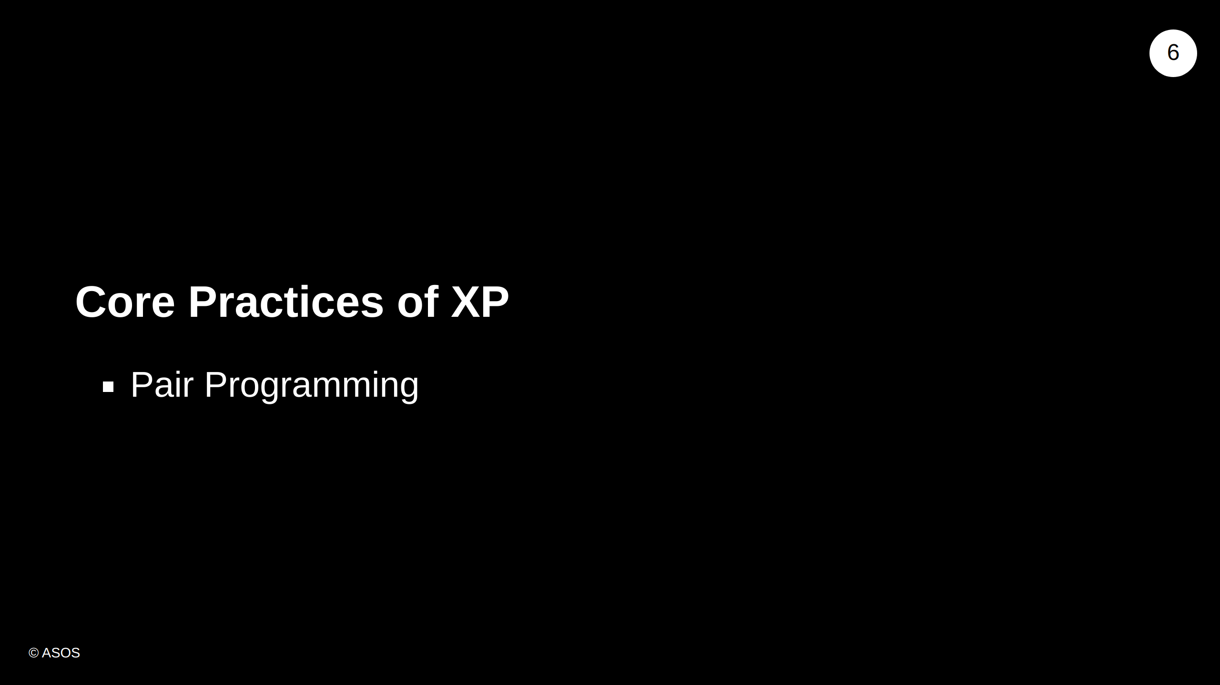

Slide 7
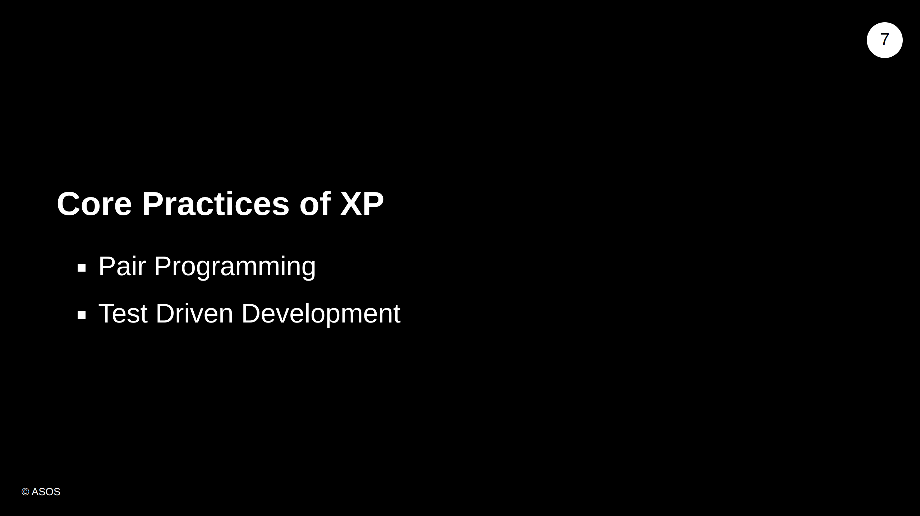

Slide 8
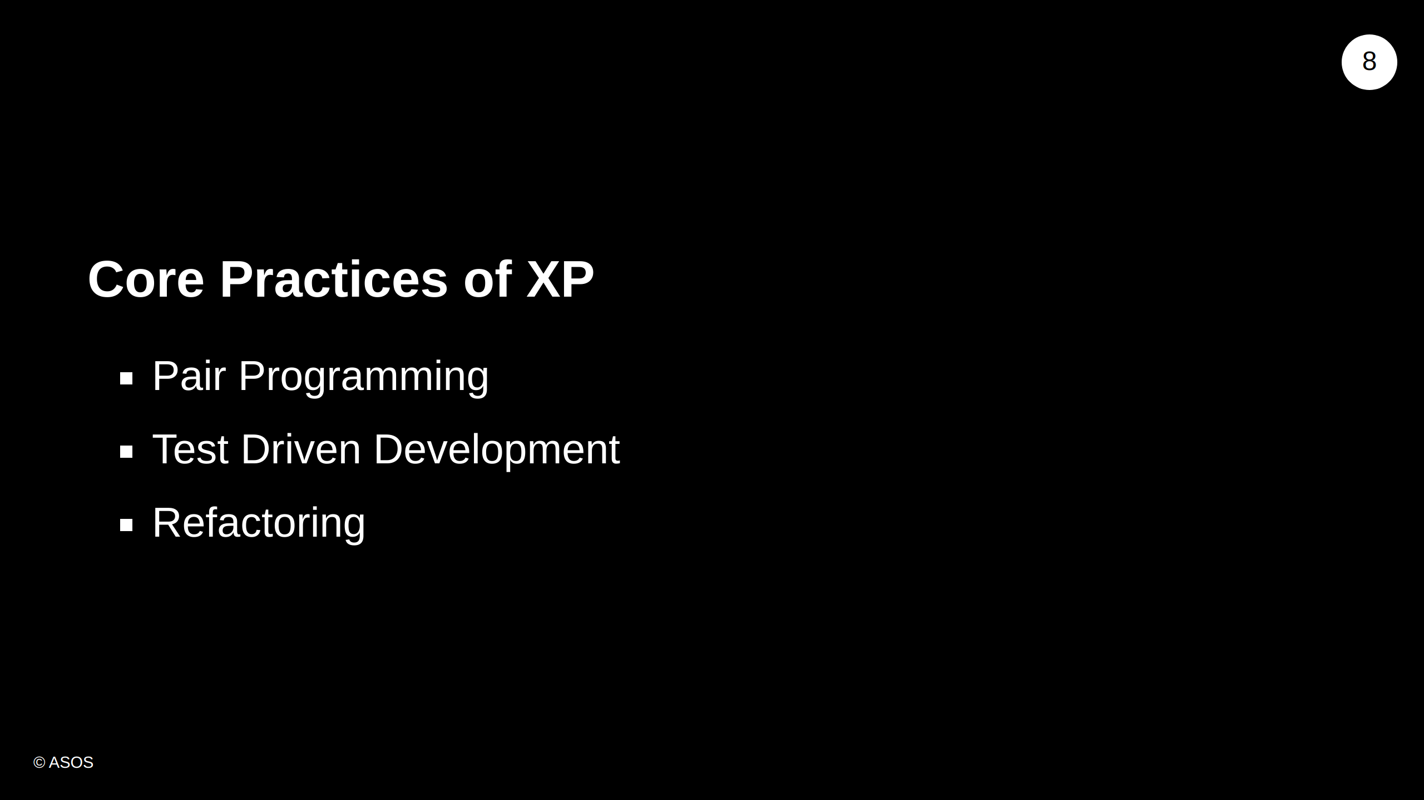

Slide 9
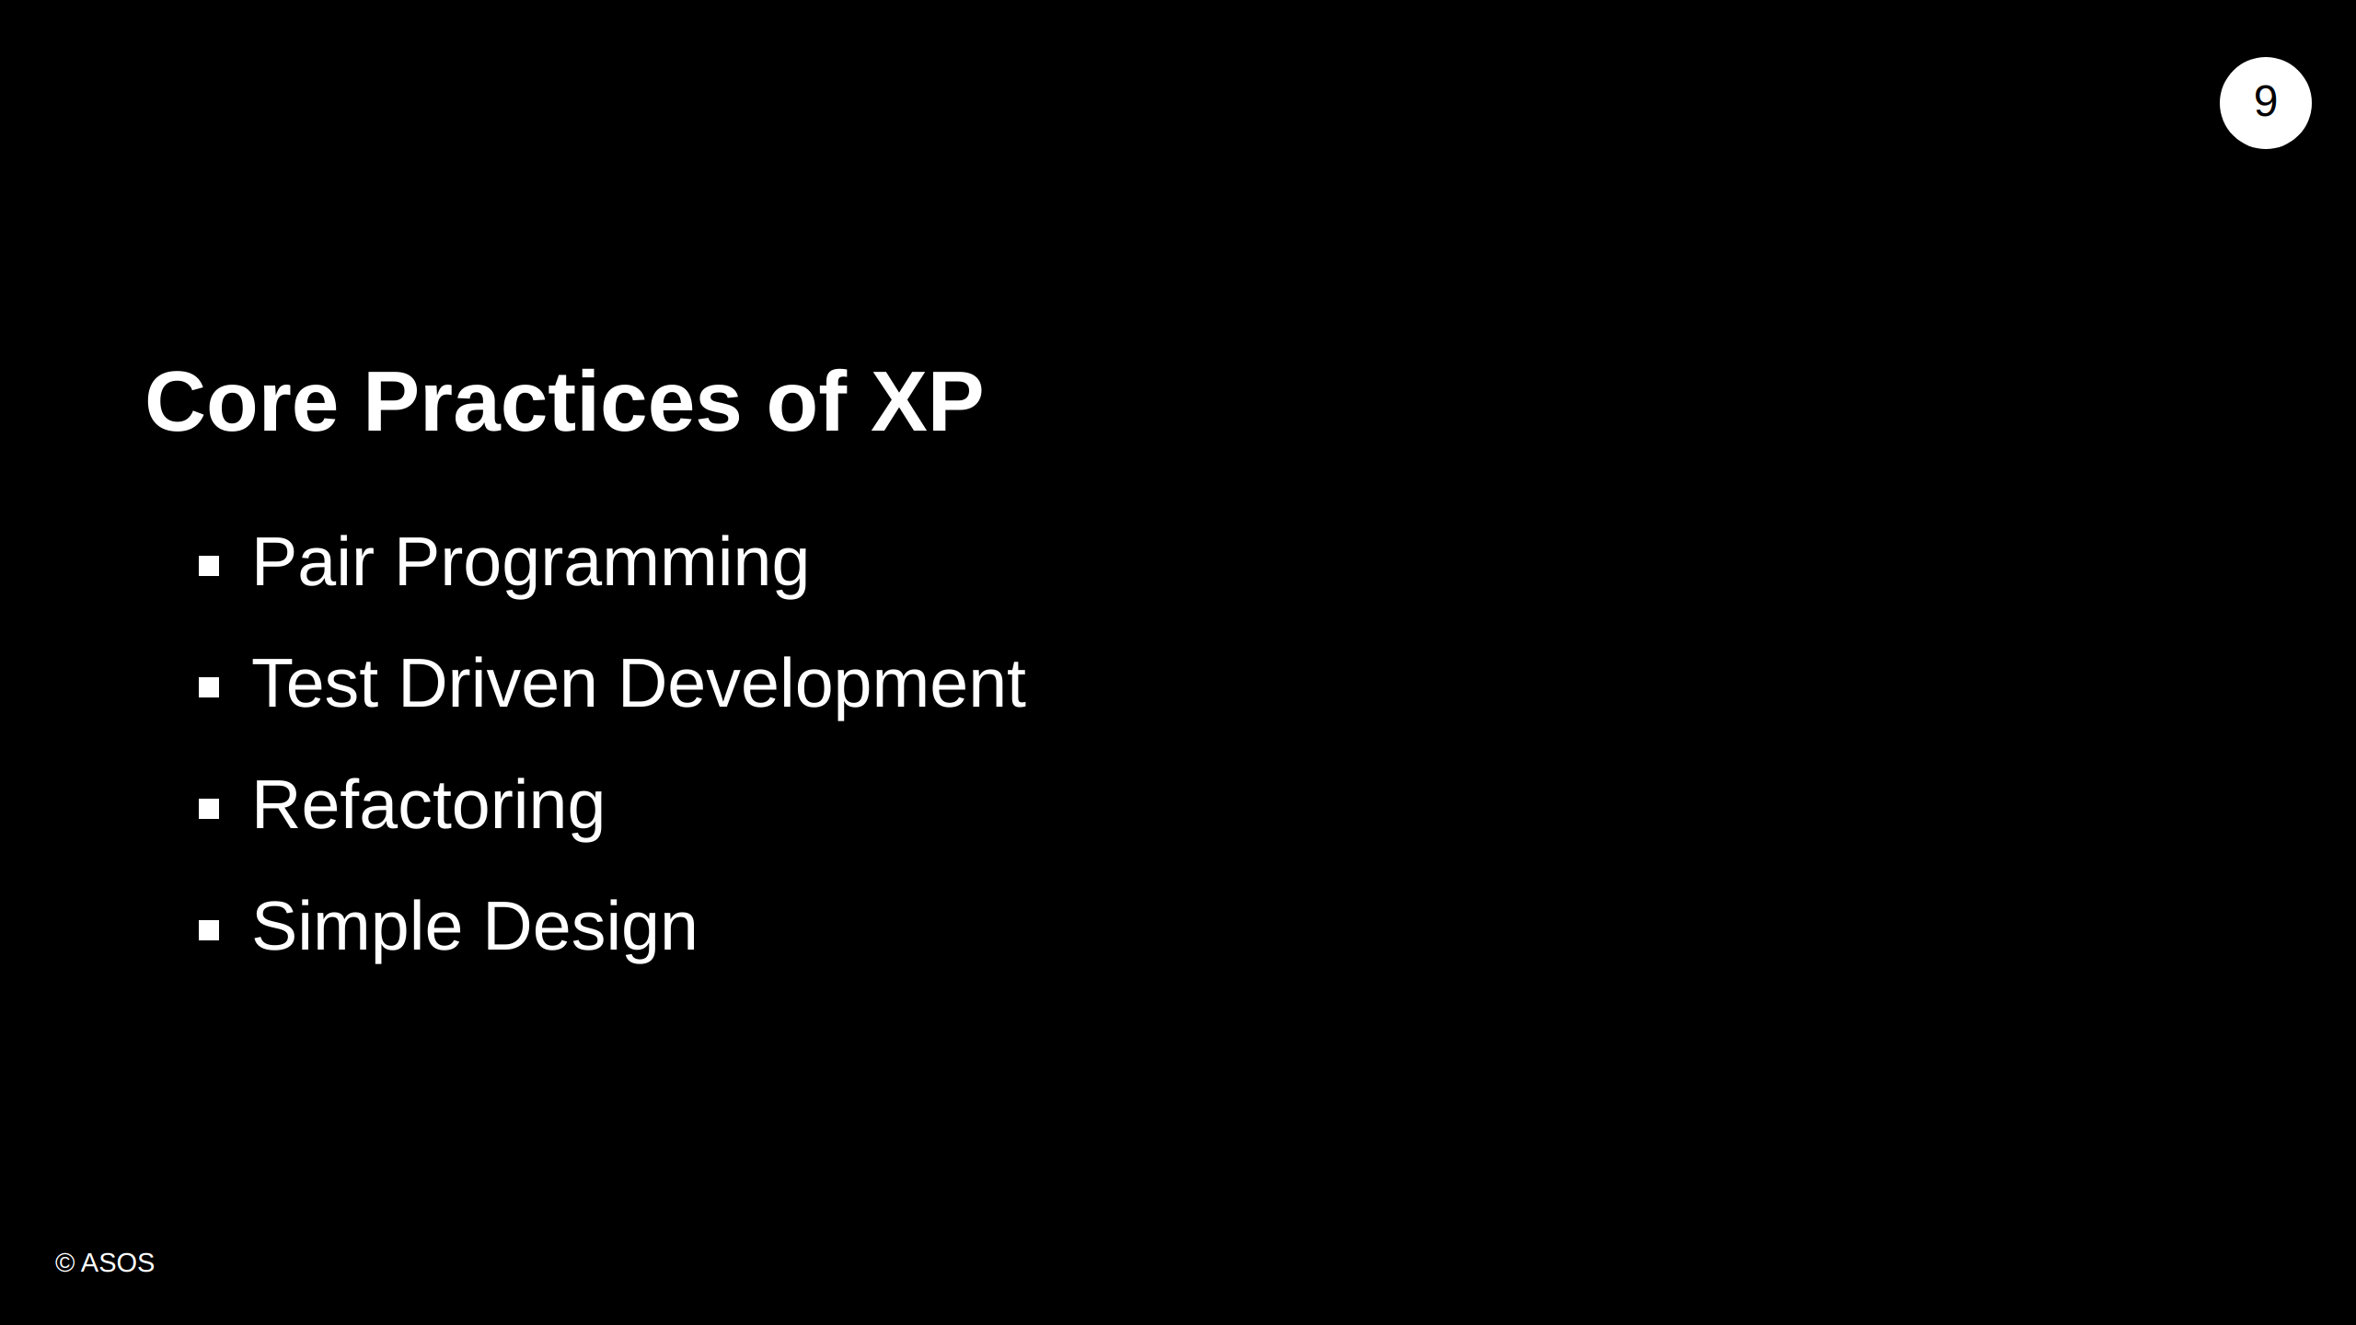

Slide 10
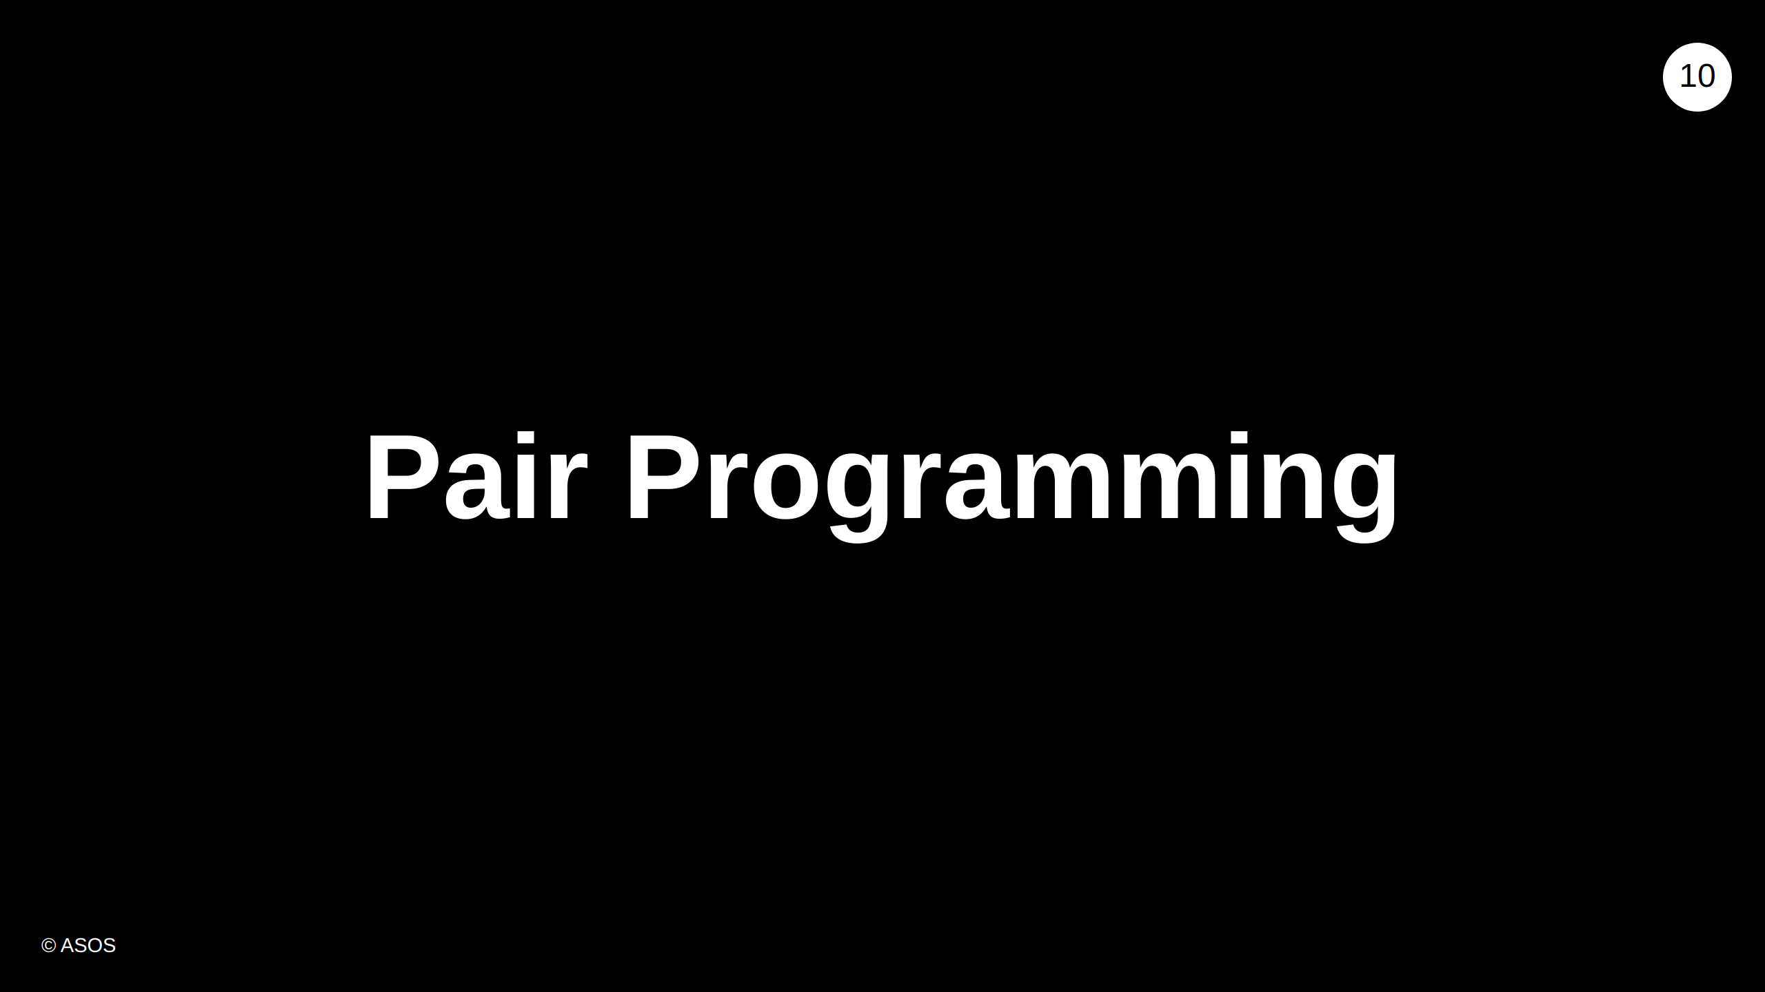
Notes:
In this section we talk about remote pairing strategies. We'll talk about what pair programming is, why it's useful, the roles of each person in the pair, different styles of pair programming, and some hints and tips about how to make pairing more effective.

Slide 11
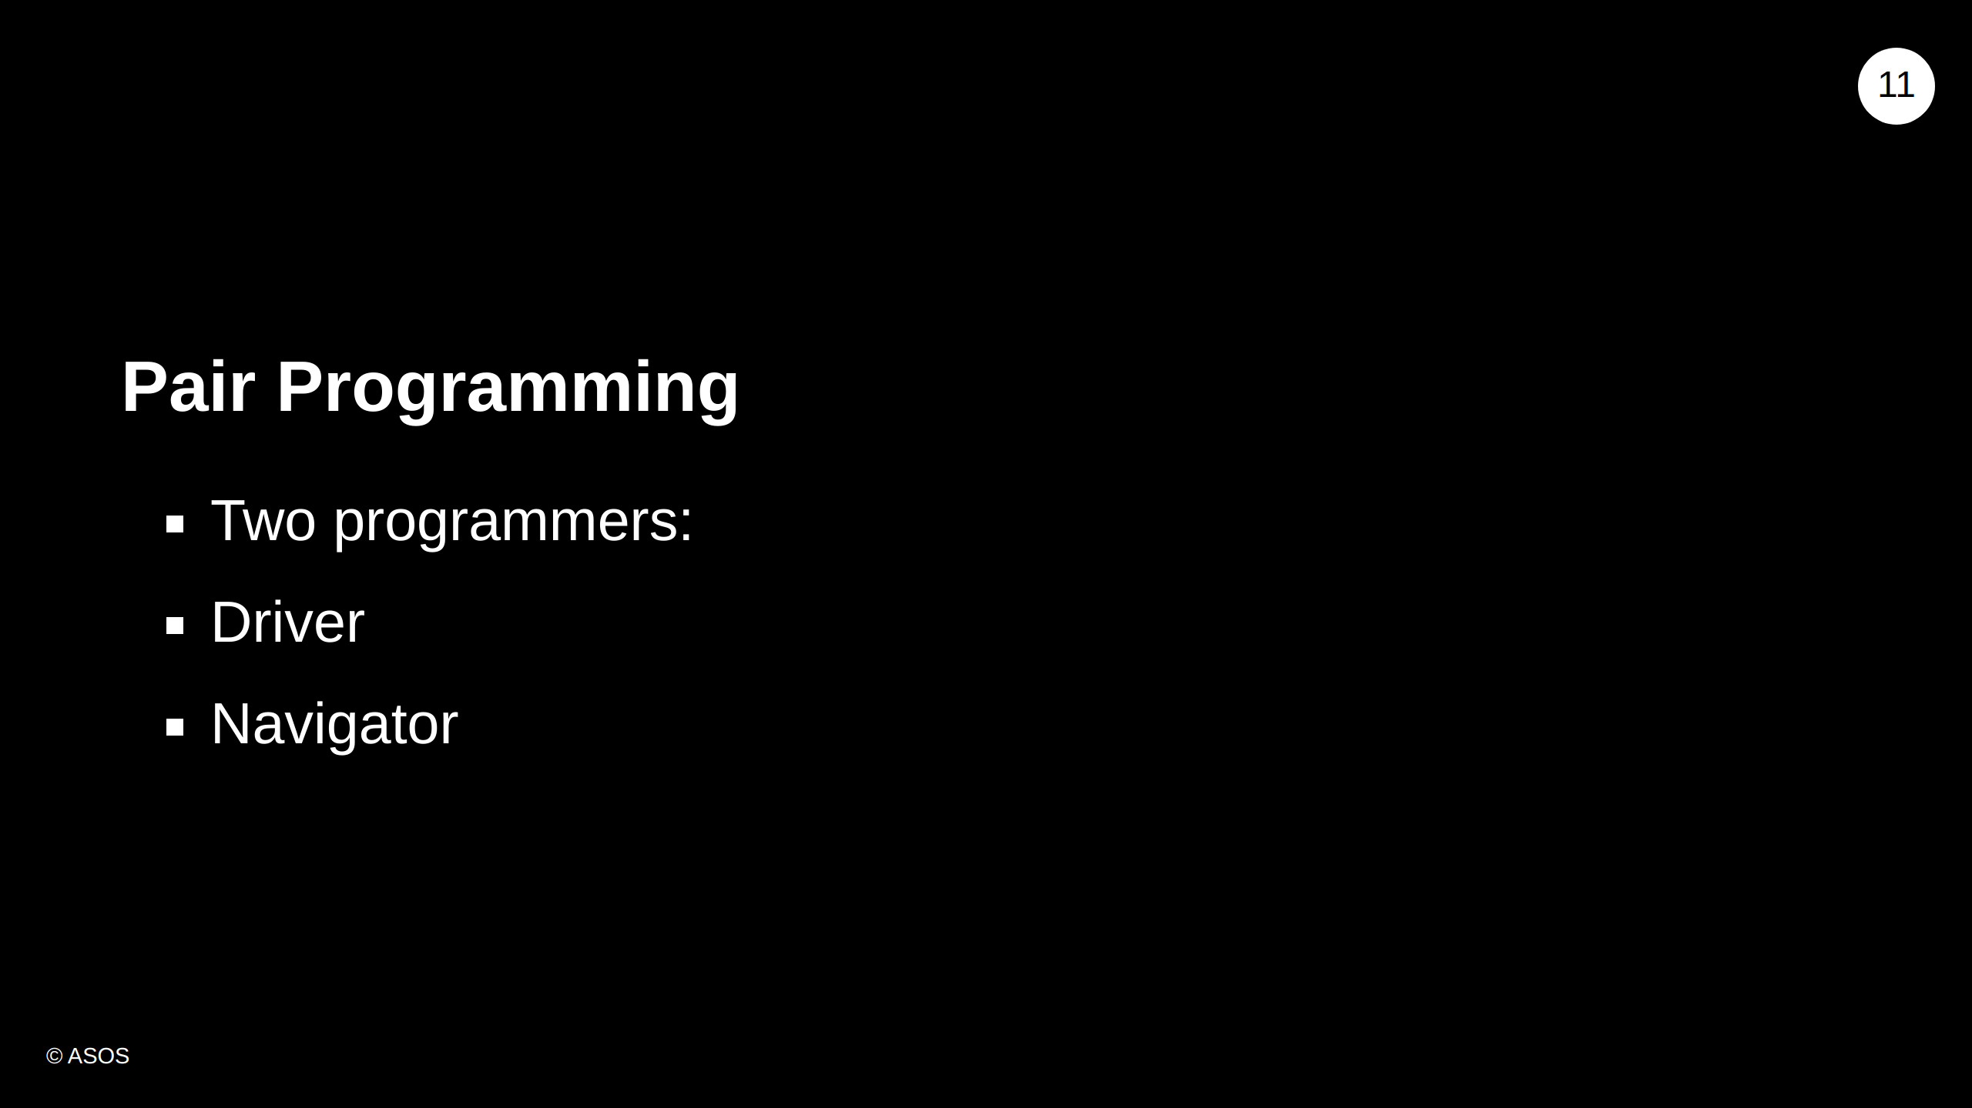
Notes:
What is pair programming? - 2 programmers working together and sharing a work station - One Driver, controls the workstation - One Navigator, does more approach thinking and checking - Why pair programming - Fast feedback from pair - Helps ensure you don't go down a rabbit hole - Keeps you honest

Slide 12
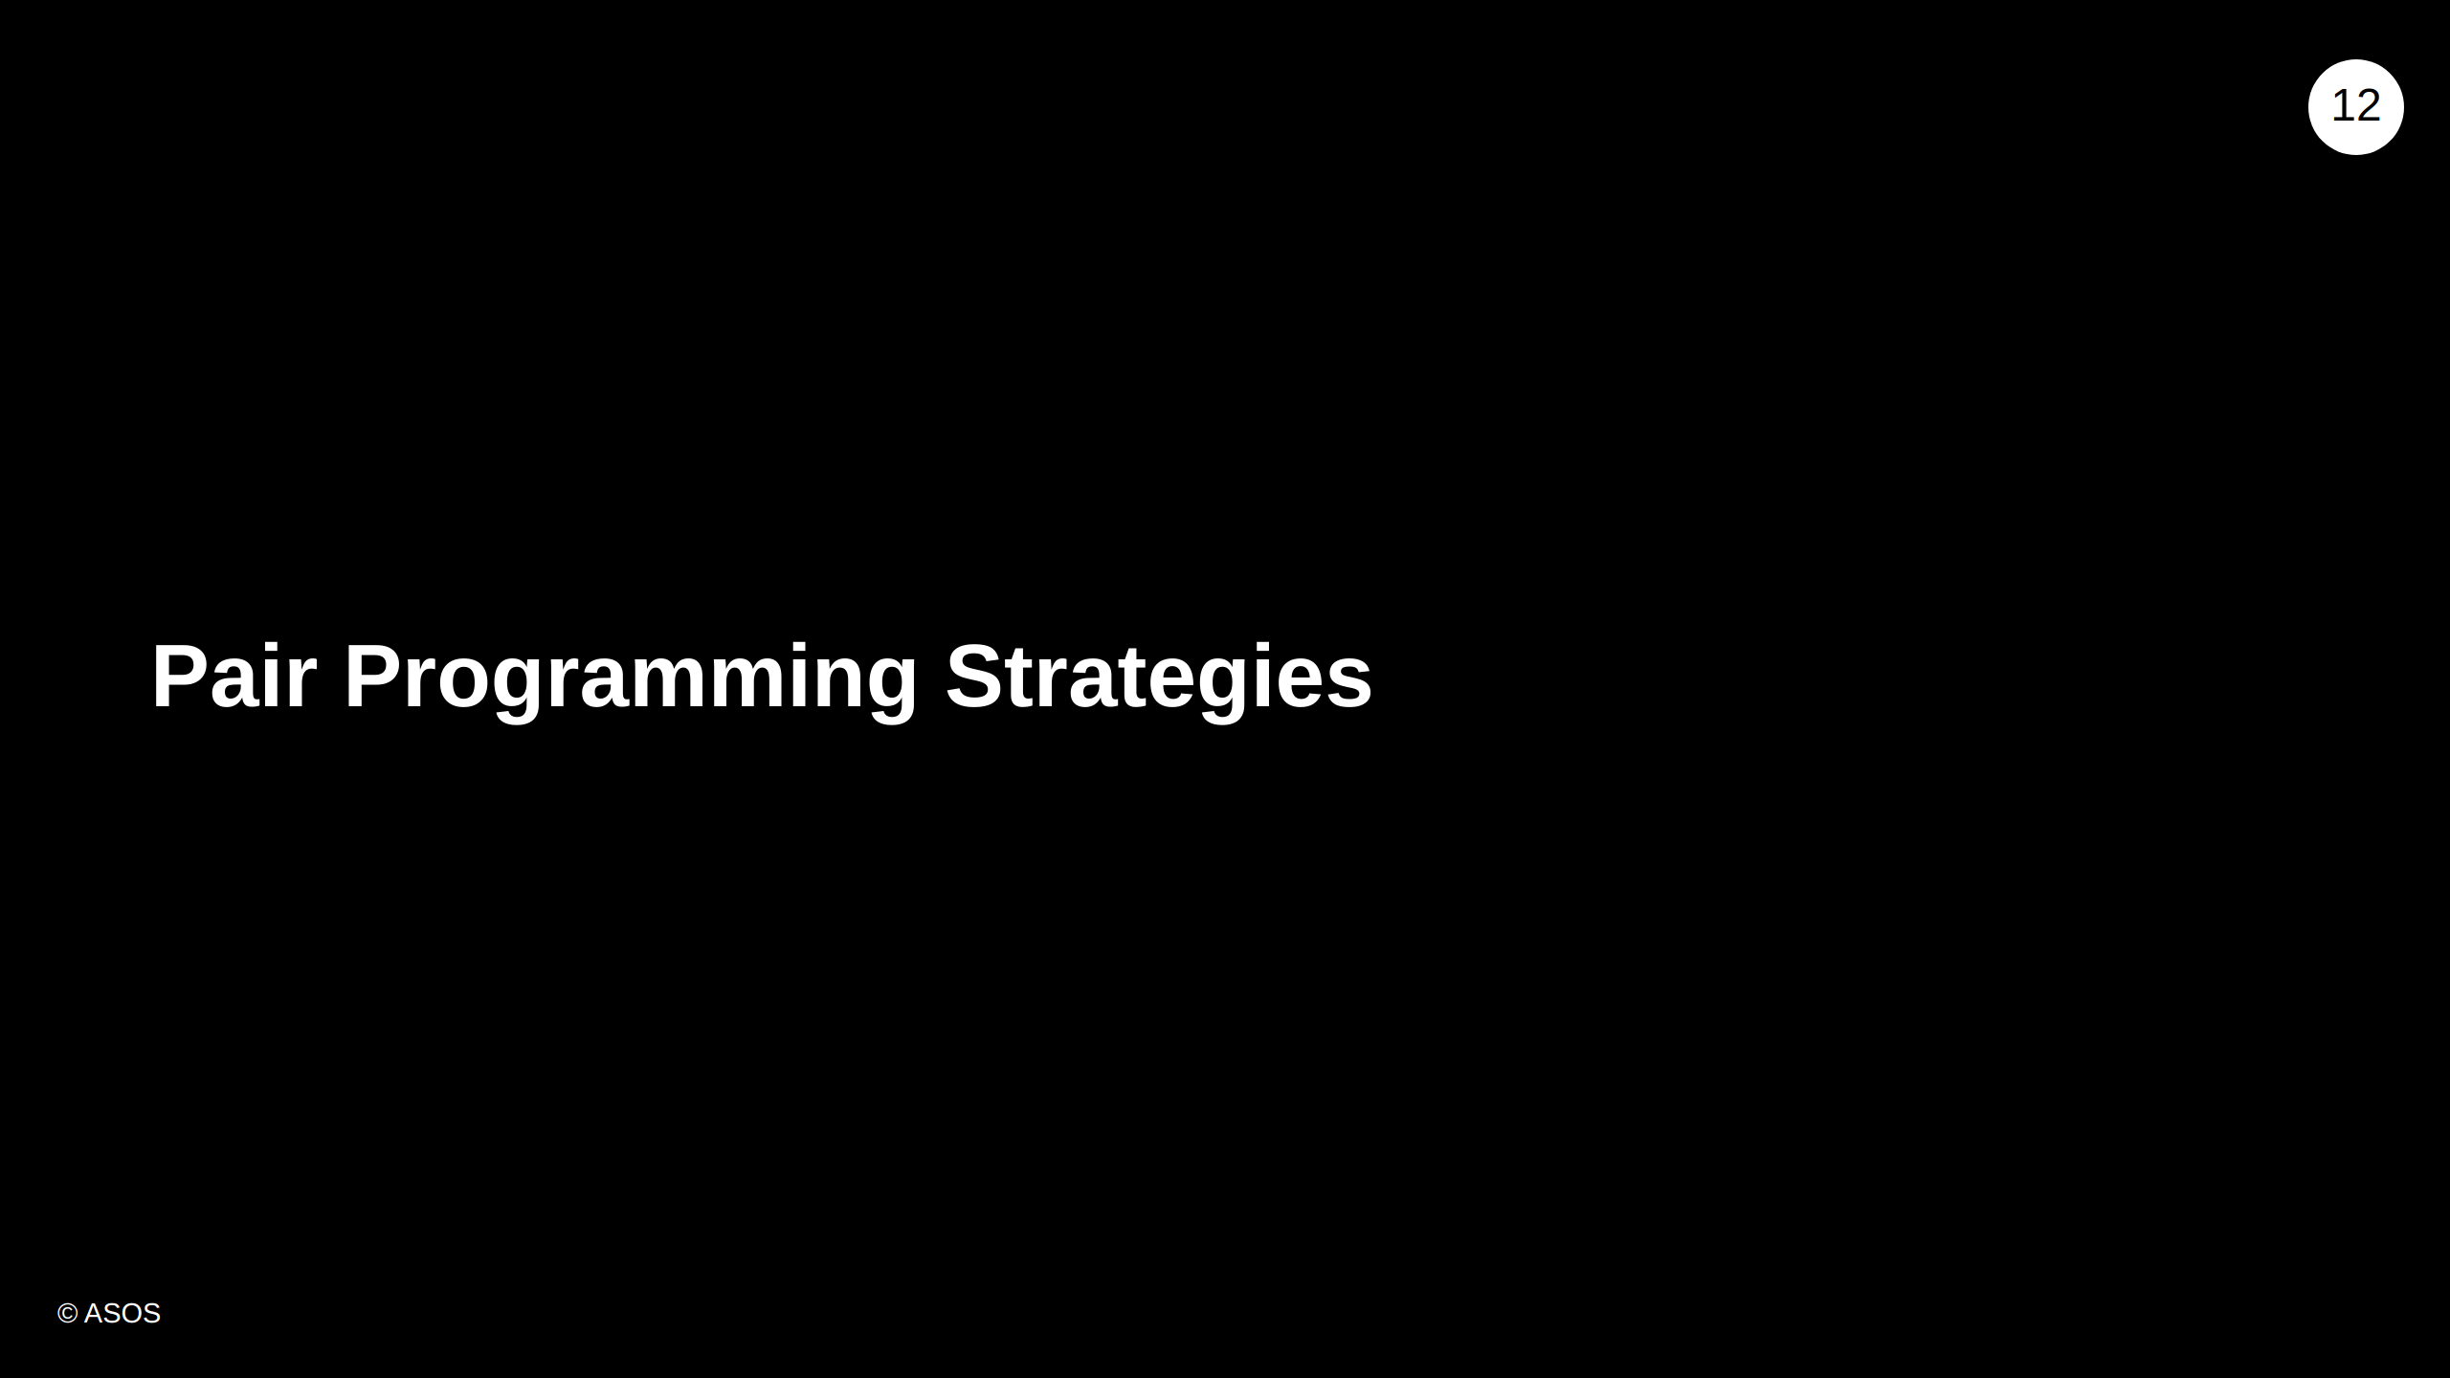

Slide 13
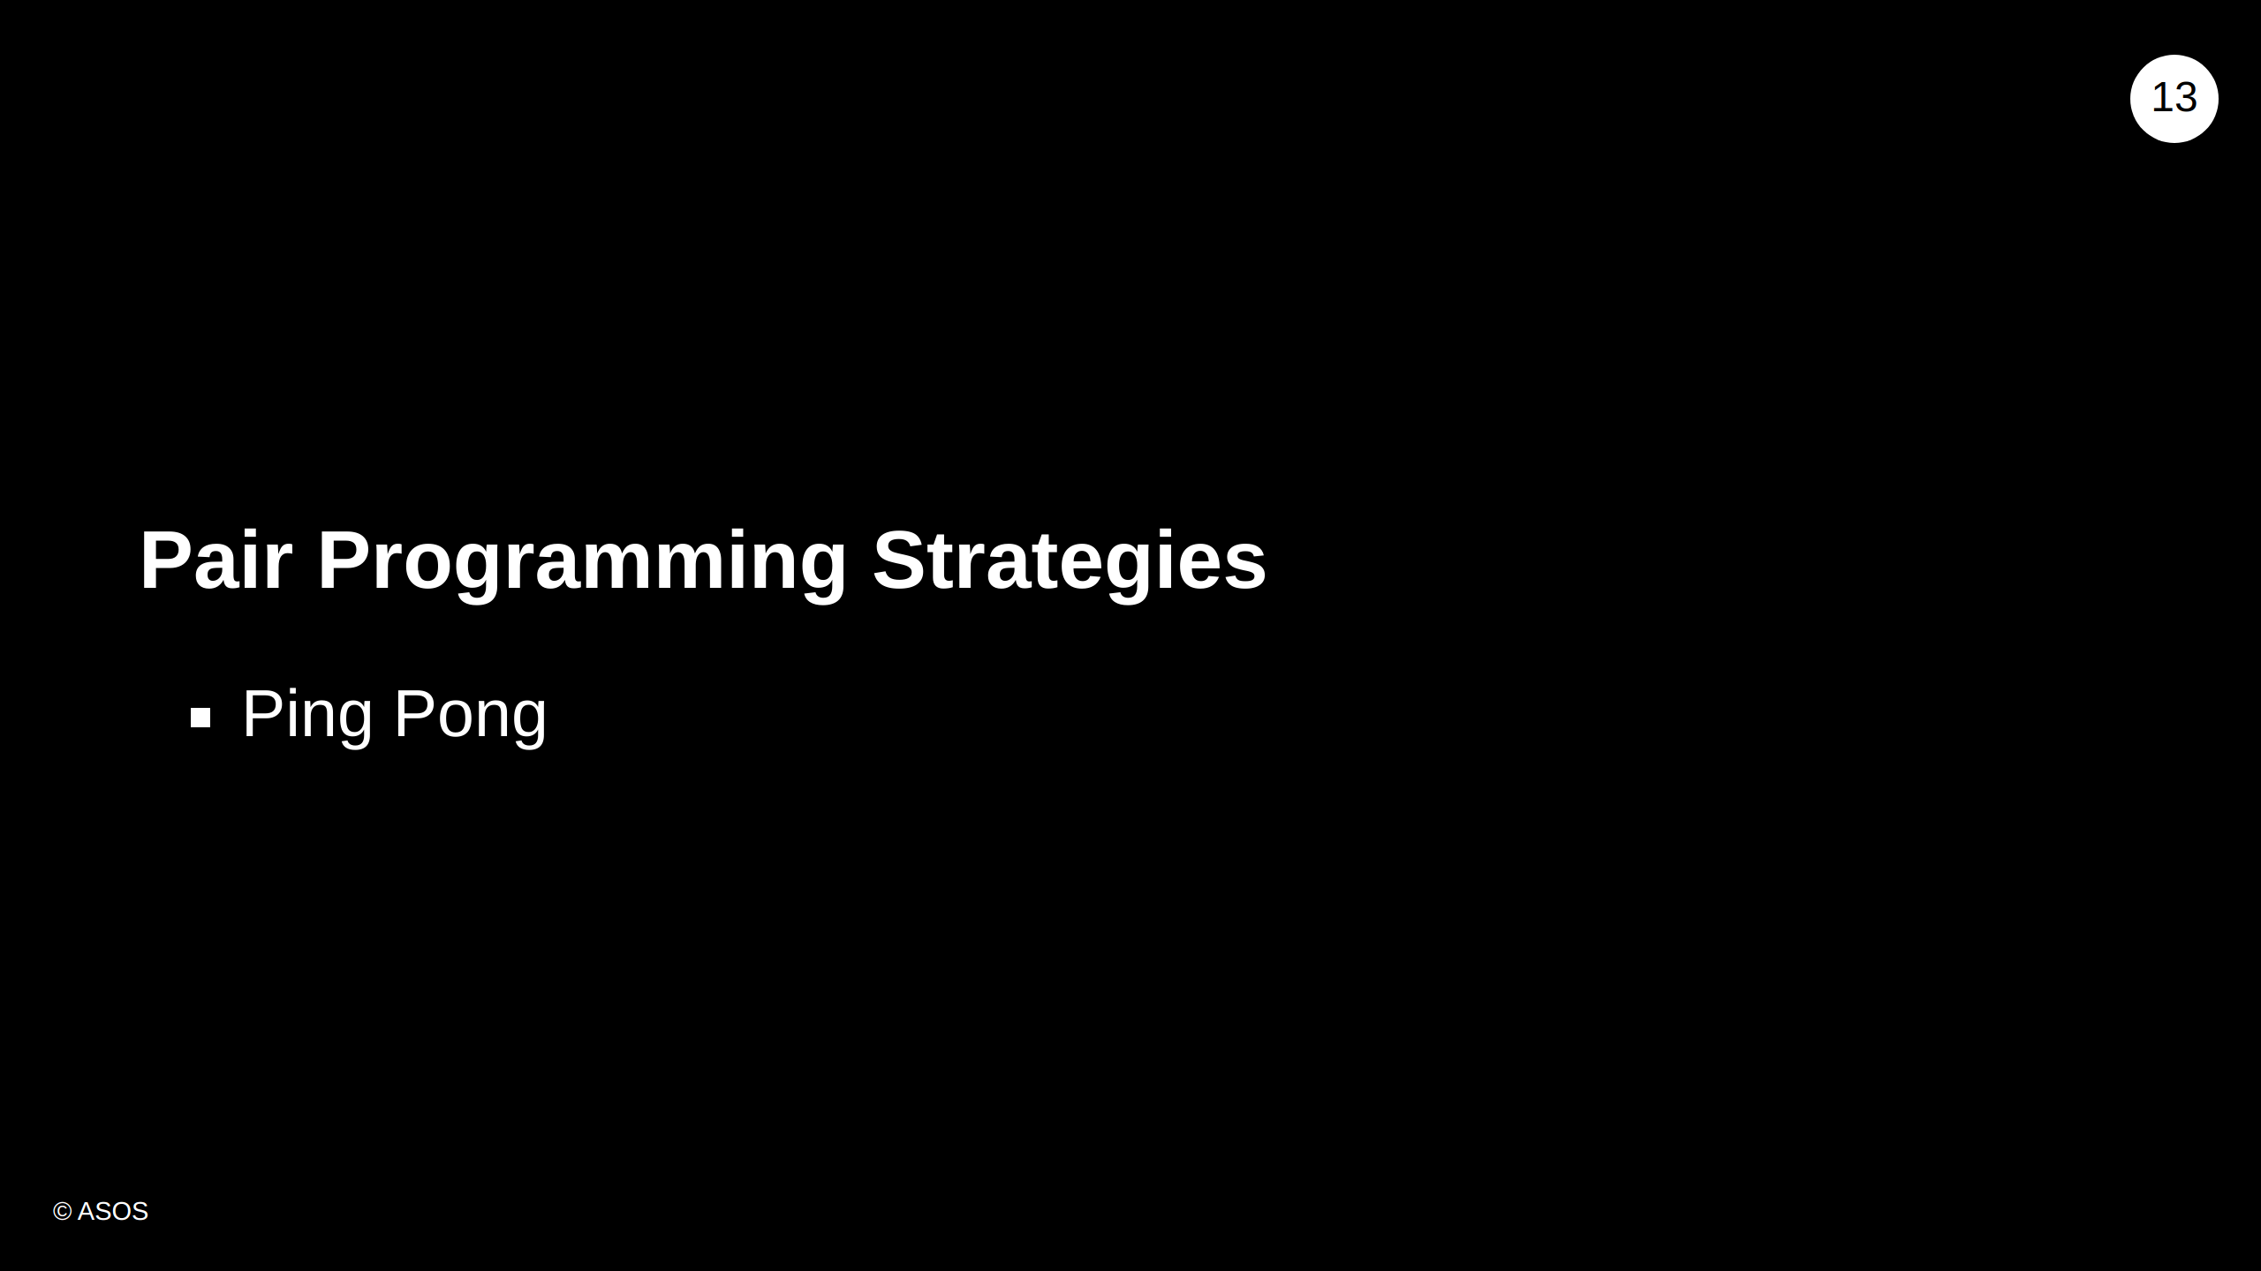
Notes:
Player 1 writes a failing test Player 2 makes the test pass, refactors and writes another failing test A variation exists where the person who made the test pass would hand back to the person who first wrote the failing test for refactoring before writing the failing test: Player 1 writes a failing test Player 2 make the test pass Player 1 refactors Player 2 writes another failing test

Slide 14
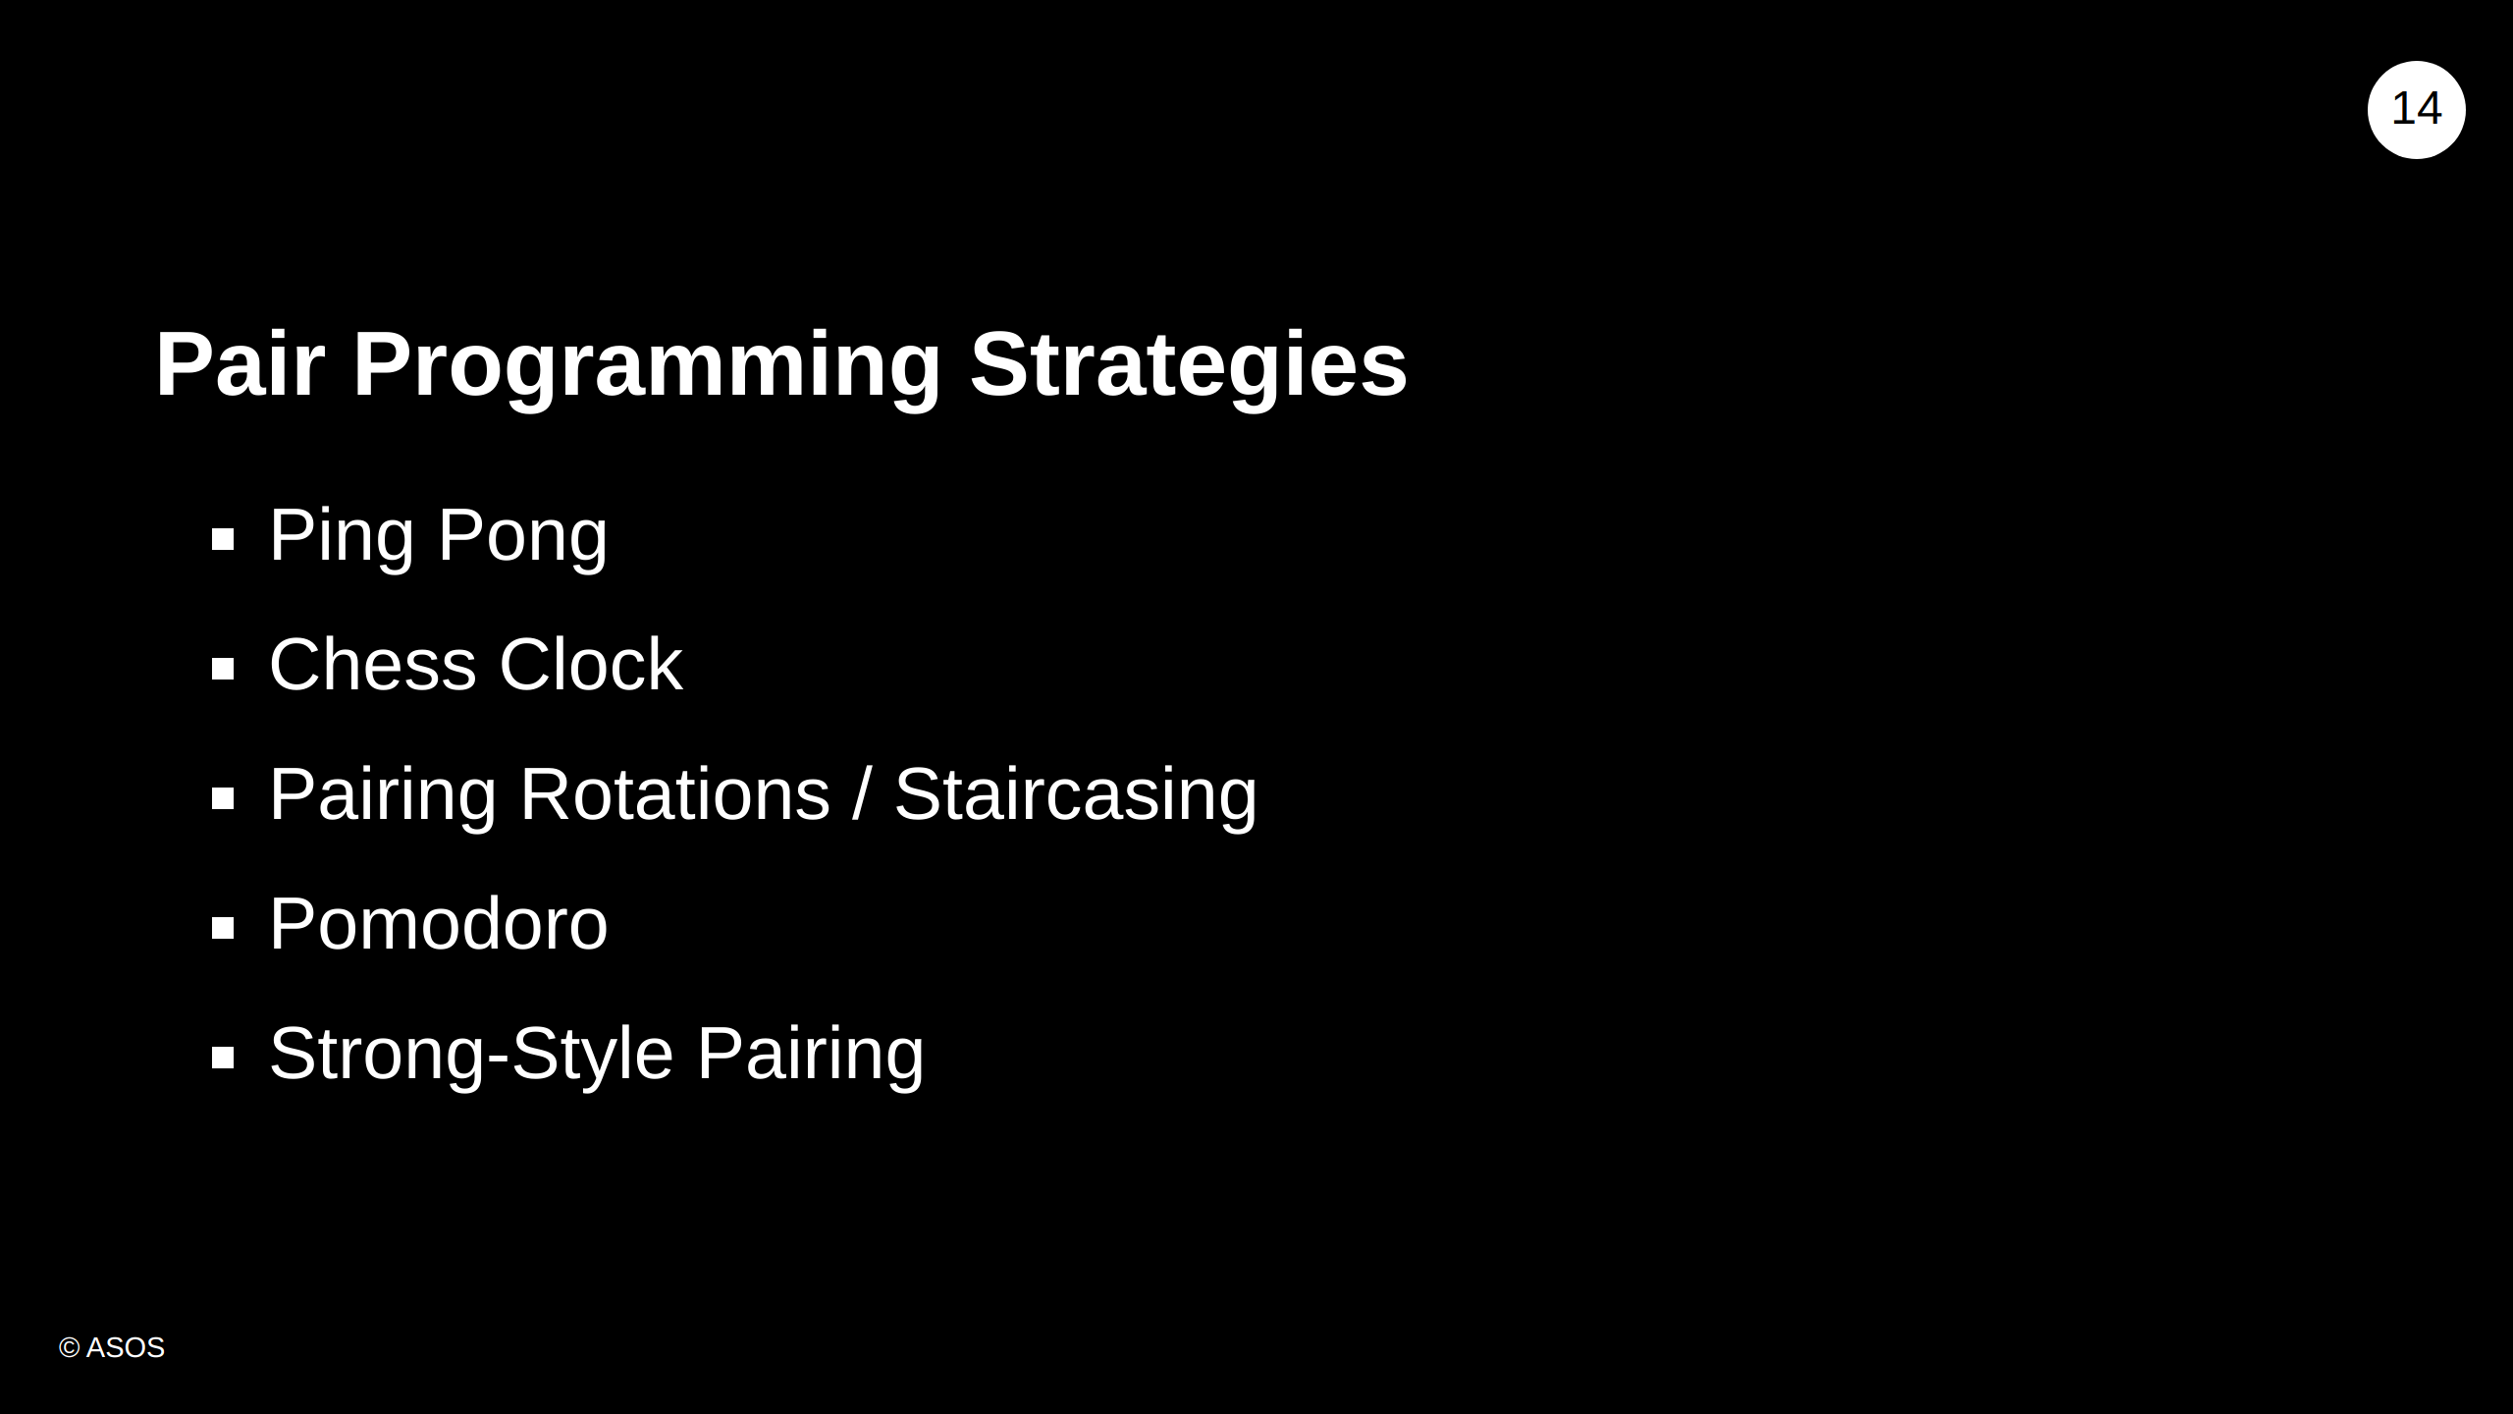
Notes:
It's worth mentioning there are different pair programming strategies. During our course we will be using ping-pong, but if you are interested in other technicques you can find it in useful links. Pairing stairs rotation: Simple matrix of all team members to keep track of who they've paired with Pomodoro: Decide on the task to be done Set the pomodoro timer to n minutes (traditionally 25) Work on the task until the timer rings; record with an x Take a short break (3–5 minutes) After four pomodori, take a longer break (15–30 minutes) You might let the less experienced person drive, but try not to fall in to the trap of just telling them which keys to press on the keyboard. We want the less experienced person to think for themselves with the expert guidance of the more experienced.

Slide 15
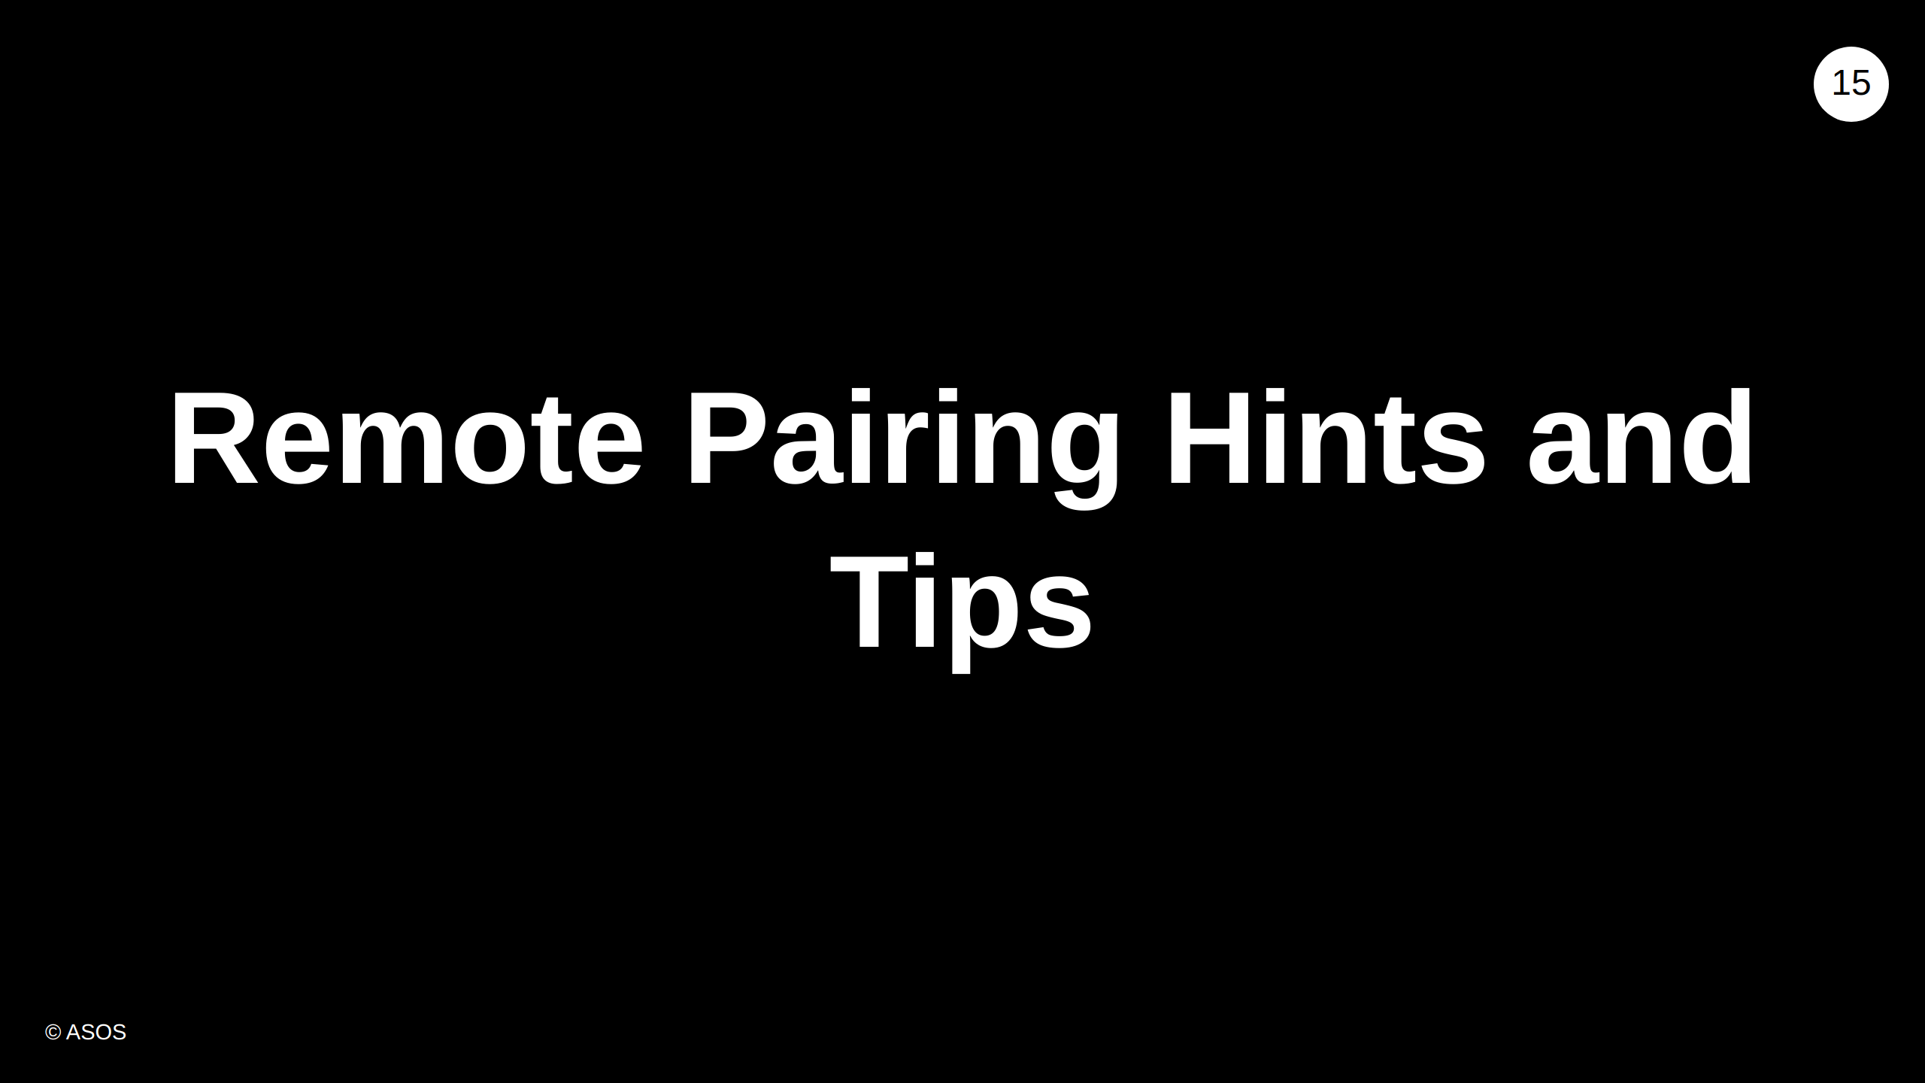
Notes:
Remote pairing is very similar to in-person pairing but the problems can be exacerbated. So it's a good idea to follow good pairing hygiene. I would say, if you're not used to pair programming you might find it strange for somebody to be watching you type. However, the more you practice pair programming the easier you'll find programming in front of someone else.

Slide 16
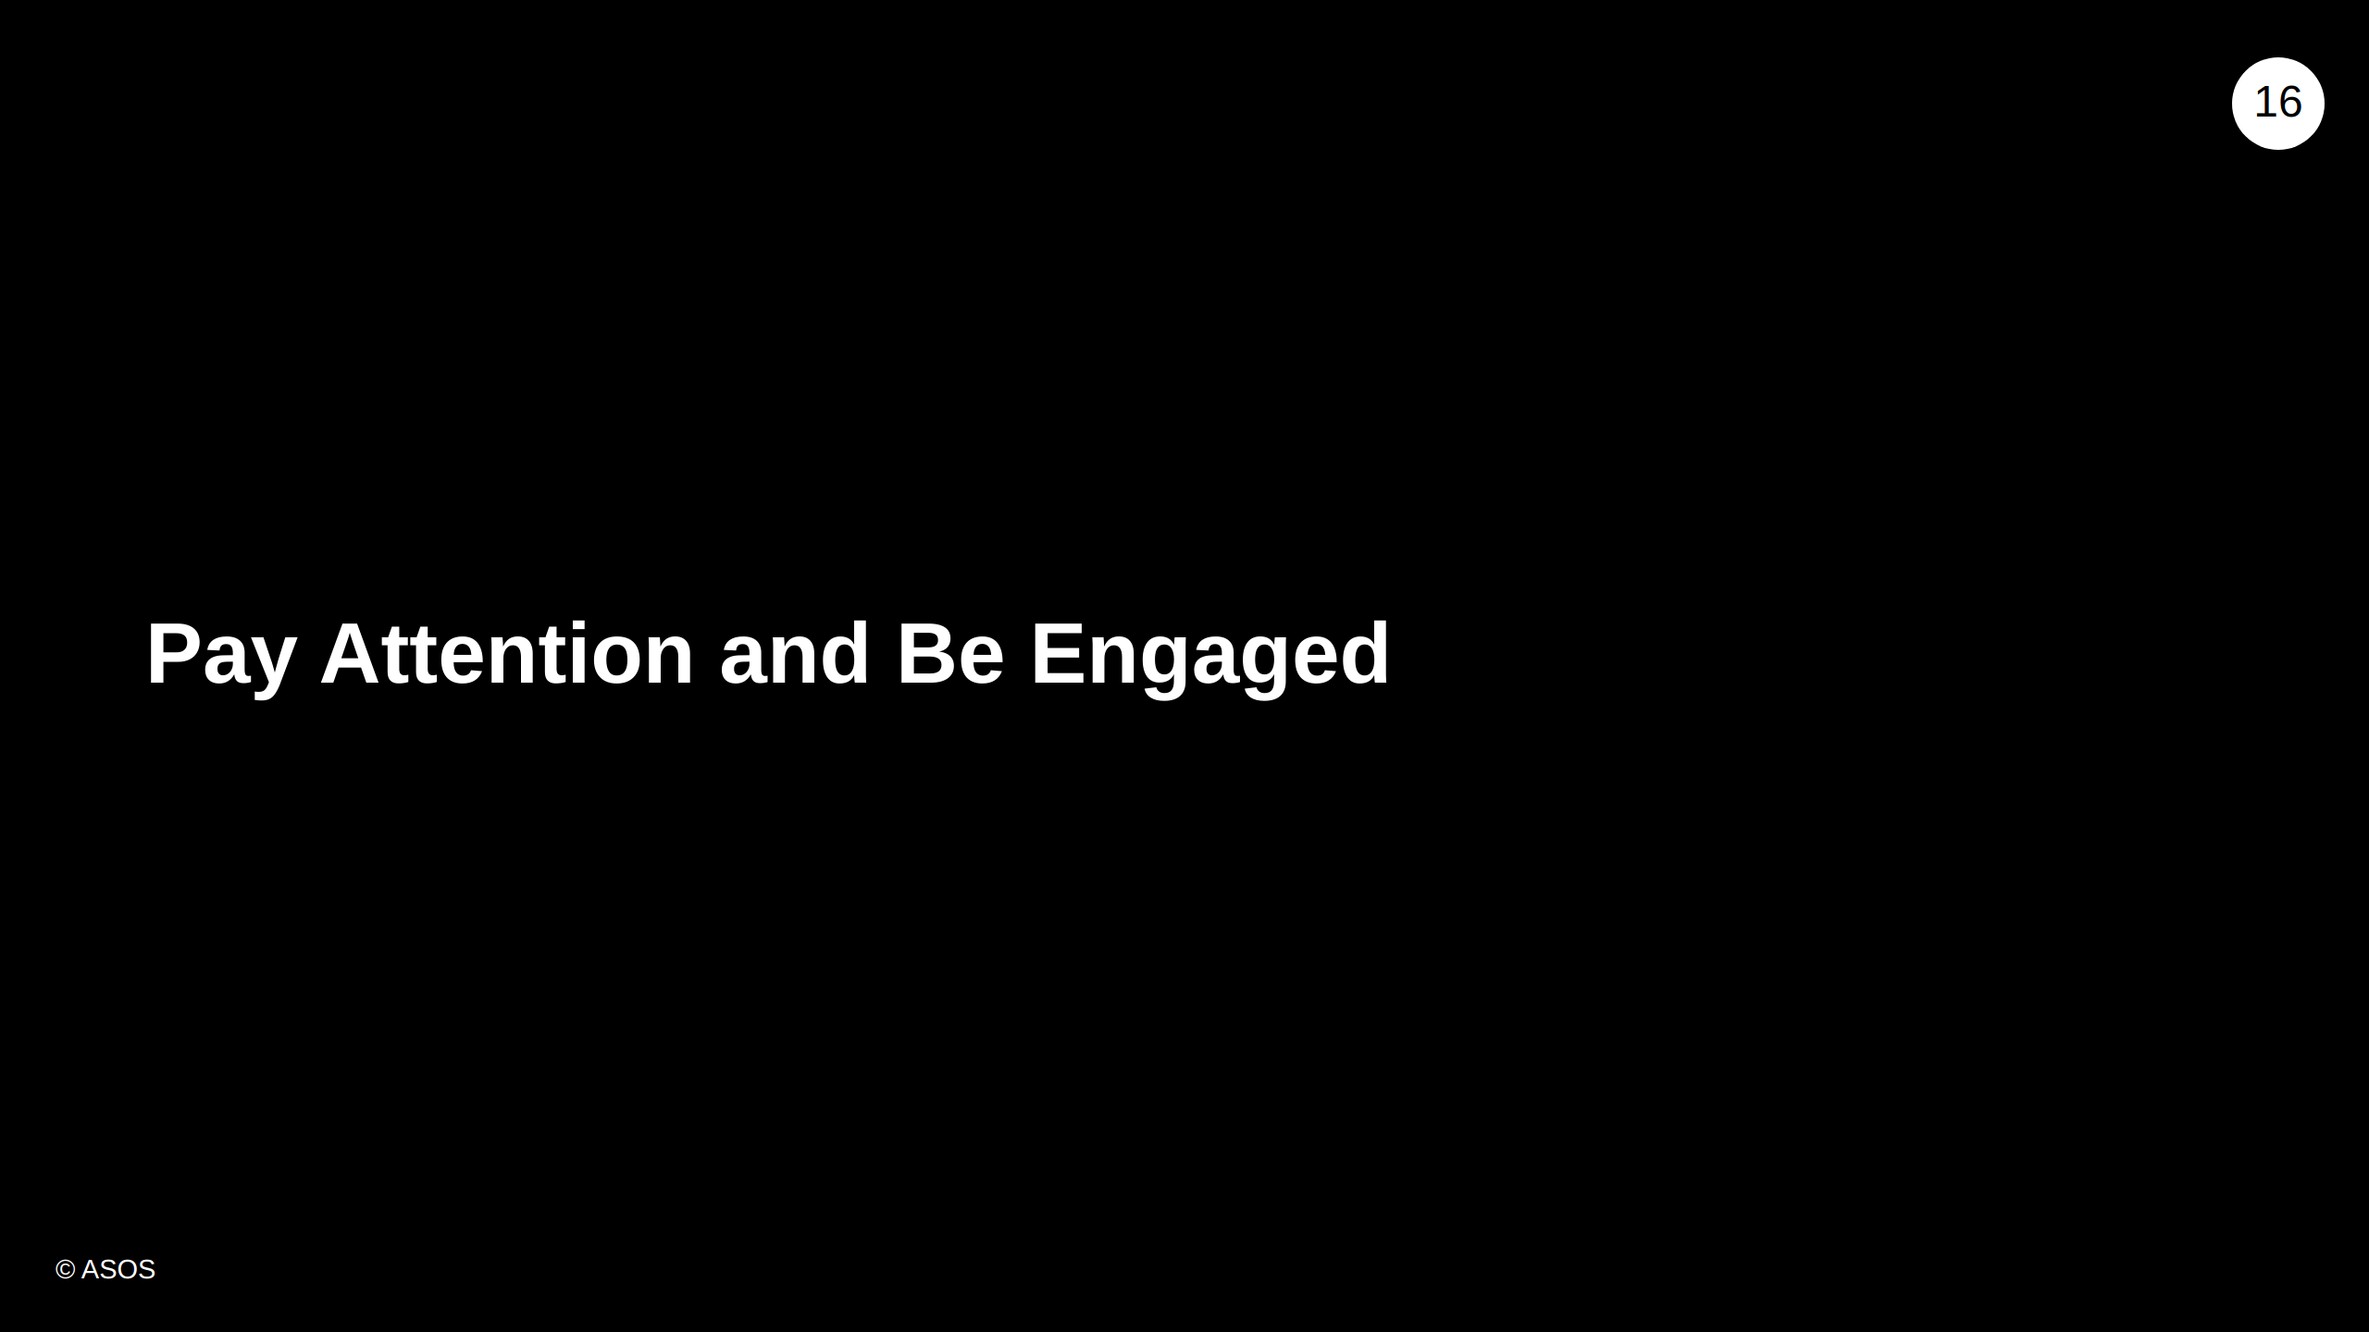
Notes:
- Ask questions - Minimal phone checking - Ask to drive if you lose the thread of your partner's thinking

Slide 17
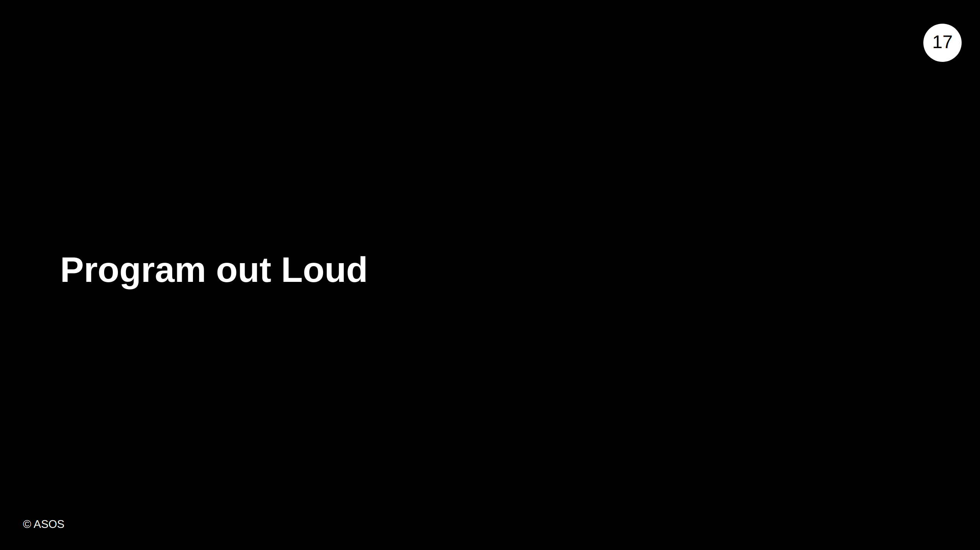
Notes:
Share your thoughts as you work. It takes a bit of practice.

Slide 18
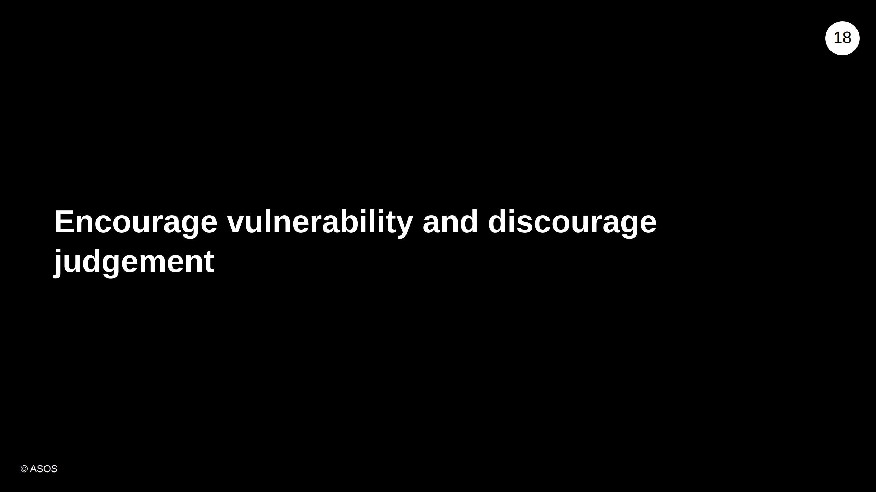
Notes:
- Admit when you don't know something - Be empathetic toward your partner - Don't judge, put-down, criticise, mock

Slide 19
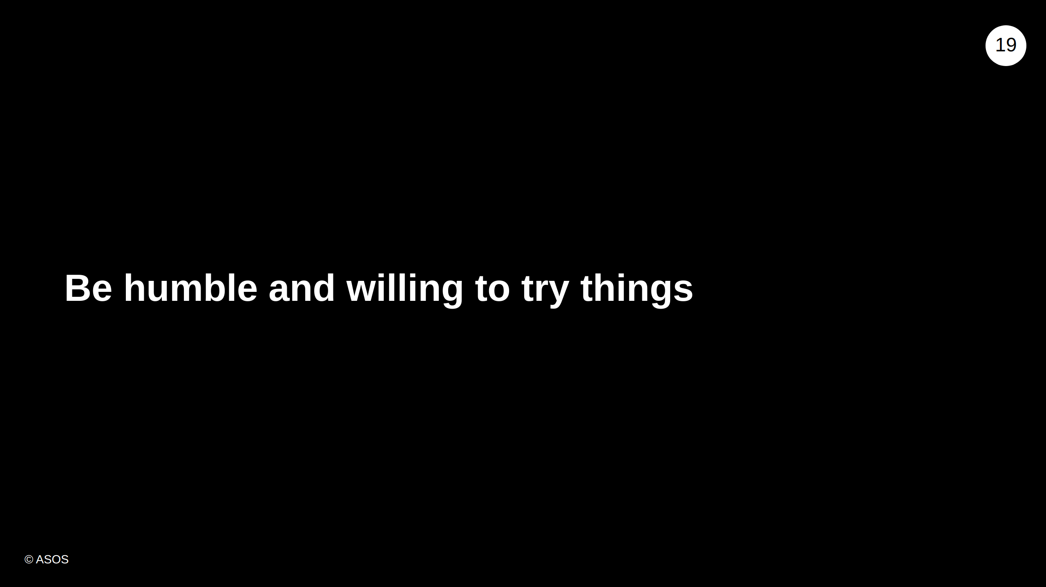
Notes:
If you go with your pair's suggestion, you might learn something you didn't know.

Slide 20

Notes:
- Give your pair a few seconds before pointing out mistakes for them to correct themselves - Don't instantly call out typos and errors

Slide 21
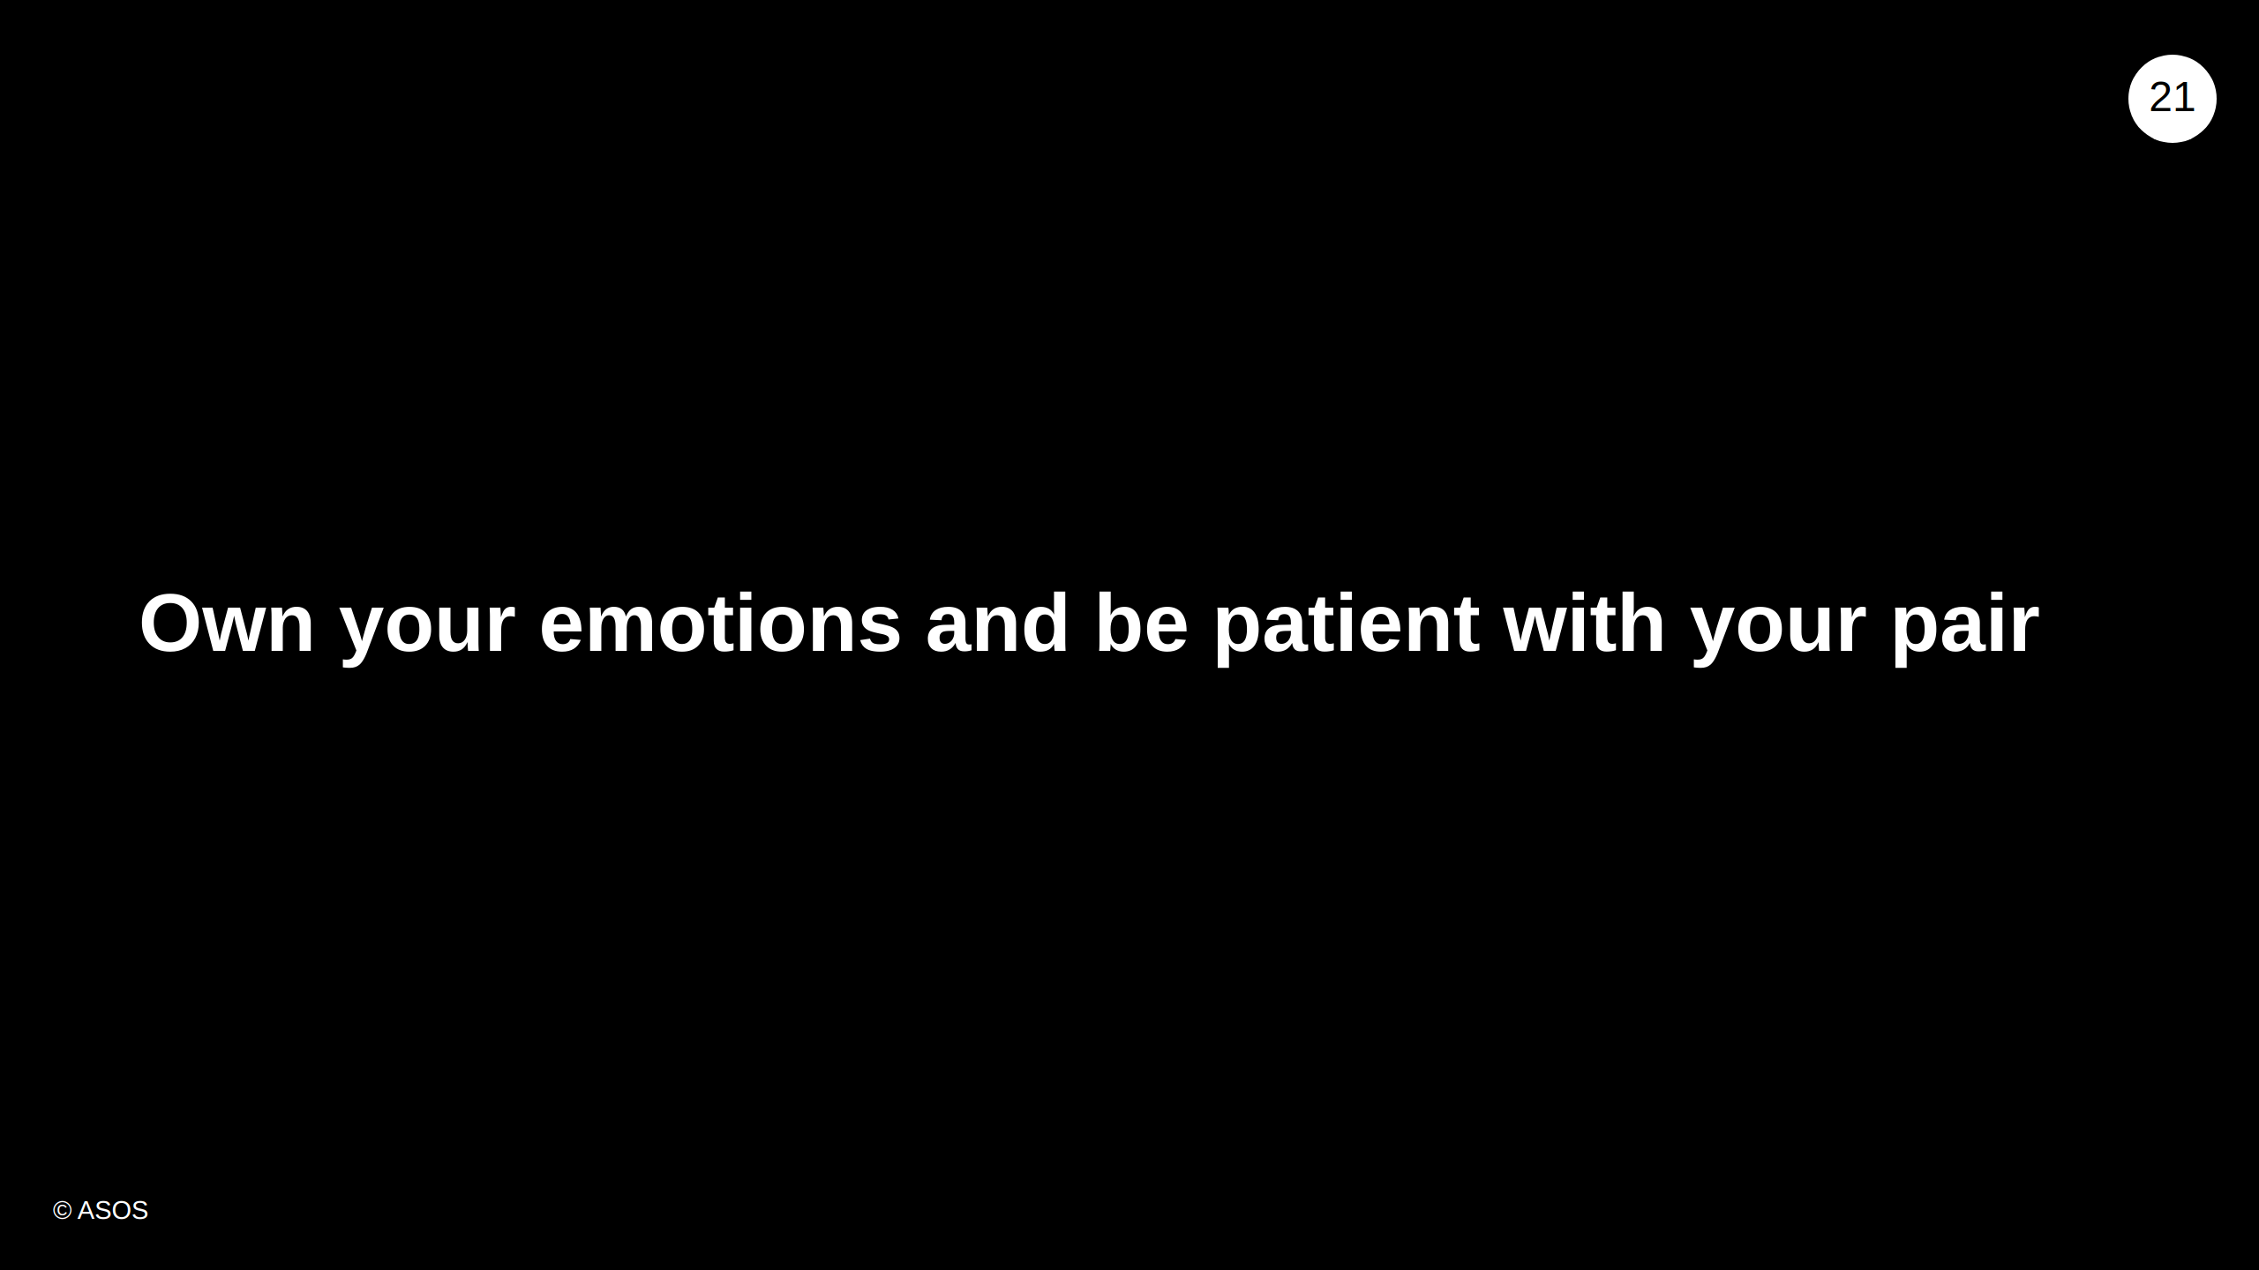
Notes:
- Be aware of your emotions and how they could affect your partner - Give your partner some slack if their emotions spill on to you - but if it becomes a pattern, let them know how you are feeling

Slide 22
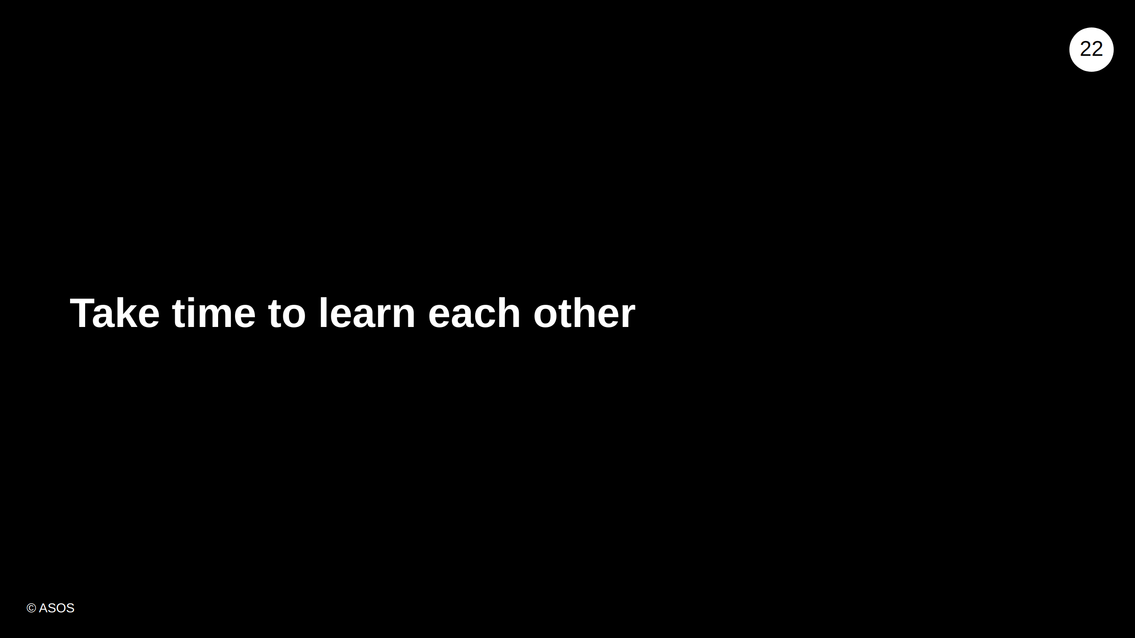
Notes:
- Might not be successful straight away - Expect miscommunications to begin with - Be prepared to ask for clarifications

Slide 23

Notes:
- Pairing can be scary - Trying something you don't know will work in front of someone - Letting someone else try their idea, at the expense of your idea - With practice it will become natural and benefit when working with different people, and in other areas of your career and life

Slide 24
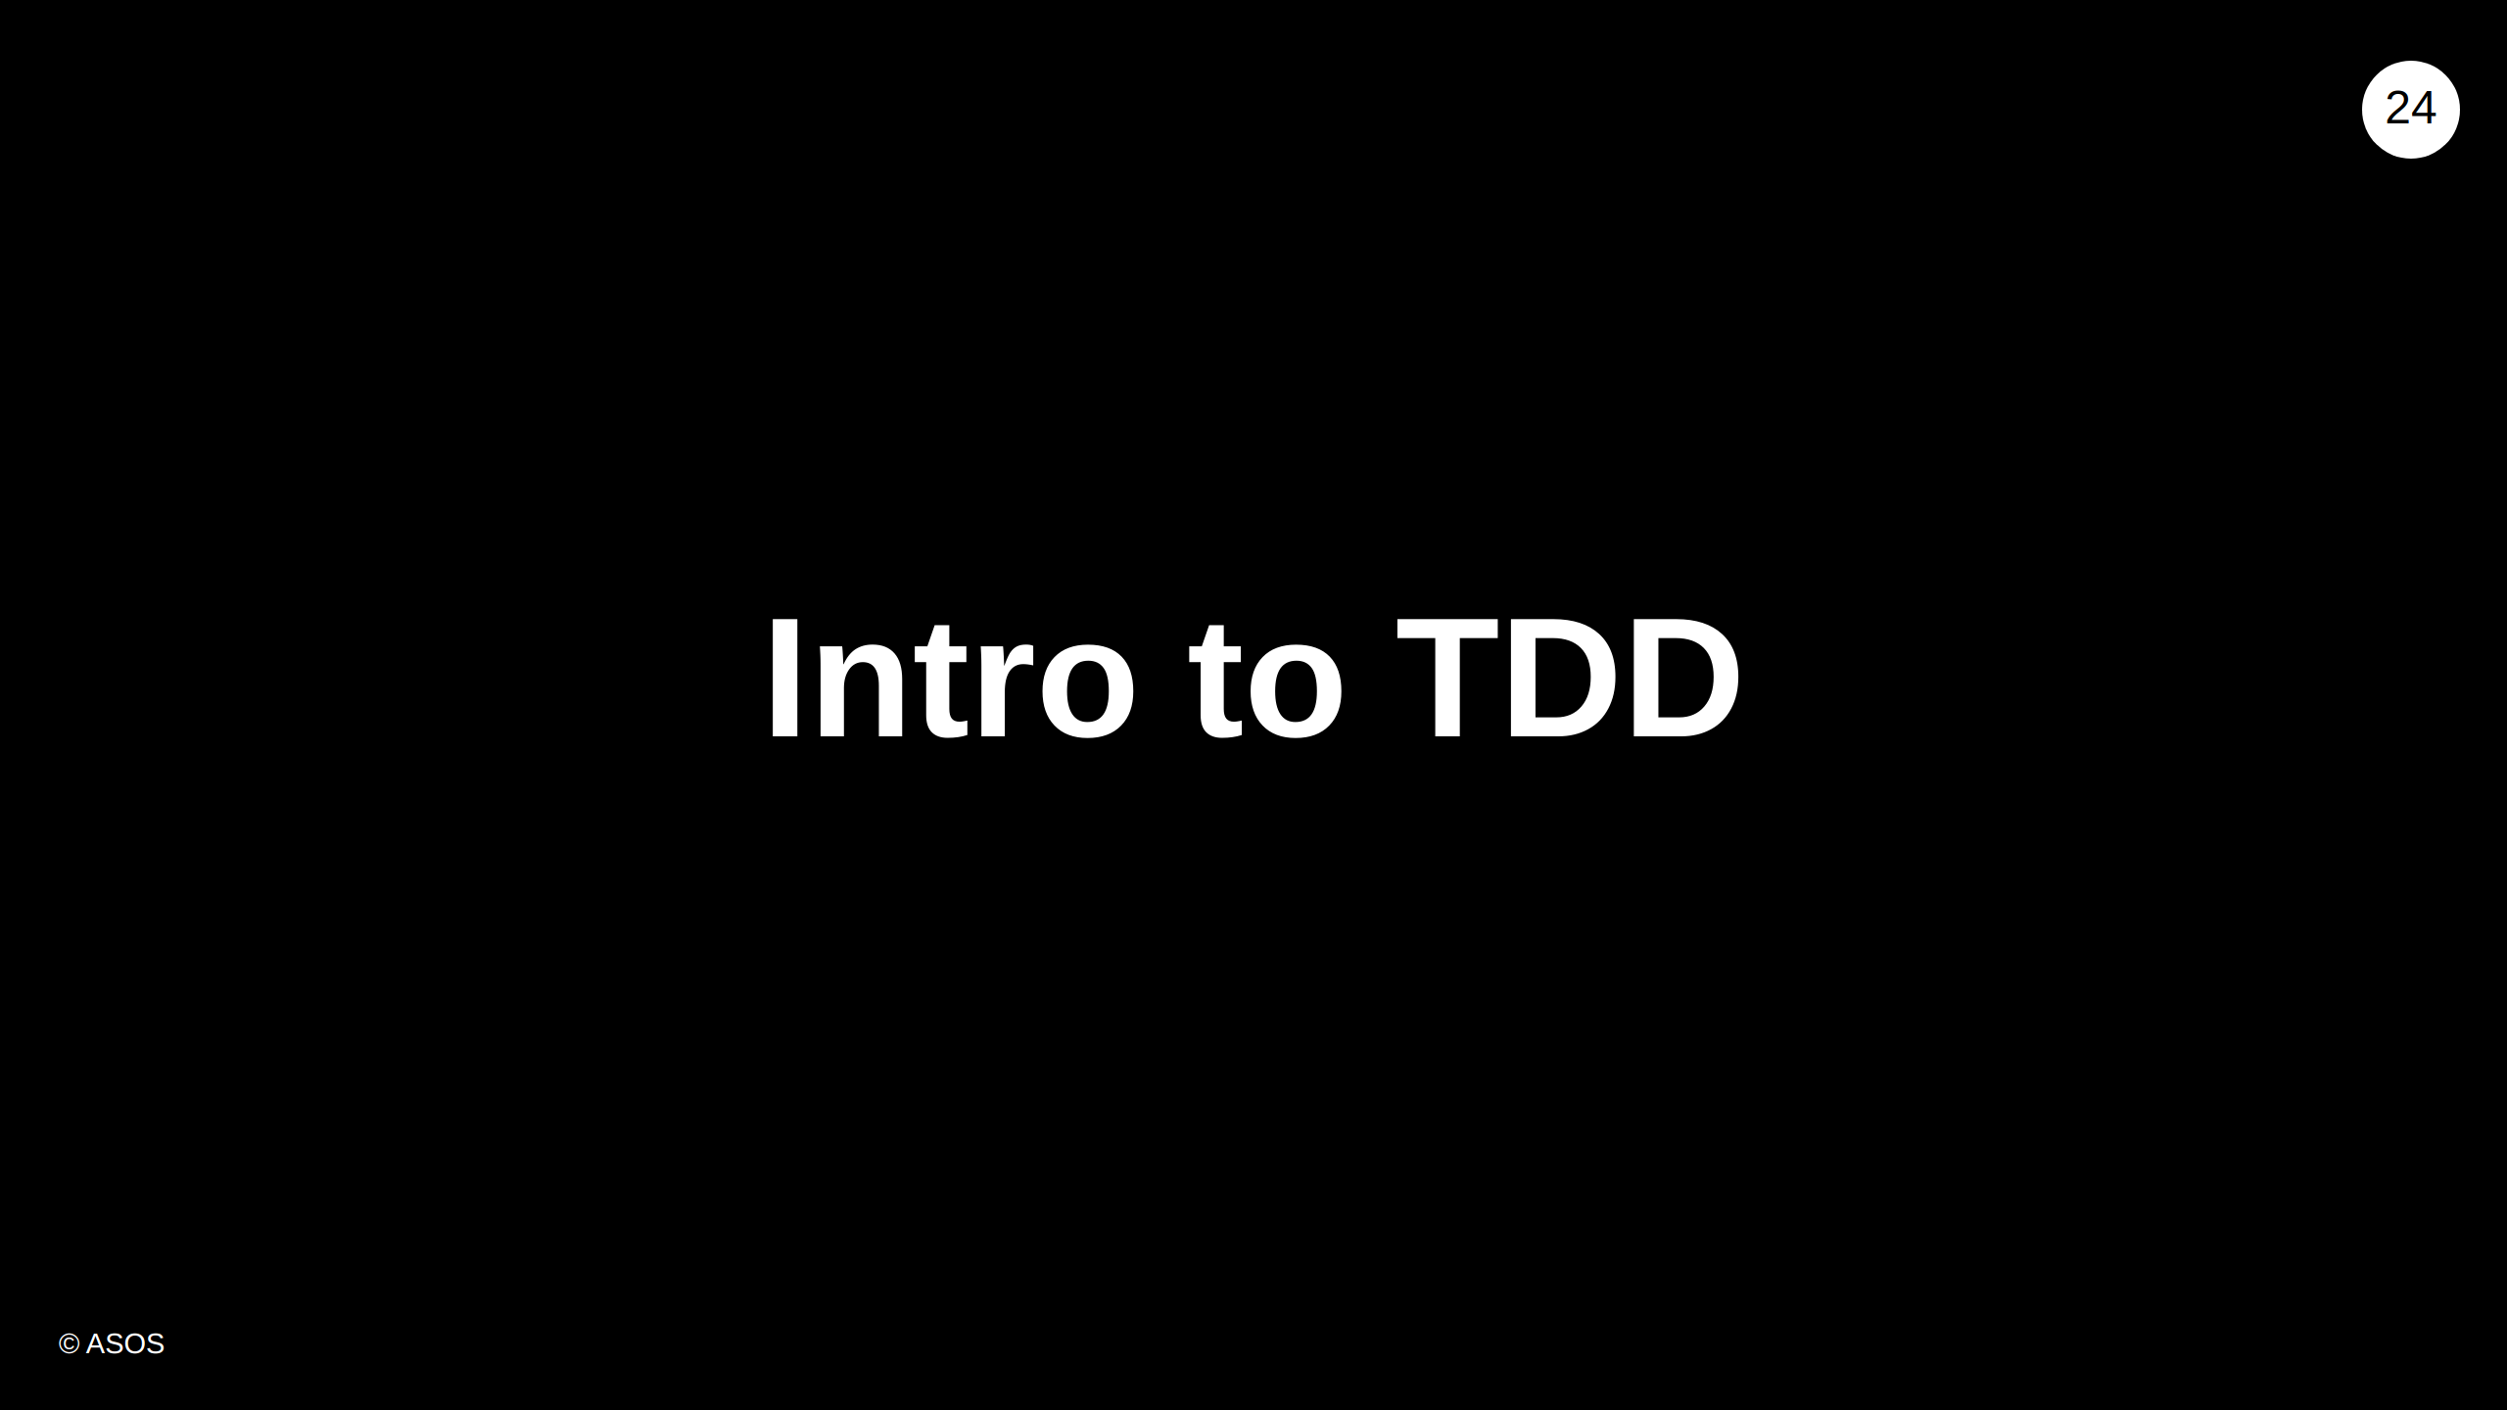

Slide 25
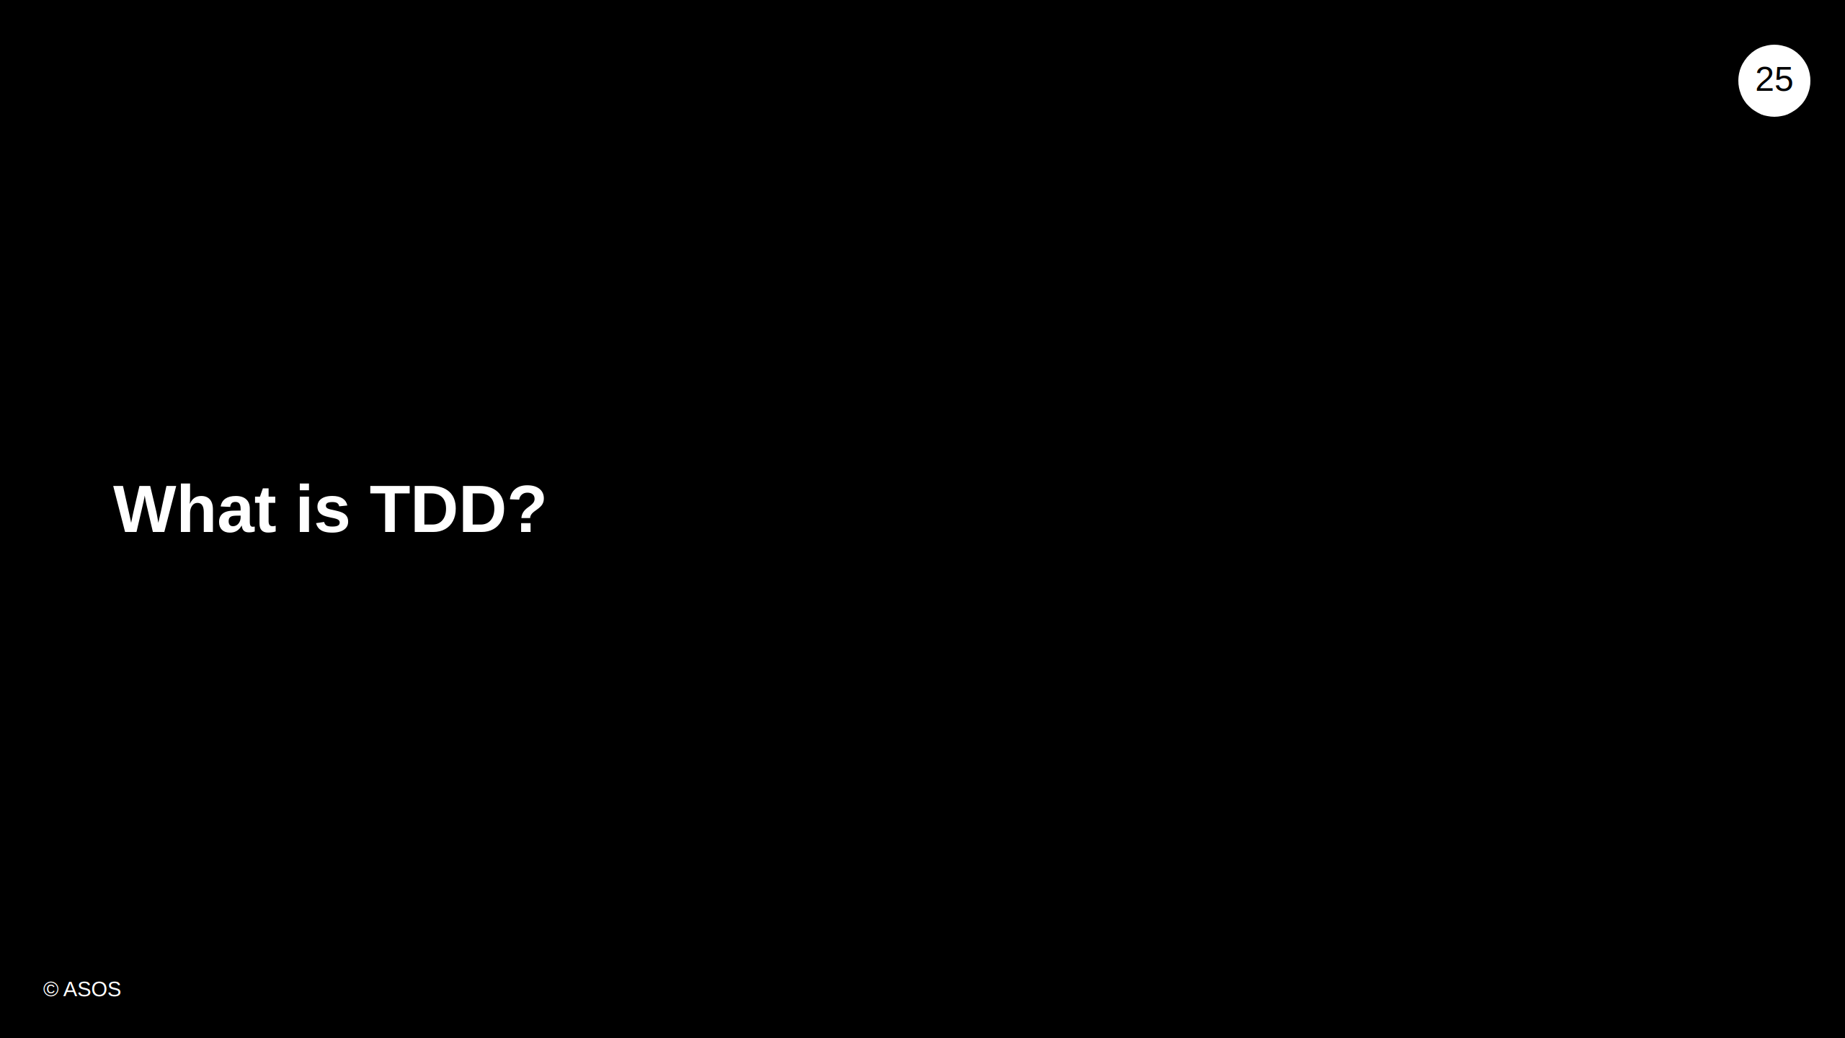
Notes:
Ask the class, what do they think TDD is, before going to our definition

Slide 26
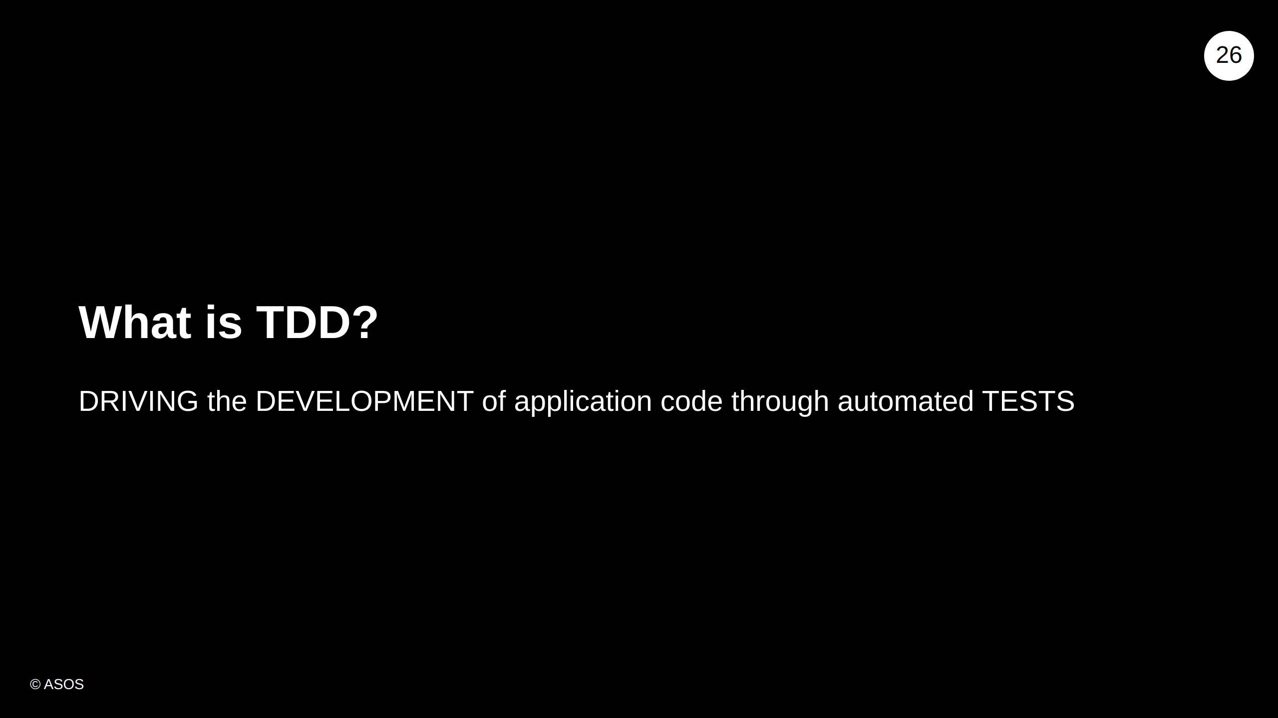

Slide 27
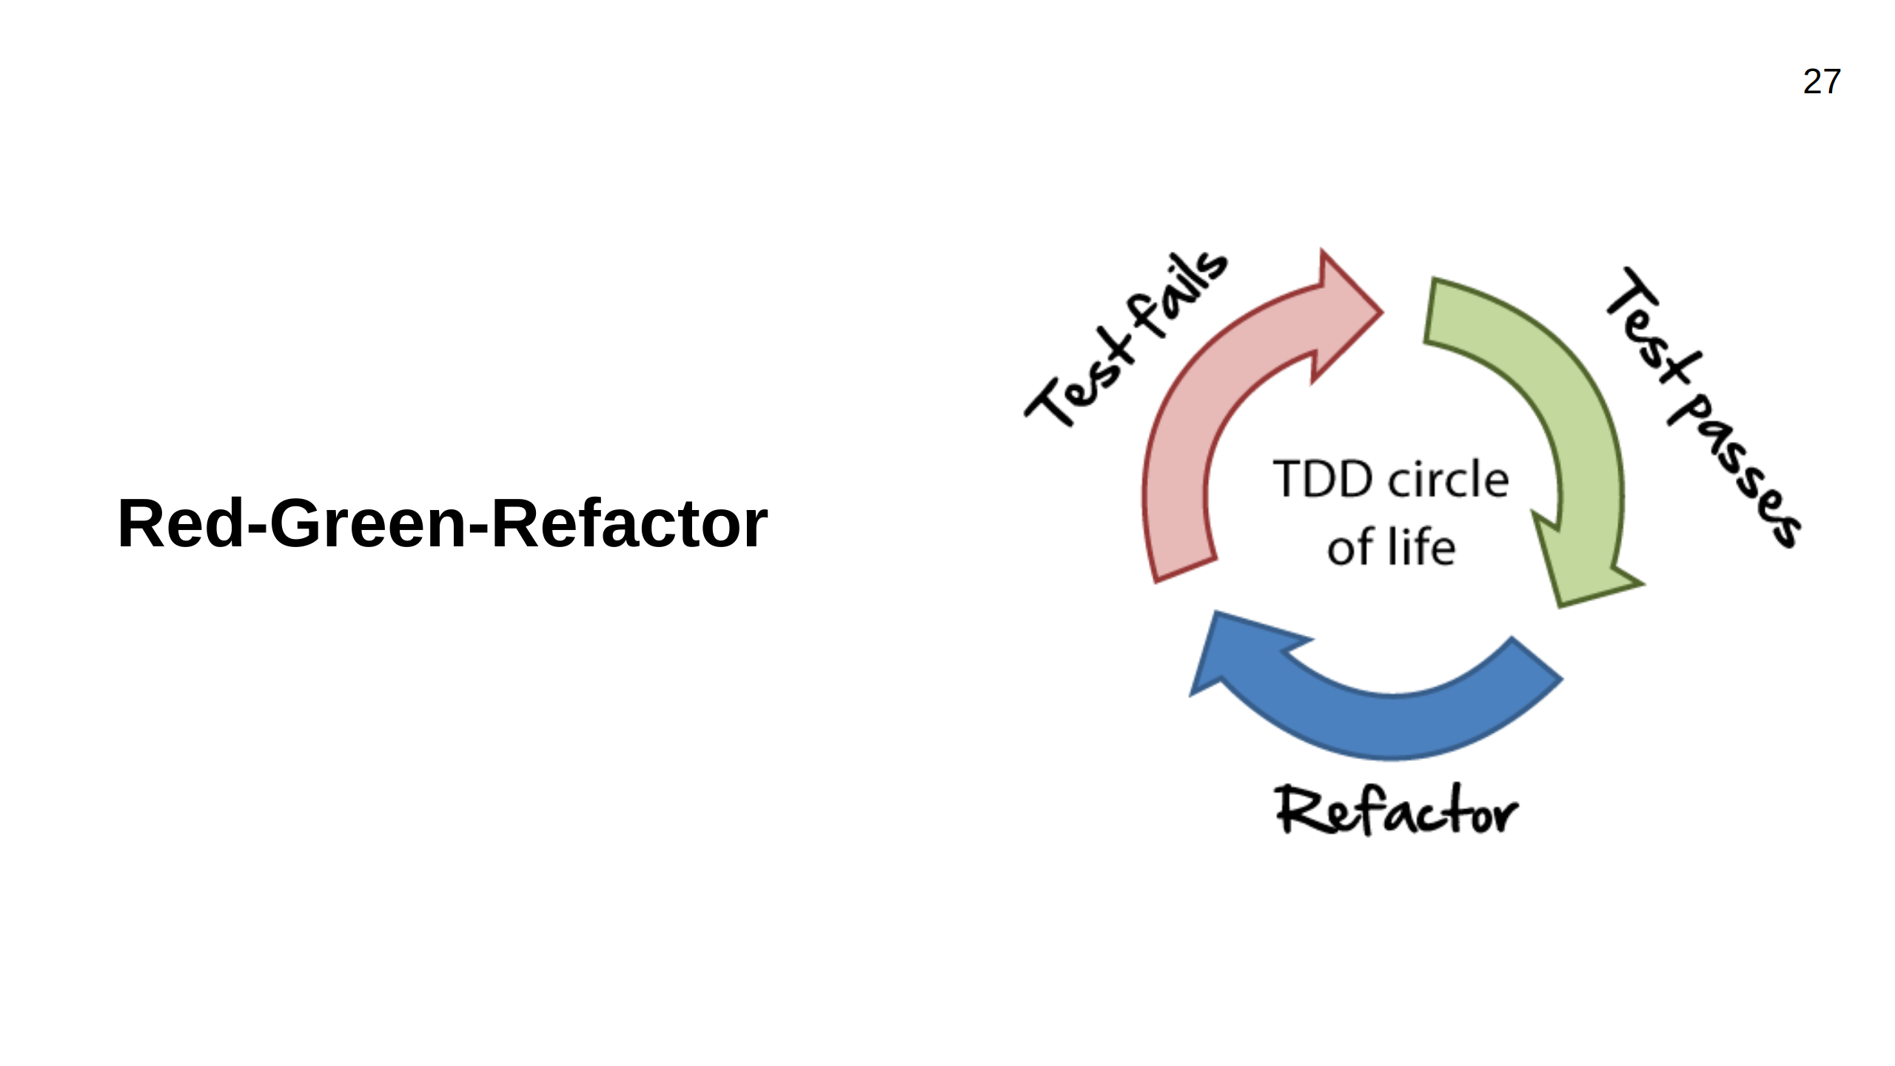
Notes:
Three simple rules of TDD: Red Green Refactor Why Test First? - YAGNI (You Ain't Gonna Need It) - Simplifies complex requirements - Tests Provide Immediate Feedback

Slide 28

Notes:
Source of many of these ideas are Kent Beck - creator of Extreme Programming of XP, and Robert C. Martin - known as Uncle Bob, software engineer, instructor and author. They both were involved in creating the Agile Manifesto We will talk about rules and practices we should follow you will see us using them during a demo and then you will have a chance to practice them during a kata

Slide 29
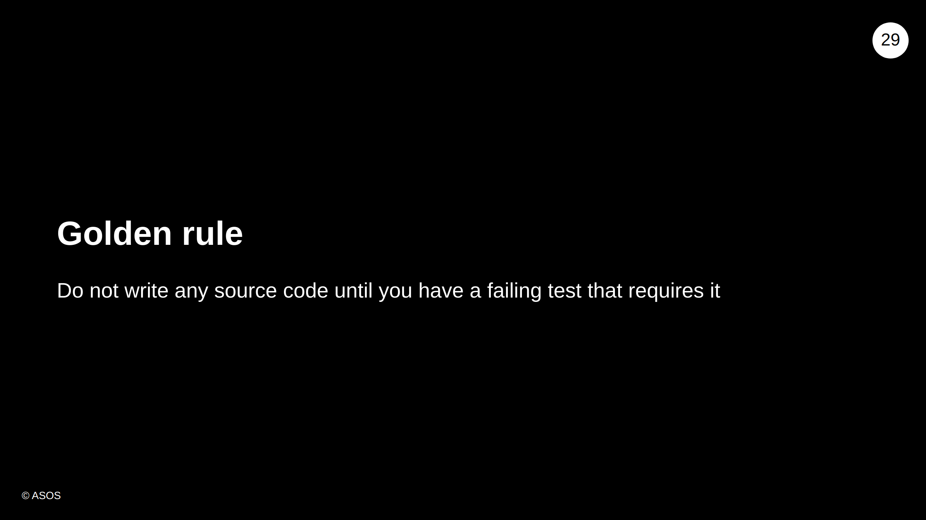
Notes:
In TDD tests drives the development of production code.

Slide 30
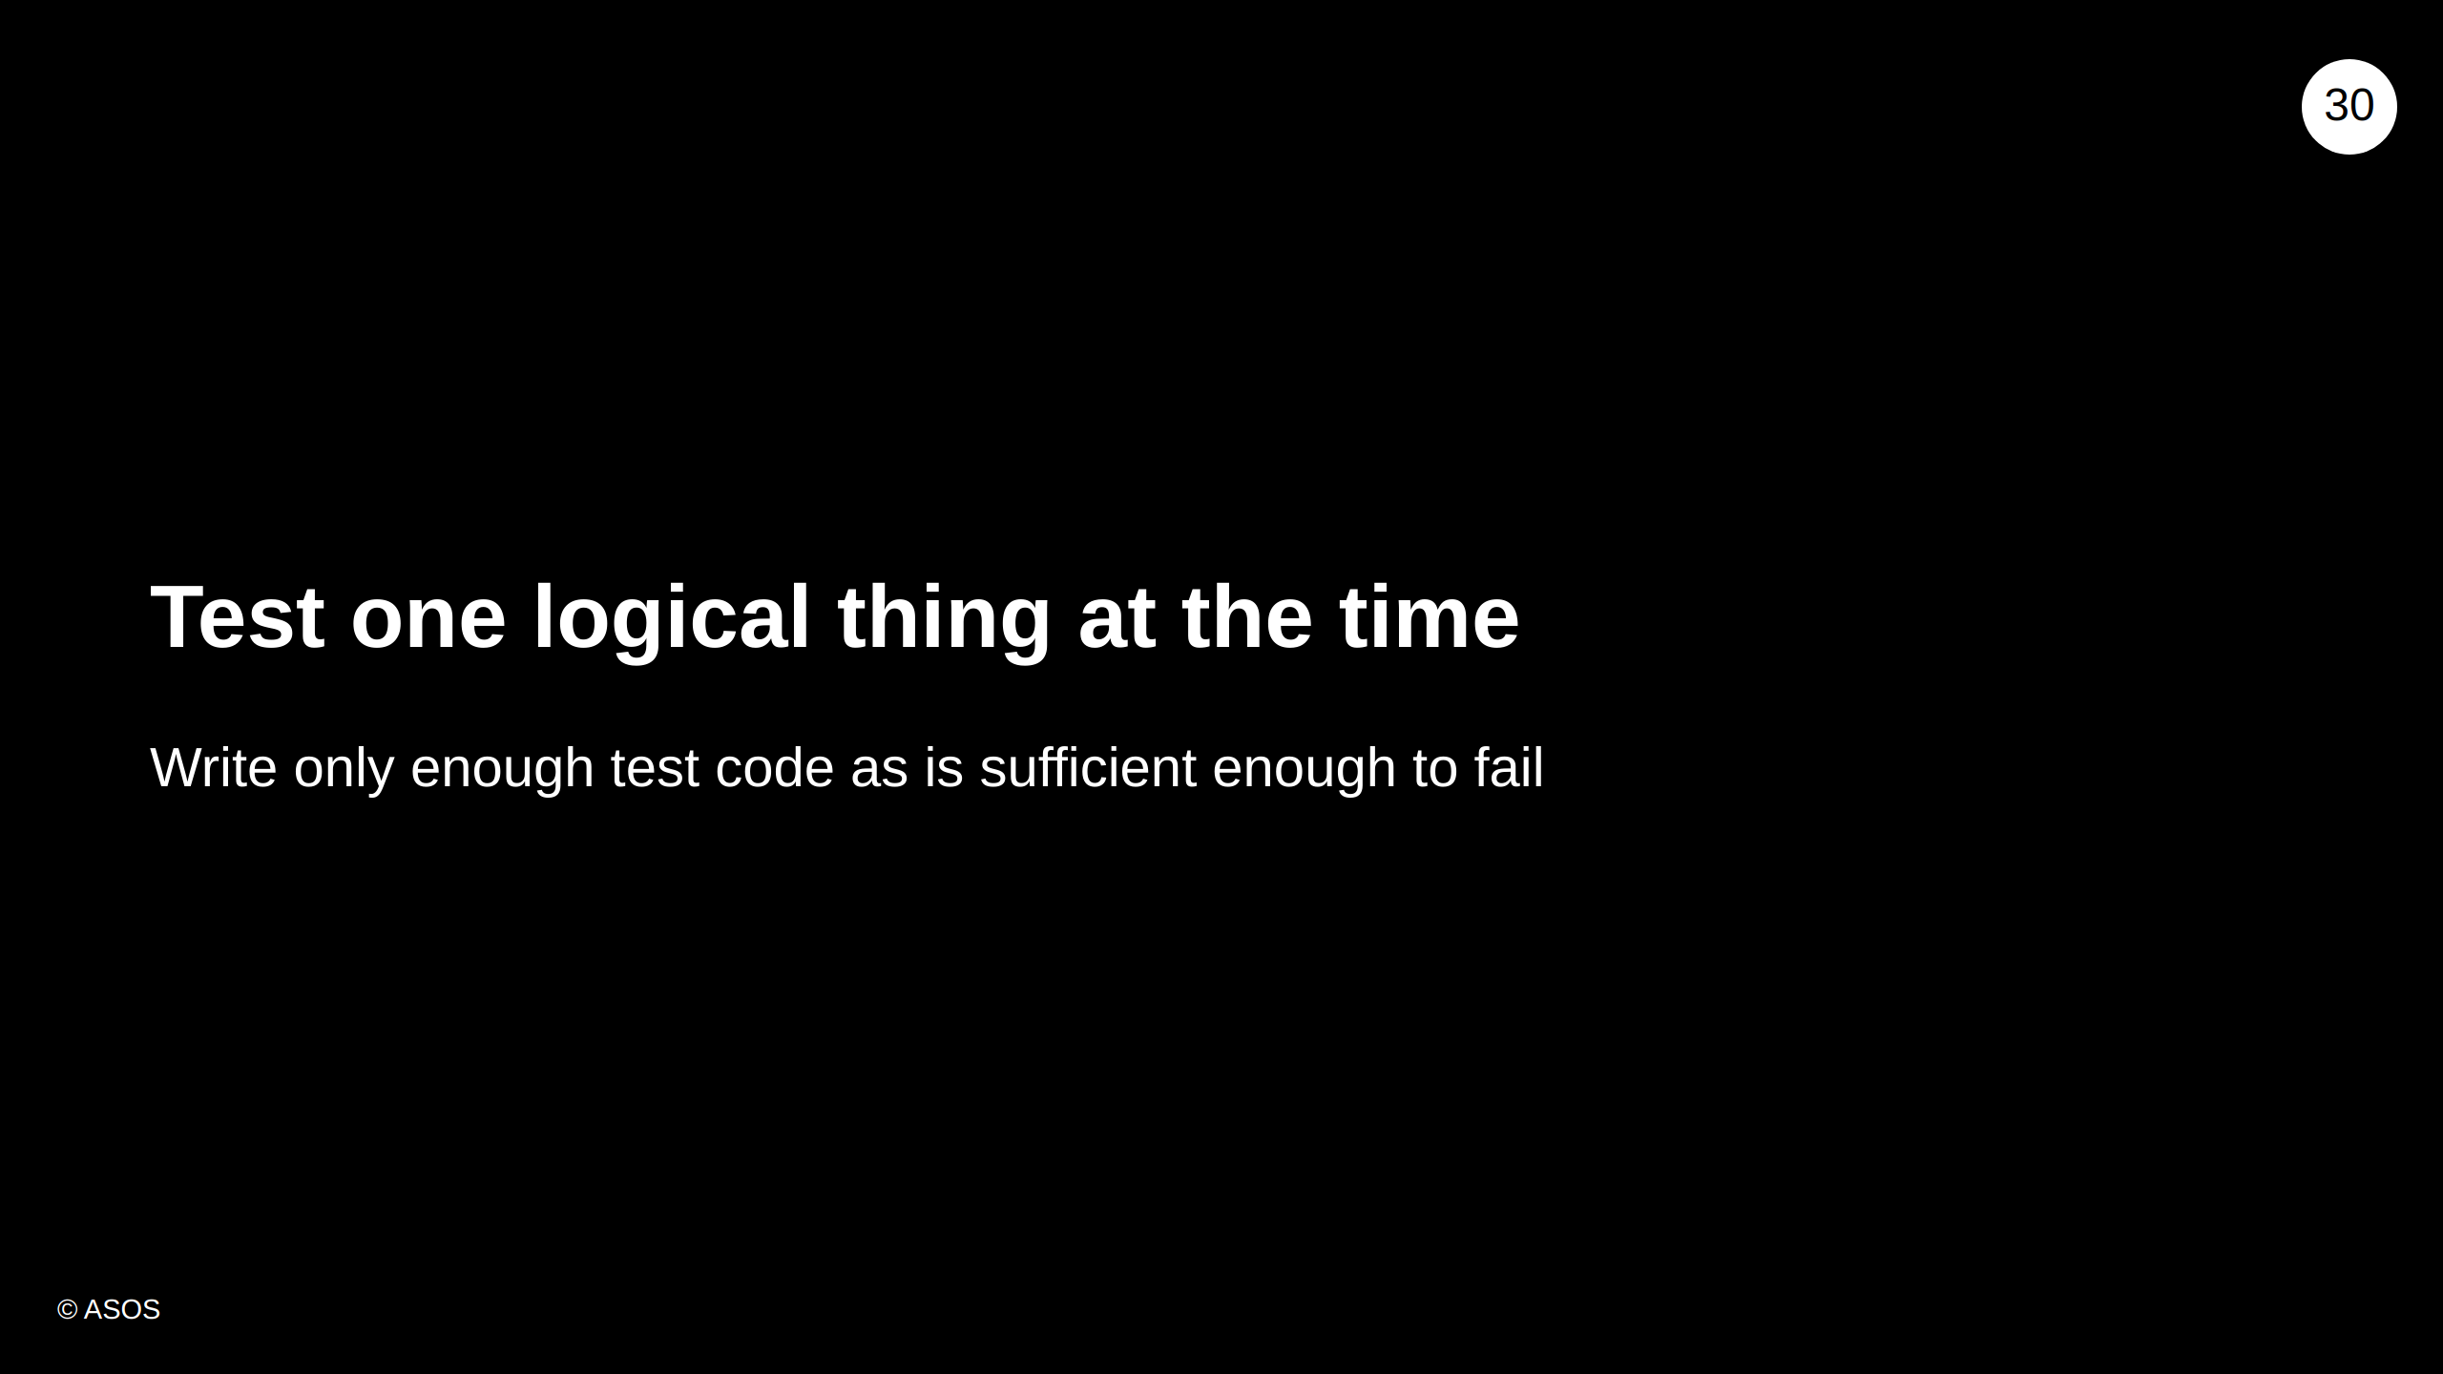
Notes:
As mentioned before, tests are driving implementation, testing one thing makes us writing simpler code. Moreover if the test fails we will be able to recognize the reason it fails.

Slide 31
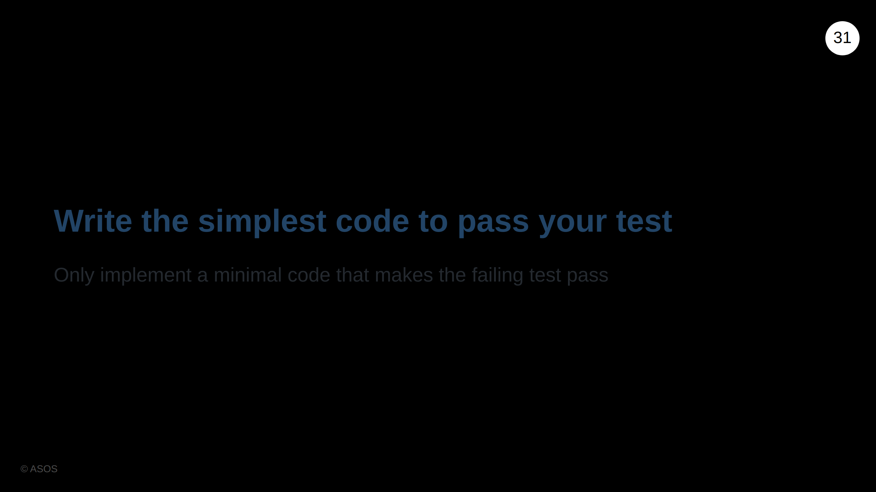
Notes:
KISS rule Writiting the simplest code to make the test green keeps us from overengineering. If simplest code works, there might not be a need for more complex solution.

Slide 32
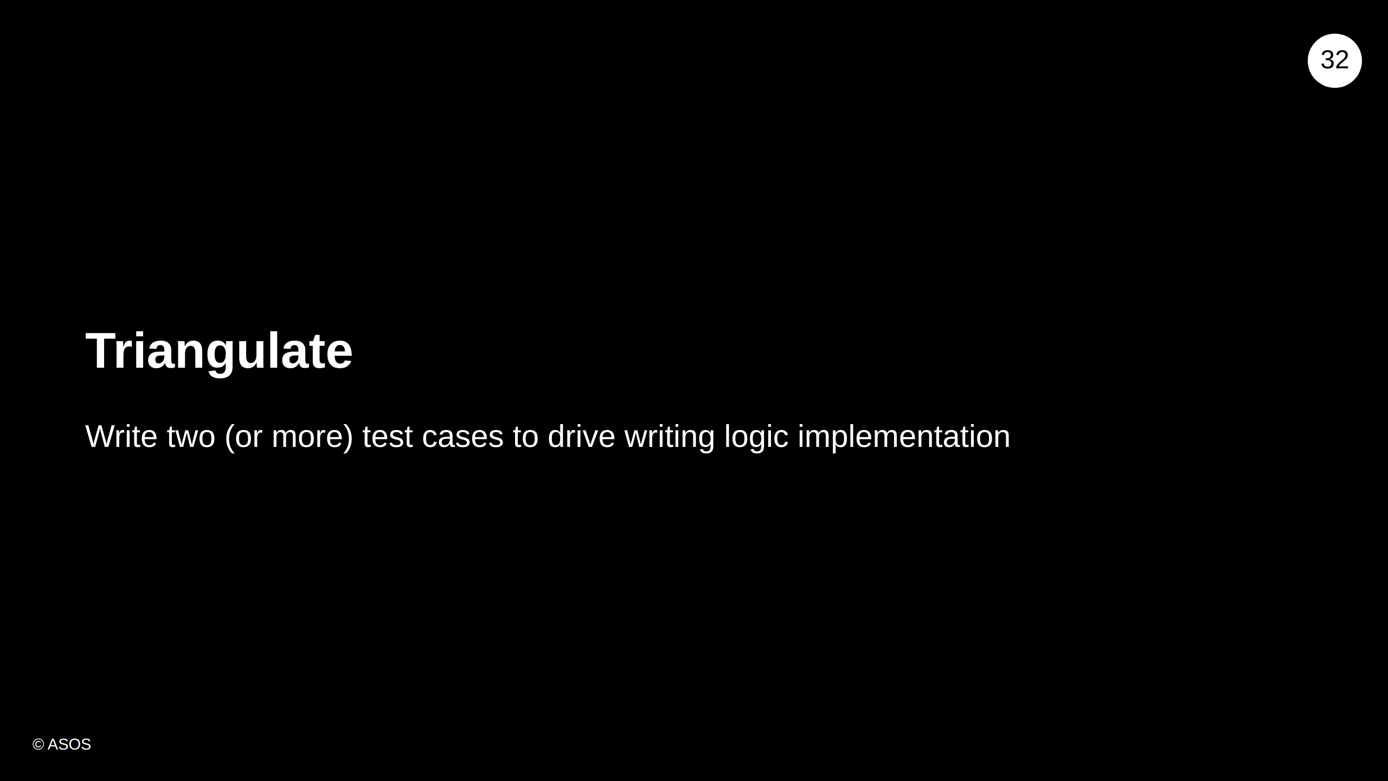
Notes:
In Math, triangulation in a technique of finding a point location by using triangles with known points. In TDD, known points are unit tests and location is logic implementation.

Slide 33
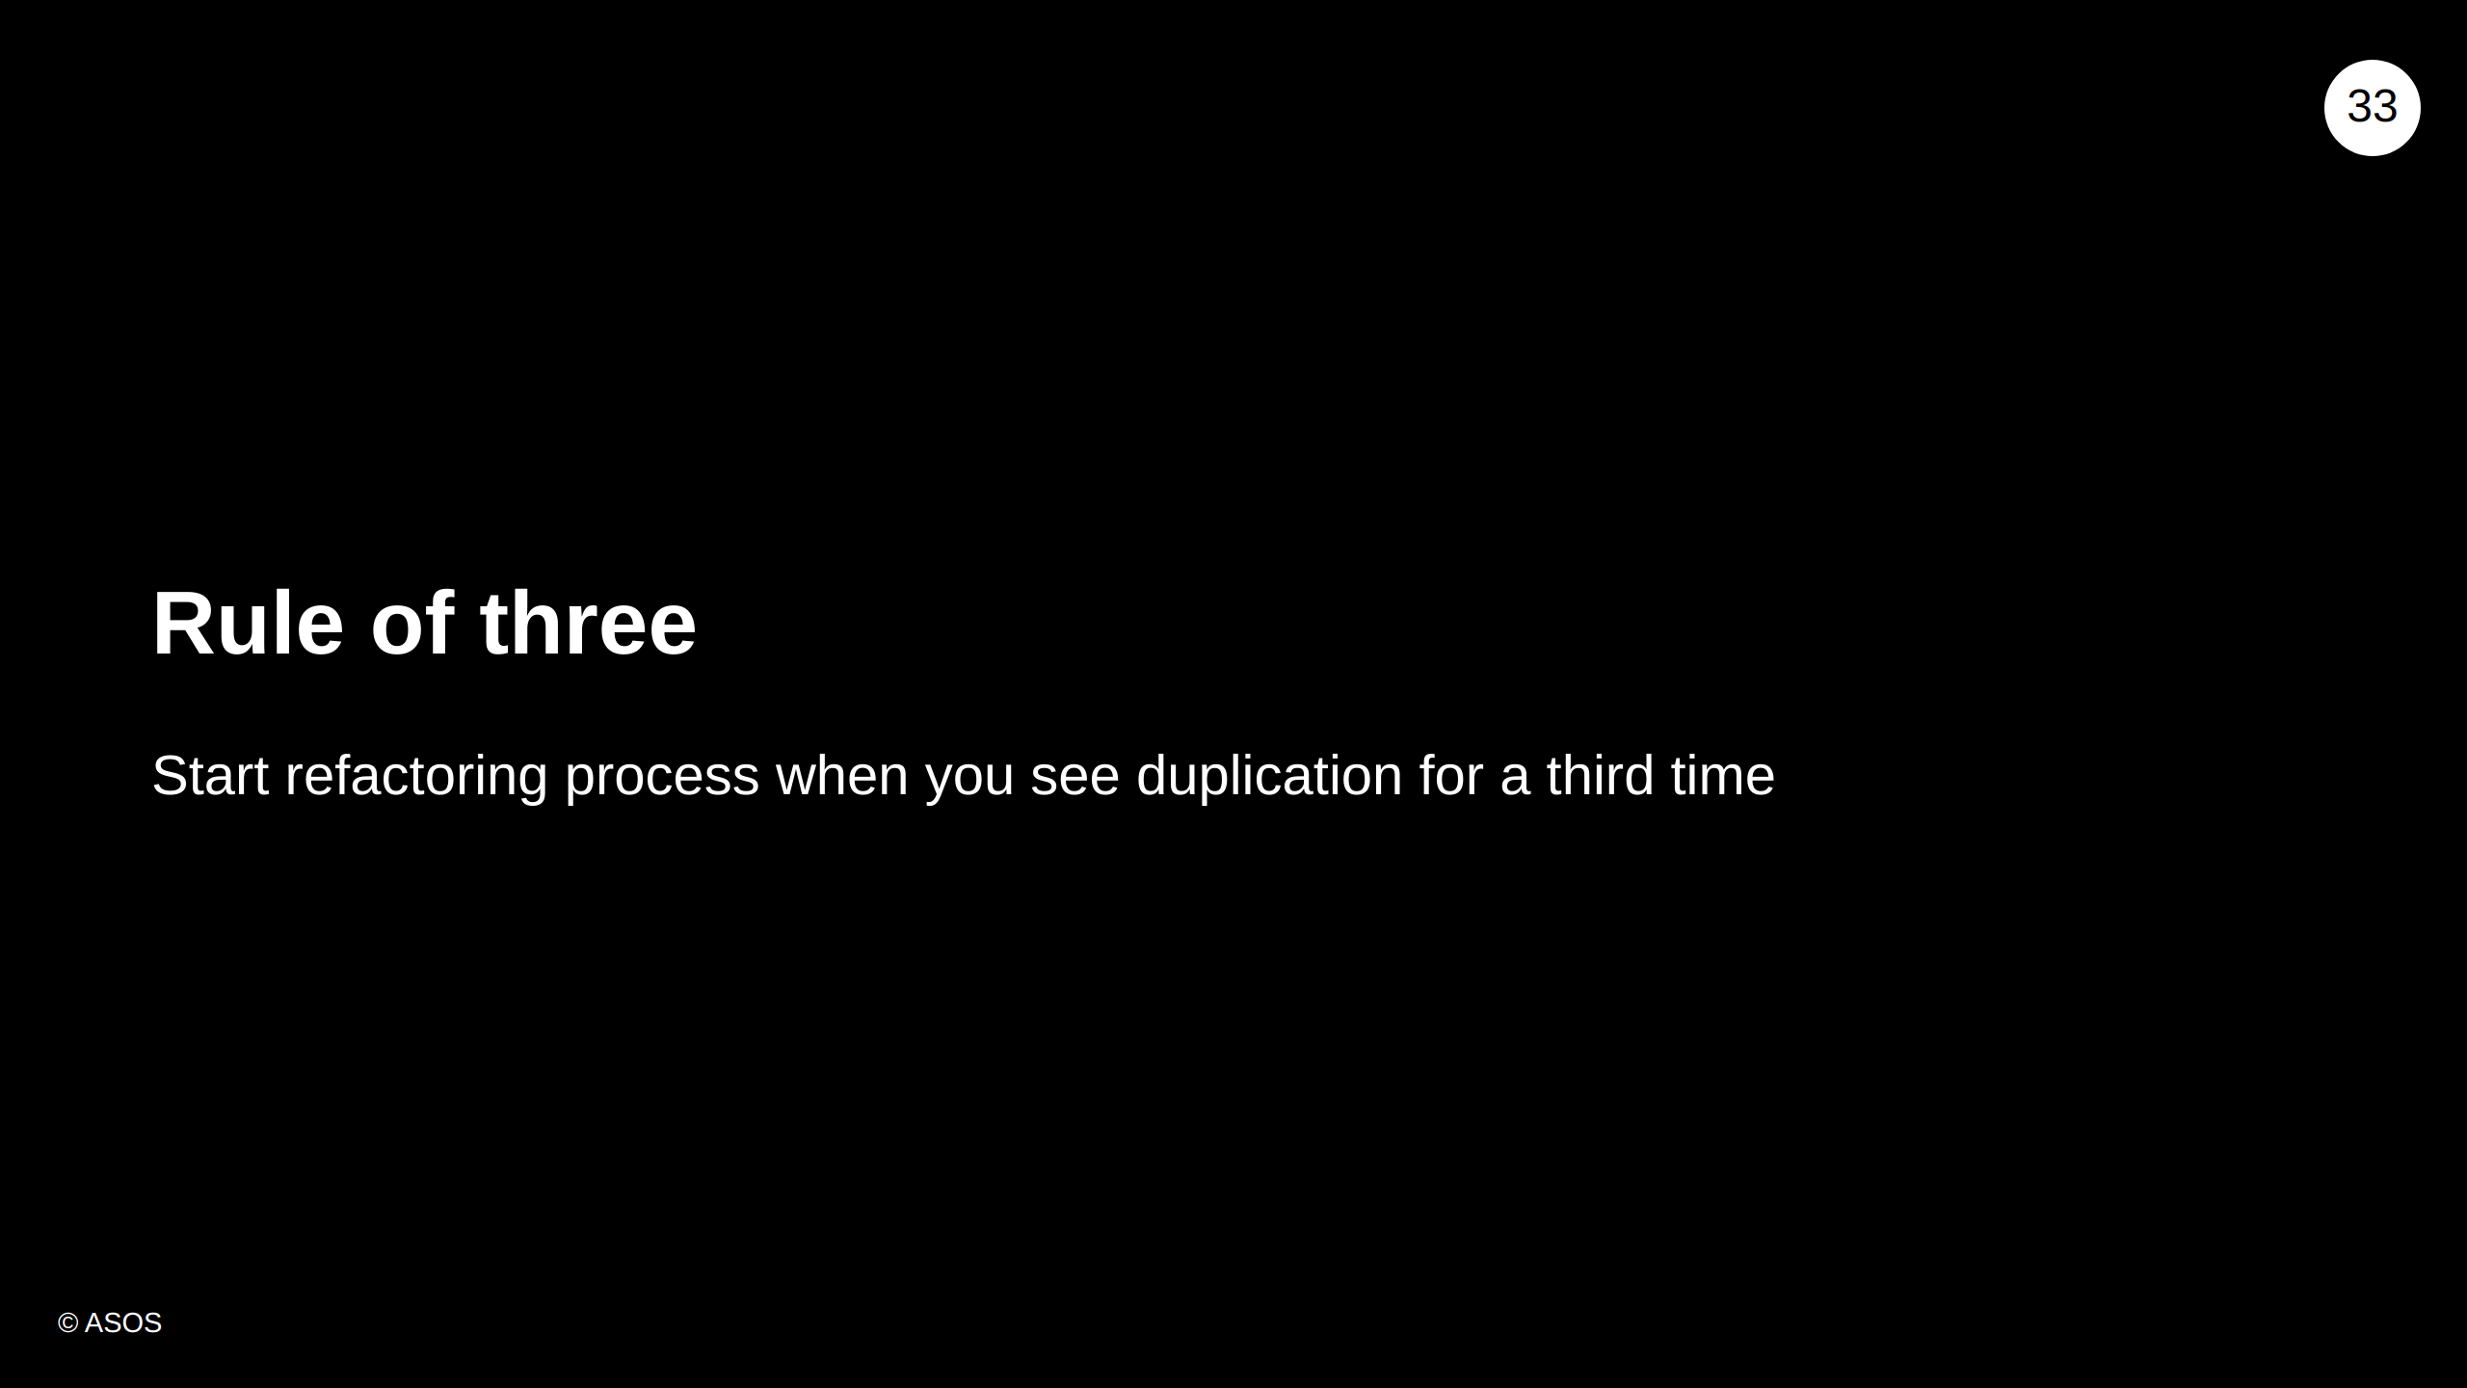
Notes:
Don't Repeat Yourself When we use the same code twice, that might be ok, but when we see another usage that's a sign to start refactoring.

Slide 34
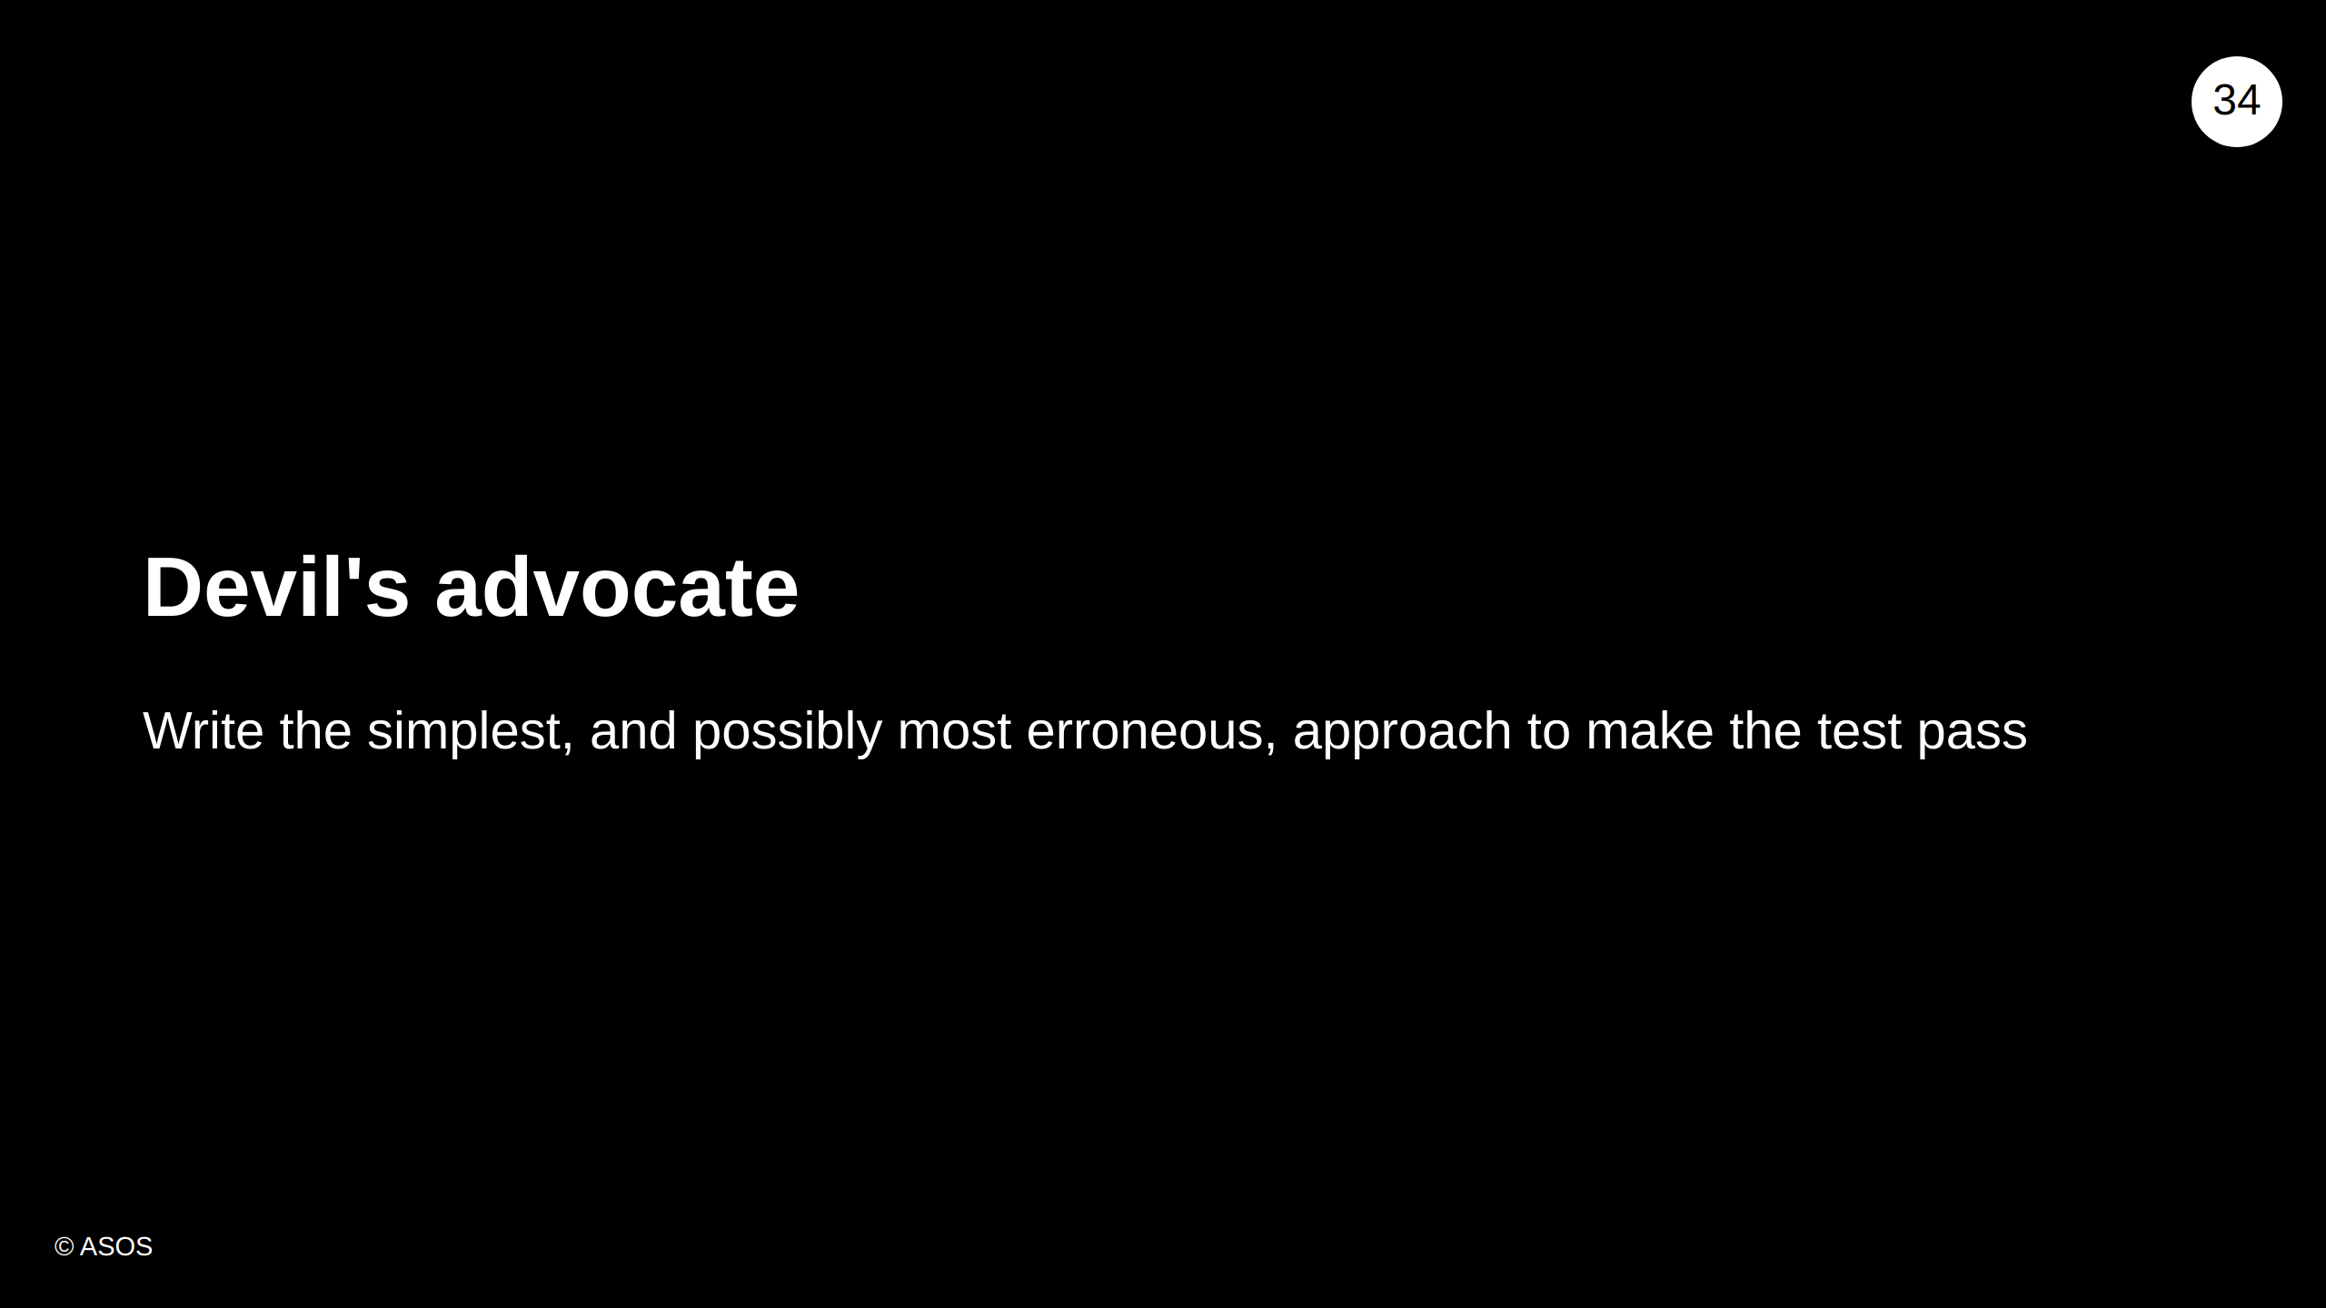
Notes:
Playing devil's advocate is a useful technique in many circumstances. The way that we play devil's advocate in TDD is by imagining the simplest, and possibly most erroneous, approach to making the test pass. We want to force the test to make the code right instead of writing the code that we believe to be correct. i.e. Don't write the algorithm for FizzBuzz first, just do "return 1"

Slide 35

Notes:
Add fake implementation which is good enough to make the first test pass. Then keep writing tests and logic until you get your final solution.

Slide 36
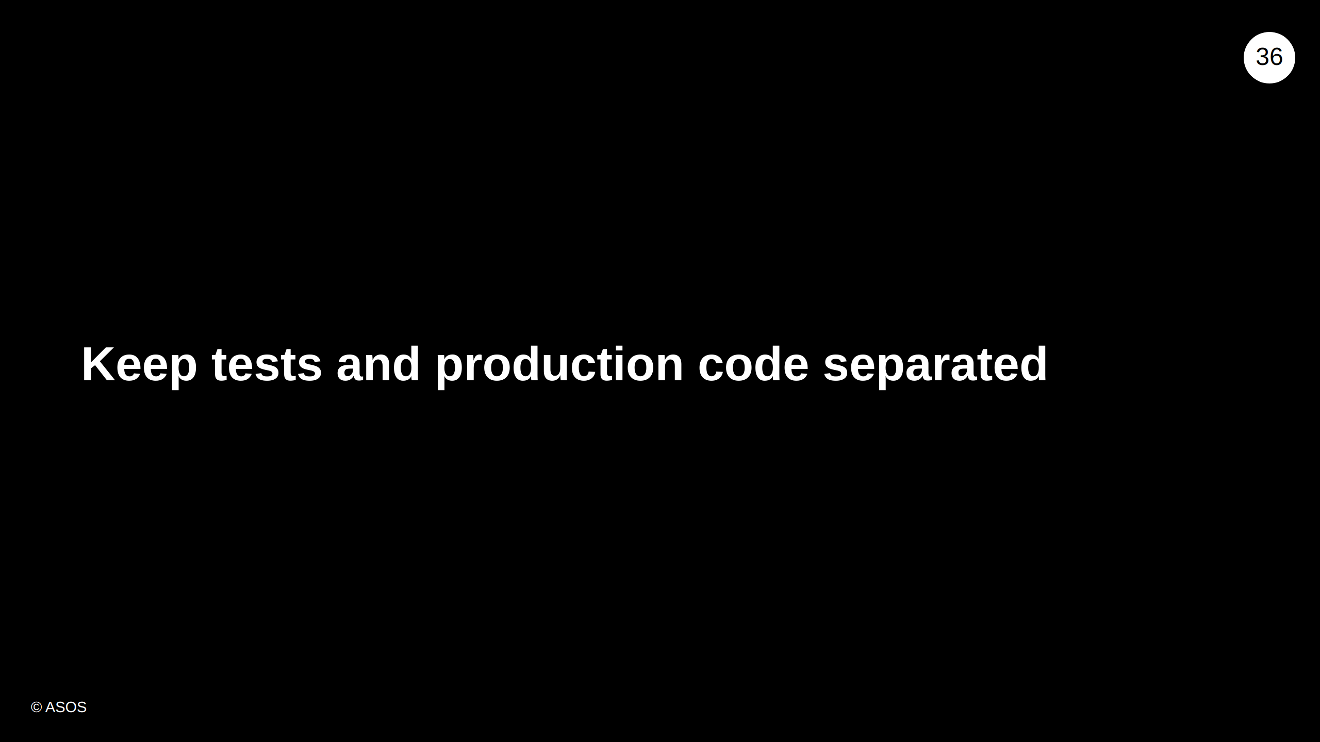
Notes:
Tests should not be coupled to the structure of application

Slide 37


Slide 38
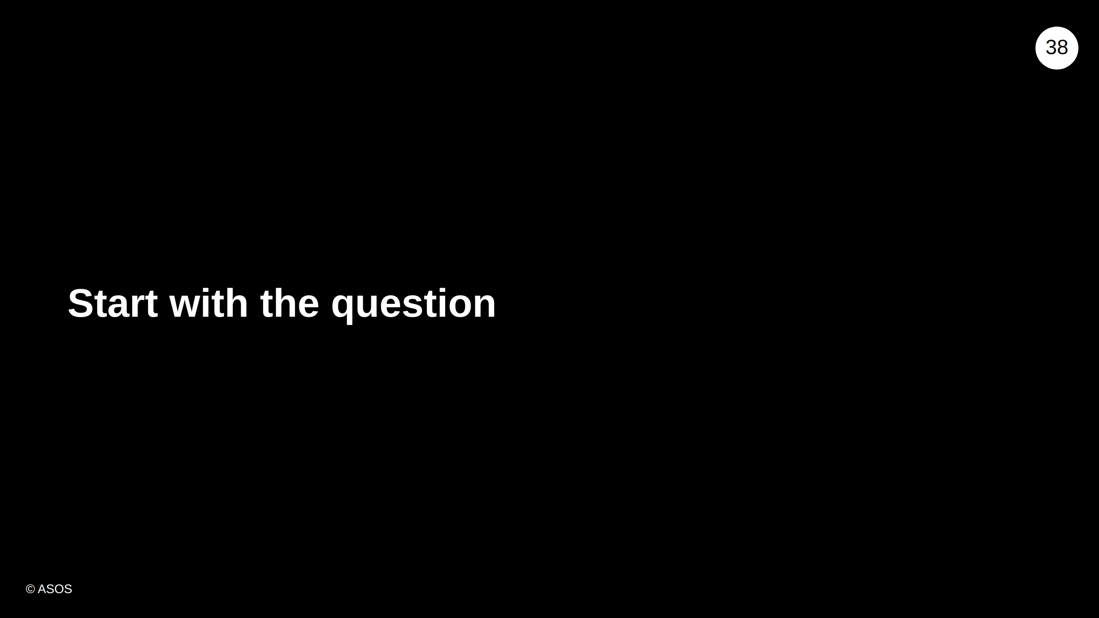

Slide 39
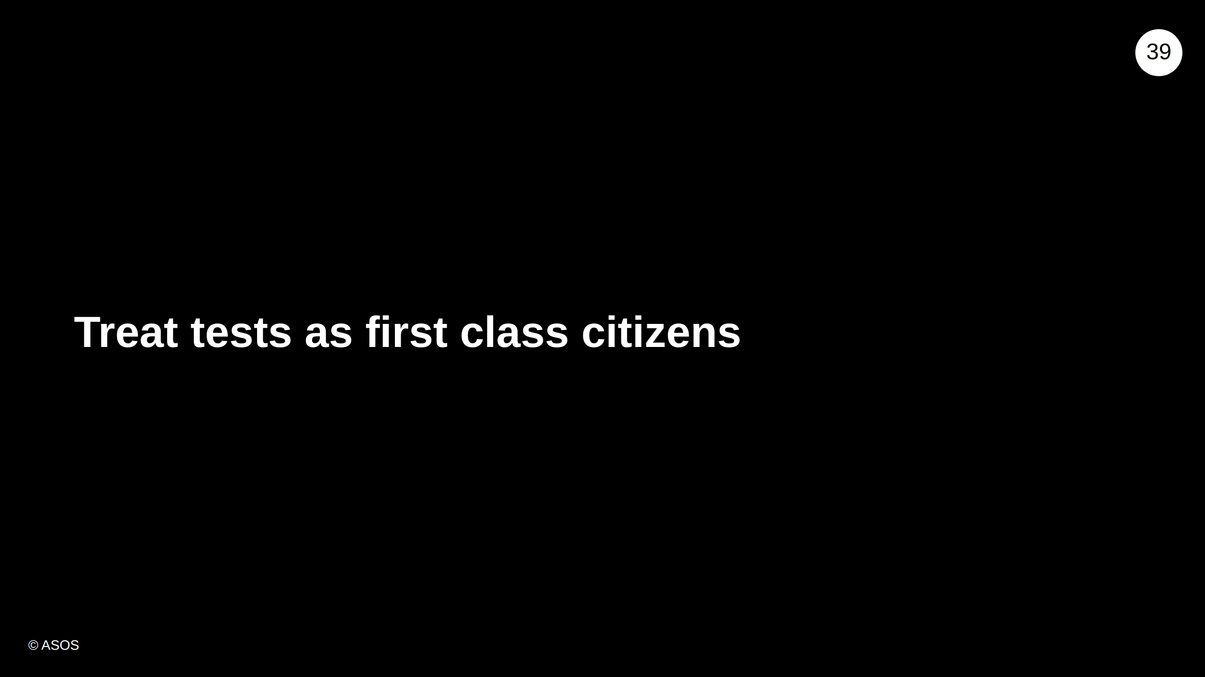
Notes:
Remember tests are as important as production code. Remember to refactor not just logic and implementation, but tests as well!

Slide 40
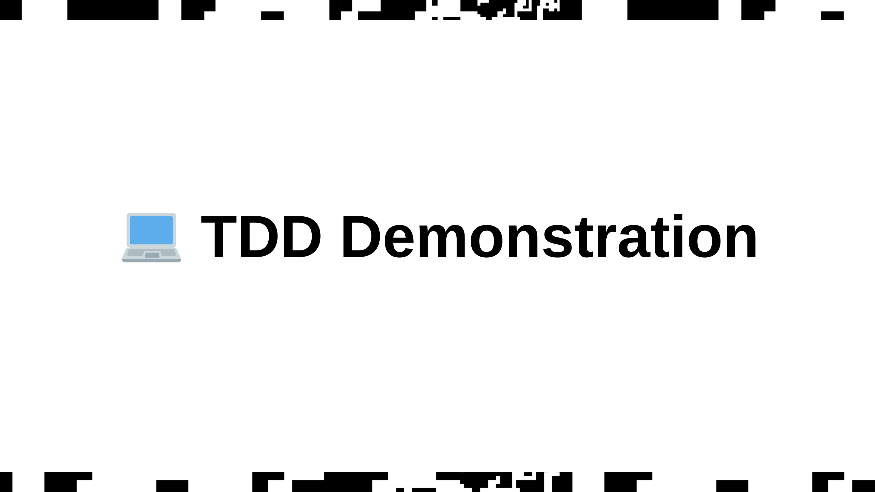
Notes:
Demonstrate solving FizzBuzz through TDD asos-training-material\courses\software-crafters-csharp-module1\demos\fizzbuzz-basic-tdd-demo\fizzbuzz-demo-instructions.md Remember to explain what you are doing and why as you go through the steps.

Slide 41
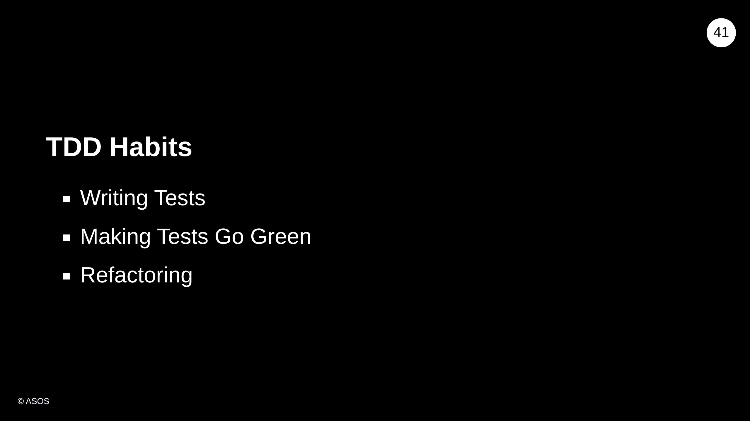

Slide 42
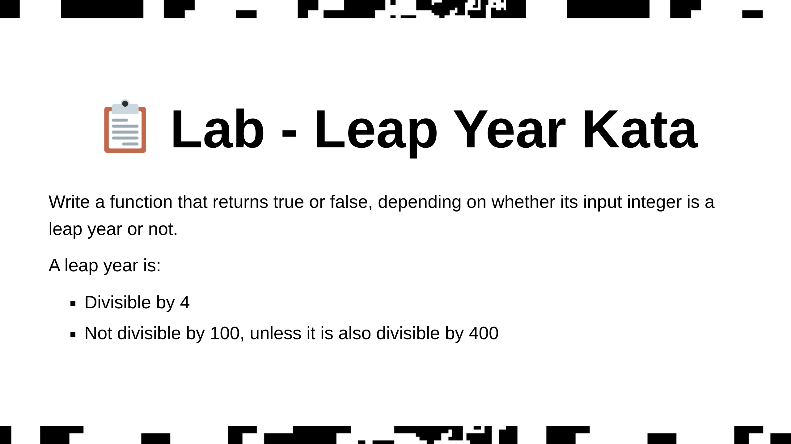
Notes:
Examples 1996 is a regular leap year 2001 is a normal year 2000 is a leap year (as it is divisible by 4, 100 & 400) 1900 is not a leap year (even though it's divisible by 4 & 100, it is not divisible by 400) see the file "leap-year.md" in the the labs/LeapYear folder for this info in a markdown file

Slide 43
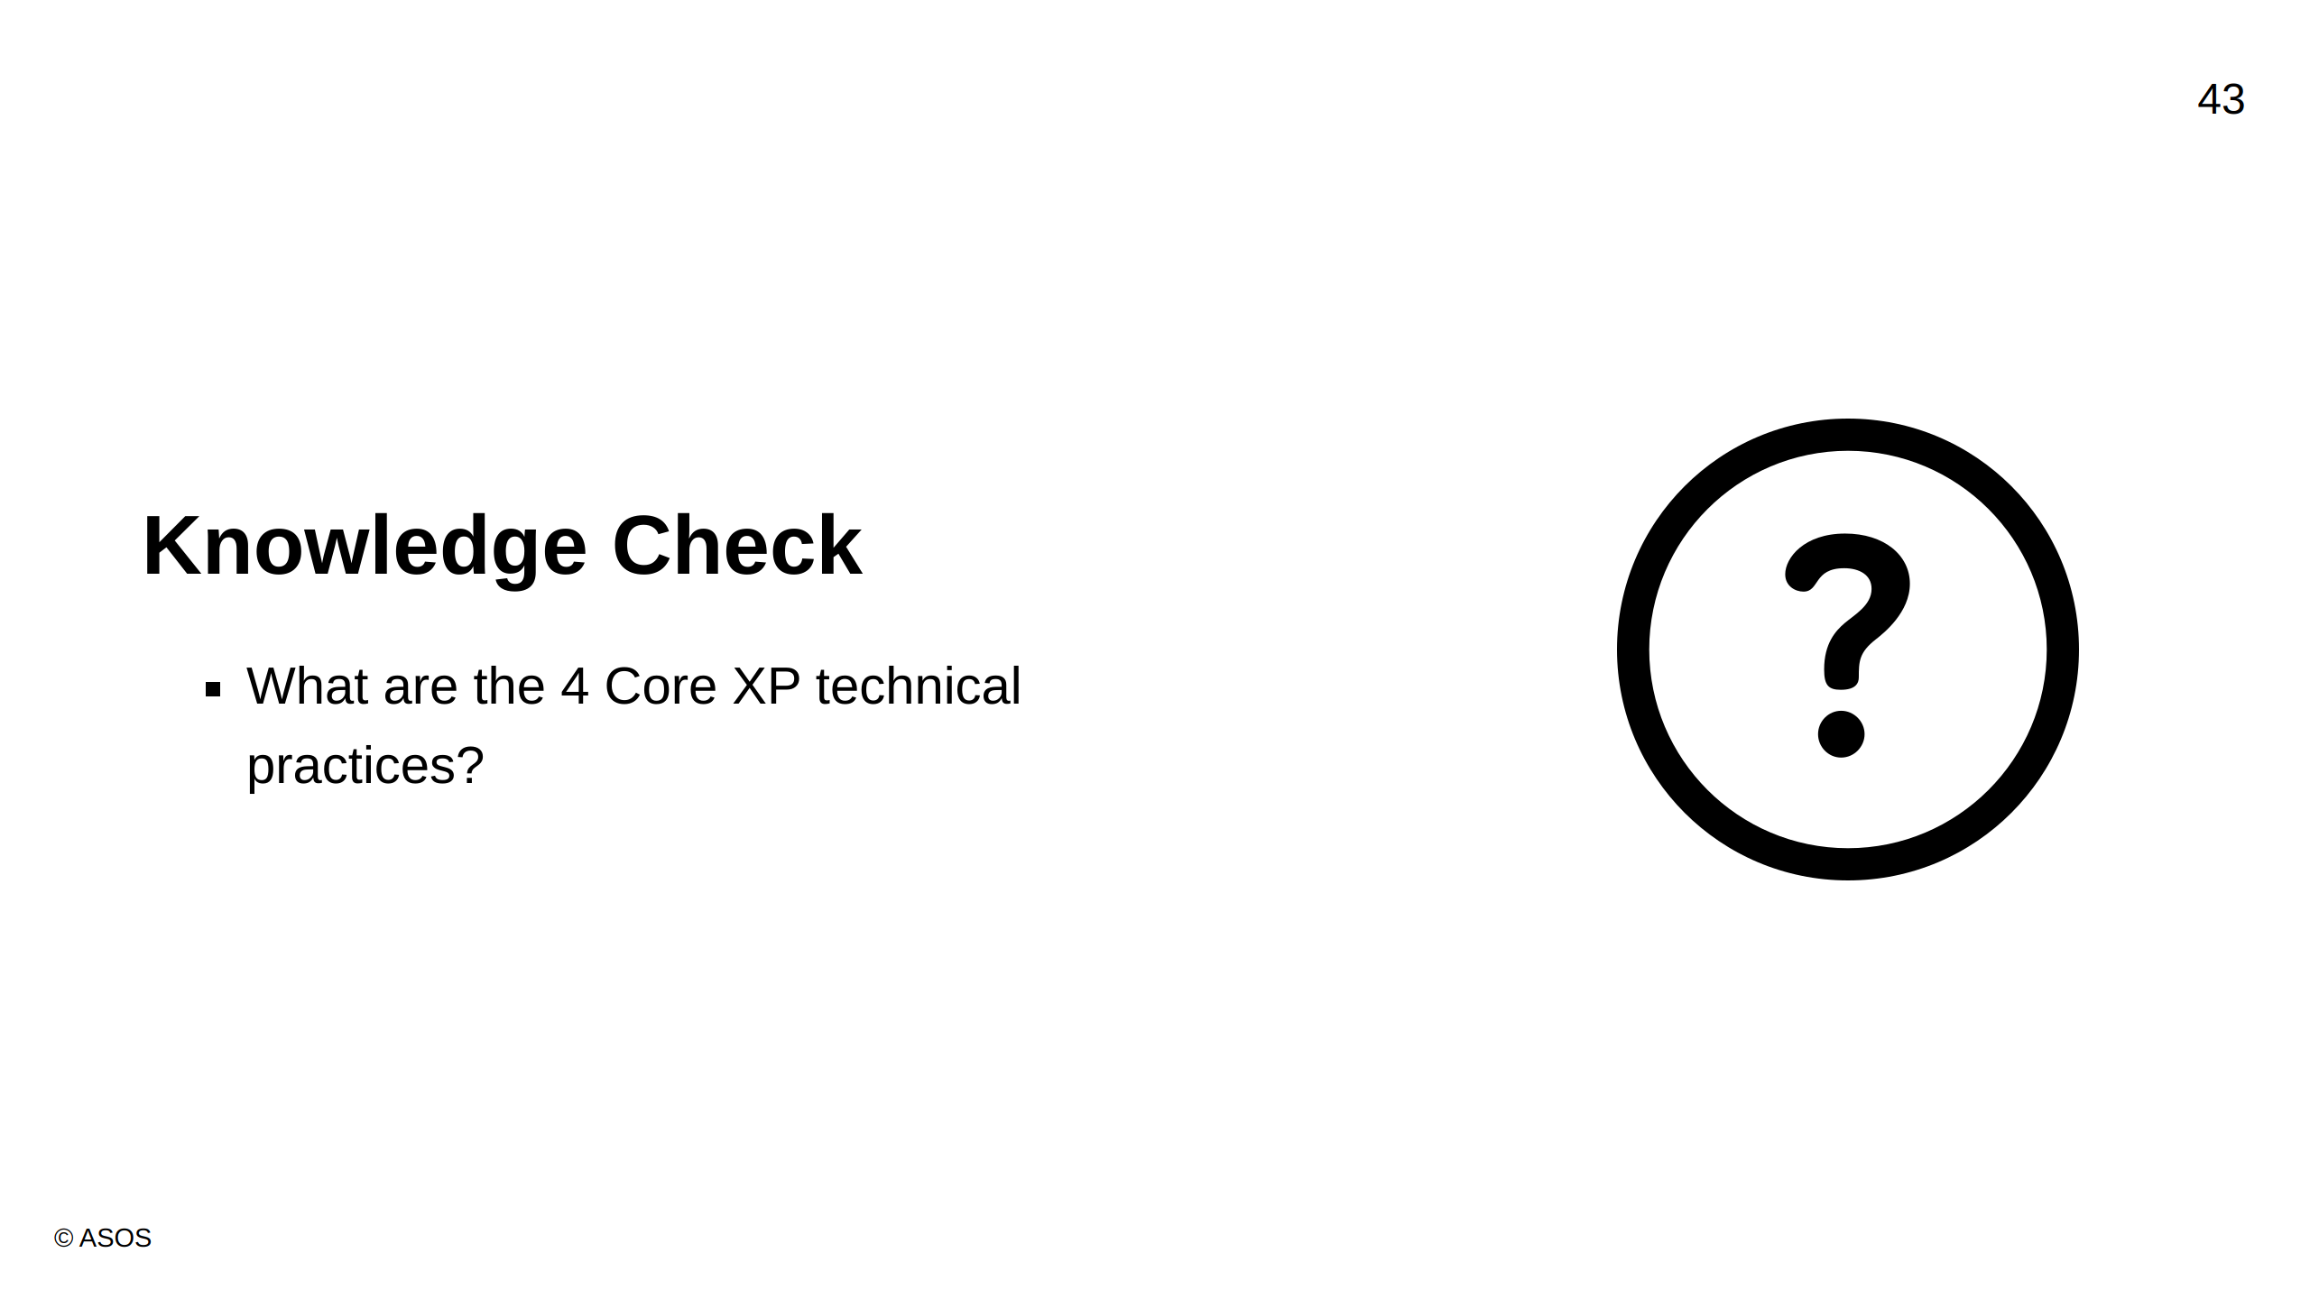
Notes:
Answer: TDD, Pair programming, Refactoring and Simple Design

Slide 44
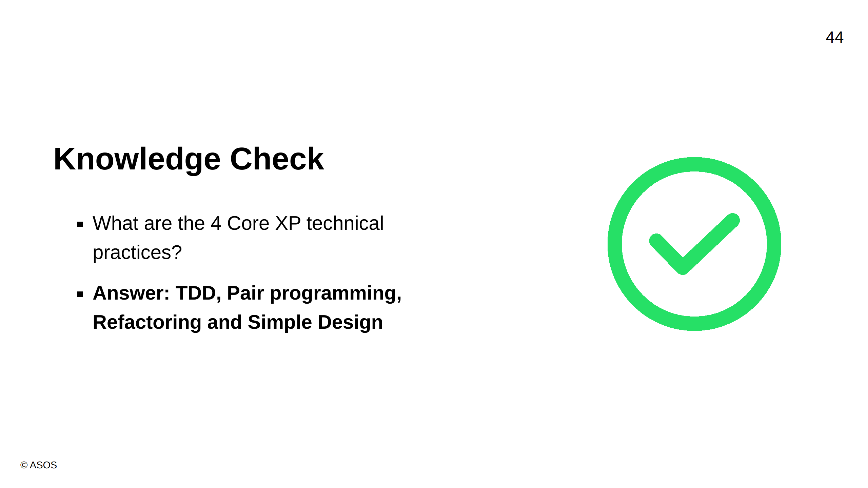

Slide 45
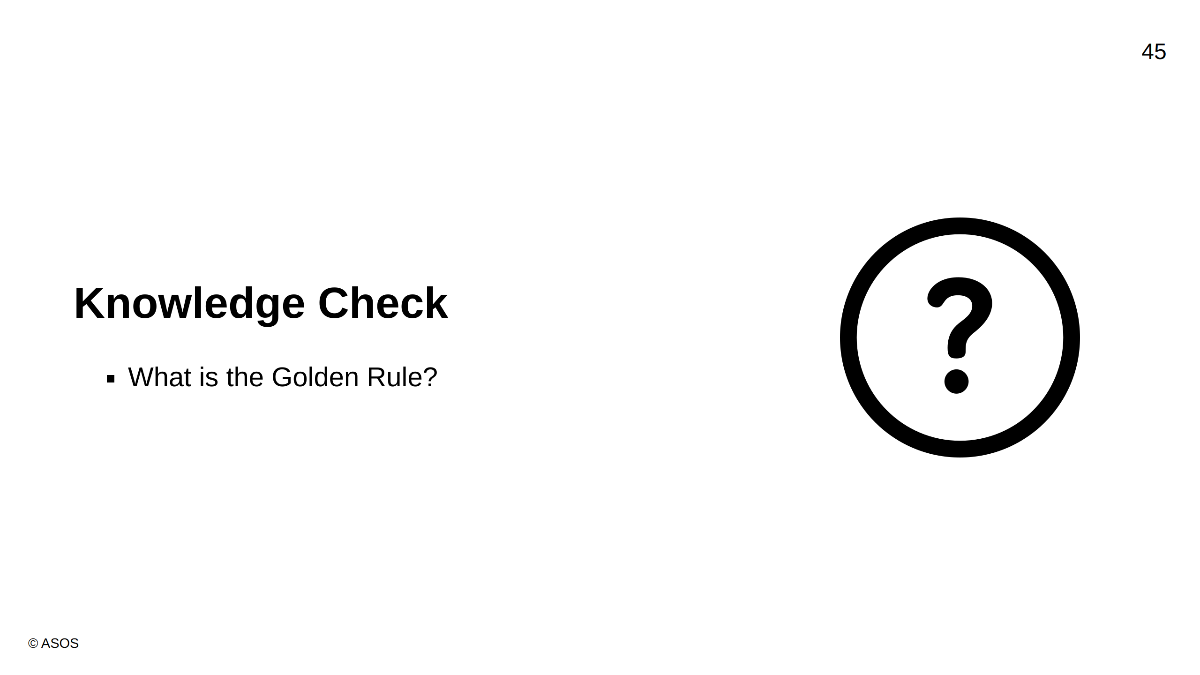
Notes:
Answer: Never write any source code without a failing test

Slide 46
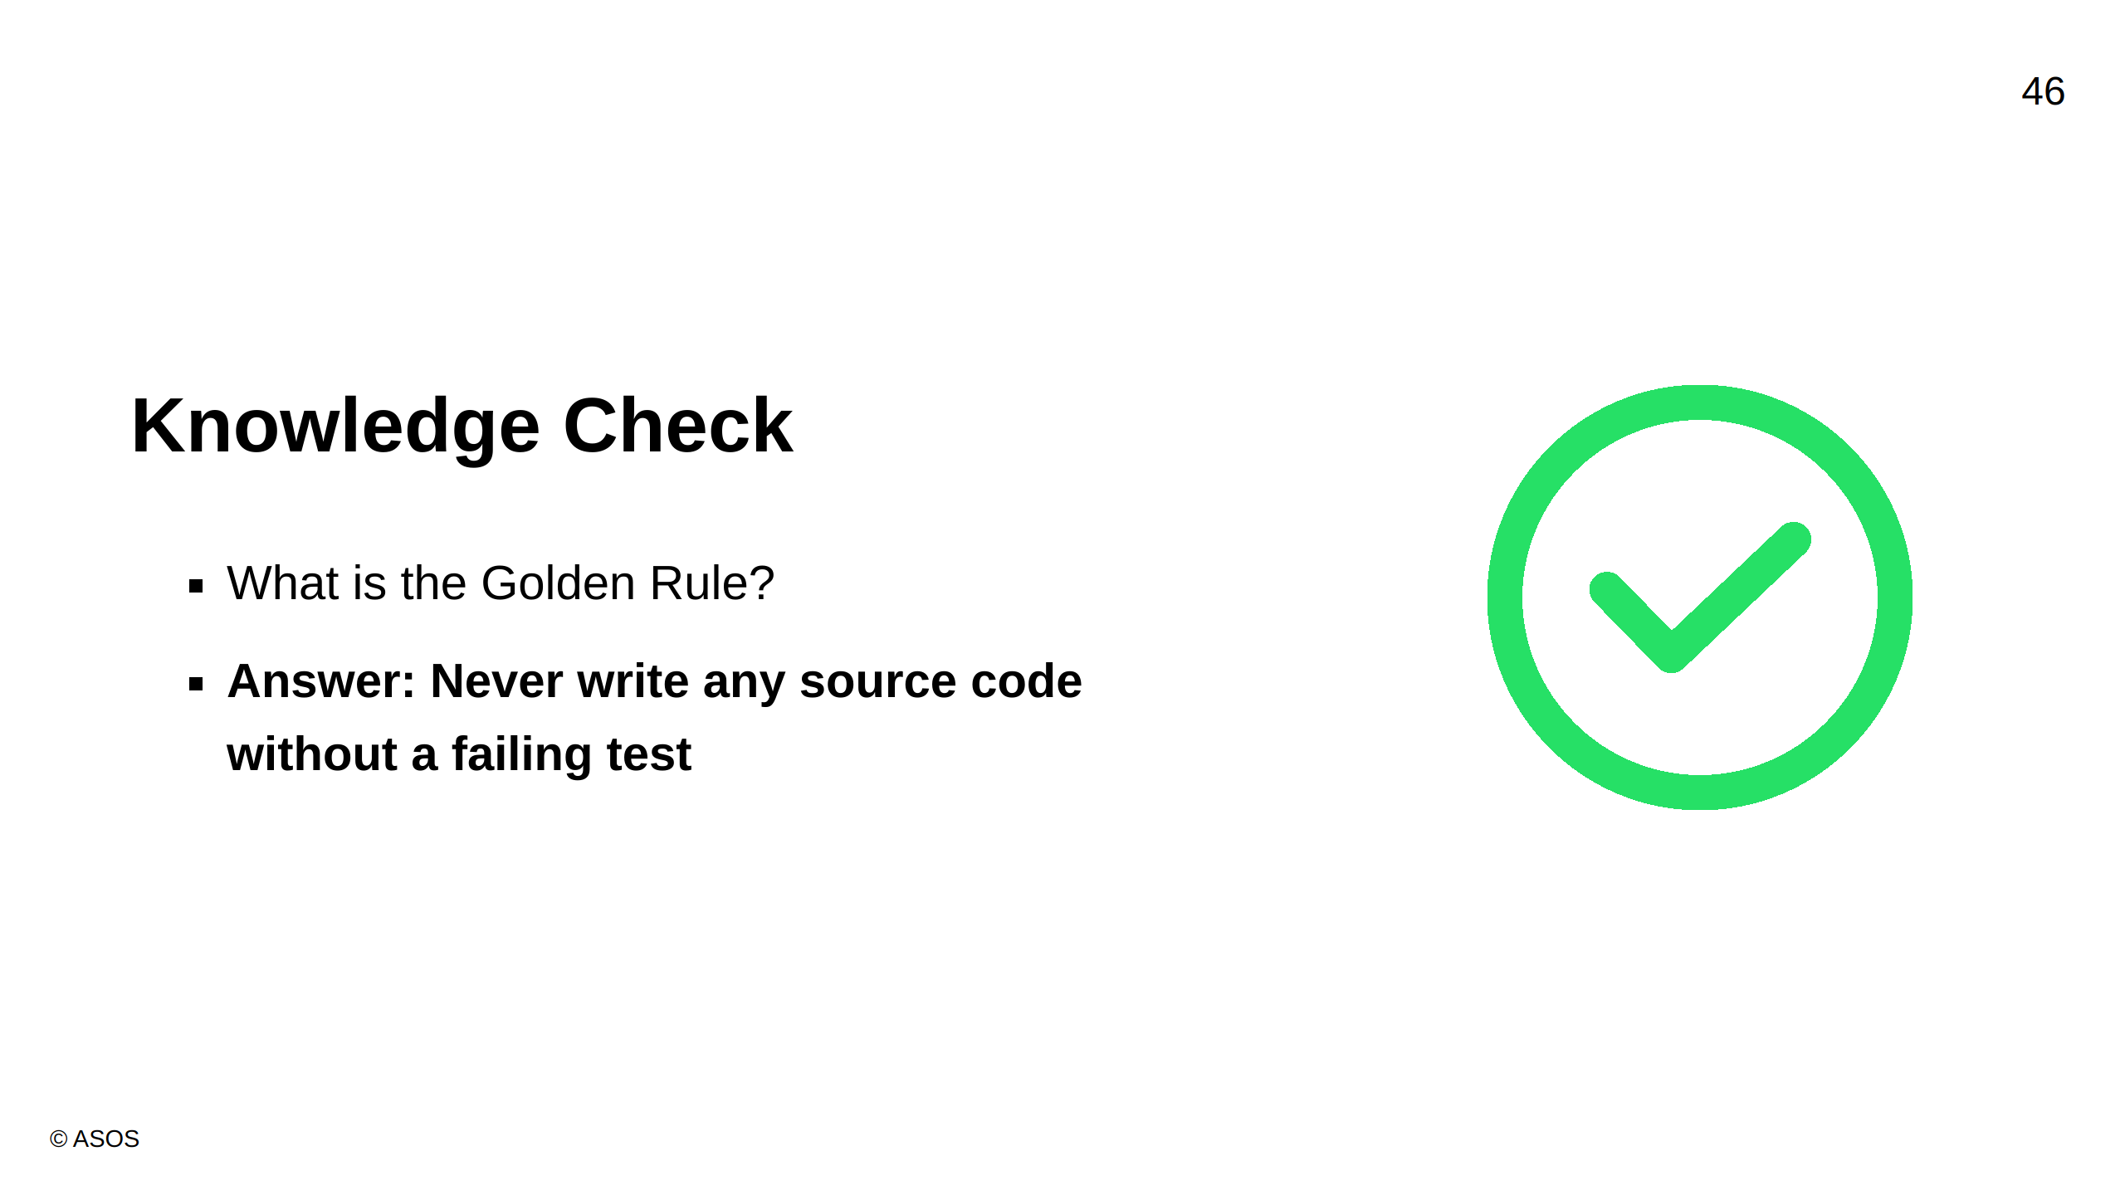

Slide 47
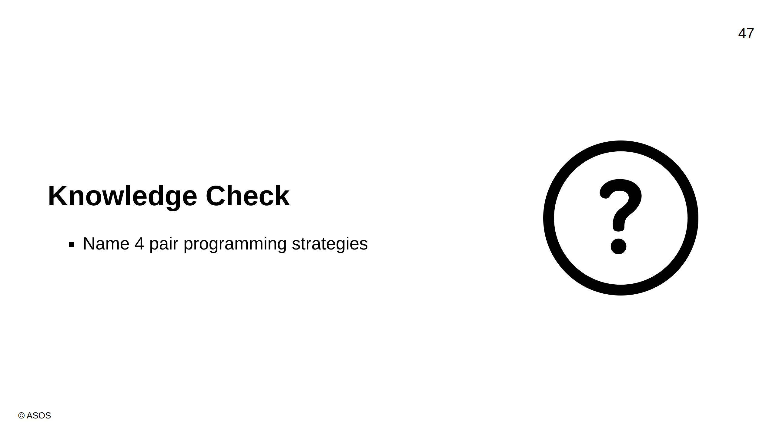
Notes:
Answer: Ping Pong, Chess Clock, Pairing Rotations / Staircasing, Pomodoro

Slide 48
