Slide 1
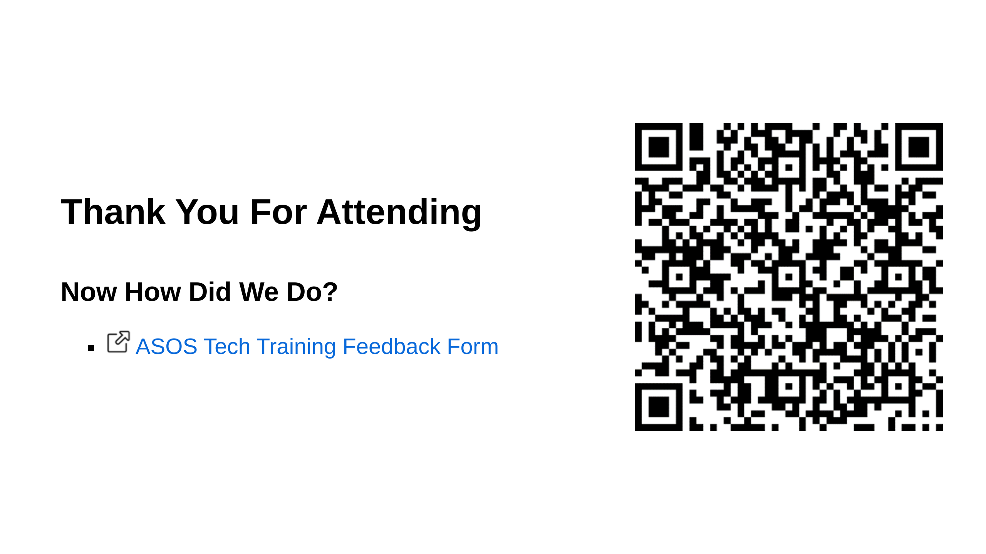
Notes:
Feedback Form Url https://forms.office.com/Pages/ResponsePage.aspx?id=LDL4Su6AGUipzoY9WvvqHAyYVZqgOotMkFQ6X-JiwEVURUtCOFNFNTU2R1RZUk9GNVVOM0k5Q1NaNiQlQCN0PWcu

