Slide 1
Trade Partner Intelligence Platform
PRODUCT PRESENTATION · NOVEMBER 2026
From commission questions to evidence-backed answers, in both directions between MTN and its trade partners
Finance · Revenue Assurance · FBB Operations
Every figure shown is fictional sample data
Notes:
Open with the purpose: this is not another reporting dashboard. It is an investigation workflow that shows what MTN owes each trade partner, what has been paid, why figures changed, and what the evidence supports. Since the last review it also shows the other direction: what a partner would owe MTN for purchases. Everything shown uses fictional sample data; nothing establishes an actual payment or balance.

Slide 2





Calculating commission is not the hard part. Proving it is.
WHY THIS MATTERS
What do we owe each partner?
Recorded commission by dealer and product, for any month
Why did it change?
Month-on-month movement explained product by product
Why was it zero?
Only the four documented causes, never a guess
Was it settled correctly?
Owed, paid, outstanding and disputes in one place
What does the partner owe us?
Purchases, invoices and collections, kept separate from commission
NEW
Notes:
Set up the pain before the tour. Finance and Revenue Assurance can see numbers; the hard part is answering the next question with evidence, quickly enough to settle a dealer dispute. The fifth question is new since the last review and is answered by Partner Sales.

Slide 3








Eight connected workspaces, one dealer and month at a time
WHAT WE BUILT
Overview
Commission
Activation
Inventory
Position and what to investigate first
Figures, with Atlas to explain them
Volume and qualification
Activations against invoiced purchases
Payments
Audit Trails
Partner Sales
Financial Health
Owed, settled and outstanding
Six-step verification behind each finding
Partner orders, invoices and collections
Dealer statements and indicators
Yellow: synthetic demonstration workspaces with fictional records. All others read existing sample commission data, read-only, with no write-back to any production system.
Notes:
One sentence per workspace. Stress read-only: the platform validates existing commission calculations; it does not replace the commission engine. Partner Sales and Financial Health are synthetic demonstrations and are labelled as such in the app.

Slide 4
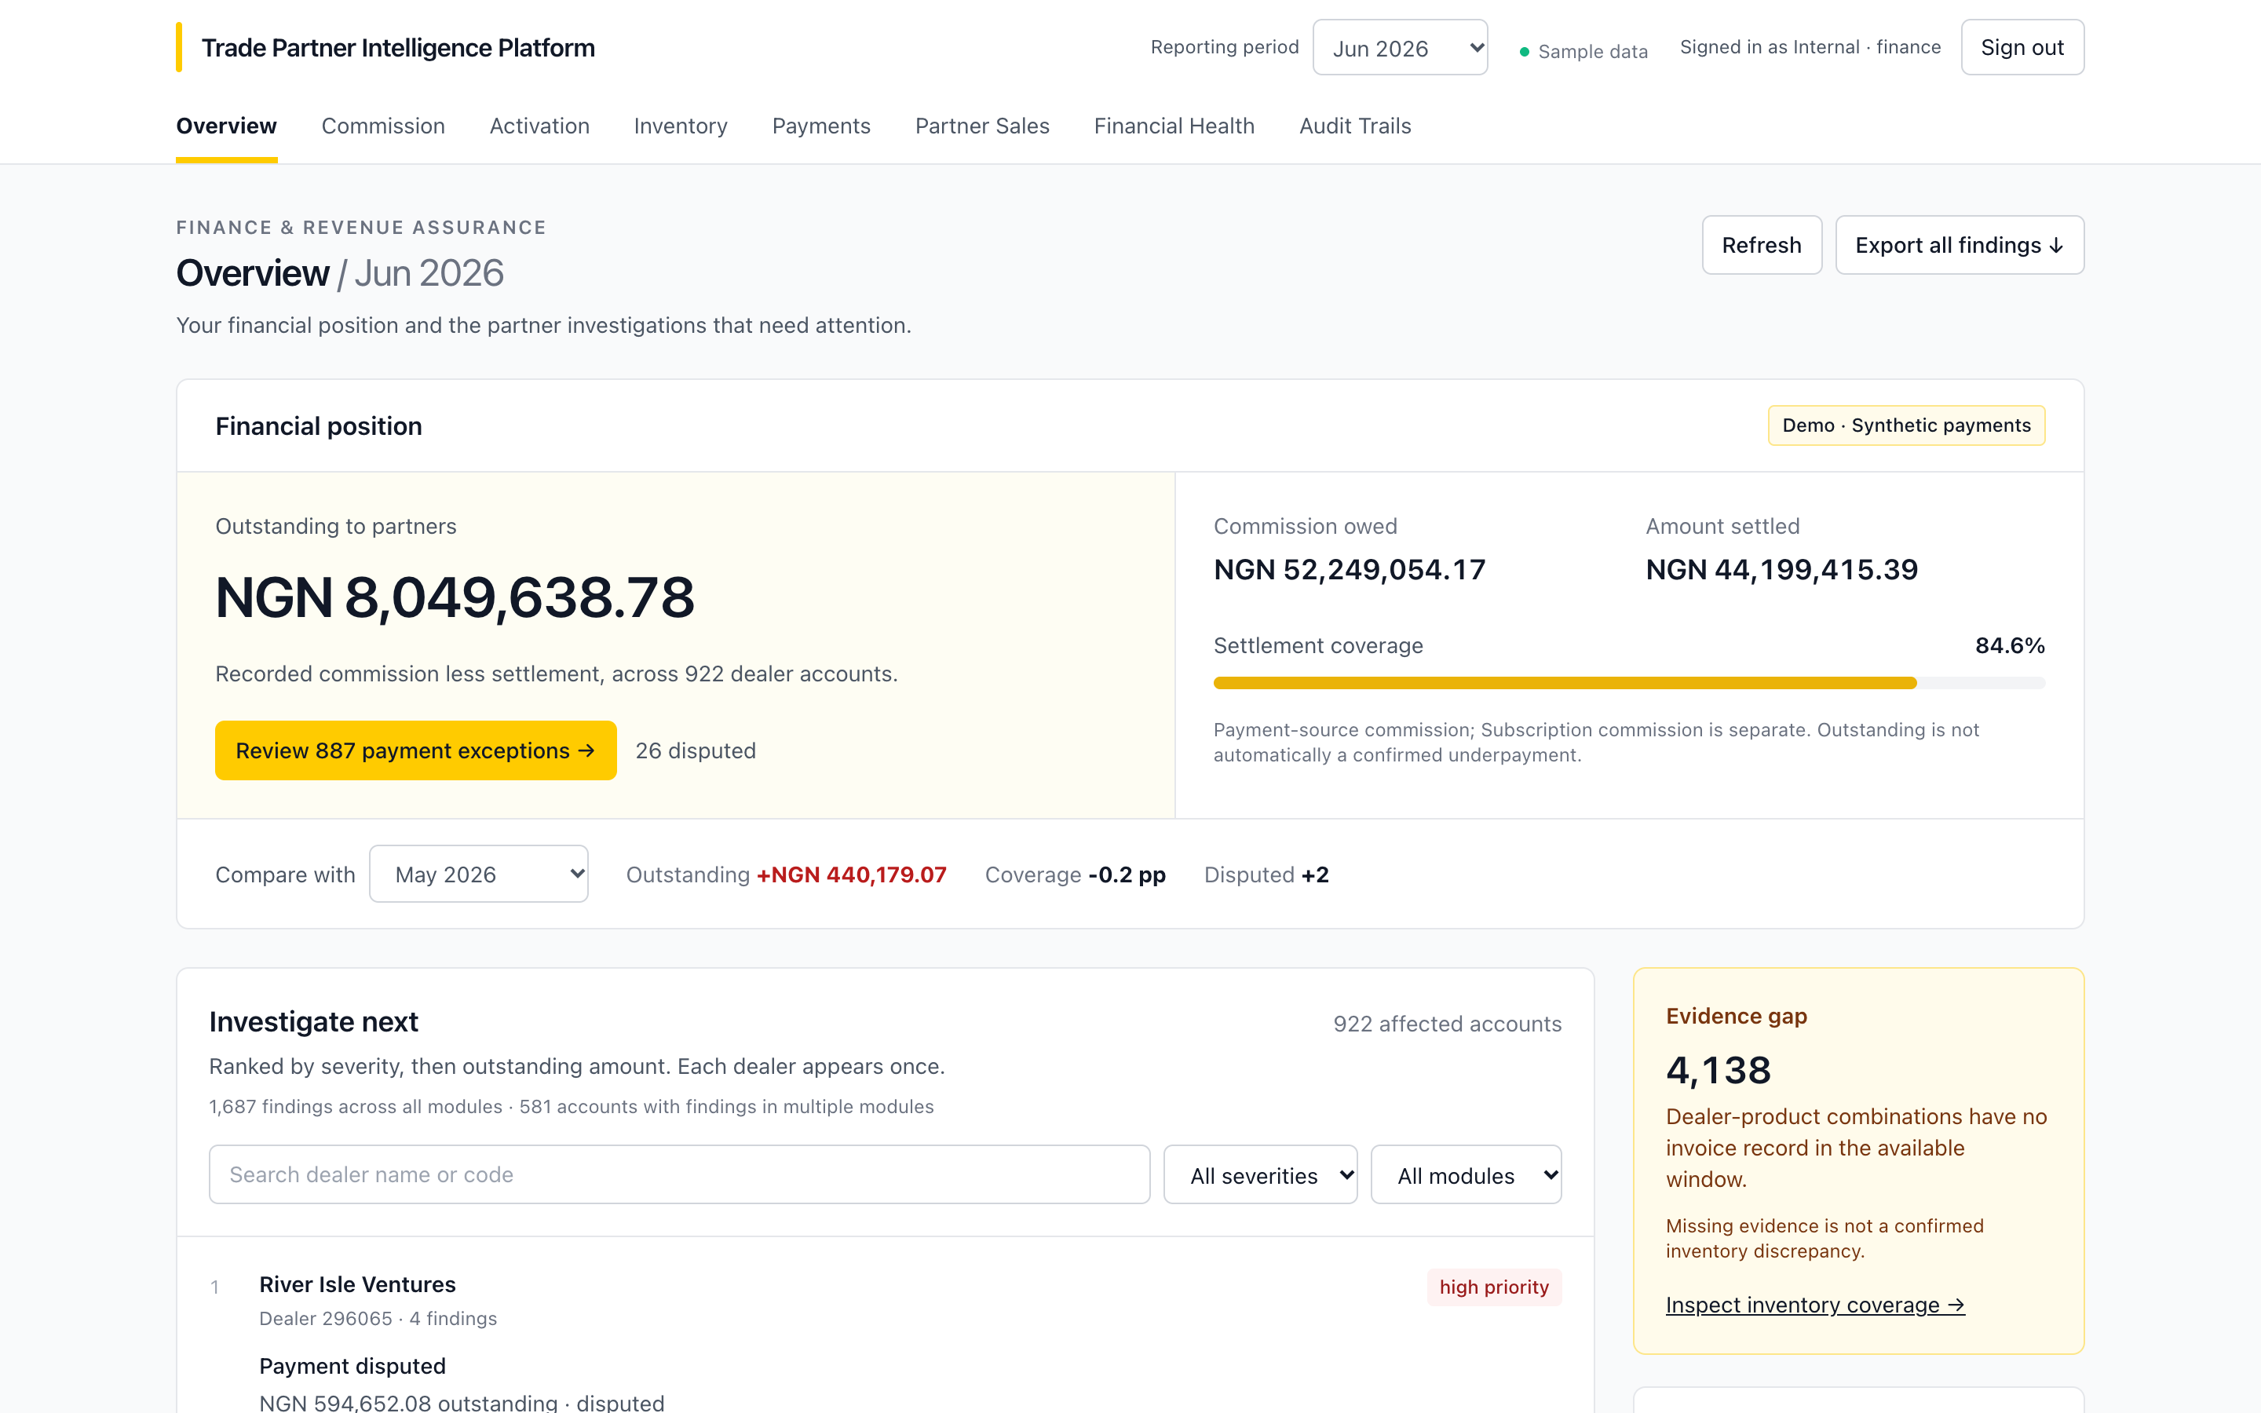
The overview turns a month into a position and a work list
OVERVIEW · JUNE 2026
NGN 52.25m
Commission owed
NGN 44.20m
Amount settled
NGN 8.05m
Outstanding to partners
84.6%
Settlement coverage, 922 dealer accounts
Notes:
Live: start here with June 2026 selected. Point out the Synthetic payments badge, the outstanding headline, the payment exceptions shortcut and the Investigate next list, which ranks dealers by severity and outstanding amount. Exact figures: owed NGN 52,249,054.17; settled NGN 44,199,415.39; outstanding NGN 8,049,638.78; 887 payment exceptions; 26 disputed.

Slide 5
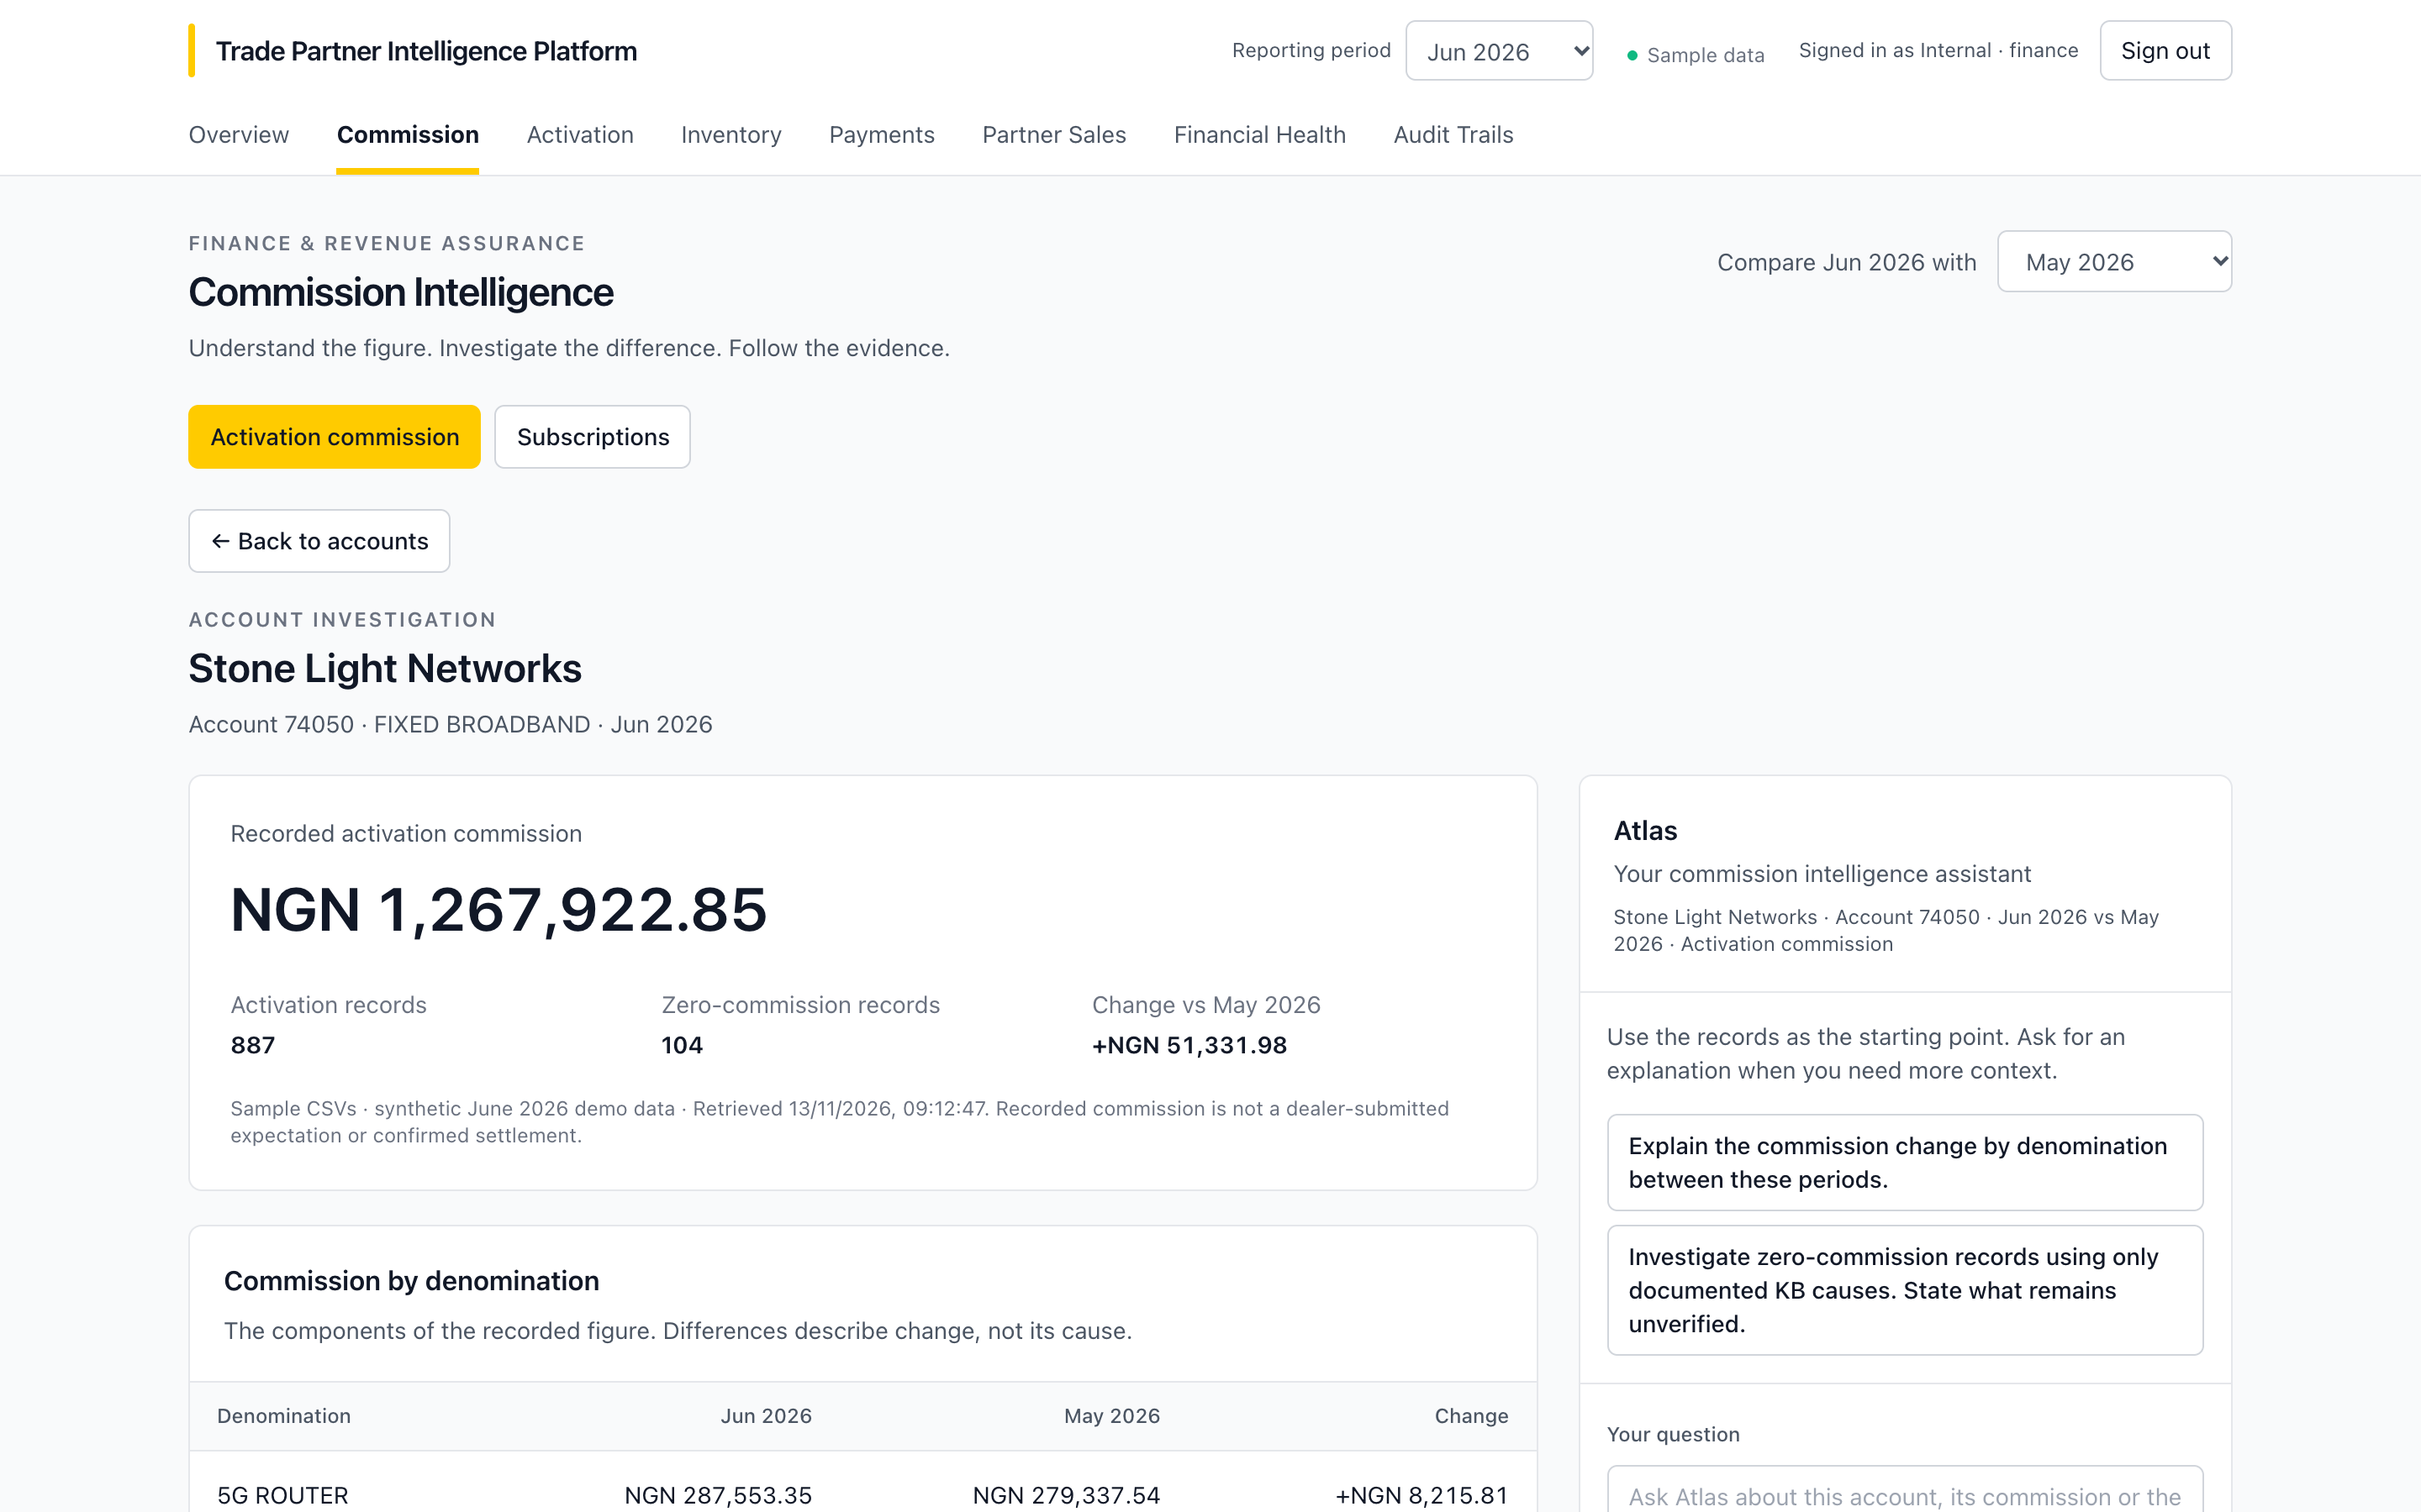
One dealer, one month: the figure and its components
COMMISSION INTELLIGENCE · STONE LIGHT NETWORKS 74050
NGN 1,267,922.85
Recorded activation commission, June 2026
887
Activation records
104
Zero-commission records to investigate
+NGN 51,331.98
Change against May 2026
Notes:
Live: open Commission, search 74050 and choose View breakdown. Show the denomination table comparing June with May. This is the dealer the Atlas conversation follows.

Slide 6
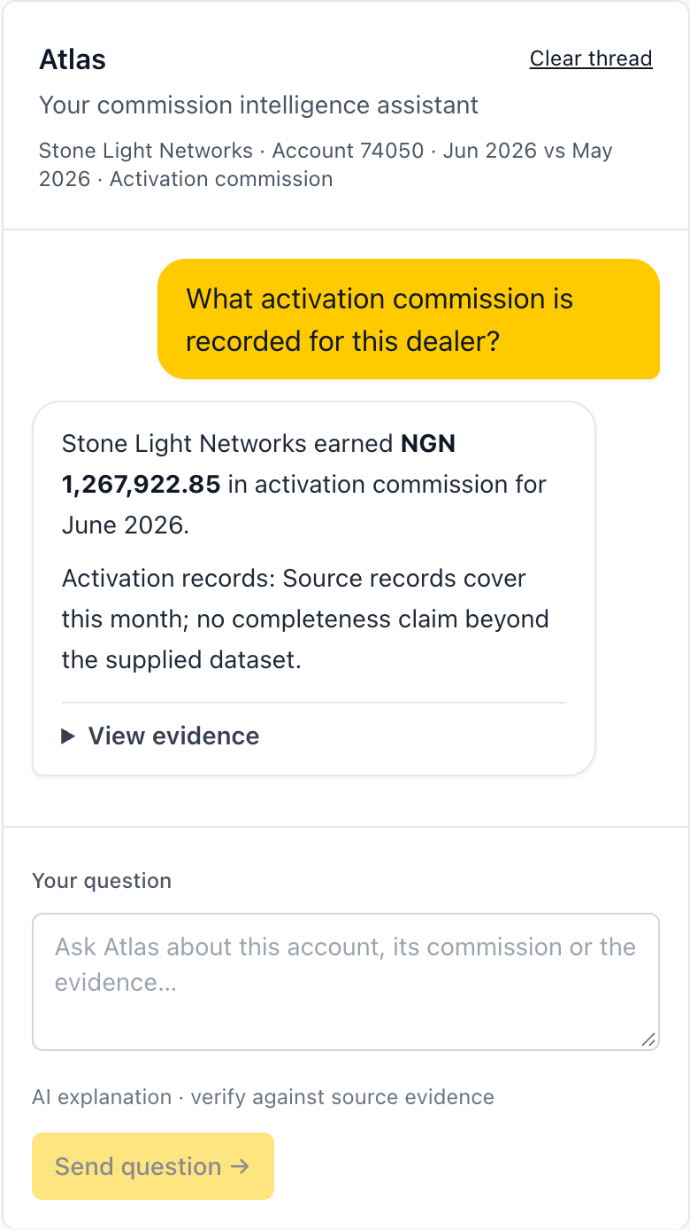
Ask in business language; every figure comes from the records
ATLAS
1
What activation commission is recorded for this dealer?
NGN 1,267,922.85 for June 2026
2
How many other dealer codes are associated with the same dealer?
2 codes, NGN 313,858.11 combined, grouped by recorded name only
3
Why did their activation commission change compared with May?
Up NGN 51,331.98 (4.2%); MIFI_1 the largest contribution
4
What evidence supports that conclusion?
Product-by-product records for both months
5
Explain that in plain language for the dealer.
The same facts, rewritten for the partner
Notes:
Ask these five in order in one Atlas thread with 74050 and June 2026 selected. Allow 10 to 25 seconds per answer. If a fallback appears, press Retry explanation. Avoid: "What can we conclude confidently", "What additional evidence would resolve this" and "Are you explaining the amount or establishing why", which may ask you to clarify.

Slide 7



Atlas explains only what the evidence supports
WHY REVENUE ASSURANCE CAN RELY ON IT
Figures come from the application
Causes come from the knowledge base
Gaps are stated, not filled
The model writes the sentences; every amount, count, dealer and month is inserted from retrieved records. Read-only, parameterised queries; no dynamic SQL.
Zero commission is explained only by the four documented causes. Unsupported causes and claims are rejected before an answer is shown.
Missing evidence is never treated as zero. When a request is ambiguous, Atlas asks which measure or month you mean.
Example: the knowledge base holds two conflicting eligibility definitions. Atlas names the conflict and leaves the decision to Finance.
Notes:
This is the slide for Revenue Assurance. The safeguards are what make the answers usable in a dispute. Mention the eligibility example: Finance must confirm the authoritative rule; audit labels and confidence describe the recorded checks, they do not settle the policy conflict.

Slide 8
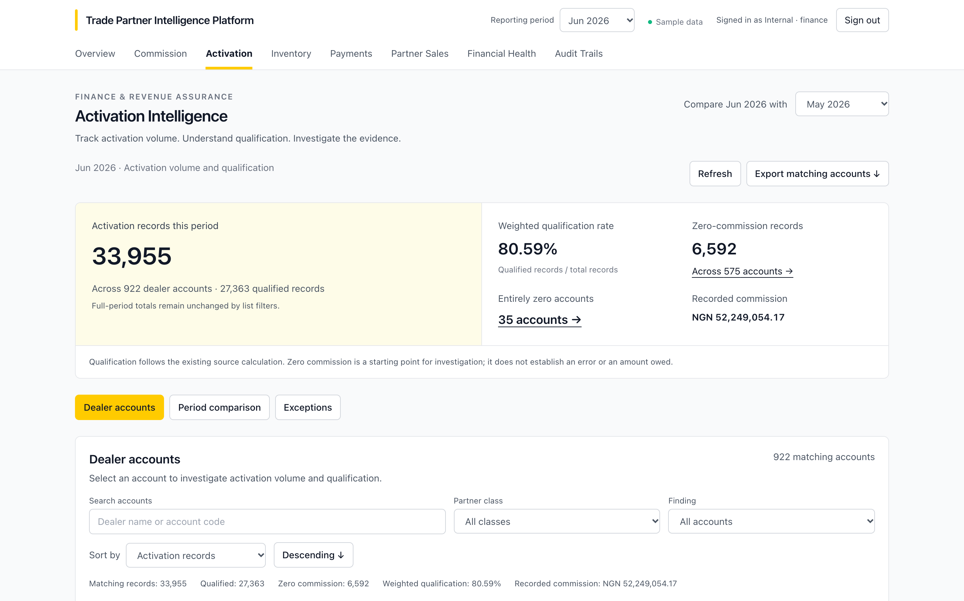
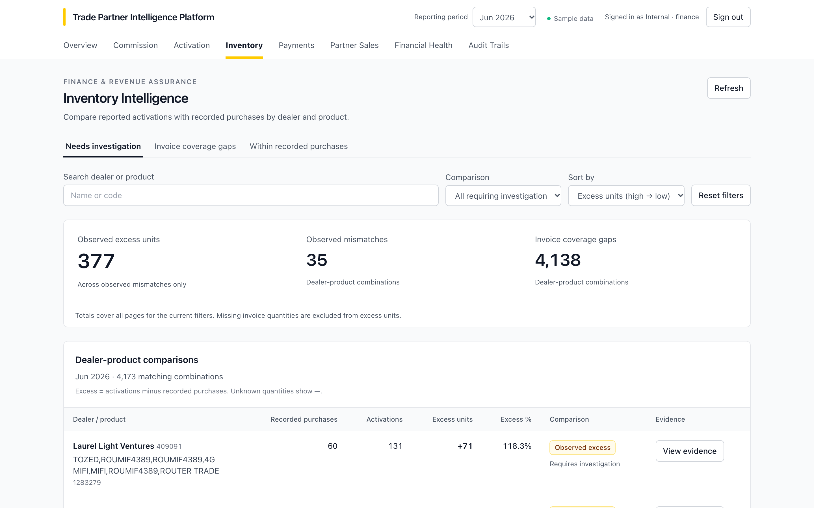
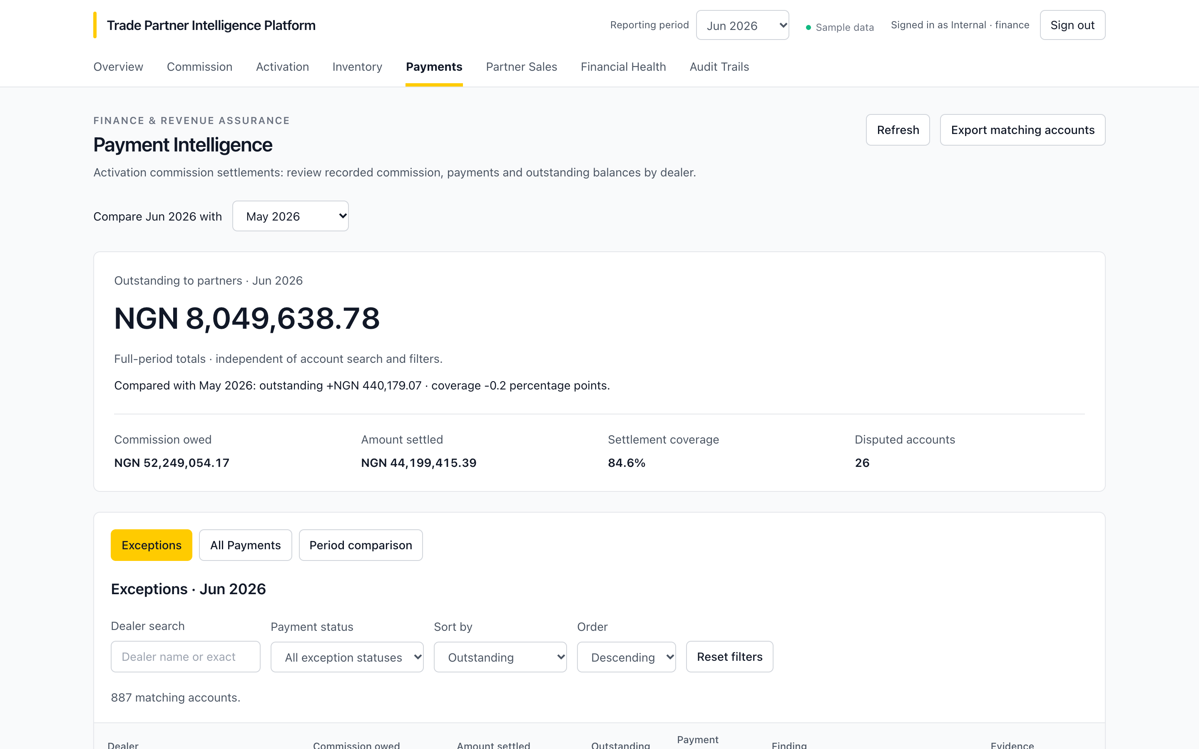
Three checks on the same dealer-month, each with its own evidence
ACTIVATION · INVENTORY · PAYMENTS
Activation
Inventory
Payments
80.59%
weighted qualification rate
35
observed mismatches
887
payment exceptions
6,592
zero-commission records
4,138
invoice coverage gaps, not proven losses
26
disputed accounts
Notes:
All figures June 2026, sample data. Activation: 33,955 records across 922 accounts. Inventory distinguishes confirmed mismatches from missing invoice evidence. Payments: exceptions and all payments are filtered views of one bounded collection; each dealer has a statement.

Slide 9
Every finding rests on a six-step chain a reviewer can challenge
AUDIT TRAILS
Zero-Commission
The chain behind every trail
Was the partner paid for zero-commission activity?
1
Scope the dealer and period
Inventory Mismatch
2
Check the source records
Do activations exceed invoiced purchases?
3
Apply the documented rule
Payment Reconciliation
Was the correct amount paid?
4
Compare with settlement
5
Record caveats and gaps
Eligibility Window
Are zero-commission records really outside the window?
6
Conclude with a confidence level
Notes:
Four modules, one shared machinery. A high-confidence conclusion means the recorded checks were clean, not that the underlying business rule is confirmed. On sample data the Zero-Commission module reads low confidence on purpose: the data is ambiguous and the system says so.

Slide 10
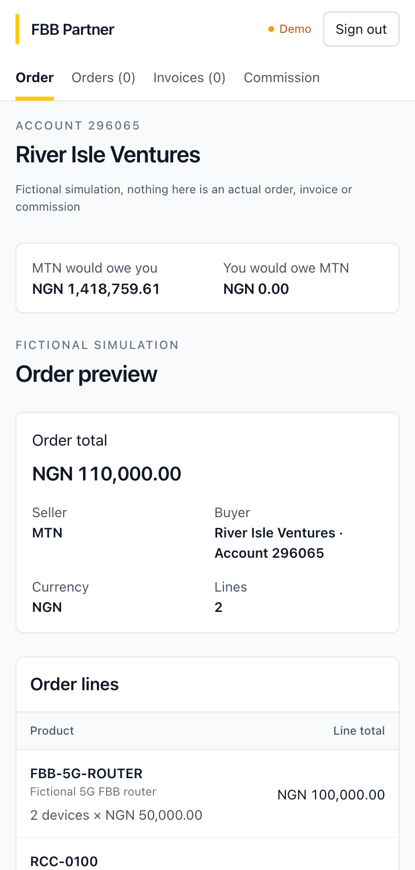
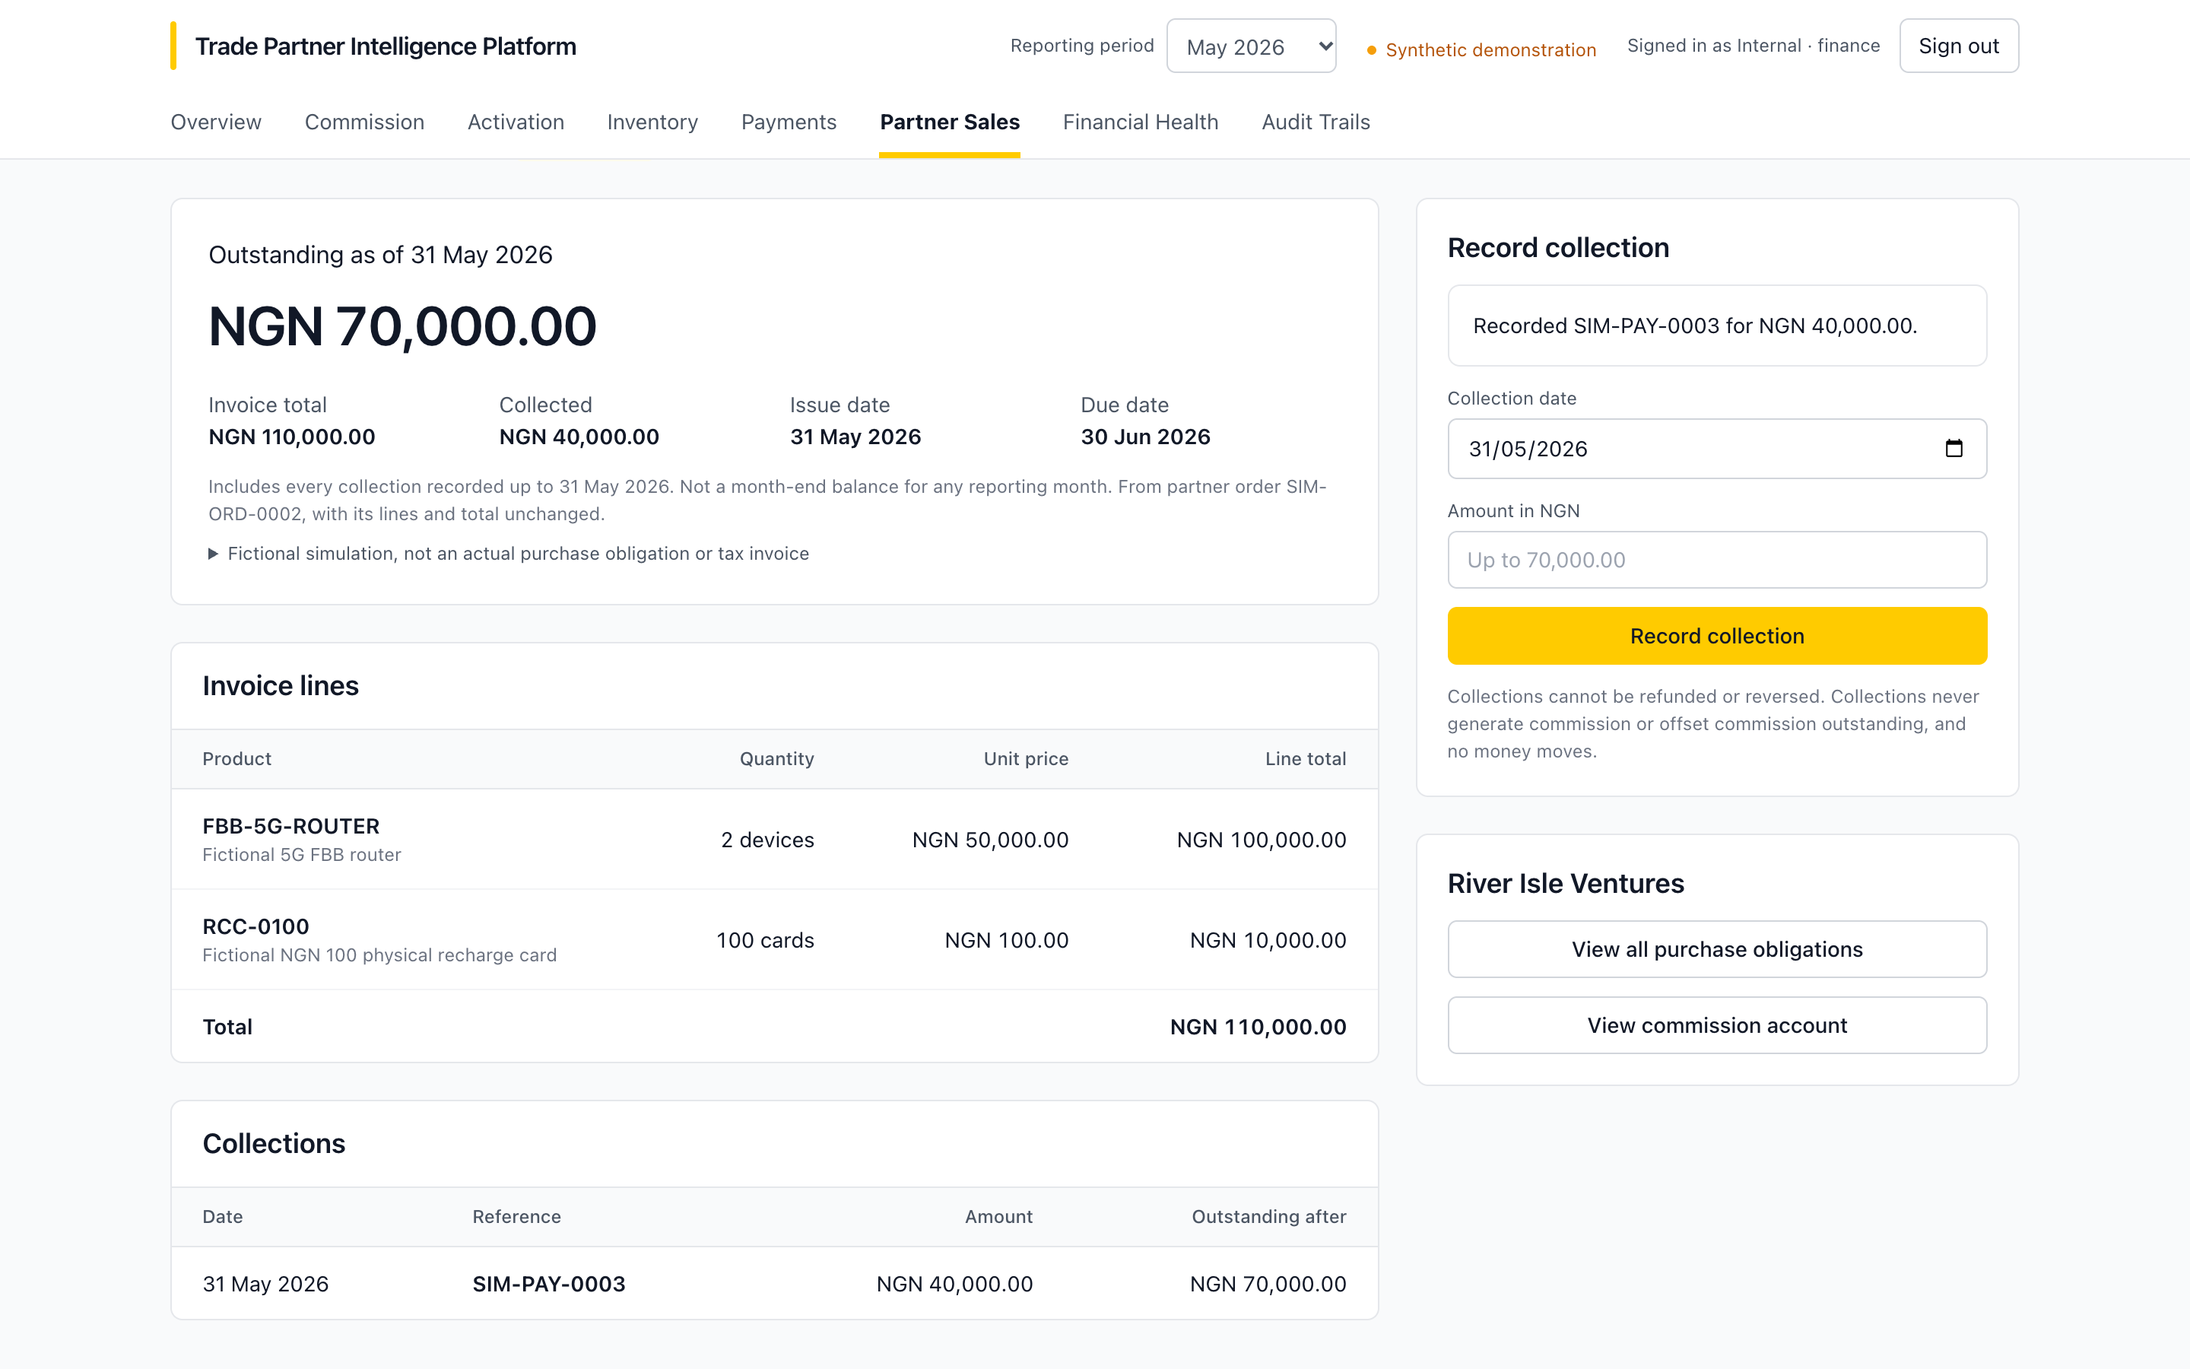
The other direction: what a partner would owe MTN
PARTNER SALES · SYNTHETIC DEMONSTRATION
1
Partner orders
2 routers + 100 recharge cards, NGN 110,000.00
2
Finance reviews
Issues the invoice, or rejects with a reason
3
Collections recorded
NGN 40,000.00, then NGN 70,000.00
Each partner signs in to their own account only. Every order, invoice and collection is fictional and never changes commission.
4
Partner sees each step
Issued, Partially paid, Paid
Notes:
Two windows side by side: Finance and the partner (partner-296065, River Isle Ventures). Reset the simulation shortly before recording. Rehearsal steps 2 to 9: the partner submits SIM-ORD-0002, Finance issues SIM-INV-0004 and records 40000 then 70000; refresh the partner window after each.

Slide 11
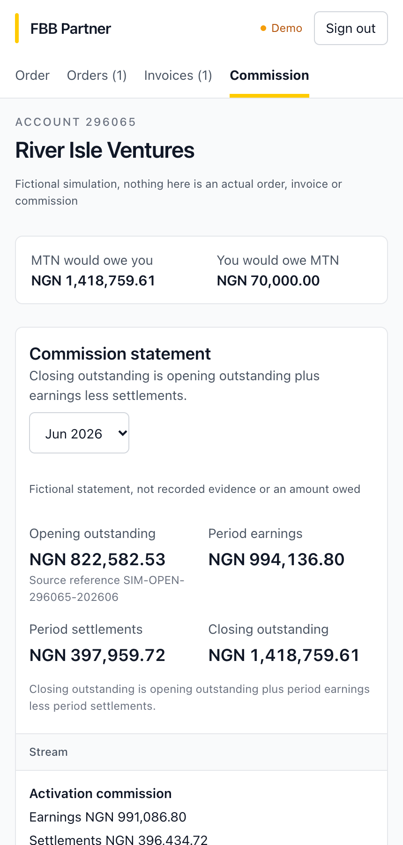
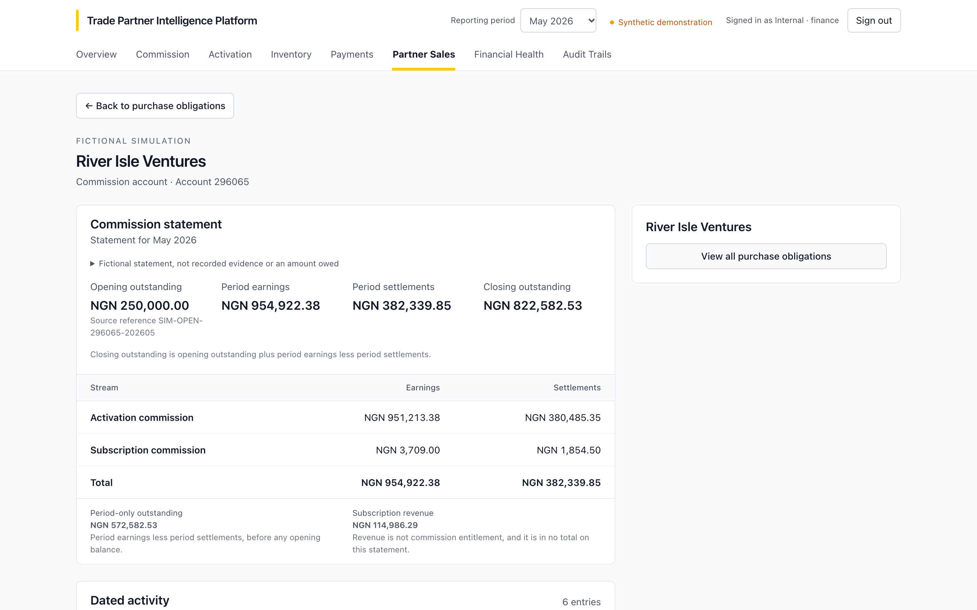
What MTN owes and what the partner owes stay separate
TWO BALANCES, NEVER NETTED
MTN would owe the partner
NGN 822,582.53
Commission account, May 2026 closing
The partner would owe MTN
NGN 70,000.00
After the first NGN 40,000.00 collection
Explain activation commission opens the recorded Commission evidence that Atlas works from.
Notes:
Rehearsal steps 10 to 12. The May commission account still closes at NGN 822,582.53 after collections: purchases never change commission and the two balances are never netted. Finish with Explain activation commission, then Return to Partner Sales.

Slide 12
One dealer from position to evidence, then the other direction
TODAY’S DEMONSTRATION
1
2
3
4
5
Overview
→
Commission
→
Atlas
→
Hand-off
→
Partner Sales
June 2026 position and work list
Stone Light Networks 74050
Five questions in one thread
River Isle Ventures 296065: 495 then 472 activations
Order, invoice, collections, two balances
About 20 minutes. Allow 10 to 25 seconds for each Atlas answer.
Notes:
Follows docs/demo presentation flow.md. For a shorter recording, skip Partner Sales rehearsal steps 13 to 15 and show issuing only, not rejection.

Slide 13



From explaining commission to helping dealers earn it
WHAT’S NEXT
Alongside it
NEXT MODULE
Dealer Marketing
Controlled pilot
Finance and Revenue Assurance on a small set of dealers
Help each dealer sell the products they already hold
1
See the stock
Routers, MiFi and SIMs a dealer has bought but not yet activated
Live data
2
Know what sells
Products that activate fastest and earn the most commission for similar dealers
Move from sample files to the development schema, read-only
3
Share ready-made material
Product messages and offers the dealer can send to customers
Confirm the rules
4
Measure the result
Activations and commission after each campaign, in the same Commission view
Finance settles the authoritative eligibility definition
Notes:
Close on where the platform goes next. Today it explains what MTN owes each dealer and why. Dealer Marketing turns the same records outward: it shows a dealer the stock they hold but have not activated, which products sell and earn best, gives them material to promote those products, and measures whether activations and commission rise afterwards. This is a proposal, not yet built. Ask for feedback: would dealers use it, and which products should come first? Alongside it: a controlled pilot, live read-only data, and Finance confirming the eligibility rule.

