Slide 1
EXECUTIVE PRODUCT REVIEW
FBB Trade Partner
Intelligence
From commission questions to evidence-backed decisions
PRODUCT DEMO
Finance · Revenue Assurance · FBB Operations
Notes:
Open with the decision: this is not another reporting dashboard. It is a finance investigation workflow that links what we owe, what was paid, why a variance exists, and the evidence behind the conclusion.
[Sources]
- Repository: PROGRESS.md, ARCHITECTURE.md, docs/GM_DEMO.md
- Product screenshots captured from localhost in sample-data mode on 2026-09-08
[/Sources]

Slide 2
WHY THIS MATTERS
The cost is not calculating commission—it is proving it
Finance teams can see numbers. The hard part is answering the next question with confidence:
What do we owe?
Ranked dealer totals and denomination-level commission evidence.
Why did it change?
Month-on-month movements explained against the documented business rules.
Why was it zero?
Root-cause classification restricted to four approved causes—no speculation.
Was it settled correctly?
Owed, paid, outstanding, disputes, and audit evidence in one investigation path.
FBB TRADE PARTNER INTELLIGENCE
02
Notes:
Set up the pain before the product tour. Emphasize auditability and dispute turnaround—not only analytics.
[Sources]
- Repository: PROGRESS.md, ARCHITECTURE.md, docs/GM_DEMO.md
- Product screenshots captured from localhost in sample-data mode on 2026-09-08
[/Sources]

Slide 3
WHAT WE BUILT
One workflow now connects entitlement, settlement, and assurance
01
02
03
04
05
Entitlement
Qualification
Inventory
Settlement
Evidence
Commission + ORSC
Activation eligibility
Purchases vs activations
Paid vs owed
6-step audit trail
The same dealer-period can be followed end to end—without dynamic SQL or production write-back.
Read-only data access · parameterized queries · documented rule boundaries
FBB TRADE PARTNER INTELLIGENCE
03
Notes:
This is the product architecture in business language. The platform validates existing calculations; it does not replace the commission engine.
[Sources]
- Repository: PROGRESS.md, ARCHITECTURE.md, docs/GM_DEMO.md
- Product screenshots captured from localhost in sample-data mode on 2026-09-08
[/Sources]

Slide 4
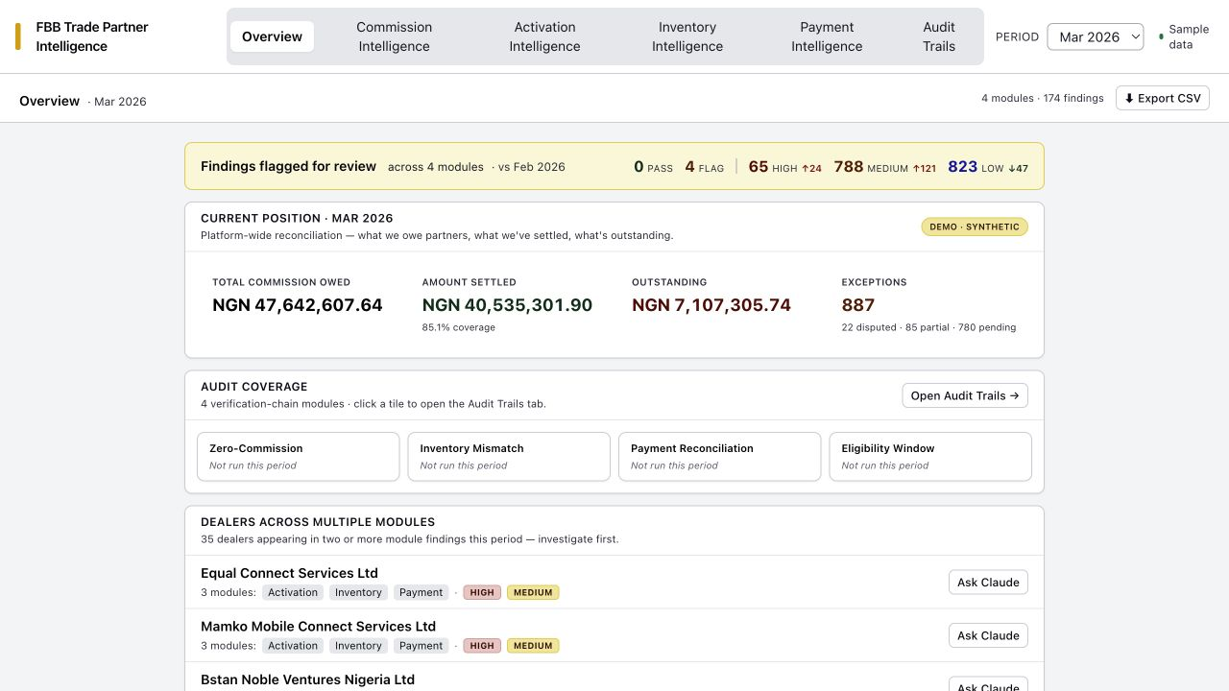
CONTROL TOWER
The overview turns a reporting month into a prioritized action list
MARCH 2026 SAMPLE
NGN 47.64m
commission owed
NGN 7.11m
outstanding
35 dealers
flagged across multiple modules
Every headline links to the investigation surface that owns it.
FBB TRADE PARTNER INTELLIGENCE
04
Notes:
Live demo: start here. Point out the synthetic badge, Current Position, exceptions deep-link, audit coverage, and dealers appearing across modules.
[Sources]
- Repository: PROGRESS.md, ARCHITECTURE.md, docs/GM_DEMO.md
- Product screenshots captured from localhost in sample-data mode on 2026-09-08
[/Sources]

Slide 5
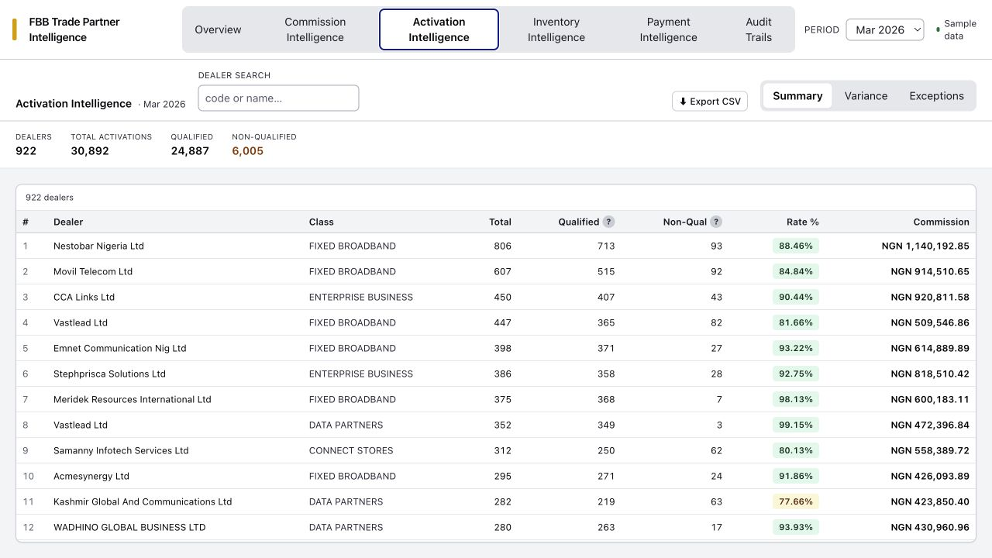
ACTIVATION ASSURANCE
Activation intelligence explains both volume and qualification
Summary
Qualified vs unqualified, rates, and expected commission.
Variance
Period-over-period movement by dealer for targeted follow-up.
Exceptions
All-unqualified, low-rate, zero-commission, and material drops.
Search persists across tabs; export matches the visible view.
FBB TRADE PARTNER INTELLIGENCE
05
Notes:
Live demo: show Summary, Variance, and Exceptions. Search for one dealer and export the current view.
[Sources]
- Repository: PROGRESS.md, ARCHITECTURE.md, docs/GM_DEMO.md
- Product screenshots captured from localhost in sample-data mode on 2026-09-08
[/Sources]

Slide 6
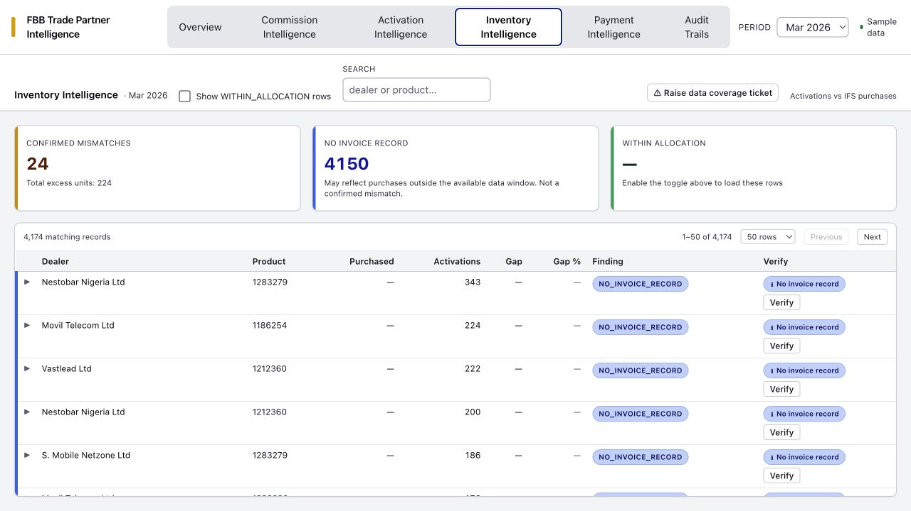
INVENTORY ASSURANCE
Inventory checks distinguish leakage risk from missing evidence
Three outcomes
Confirmed mismatch
Activations exceed invoiced purchases after supported checks.
No invoice record
A data-coverage gap—not automatically a mismatch.
Within allocation
Available purchase evidence supports the activation volume.
Server-owned search, filtering, sorting, totals, and pagination keep the table bounded.
FBB TRADE PARTNER INTELLIGENCE
06
Notes:
Live demo: search Hynex to show the known SKU alias pattern. Expand Verify on a mismatch. Mention ServiceNow-ready data-coverage ticket drafting.
[Sources]
- Repository: PROGRESS.md, ARCHITECTURE.md, docs/GM_DEMO.md
- Product screenshots captured from localhost in sample-data mode on 2026-09-08
[/Sources]

Slide 7
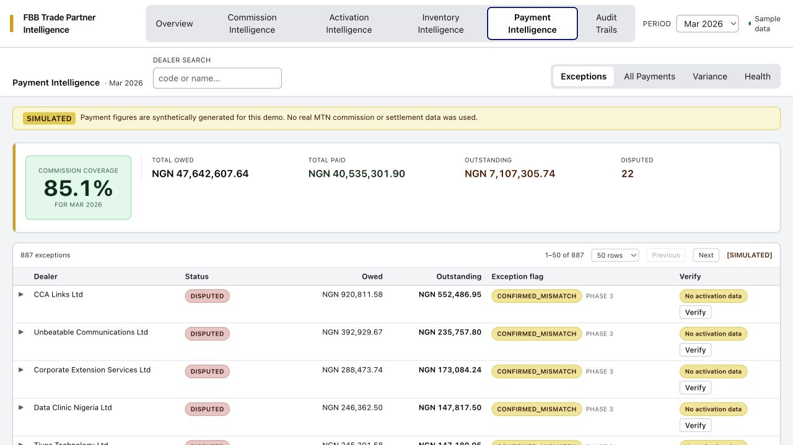
SETTLEMENT ASSURANCE
Payment intelligence closes the loop from owed to settled
One bounded collection
Exceptions and All Payments are filtered views of the same source—avoiding duplicate reads and hidden rendering.
Dealer statement
Combines commission entitlement, payment settlement, ORSC context, position, and linked audit trails.
Exports: Markdown · CSV · XLSX · XLSB
FBB TRADE PARTNER INTELLIGENCE
07
Notes:
Live demo: Payment Intelligence → All Payments → Statement. Walk owed, settled, variance, position, linked trails, and export options. Then return to Exceptions and open a dispute draft.
[Sources]
- Repository: PROGRESS.md, ARCHITECTURE.md, docs/GM_DEMO.md
- Product screenshots captured from localhost in sample-data mode on 2026-09-08
[/Sources]

Slide 8
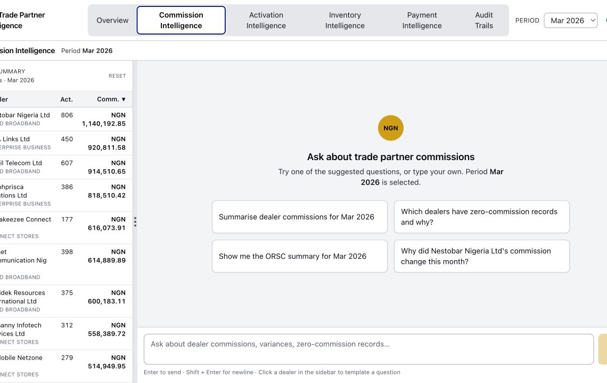
COMMISSION INTELLIGENCE
The finance assistant turns a finding into a grounded explanation
Ask in business language
“Summarise dealer commissions for March”
“Why did this dealer change vs February?”
“Classify the zero-commission records”
“Show the ORSC summary for the period”
Answers identify the tools called and stay inside the knowledge base.
FBB TRADE PARTNER INTELLIGENCE
08
Notes:
Live demo only if the Anthropic key is healthy. Use a templated Ask Claude action from Overview or a row. Multi-tool responses may take 20–30 seconds.
[Sources]
- Repository: PROGRESS.md, ARCHITECTURE.md, docs/GM_DEMO.md
- Product screenshots captured from localhost in sample-data mode on 2026-09-08
[/Sources]

Slide 9
VERIFICATION CHAINS
Four audit modules make conclusions challengeable—not opaque
Zero-Commission
Was a partner paid for zero-commission activity?
PAID · NOT_PAID · INSUFFICIENT_DATA
Inventory Mismatch
Do activations exceed supported purchases?
RECONCILED · EXCESS_ACTIVATION · INSUFFICIENT_DATA
Payment Reconciliation
Was the partner paid the correct amount?
PAID_IN_FULL · UNDERPAID · OVERPAID · ROUNDING
Eligibility Window
Is the six-month rule truly the cause?
POLICY_MET · POLICY_VIOLATED · MIXED_ATTRIBUTION
Each persisted chain records what was checked, what was found, step-level caveats, and HIGH / MEDIUM / LOW confidence.
FBB TRADE PARTNER INTELLIGENCE
09
Notes:
Audit Trails requires Postgres. In the local session Docker was not running, so use the hosted preview or start Docker before presenting. Pick Payment Reconciliation for the clearest business story.
[Sources]
- Repository: PROGRESS.md, ARCHITECTURE.md, docs/GM_DEMO.md
- Product screenshots captured from localhost in sample-data mode on 2026-09-08
[/Sources]

Slide 10
RECOMMENDED LIVE PATH
The demo should follow one dealer from signal to evidence
1
2
3
4
5
Start with
Current Position
Open a
payment exception
Verify the
activation evidence
Open the
dealer statement
Walk the
audit chain
→
→
→
→
Close the story with the decision the evidence supports—not with a tour of every tab.
Backup paths: activation exception · Hynex inventory pattern · dispute-response draft · CSV export
FBB TRADE PARTNER INTELLIGENCE
10
Notes:
Use this sequence as the live-demo spine. Aim for 6–8 minutes, then use the deck for architecture, readiness, and the approval ask.
[Sources]
- Repository: PROGRESS.md, ARCHITECTURE.md, docs/GM_DEMO.md
- Product screenshots captured from localhost in sample-data mode on 2026-09-08
[/Sources]

Slide 11
DELIVERY CONFIDENCE
The MVP is demo-ready, bounded, and tested
215
28
100
6
tests passing
live tests skipped by default
maximum rows per page
integrated product surfaces
Safe by design
Read-only development sources, parameterized queries, no write-back, no dynamic SQL.
Honest demo mode
Synthetic FBB and simulated payment data are visibly labelled and deterministic.
Production foundation
Bounded APIs, server-side filtering, lazy verification evidence, request timing, and query caching.
FBB TRADE PARTNER INTELLIGENCE
11
Notes:
State the boundary plainly: native Presto/Postgres pagination and real MTN data connections are follow-up work after production access and query plans are available.
[Sources]
- Repository: PROGRESS.md, ARCHITECTURE.md, docs/GM_DEMO.md
- Product screenshots captured from localhost in sample-data mode on 2026-09-08
[/Sources]

Slide 12
DECISION
Approve the next validation step
Move from a deterministic sample-data demo to a controlled pilot with Finance and Revenue Assurance.
01
Confirm Finance-facing terminology and audit conclusions
02
Select the first real data integration and pilot period
03
Nominate users to validate dispute and dealer-statement workflows
The platform already demonstrates the control model. Approval unlocks validation on governed real data.
Notes:
End with a specific approval request. Ask for a controlled pilot—not blanket production deployment.
[Sources]
- Repository: PROGRESS.md, ARCHITECTURE.md, docs/GM_DEMO.md
- Product screenshots captured from localhost in sample-data mode on 2026-09-08
[/Sources]

