Slide 1

Helpers on Hand
A Task Management System for small communities
by: Jennifer Rose
Indiana University
INFO-C450 Midterm Demo

Slide 2

STAKEHOLDERS
Clients – individuals that may need help with domestic tasks such as laundry, changing a lightbulb, bringing in the trash cans, balancing a checkbook, etc.
Volunteers – individuals with time on their hands and a desire to complete tasks.
Managers – individuals that track the requests and match them to volunteers.

Slide 3
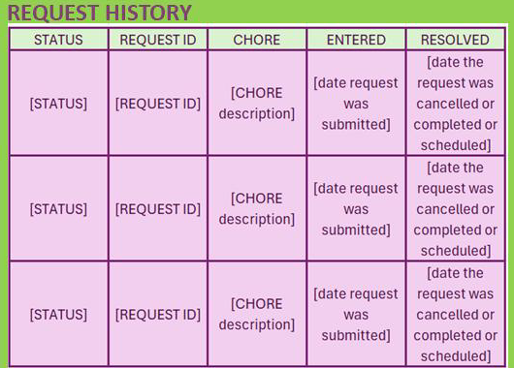
TABLES
Person
Role
Chore
Task Request
User
Calendar
FUNCTIONS
Adding data
Changing data
Reporting data

Slide 4
Next: Demonstration
Thank you

