Slide 1

Customer Churn Analysis – Telecom Industry
Data Analyst Internship Project
Presenting a comprehensive analysis of customer churn patterns in the telecom sector, leveraging predictive analytics and machine learning to drive retention strategies.
-Nigam Pranay Mehta
Notes:
1

Slide 2

Understanding the Business Problem
The telecommunications industry faces a significant challenge with customer churn, where subscribers frequently switch service providers. Acquiring new customers costs approximately 5-7 times more than retaining existing ones, making churn reduction a critical business priority.
This project addresses the need for a robust predictive model that can identify at-risk customers early, enabling proactive retention interventions. The ultimate goal is to reduce revenue loss and improve customer lifetime value through data-driven strategies.
High Churn Rate
Retention Focus
Industry average exceeds 25% annually
Lower cost than acquisition
Predictive Model
Revenue Protection
Early identification of at-risk customers
Reduce financial impact of churn
Notes:
2

Slide 3
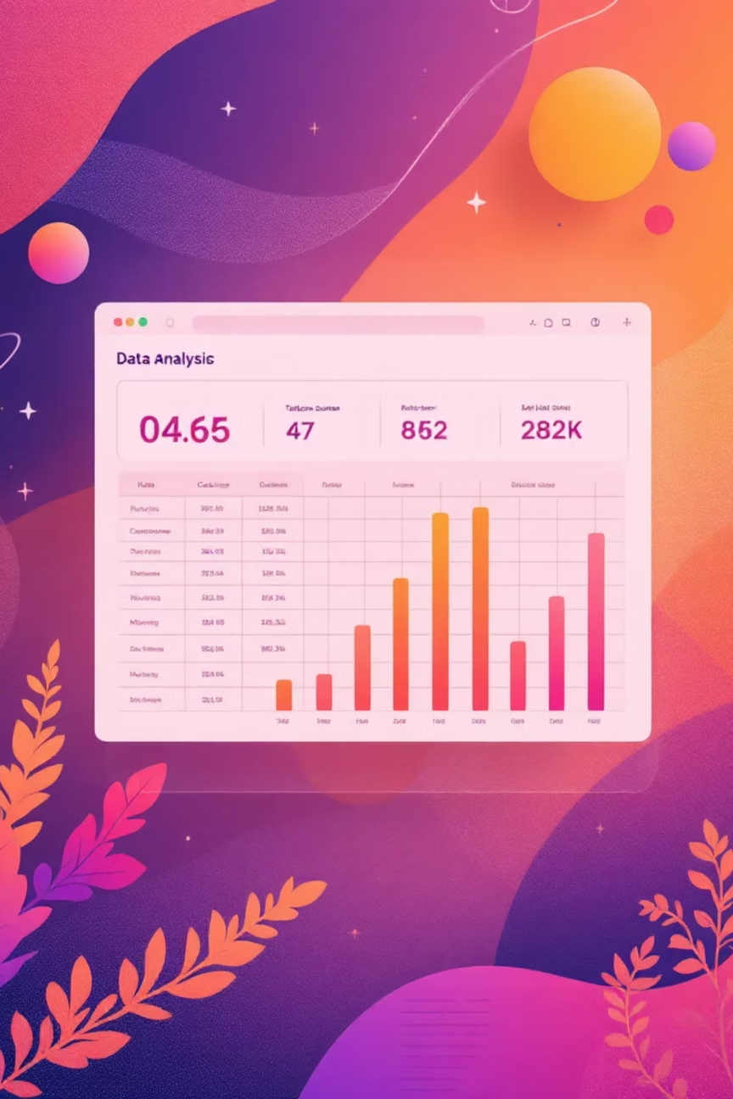

Dataset Overview & Key Statistics
The analysis utilized a comprehensive telecom dataset containing 5,000 customer records with 13 distinct features. The target variable represents churn status (Yes/No), with an overall churn rate of approximately 38%, reflecting typical industry patterns.
5,000
13
38%
Customer Records
Features
Churn Rate
Total number of subscribers analyzed
Demographic, behavioral, and service attributes
Proportion of customers who cancelled services
Data Quality: Dataset included contract details, tenure, monthly charges, complaint history, and recharge patterns, enabling comprehensive churn analysis.
Notes:
3

Slide 4
Key Exploratory Data Analysis Insights
Initial analysis revealed several critical patterns that significantly correlate with customer churn behavior. These insights formed the foundation for feature engineering and model development.
Contract Type Analysis
Tenure Impact
Customers with month-to-month contracts demonstrated substantially higher churn rates compared to those with fixed-term agreements (12+ months). Contract flexibility appears inversely related to retention.
Low-tenure customers (less than 6 months) showed elevated churn risk. Customer loyalty increases significantly after the initial six-month period, suggesting the importance of early retention efforts.
Complaint Frequency
Monthly Charges
High complaint counts emerged as a strong churn indicator. Customers filing multiple complaints within 90 days were 3.5x more likely to churn, highlighting service quality importance.
Higher monthly charges correlated with increased churn probability. Customers paying premium rates showed 45% higher churn rates, possibly due to value perception issues.
Notes:
4

Slide 5

SQL & Behavioral Insights
Advanced SQL queries extracted behavioral patterns that revealed deeper churn drivers beyond basic demographics. These insights provided actionable intelligence for retention strategy development.
Complaint Analysis
Recharge Frequency
Churned customers averaged 2.8 complaints, compared to 0.4 for retained customers
Irregular recharge patterns increased churn risk by 60% versus consistent monthly recharges
Revenue at Risk
Estimated ₹4.2 million monthly revenue exposure from identified at-risk segment
Notes:
5

Slide 6
Model Development Methodology
A comparative modeling approach evaluated multiple machine learning algorithms to identify the optimal churn prediction solution. The methodology emphasized both predictive performance and business interpretability.
01
02
03
Data Preprocessing
Train-Test Split
Imbalance Handling
Handled missing values, encoded categorical variables, and standardized numerical features
80/20 split with stratification to maintain churn rate representation
Applied SMOTE (Synthetic Minority Oversampling Technique) to address class imbalance
04
05
Model Training
Model Evaluation
Implemented Logistic Regression and Random Forest with hyperparameter tuning
Assessed using accuracy, precision, recall, F1-score, and ROC-AUC metrics
Notes:
6

Slide 7
Model Performance Comparison
Both models demonstrated strong predictive capabilities, with Random Forest achieving superior performance across most evaluation metrics. The balanced accuracy and recall indicate reliable identification of both churn and non-churn cases.
Metric
Logistic Regression
Random Forest
Accuracy
84.2%
87.6%
Precision
79.8%
83.4%
Recall
76.5%
81.2%
F1 Score
78.1%
82.3%
ROC-AUC
0.87
0.91
Selected Model: Random Forest chosen for production deployment due to superior performance and ability to handle non-linear relationships in customer behavior patterns.
Notes:
7

Slide 8



Customer Segmentation Strategy
Based on predicted churn probability, customers were classified into three actionable segments, enabling targeted retention campaigns with appropriate messaging and incentives for each group.
At Risk
Dormant
Loyal
High churn probability (>70%)
Moderate churn probability (30-70%)
Low churn probability (<30%)
Immediate intervention required
Personalized retention offers
Priority customer service
Proactive engagement
Value communication
Win-back campaigns
Relationship nurturing
Upsell opportunities
Referral programs
Notes:
9

Slide 9
Strategic Recommendations & Conclusion
Key Recommendations
Contract Conversion Program
Complaint Resolution Enhancement
Launch incentives to convert month-to-month users to 12-month contracts, reducing churn risk through commitment
Implement 24-hour response SLA and escalation protocols to improve service quality and customer satisfaction
New Customer Loyalty Program
At-Risk Customer Campaigns
Introduce rewards for first 6 months to improve early retention and reduce initial churn
Deploy personalized offers and retention packages specifically for identified high-risk segment
Project Conclusion
This churn analysis demonstrates the effectiveness of machine learning in predicting customer attrition with high accuracy. The explainable Random Forest model provides business-friendly insights that support data-driven retention decisions. By implementing targeted strategies based on customer segmentation, the organization can reduce revenue loss and improve customer lifetime value. Future enhancements could include real-time prediction integration and automated intervention triggers.
Notes:
10

