Slide 1
Integrated Approach to Depression Detection

Slide 2
Table of Contents
S.No. | Topic
1. | Abstract
2. | Introduction
3. | Related work & Literature Review Table
4. | Motivation and Objective
5. | Proposed Approach
6. | Technical stack
7. | Challenges faced
8. | Implementation
9. | Results and Conclusion
10. | Future work
11. | References

Slide 3

Depression is a prevalent mental condition with three primary symptoms: persistent low mood, loss of interest, and tiredness. Depression affects more than 264 million individuals worldwide.
In severe cases, depression can lead to self-harm or suicide attempts. According to studies, persons who are depressed tend to avoid eye contact, communicate less verbally, speak hurriedly and monotonously.
The major cause of disability in the world today is depression, which also significantly increases the burden of disease on the world.
Introduction

Slide 4

Detection of depression has attracted increasing attention from researchers in psychology, computer science, linguistics, and related disciplines that integrate an individual's indicators in combination with machine learning and deep learning models to perform automated depression level assessments.
NLP research has attempted to identify depression from formal and informal (i.e. online text) writing. speech processing research has attempted to evaluate depression levels from audio, whereas Human computer interaction(HCI) and allied disciplines have attempted to estimate depression levels from video.
Using Artificial Intelligence

Slide 5
In this study, we review the various related work going on in the research field regarding depression detection techniques
There are various machine learning and deep learning algorithms that can support for depression detection. Wang et al. (2013) constructed a model to detect depression from online blog posts. The features they extracted included first person singular and plural pronouns, ratio of first person singular pronouns to first person plural pronouns, user interactions with others, number of posts etc.
Schwartz et al. (2014) showed that regression models based on Facebook language can be used to predict an individual’s degree of depression.
Related Work

Slide 6
Recent research has shown the promise in using speech as a diagnostic and monitoring aid for depression. Cummins et al. (2015) have provided a thorough review of speech processing research for depression detection.
Shubham Dham et al. (2017) presents methods of visual, audio and text feature extraction, followed by decision level fusion which help identify depressed subjects.
Ying Shen et al. (2022) have proposed a novel depression detection approach utilizing speech characteristics and linguistic contents from participants’ interviews as Emotional Audio-Textual Depression Corpus (EATD-Corpus) which contains audios and extracted transcripts of responses.
Related Work

Slide 7
The major part of this project was aimed at reviewing, analyzing and comparing existing models and approaches proposed in the research field.
For instance, Lin Zhang et al (2020) suggested automatic depression detection approach to assist clinical diagnosis with objective and quantitative measures and provide a rapid, effective, self-assessment of depression using a 1D CNN model and a BiLSTM model with an attention layer to process audio features and text features, respectively.
For the literature review, detailed study of research papers was done and summarized in the project report. These papers are mentioned in the table below:
Literature Review

Slide 8
Literature table
S. No. | TITLE
1. | Junhee Park et al. ,Design and Implementation of Attention depression detection based on Multimodal Analysis
2. | Luna Ansari et al. ,Ensemble hybrid learning methods for automated depression detection
3. | Shubham Dham et al. ,Depression scale recognition from audio, visual text analysis
4. | Jiri Havijer et al. ,Text-based detection of the risk of depression
5. | Le Yang et al. ,Integrating deep and shallow models for multi-modal depression analysis hybrid architectures
6. | Soundariya R S, et al. ,Application of various machine learning techniques in sentiment analysis for depression detection
7. | Yan Zhao et al. ,Multi-head attention-based long short-term memory for depression detection from speech
8. | Ying Shen et al. ,Automatic depression detection: an emotional audio-textual corpus and a gru/bi-lstm-based model
9. | Xuri Chen et al. ,Towards automatic depression detection: a bilstm/1d cnn-based model
10. | Michelle Renee Morales et al. ,A cross-modal review of indicators for depression detection systems

Slide 9
Depression is a common mental disorder, which in worse case, can lead to suicide.
The treatment rate of depressed people remains very low because of traditional time-consuming, costly and sometimes ineffective diagnosis and treatment.
Such reasons compel development of automatic depression systems with the help of models to predict or asses depressive state of individuals.
Researchers have made a lot of progress in diagnosis of depression but great difficulties still exist in practice and leaves huge scope to improve the efficiency and suggest models.
Motivation

Slide 10


Objective
Literature survey of the existing approaches to depression detection systems in the field of research.
Review of related work in depression detection using text, audio, video and different models.
Proposes an integrated approach to depression detection using text and speech features.

Slide 11
We propose a deep learning based approach for depression detection accepting speech signals and linguistic (text) content.
This methodology makes use of CNN model and LSTM model to process audio and text features. The two models summarize audio and text representations, which are then concatenated and passed to a fully connected layers for output and prediction.
Blending multimodal characteristics using machine learning models and deep learning models, is effective because it improves the biased data problem of existing single data and increases the weighting for important vectors, enabling high-accuracy depression detection
Proposed approach

Slide 12
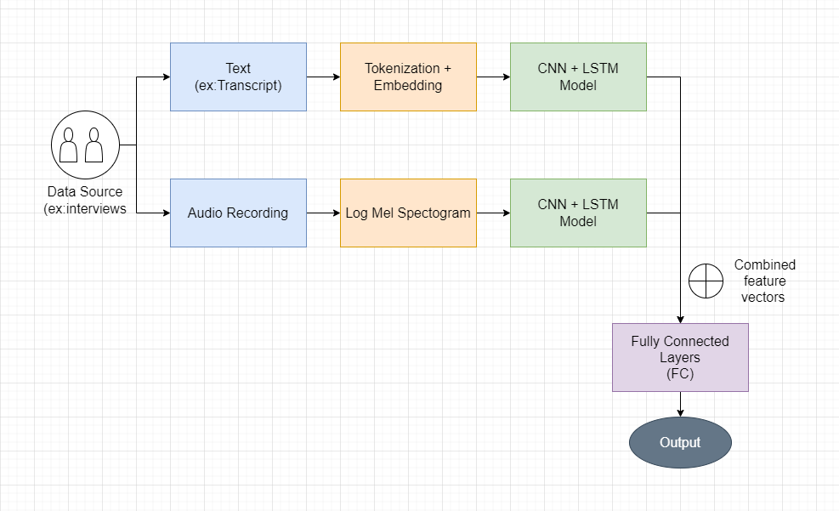
Architecture

Slide 13
Audio Analysis Approach -
Voice data are sound forms quantized via Analog-Digital Conversion, but because the dimensions are too vast and several frequencies are merged, the data is utilised by extracting characteristics that indicate the signal's attributes rather than utilising the data as is. It is also converted in log-mel spectrogram before passing into the neural net.
The speech features extraction methodology also involves a CNN- LSTM neural network. Additionally, an attention mechanism can also be added to the model.
Integration -
Each model is converted into a feature vector of the same form and passed to fully connected dense layers for final prediction.

Slide 14
Dataset compatibility -
The proposed model can accommodate variety of different datasets which have text, audio or both with transcripts. This can be medical diagnostic data or social data.
Text Analysis Approach -
It involves two stages which are preprocessing and CNN + LSTM network respectively. Preprocessing mainly involves tokenization of text and generating embeddings using NLP techniques.
CNNs are excellent at learning spatial structure from data, the convolutional layer takes advantage of that and learn some structure from the sequential data.
After the CNN Layers, the sequential data is passed into LSTM layer which can effectively capture long term dependencies from the text.

Slide 15
Technical Stack
& tools required
Python language
We experimented the proposed approaches in jupyter labs and google colab environments
Extensively used libraries: Tensorflow, keras, pandas, numpy, matplotlib

Slide 16
Limited and constrained accessibility of datasets. Also most datasets in case of depression detection rely on the condition of individual/interviewee being honest.
Imbalanced nature of datasets introducing bias into models. Also a key issue of the problem is how to design and extract representative features.
Specifically regarding audio datasets, lack of datasets publicly available and size of the available dataset being too large to use them as college students.
Less availability of sample codes to refer and high complexity of integrated/ fusion models with audio processing to understand.
Challenges Identified

Slide 17
Due to above stated challenges, we have currently implemented the proposed text features model for detecting depression in individuals.
For this we have used the data from social media such as twitter. For normal tweets, Sentiment140 dataset is taken and depressive tweets are collected using a twitter scraping tool.
This kind of model takes this tweets as text data and predicts whether the user is depressed or not.
The steps for this implementation are as follows:
Implementation

Slide 18
Workflow
Data Preprocessing
Tokenization and Embedding
Building Models
(expand contractions, remove punctuations and stop words)
(separating text into tokens and word vectors)
Model Prediction

Slide 19
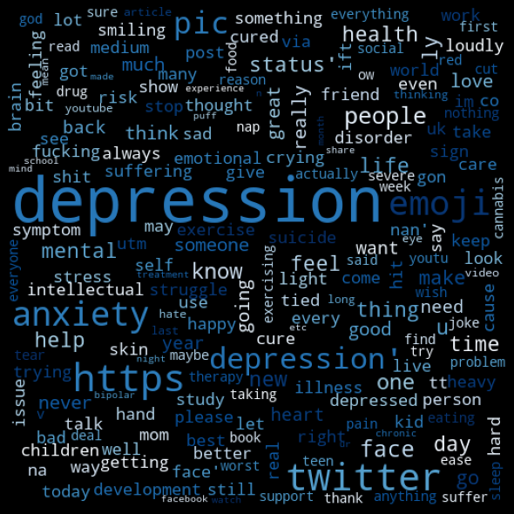
While implementing, initially these extracted text features were passed to machine learning models such as Naive Bayes and State Vector Machine (SVM).
After testing those models, we applied a CNN- LSTM model with an embedding layer, a convolutional stage (Conv + max pooling + dropout), an lstm layer and finally a dense layer.
Word cloud for depressed words

Slide 20
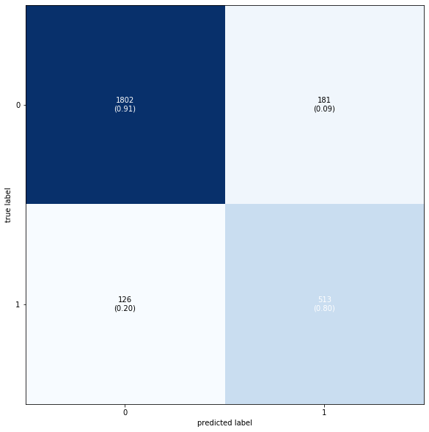
The CNN- LSTM model for text based depression detection from tweets of an individual gave an accuracy of around 90% with an F1 score of 92%. This accuracy was better than the other machine learning models and simple neural network and can be increased by increasing the data size for better training.
The confusion matrix is shown.
Results

Slide 21
Conclusion
This result shows the potential of this proposed approach in the field of research on depression detection.
In this project, we have extensively reviewed the ongoing work on depression detection systems and also proposed an integrated approach for the same. The implementation result of text part that can be combined with speech features to make high performance automatic depression models

Slide 22
The speech analysis and integration part is not implemented currently and is the future aspect for this project. The proposed model can be trained with any available data in future with appropriate resources to realize the full potential for this methodology.
This approach can also be utilized to create an app that allows users to self-diagnose their depression states using the suggested techniques.
Such a model can be implemented in a wearable device or home device. The device could prompt you to answer a simple question (example : in the morning and before bed) on a daily basis. This records the audio and transcript which can be fed into the model and over time give alerts for depression related symptoms
Future Work

Slide 23
[1] Park, Junhee, and Nammee Moon. "Design and Implementation of Attention Depression Detection Model Based on Multimodal Analysis." Sustainability 14.6 (2022): 3569.
[2]Ansari, Luna, et al. "Ensemble hybrid learning methods for automated depression detection." IEEE Transactions on Computational Social Systems (2022).
[3] Dham, Shubham, Anirudh Sharma, and Abhinav Dhall. "Depression scale recognition from audio, visual and text analysis." arXiv preprint arXiv:1709.05865 (2017).
[4] Havigerová, Jana M., et al. "Text-based detection of the risk of depression." Frontiers in psychology 10 (2019): 513.
[5] Yang, Le, Dongmei Jiang, and Hichem Sahli. "Integrating deep and shallow models for multi-modal depression analysis—Hybrid architectures." IEEE Transactions on Affective Computing 12.1 (2018): 239-253.
[6] Zhao, Yan, et al. "Multi-Head Attention-Based Long Short-Term Memory for Depression Detection From Speech." Frontiers in Neurorobotics (2021): 111.
[7] Shen, Ying, Huiyu Yang, and Lin Lin. "Automatic Depression Detection: An Emotional Audio-Textual Corpus and a GRU/Bi LSTM-based Model." ICASSP 2022-2022 IEEE International Conference on Acoustics, Speech and Signal Processing (ICASSP). IEEE, 2022.
[8] Lin, Lin, et al. "Towards automatic depression detection: A bilstm/1d cnn-based model." Applied Sciences 10.23 (2020): 8701.
[9] Morales, Michelle, Stefan Scherer, and Rivka Levitan. "A cross-modal review of indicators for depression detection systems." Proceedings of the fourth workshop on computational linguistics and clinical psychology—From linguistic signal to clinical reality. 2017.
References

