Slide 1
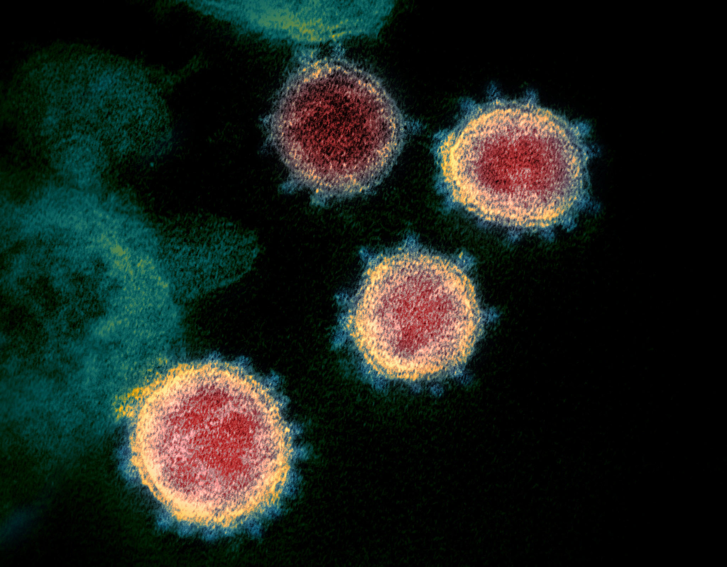
Summary of Project
Nigam Padhiar
12/1/2021
Notes:
https://www.niaid.nih.gov/news-events/novel-coronavirus-sarscov2-images

Slide 2
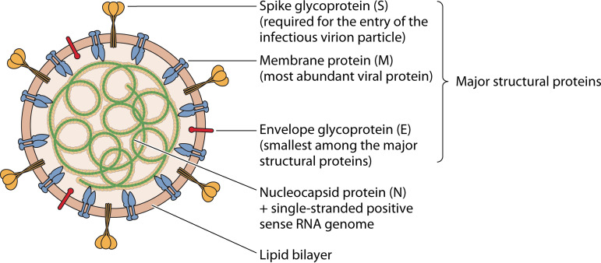
Background
Virus = SARS-CoV-2
Disease = COVID-19
First identified in Wuhan City, Hubei Province, China on December 12, 2019
Positive-sense RNA virus
Spike protein allows for cell entry, mediated through interaction with Angiotensin Converting Enzyme 2 (ACE2) receptors
Notes:
https://www.ncbi.nlm.nih.gov/pmc/articles/PMC7405836/

Slide 3
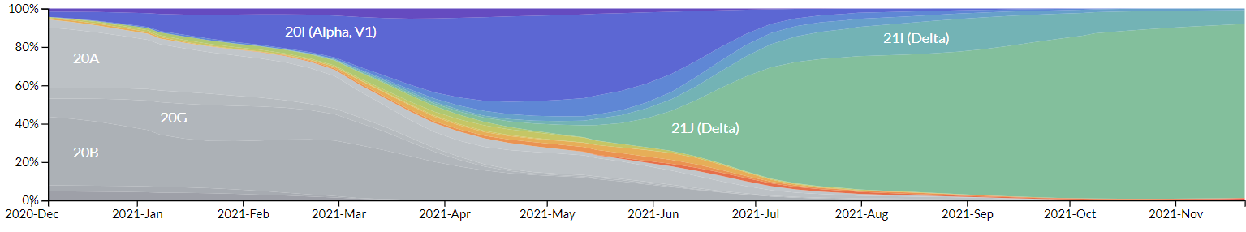
Background
Although estimates for the mutation rate of SARS-CoV-2 vary, it is generally accepted that RNA viruses have relatively high mutation rates because the RNA-dependent RNA polymerases which replicate their genomes do not have proofreading activity
This then raises the issue of antigenic drift – viruses will accumulate mutations in viral genes that host antibodies recognize, eventually leading to immune evasion
Over the course of 2020-2021, many named SARS-CoV-2 variants have emerged and supplanted previous versions
Notes:
https://journals.asm.org/doi/10.1128/JVI.01031-17
https://nextstrain.org/ncov/gisaid/north-america

Slide 4



Bioinformatics Tools & Resources
Many exist:
Nextstrain – Real-time tracking of pathogen evolution
GISAID – repository of over 5 million SARS-CoV-2 sequences
CDC – contains many API endpoints to help track data ranging from vaccination rates to daily COVID cases

Slide 5
Aims and Hypotheses
Aim 1: To obtain sequence data from the GISAID database and calculate the average Jukes Cantor (JC) Distance (from the WT reference sequence) for all spike protein sequences over a given interval of time (every 15 days) from late 2020 to November 2021
Hypothesis: As vaccination rates rise and mutations driven by antigenic drift accumulate, the average JC distance for a 15 day period at the end of 2021 will be higher than at the end of 2020
Aim 2: To calculate the variance of those same JC distances over the same interval of time
Hypothesis: As vaccination rates rise, there will be an increase in selection pressure on SARS-CoV-2, leading to the emergence of a smaller number of dominant strains that are of a similar JC distance from the WT strain (decreased variance at end of 2021 compared to the end of 2020)

Slide 6
Aims and Hypotheses
Aim 3: To calculate the proportion of unique SARS-CoV-2 spike protein sequences to total sequences over the same interval of time
Hypothesis: The proportion of unique SARS-CoV-2 sequences to total sequences will decrease when comparing a 15 day period at the end of 2021 to the end of 2020, for the same rationale as Aim #2
Aim 4: To compare the prior results with vaccination data and daily COVID-19 cases, as obtained from the CDC database
Hypothesis: Vaccination rates will steadily increase, corresponding with decreased species variation and the emergence of several dominant SARS-CoV-2 strains

Slide 7
Code Structure (methods)
3 Classes:
“cleanandcompiledata” – will take an input of several fasta files (downloaded from GISAID) and parse through all sequences, eliminating those with invalid nucleic acid denominations (‘N’, ‘Y’, etc) and isolating the spike protein from each sequence
“sequencediversity” – will take an input of the cleaned and compiled data and will calculate the JC distance and unique sequence counts using biopython modules
“vaccineandcasedata” – will use the CDC API’s to obtain and organize relevant vaccination data and daily SARS-CoV-2 cases over the given time period
After all data is obtained and cleaned, matplotlib is used to graph the results

Slide 8
Results
Raw data: 257,274 sequences downloaded from GISAID, exclusively from California
This state was selected due to the large number of available sequences
After cleaning: 125,821 spike protein sequences (~49% of original sequences) – roughly half were eliminated due to poor quality sequencing.

Slide 9
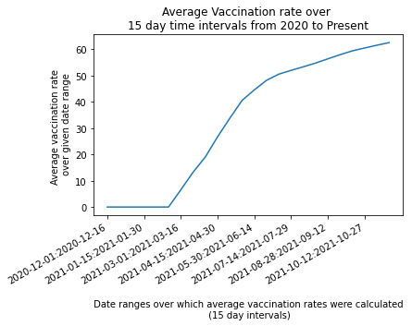
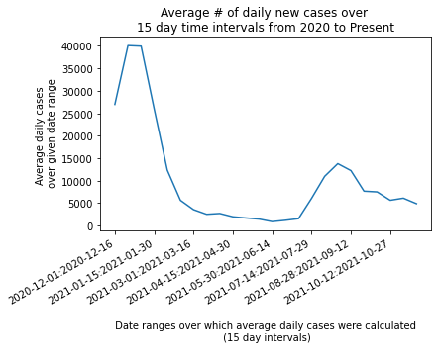
Vaccination Data & SARS-CoV-2 Daily Cases

Slide 10
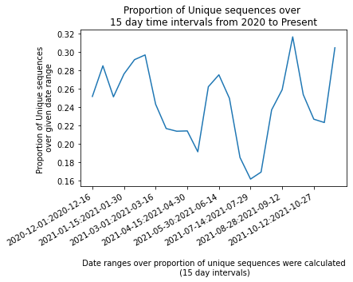
Vaccination Data and Unique Sequences

Slide 11
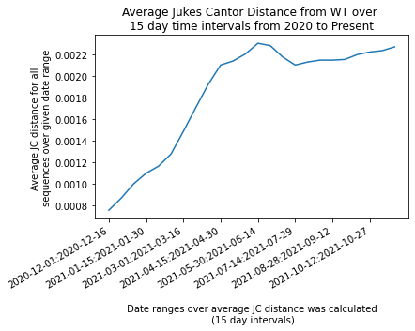
Vaccination data and Average JC Distance

Slide 12
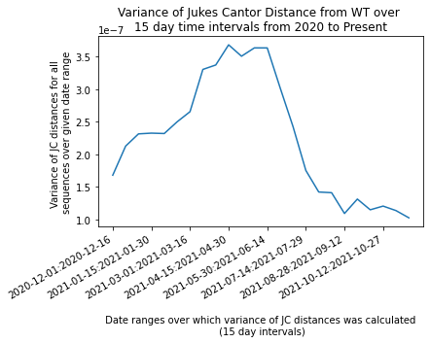
Vaccine Data and Variance of JC Distances

Slide 13
Accepting/Rejecting Hypotheses
Hypothesis #1: Accepted, average JC distance steadily rose from 2020 to the end of 2021
Hypothesis #2: Accepted, as JC distance variance began to steeply drop after vaccination rates rose
Hypothesis #3: Rejected, there appeared to not be a consistent trend with the proportion of unique SARS-CoV-2 sequences from 2020-2021
Hypothesis #4: Accepted, as there did seem to be some correlations of vaccination rate with the aforementioned calculations

Slide 14
Limitations
No single value that was calculated is truly representative of SARS-CoV-2 diversity:
For example, the proportion of unique species calculation will treat a heavily mutated sequence with the same weight as a sequence with a single base pair substitution
Conversely, the JC distance variance calculation will not identify any difference in two different sequences if they are the same phylogenetic distance from the WT
None of these data imply causation (ex: vaccination results in more/less unique species) – this would need far more empirical evidence
Some of the data collection is extremely time consuming
Despite being the largest database of SARS-CoV-2 sequences, GISAID only allows 10,000 sequences to be downloaded at once, and has no API (that I could locate) to enable expedient data collection
Additionally, all sequences need to be aligned (or at least have a match score calculated) with the WT sequence – on my computer, this took over two hours to run

