Slide 1
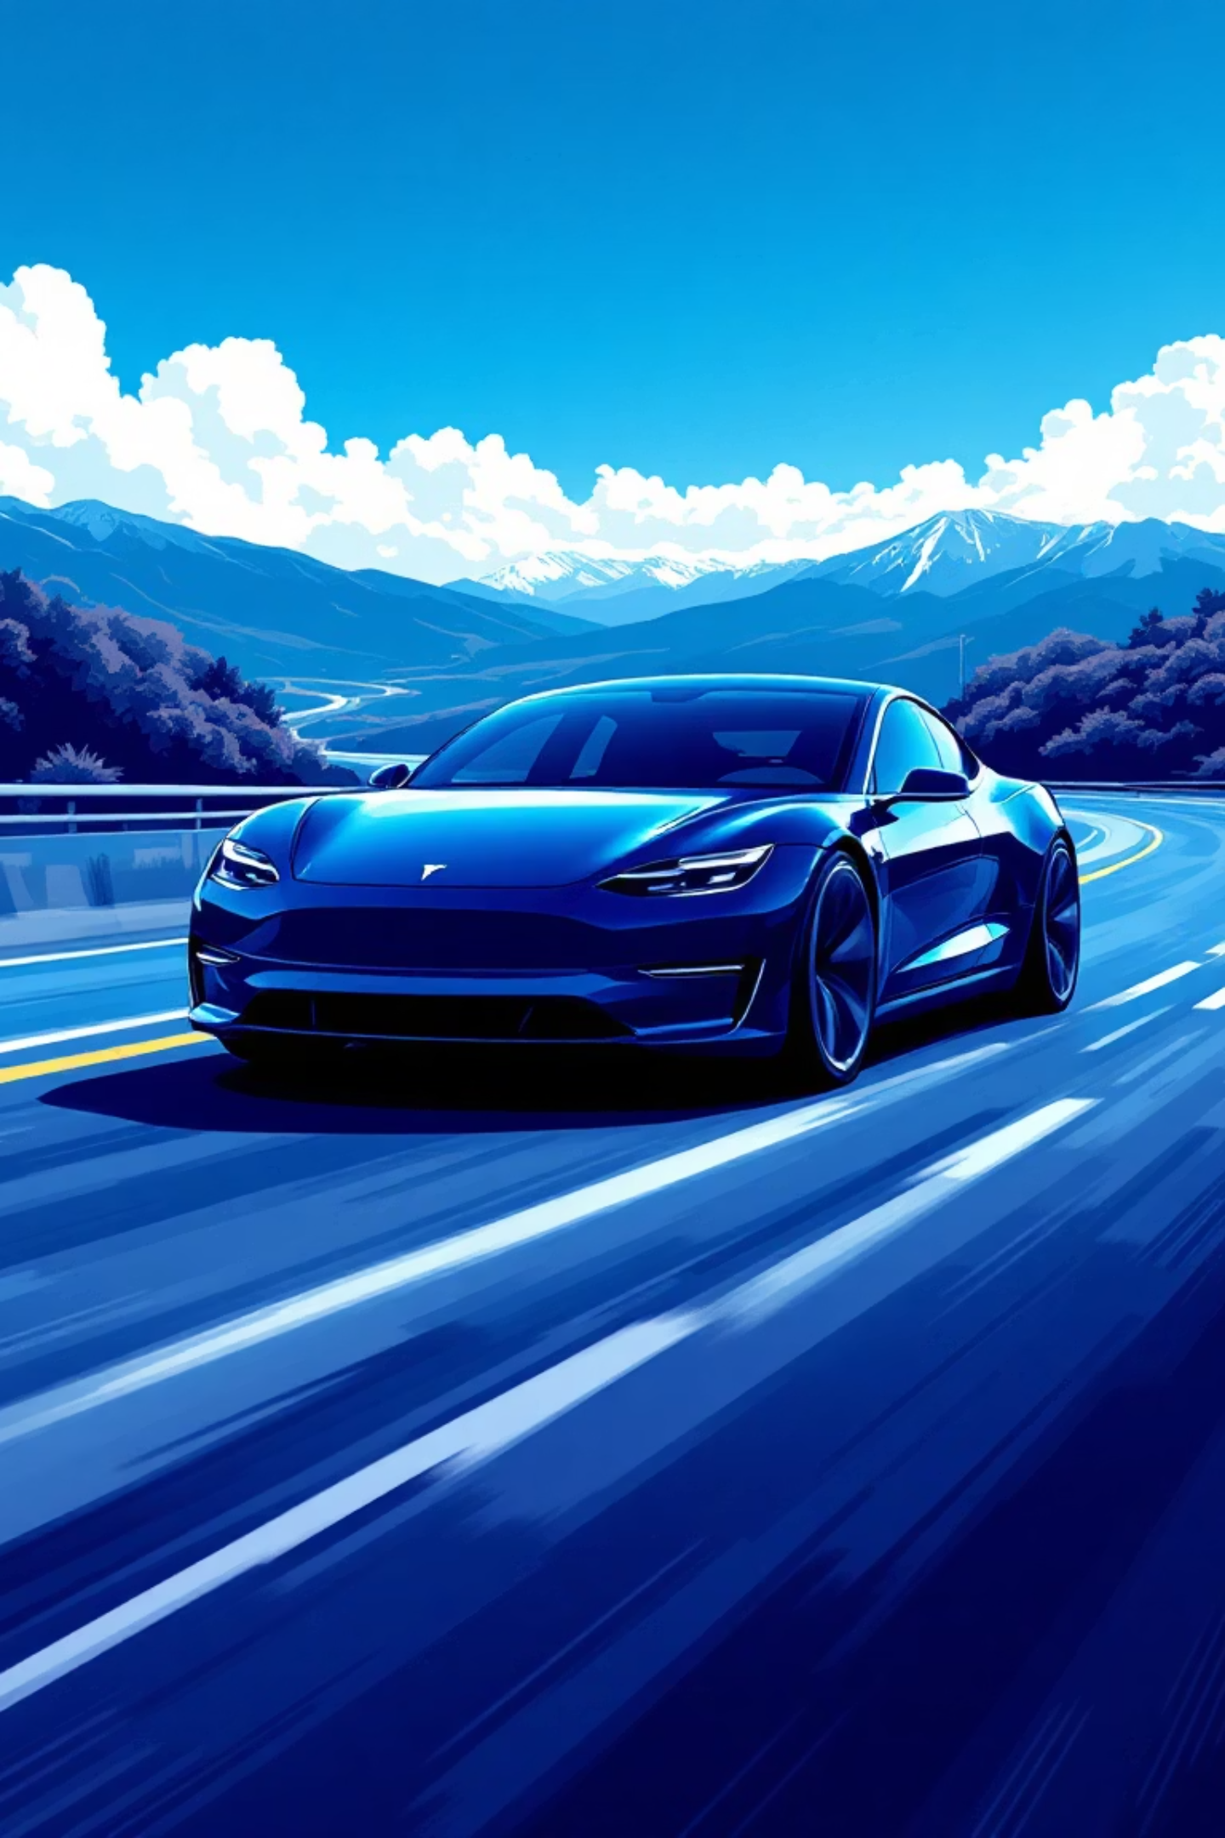
Media Coverage & Brand Intelligence Report
Brand: Tesla | Data Source: NewsAPI | Analysis Period: Recent Coverage Window
Prepared by: Shivanshu Nigam

Slide 2


Why Media Intelligence Requires Structured Analysis
Objective Measurement
Trend Identification
Risk Detection
Structured coding enables consistent classification of coverage volume, sentiment, and topic distribution.
Systematic analysis reveals patterns in media attention and narrative shifts over time.
Monitoring coverage volatility and sentiment changes helps identify potential reputation risks early.

Slide 3
Executive Summary
Coverage Stability
Topic Distribution
Volume remained consistent with no major spikes, indicating absence of crisis-driven attention or breaking news events.
Technology narratives dominated coverage, followed by finance-related discussions reinforcing innovation-centric perception.
Sentiment Shift
Brand Visibility
Gradual movement toward neutral coverage with declining negative sentiment and modest reduction in positive framing.
Most articles referenced Tesla as secondary mention, suggesting steady visibility within broader industry contexts.

Slide 4
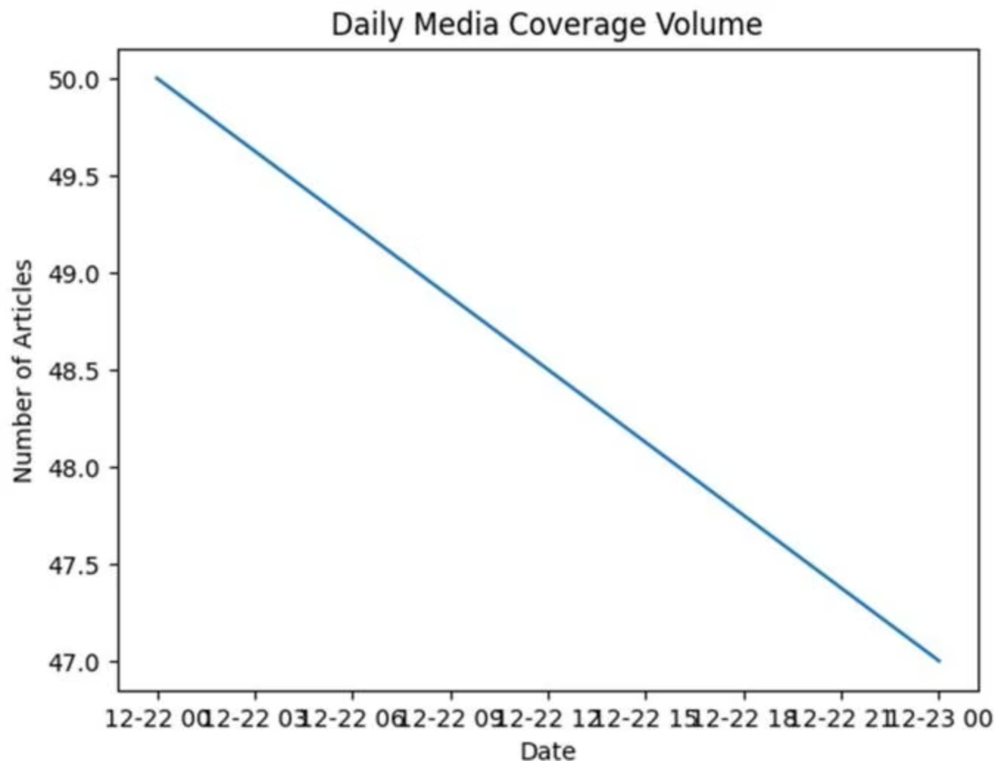
Daily Media Coverage Volume
Key Insight
Coverage remained consistent throughout the period, with daily article counts fluctuating within a narrow range (47-50 articles).
No sharp spikes suggest stable media attention with no major events during this timeframe.

Slide 5
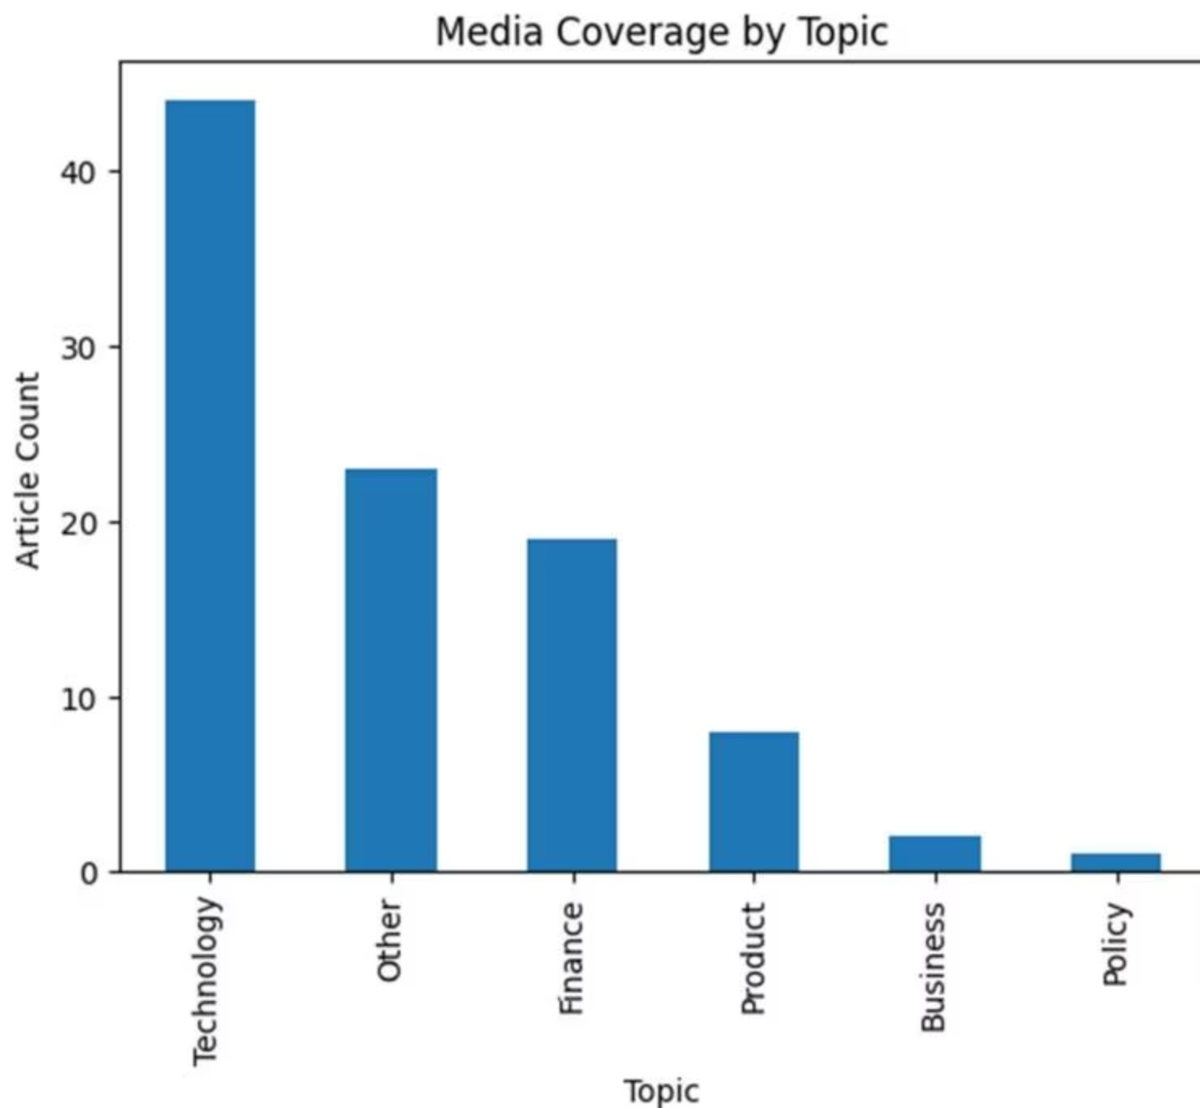
Media Coverage by Topic
Technology: 45 articles
Dominant topic accounting for majority of coverage
Finance: 19 articles
Market performance and investor discussions
Product: 8 articles
Limited product-focused coverage
Policy: 1 article
Minimal regulatory developments

Slide 6
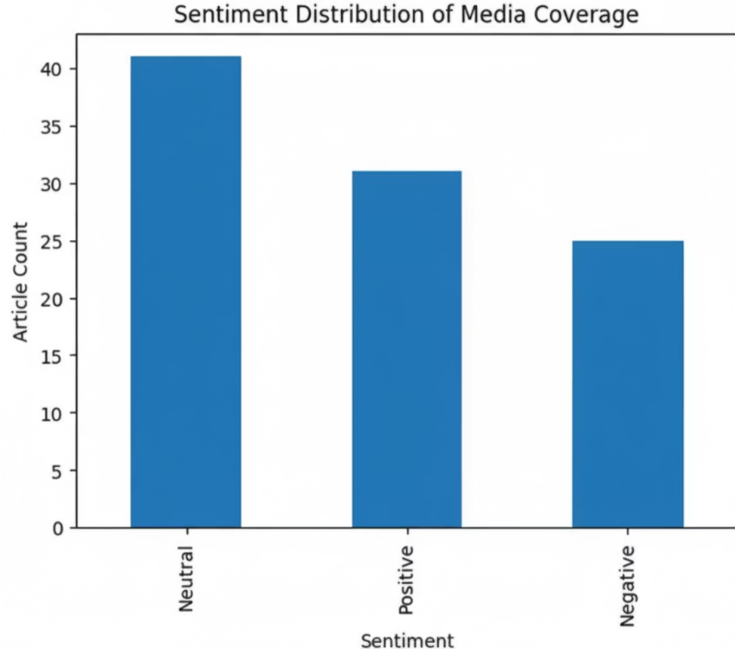

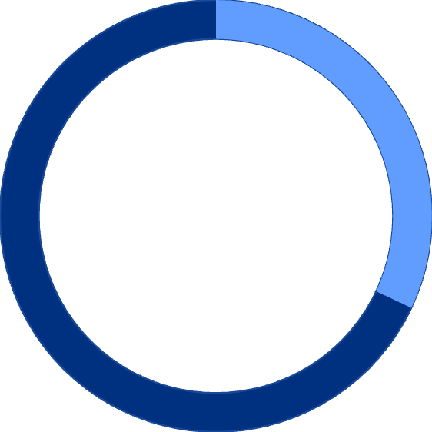
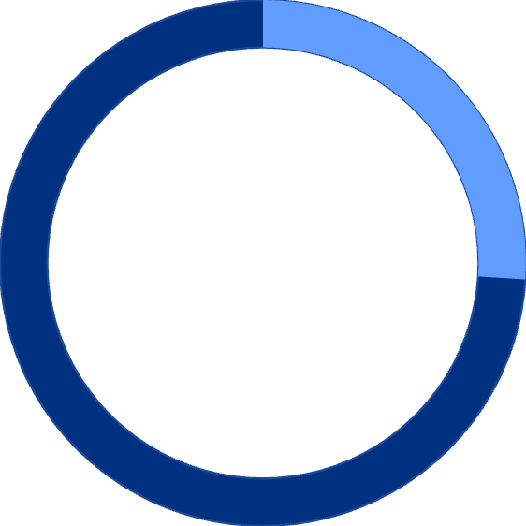
Overall Sentiment Distribution
42%
32%
26%
Neutral
Positive
Negative
Factual reporting
Favorable framing
Critical coverage
Neutral sentiment dominated, reflecting predominantly informational reporting with positive sentiment outweighing negative.

Slide 7
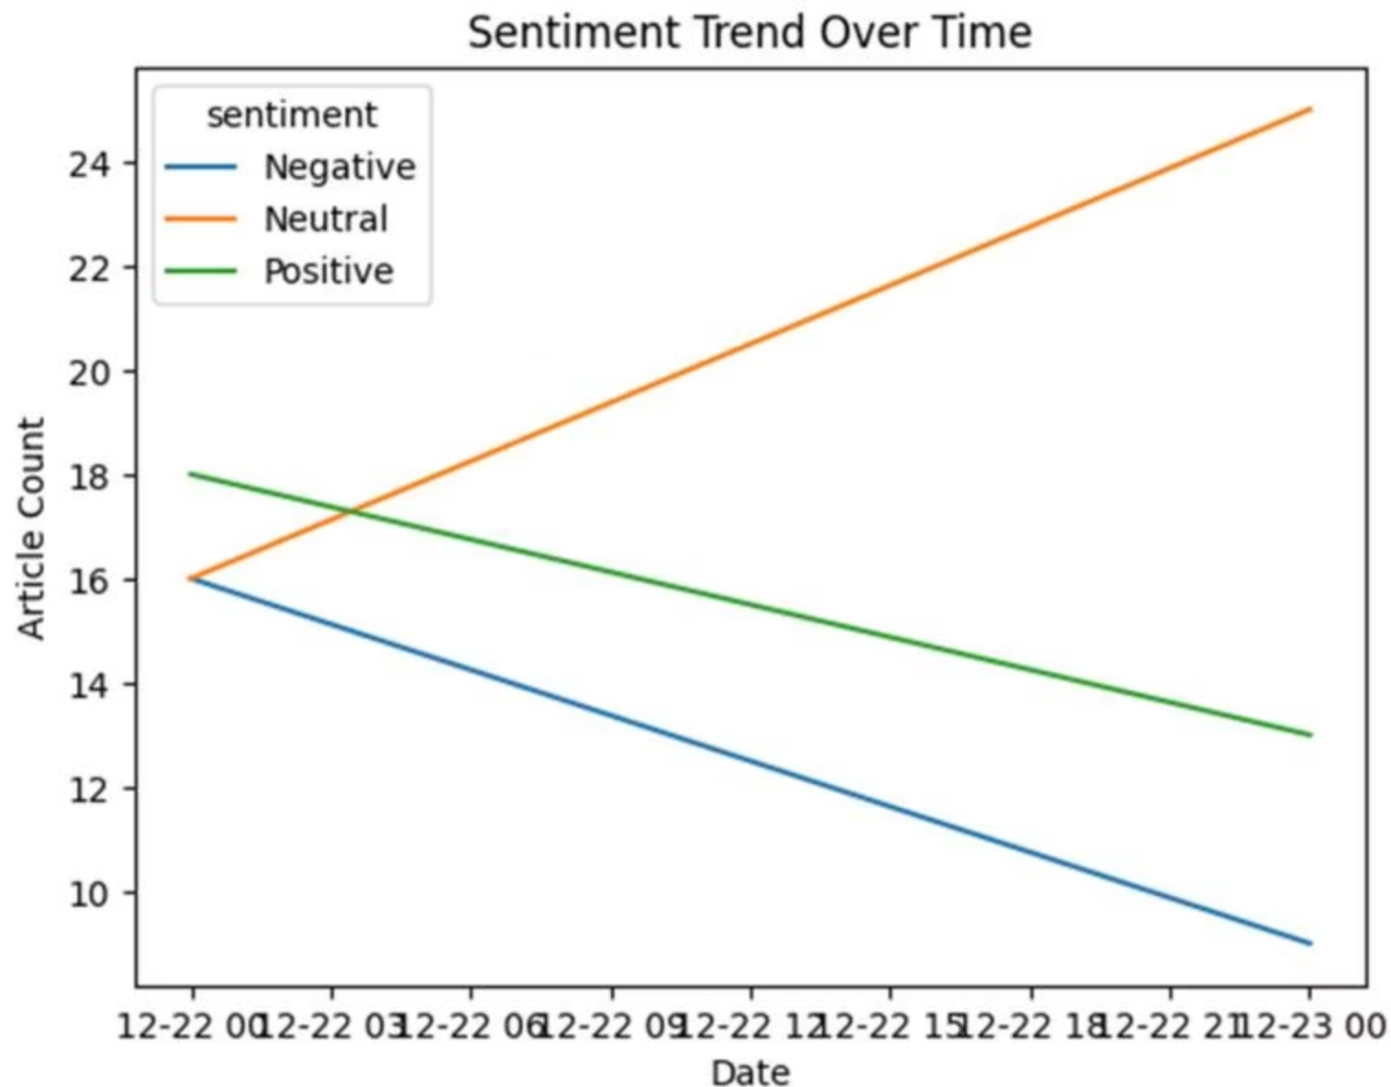



Sentiment Trend Over Time
Negative Declined
From 16 to 10 articles, indicating less critical coverage
Neutral Increased
From 16 to 24 articles, shift toward factual reporting
Positive Decreased
From 18 to 13 articles, reduced favorable framing

Slide 8
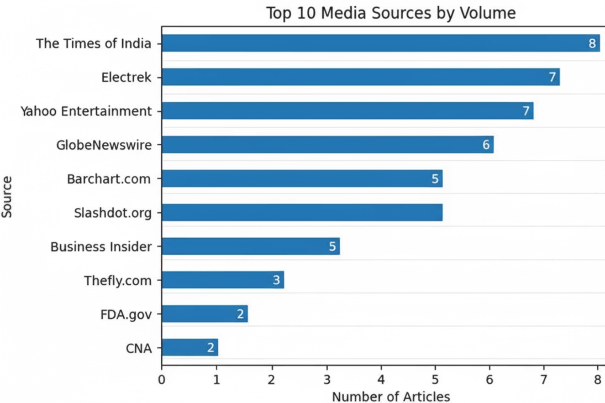

Top Media Sources
Key Finding: Coverage was distributed across multiple publishers with no single outlet dominating. The Times of India led with ~8 articles, followed by Electrek and Yahoo Entertainment. This dispersion suggests broad but moderate media attention.

Slide 9
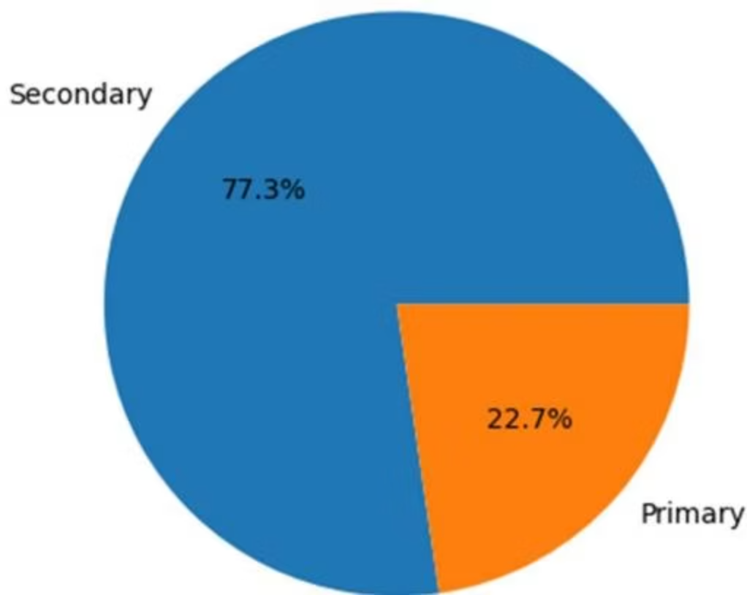
Brand Mention Analysis
77%
23%
Secondary Mentions
Primary Focus
Tesla referenced within broader industry or market discussions
Articles with Tesla as main subject
Tesla frequently appeared in wider contexts rather than being the sole coverage focus, indicating steady brand visibility across industry narratives.

Slide 10
Key Analytical Takeaways
Stable Coverage Pattern
Technology Narrative Dominance
Media coverage remained stable with no volatility-driven risk indicators or sudden attention shifts during the analysis period.
Technology topics dominated coverage, reinforcing an innovation-centric media perception of the brand.
Sentiment Normalization
Distributed Publisher Landscape
Neutral sentiment increased over time, indicating shift toward factual and informational reporting with reduced critical framing.
Coverage spread across multiple publishers reduces concentration risk and indicates broad industry relevance.

Slide 11




Strategic Observations & Recommendations
Monitor Technology Narratives
Track technology-focused coverage for early indicators of product or innovation-related narrative shifts.
Track Finance Coverage
Monitor finance-related discussions closely during earnings announcements or major market movements.
Increase Primary Mentions
Implement proactive media engagement strategies to drive higher share of primary brand mentions in coverage.

Slide 12

Data Quality, Limitations & Closing Notes
Methodology
Known Limitations
Articles collected via NewsAPI
Analysis based on limited time window
Rule-based classification framework
English-language articles only
URL-level deduplication applied
Rule-based coding may classify nuanced topics under "Other"
Timestamp normalization to UTC
Coding consistency checks performed
Secondary mentions may underrepresent brand prominence
This report provides structured analysis of recent media coverage. Results should be interpreted within the context of the specified time window and data collection parameters

