Slide 1
Relocation Support
Capstone Presentation
IBM Applied Data Science Capstone on Coursera
Nigar Rustamova

Slide 2
Relocation opportunities
Globalised world facilitates people moving around to take good opportunities
Relocation by itself also brings opportunities for service providers
Supporting people selecting possible districts or neighbourhood in their target location brings great value

Slide 3
Project Goal
Create a Districts Rank for selected target location using relocator requirements.

Slide 4
Input data
Relocation family profile
2 adults / 2 kids / 1 dog as pet
Family priority list
Primary school
Outdoor park
Supermarket
Pharmacy
Metro station

Slide 5
Input data
Housing wishes
Apartment 2 or 3 bedrooms
80 m² approx.
1 garage spot
Rental budget
BRL 2000.00 per month (BRL 25.00/m²)
Tolerance range +-5%: 23.75 - 26.25 BRL/m²

Slide 6
Input data
Target location - São Paulo, Brazil
Over 12 million inhabitants in capital city
Over 22 million inhabitants in metropolitan area
Main financial and business location in South America
It responds for 11% of Brazilian GDP

Slide 7
Acquired data
São Paulo districts information
96 districts in 5 regions
Data scraped from city São Paulo official website
http://www.capital.sp.gov.br/
Rental prices
Mean rental prices per district in BRL/m²
Data scraped from Blog SP Imóvel
http://www.spimovel.com.br/

Slide 8
Acquired data
Districts geolocation
Coordinates per district
Data acquired with Geopy package
Venues information
Venues categories per district
Data acquired with API Foursquare

Slide 9
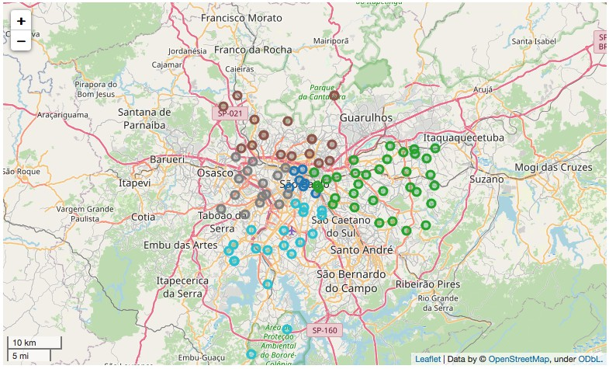
São Paulo Map
Districts coloured by region

Slide 10
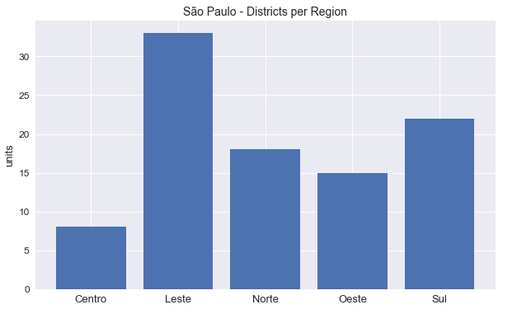
São Paulo Regions
Districts counting per region

Slide 11
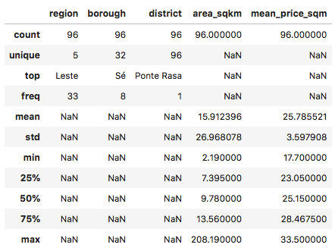
Districts and Rental Prices
Rental prices (BRL/m²⁾
Min = 17,70
Max = 33,50
Q1 = 23.05
Q3 = 28,47

Slide 12
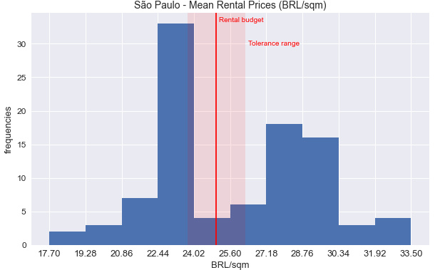
Mean Rental Price
Histogram with rental budget

Slide 13
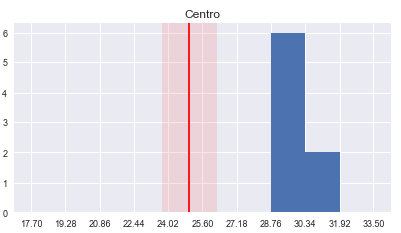
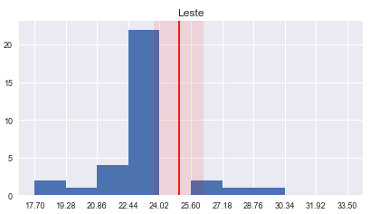
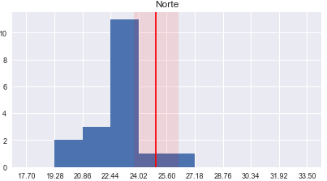
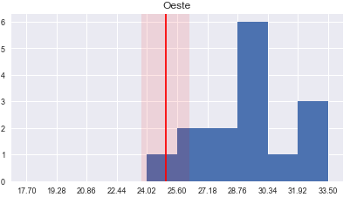
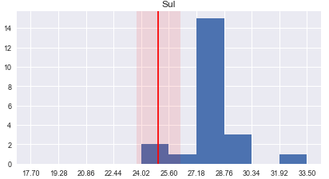
Mean Rental Price
Region histograms with rental budget

Slide 14
Clustering Algorithm
DBSCAN - Density-Based Spatial Clustering of Applications with Noise
Clusters with different densities
Clusters with different sizes
Clusters with different shapes
No need of setting number of clusters
Outliers and noise identification

Slide 15
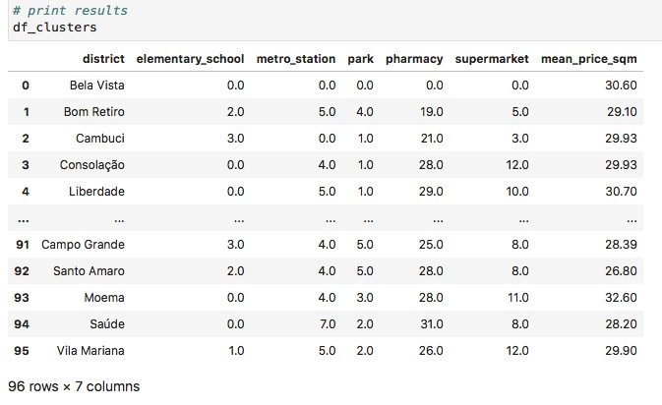
Clustering features
Venues categories counting
Mean rental price

Slide 16
Clustering data preparation
District name removed
Venues categories counting converted to
0 when counting = 0
1 when counting > 0
Mean rental price converted to rental groups
0 when below tolerance range (below 23.75)
1 when into tolerance range (between 23.75 and 26.25)
2 when above tolerance range (above 26.25)

Slide 17
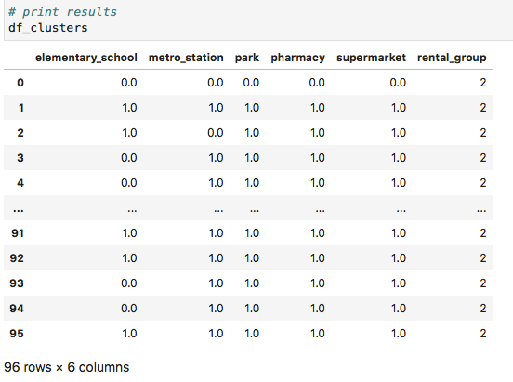
Clustering features ready

Slide 18
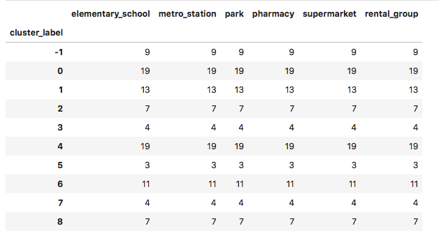
Clustering Results
Clusters size

Slide 19
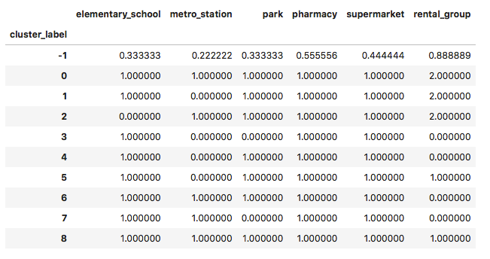
Clustering Results
Clusters characteristics by mean value

Slide 20
Districts Rank (cluster analysis)
Outliers
Group -1
Priority List not satisfied
Cluster 1, missing Metro Station
Cluster 2, missing Elementary School
Cluster 3, missing Metro Station and Park
Cluster 4, missing Metro Station
Cluster 5, missing Metro Station
Cluster 7, missing Park

Slide 21
Districts Rank (cluster analysis)
Priority List satisfied
Cluster 0, Rental Group 2 (above rental price tolerance range)
Cluster 6, Rental Group 0 (below rental price tolerance range)
Cluster 8, Rental Group 1 (into rental price tolerance range)

Slide 22
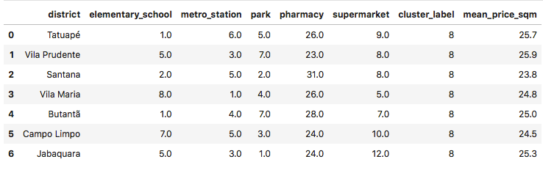
Districts Details
Cluster 8 - Relocator requirements satisfied

Slide 23
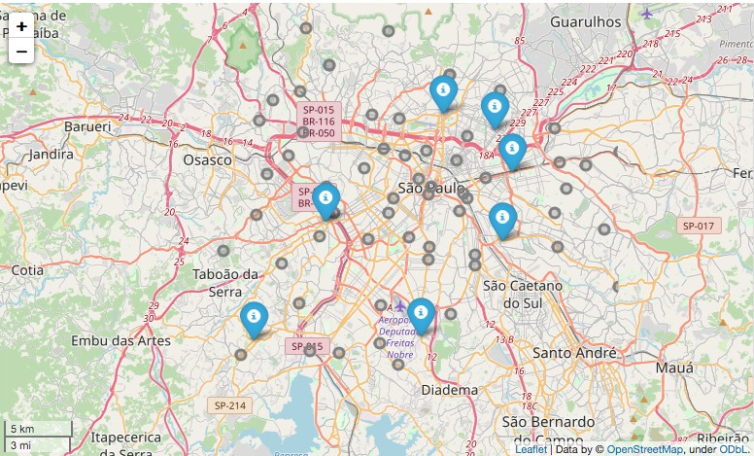
São Paulo Map
Selected districts in Cluster 8

Slide 24
Conclusion and Future directions
The solution successfully created Districts Rank to satisfy Relocator Requirements
It has market value, Relocation Service Providers could make use of it to improve and speed up locations selection
It could be enhanced to a configurable and flexible solution, including additional parameters for searching features
It could be enhanced also to select rental ads. after creating the rank
The solution has a great potencial for future developments.

