Slide 1
Spam Email Classification Using Machine Learning
An Intelligent System for Detecting Spam and Legitimate Emails
1.Vibhavari Kadam
2.Yash Kharode
3.Aditya Nigde
PRESENTED BY
DOMAIN
Machine learning

Slide 2
Introduction
Email is one of the most widely used communication methods.
1
Unwanted emails, advertisements, and fraudulent messages are commonly received.
2
Spam emails may contain misleading information and suspicious links.
3
Manually identifying spam emails requires time and attention.
4
Machine Learning can automatically classify emails into Spam and Legitimate categories.
5

Slide 3
Problem Statement
Increasing numbers of unwanted emails make inbox management difficult.
1
PROBLEM STATEMENT
To develop a Machine Learning-based system that automatically identifies whether an email message is Spam or Legitimate.
Manual identification of spam emails is time-consuming.
2
Suspicious emails can expose users to misleading content.
3
Traditional filtering methods may fail to recognize new spam patterns.
4

Slide 4
Objectives
1
2
3
Develop an automated spam email classification system.
Apply NLP techniques to clean email text.
Convert text into numerical features using TF-IDF.
4
5
6
Train a Linear SVM classification model.
Classify user-provided messages into Spam and Legitimate categories.
Develop a simple and interactive web interface.

Slide 5
Existing System
Traditional email filtering uses predefined rules and keyword matching.
1
Some systems depend on manually created spam filters.
2
Rule-based systems may not recognize new spam patterns.
3
Manual filtering can be time-consuming.
4
Machine Learning provides a more flexible approach by learning from examples.
5

Slide 6
Proposed System
1
2
3
The proposed system uses Machine Learning to classify email messages.
Users enter or paste an email message into the application.
The input text is cleaned using preprocessing techniques.
4
5
6
TF-IDF converts the text into numerical features.
A trained Linear SVM model predicts the category.
The result is displayed as Spam Email or Legitimate Email.

Slide 7
Technologies Used
Technology | Purpose
Python | Main programming language
Pandas | Dataset handling
NumPy | Numerical operations
Scikit-learn | Machine Learning
NLP | Text processing
TF-IDF | Feature extraction
Linear SVM | Classification algorithm
Streamlit | Web application interface
Pickle | Saving trained models

Slide 8
Dataset Description
The system is trained using a labelled email/message dataset.
1
Each record contains text and its corresponding category.
2
The dataset teaches the model the difference between Spam and Legitimate messages.
3
The dataset is divided into training and testing sets.
4
The model learns patterns from the training data and is evaluated using testing data.
5

Slide 9
Text Preprocessing
Text preprocessing prepares raw email messages for Machine Learning.
1
2
3
Convert text into lowercase.
Remove URLs.
Remove email addresses.
4
5
6
Remove numbers.
Remove punctuation.
Remove unnecessary spaces.

Slide 10
TF-IDF Feature Extraction
Machine Learning algorithms require numerical input.
1
TF-IDF converts text into numerical feature vectors.
2
It identifies important words based on their frequency and importance across documents.
3
These numerical features are provided to the classification model.
4

Slide 11
Machine Learning Algorithm: Linear SVM
Support Vector Machine is a supervised Machine Learning algorithm.
1
Linear SVM is used for classifying text into different categories.
2
It learns patterns from labelled training data.
3
It identifies a decision boundary between Spam and Legitimate messages.
4
The trained model predicts the category of new input messages.
5

Slide 12
System Architecture
The system follows these steps:
1
2
3
4
5
6
User enters an email message.
Streamlit receives the input.
Text preprocessing cleans the message.
TF-IDF converts the text into numerical features.
Linear SVM performs classification.
The result is displayed to the user.
›
›
›
›
›

Slide 13
Implementation
The project is implemented using Python and Streamlit.
Main Project Files
File | Description
app.py | Application code
spam_model.pkl | Trained classification model
vectorizer.pkl | Saved TF-IDF vectorizer
Spam_Email_Classification.ipynb | Model training notebook
run_app.bat | Application launcher

Slide 14
Results and Testing
The system is tested using different email messages.
Input Type | Expected Output
Promotional spam message | Spam
Suspicious unwanted message | Spam
Normal personal email | Legitimate
Regular communication message | Legitimate
Performance Evaluation
Accuracy
Precision
Recall
F1-score
Confusion Matrix

Slide 15
Conclusion and Future Scope
Conclusion
Future Scope
Successfully developed a Machine Learning-based spam email classification system.
Used NLP and TF-IDF for text processing and feature extraction.
Implemented Linear SVM for classification.
Developed an interactive Streamlit interface.
The system predicts whether an input message is Spam or Legitimate.
Support email dataset updates.
Improve detection of new spam patterns.
Add multilingual email classification.
Integrate with email platforms.
Explore advanced Deep Learning techniques.

Slide 16
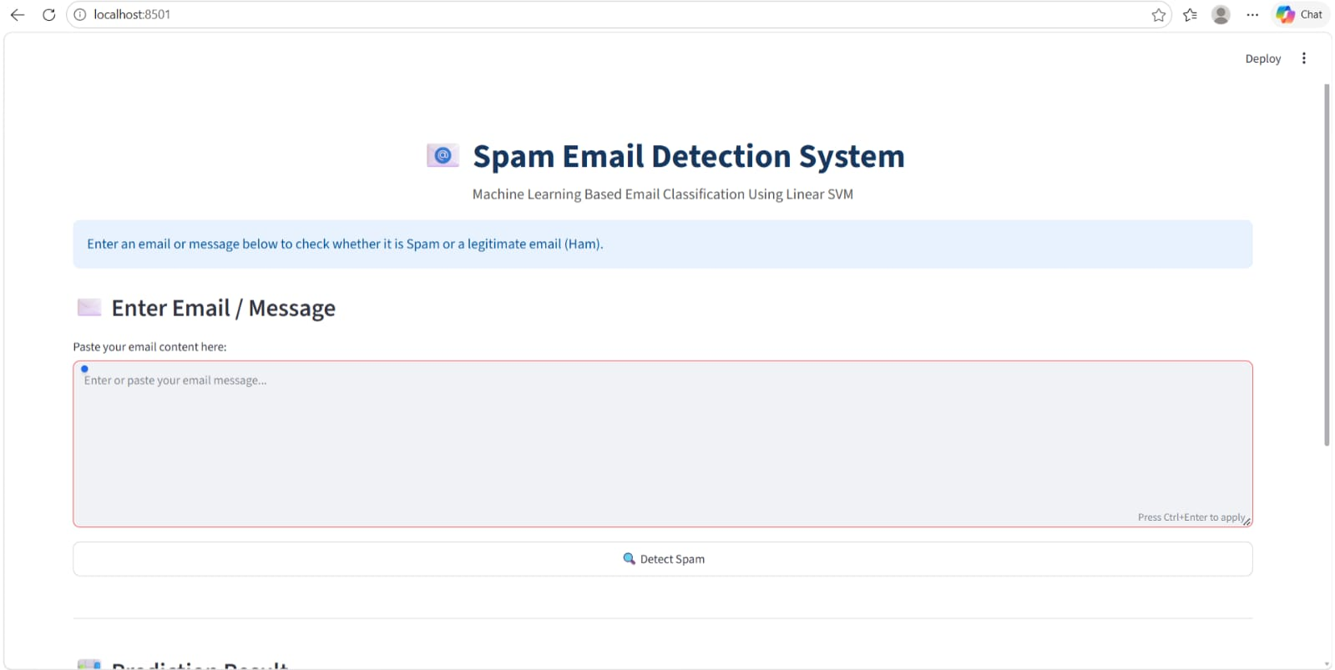
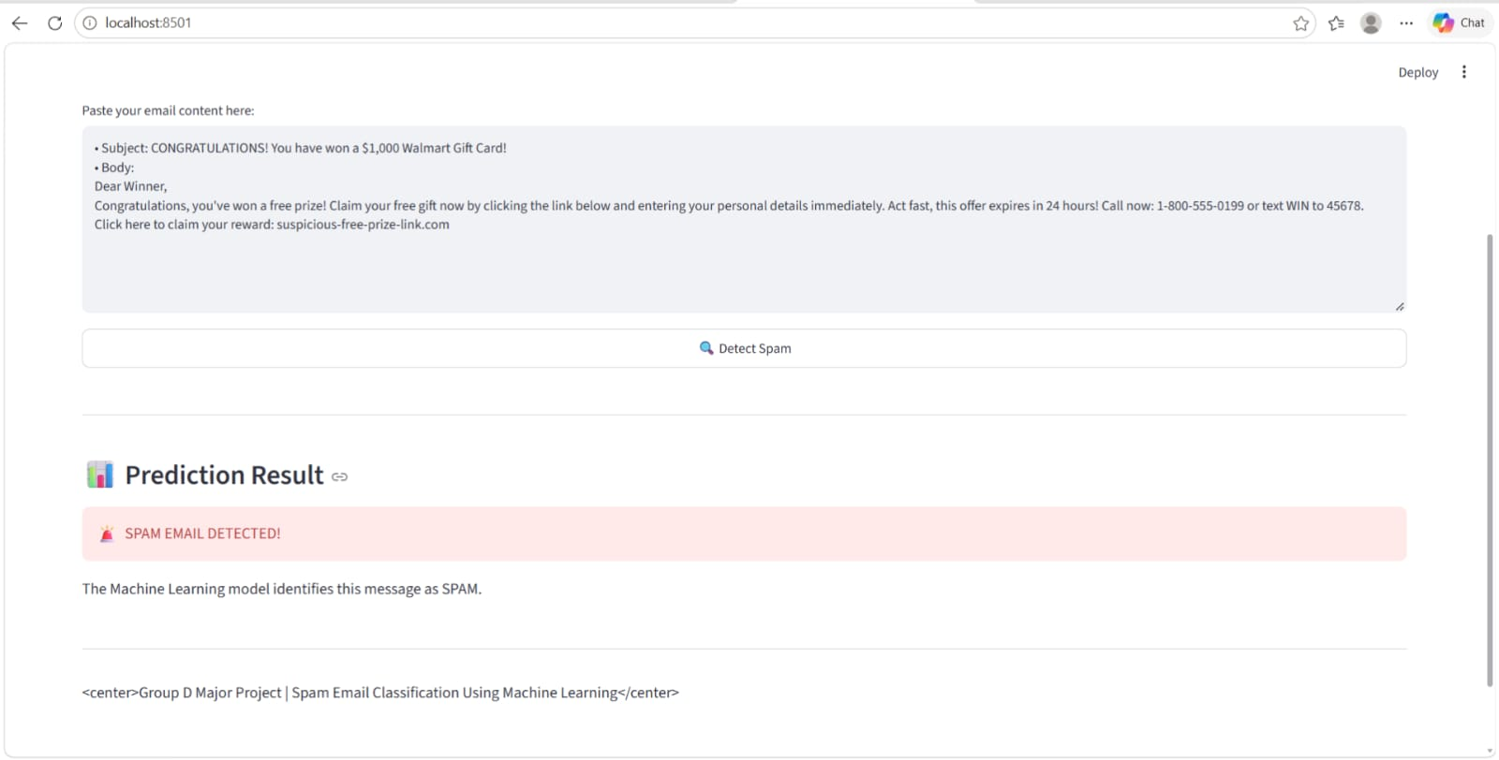
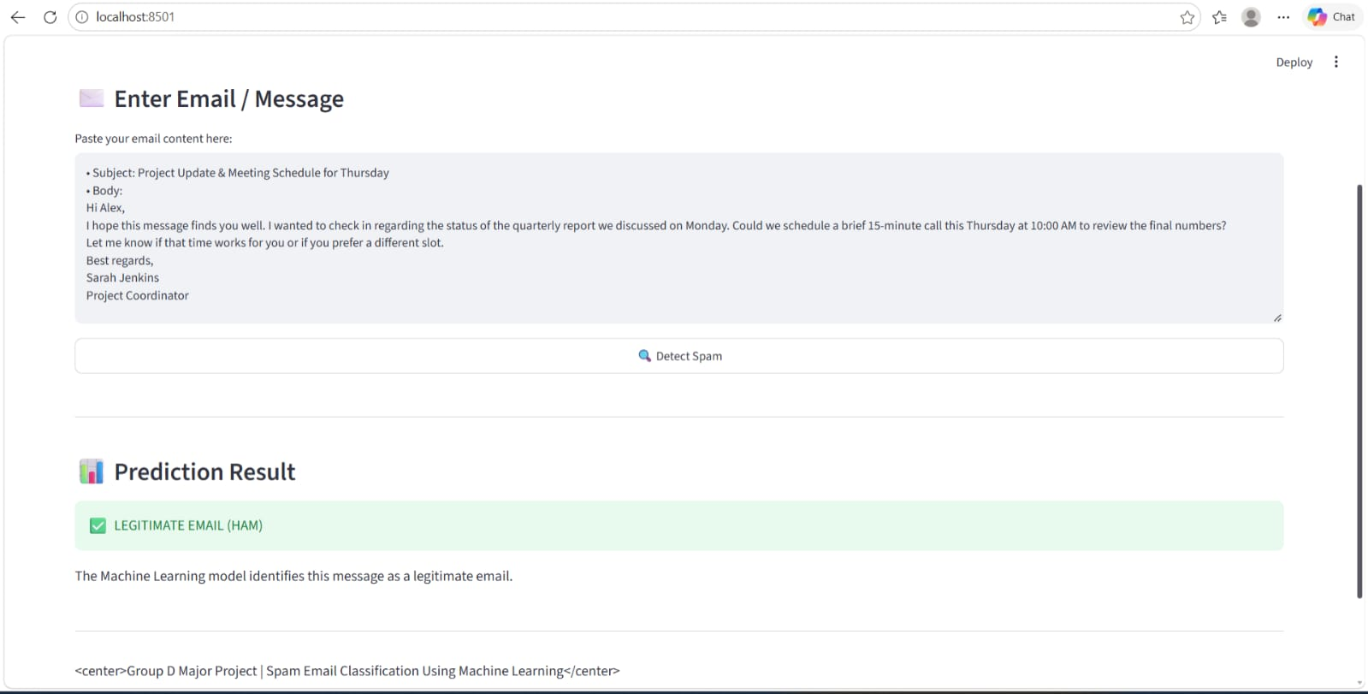
Project Screenshots and Visuals
Spam Email Detection homepage and email input interface
Spam email prediction result
Legitimate email prediction result

