Slide 1
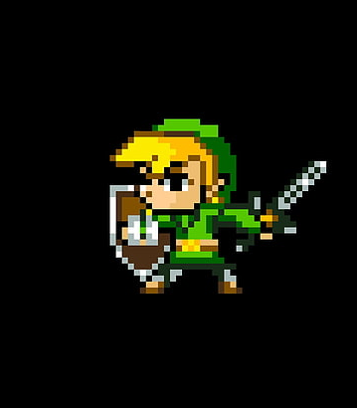
Zelda
A Basic text base java game for beginners

Slide 2
Project description

Slide 3
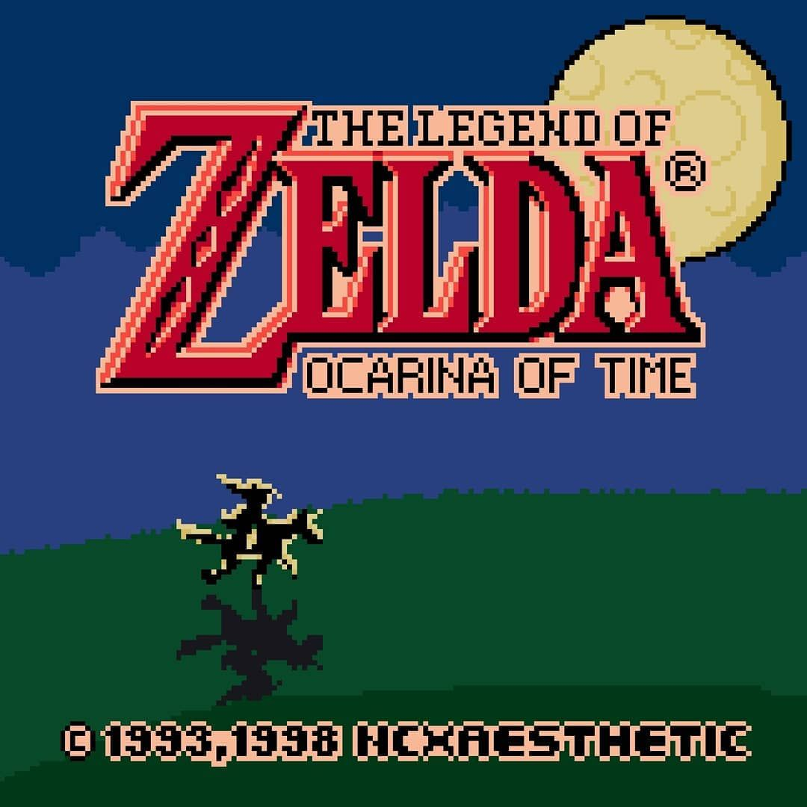
Our concept base on:
Zelda, a 1986 action-adventure video game created by Japanese game designers Shiguru Miyamoto and takashi Tezuka. The series centers on various incarnations of Link, the player character and chief protagonist. Link is often given the task of rescuing Princess Zelda and the kingdom of Hyrule from Ganon, an evil warlord turned demon who is the principal antagonist of the series; however, other settings and antagonists have appeared in several games. The plots commonly involve the Triforce, a relic representing the virtues of Courage, Wisdom and Power that together are omnipotent. The protagonist in each game is usually not the same incarnation of Link, but a few exceptions exist.

Slide 4
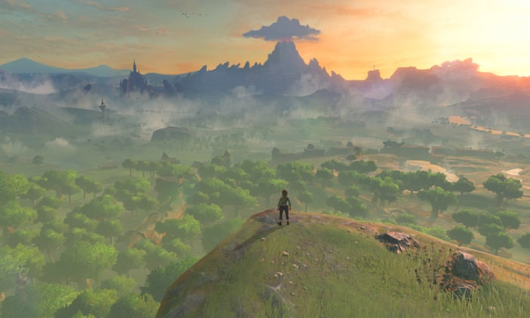
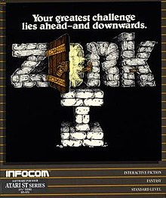
Algorithm and Gameplay based on:
Zork is one of the earliest interactive fiction computer games, with roots drawn from the original genre game “Colossal Cave Adventure.” The first version of Zork was written between 1977 and 1979 using MDL programming language on DED PDP-10 computer.

Slide 5
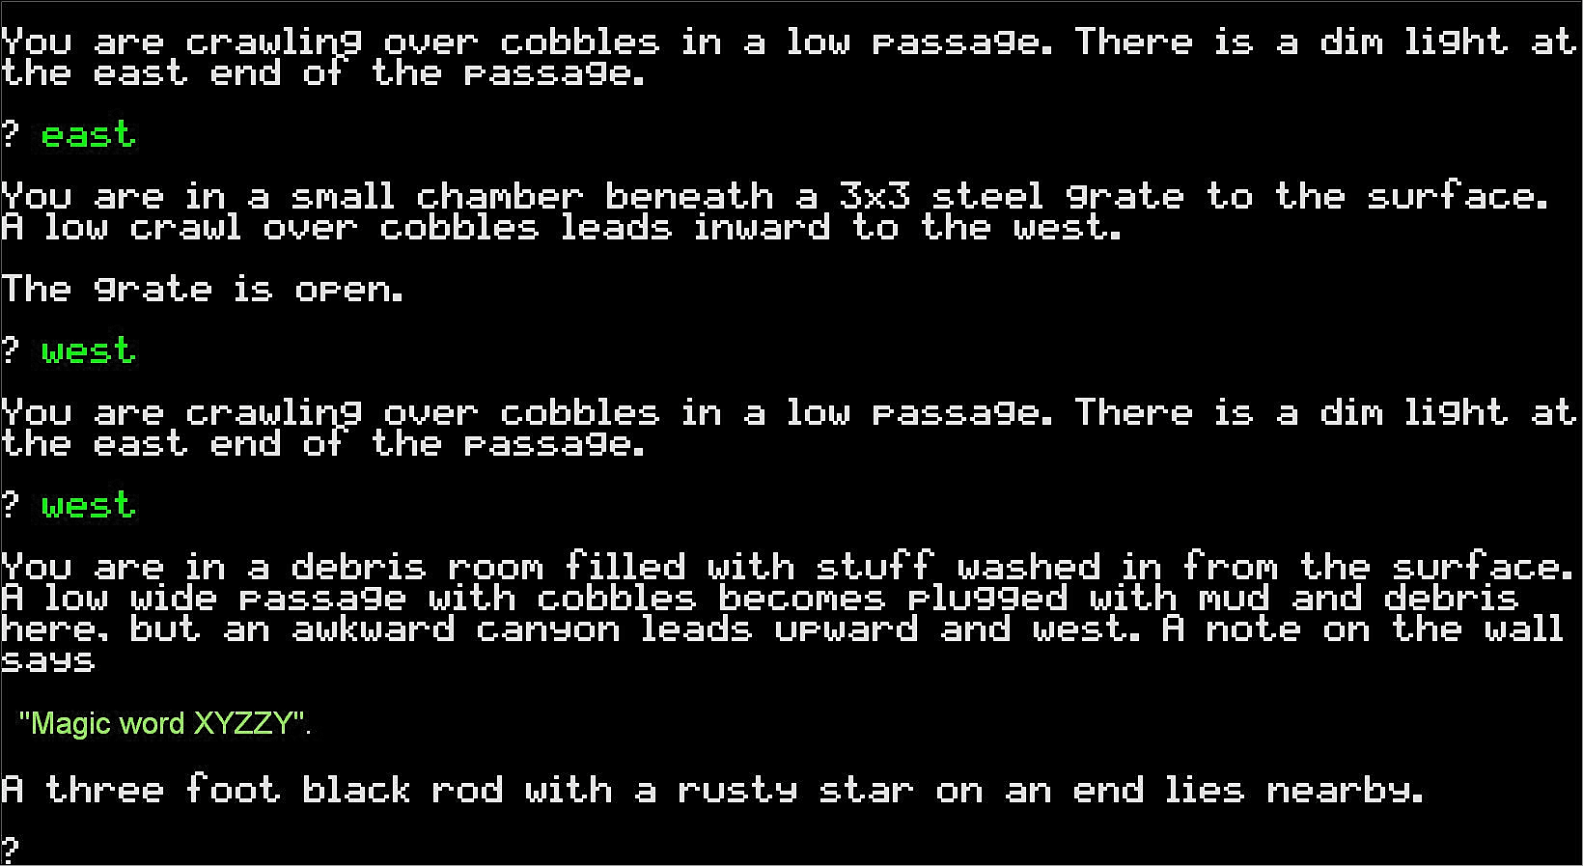
Text-based games have been well documented since at least the 1960s, when teleprinters were interlaced with mainframe computers as a form of input, where the output was printed on paper. With that, notable titles were developed for those computers using the teleprinter in the 1960s and 1970s, and numerous more have been developed for video terminals since at least the mid-1970s, having reached their peak popularity in that decade and the 1980s, and continued as early online games into the mid-1990s.

Slide 6
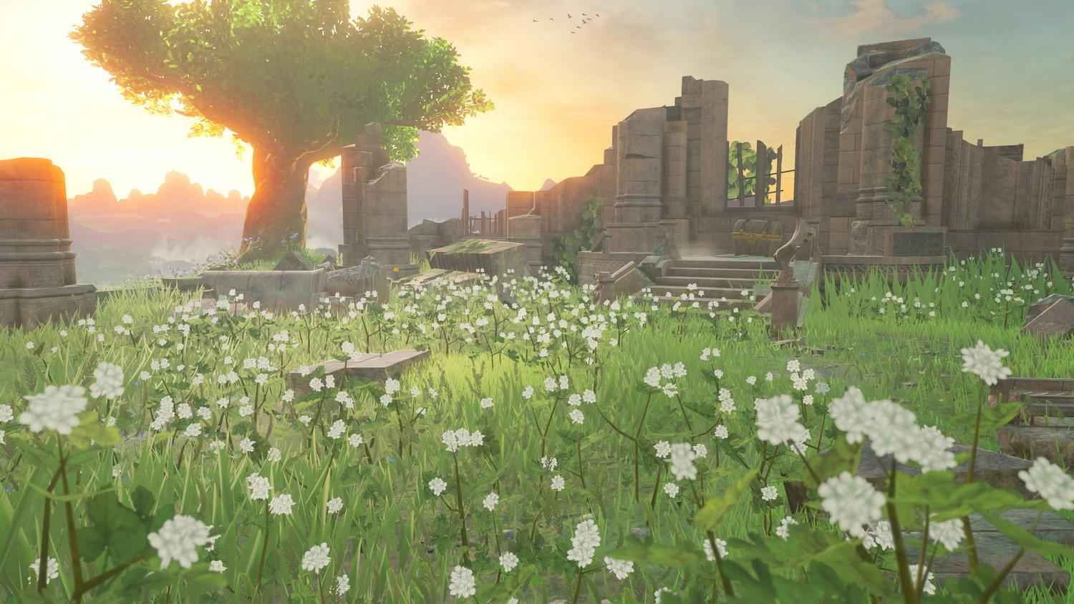
Game Description

Slide 7
A nomad man are on his journey to find a new home, while travelling he saw a town full of resources, while trying to go to that town he was surrounded by guards of the town and didn’t allow him to enter the town. So he goes another way around, while travelling again he encounters a goblin and fought it until the goblin is defeated, after defeating the goblin he obtain a valuable item and present it again to the guard town, the guard town were shock and rejoice with happiness. After of that certain events the town guard let the nomad man enter their town.

Slide 8
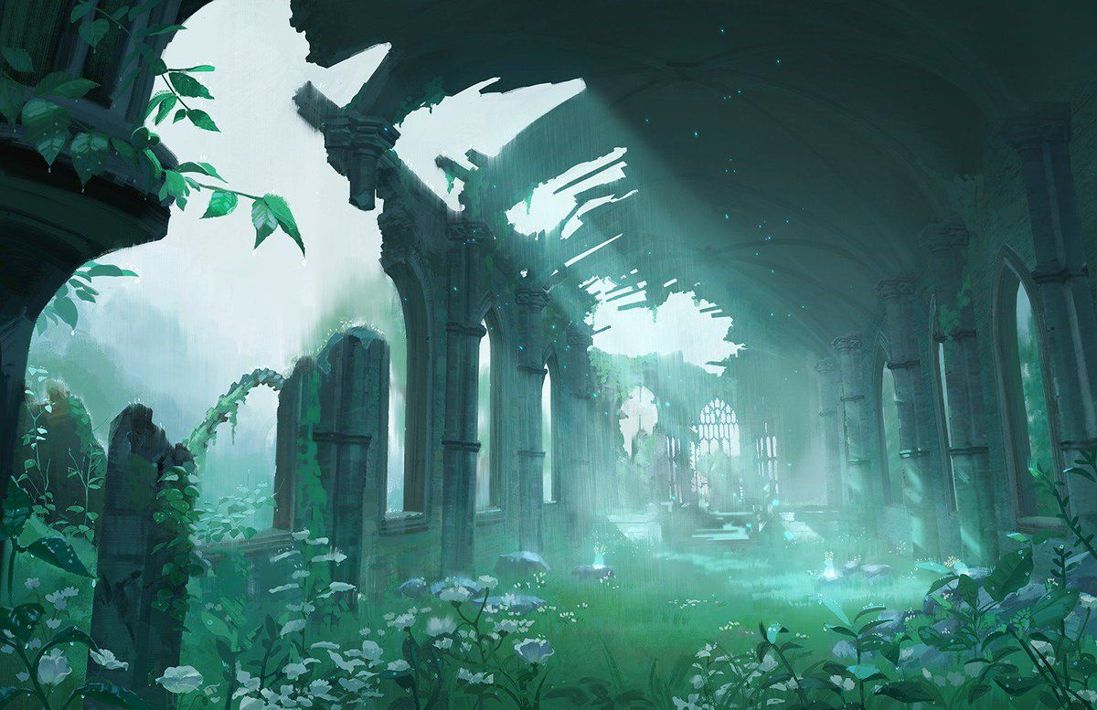
Basic Gameplay

Slide 9
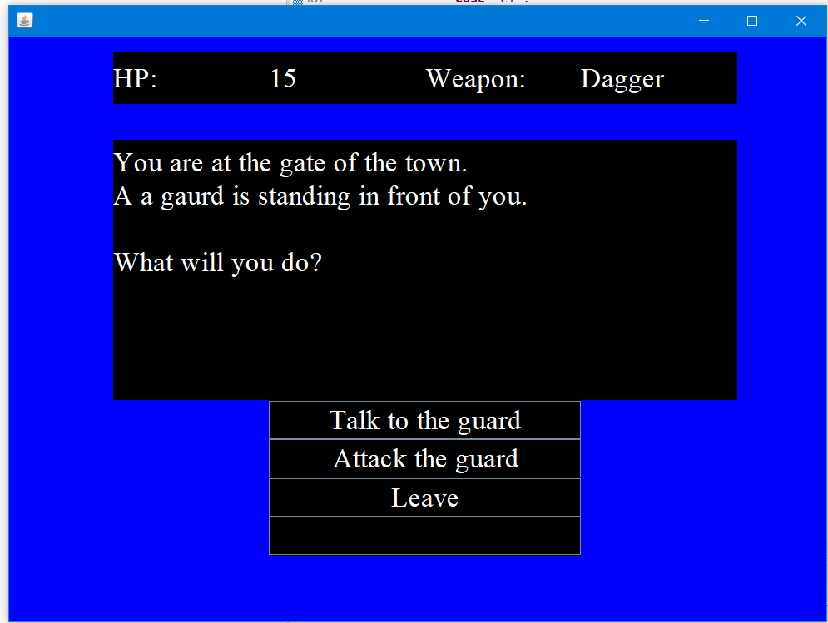
>Choices boxes
Our game is not that complicated all you need to do is choose between the choices and the story will proceed depending on the choice you make
>Start
Will go to the panel and will start the game

Slide 10
How to Finish the game
>Explore the north, east, and west of the game, obtain item and defeat the Goblin, after defeating the goblin obtain a silver ring and go back to the town guard and present the silver ring

Slide 11

Significant codes of our game

Slide 12
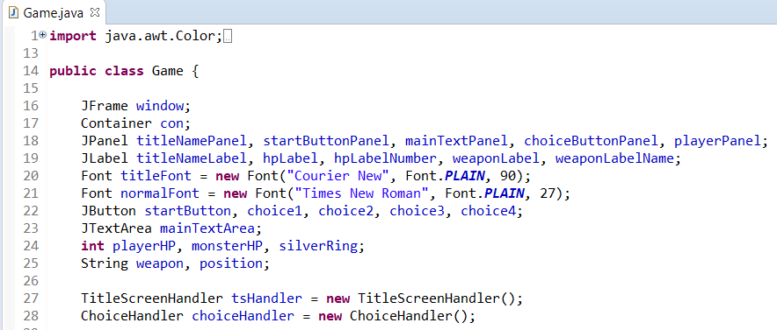
Jframe

Slide 13
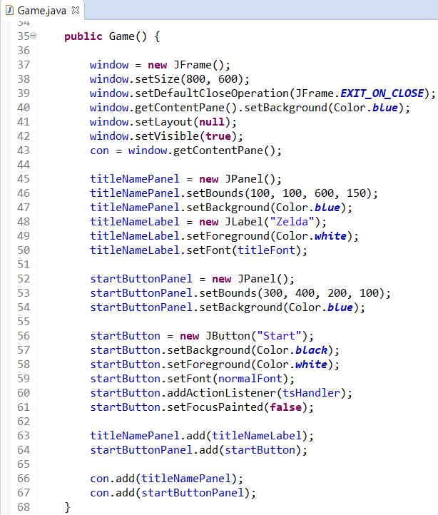
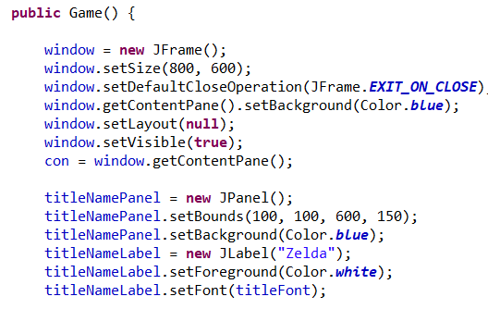
Public game

Slide 14
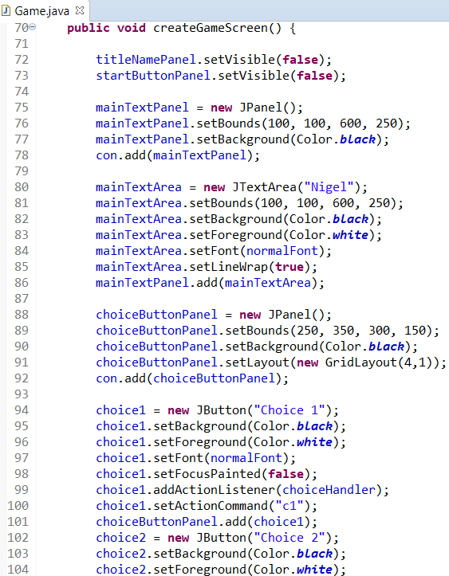
Content

Slide 15
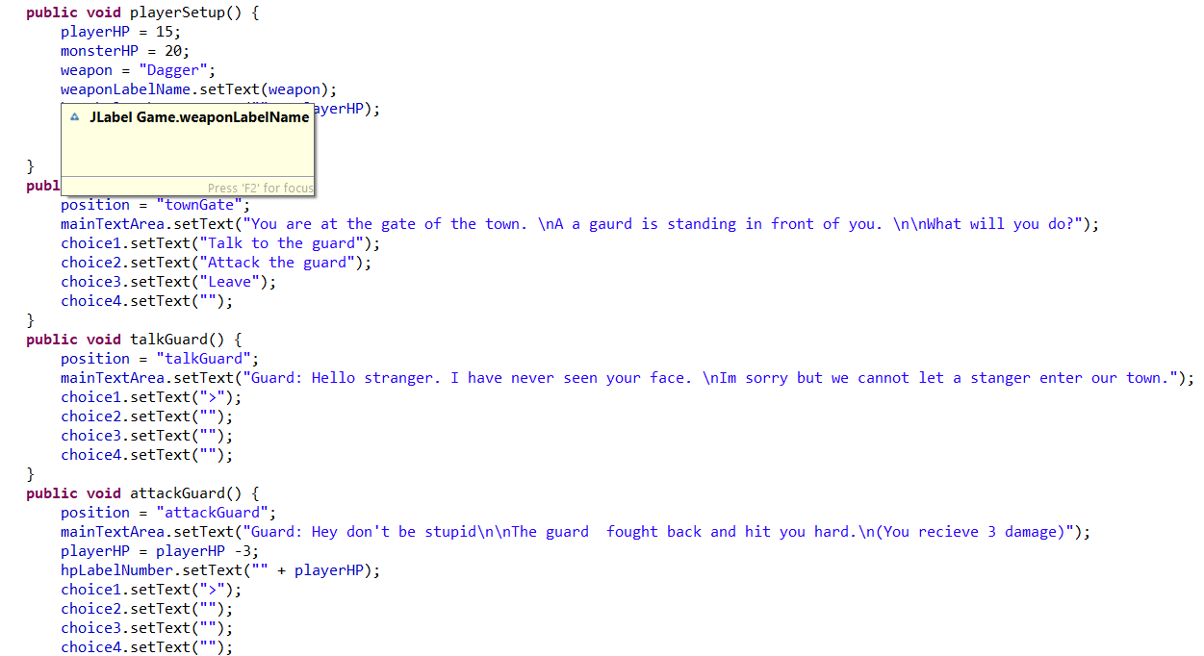
Play state

Slide 16
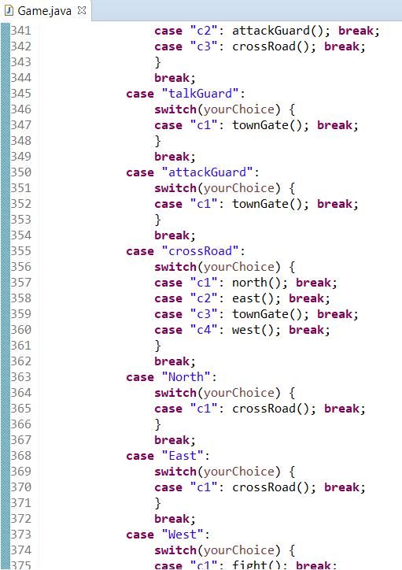
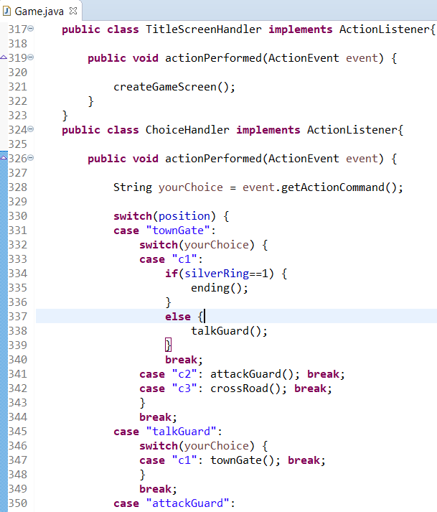
If Else

