Slide 1

Statistical Graph
Understanding Data type
Box plot
Histogram

Slide 2

Data Visualisation and Analytics (ESE1008)
Topics
- Data Types & Structure
- Data Distribution (univariate)
Do
Practices on Box plot and histogram
Week 2 > Learning Material
Intro
Review Last Week lesson
Self-reading
/Self-assessment
Hands-on
Introduction to TABLEAU
Submit Exercise 9 and 10
20 min
60 min
60 min
Notes:
Give an overview of our lesson plan.
Check on Self-assessment 1, how did the class perform.

Slide 3
Review
Four Level of data Analytics
Data Analytics Flow
Central Tendency and Spread
Mean Vs Median
Check point
Notes:
Check with the class for clarification
Check that all has attempted the eLearning material.
Remind students to read through the Learning Material (refer to LMS)

Slide 4
Data Types and Structure
Data Structure
Data Type
Notes:
First 30 minutes, we will cover how data is presented.

Slide 5
Activity 1
Structured Data
Data is arranged in rows and columns.
Excel file keep data in rows and columns. (why?)
What are the rows representing?
Whare are the columns representing?
CO2_data_Jan.xlsx
Rows are observations.
Columns are the variables.
Notes:
Download the CO2_data_jan.xlsx file.
Open in Excel.
This file contains data. They are arranged in rows and columns.
Why?
Notice the rows shows data collected on particular hour of the day.
How many rows are there? 97 rows.
Each row, 3 measurements were collected. What are they?
CO2 level, Temperature and relative humidity
These 3 variables are in columns.
The column Date&Time is not a measured value, but arranged in sequence of time.
Date&Time is a special variable.
By arranging in rows and columns, it is easier for computer program to access the data and perform computation.
For example, to compute the average CO2 measured, we can sum up all the values of CO2 in one column, and divide by number of rows.
The rows are observations. Total number of rows is the sample size.

Slide 6
Activity
Data is organized in rows and columns.
Known as Table format.
Excel files (.xlsx) arranged data in rows and columns.
How many observations were collected?
CO2_data_Jan.xlsx
97 observations.
Collected over 4 days: 18, 19, 20 and 21 Jan 2014
What are the variables?
CO2, Temperature, Relative Humidity
Notes:
Download the CO2_data_jan.xlsx file.
Open in Excel.
By arranging in rows and columns, it is easier for computer program to access the data and perform computation.
For example, to compute the average CO2 measured, we can sum up all the values of CO2 in one column, and divide by number of rows.
The rows are observations. Total number of rows is the sample size.

Slide 7
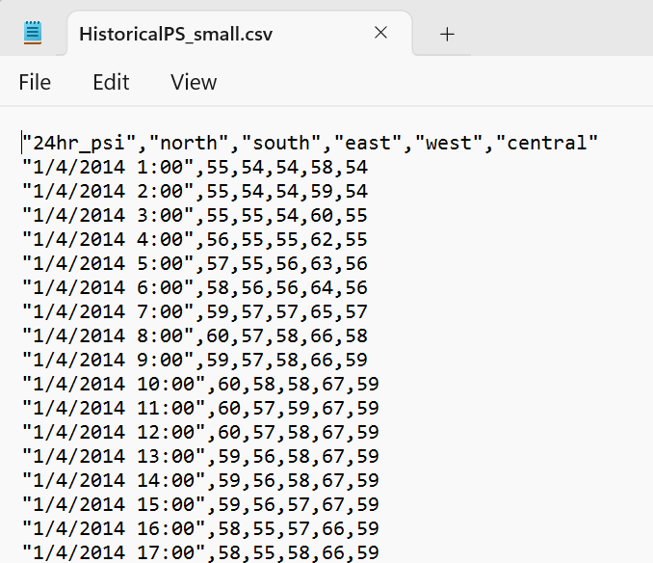
Activity
Comma-Separated Values
Another file type is Comma-Separated Value (CSV).
CSV file has the data in rows.
Where are the columns?
HistoricalPSI_small.csv
Columns are separated by “delimiter”.
For this example, it is the “comma”.
**Note:
Some CSV format, the columns are separated by:
Semi-colon (;)
Or “space”
Or “tab”
Different delimiter
Notes:
Rows is obvious.
Columns?
It is separated by “comma”.
In some CSV file, the columns are separated by semi-colon (;), and some is just “space” or “tab”.

Slide 8
Activity
Comma-Separated File (.CSV)
This file can be opened in Excel program.
(because Excel application has extension program to interpret CSV format and put into Table format)
This file is a text file, can also be opened in NotePad or WORD.
HistoricalPSI_small.csv
Notes:
Another common file type is CSV.
CSV file can be opened in Excel.
Actually Excel program convert the format to rows and columns.
CSV is just a normal text file. It can be opened by WORD or notepad.
Data collected from sensors are saved in CSV format.

Slide 9
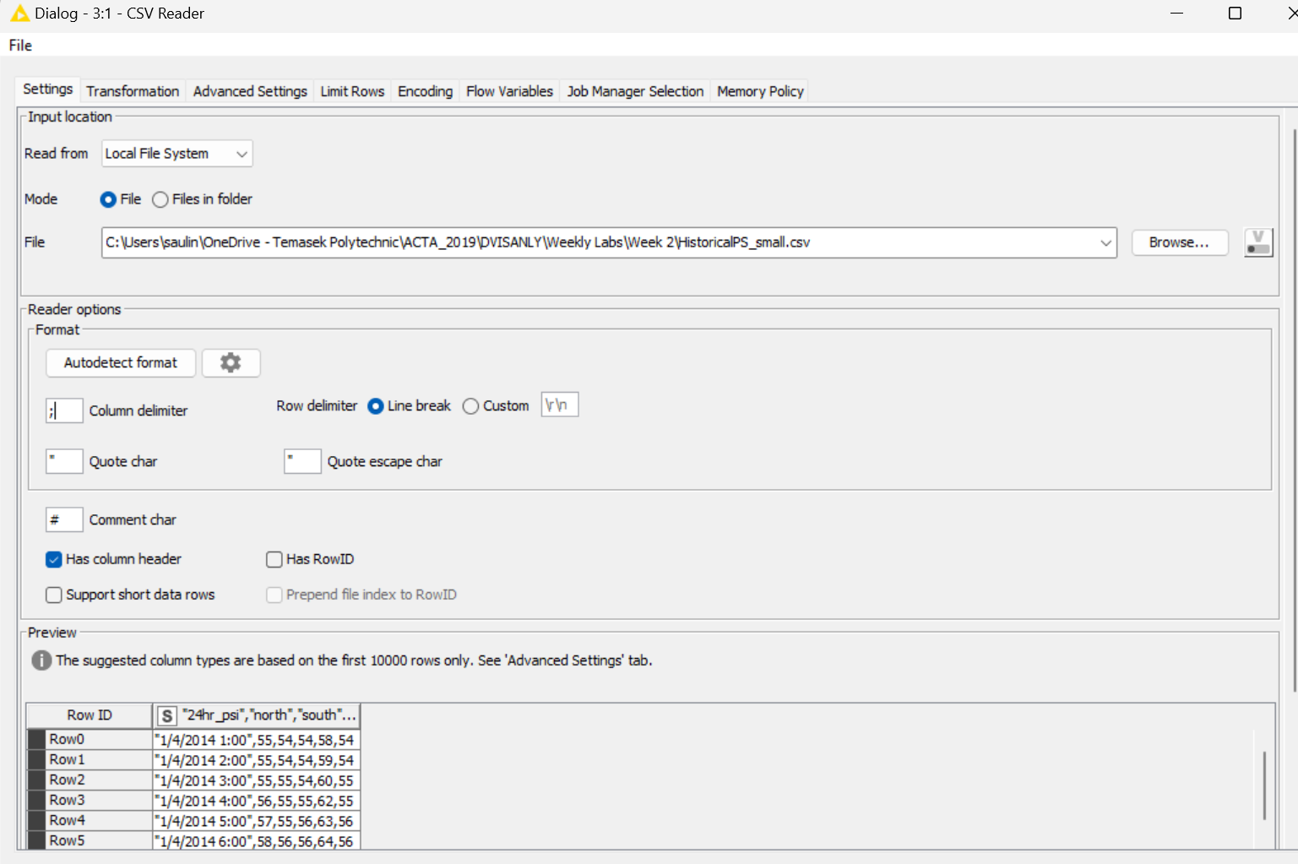
Activity 1 Wrong delimiter was defined
Preview:
Data was not split into columns
Notes:
This is using KNIME program.
The delimiter was specified as “;”, resulted in no columns created.
But, you may not encounter such problem now, as the software has included a “Autodetect format” function.
Click on it, and the data will be split correctly.

Slide 10
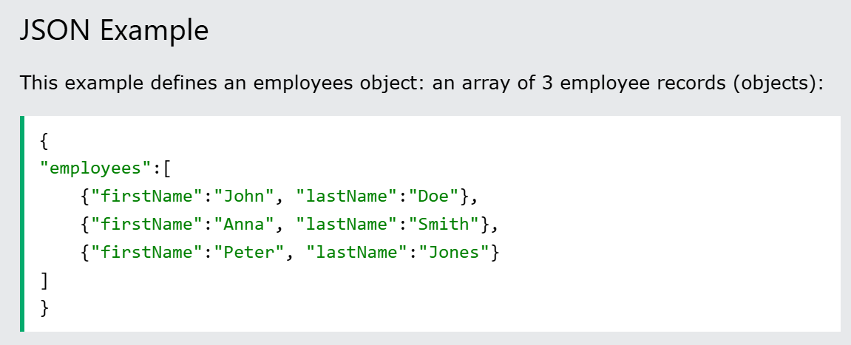
Activity
JSON File
JavaScript Object Notation (JSON)
JSON is often used when data is sent from a server to a web page.
This structure is very different from Row & Column.
**For this subject, we will handle data mainly from CSV or Excel
Notes:
JSON file is another data format.
The structure is not in row and columns.
For this course, we will handle data from CSV or EXCEL.

Slide 11
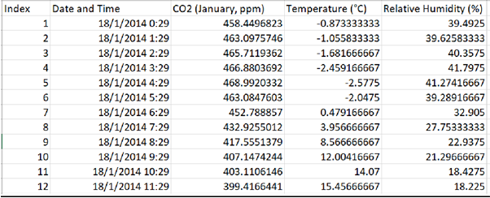
Activity
Is this a tidy table?
A tidy table is a concept from data science, it refers to a table where:
Each variable forms a column: Every column represents a different variable.
Each observation forms a row: Every row represents a different observation or data point.
CO2_Jan_data.xlsx
Date&time
Notes:
A Tidy Table has rows representing each observation (a student, an object, per hour, per minute , etc)
This example, each row represent a time.
Every hour, 3 measurements were taken: CO2 level, Temperature reading, Relative Humidity
Each column represent one variable (except the Index and date&time)

Slide 12
Activity
Is this a tidy table?
Data in this file can be “transpose” to tidy table.
SG_GDP_Summary.xlsx
Notes:
This file is not a tidy table,
The rows are not observations.
The rows are variables.
The columns are observations by year.
How can we convert to a tidy Table that we know?
The table will need to be transpose. Columns becomes rows and rows becomes columns.
For such number of data, we will need program to transpose.
We will not do any transpose now. Just keep this in mind.
When you learn about KNIME, you can use it to transpose quickly.

Slide 13
Activity
What are un-structured data?
Data is not organized systematically.
Example:
Text documents
Multimedia files (Images, videos, audio)
**In this subject, we will not handle un-structured data.
Notes:
Table format, CSV or JSON has some structure in organizing the data.
There are data that is un-structured.
Example, text document, and multimedia files.
In this subject, we will not handle such data.

Slide 14
Recap
How many data file types were covered?
Three types:
Excel (.xlsx)
CSV
JSON

Slide 15
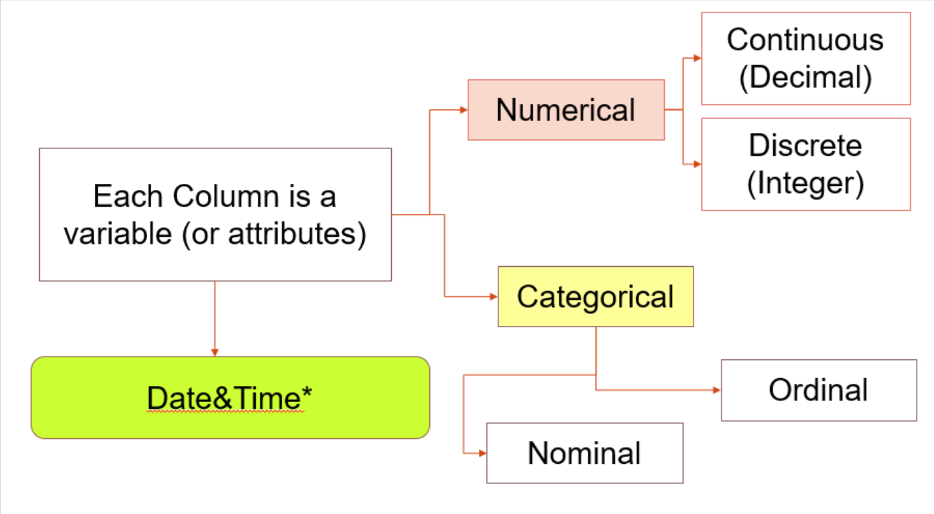
Data type
Notes:
Let’s look at the variables. They are the columns.
We learned there is this special variable for date&time.
CO2, temperature and relative humidity are numerical. They are decimal values.
The values are continuous not discrete.
What are categorical variable?
Name, country, education level
What about telephone number and Matriculation number?
Ae they numerical?
They are not consider numerical in data analytics.
There is no meaning in computing the average phone number or ID number.
What is Nominal and Ordinal?
Nominal refers to names. There is no level.
Ordinal refers to levels, example Freshmen, Junior and Senior.
Another example of Ordinal: Primary, Secondary, Polytechnic, University
These items have some kind of “order”.

Slide 16
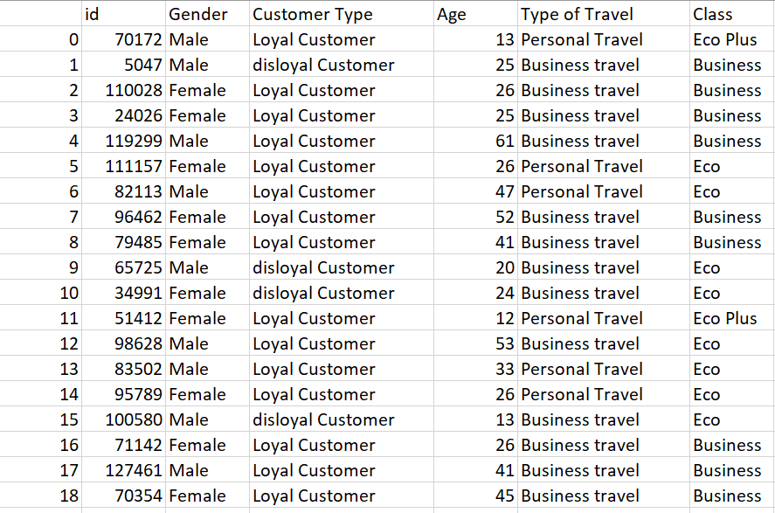
What are the variables in this data table? Numerical or Categorical?
Notes:
Define the data type for each variable.
Is id a useful variable? It is categorical and unique. Is more for identification than analysis.
Gender: Categorical/Nominal
Customer type: Categorical/Nominal
Age: numerical/discrete
Type of travel: Categorical/Nomina;
Class: Categorical/Ordinal
Which variable can we summarized using Mean and Median?
Ans: Age.

Slide 17
Analysis method for different data types
Notes:
Statistical method is performed on numerical data type.
For categorical data type, we shows probability.
We will cover analysis of categorical in Week 4 and 5.
Today we will continue to describe numerical data using statistics.
But in graphical form, called box plot and histogram.

Slide 18
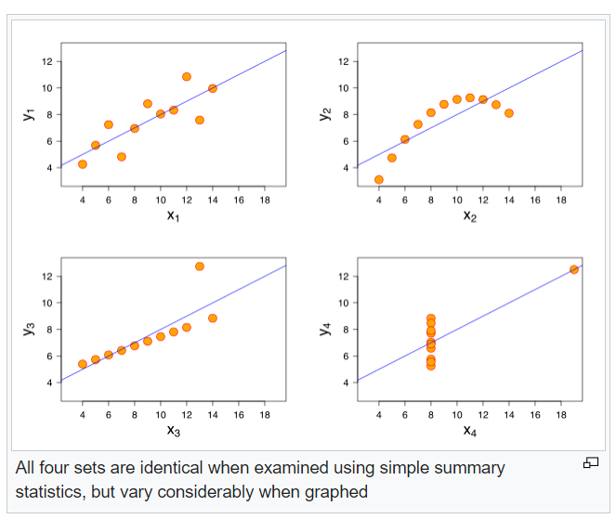
Why Visualisation?
Ancomsbe Quartet
Open the Excel file “Anscombe_Quartet.xlsx” (in Excel application)
https://en.wikipedia.org/wiki/Anscombe%27s_quartet
Notes:
Ancomsbe illustrate the scatter plot of 2 variables that have the same statistics, but visually different
Visualisation provide a better insight than just statistics.
It shows how data behaves relatively.
Statistical provide some insights.
But visualization shows pattern and is easy to understand.

Slide 19
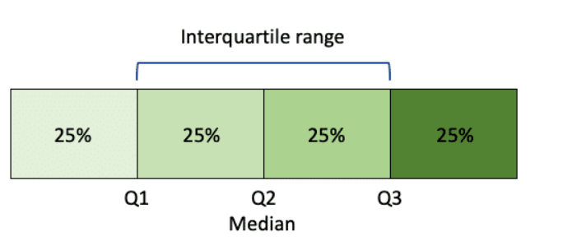
Median and Interquartile Range in Box Plot
The graphical presentation of Median and IQR is a box plot.
Notes:
We will learn Box Plot.
This plot is related to the Median and IQR.
Recall what is Median and IQR.
Recall what is Median, Quartile 1, and Quartile 3.

Slide 20
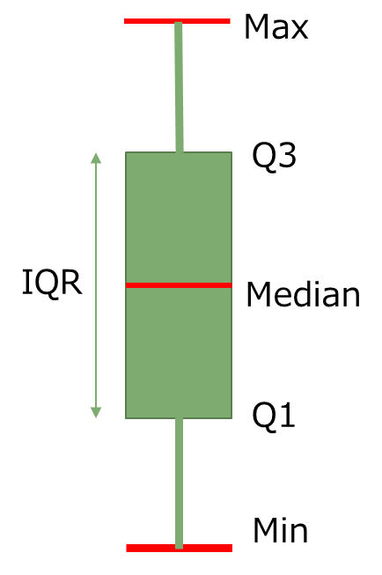
A box plot can be presented in 2 orientations
IQR
Min
Q1
Median
Q3
Max
Notes:
Bos plot indicate 6 key values:
Min, Max
Median, Q1 and Q3
Length of the box indicate the IQR.
We will have lab exercises to sketch box plots.

Slide 21
Lab Exercises
Refer to worksheet
Notes:
Class can have 5 minutes break.

Slide 22
How to Construct the box plot (Lab Ex 1)
Refer to our last practice, on the subject marks: Oct21_Marks.xlsx
Lower Quartile = 44
Median = 76
Upper Quartile = 81.5
Max = 96
Min = 25
Notes:
Let the students try out.
Draw on whiteboard. Or you classpoint whiteboard.
Explain each significant values on the plot.
Notice that the Median is not necessary be in the middle of the box.
If the Median is nearer to the Upper Quartile, means the data below median has more variability. Wider Spread.

Slide 23
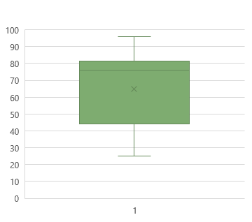
What is Interquartile Range?
Lower Quartile = 44
Median = 76
Upper Quartile = 81.5
Max = 96
Min = 25
96
81.5
76
IQR = Q3 – Q1
= 81.5 –44
= 37.5
IQR
44
25
Notes:
Wider IQR can be observed with longer box.
Small box length, means smaller IQR

Slide 24
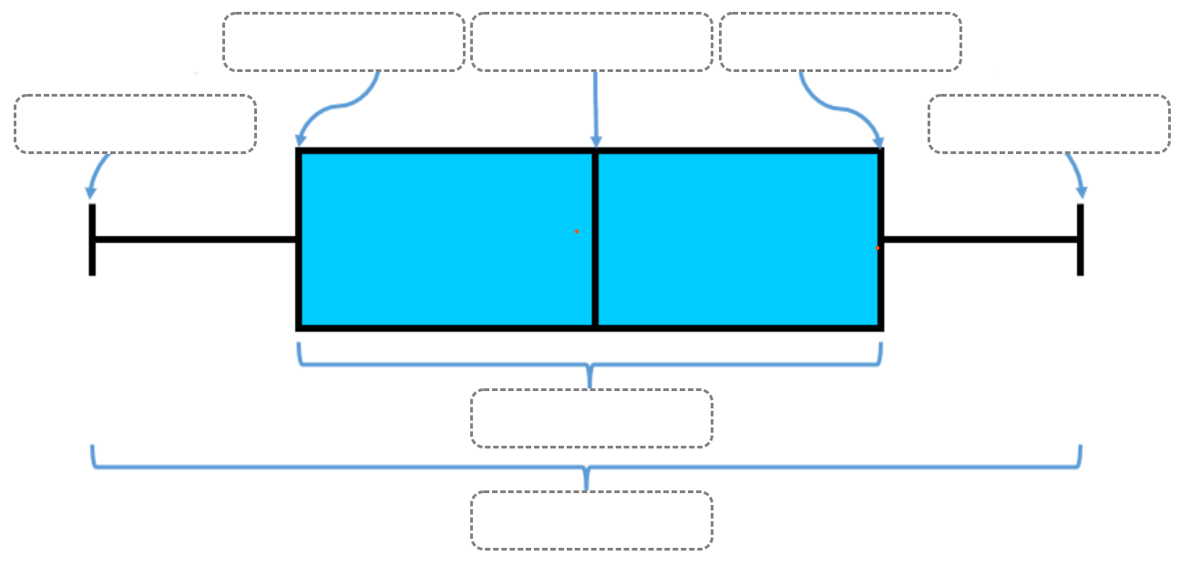
Exercise 1
Notes:
Get students to attempt labelling this box plot.
This activity is also in lab sheet.
They can open the work sheet 2.

Slide 25
Worksheet Activity (solution)
Lower Quartile
Median
Upper Quartile
Minimum
Maximum
Inter-Quartile
Range
Notes:
quiz

Slide 26
Plotting and Interpreting the box plot (Exercise 2)
Box Plots (transum.org
Notes:
More practice.
Get students to show you at least 3 correct answers.

Slide 27
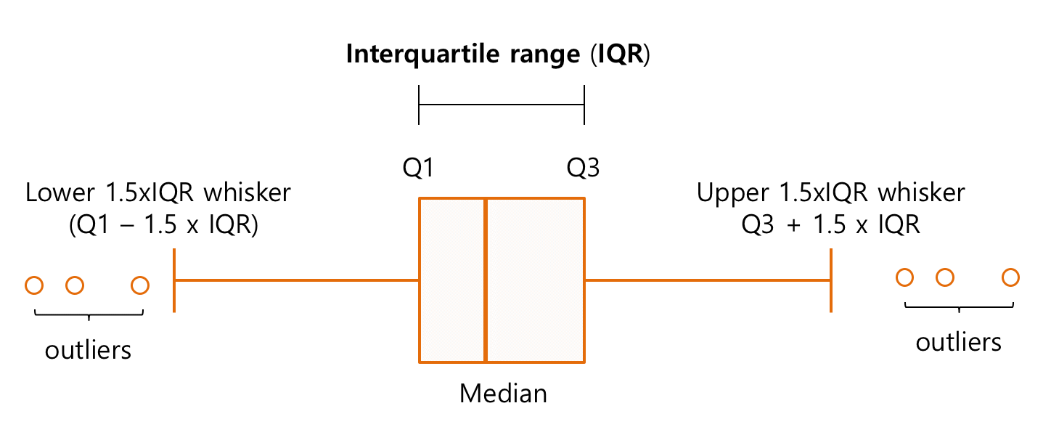
Box Plot with extremely low and high value
https://help.ezbiocloud.net/wp/wp-content/uploads/2018/03/A-typical-box-plot.png
Once there are OUTLIERS, the whiskers’ ends are no longer the Max or Min values.
Data points are classified as outliers when their values go beyond Q1/Q3 +/- 1.5xIQR
Notes:
What if the values containing extremely high and low values?
What values are consider extremely high or low?
For box plot, if the value is higher than 3xIQR + Q3 or lower than Q1 - 3xIQR, are consider outliers

Slide 28
Box Plot with extremely low and high value (Exercise 3)
Let's calculate the upper whisker step by step:
1. Find the Interquartile Range (IQR):
IQR=Q3−Q1=44−30 = 14
2. Calculate 1.5 times the IQR:
1.5×IQR=1.5×14=21
3. Add this value to Q3 to find the upper whisker limit:
Upper Whisker Limit=Q3+1.5×IQR=44+21=65
4. Determine the value at the upper whisker:
The upper whisker should be the highest data point that is less than or equal to 65. In the sorted data:
48,48,49,55,67,76,78,80
The highest data point less than or equal to 65 is 55.
Therefore, the value at the upper whisker is 55.
Notes:
How to calculate the threshold for upper whisker and lower whisker?
Note, this will be tested in online test.

Slide 29

After the break,
We will use TABLEAU to plot the graphs.
15 min

Slide 30
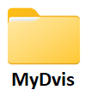
Where should you save your files?
Create a folder for this subject. Can name it as MyDvis
On your “desktop” or “document” folder
Keep all exercises in this folder for easy reference.
Notes:
Before we start using any program, lets create a folder for this subject.
Students can download the ZIP data files to this folder.
They are the data files for all lab exercises.

Slide 31
Exercise 4: Introduction to TABLEAU
How to read in EXCEL file
Understand the User Interface
How to use it to create box-plot.
Refer to worksheet:
Introduction to TABLEAU
Create box plot for CO2 and Temperature
Notes:
Tutor will demonstrate how to create box plot for CO2.
Student can try create one for Temperature and interpret the result.
Refer to lab sheet for the steps.
Check that all students are able to create box plot.

Slide 32
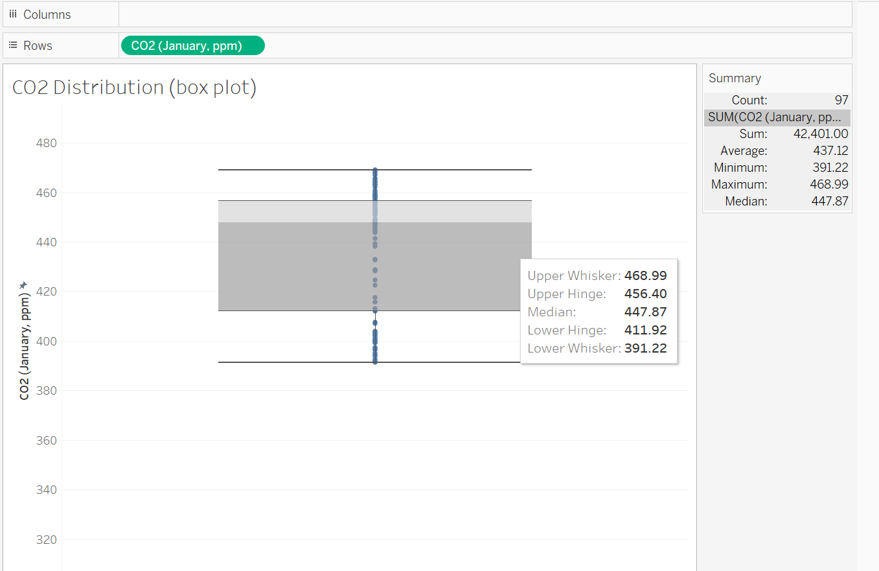
Exercise 4A
C02_Jan_data.xlsx
Insights:
The CO2 level has more variability below the Median, 447.87 ppm (parts per million)
There are no outliers.
(more insights with comparison)
50% of the times the CO2 stays below 447.87ppm.
The air quality is acceptable with well-ventilated outdoor air.
Ideal CO2 leve for outdoor is 350 – 450 ppm
(ref:Acceptable Levels of CO2 in Your Home: What Is Safe? – YourIAQ)
Notes:
Solution to CO2
This shows how student should present their chart (with proper title)
And provide a statement of insight.

Slide 33
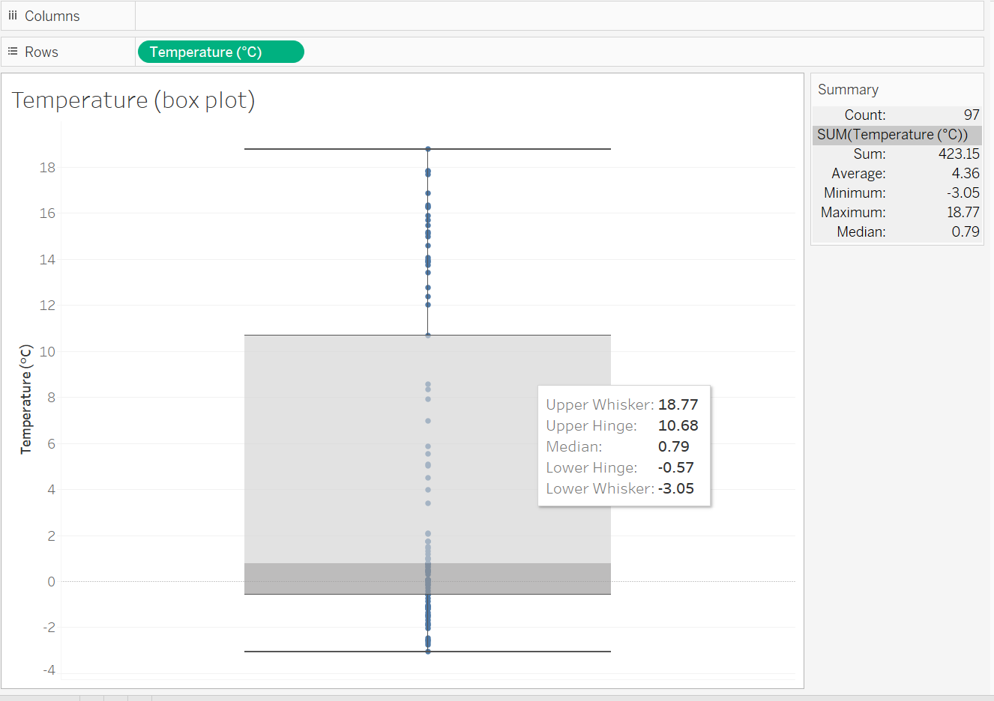
Exercise 4B: On your own Show box plot for Temperature
Temperature range from -3 to 19 degree C.
50% of times were lower than 0 degree (0.79)
The variability at lower temperature is less.
25% of times were higher than 10.68 degree C.
Notes:
Answer. Only show after students has completed theirs.

Slide 34
Histogram
Another way to describe distribution

Slide 35
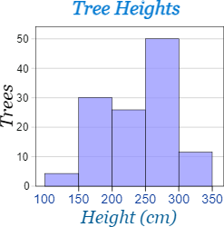
Histogram
A histogram is another way to show distribution of the values.
How is it different from box plot?
It groups the data into smaller bins and count the number of values that falls in that bin.
A bin
https://www.mathsisfun.com/data/histograms.html
Notes:
The chart shows the variable, height
They are grouped into “bin”. A fixed interval.
This is uni-variable. The height shows the count.
IT look like bar chart, but is not called a bar chart.
It is called a histogram.
What insights can we gather from this graph.

Slide 36
Histogram
Most of the trees are between 250 and 300 cm tall.
(The MODE)
MODE
A bin
Notes:
We can find the Mode.
Mode is the range of values that most frequently occurred.

Slide 37
Histogram (Univariable)
Characteristics:
Values on the X-axis are grouped at equal interval (called Bins)
This chart shows 5 bins with bin interval = 50 cm
Notes:
The variable values are on the X-axis.
The are grouped with fixed interval ( can be different intervals)
When the intervals are changed, the shape of the distribution, or the mode, will change.

Slide 38
Histogram (Univariable)
The Mode
Characteristics:
Values on the Y-axis measure the count (Frequency).

Slide 39
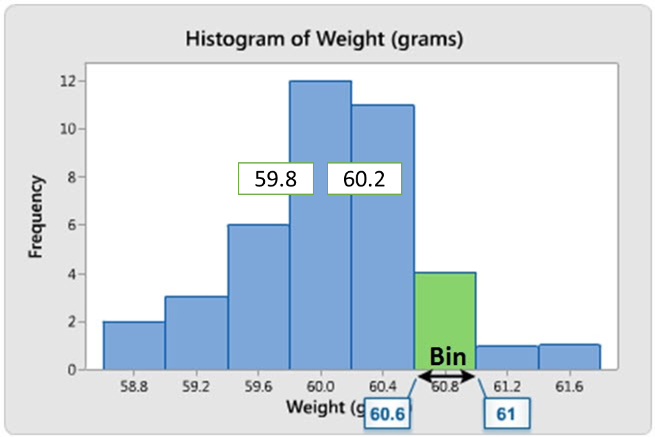
Histogram (Univariable)
Count/Frequency on the Y-axis
Continuous values (No gaps)
Counts from each bin add up to the total number of observations in the data set.
Continuous variable
Lower and upper bound of each bin
Notes:
Need to explain the word “observations”.
Observations could refer to number of tress, number of students or number experiments, or total number of values, eg, temperature readings

Slide 40
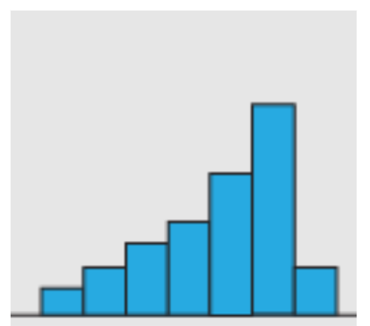

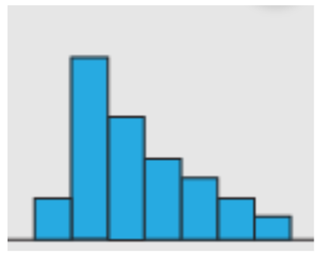

Shape of the histogram
Bell-shape
Symmetry
Skewed to left
Bi-modal
Skewed to right
https://youtu.be/fjTKol_teNw?si=qDCYGBU59DBwCcCA

Slide 41
Return to Lab Ex
Ex 5, 6, 7,8

Slide 42
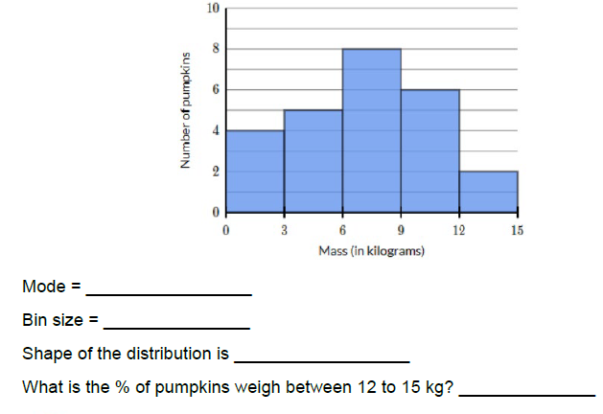
Exercise 5
6 to 9 kg
3 kg
Single Mode
8%
Notes:
Mode is 6 to 9 kg (not the frequency count)
Bin size is 3 kg
Single Mode.
% = 2 out of (4+5+8+6+2) = 2 out of 25 = 0.08 or 8%

Slide 43
Exercise 6
Plot a histogram for the following values, using a bin interval of 5:
71 ,74, 69, 76, 77, 72, 71, 62, 68, 76, 66, 74 , 77 , 73, 61
10 min
Notes:
If student is not able to write on the “worksheet”, can use powerpoint slide to draw the histogram.
Purpose of manually drawing the histogram, is to show them how histogram is plotted, and they will remember better when they plot it manually.

Slide 44
Exercise 6 (solution)
Plot a histogram for the following data, using a bin interval of 5:
71 ,74, 69, 76, 77, 72, 71, 62, 68, 76, 66, 74 , 77 , 73, 61
6
Sort in increasing order
61 62 66 68 69 71 71 72 73 74 74 76 76 77 77
5
4
3
2
1
60
65
70
75
80
values
Notes:
Histogram is plotting the frequency vs the value.
Given a set of values, we need to count how many times it occurs in the list.
To group into 5 bins, we need to know what is the minimum and the maximum, and decide on a suitable range for each bin.
We will begin by sorting the numbers from small to big.

Slide 45
Exercise 6 (solution)
Plot a histogram for the following data, using a bin interval of 5:
71 ,74, 69, 76, 77, 72, 71, 62, 68, 76, 66, 74 , 77 , 73, 61
6
Sort in increasing order
61 62 66 68 69 71 71 72 73 74 74 76 76 77 77
5
4
3
2
1
60
65
70
75
80
values
Bin 1
Notes:
Count the number of values that lies between first bin (60 to 65)

Slide 46
Exercise 6 (solution)
Plot a histogram for the following data, using a bin interval of 5:
71 ,74, 69, 76, 77, 72, 71, 62, 68, 76, 66, 74 , 77 , 73, 61
6
Sort in increasing order
61 62 66 68 69 71 71 72 73 74 74 76 76 77 77
5
4
3
2
1
60
65
70
75
80
values
Bin 2
Notes:
Count the number of values that lies between 65 to 70 (bin 2)

Slide 47
Exercise 6 (solution)
Plot a histogram for the following data, using a bin interval of 5:
71 ,74, 69, 76, 77, 72, 71, 62, 68, 76, 66, 74 , 77 , 73, 61
6
Sort in increasing order
61 62 66 68 69 71 71 72 73 74 74 76 76 77 77
5
4
3
2
1
60
65
70
75
80
values
Bin 3
Notes:
Count the number of values that lie between 70 to 75 (bin 3)

Slide 48
Exercise 6 (solution)
Plot a histogram for the following data, using a bin interval of 5:
71 ,74, 69, 76, 77, 72, 71, 62, 68, 76, 66, 74 , 77 , 73, 61
6
Sort in increasing order
61 62 66 68 69 71 71 72 73 74 74 76 76 77 77
5
4
3
2
1
60
65
70
75
80
values
4 bins
Notes:
Count the number of values that lie between 75 to 80 (bin 4)
As you can see, the total number of counts should add up to the total number of observations.

Slide 49
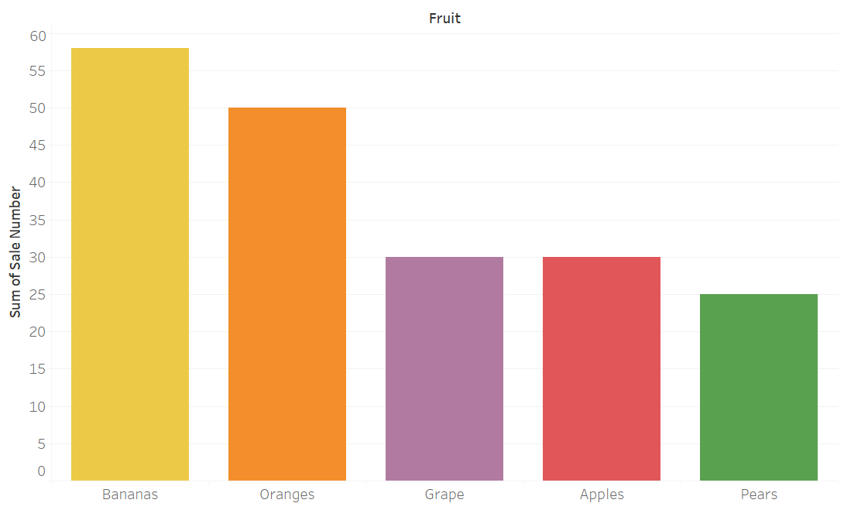
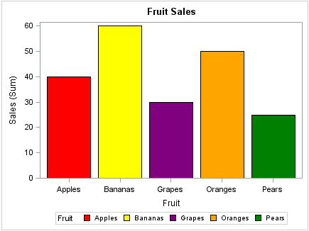
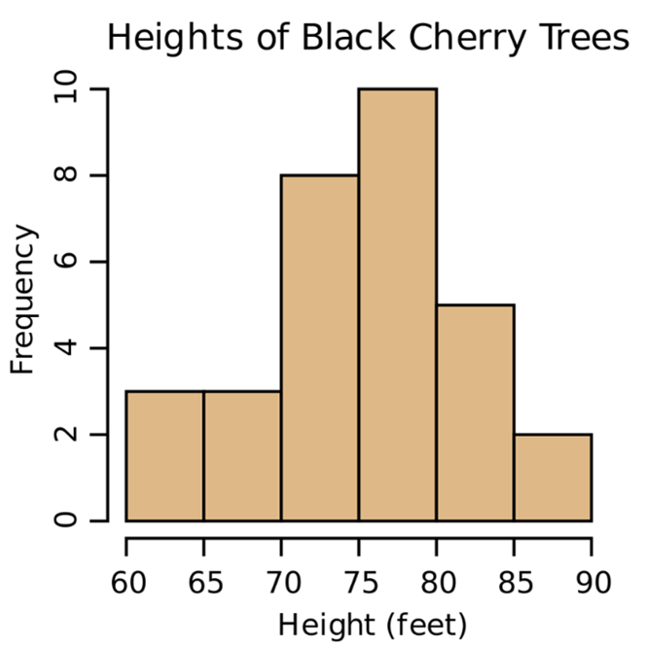
Which graph shows a histogram?
No Gaps
Graph A
Graph B
Category
Number Range
Notes:
Discuss the difference between a bar chart and a histogram.
Answer : Chart B (click)
Note also, in bar chart, we can sort from highest sale to lowest. (click)
But, we cannot sort histogram.
Their difference is the measure in X-axis (click)
Also, no gaps between bars. (click)

Slide 50


Summary Difference between Histogram
Bar Chart | Histogram
X can be categorical | One variable (numerical)
Y can be numerical | Y-axis is always count of occurrences
X-axis data is categorical, not numerical | X-axis is continuous numerical values
There are gaps between bars | No gaps between bars
Category on the x-axis can be sort from high Y-values to lowest or vice versa | Cannot sort the bars from highest to lowest or vice versa
 | Each bar is a bin. Bin is a set interval at the X-axis.

Slide 51
Interpreting a histogram (Exercise 7)
Interpreting a histogram
Do the activity in this site:
https://www.transum.org/Maths/Exercise/Histogram/
Select Level 2. Post at least 2 correct attempts here.

Slide 52
TABLEAU
Exercise 8: Create a histogram for Temperature
Notes:
Demonstrate how to create histogram

Slide 53
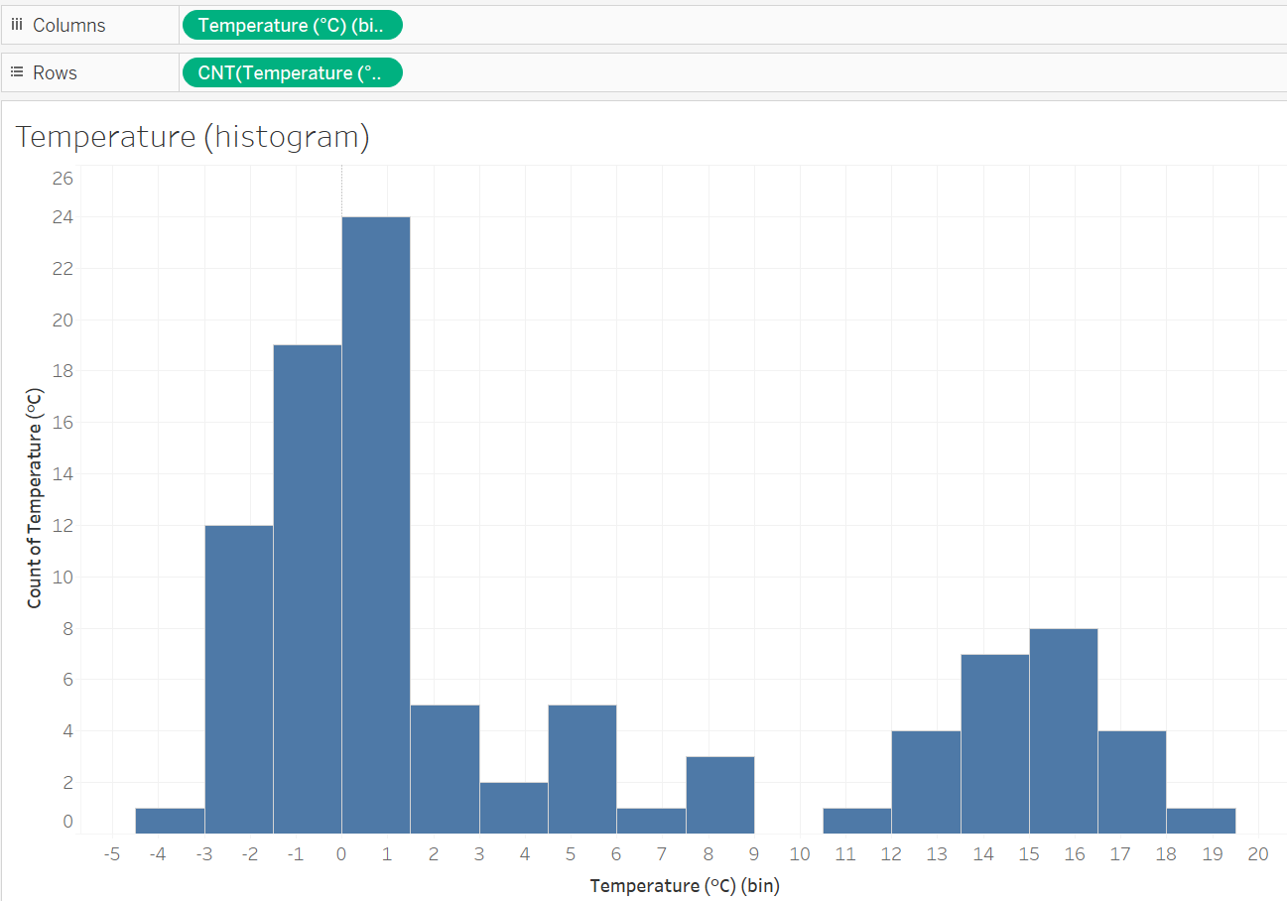
Exercise 8 Temperature histogram
Insights:
There were 2 distinct distributions.
Temperature < 9ºC, the mode is between 0 – 1.5ºC, happening 24 times.
Temperature > 10ºC, the mode is 15ºC – 16.5ºC, happening 8 times.
Notes:
When bin interval is set differently, the mode will change.
What should be the bin interval?
No standard rule. You can adjust the bin size until you are able to see some “shape”.
Or, you could base on the standard deviation to estimate your bin size. Standard deviation gives you some idea the “spread” interval.

Slide 54
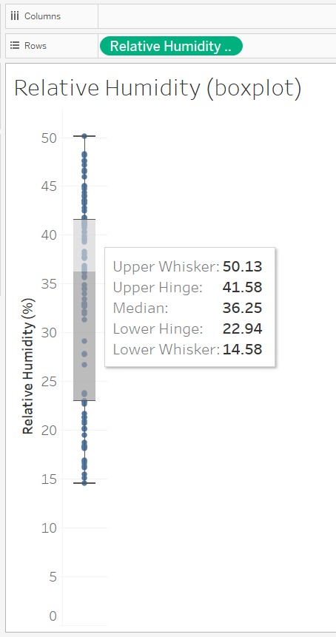
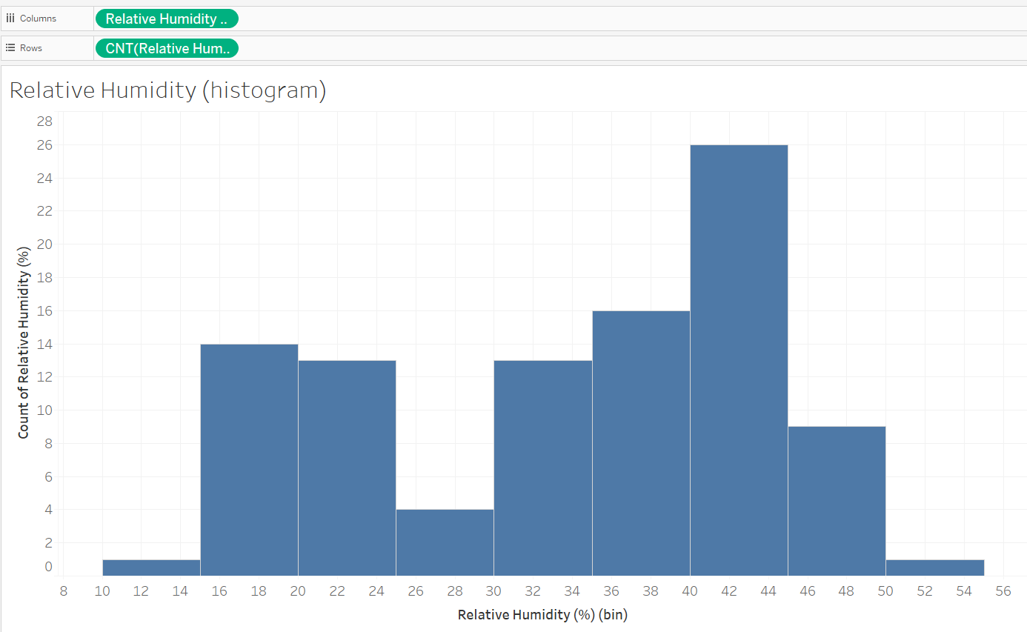
Univariate Analysis
REVIEW
Histogram
Box plot
Notes:
Summary Statistics
Box-plots
Histogram
Both boxplot and histogram show distribution of one variable.
Hence, it is called uni-variate.
Although histogram shows 2 axes, but the vertical axis is count, not second variable.

Slide 55

To Be Submitted by end of the week
Self Assessment #2
Lab #2 Submit to LMS
Ex 9 and 10
Screen capture your charts for your submission
3. Download and install software

Slide 56
References
Images used are sourced from the internet under Creative Commons licenses, unless stated otherwise. Proper attribution has been provided where required.
Statistics Tutorial
Central Tendency | Understanding the Mean, Median & Mode
Mean, Median, and Mode: Measures of Central Tendency - Statistics By Jim
Data Types in Statistics | GeeksforGeeks
Anscombe's quartet – Wikipedia
Box Plots
https://researchmethod.net/histogram/
https://www.transum.org/Maths/Exercise/Histogram/

