Slide 1

Weekly Task
Lesson plan
Topics
Scatter plot/Linear correlation
Data Exploratory Analysis with KNIME
Do
Lab 3 Ex 1, 2 and 3 Submit Ex 4
Self-Learning
/Self-assessment
Week 3 > Learning Material
Review
Notes:
Give an overview of our lesson plan.
(5 min)

Slide 2

Review: What did you Learn last week?
Box-Plot
Histogram
Notes:
Check on the lab2 submission.
Check Self-Assessment 2. How did the students perform?
Go through the answers by picking up some students’ work.
For Lab2 Ex 10, may want the students to try again to put all 5 boxplots in one worksheet.
(Take time to revise again)
Get the students to do again.

Slide 3
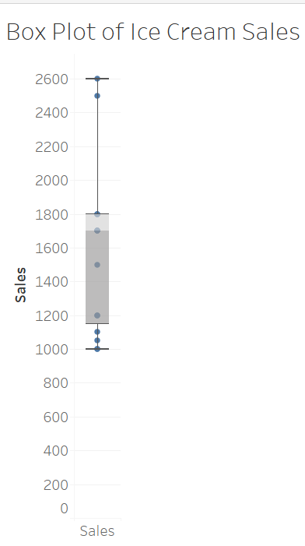
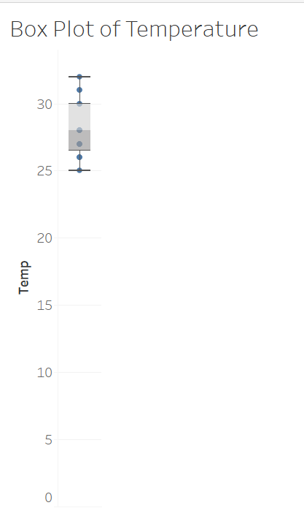
Uni-variate and Bi-Variate
Box Plot and Histogram are uni-variate.
What is the correlation between the Sales and Temperature?
Variable : Ice cream sales
Variable : Temperature
https://data.gov.sg/datasets?query=historical+temperature+&page=1&resultId=d_03bb2eb67ad645d0188342fa74ad7066
3
Notes:
Scenario
You sell ice-cream.
You can gather daily average temperature from data.gov.sg site.
data.gov.sg
https://data.gov.sg/datasets?query=historical+temperature+&page=1&resultId=d_03bb2eb67ad645d0188342fa74ad7066
You want to know how weather condition affect your sale of ice-cream.
How can you find out?
For such question, the statistics term is correlation.
How do we measure correlation?

Slide 4
Bivariate Analysis - analysis of 2 variables
Scatter Plot (data visualisation)
Linear correlation coefficient (Statistical method)
Notes:
Correlation is a measure of comparing 2 variables on the same chart.
The visual chart is called Scatter Plot.
The statistics measure is called Linear Correlation Coefficient, or more exact to say is Pearson’s Correlation coefficient, r-value.

Slide 5
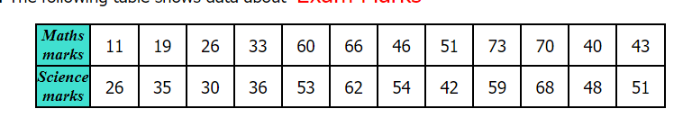
Do Lab 3 Activity 1
Plotting Scatter Graphs (transum.org)
Plot the Exam marks for Maths and Science
One axis is the Maths marks (variable 1)
Another axis is the Science marks (variable 2)
What is the correlation between the marks for Maths and Science?
Variable 1
Variable 2
Notes:
Let’s start by understanding the scatter plot of 2 variables.
How to create a scatter plot.
Student can pick any scenario, and start plotting the points.
Highlight that each axes represent a variable.
After they have all the dots done, what do they observe?
Any pattern or trend?

Slide 6
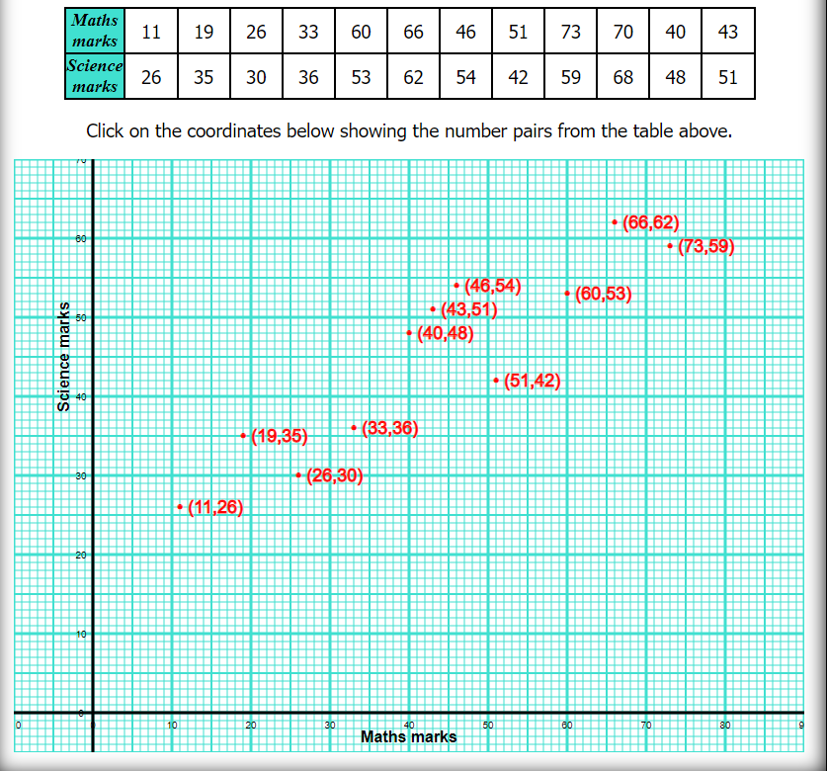
What is the correlation between the marks for Science and Maths?
Variable 1
Variable 2
There is a positive correlation.
This is a Scatter Plot.
Each dot is an observation.
Notes:
For Matns and Science marks of a student, it shows that when the maths marks is good, the science marks is also good.
Note that each dot on the chart is an observation ( within a row in the table).
This type of chart is called Scatter plot.
From the pattern of the scatter plot, we can gather if the correlation between the 2 variables, a positive, negative or none.
There is one scenario (sale of soup and temperature) is negatively correlated.

Slide 7
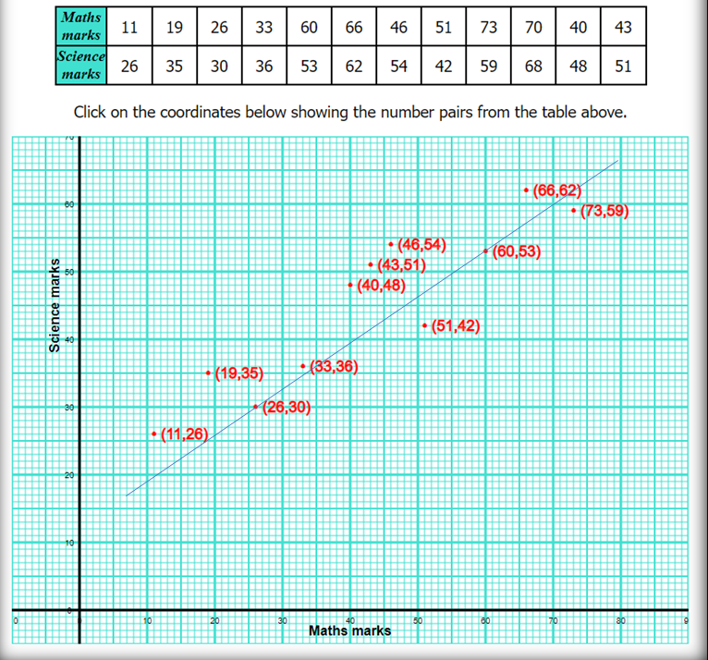
Scatter Plot
Shows association between 2 variables.
But not Causation!
https://youtu.be/x9llnUN-Bnw (My car cannot start when I buy vanilla ice cream)
Notes:
Correlation not Causation!
There is an interesting story about “His car cannot start when he buys vanilla ice cream” (optional to play in class. The video is also in LMS)
Depend on time, this video is interesting, helps to “break” the lesson.

Slide 8
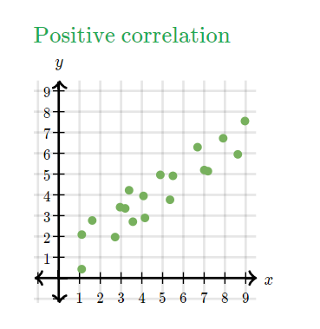
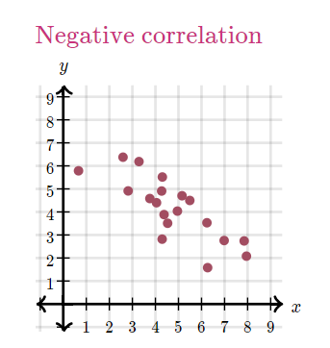
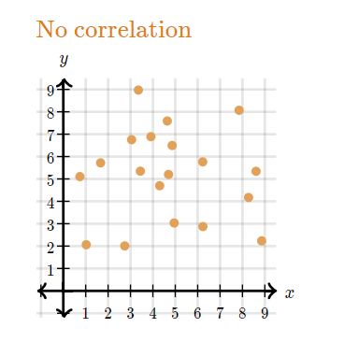
Possible correlation
Do Lab 3 Activity 2
When x↑, y ↑
When x↑, y ↓
When x↑, y no change
Direction of correlation
Notes:
From the scatter plot of 2 variables, we can know if the 2 variables are positively correlated, negatively correlated or no correlation.
If we were to add a “trend” line, we can see a positive gradient, negative gradient and 0 gradient. (click)
This actually indicate the Direction of correlation.
Student nee to understand what it means by positive correlated or negative correlated.

Slide 9
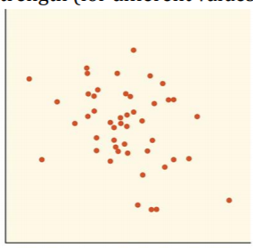
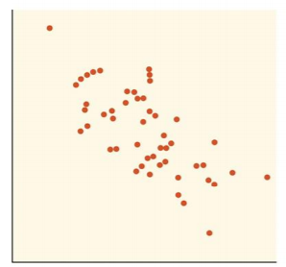
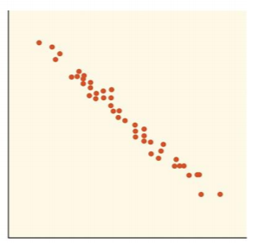
Possible correlation
Weakest
Weak
Strong
Direction of correlation
Strength of correlation
Notes:
For all 3, we can see they are negatively correlated. (click)
But which one is Strongly correlated?
(click) to reveal the answer.
The correlation may be in the same direction, but their strength may be different.
Strength is measure of how close are the points near to the projected linear line.
There is a calculation for the strength.

Slide 10
Statistically
Can we determine the strength of the correlation?
Strongly Correlated
Weakly Correlated

Slide 11
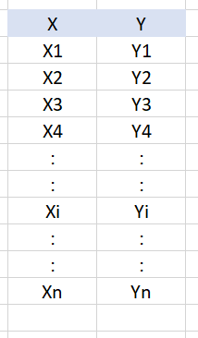
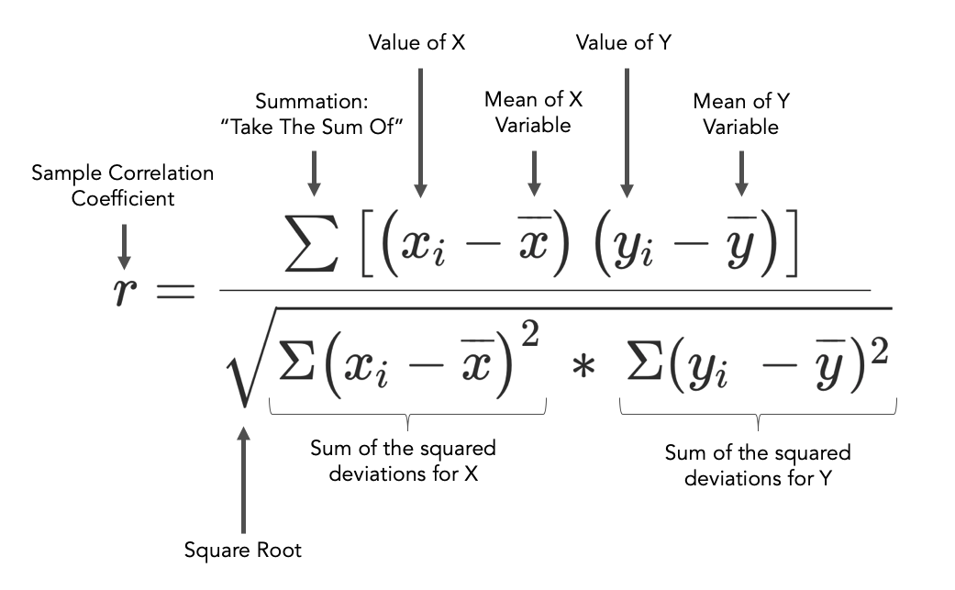
Linear Correlation coefficient, r
Calculate the Linear Correlation Coefficient
Only Linear Relationship
x – variable 1
y – variable 2
Covariance
Product of each Standard Deviation
Notes:
Other from drawing the correlation from the scatter plot, there is a calculation to determine the linear correlation coefficient.
No need to memorise this formula (not tested). But, you need to know how to interpret the r-value.
r is the linear correlation coefficient.
The r-value indicates the strength of the correlation.
r-value > 0.7 is consider strong
Exaple -0.7 and 0.7 are strong correlation.
-0.3 and 0.3 are weak correlation.
For this subject, you just need to be aware there is a formula to calculate the r-value, involving the standard deviation of the 2 variables.

Slide 12
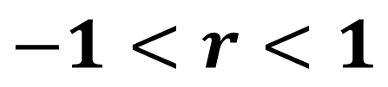
Interpreting the r-value
Pearson correlation coefficient, r, is a statistical measure of the strength of the relationship between the relative movements of two variables.
$$−1<r<1$$
Only Linear correlation.
Correlation Coefficient, r
r < 0 | Negatively Correlated
r = 0 | No correlation
r > 0 | Positively Correlated
r>0.7 or r<-0.7
is considered as strongly correlated
Notes:
Take note that this is calculation of how strong are the data points falling on a linear trend lines.

Slide 13
Quiz
Consider the following r-value, and indicate if the correlation Strong or Weak?
r-value | Direction | Strength
0.3424 | Positive | Weak
-0.5678 | Negative | Weak
0.7899 | Positive | Strong
-0.7432 | Negative | Strong
0.1234 | Positive | Weak
Notes:
r > 0.7 or r < -0.7 are consider Strong.

Slide 14
Correlation coefficient Vs Scatter Plot
https://youtu.be/cwc2JWqI6aQ
Watch this video to see how the scatter plot look like when r=-1 and r=1.
How r-value’s direction and strength presented in scatter plot.
Notes:
What is the scatter plot look like at different r-value?
This is a silent video.

Slide 15
Activity 3 (Review)
r >0.7 is relatively strong ________________correlation.
r <-0.7 is relatively strong ________ correlation.
So, r value is between ____ and .
Positive
Negative
-1
1

Slide 16

Lab 3 Exercise 1
Creating scatter plot in TABLEAU
CO2_data_Jan.xlsx
Notes:
Student go through the steps in workbook

Slide 17
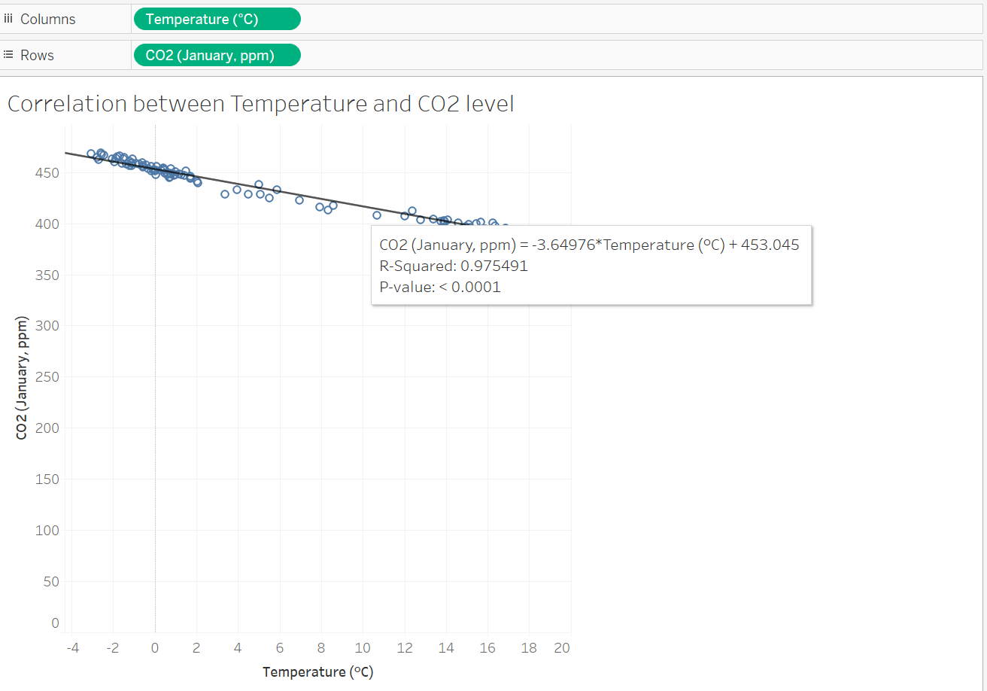
(Soln) What is the correlation between CO2 and Temperature?
Strong Negative Correlation.
R²=0.975491
The square-root of this value is the
Pearson linear correlation coefficient , r
r = 0.9877

Slide 18

After the Break, we will start using the KNIME software. Please ensure that you download the latest v5.4.3 version.
15 mins
Notes:
Short break of 15 min.
After the break, we will proceed with probability.
Analysing categorical function.

Slide 19

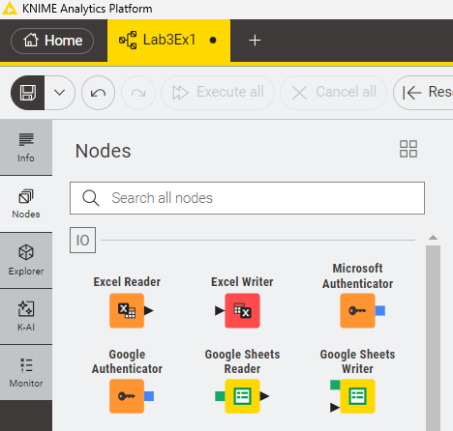
DEMO
Set workspace to “MyDvis”
Create a workflow.
Name the workflow: Lab3Ex2
Notes:
Show there is a “workspace”.
Set the “workspace” to “MyDivs”
Explain the navigation icon on the left:
Info
Node
Explorer

Slide 20
Lab Ex 2 (Linear Correlation Node)
CO2_data_April.xlsx
(follow the steps in workbook)

Slide 21
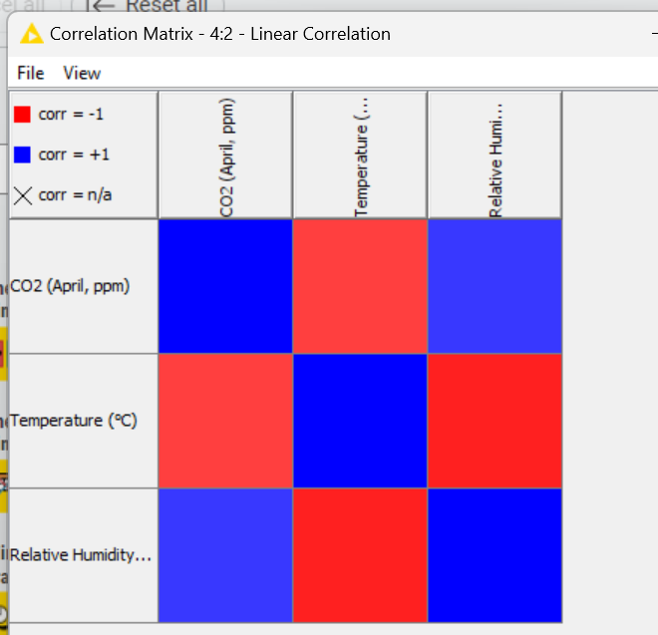
Interpreting the Correlation Matrix
Red – Negative Correlation
Blue – Positive Correlation
Notes:
How to interpret the Correlation Matrix
Dark Red is high negative
Pink – weak negative
Dark blue – highly positive
Light blue – weak positive
What insights can we gather?
When EU_Sales is high, we can expect Other_Sales is also high.

Slide 22
Lab 2 Activity
What is the correlation between Temperature and CO2 level?
Which pair of variables have positive correlation?
Negative correlated
Relative Humidity and CO2
Notes:
How to interpret the Correlation Matrix
Dark Red is high negative
Pink – weak negative
Dark blue – highly positive
Light blue – weak positive
What insights can we gather?
When EU_Sales is high, we can expect Other_Sales is also high.

Slide 23
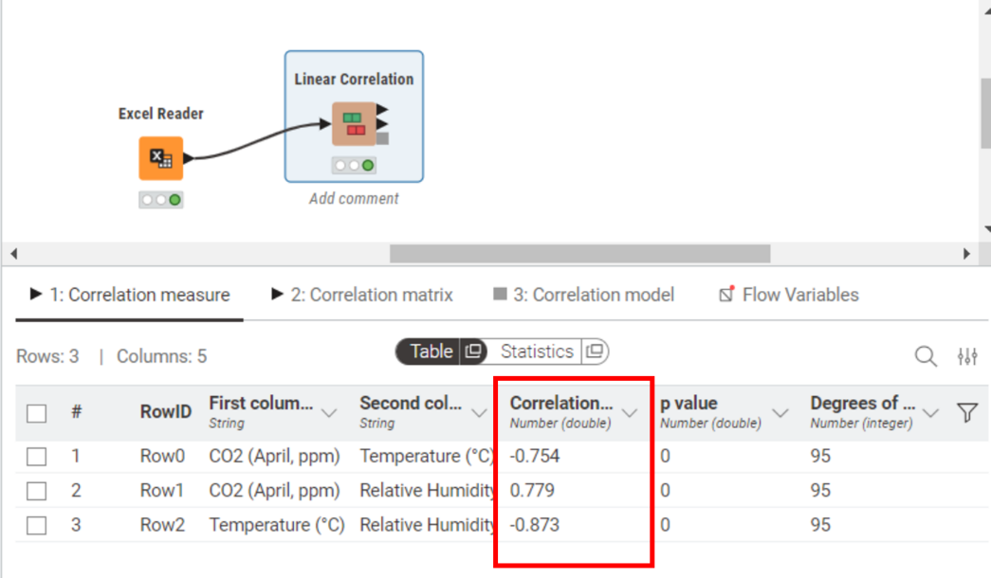
Lab 2 Activity
How to find the Pearson Linear Correlation Coefficient?
Notes:
How to interpret the Correlation Matrix
Dark Red is high negative
Pink – weak negative
Dark blue – highly positive
Light blue – weak positive
What insights can we gather?
When EU_Sales is high, we can expect Other_Sales is also high.

Slide 24
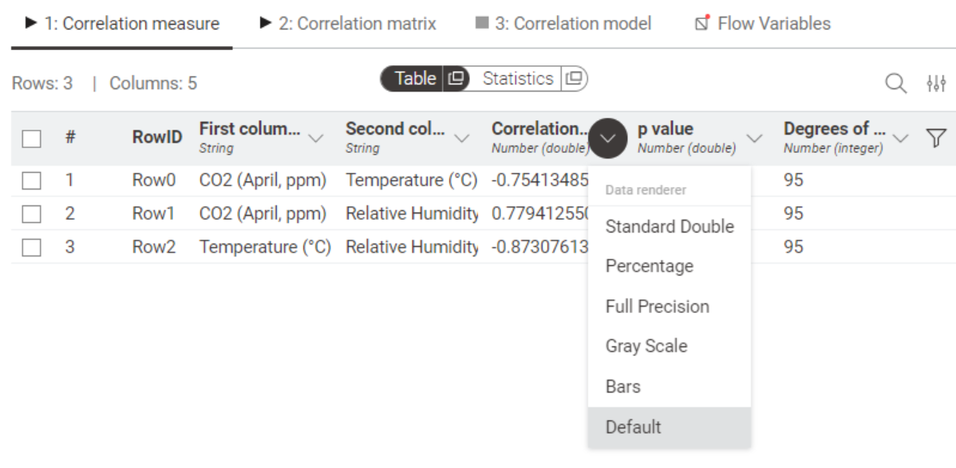
Lab 2 Activity
How to set the decimal values to reveal more than 3 decimal places?
Notes:
How to interpret the Correlation Matrix
Dark Red is high negative
Pink – weak negative
Dark blue – highly positive
Light blue – weak positive
What insights can we gather?
When EU_Sales is high, we can expect Other_Sales is also high.

Slide 25
Exercise 3: Exploratory Data Analysis
vgSales_small.csv
Video Games Sales ( extracted from Video Games Sale)
This is CSV File.
Not EXCEL.
Notes:
We have covered all the statistical analysis to explore the data.
Using this exercise, to walk through with the students, what they need to do when given a data set, how should they go about exploring.

Slide 26
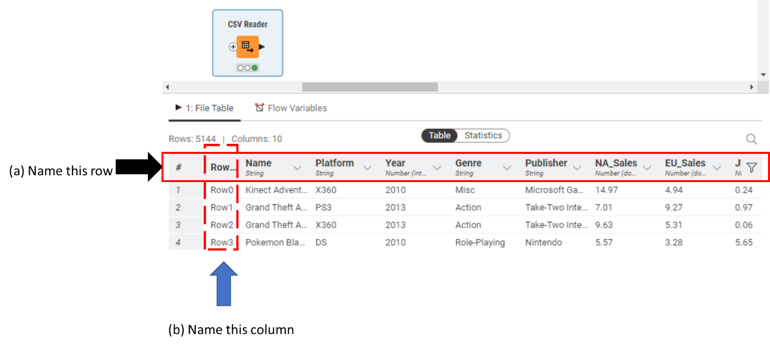
Lab Ex 2 ( Use CSV Reader in KNIME)
Notes:
Read the CSV file, and study what the file is about.
Refer to the lab workbook, to answer the questions.

Slide 27
Lab Ex 2 (Understanding the rows and columns)
General name for the first row is
General Name of the first column is .
Each row represents a .
The columns are _________. (hint: observations or variables?)
There are (how many?) ____________variables.
There are (how many?) ___________ observations.
Column Header
Row ID
Video Title
Variables
10
5144

Slide 28
Investigative question: Which region has the best video game sales performance?
Notes:
Here, we started with a question in mind. Or is called Investigative questions in our project.
You can open this question to the students, and see what method they will propose.
From question to insight.

Slide 29
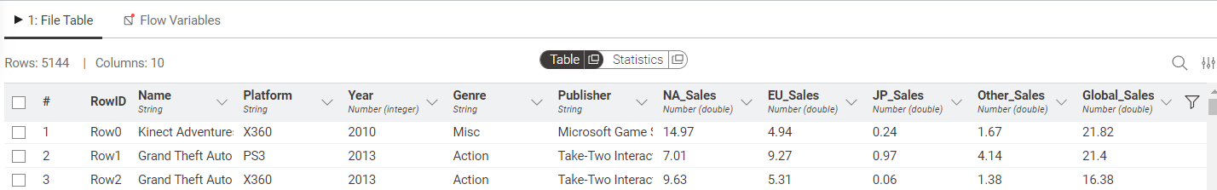
Which region has the best video game sales performance?
Which variables measures the sales performance?
Which statistics value to use? Sum? Mean? Median? SD?
This is the sum of sales for all regions.
Notes:
Here, we started with a question in mind. Or is called Investigative questions in our project.
You can open this question to the students, and see what method they will propose.
We are interested n the sales from each region: NA, EU, SP, or Others
We can compare the median sale for these 4 regions
Should we compare the SUM of sales from each region?
The higher the SUM, means the best performance? Yes.
What about the Mean and Median? They give the Central Tendency. YES.
What about SD? It tells the variability of the data, whether the spread is wide or narrow? YES.
Next, let’s see how to find out these statistics from KNIME.

Slide 30
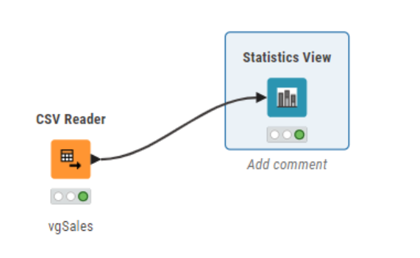
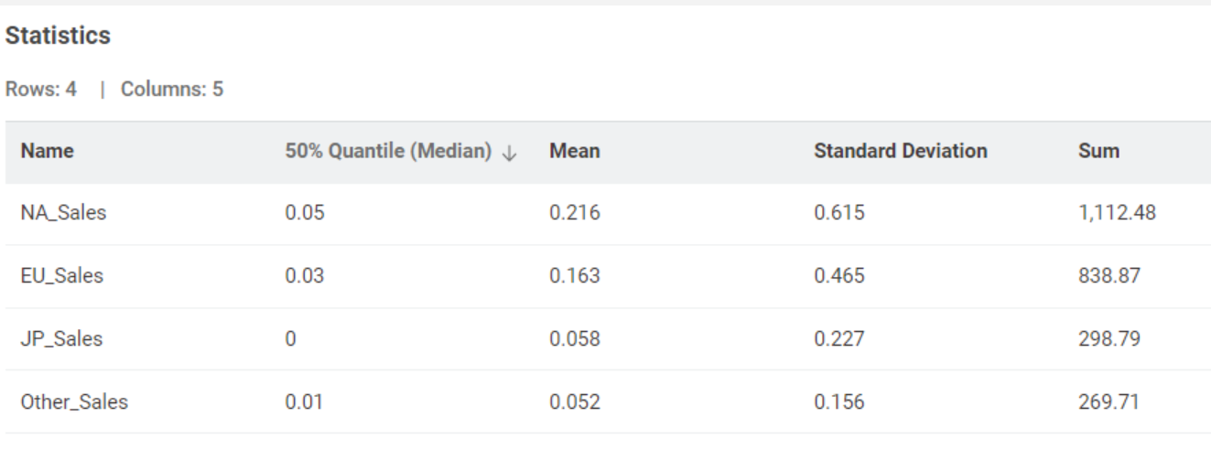
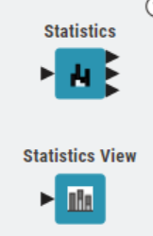
Insights 1: Which region has the best video game sales performance?
North America region generates the highest total, mean and median sales.
Show Me
Notes:
We can use any of the Statistics node.
For this example, I will use the Statistics View, as the presentation is clearer.
Configure the Statistics to show
Mean, Median, Sum, SD
Describe what you observe?
NA_Sales (Sale from North American Region) has the highest sale in terms of total, average and median.
However, it also shows the highest Standard Deviation. This means, some times sale can be quite low, and sometime can be much higher than the average 0.216 Million.
50% of the time, the NA_Sales e 0.05 Millions.
Other_Sales has the lowest SD. Many sales are close to the 0.052 million average.
We can conclude that NA_Sales is performing better.

Slide 31
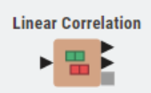
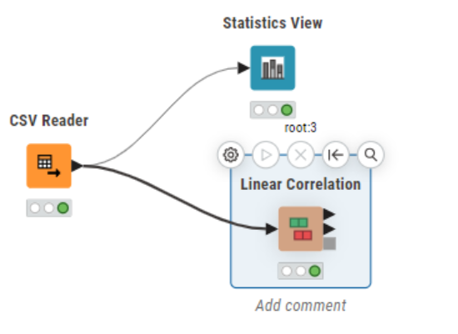
Investigative Question 2: Are there any linear correlation among the sales in the 4 regions?
How to determine the linear correlation?
Show Me
Notes:
There are 2 ways:
Using Pearson Correlation Coefficient formula
Or create the scatter plot for each pairs
Here, we introduce the Linear Correlation Node from KNIME.

Slide 32
Are there any linear correlation among the sales in the 4 regions?
Configure the Linear Correlation Node
Notes:
There are 2 ways:
Using Pearson Correlation Coefficient formula
Or create the scatter plot for each pairs
Here, we introduce the Linear Correlation Node from KNIME.

Slide 33
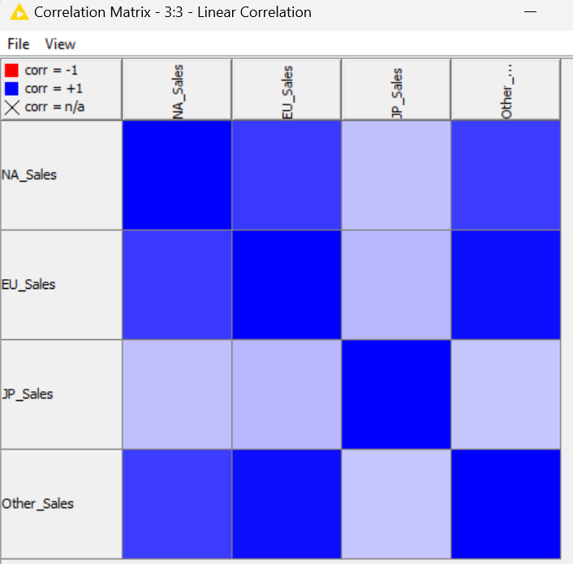
Are there any linear correlation among the sales in the 4 regions?
Interpreting the Correlation Matrix
Red region – negative correlated
Blue region – Positively Correlated
Dark blue region
Other_Sales and EU_Sales are strong positive correlation
Light blue region
JP_Sales and NA_Sales (and EU_Sales) are weak positive correlation
They are all positive correlation.
Notes:
How to interpret the Correlation Matrix
Dark Red is high negative
Pink – weak negative
Dark blue – highly positive
Light blue – weak positive
What insights can we gather?
When EU_Sales is high, we can expect Other_Sales is also high.

Slide 34
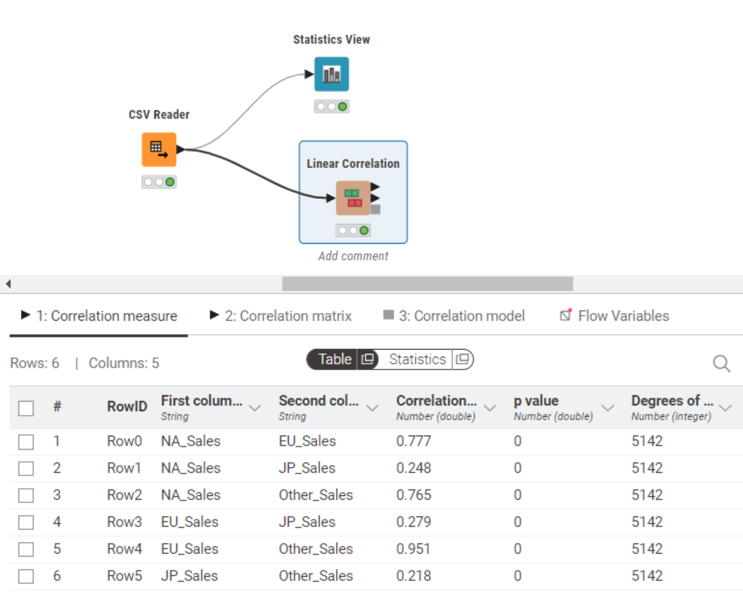
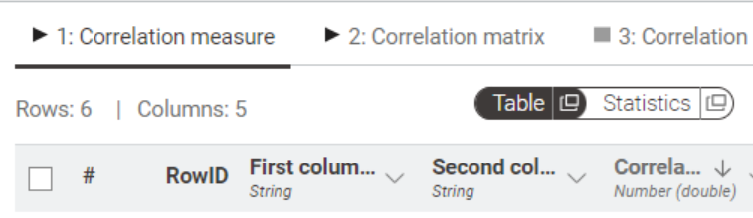
Are there any linear correlation among the sales in the 4 regions?
Find the Linear Correlation Coefficient
Mouse-over
The Sort arrow will appear.
Notes:
KNIME also calculate the Pearson Linear Correlation Coefficient.
You can view the r-value from the table result of Linear Correlation node.
You can also sort the values to show the highest positive at the top.

Slide 35
I
Insights 2: Are there any linear correlation among the sales in the 4 regions?
Conclusion
EU_Sales and Other_Sales are strong positive correlated.
High EU_Sales, Other_Sales will also be predictable high.

Slide 36
I
Graphical method for Correlation: Scatter Plot
Can we show the correlation in graphical way?
Scatter Plot
Revision
Create the scatter plot in TABLEAU for EU_Sales and Other_Sales
**The file is CSV format.
Use “Text” to read this file in TABLEAU.
Notes:
Check who still remember how to create the scatter plot.
Class Participation marks.

Slide 37
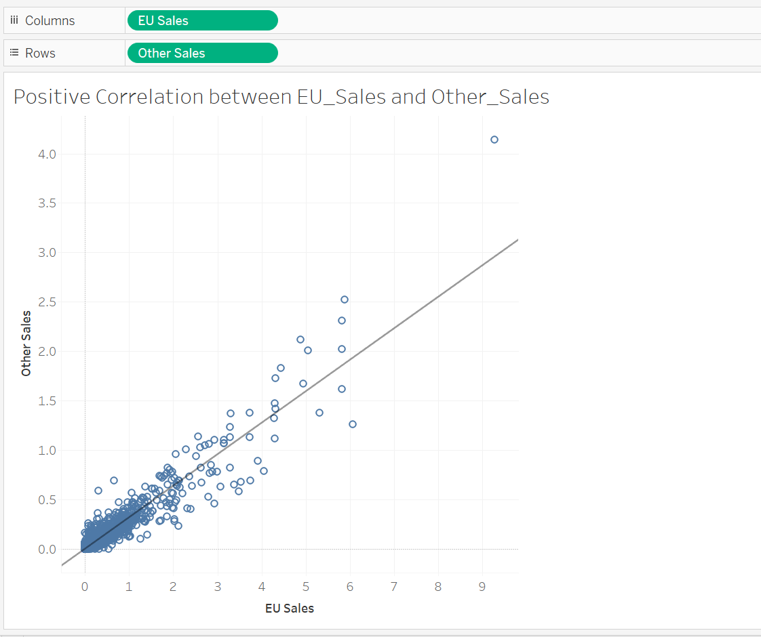
Scatter plot Solution

Slide 38

To Be Submitted by end of Lesson - Self Assessment #3
Exercise 4 (submit to LMS)

Slide 39
Useful resource ( self-reading)
https://youtu.be/puKodFOolQw?si=936LFvi5mQ7SIVLY
This is additional reading material. It helps you to understand how to analyse the data and present the result. Keep this video in bookmark.
You can refer to this when you work on your project.
It explains the background of the data, then further into his investigative question, and show the various charts that help to answer his questions.
Notes:
This video illustrate how data analysis was performed on the Video Game data set.
This author has his own investigative questions.
With the same data, different people can focus on various variables, and generate insights base on his/her investigative questions.
Right questions mean as long as the questions can be answered from the data.
There is no model questions.
You can generate different questions.
Hence, for student project, you may be sharing the same data set, but should not share the same investigative questions.
Students can discuss but should not shae the same questions. It will not be considered “very good” grading.
But, can pass.

Slide 40
End of slides

Slide 41
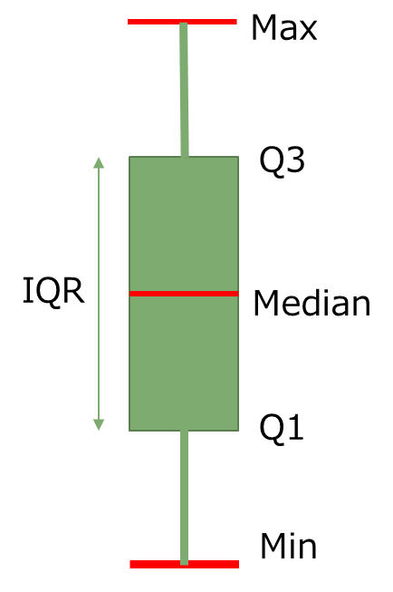

A box plot can be presented in 2 orientations
IQR
Min
Q1
Median
Q3
Max

Slide 42
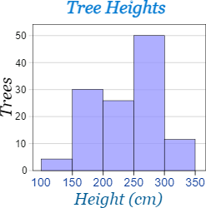
Histogram
A histogram is another way to show distribution of the values.
How is it different from box plot?
It groups the data into smaller bins and count the number of values that falls in that bin.
A bin
https://www.mathsisfun.com/data/histograms.html
Notes:
The chart shows the variable, height.
What insights can we gather from this graph.

