Slide 1

Introduction
Data Visualisation and Analytics

Slide 2
Able to:
Gather meaningful insights from data
Apply data analytics techniques to large data sets to support data-driven decisions across different domains
Subject Aims

Slide 3
Intended Learning outcomes
Demonstrate basic data handling workflow
Examine the structure of data using graphical and numerical methods
Apply data transformation and visualization to identify significant relationship/trends
Apply basic predictive analytics for decision-making

Slide 4
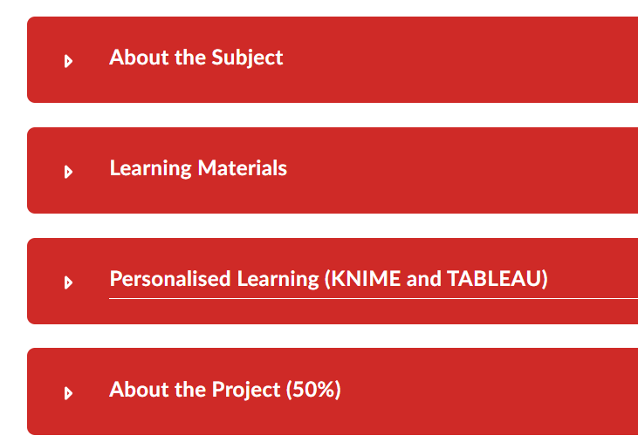
Subject Learning Management System (LMS)
Data Visualisation and Analytics (ESE1008)
Notes:
Get students to access LMS to familiarise where to get information.
About the subject
[Project-based Learning]
Teaching and learning pedagogy is applying project-based learning
The project will require you to apply what you learn, and also source for additional information and technique to achieve better result.
Hence, when doing the project, you will have a lot of unknown and questions.
Do expect many learnings will happen when you start working on your project. (it is not just applying what we tell you to do)
Is this easy or difficult? It is challenging because there is no right or wrong answer.
More will be discussed when we distribute the project question. Individual project.
[Intended Learning Outcomes] – this section indicate the scope of this subject. From Descriptive Analytics to Predictive Analytics(last topic).
Most of the time, you will learn the various ways to describe insights from data. The last topic, is the first step to machine learning covering only one model. We are giving the concept of machine learning. If you are interested in machine learning, you can go further study to AI and ML.
[Learning Resources in Print]: This is the PDF copy of the labwork and slides ( in Student Guides). If you prefer to have a hard-copy of the lab workbook, you may print them. It is not compulsory to have a hard-copy. TP supports sustainability practice.
[Teaching Schedule] : Important to take note of the assessment dates and submission due dates.
Emphasize FLEX weeks has self-learning materials that students need to complete. Students should not plan holidays during FLEX Week.
Get students to enter important dates in their handphone.
[Assessment Schemes]: Take note of the assessment dates and weightage. Heavy 50% weightage on Project. Take note of how CP marks is given. It is not default 10 marks. Student need to participate to earn this 10 marks.
How can a student participate? – submit labwork ontime, demonstrate work doen in class, complete eLearniing materials, achieve 80 marks for Personalised Learning module, answer questions in class. So, there are many ways for student to earn CP marks.
[Class Attendance & Participation] – Student should keep track of their own attendance. If student are late for class, need approach tutor, otherwise, his/her attendance may marked as “absent”. Student will be marked as “late”. Late attendance is consider absent when computing the attendance percentage.
Wanred student to keep track of their attendance, and should not absent for lessons with or without MC. Absent 5 times, with or without MC, will result in CP marks deduction.
[Install KNIME] – Any issues installing?
[Install Tableau] – Any issues installing?
[LMS FAQ] – this is referring to the LMS feature that students may need to use
[Setup Microsoft Teams ..]- Lesson will be conducted online during Campus Shutdown ( for any unforeseen situations)
[Teaching Team] – Get your tutor contact email. Student should check their email and MS Teams, and use these as main communication channel with your tutors. Student should make use of class time to clarify. If a student need help from tutor, he/she can make appointment via email or post your questions in MS Chat. Tutor may not reply immediately as he/she may be in a meeting or conducting lessons.
[Learning Materials] – Weekly lesson that students should at least go through the materials once, before or after the lesson. There are useful materials that will not be covered in class, but is good for students to read through to help “remembering” and enhance understanding.
[Personalised Learning]
Self-Learning checking of your understanding in using KNIME and TABLEAU.
You should do one diagnostic test and continue to do “test” until you achieve 50% passing marks.
Two weeks before practical test, we will check on their progress to determine if they are ready to take the test.
**To tutor only: Those who did not do, or did not pass, please make effort to talk to them and find out the problem.
[About Project]
We will distribute the project in Week 5.

Slide 5

How can I do well?
Plan/Set Goals
Monitor & Track
Reflect
Perform
Discussion
eLearning
Self-Directed
Learning
Lab Ex
Self-Assessment
Personalised Learning
Notes:
Re-emphasize to the students that they cannot just follow steps and passed the subject.
The subject is about “Analysis”. Hence, student need to train to think critically. The way is to really “think” and not “take”.
There are self-learning materials that students need to view on their own, which will not be covered in F2F session.
There eLearning materials are also tested.
The self-assessment is a very important tools to test yourself. All students must attempt.
Asking question is very important in class to clarify doubts. This is also an important skill sets in future career.
Be clear of what you need to do, and don’t assume.
Complete all lab exercises. You may repeat the exercise to familiar with the steps.
Not to be afraid of making mistake, just redo, is very fast. Practice make perfect.
Plan in time to revise for at least 30 min every week, if you really don’t have time.
Planning will be crucial for project. Space out your tasks. You may have project deadline from other subjects. Better start early.
Following your plan to avoid procrastination. (human bad habit).
No need to spent too much time on this slide. Don’t want to sound too “windy”.
Pause for Q&A.
Can give 3 minutes break. After the break, do the Check 1.

Slide 6
Is there Learning Support Programme (LSP)?
Q & A
Notes:
There is LSP.
You may find the subject very easy, after first 2 weeks of lesson.
But you will find it challenging when we start creating charts, and especially the project.
It is challenging because the project require critical thinking, to hone your analytics skill.
There are failures in this subject. LSP is specially scheduled. Refer to LMS announcement for the schedule for LSP.
LSP will start from Week 2, Wednesday afternoon, 2pm. It is conducted by lecturer.
Or, Check point 1
Get them to navigate the LMS on their own.
3 min break

Slide 7

Lesson Plan
Topics
Why data analytics?
Four levels of data analytics
Data analytics Process
Central Tendency/Spread
Exercise
Self-Assessment (week 1)
Installation
KNIME and TABLEAU
Self-Learning
Week 1 > Learning Material
Intro
Subject Overview
Classroom Rules
30 min
30 min
30 min
15 min
Notes:
Give an overview of how lesson will be conducted.
Give 15 minutes break after 1-hour.
Give 5 minutes after 2nd hour.
(5 min)
This will help students to stay focus, looking forward to a break.

Slide 8
Today’s Learning Topics
Why data analytics?
Data Analytics Process
The four levels of analytics
Central Tendency/Spread
Notes:
An overview of the topic to cover.
First 3 topics are theory.
Last topic, is the first insights we can gather from data. Central Tendency, a way to summarise the data collected over a period of time, or a number of responses.

Slide 9
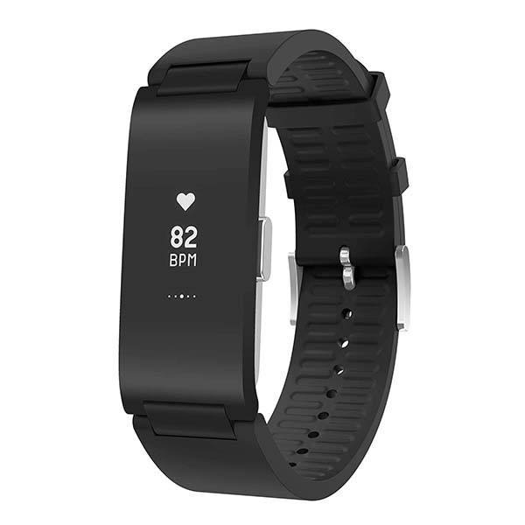
Activity 1
What data do you check before you leave your house to take a bus to school?
What data does a fitness tracker collect?
Are these data useful?
Notes:
Bus arrival time.
Bus arrival time is one kind of a data. Imagine a world without data. I was not able to know when the bus will come. The bus stop will always have many people waiting, without knowing when the bus will arrive. In this digital world, we can track the location of the bus in real-time.
Fitness tracker – track the number of setps, heartbeat rate
These data are useful. Bus arrival time help us to plan our journey. We make decision ( to leave now or later) base on the bus arrival time.
Health tracker help to monitor our activities to keep track of our fitness. We take necessary action ( data-driven decision) when the data is showing abnormally.
We are tracking and receiving more and more data in this digital economy.
We use data in many ways. To predict, to find trends, to make decision.
Data tells the truth. A website that attracts many hits means that there are potential customer or buyer.
Data validate hypothesis.

Slide 10

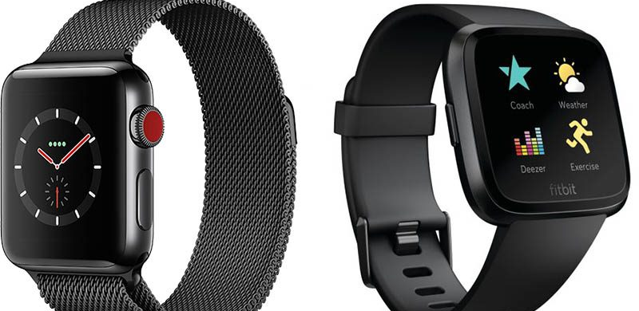

Big Data (The 3 Vs’)
Data is streaming at very high speed (Velocity).
Volume of data
Where are these data come from?
Variety of data
What are the different forms of data?
Notes:
Data Analytics is possible now because of BIG Data. The 3 V’s.
Our smart phone is the main source for all the data. There were so many different Apps, in our phone that track our usage, and companies analyse these data to get to know our behaviour pattern, our interest, and our location.
You will hear this Term, BIG Data.
Characteristics of Big data is 3 Vs, Velocity, Volume and Variety.
Velocity – data is streaming in real-time
Volume – data is collected from any sources
What other devices or program is also gathering data?
(pause for discussion)
Social media
Web browser
CCTV
Card Access system
Credit Card
Sensors (Weather report get data from temperature sensors, Wind Speed,etc)
Smart Lamp-post (this will lead to our next slide)
Variety – data is collected in many forms.
What are the different form of data?
(answer) Numbers, times, images, videos

Slide 11

Smart City and Smart Lamp-post
A video created by GovTech
To educate public on video analytics
(2019) 3 min
https://youtu.be/x8HxxVbSvS8?si=up357IGvm1v973Yyy
Notes:
With big data, the world is now a Smart City.
A Smart Cit
https://youtu.be/x8HxxVbSvS8?si=up357IGvm1v973Yyy that started from a Smart Lamp-post.

Slide 12
Summary of Activity 1
Many
Different
Data exists in ____________ forms.
Data can be N________, I______ and V_______.
We use data to _________ the situation; to m__________ outcome , to v__________ hypothesis; to _________ decision.
The method of using data to make decision is called ________________.
umbers
mages
ideos
Explain
Describe
easure
alidate
make
Data-driven

Slide 13
Technological Advancement to manage Big Data
Data analytics is possible because of
High computing processor
Smart Sensors
Cloud Computing
Notes:
Scientist perform data analysis by doing experiments, to gather data.
Economist perform data analysis by tracking stock markets.
Now, we have Big Data due to smart sensors and high computing processor, and Cloud computing.
Business and even individual, can perform data analysis as data can be collected easily now.
Now, high computing processor can process data faster. No need to wait too long to find the average, highest, lowest or sort ….etc
Smart Sensors can collect data and shared via cloud computing. Cloud serves as data storage point.
These technologies are making data analytics possible for everyone, every industry.

Slide 14
Data Literacy
Reading data
Interpret (numerical/categorical)
Communicating with data
Data visualisation
Working with data
Ask the right questions
Gather insights
Make decision
Notes:
Data literacy is about ability to interpret from data.
Ability to use data to present (communicating with data)
Ability to work with data ( data driven decision)

Slide 15
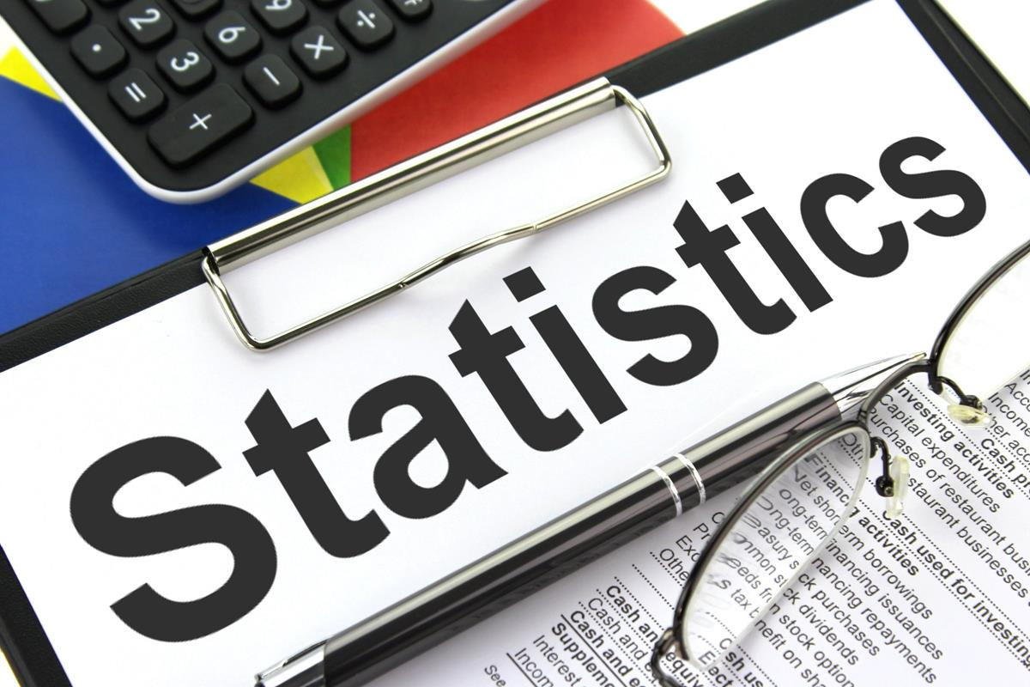


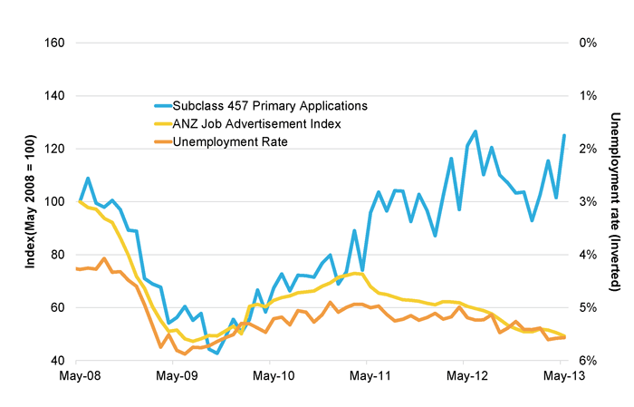
What is Data Analytics?
Science of analysing raw data
Using a tool to transform the raw data into usable information
To gather insights ( a data mining process)
To observe trends and patterns
Analytics that look beneath the surface
Notes:
What is data analytics? By definition.
Difference between analytic and analysis, is the use of software tool to help the analysis.
The term data mining is another word to mean gathering insights. It is a process to “see” the “story” underneath the data.
Data analytics is not just looking at data, but summarizing, transforming for useful insights.
We need software tools to help us to handle large data sets.
We will manage small number of data to understand how we process, then you will understand how the software help us in a faster way.
Statistic is a way to describe the data.

Slide 16
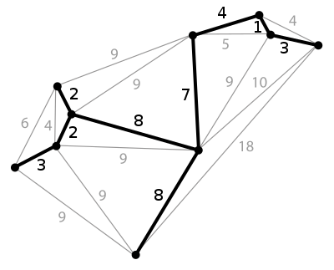
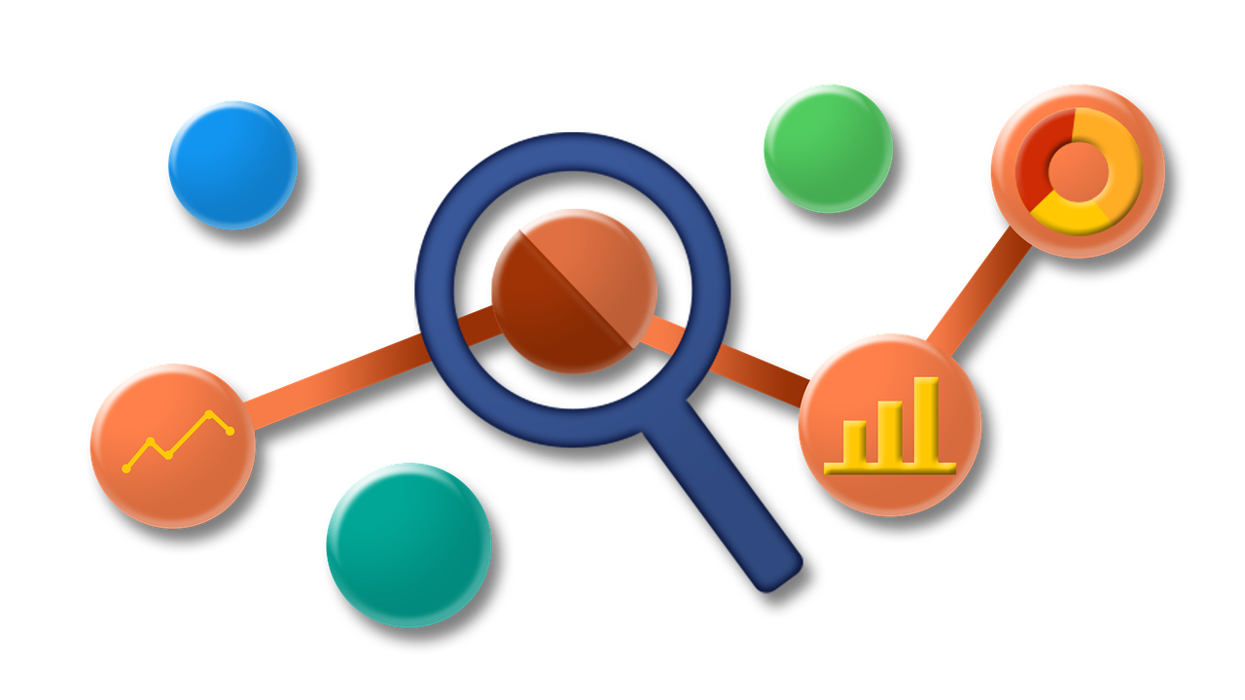

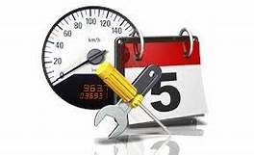
Why does it matter?
To predict outcomes (possible machine/components failures)
To optimize processes
To make actionable decision (data driven)
To increase overall efficiency of a business process
Notes:
This slide is to reiterate what we can learn from the data and how the insights can help in business and process efficiency.
Just another way to look at data.

Slide 17
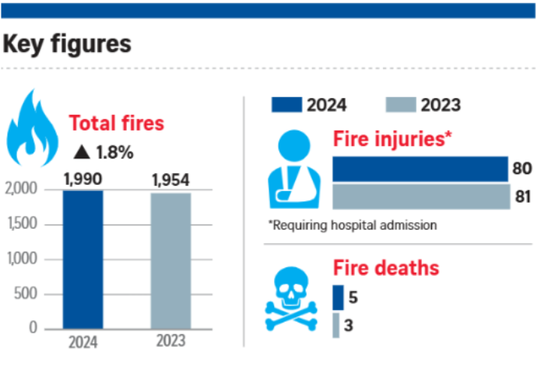
Example of gathering insights from data
What can you interpret from these charts?
Insights:
There are lesser fire injuries but more deaths compared to last year.
There is an increase of fire incidences.
Next question:
What are the causes for the fire?
Notes:
What insights can we gather?
This example explain how “insights” are gathered from data.
Here, we also see how we present data ( in the form of bar charts).
What does the axes presenting?
This is to give students a preview and also what they will do for the project.
From data to charts, to insights.
Notice the use of questions to decide how we can plot the chart to answer our questions and validate our insights.

Slide 18
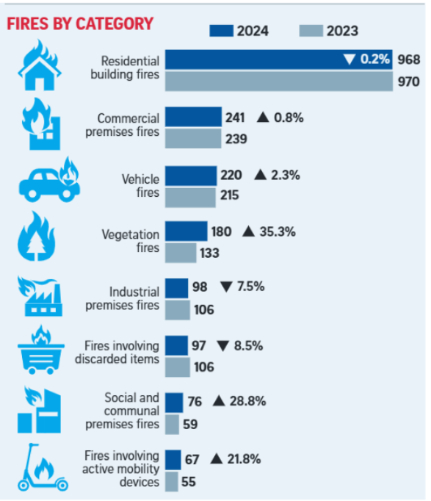
Further insights
Which fire category has the highest increasing case compared to last year?
Vegetation fire has the highest percentage of increase cases in 2024.
Next question: Is Climate change a key factor?
Notes:
Resources:
Fires involving AMDs up again in 2024 with 21.8% rise in cases; more people died in fires | The Straits Times
Some measure to take to reduce vegetation fire:
Help prevent vegetation fires by not smoking or littering in green spaces: NParks | The Straits Times
Wildfire Task Force was setup to look into fire safety measure in national parks.
Students can make any conclusion or insights from this chart.
This slide can be skipped if time is not enough.

Slide 19
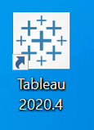
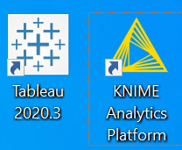
Tools that help us to manage data: - Use KNIME and TABLEAU Gather insights from statistics and data visualisation
We must be able to question and analyse the underlying raw data effectively with modern tools.
Notes:
There are many analytics programs available. Some free one, some customised one, and some open source, that you can program your analysis.
We use 2 common tools;
KNIME, a free and open source program
TABLEAU, not free but available for public use (meaning no uploading of confidential data).
But, for education, they are giving free license during the period of study.
A very good visualisation tool.
At the end of the course, you should demonstrate your ability to use KNIME and TABLEAU to present insights.
Insights are summary statistics, and data visualisation.
The challenge is to produce meaningful and easy to understand data visualisation that provide valuable insights.
Creating an interactive and meaningful dashboard will be a bonus. (not just pack a few worksheets into one dashboard)
(This learning outcomes need to be clear to all students)
A quick intro will do. Let students know that there are many tools in the market.

Slide 20
Applications of Data Analytics
Manufacturing Industry: Preventive Maintenance
Facility/Building Management : Optimize facility’s energy performance and remove any inefficiencies.
Aviation Industry: To Optimize Flight Route
To forecast demand
To improve fuel efficiency
To measure performance
Notes:
Just some examples where data is used.
No need to spend too much time on this slide.
This is to get students from diploma to understand why they are learning this subject.

Slide 21
Why data analytics? The Purpose
To discover insights.
To make decisions.
To identify gaps/problems/issues
To improve process
To detect growth opportunities
Provide evidences to support change
To answer questions (related to a problem)
REVIEW
Notes:
A conclusion on What is data analytics.

Slide 22

Today’s Learning Topics
Why data analytics?
Data Analytics Process
The four levels of analytics
Central Tendency/Spread
Notes:
Next, Level of analysis.
4 levels.

Slide 23

Four levels of analytics
Descriptive
Diagnostic
Predictive
Prescriptive
volume of data
Optimisation
What can we do?
Information
Why did it happen?
What will happen?
What happens?
Computing Process
Notes:
The four levels are Descriptive, Diagnostic, Predictive and Prescriptive.
Data is described using the Statistics and visualisation.
Second level of analytics look into the correlation, or other data like GDP growth or weather information to explain the result.
Third level of analytics use the data to predict, and that is machine learning.
The fourth level of analytics is to prescribe, just like doctor prescribing medicine. This is Artificial Intelligence.
(click) show doctor examine patient image – describe and diagnose, predict that the fever will last for few days, prescribe a medicine
The X-axis shows the increasing demand of computer processor for prescriptive analytics.
The Y-axis shows the demand of large volume of data for prescriptive analytics.
The Y-axis shows the increase volume of data needed to perform higher level of analytics.
The X-axis shows the increase power of computing process to perform higher level of analytics.
Higher level of analytics is possible now as there are now bigger data storage space and faster computing power.

Slide 24
Types of Data Analytics (Review)
Descriptive Analytics
What happened?
Uses historical data to give a perspective of what is going on
Diagnostic Analytics
Why did it happen?
What and why it went wrong?
Predictive Analytics
What is going to happen?
Building mathematical model using historical data
Prescriptive Analytics
What could we do about it?
Find the best actions to achieve desired goal
Notes:
In this subject, we will focus more on descriptive analytics (“Tell a story”) and a small portion on prescriptive analytics.
Good to provide an example for each type of analytics.

Slide 25
Today’s Learning Topics
Why data analytics?
Data Analytics Process
The four levels of analytics
Central Tendency/Spread

Slide 26

Data Analytics Process
Data collection
Data Cleaning
Exploratory Data Analysis
Data Transformation
Data Presentation
Formulate Key Questions
Data Modelling
Statistical Analysis
Data Visualisation
Notes:
The data collected and the questions are closely related. They are the starting point.
In this subject, data will be given to you for project.
You will base on the given data, and formulate your key questions (working reverse).
In industry practice, we often get data from various sources, even sensors. We need to know how can we extract relevant information from these data.
Example of questions:
What is the maximum waiting time?
What is the chances of an airline to cancel the flight?
Which month of the day has the highest sale of ice-cream?
Is there a correlation between the weather and ice-cream sale?
How would you collect the data to answer the questions?
See if any student is able to answer this
The question serves the purpose of collecting and analysing the data

Slide 27
Data Analytics Process
Data collection
Data Cleaning
Exploratory Data Analysis
Data Transformation
Data Presentation
Formulate Key Questions
Data Modelling
Data collection:
Forms of Survey
Measured values
Smart Sensors/Tracking devices
Statistical Analysis
Data Visualisation
Notes:
Data can be collected through form of survey, or measured values, like the temperature reading.
Or smart sensors that measure and upload every second.
The key questions help to guide the analysis, on what to find.
For example:
To understand if there is any correlation between the weather temperature and sale of ice-cream, we will collect the daily temperature and the amount of money earned from the sale of the ice-cream

Slide 28
Data Analytics Process
Data collection
Data Cleaning
Exploratory Data Analysis
Data Transformation
Data Presentation
Formulate Key Questions
Data Modelling
Missing values
No entries
Error in sensor
Wrong Data Type
ID | Gender | Height | ProdTime | SleepHr | StudyHr | ExHr | Favfruit
1 | Female | 1.7 | Morning | 5 | 8 | 1 | Orange
2 | Male | ? | Evening | 8 | 2hr | 12hr | None of the above
3 | Male | 171 | Evening | 9 | 10 | 12 | None of the above
4 | Male | 1.76 | Evening | 7 | 50 | 8 | Grapes
5 | Male | 1.71 | Afternoon | 8 | 4 | 0 | Apple
6 | Male | 1.74 | Evening | ? | 7 | 5 | ?
7 | Male | 1.73 | Evening | 7 | 7 | 4 | Water Melon
8 | Male | 1.9 | Evening | 6 | 9 | 11 | Orange
9 | Male | 1.9 | ? | 6 | 5 | 11 | Orange
10 | Male | 1.7 | Evening | 7 | 8 | 2 | Water Melon
Statistical Analysis
Data Visualisation
Notes:
Identify the problem with this set of data.
(click) These field has no values.
(click) These values are not entered in the right format. We are using program like KNIME to perform analysis, and the program will not be able to interpret correctly for “StudyHr” and “ExHr” (physical exercising time). Are these two variables a number or text? Mathematical function like addition subtraction cannot be performed on a value that has mixture of number and letters.
So, because of these, we need to “clean” and transformed the data.
Before analysing the data, we need to check if the data is “cleaned”, Meaning, checking for wrong input format, missing values, duplicates
Example:
StudyHrs
Should this variable be a decimal data type or String data type? (8hrs is a string)
Just for discussion, as student, how would you check the data?
- We can then bring in software tools that help to make it easier to search for missing values, instead of using “eye” power to scan

Slide 29
Data Analytics Process
Data collection
Data Cleaning
Exploratory Data Analysis
Data Transformation
Data Presentation
Formulate Key Questions
Data Modelling
Statistical Analysis
Data Visualisation
Notes:
After data cleaning, next, is Exploratory Data Analysis (EDA)
We will do a lot of exercises on Data Exploration Analysis, in short is EDA.
Exploratory Data Analysis starts with finding the Statistics of every variable.
Example, what statistics can you find from Age? Height? Weight?
Solution: The average, the max and min, the standard deviation
Statistics in visual form: box-plot; histogram
You will learn how to find these statistics in the next 2 lessons. This is the most basic ways to describe data.
This is the first level of analytics.

Slide 30
What is Exploratory Data Analysis?
Descriptive Analytic
Statistical Analysis
Visualisation
Central Tendency
Linear correlation coefficient
Normal Distribution
Probability
Cross Tabulation
Box-plot
Histogram
Bar Chart
Pie-Chart
Line Graph
Notes:
This slide repeat what we explained in previous slide.
It shows the 2 ways to describe data. EDA is descriptive analytics.
Statistics and visual charts describe the statistics in visual form.
This is also what you need to do for Project Report 1.
**Inject the term EDA. When comes to project, report 1 is complete the EDA.
Student will come back again to ask “what is EDA”.

Slide 31
Data Analytics Process
Data collection
Data Cleaning
Exploratory Data Analysis
Data Transformation
Data Presentation
Formulate Key Questions
Data Modelling
Statistical Analysis
Data Visualisation
Notes:
Data Transformation is a process to re-shape the data for meaningful analysis.
Example: You have the age value of your customer. To have meaningful insight, you can group the age into below 20, below 60 and others.
We can name Age > 60 as “Senior”. And find the statistics for “Senior”, then compared with those who are younger than Senior.
Or setting a status like “High” and “Low” when the values reached certain threshold value.
Or “low in toner” when volume reduces to certain threshold value.
Other example to give:
Knowing Weight and Height, we can compute another variable: BMI= weight(kg) divide by height(m) squared
This is transforming the 2 variables into another variable
Lesson on data transformation will be covered in Week 7 before Term Break.

Slide 32
Data Analytics Process
Data collection
Data Cleaning
Exploratory Data Analysis
Data Transformation
Data Presentation
Formulate Key Questions
Data Modelling
Statistical Analysis
Data Visualisation
To determine a suitable model that can be used to predict the outcome
Notes:
Data Modelling is also known as Machine Learning. It is predictive Analytics.
This part may be difficult to understand at this moment. We will cover in Term 2.
This is a process to predict outcomes. Base on a few critical parameters, we use analytics program to perform iteration to fit a mathematical model that best explains the behaviour of the data, and use it to predict the outcomes. Of course, this prediction has some percentage of error. Hence, we need to know how to interpret the error.
The predicting outcome can be laptop price, predict air quality index. It can also be predicting types, like predict the object is A or B. This is know as Classification. There are many type of models to predict outcomes, we will cover only Linear Regression model.
Lastly, we “tell the story” in Data Presentation phase, using all the relevant charts and dash-boards. Remember, data analytics will compile findings into easy to understand report or presentation to Management or client.

Slide 33
Data Analytics Process (Review)
Data collection
??
??
Data Transformation
Data Presentation
Formulate Key Questions
??
Data Cleaning
Statistical Analysis
Exploratory Data Analysis (EDA)
Data Visualisation
Data Modelling
Notes:
Let’s recap. Fill in the blanks
(random pick a student to answer)
Question to the student: Which phase is the most time consuming?
Practically, data cleaning will take longer time when the data is raw from the sensor
But, for this project, the most time consuming is EDA. Why?
Because the data given to you is unknown to you, and need to search internet for background.
Example, you are given data on wildfire scenario, which you do not have any idea what is it, how it happened, and what are the impact, you will need to do research to find out, so that you can understand the variables that were measured in the data.
This is to prepare students on the work that they will be doing.
**Data Modelling may be time consuming. For this subject, we want to focus more on EDA.
We use only one model. Student don’t have to determine the best model.
Student need to understand what the model does and how to interpret the model and the prediction accuracy.

Slide 34
Q & A

Slide 35
Today’s Learning Topics
Why data analytics?
Data Analytics Process
The four levels of analytics
Central Tendency/Spread
Notes:
Next, we will proceed to learn methods to describe data : Descriptive Analytic
This is also in the phase of EDA.
Statistics is one of the way to describe analytics. The first statistics for today is to describe the Central Tendency and Spread.
You would have practiced in your maths subject.
Student can open the lab worksheet 1 or Classkick for the exercises.

Slide 36
Activities
Refer to lab 1 worksheet
Notes:
Can switch to lab 1 worksheet.
No need to show the next few slides.

Slide 37

How to summarise data?
Central Tendency and Spread
Average daily adult ICU bed utilisation by Epi-week | MOH | data.gov.sg
How is the count of ICU admissions shown?
What insights can you gather?
Ministry of Health. (2023). Average daily adult ICU bed utilisation by Epi-week (2024) [Dataset]. data.gov.sg. Retrieved March 23, 2025 from https://data.gov.sg/datasets/d_ac42b0ea4ae0528bc9dbef90f0658f2b/view
Notes:
Student can now open the Worksheet 1 (pdf in LMS) or ClassKick
X-axis shows the day. Is weekly.
Y-axis shows the count of patient admitted to ICU bed.
Question: patient coming in at different timing of the day, One week has 7 days.
Is the count the sum of patient in 7 days?
Why is there decimal values in the data?
**You can elicit response from students. Understand how they interpret.
It is taking the average number of patient admitted to ICU bed. It has grouped the data into Covid, Non-Covid and Empty.
Insight: There are more non-Covid patient admitted to ICU than Covid status.
On average, there are 300 ICU beds available per week.
There are at least 100 empty ICU beds (average) per week.
Our health care facility is able to cope with current Covid-19 situations.

Slide 38

How to summarise data?
Central Tendency and Spread
Waiting Times for Registration and for Consultation at Polyclinics | Ministry of Health
Which Statistics is used to present the “waiting time”?
Ministry of Health. (2023). Average daily adult ICU bed utilisation by Epi-week (2024) [Dataset]. data.gov.sg. Retrieved March 23, 2025 from https://data.gov.sg/datasets/d_ac42b0ea4ae0528bc9dbef90f0658f2b/view
Notes:
**You can elicit response from students. Understand how they interpret.
X-axis is the waiting time duration in minutes ( how do you is measured in minutes?)
The Excel file (I downloaded) has the column name indicated “Minutes” as the units.
Vertical axis is not measured value. It is the different polyclinics. The y-axis is not numerical data, but categorical.
The chart plot categorical variable Vs numerical and the numerical values are Median and 95th percentile.
These 2 examples show how measured values can be summarised to give insights.

Slide 39
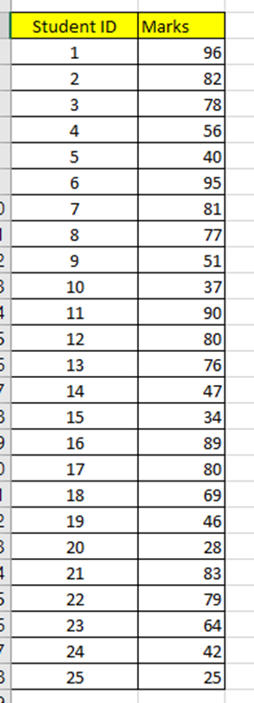
Scenario
Sam scores 77 in recent online test.
He went home, and his father asked him the following questions related to the test scores after knowing his result:
What do you think he will ask?
Notes:
What do you think the father ask?

Slide 40
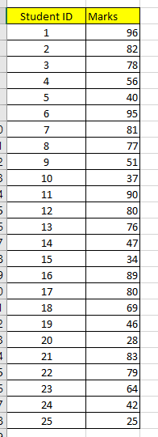
Scenario
25 students took the online test. The marks are recorded as follows:
Asking the right questions:
What is the average marks?
What is the highest marks?
What is the lowest marks?
What is the range?
What is the Standard Deviation?
What is the Median?
What is the marks on the 75th percentile?
(is the score in the top 25%?)
Notes:
He asked those questions to compare his marks with others.
Whether the test is manageable.
Asking right questions, means asking questions that the answer can be deduced from the data.
You can pause for the students to find the answer.
You can ask them to open the workbook (from LMS) or Classkick Worksheet 1

Slide 41
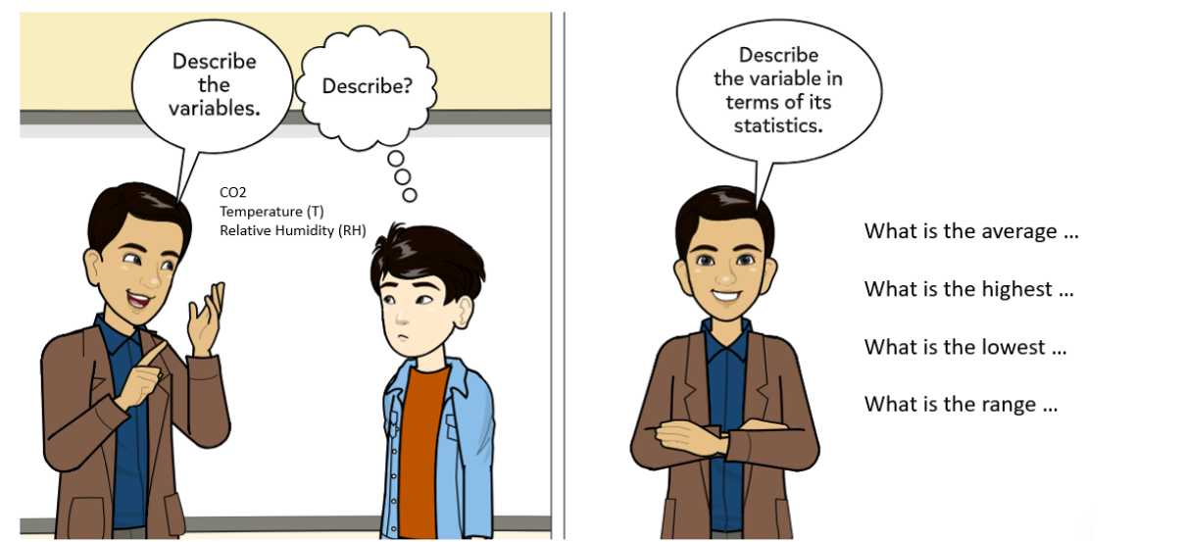
Describing data using Statistics
Central Tendency and Spread
Basic Statistics:
Central Tendency
Spread
Notes:
This slide re-emphasize the statistics we are covering

Slide 42

Two columns: StudentID, Marks
StudentID – not useful data.
Marks- Numerical data.
There are 25 rows. ➔ 25 Observations
What is the maximum marks ?
What is the minimum marks?
What is the mean?
What is the median?
Notes:
Either check from ClassKick for their answer or walk around to check their answers.
You can ask student to download the PDF worksheet, and open the PDF in Edge browser.
They can write their answer on it, and later keep a copy.
They should create a folder for this subject. A sub-folder for Lab worksheet.
You can get the student to show their answer, or explain.
This is also a way for you to check level of understanding for the class.
You can then spent more time on areas that they are clear.

Slide 43
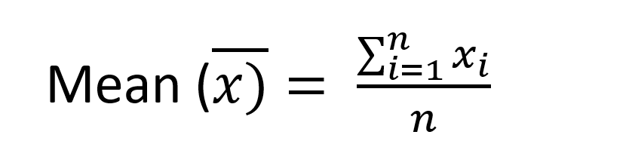
Exercise 1: Calculate Mean
What is the average mark?
SUM = 1625
Total students =25
Mean = (1624/25) = 65
(Show me how)
Notes:
Explain how to find the average mark. How to interpret the formula.
Student can either use calculator or make use of the Excel function.
But for this subject, we will not test them how to Excel.
We can show that software tools help us to manage large volume of data.
We can compute it manually, but is too tedious for us.
Although software tools give us the answer, but we must know how this answer is derived.
For online test, student will be test on manual calculation. The data set will be 4 to 5 numbers.
Also, take this opportunity, to explain the symbol used in the formula.
** Student is not familiar with the bar-X symbol
The summation symbol. What it means.
$$$ The “show me how” link to a video demonstration of using Excel to calculate the Mean.

Slide 44
Exercise 1
96
What is the maximum mark?
What is the minimum mark?
25
(Show me how)
Notes:
This should be easy.

Slide 45
Exercise 1: Calculate Median
What is the Median?
Step 1: Sort the values in ascending order.
Step 2:
There are 25 rows. The centre position is (N+1)/2, which is (25+1)/2 = 13
Row 13th is the Centre.
What if the number of rows, or N is even number? E.g. 24
Which is the centre position?
Notes:
Mean value represent the central of the data.
Another way to measure the central of the data is Median.
**Common mistake: Student did not sort the data in ascending order.
If the number of rows, or N is even, the centre position will be 12.5. Then, take the average of 12th and 13th values as the Median.

Slide 46
Mean Median Range Standard Deviation
Central Tendency and Spread
Mean and Median measure the Central Tendency.
Range and Standard Deviation measure the Spread.

Slide 47
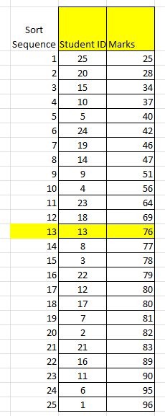
Exercise 1:
Summary Statistics:
The Range = Max – Min
= 96 – 25
= 71
Mean = 65
Max = 96
Min = 25
Median = 76
50% of the students score less than 76.
Notes:
The range is big. Which mean the marks are widely spread.
As the spread is wide, Median is a better representation.

Slide 48
Spread measured in Standard Deviation
This question is checking the “spread” of the data or the “dispersion”.
The statistics to determine the spread is the Standard Deviation.
How far are the rest of the values deviate from the Mean?
Notes:
The range is big. Which mean the marks are widely spread.
Another way to measure spread is measure the Standard Deviation (SD)
Wider SD, means the spread is wide.
SD measures the average distance of the values away from the mean.

Slide 49


There are 2 ways to calculate Standard Deviation. What is their difference?
N
N - 1
Method 1
Method 2
Sample Mean
Population Mean
A sample is a subset of a population.
Sample < population
N is the sample size.
Notes:
There are 2 formula for calculating Standard Deviation.
One is called Population SD and another is Sample SD.
Sample SD is for small sample size < 30.
The keyword is “population” and “sample”.
A sample is a subset of a population.
Your calculator calculates the Population Standard Deviation.
Notice the different symbol use for population mean and sample mean, and also the population standard deviation and sample standard deviation.
##Explain the square of difference in the formula. That was explained in the previous slide. Hope this will help the students to understand the meaning of SD.
For online test, they can use calculator to calculate the SD. But they need to find out how. If not, formula will be given.

Slide 50
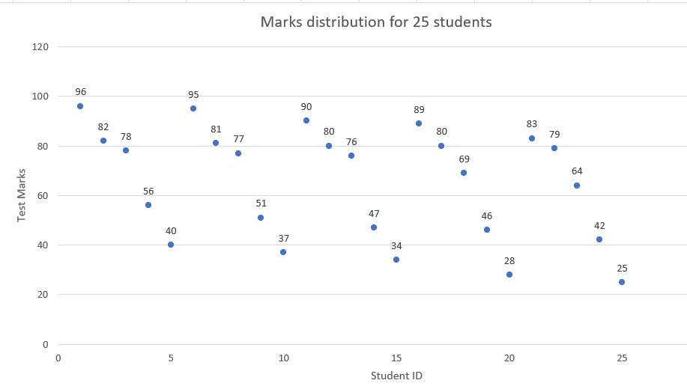


Average marks
Notes:
This slide explains the computation of differences.
Comparing all data points with the average marks.
Some are far, and some are near.
Calculate the difference between the data points and the average marks.
Average marks is fixed.
There will be negative values for data points lower than average marks. So, we will square all the differences.
This will give the average of the differences.

Slide 51
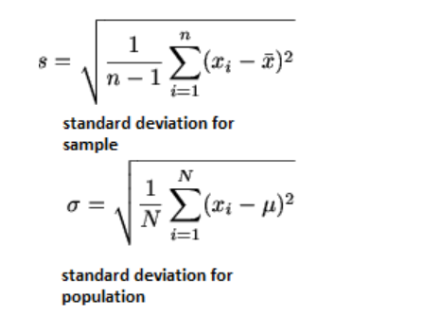
Exercise 1: Calculate SD
If we are going to use this Sample to estimate the standard deviation for all classes, then we will use the Sample Standard Deviation.

Slide 52

Exercise 1: Calculate SD
Calculate the Sample Standard Deviation.
$$\sqrt{\frac{1}{25−1}[{\left(96−65\right)}^{2}+{\left(82−65\right)}^{2}+{(78−65}^{2}+{\left(56−65\right)}^{2}{+(40−65}^{2}+…+{\left(X_{i}−65\right)}^{2}+{\left(25−65\right)}^{2}]}$$
$$Average, \overline{X}=65$$
Sample SD = 22.2
(Show me how in Excel)
Notes:
This shows how the formula is used to calculate the SD.
(Show me how in Excel) – will launch Panopto video that demonstrate how software tools can help in productivity.

Slide 53
Exercise 1: Calculate SD
Mean = 65
Sample Standard Deviation = 22.2
This means the difference in marks is about 22.2 more or less than the average value.

Slide 54
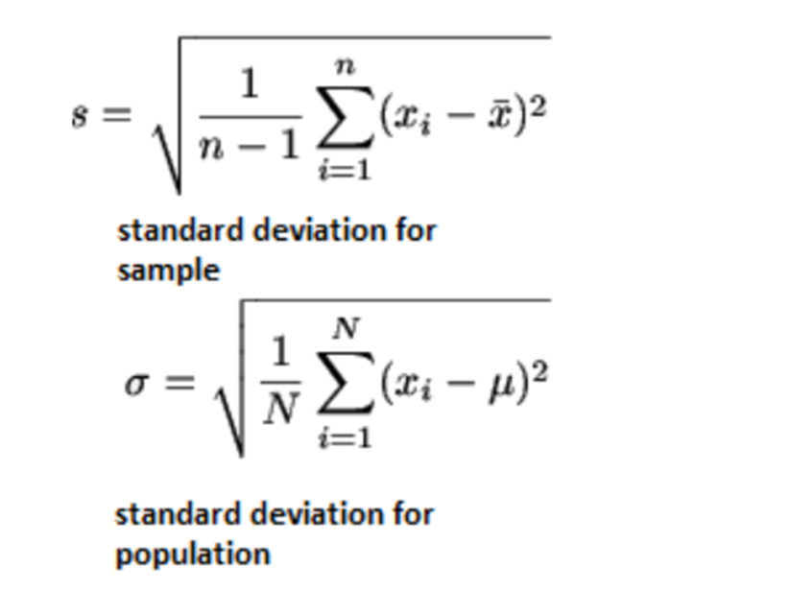
3rd way of measuring the Spread
Term | Mathematical Formula
Range | Max. - Min.
Standard Deviation (SD)
Interquartile range (IQR) | Upper Quartile – Lower Quartile
Notes:
SD is used to measure the spread with reference to Mean.
There is another statistics called Interquartile Range or IQR.
This is the measure of spread in respect to the Median.

Slide 55
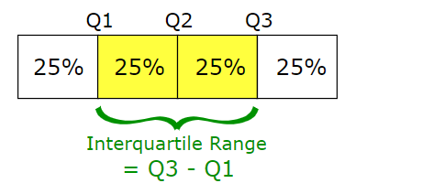
Exercise 1 – Calculate IQR
MEDIAN
Q1
Mid of Lower Half
Q3
Mid of Upper Half
**
The values must first be sorted in increasing order
Notes:
We can divide a data set into 4 quadrants.
First 25% of the data is Quadrant 1
50% of the data is Median (or Quadrant 2)
The first 75% of the data is Quadrant 3.
IQR is the measure of the range between Quadrant 3 and Quadrant 1.
Another name will be Quartile 1 (25th percentile), Quartile 3 (75th Percentile)

Slide 56
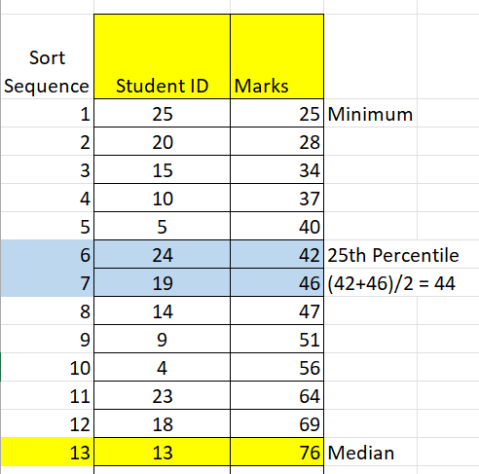
Exercise 1 – Calculate IQR
First Quartile = 44
25th percentile
Lower Quartile
Second Quartile = 76
50th percentile
Median
1st Quartile
Index = (n+1)/4
Is 6.5
Median
2nd Quartile
Notes:
We can divide our data set into 4 quarters.
Each quartile represent 25%.
How to find Quartile 1? The lower quartile.
0.25 * (25+1) = 6.5 So, is average of 6th and 7th values.

Slide 57
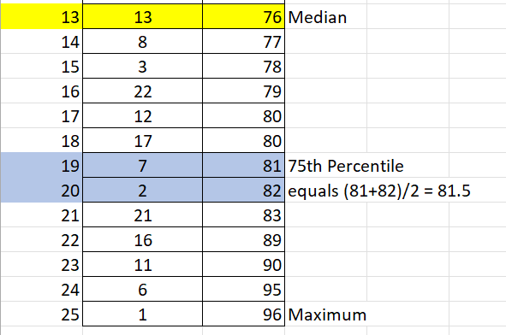
Exercise 1 – Calculate IQR
Third Quartile = 81.5
Upper Quartile
75th percentile
The Percentile shows how well a student do compare with the others.
3rd Quartile
Index = ¾ (n+1)
Is 19.5
Sam scored 77 marks so he is above 50% of the class.
Notes:
How to determine Quartile 3? The upper quartile
0.75 * (25+1) = 19.5
So the values is the average of 19th and 20th
The Percentile shows how well a student do compare with the others.
So, how well did Sam do? Describe.

Slide 58
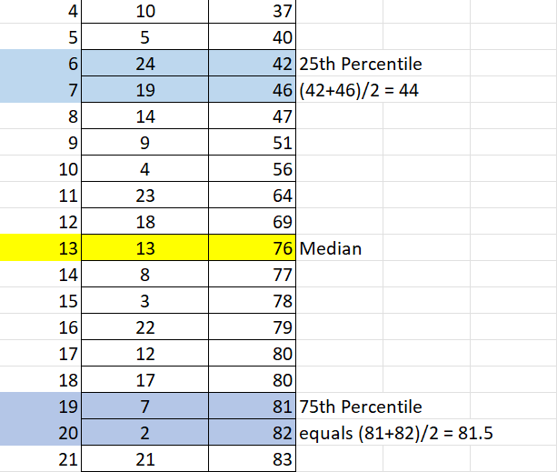
Exercise 1 – Calculate IQR
The difference between Upper Quartile and Lower Quartile is called the Interquartile range.
Interquartile Range, IQR =
81.5 – 44 = 37.5
IQR is another way to measure data spread.
The smaller the IQR, the smaller the spread.
Meaning, the values are very close to the Median.
Notes:
IQR shows 35 marks between 75th and 25th percentile.

Slide 59
IQR Revision
1st quartile = 44, Median = 76, 3rd quartile= 81.5
True or False:
50% of the class is less than 76 marks.
True or False:
25% of the class set is less than 44 marks.
True or False:
If you score 82, you are at the top 25%.
Notes:
The range is big. Which mean the marks are widely spread.
As the spread is wide, Median is a better representation.

Slide 60
Review
Central Tendency can be represented by the Mean or the Median of the data set.
Question:
Which measure is a better representation of the central tendency if the data set contains extremely large or extremely small values?
Ans: Median
Notes:
If the data set contains extremely large and extremely small values, the average will be affected.
But, if we use Median, it is not affected by extremely large or extremely small value.
Previous activity, we notice Polyclinic waiting time is presented as Median.
Mean value will be mis-leading if one or two patient waited for very long.

Slide 61
Review
The spread of the data set can be measured by Range, standard deviation and Interquartile Range (IQR)
Term | Mathematical Formula
Range | Max. - Min.
Standard Deviation (SD)
Interquartile range | Upper Quartile – Lower Quartile

Slide 62
Self-assessment
Check your understanding
Score < 50
Consultation with your tutor
Score < 70
Read the eLearning materials
And redo
Notes:
Read the learning materials. Do self-assessment

