Slide 1
MILITARY, EDUCATION & HEALTHCARE EXPENDITURE ANALYSIS OF THE TOP 10 NATIONS.
PRESENTATION BY: NIGEL SAVIO MARTIS

Slide 2
DATA SOURCE
Raw Data source:
The World Bank (https://data.worldbank.org/).
SIPRI Military Expenditure Database (https://www.sipri.org/databases/milex).
Raw Data includes:
Population, GDP (current US$), GDP Per Capita (current US$), Military Expenditure (current US$), Education Expenditure (current US$), Health Expenditure (current US$), Expenditure (% of GDP) and Per Person Expenditure (current US$) for the G20 Nations.
From year 2012-2019.

Slide 3
DATA PRE-PROCESSING
Tools used:
DataBank tool provided by the World Bank to filter out the data of my concern
Excel and Spreadsheets for creating additional worksheets and for further calculations.
Tasks (Calculations):
Missing values for Per Person Expenditure calculated from the Expenditures of the respective sector and Population data.
Growth in each sector by calculating the percent change, Mean Expenditures across each sector (2014-2018).

Slide 4
CLEANED DATA
File Name and Link:
“Clean Data.xlsx”
(https://docs.google.com/spreadsheets/d/1xASEhzVzs7LafbFPqsbp0Ow5Ehjplj-e59soDrUz_Ms/edit?usp=sharing.)
Countries Selected: Australia, Canada, China, Germany, India, Japan, Russia, Saudi Arabia, United Kingdom and United States.
Years Selected: 2014, 2015, 2016, 2017 and 2018.
Data used: Military Expenditure, Military Expenditure Per Person, Education Expenditure, Education Expenditure Per Person, Healthcare Expenditure, Healthcare Expenditure Per Person, Expenditure Growth, GDP and GDP Per Capita, Mean Expenditure for countries (2014 to 2018).

Slide 5
TOOLS AND TECHNOLOGIES USED
Tools Used: HTML, CSS, JavaScript, Google API
HTML used for basic webpage layout for main page (”index.html”).
CSS file used for design/ layout of the webpages (“style.css”).
JS script tags used within HTML to make Google API calls to graph charts for the main page.
Types of Charts used: Column chart, Stacked bar chart, Bubble chart, Scatter chart, Line chart and Geo chart
Sectors Explored: Military, Education and Healthcare.

Slide 6
VISUALIZATION OVERVIEW
Understanding the spending behavior (on education, healthcare and military) of the top 10 countries.
Comparison of expenditure on different sectors compared to the country’s GDP (expenditure on a certain sector as a % of their GDP).
Comparison of Military expenditure to the countries’ Education and Healthcare expenditure.
Comparison (to see if there is a correlation) between per capita expenditure on each of the sectors and per capita GDP.
Identify the fastest growing countries in Education and Healthcare spending.

Slide 7
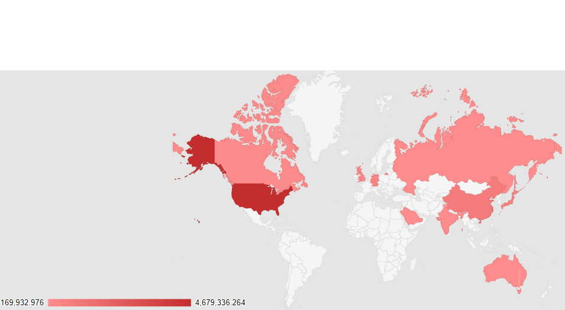
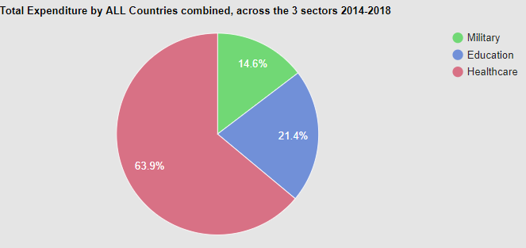
ANALYSES AND KEY INSIGHTS
> United States has the highest spending across all 3 sectors.
> China has the second highest spending but behind United States by a huge margin.
> The total spending in each sector by combining each country's expenditure is calculated.
> The highest spending are in the Healthcare sector (63.9%).
> The least spending are in the Military sector (14.6%).

Slide 8
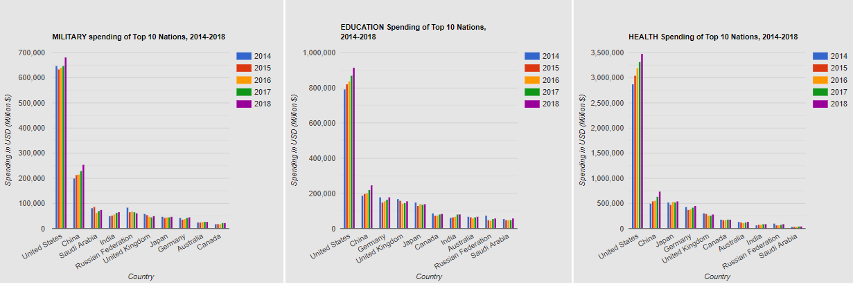
ANALYSES AND KEY INSIGHTS
> There is an increasing expenditure trend across all 3 sectors in USA and China from 2014 to 2018.
> The expenditure trend is inconsistent for the remaining Countries.

Slide 9
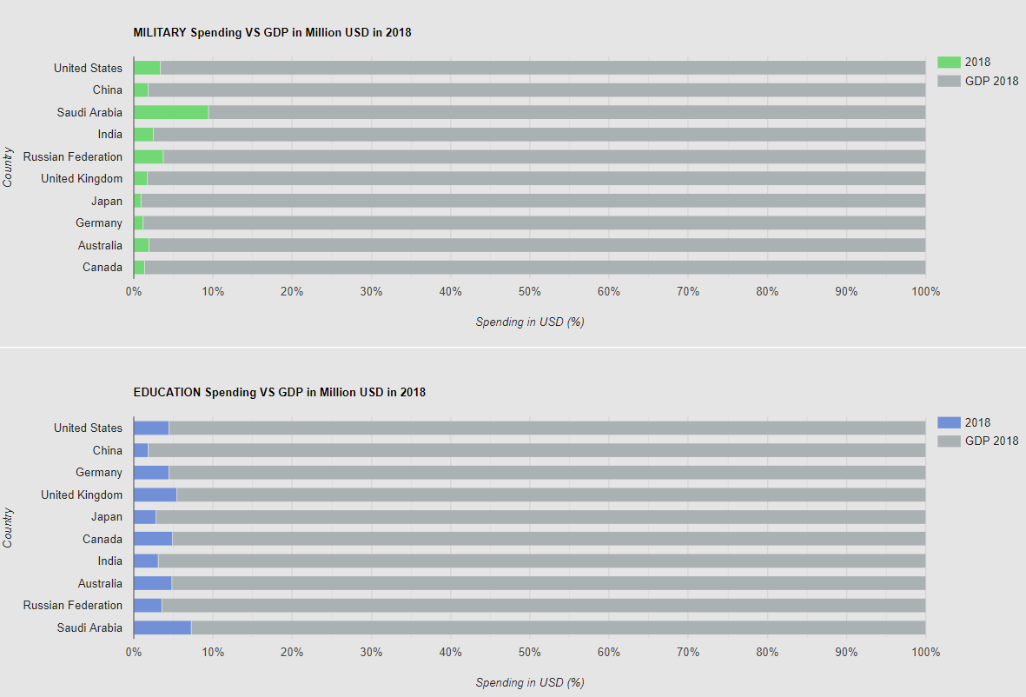
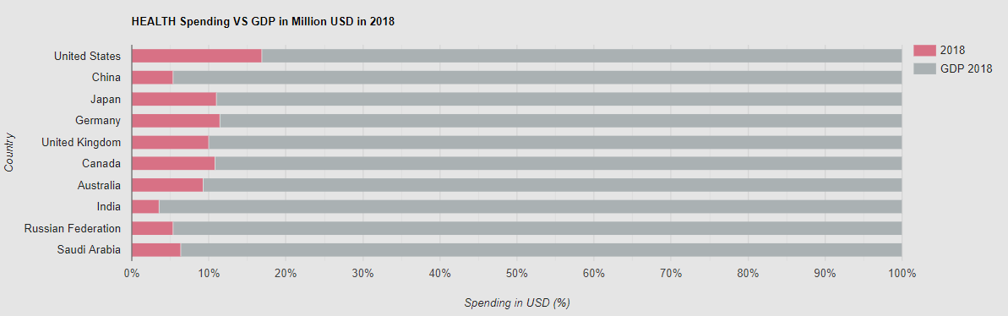
ANALYSES AND KEY INSIGHTS
> The data used for this insight is the latest 2018 data.
> All Countries spend approximately 10% of the GDP or less towards each of the sectors.
> Saudi Arabia spends 9.46% and 7.25% of its GDP towards Military and Education respectively, which is the highest compared to the other Nations.
> United states spends 16.89% of its GDP towards Healthcare, which is the highest compared to the other Nations.

Slide 10
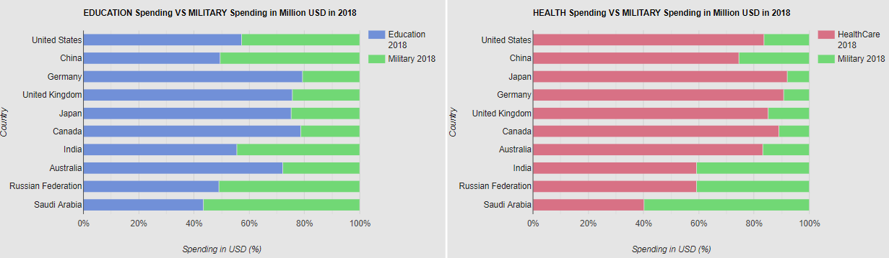
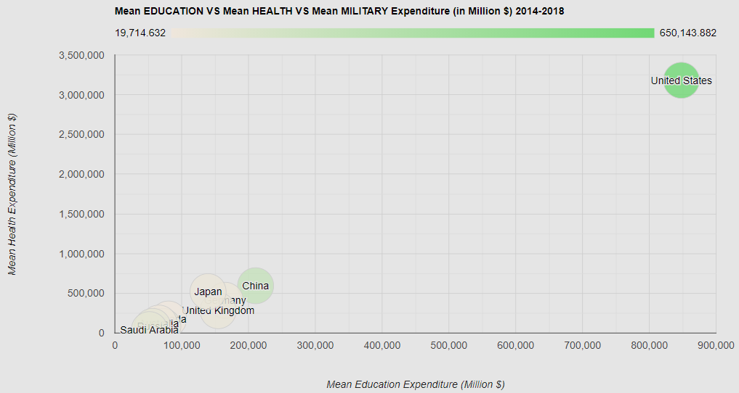
ANALYSES AND KEY INSIGHTS
> The data used for this insight is the mean of all years as well as the latest 2018 data.
> Countries like USA, China, India, Russia and Saudi Arabia spend approximately similar amounts of its expenditures towards Education and Military.
> All countries except Saudi Arabia spend the most amount in the Healthcare sector.
> Saudi Arabia spends the most towards Military and second towards Education, giving the least priority to Healthcare in comparison.

Slide 11
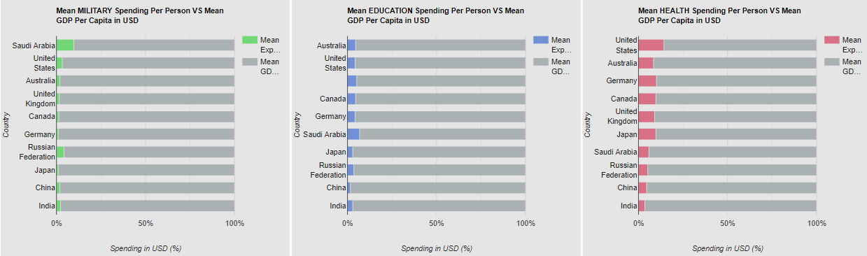
ANALYSES AND KEY INSIGHTS
> Saudi Arabia has the highest Military and Education Expenditure per person as a share of its GDP per capita.
> USA spends its highest share of GDP per Capita towards Healthcare per person in comparison with the other sectors.
> Japan, China and India spend the least per person as a share of its GDP towards Military, Education and Health respectively.

Slide 12
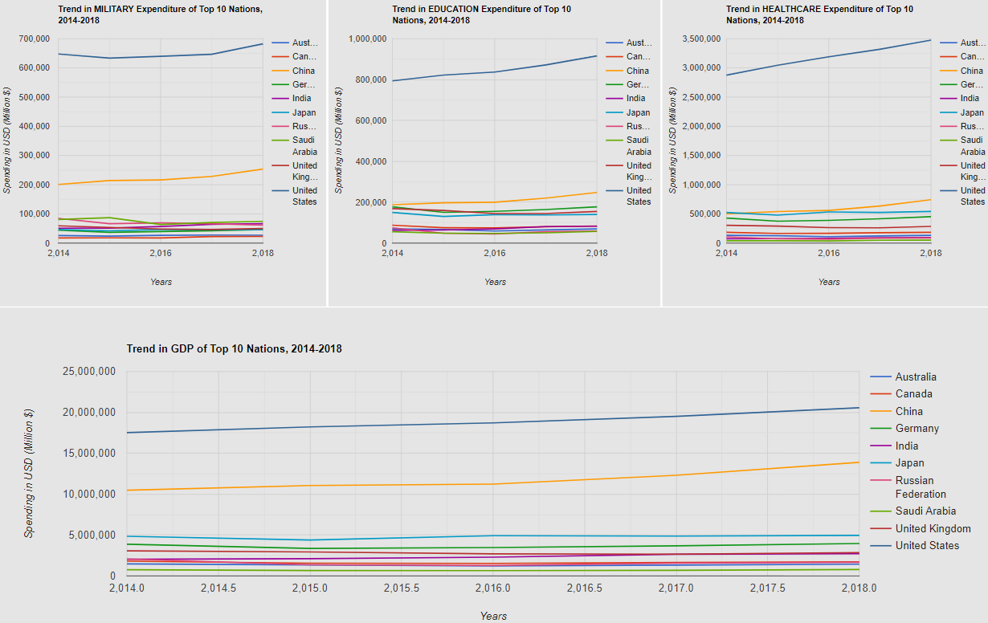
ANALYSES AND KEY INSIGHTS

Slide 13
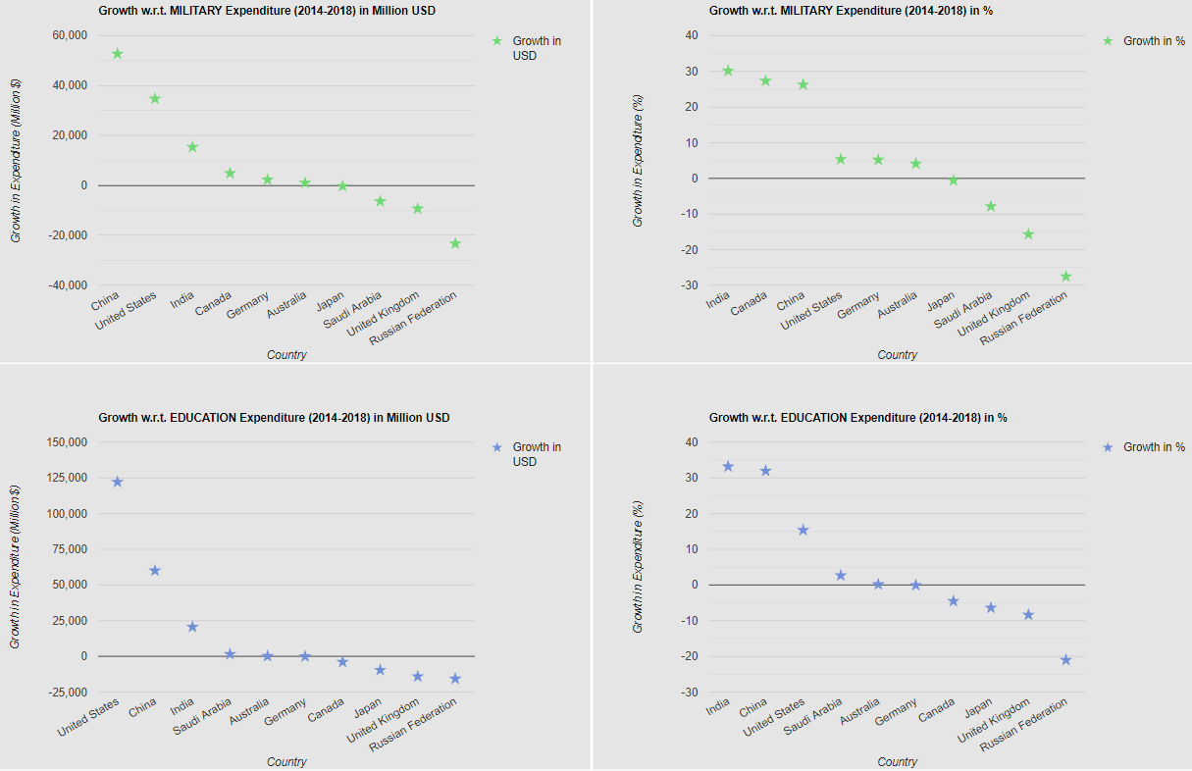
ANALYSES AND KEY INSIGHTS

Slide 14
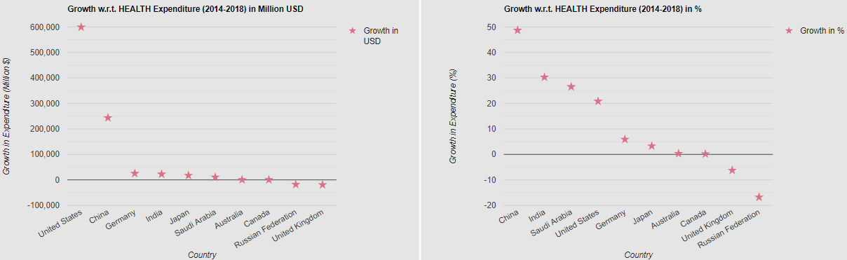
ANALYSES AND KEY INSIGHTS
> China and India show the highest % growth in all the 3 sectors
> USA shows the highest growth in current USD in the Education and Healthcare sector.
> China shows the highest growth in current USD in the Military sector.
> Russia and UK show the least growth in % growth as well current USD across all 3 sectors. > Positive correlation between GDP and Expenditure.

Slide 15
CONCLUSION
United States has the highest spending across all 3 sectors. China has the second highest spending but behind United States by a huge margin.
There seems to be a positive correlation between GDP Per Capita and Per Person Expenditures on either of the three sectors (Military, Education and Healthcare).
Saudi Arabia spends the most towards Military and second towards Education, giving the least priority to Healthcare in comparison.
China and India are the fastest growing Nations with respect to expenditure across all 3 sectors.

Slide 16
LEARNING PROCESSES
Revision of the in-class practical work.
https://www.w3schools.com/ for additional information about styles and layouts on HTML/CSS
https://developers.google.com/chart for key information on different graph selections and styles for Google API.
Prior knowledge about Data preprocessing on Excel.

