Slide 1
Basic Primitive of Computer Graphics
Fall 2018

Slide 2
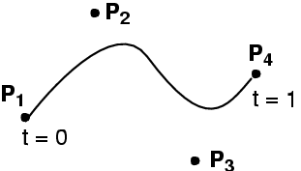
Today
Line
Curves
Fall 2018

Slide 3
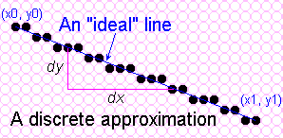
Towards the Ideal Line
We can only do a discrete approximation
Illuminate pixels as close to the true path as possible, consider bi-level display only
  Pixels are either lit or not lit
Fall 2018
Notes:
双电平显示

Slide 4
What is an ideal line
Must appear straight and continuous
  Only possible axis-aligned and 45º lines
Must interpolate both defining end points
Must have uniform density and intensity
  Consistent within a line and over all lines
  What about anti-aliasing?
Must be efficient, drawn quickly
  Lots of them are required!!!
Fall 2018

Slide 5
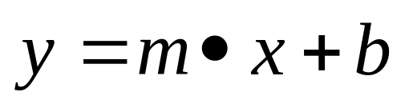
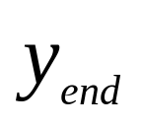
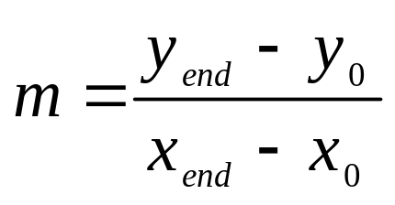
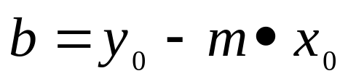


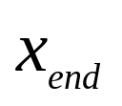
Simple Line
Based on slope-intercept algorithm from algebra:
Simple approach:
increment x, solve for y
Floating point arithmetic required
Fall 2018
Notes:
斜率截距方程

Slide 6
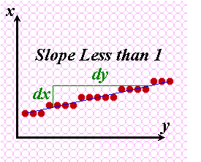
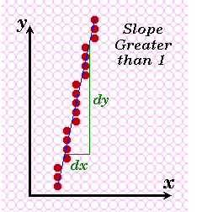
Does it Work?
It seems to work okay for lines with a slope of 1 or less
But doesn’t work well for lines with slope greater than 1 – lines become more discontinuous in appearance and we must add more than 1 pixel per column to make it work.
Solution? - use symmetry.
Fall 2018

Slide 7
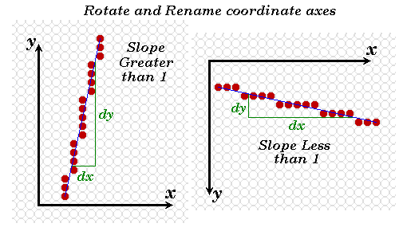
Modify algorithm per octant
OR, increment along x-axis if dy<dx, dy/dx<1
else increment along y-axis
Fall 2018

Slide 8
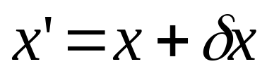
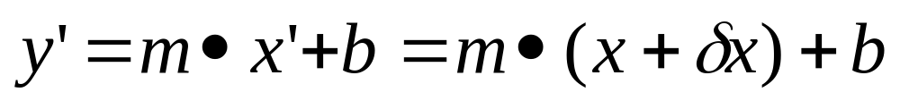
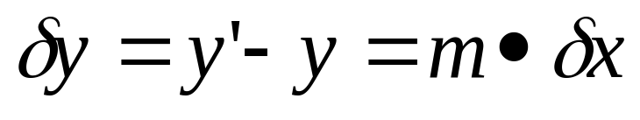
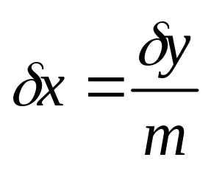
DDA algorithm
DDA = Digital Differential Analyser
  finite differences
  If
(1)
(2)
(3)
(4)
Fall 2017
Notes:
Important algorithm.
（数值微分）
有限差分

Slide 9


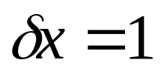
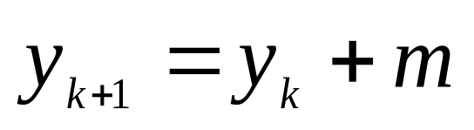
DDA algorithm
According to (3),(4), we compute or
Sampling the segment along on x/y axis with unit length, and computing the y/x coordinate that nearest to the segment , integer value
If m<1,
Fall 2018

Slide 10
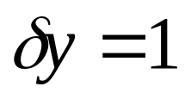
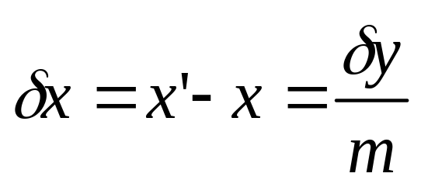
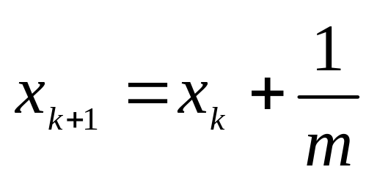
DDA algorithm
If m>=1
Fall 2018

Slide 11
DDA algorithm
void lineDDA(int x0, int y0, int xEnd, int yEnd)
{
int steps,k;
int dx = xEnd-x0, dy = yEnd-y0;
float xIncrement,yIncrement, x=x0,y=y0;
if (fabs(dx)>fabs(dy))
steps = fabs(dx);
else
steps = fabs(dy);
………
}
Fall 2018

Slide 12
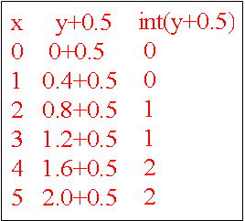
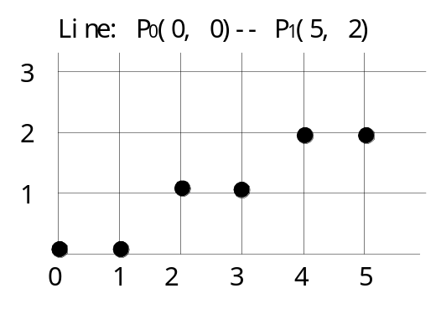
DDA algorithm
void lineDDA(int x0, int y0, int xEnd, int yEnd)
{
………
xIncrement = float(dx)/float(steps);
yIncrement = float(dy)/float(steps);
setPixel(round(x),round(y));
for (k=0;k<steps;k++)
{
x = x+ xIncrement;
y = y+ yIncrement;
setPixel(round(x),round(y));
}
}
For example
segment P0(0,0) P1(5,2)
Fall 2018
Notes:
int(Y+0.5)相当于四舍五入

Slide 13
DDA algorithm
Still need a lot of floating point arithmetic.
  2 ‘round’s and 2 adds per pixel.
Is there a simpler way ?
Can we use only integer arithmetic ?
  Easier to implement in hardware.
Fall 2018
Notes:
上述采用的增量计算方法称为数值微分算法(Digital Differential Analyzer，简称DDA)。数值微分法的本质，是用数值方法解微分方程，通过同时对x和y各增加一个小增量，计算下一步的x、y值。
DDA算法与基本算法相比，减少了浮点乘法，提高了效率。但是x与dx、y与dy用浮点数表示，每一步要进行四舍五入后取整，不利于硬件实现，因而效率仍有待提高。

Slide 14
Bresenham’s Line Algorithm
An accurate, efficient raster line drawing algorithm developed by Bresenham 1965, scan converts lines using only incremental integer calculations that can be adapted to display circles and other curves.
Keeping in mind the symmetry property of lines, lets derive a more efficient way of drawing a line.
Fall 2018
Notes:
优点
整数运算，速度快
精度高
乘2运算可用移位实现，适于硬件实现
合理地取deta X（不为1的整数），m*deta x可以为整数，可以使得deta y也变成整数，例如m=0.17，deltax=100，deltay=17
算法实现，要求符号，在这个过程中还是要不加浮点数，加整数，但是对于点本身，只是加个整数1或者不加。

Slide 15
Bresenham’s Line Algorithm
13
12
11
10
 | 10 | 11 | 12 | 13
  Starting from the left end point (x0,y0) of a given line , we step to each successive column (x position) and plot the pixel whose scan-line y value closest to the line path
  Assuming we have determined that the pixel at (xk,yk) is to be displayed, we next need to decide which pixel to plot in column xk+1.
Which one is the next one?
(11,11) or (11,12) ?
Fall 2018

Slide 16
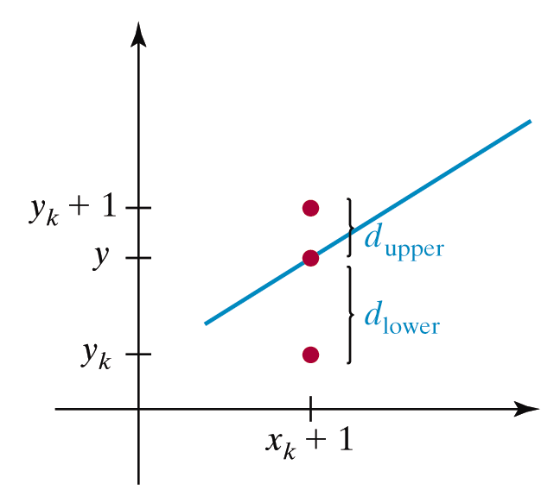
Bresenham’s Line Algorithm
Choices are (x_{k} +1, y_{k}) and (x_{k}+1, y_{K}+1)
d_{lower} = y – y_{k} = m(x_{k} + 1) + b – y_{k}
d_{upper} = (y_{k} + 1) – y = y_{k} + 1- m(x_{k} + 1) – b
The difference between these 2 separations is
d_{lower} - d_{upper} = 2m(x_{k} + 1) – 2 y_{k} + 2b – 1
Fall 2018

Slide 17
Bresenham’s Line Algorithm
d_{lower} - d_{upper} = 2m(x_{k} + 1) – 2 y_{k} + 2b – 1
A decision parameter p_{k} for the k^{th} step in the line algorithm can be obtained by rearranging above equation so that it involves only integer calculations
P_{k} = Δx (d_{lower} - d_{upper} ) = 2Δyx_{k}-2 Δxy_{k} + c
The sign of P_{k} is the same as the sign of d_{lower} - d_{upper}, since Δx > 0.
Parameter c is a constant and has the value 2Δy + Δx(2b-1)
(independent of pixel position)
If pixel at y_{k} is closer to line-path than pixel at y_{k} +1
(i.e, if d_{lower} - d_{upper} ) then p_{k} is negative. We plot lower pixel in such a case. Otherwise , upper pixel will be plotted.
Fall 2018

Slide 18
Bresenham’s Line Algorithm
At step k + 1, the decision parameter can be evaluated as,
p_{k+1} = 2Δyx_{k+1} - 2Δxy_{k+1} + c
Taking the difference of p_{k+ 1} and p_{k} we get the following.
p_{k+1} – p_{k} = 2Δy(x_{k+1}- x_{k})-2Δx(y_{k+1} – y_{k})
But, x_{k+1} = x_{k} +1, so that
p_{k+1} = p_{k} + 2Δy - 2 Δx(y_{k+1} – y_{k})
Where the term y_{k+1}-y_{k} is either 0 or 1, depending on the sign of parameter p_{k}
Fall 2018
Notes:
Pk决定yk+1是否增加1

Slide 19
Bresenham’s Line Algorithm
The first parameter p₀ is directly computed
p₀ = 2 Δyx_{k} - 2 Δxy_{k} + c = 2 Δyx_{k} – 2 Δx y_{k} + 2 Δy + Δx (2b-1) ,k=0
Since (x₀,y₀) satisfies the line equation , we also have
y₀ = Δy/ Δx * x₀ + b
Combining the above 2 equations , we will have
p₀ = 2Δy – Δx
Thus
p1 = p0 + 2 Δy -2 Δx or p1=p0+2 Δy (p_{k+1} = p_{k} + 2Δy - 2 Δx(y_{k+1} – y_{k}))
The constants 2Δy and 2Δy-2Δx are calculated once for each time to be scan converted
Fall 2018

Slide 20
Bresenham’s Line Algorithm
So, the arithmetic involves only integer addition and subtraction of 2 constants
Input the two end points and store the left end point in (x0,y0)
Load (x0,y0) into the frame buffer (plot the first point)
Calculate the constants Δx, Δy, 2Δy and 2Δy-2Δx and obtain the starting value for the decision parameter as
p0 = 2Δy- Δx
Fall 2018
Notes:
So, the arithmetic involves only integer addition and subtraction of 2 constants
int deltax := x1 - x0 int deltay := abs(y1 - y0)

Slide 21
Bresenham’s Line Algorithm
At each x_{k} along the line, starting at k=0, perform the following test:
If p_{k} < 0 , the next point to plot is (x_{k}+1, y_{k}) and
p_{k+1} = p_{k} + 2Δy
Otherwise
Point to plot is (x_{k}+1, y_{k}+1)
p_{k+1} = p_{k} + 2Δy - 2Δx
Repeat step 4 (above step) n-1 times
Fall 2018

Slide 22
Circle drawing.
Can also use Bresenham to draw circles.
Use 8-fold symmetry
E
M
SE
Previous
Pixel
Choices for
Current pixel
Choices for
Next pixel
Fall 2018

Slide 23
Problems with Bresenham algorithm
Pixels are drawn as a single line ⇒ unequal line intensity with change in angle.
Pixel density = n/√2 pixels/mm
Can draw lines in darker colours according to line direction.
- Better solution : antialiasing !
Pixel density = n pixels/mm
Fall 2018

Slide 24
Summary of line drawing so far.
Explicit form of line
  Inefficient, difficult to control.
Parametric form of line.
  DDA algorithm
Implicit form of line
  Only need to test for ‘side’ of line.
  Bresenham algorithm.
  Can also draw circles.
Fall 2018

Slide 25
Today
Line
Curves
  What's a Spline?
  Linear Interpolation
  Interpolation Curves vs. Approximation Curves
  Bézier
Fall 2018

Slide 26
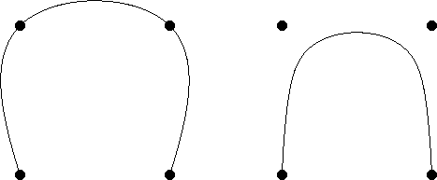
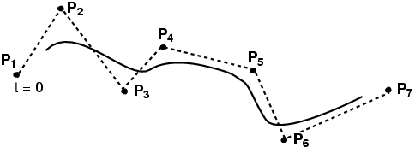
Definition: What's a Spline?
Smooth curve defined by some control points
Moving the control points changes the curve
Interpolation
Bézier (approximation)
BSpline (approximation)
Fall 2018
Notes:
插值曲线，逼近曲线
B样条多项式的次数独立于控制点数目（有一定的限制）
B样条允许局部控制曲线或曲面,bezier曲线不能做局部控制，如果改变一点，整个曲线都变化
B样条比Bezier更复杂

Slide 27
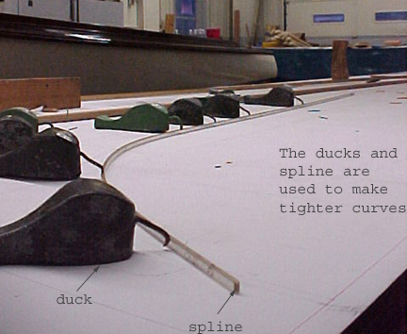
Interpolation Curves / Splines
www.abm.org
Fall 2017

Slide 28
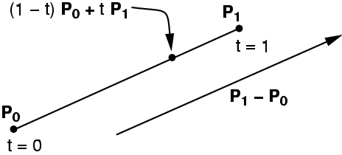
Linear Interpolation
Simplest "curve" between two points
Q(t) =
Fall 2018

Slide 29
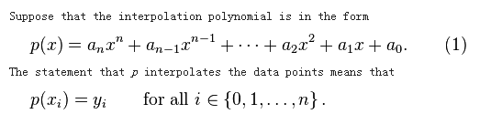
Interpolation Curves
Curve is constrained to pass through
all control points
Given points P₀, P₁, ... P_{n}, find lowest degree polynomial which passes through the points
Fall 2018

Slide 30
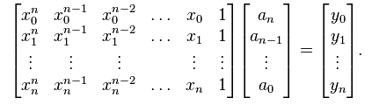
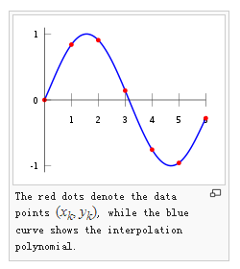
Interpolation Curves
Fall 2017

Slide 31
Interpolation vs. Approximation Curves
Interpolation
curve must pass through control points
Approximation
curve is influenced by control points
Fall 2018

Slide 32
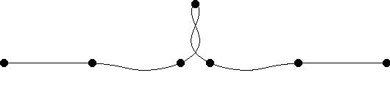
Interpolation vs. Approximation Curves
Interpolation Curve – over constrained →
  Goes through all specified points
  Sounds more logical
  But can be more unstable, ringing
Fall 2018
Notes:
Oscillations 震荡

Slide 33
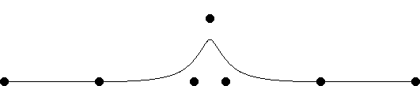
Interpolation vs. Approximation Curves
Approximation Curve – more reasonable?
  – Does not go through all points
  – Turns out to be convenient
  – This is what we’ll focus on
Fall 2018
Notes:
Oscillations 震荡

Slide 34
Bézier Curve
Bézier curves were widely publicized in 1962 by the French engineer Pierre Bézier, who used them to design automobile bodies.
cubic Bezier curve
Fall 2018

Slide 35
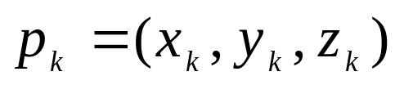
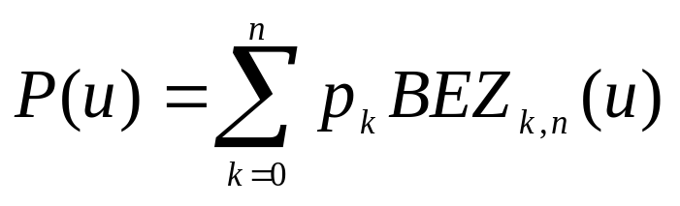
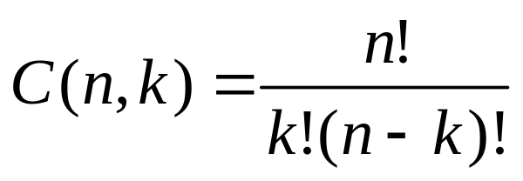
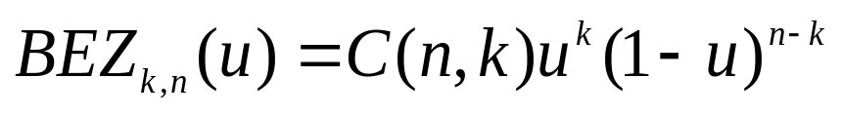
Bézier Curve
Give n control points
Bernstein Polynomials as the basis functions
Fall 2018

Slide 36
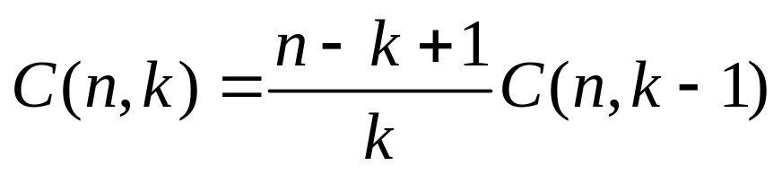
Bézier Curve
Recursive computation
  C(n,k)
  BEZ
Fall 2018

Slide 37
Bézier Curve
Linear Bézier curves
  Given points P0 and P1, a linear Bézier curve is simply a straight line between those two points. The curve is given by
  and is equivalent to linear interpolation.
Quadratic Bézier curves
  A quadratic Bézier curve is the path traced by the function B(t), given points P0, P1, and P2
Cubic Bézier curves
  Four points P0, P1, P2 and P3 in the plane or in three-dimensional space define a cubic Bézier curve.
Fall 2018

Slide 38
Cubic Bézier Curve
• User specifies 4 control points Pi
• Curve goes through the two extremities
• Approximates the two other ones
• Cubic polynomial
Fall 2018

Slide 39
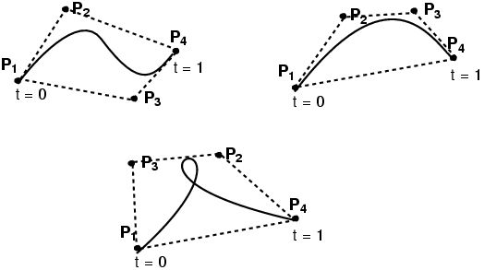
Cubic Bézier Curve
Curve is tangent at P₁ to (P₁-P₂) and at P₄ to (P₄-P₃)
A Bézier curve is bounded by the convex hull of its control points.
Fall 2018

Slide 40
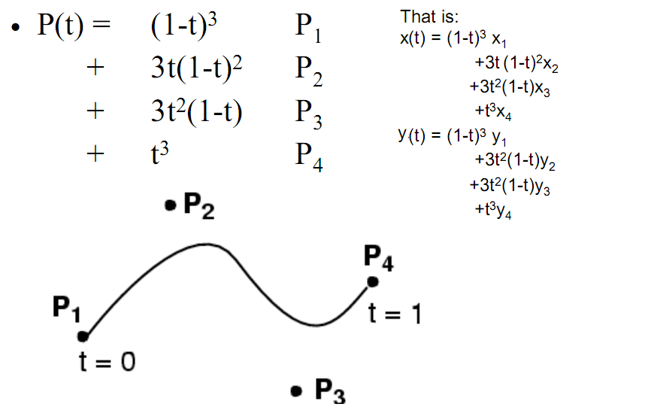
Cubic Bézier Curve
Fall 2018

Slide 41
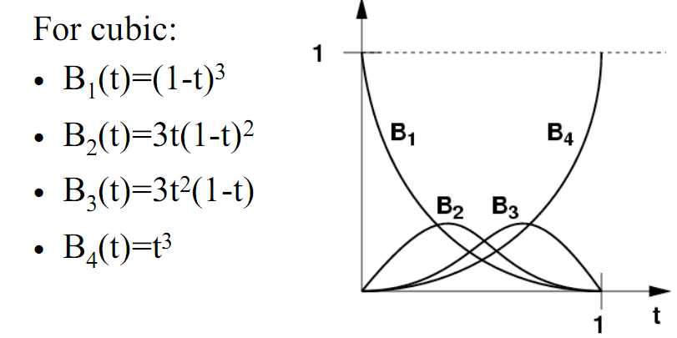
Cubic Bézier Curve
Fall 2018

Slide 42
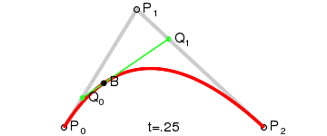
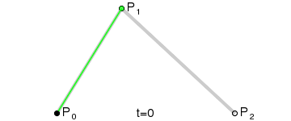
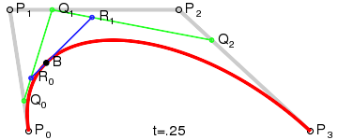
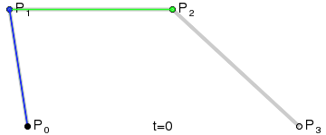
Cubic Bézier Curve
Quadratic Curves
Cubic Curve
Fall 2018

Slide 43
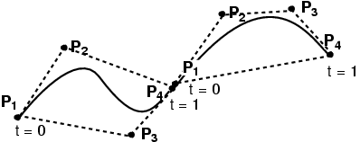
Connecting Cubic Bézier Curves
Asymmetric: Curve goes through some control points but misses others
Fall 2018
Notes:
曲线穿过一些控制点，不过一些控制点

Slide 44
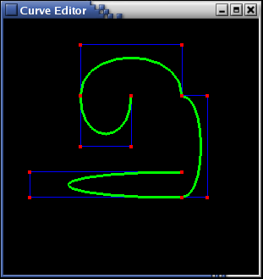
Connecting Cubic Bézier Curves
Fall 2018

Slide 45
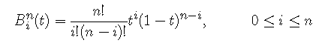
Higher-Order Bézier Curves
> 4 control points
Bernstein Polynomials as the basis functions
Every control point affects the entire curve
  Not simply a local effect
  More difficult to control for modeling
Fall 2018

Slide 46
Implement detail
Computing C(n,k)
k=0 to n
Void binomialCoeffs(int n, int *C)
{
int k,j;
for (k=0;k<=n;k++)
{
C[k]=1;
for(j=n;j>=k+1;j--)
C[k]*=j;
for(j=n-k;j>=2;j--)
C[k]/=j;
}
}
Fall 2018

Slide 47
Implement detail
Computing the coordinates of one point on the curve path
Void computeBezPt(float u, WcPt3D *bezPt,int nCtrlPts,wcPt3D *ctrlPts, int *C)
{
int k, n=nCtrlPts -1;
Float bezBlendFcn;
bezPt->x = bezPt->y=bezPt->z =0.0;
for(k=0;k<nCtrlPts;k++)
{
bezBlendFcn = C[k]*pow(u,k)*pow(1-u,n-k);
bezPt->x +=ctrlPts[k].x*bezBlendFcn;
        bezPt->y +=ctrlPts[k].y*bezBlendFcn;
        bezPt->z +=ctrlPts[k].z*bezBlendFcn;
}
}
#include <math.h> double pow( double base, double exp );
Fall 2018
Notes:
Pow是幂函数

Slide 48
Implement detail
The whole Bezier
Void bezier( WcPt3D *ctrlPt3D, int nCtrlPts, int nBezCurvePts)
{
WcPt3D BezCurvePt;
Float u; int *C,k;
C= new int[nCtrlPts];
binomialCoeffs(nCtrlPts-1,C);
for(k=0;k<nBezCurvePts;k++)
{
u= float(k) / float(nBezCurvePts);
computeBezPt(u,&bezCurvePt,nCtrlPts,ctrlpts,C);
plotPoint(bezCurvePt);
}
delete []C;
}
Fall 2018

Slide 49
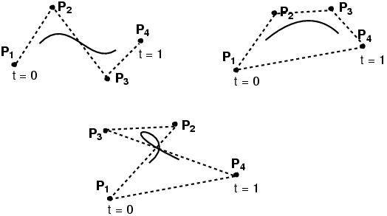
Cubic BSplines
≥ 4 control points
Locally cubic
Curve is not constrained to pass through any control points
A BSpline curve is also bounded by the convex
hull of its control points.
Fall 2017

Slide 50
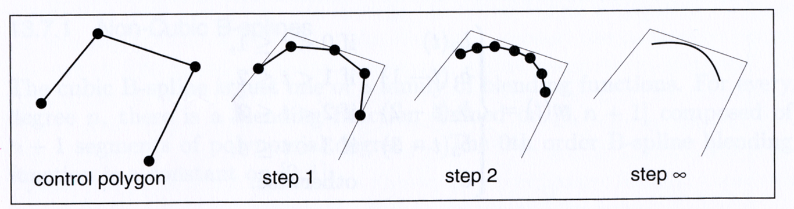
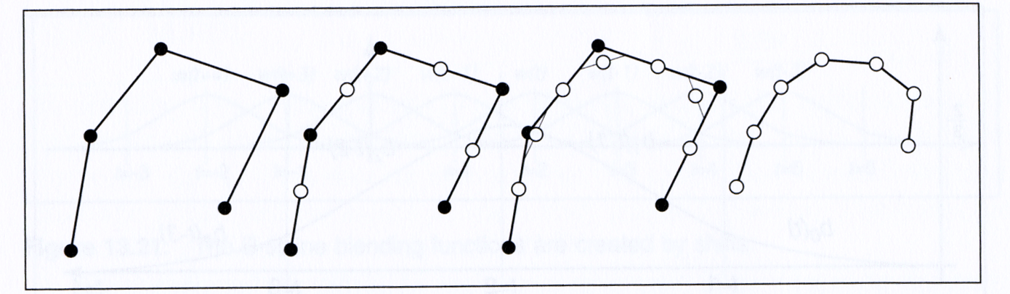
Cubic BSplines
Iterative method for constructing BSplines
Shirley, Fundamentals of Computer Graphics
Fall 2017
Notes:
下面是介绍上面黑色点是怎样生成的

Slide 51
Questions?
Fall 2018

Slide 52
Interpolation Curves
Curve is constrained to pass through
all control points
Given points P₀, P₁, ... P_{n}, find lowest degree polynomial which passes through the points
x(t) = a_{n-1}t^{n-1} + .... + a₂t² + a₁t + a₀
y(t) = b_{n-1}t^{n-1} + .... + b₂t² + b₁t + b₀
Fall 2018
Notes:
n+1, 2(n+1),n,2n

Slide 53
Interpolation Curves
Curve is constrained to pass through
all control points
Given points P₀, P₁, ... P_{n}, find lowest degree polynomial which passes through the points
Fall 2018

