Slide 1
Bike-Sharing
Capstone Project
By Nigel

Slide 2
Summary of Scenario
You are a junior data analyst working in the marketing analyst team at Cyclistic, a bike-share company in Chicago. The director of marketing believes the company’s future success depends on maximizing the number of annual memberships. Therefore, your team wants to understand how casual riders and annual members use Cyclistic bikes differently.
From these insights, your team will design a new marketing strategy to convert casual riders into annual members. But first, Cyclistic executives must approve your recommendations, so they must be backed up with compelling data insights and professional data visualizations.

Slide 3
The Data Analysis Process
01
02
03
Ask
Prepare
Process
04
05
06
Analyze
Share
Act

Slide 4
01
Ask

Slide 5
Ask (Problem Statement)
What is the main business task?
              What is the most effective market strategies to convert casual riders into annual members?
Assigned Task:
    How do annual and casual riders use Cyclistic bike differently?

Slide 6
02
Prepare

Slide 7
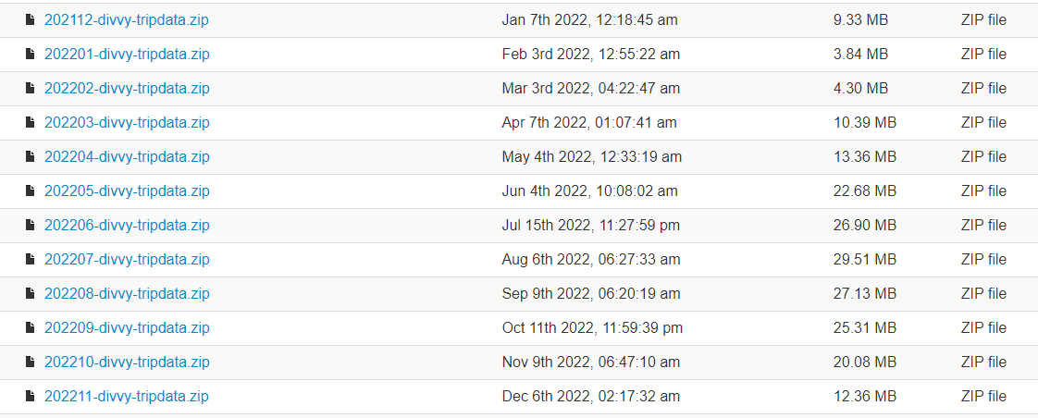
Prepare
Preparation of Data – Downloading previous 12 months of cyclistic data:
https://divvy-tripdata.s3.amazonaws.com/index.html
    Data made available by Motivate International Inc.: Data License Agreement | Divvy Bikes

Slide 8
03
Process

Slide 9
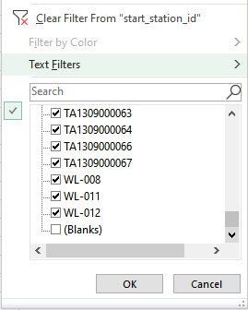
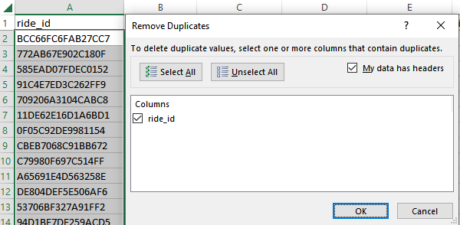
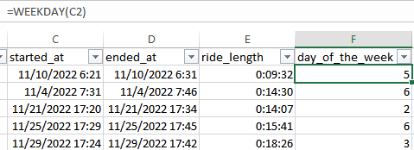
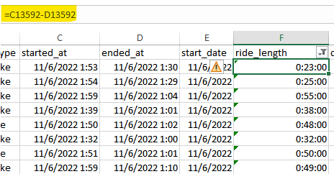
Process
Filter all the columns to remove blanks,
as well as removing duplicates if any.
Insert columns; trip duration as “ride_length”, and “day_of_the_week”, where 1 = Sunday, 7 = Saturday respectively.
For overnight trips, subtract “end_date” from “start_date” instead of the other way round for “ride_length”.

Slide 10
04
Analyze

Slide 11

Analyze (Excel)
Analyzing data by calculating the following values:
        Mean of ride_length
        Max of ride_length
        Mode of day_of_the_week
    Formulas:
      AVERAGE(ride_length)
      MAX(ride_length)
      MODE.SNGL(day_of_the_week)

Slide 12
Analyze (Excel)
From the information calculated, we can tell that the
  Average trip length = 12min40s
  Max trip length = 24H 53Min 14s
  Most common day for bike rented = Wednesday

Slide 13
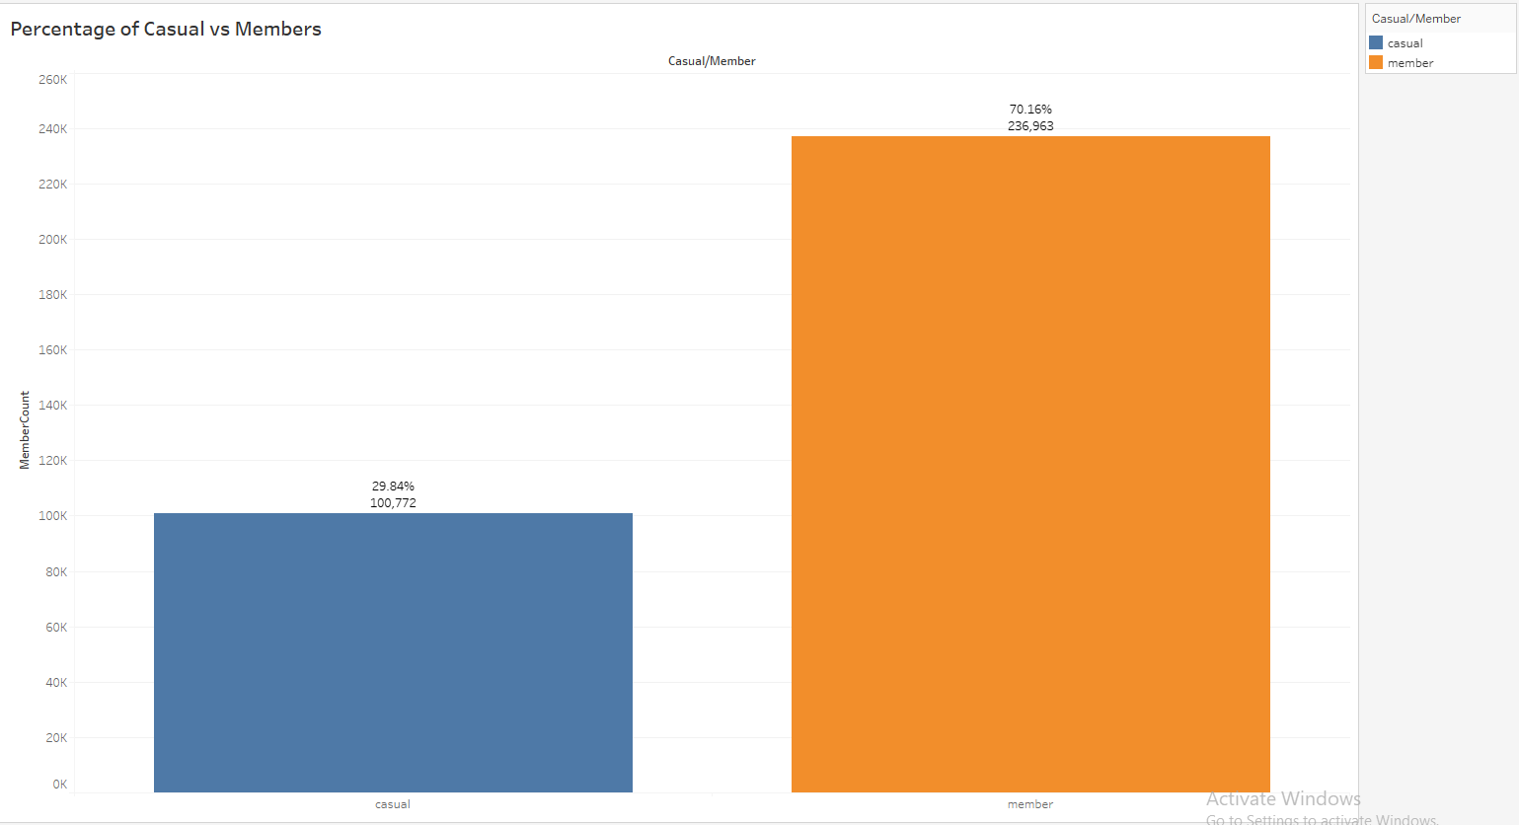
Analyze (Tableau)
From the graph, we can see the percentage of casual vs members that used the bike.
There is a large number of members – about 70%, as compared to casual members of 29%.

Slide 14
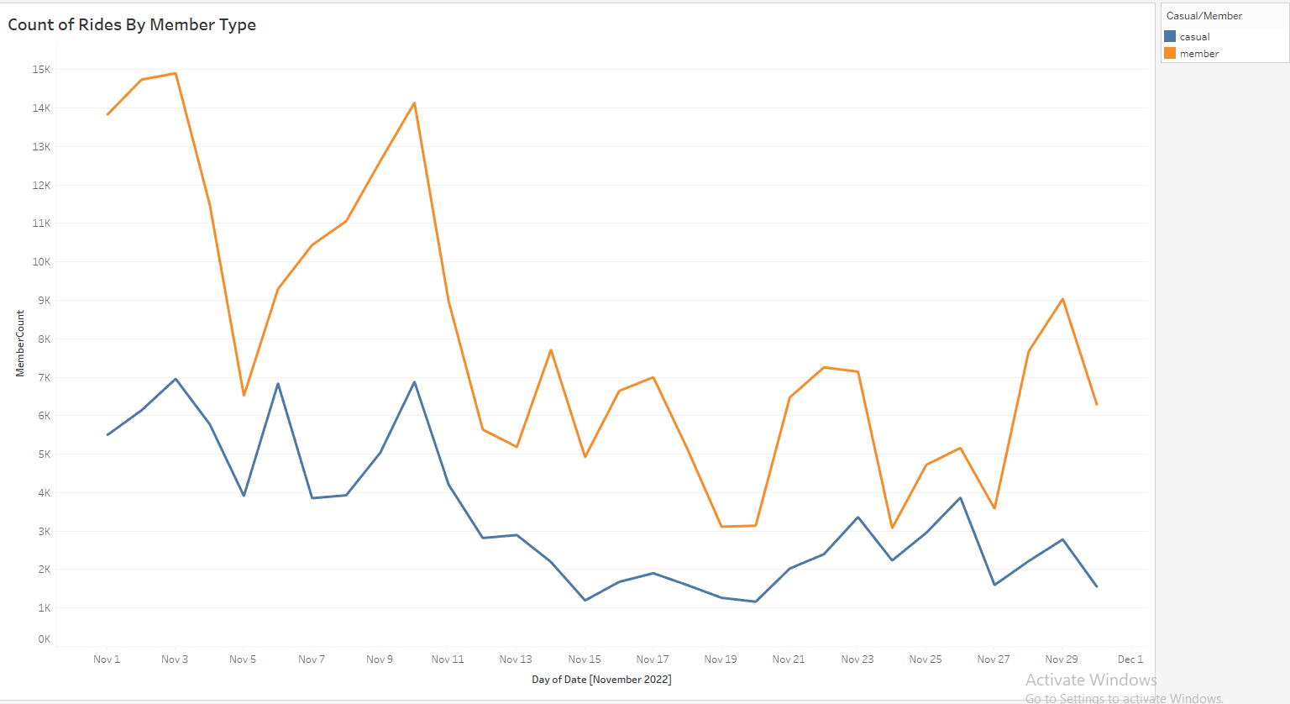
Analyze (Tableau)
From the line graph, we can see that the number of rides by members are at a consistently higher rate as compared to casual members.

Slide 15
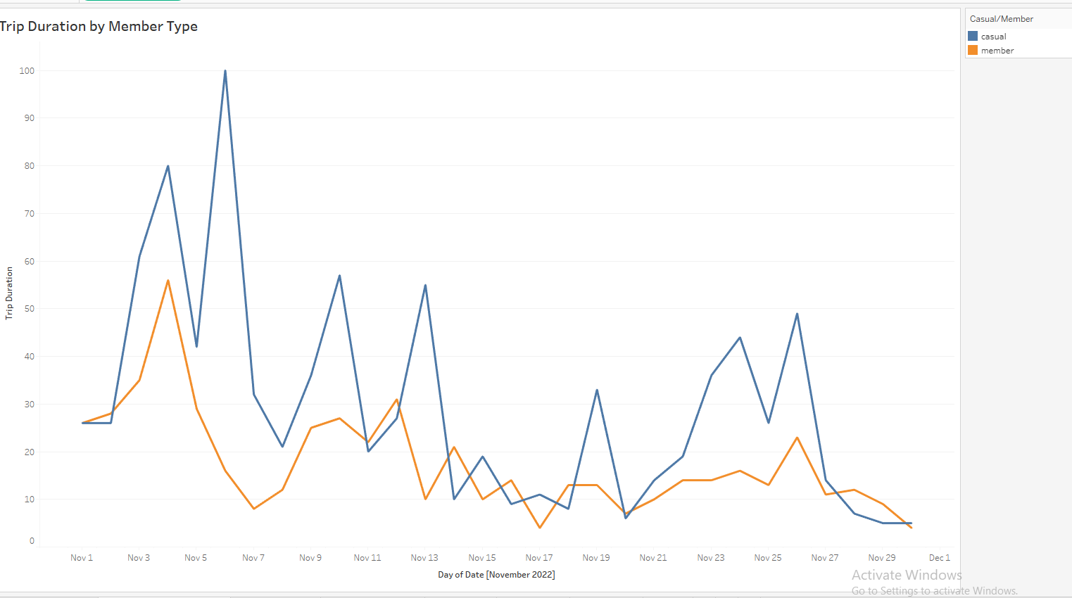
Analyze (Tableau)
From this graph however, we can spot a trend where casual members typically use the bike services for a longer duration compared to members.

Slide 16
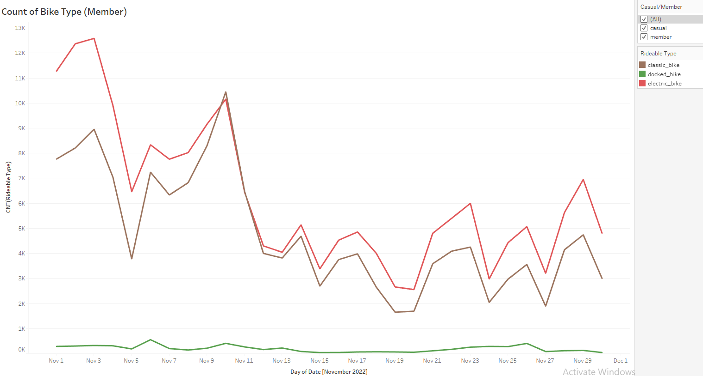
Analyze (Tableau)
Here, we can see the types of bike used – class, docked, and electric.
The classic and docked bike is used more commonly as compared to the dock bike.

Slide 17
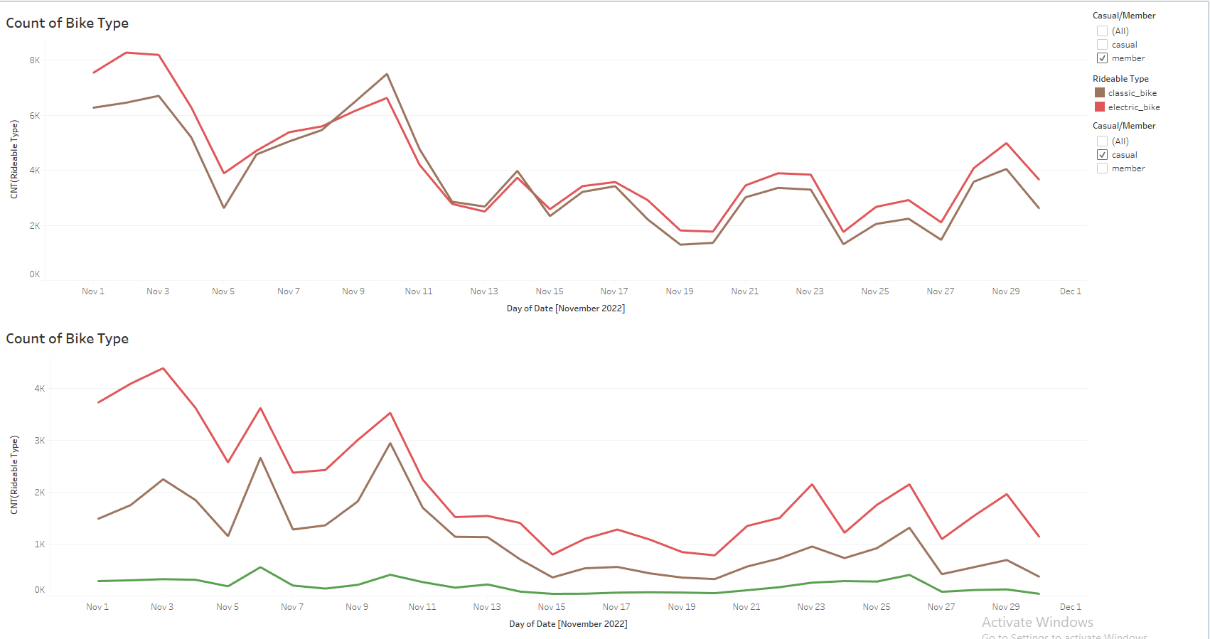
Analyze (Tableau)
However, by adjusting the member/casual filter, we can see that members do not use the docked bike at all. The docked bike uses comes from the casual members.

Slide 18
05
Share

Slide 19
Share (Tableau) – Link to Live Version
https://public.tableau.com/views/Cyclistic_CapstoneProject/Story1?:language=en-US&publish=yes&:display_count=n&:origin=viz_share_link

Slide 20
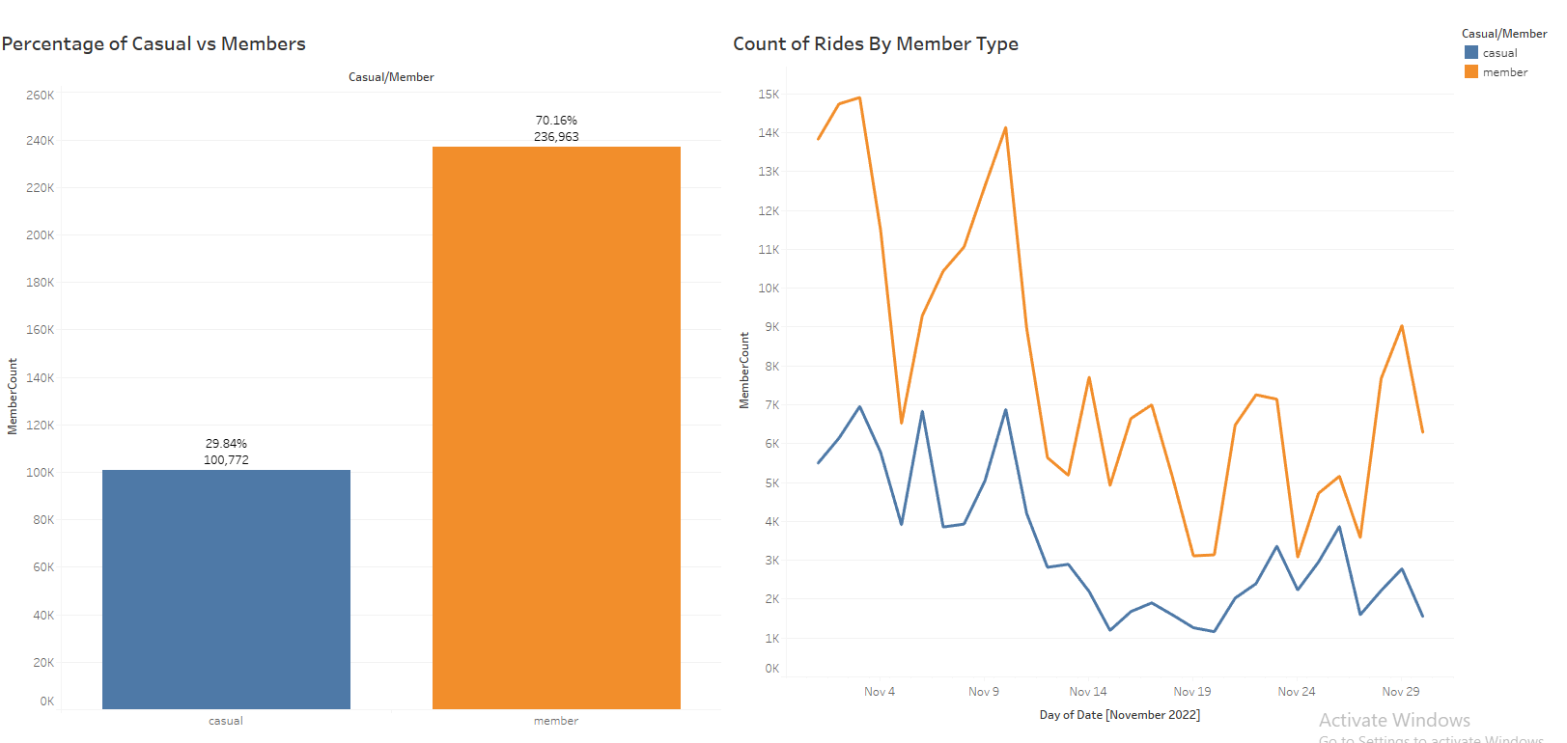
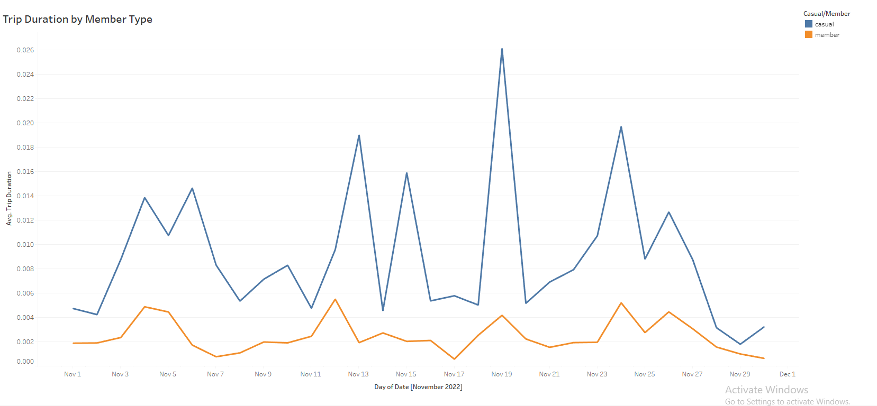
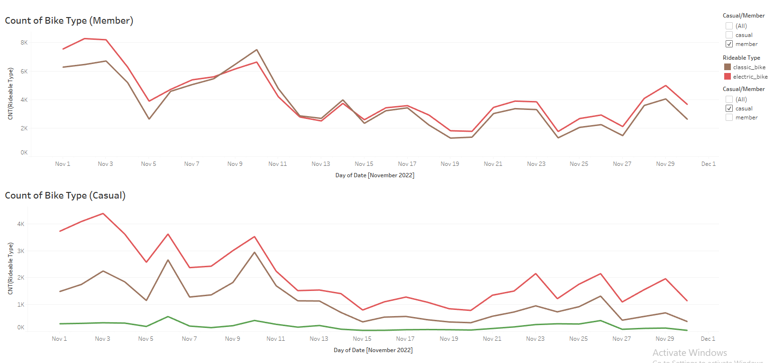

Slide 21
06
Act

Slide 22
Conclusion
From the visualized data, we understand that casual members sometimes use the bike services for a longer period, although the frequency of uses is significantly lower than the members.
This could be due to the fact that the casual members will want to maximize a longer trip for a “one-time-use” rather than having the need to use the services on multiple occasions.
RECOMMENDATION 1:
Marketing strategies could revolve around this fact, for example, the company could implement a cost-by-mileage system for trips which exceed a certain mileage. Meaning it will be more advisable to apply for a membership, especially for customers who often ride for a long distance.

Slide 23
Conclusion
Another significant trend is when the docked bike are being used by the casual members rather than members themselves.
This could be due to reasons such as the functionality of the electric/classic bikes being much better than the docked bikes. Or because it is more convenient in the sense that customers will not have to spend time undocking the bike.
RECOMMENDATION 2:
A marketing strategy could be to promote these unique features where the electric and classic bike would be more accessible to members only. This could be in terms of cost, for example, the electric/classic bikes would cost more than the docked bikes for casual members.

Slide 24
Thank You

Slide 25
Credits
    Data License Agreement | Divvy Bikes
    https://www.coursera.org/learn/google-data-analytics-capstone

