Slide 1
SC5010 Introduction to Data Analysis
Group Project
TEL2 Group 1
Brad Lee (U2130355E)
Cheng Jun Long Brandon (U2222813C)
Nicolas Chan Han Hui (U2230785E)
Nigel Max Wee Yaohan (U2221718B)

Slide 2

Diabetes
Diabetes is a chronic, metabolic disease characterized by elevated levels of blood glucose (or blood sugar), which leads over time to serious damage to the heart, or other organs.

Slide 3
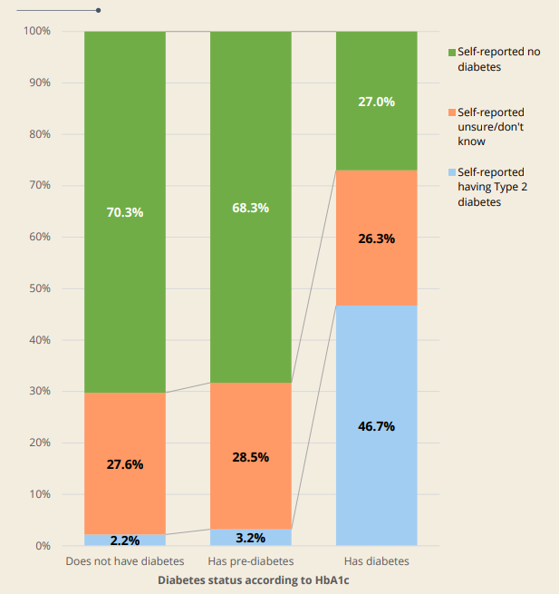
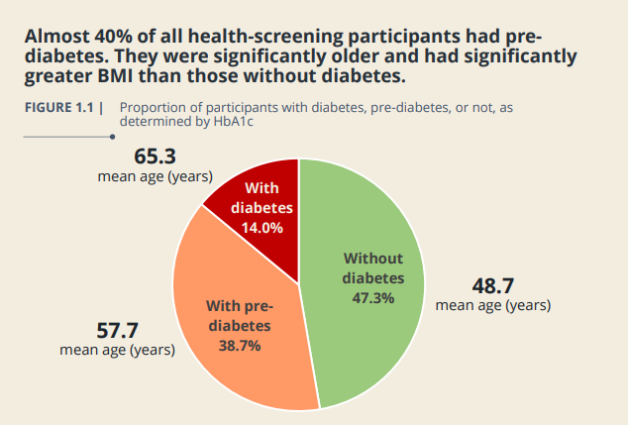


Significance of Diabetes
[1]
[1]

Slide 4
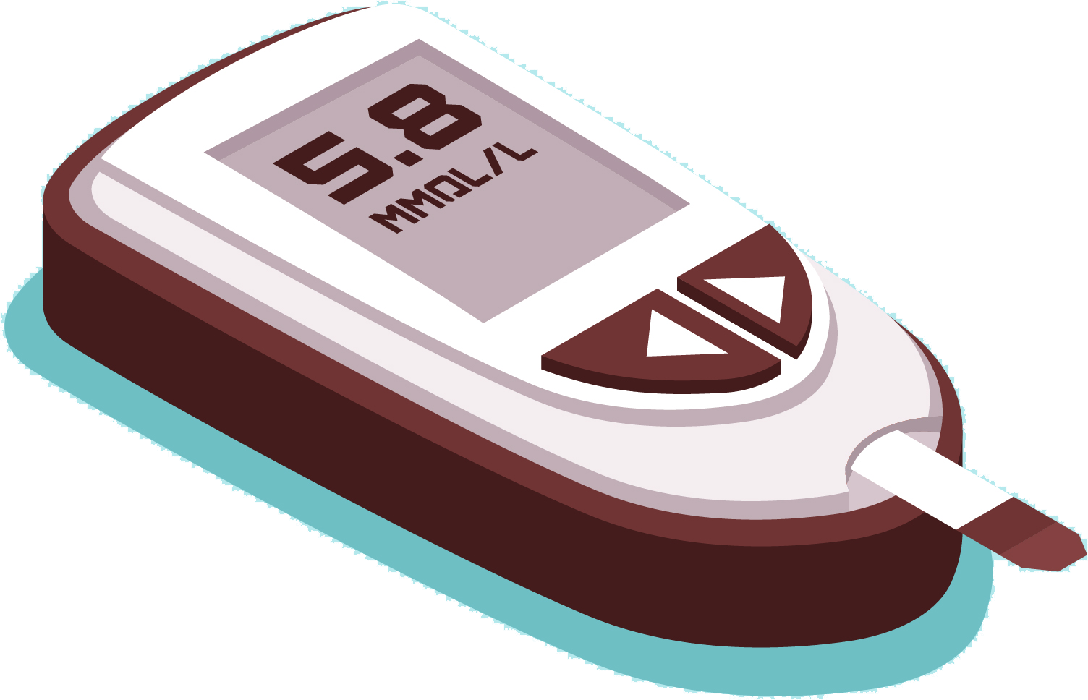
Problem Statement
How can machine learning help identify individuals with early signs of diabetes so that timely action can be taken to prevent progression?

Slide 5
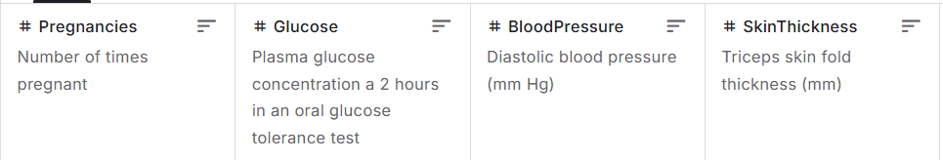
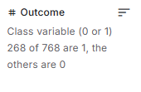
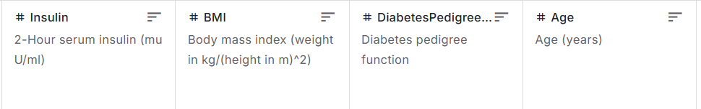

Our Data
Pima Indians Diabetes Database (n=768)
8 features, 1 target

Slide 6
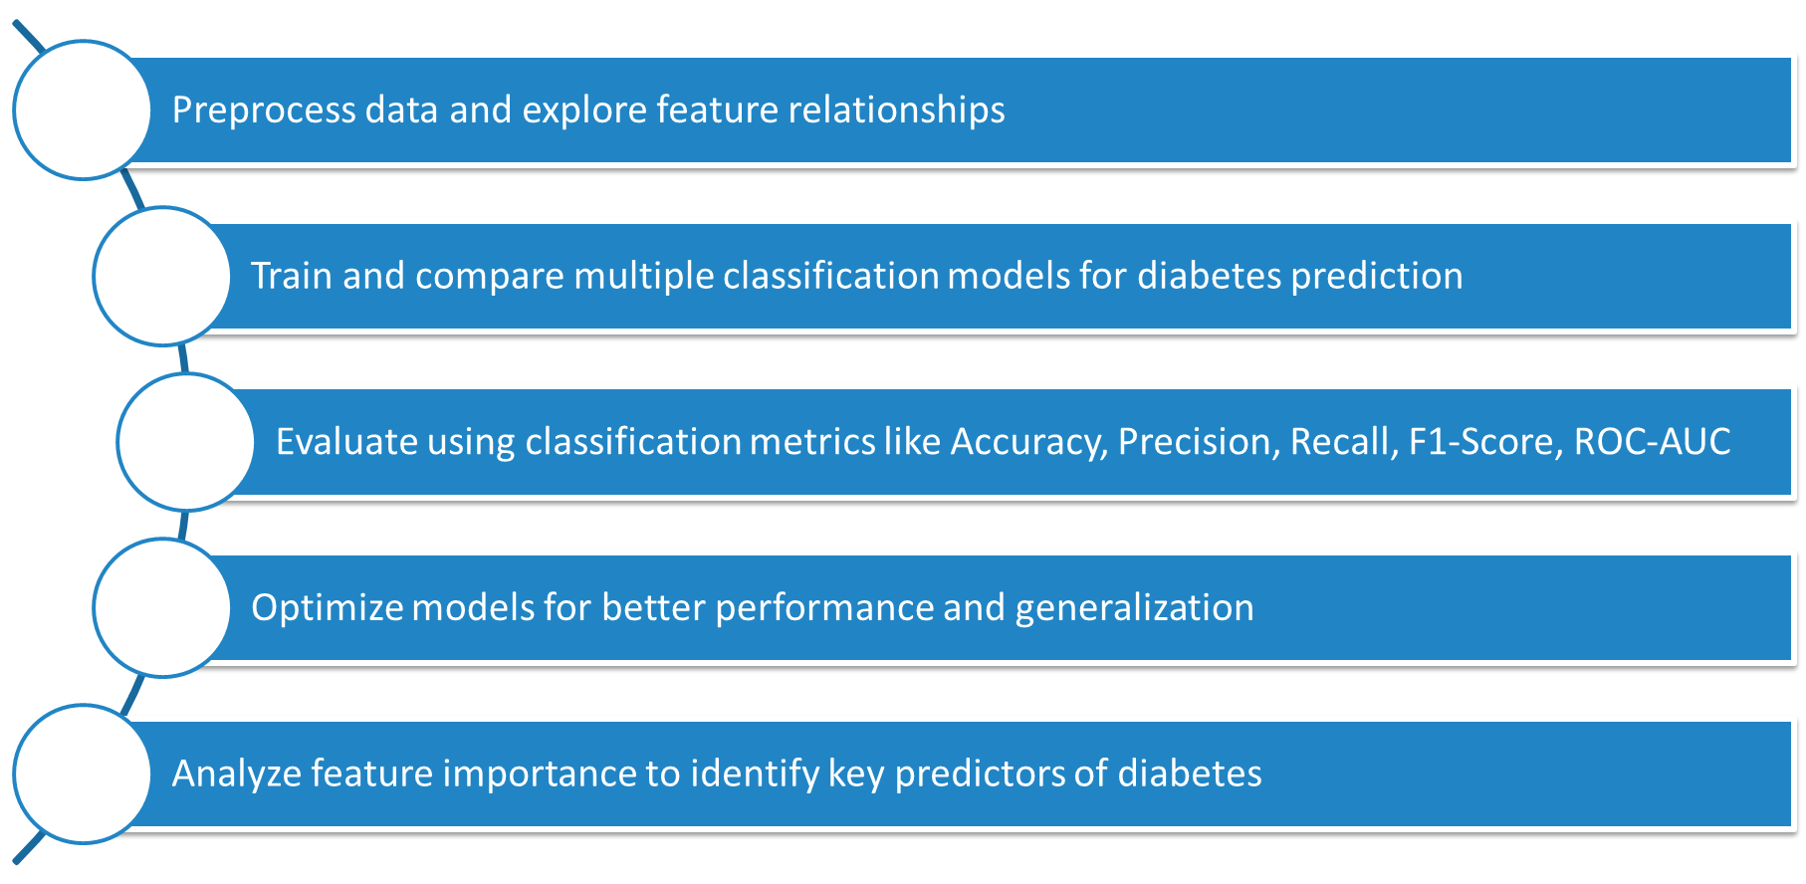
Objectives

Slide 7
01
Exploratory Data Analysis
(EDA)

Slide 8
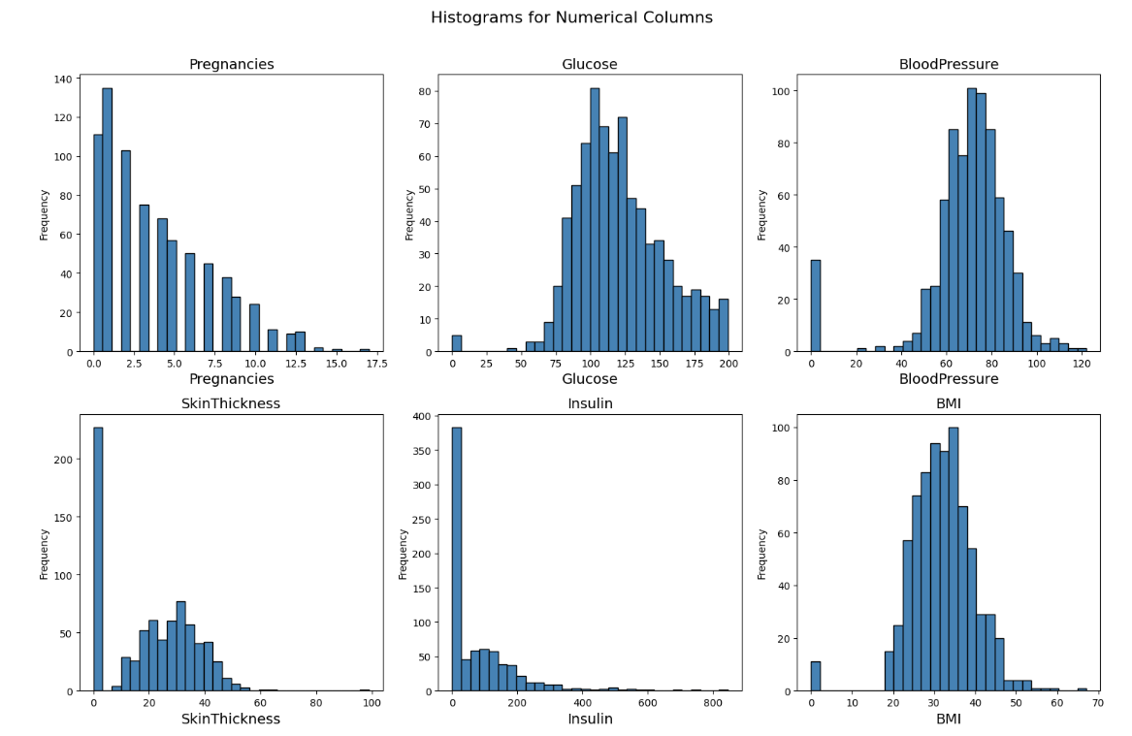
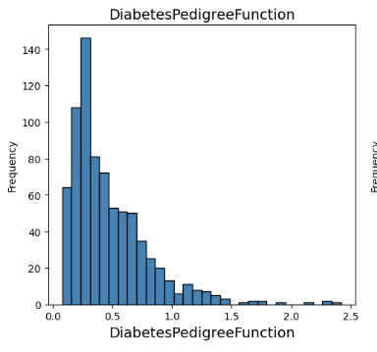
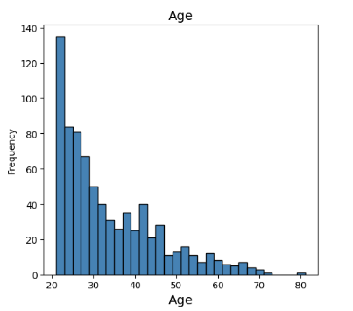
Histograms of unprocessed features

Slide 9
Replacing 0 values in appropriate columns with class-specific median

Slide 10
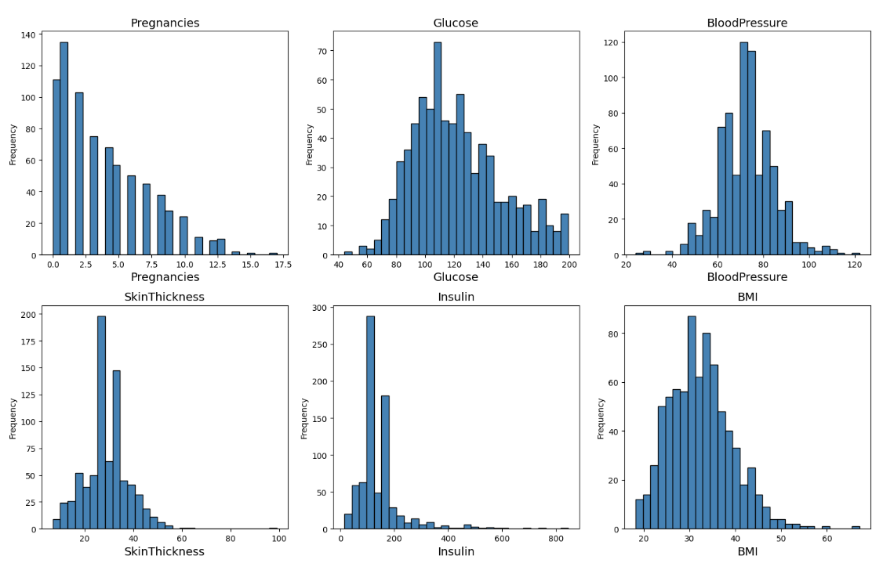
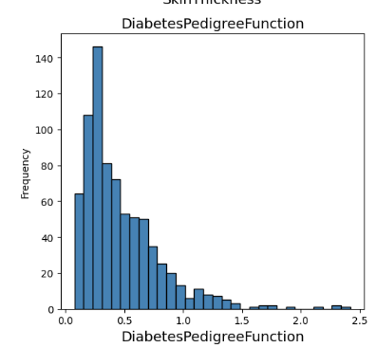
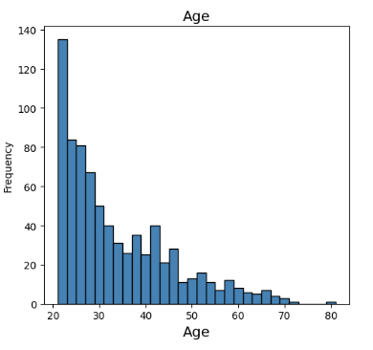
Histograms after replacing 0 values

Slide 11
Removing outliers using
z-score (±3) and IQR (1.5×IQR) methods

Slide 12
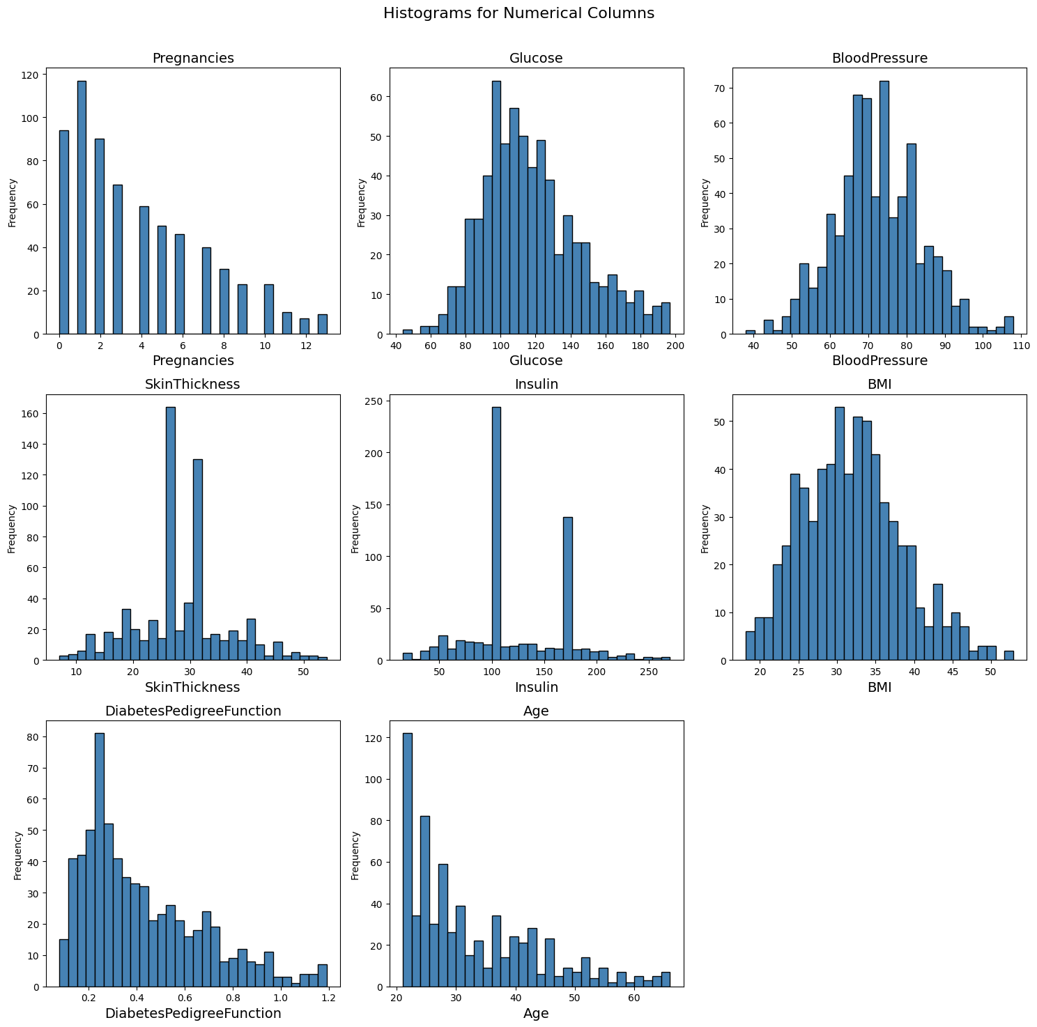
Histograms after removing outliers
(n=667)

Slide 13
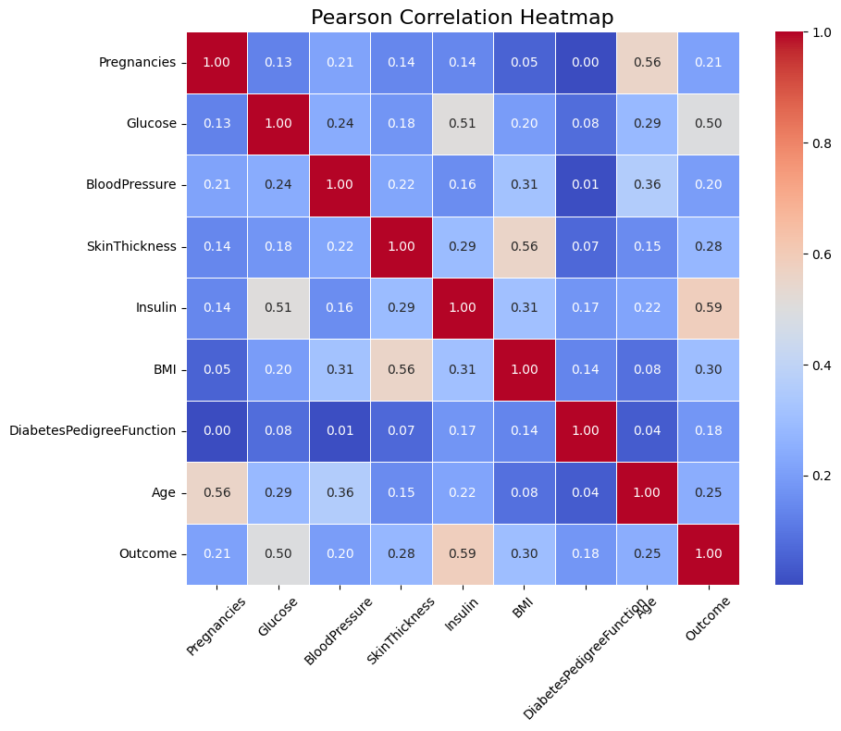
Pearson Correlation Heatmap
Visualizes the strength of linear relationships between features and the target (Outcome)
Helps identify important predictors and potential multicollinearity

Slide 14
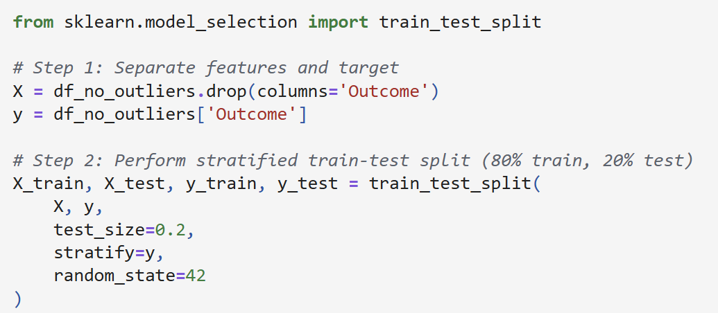
Train-Test Split with Stratification
train_test_split() from sklearn.model_selection
80% Training, 20% Testing
Stratified sampling using stratify=y to maintain class balance
random_state = 42 for reproducibility
Resulting Split
X_train: (533 samples, 8 features)
X_test: (134 samples, 8 features)

Slide 15
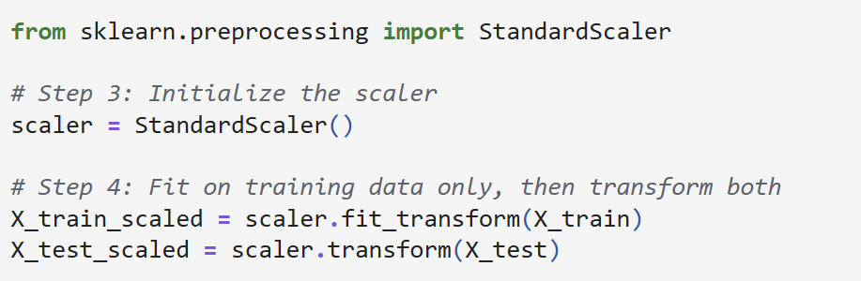
Feature Scaling
Applied StandardScaler from sklearn.preprocessing
Transformed features to have mean = 0 and standard deviation = 1
Fitted on training data only to avoid data leakage
Same scaling applied to both training and test sets

Slide 16
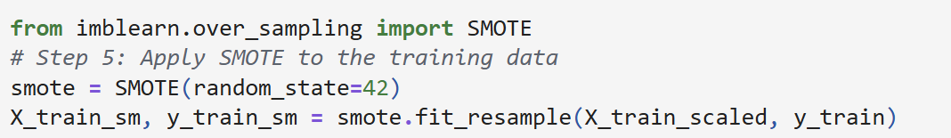
SMOTE: Synthetic Minority Oversampling
Result
Classes perfectly balanced → 363 vs 363 samples.
Reduces bias, boosts recall & F1 on minority class.
Original classes imbalanced (Outcome = 1 only 34 %).
Perform Synthetic Minority Oversampling Technique (SMOTE) on training data only.

Slide 17
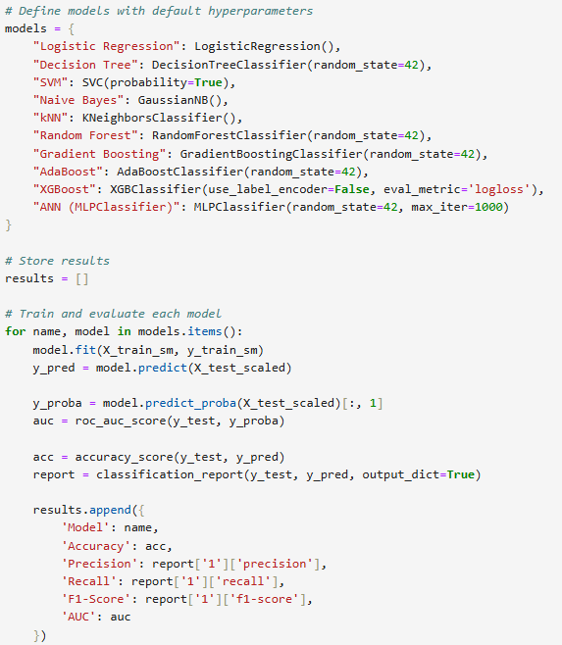
Model Selection

Slide 18
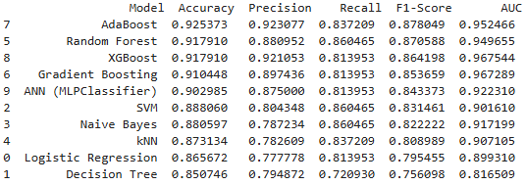
Model Performance
AdaBoost
Random Forest
XGBoost

Slide 19
AdaBoost
Starts by training a base classifier on the original dataset
Then, adjusts weights of the training samples:
Misclassified samples are given higher weights
This makes the next classifier focus more on the "hard" cases
This process is repeated for several rounds, each time creating a new classifier that learns from the errors of the previous one
The final prediction is a weighted vote of all classifiers

Slide 20
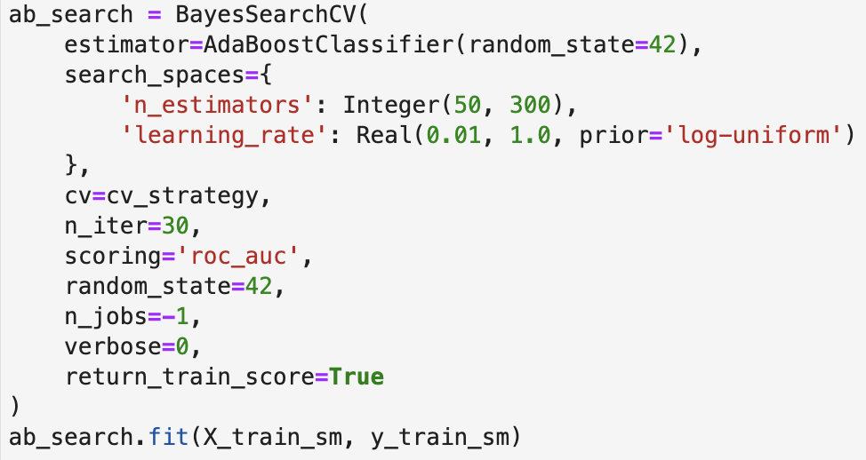
AdaBoost - Hyperparameter Tuning
Best Parameters:
'learning_rate': 0.4729080547055919, 'n_estimators': 271
Best Validation AUC Score: 0.9582

Slide 21
Random Forest
Ensemble of decision trees
Each tree is trained on a bootstrapped (randomly sampled with replacement) subset of the data.
Trees in the forest use the “best” split strategy

Slide 22
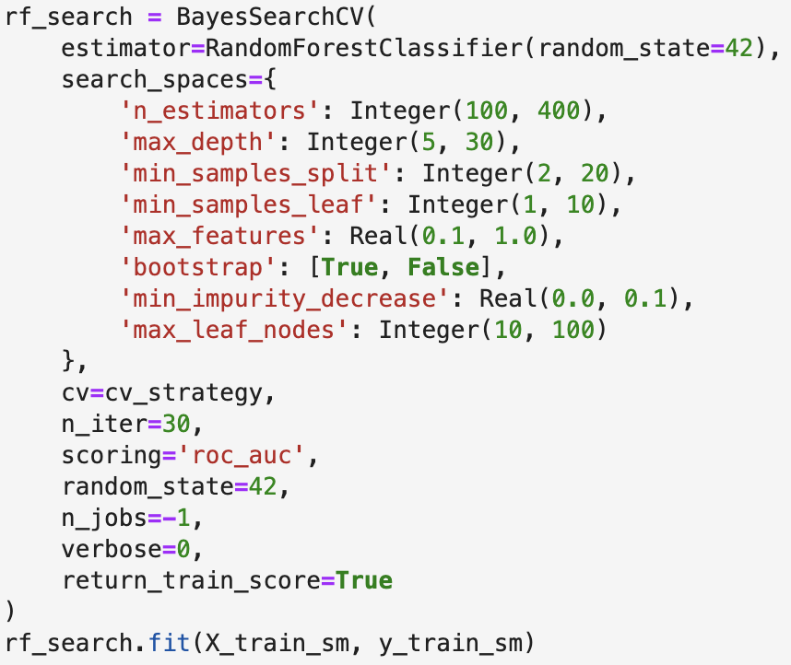
Random Forest - Hyperparameter Tuning
Best Parameters:
'bootstrap': True, 'min_impurity_decrease': 0.0,
'max_depth': 10, 'min_samples_leaf': 2,
'max_features': 0.5365005170541954, 'min_samples_split': 4,
'max_leaf_nodes': 61, 'n_estimators': 163
Best Validation AUC Score: 0.9636

Slide 23
Extreme Gradient Boosting (XGBoost)
Ensemble of decision trees built using a gradient boosting framework
Improves on the gradient boosting framework by:
using systems optimization and algorithmic enhancements
producing an accurate model of the relationship between the dependent variable and the independent variables

Slide 24
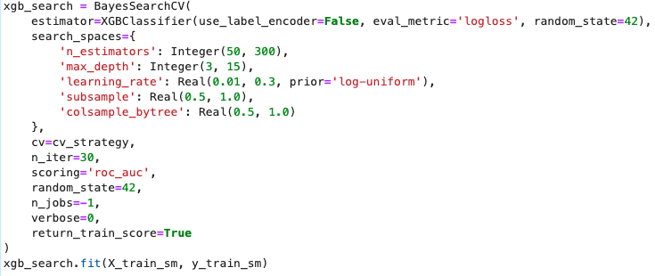
XGBoost - Hyperparameter Tuning
Best Parameters:
'colsample_bytree': 0.5264102643726934, 'n_estimators': 284,
'learning_rate': 0.045222143641251954, 'subsample': 0.9183503252059635
'max_depth': 15,
Best Validation AUC Score: 0.9694

Slide 25
Summary of Tuned Models
 | Accuracy | Precision | Recall | F1-Score | AUC
AdaBoost | 0.925 | 0.923 | 0.837 | 0.878 | 0.961
Random Forest | 0.918 | 0.881 | 0.860 | 0.871 | 0.950
XGBoost | 0.918 | 0.921 | 0.814 | 0.864 | 0.968
Tuned AdaBoost | 0.933 | 0.925 | 0.860 | 0.892 | 0.967
Tuned Random Forest | 0.925 | 0.884 | 0.884 | 0.884 | 0.960
Tuned XGBoost | 0.918 | 0.921 | 0.814 | 0.864 | 0.971
Final Model: Tuned Random Forest

Slide 26
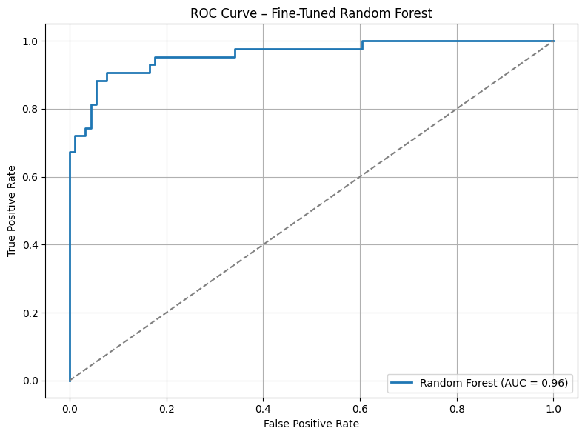
Receiver Operating Characteristic (ROC) curve

Slide 27
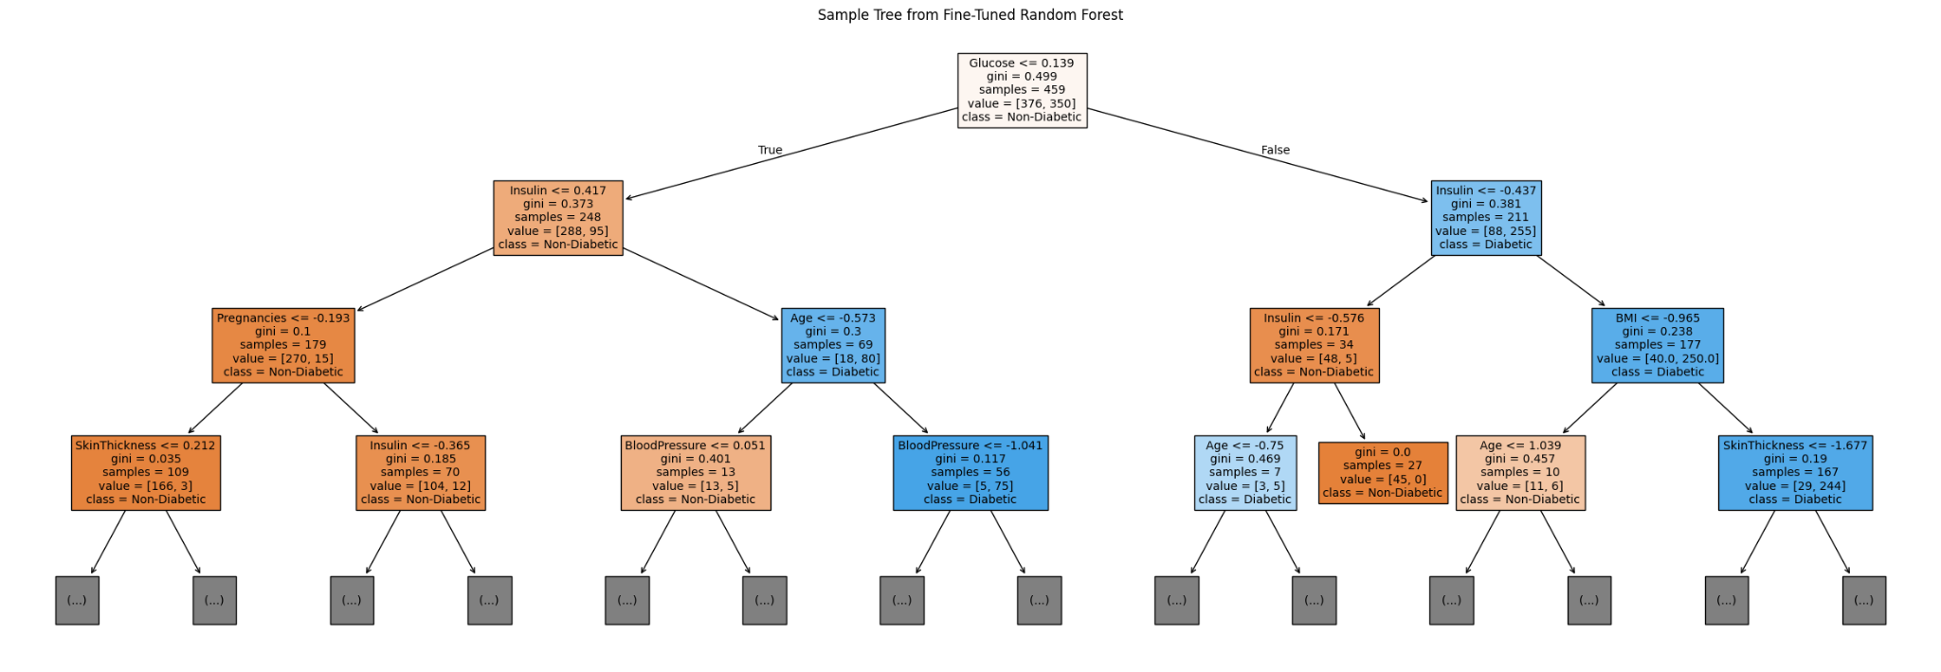
Permutation-based feature importance

Slide 28
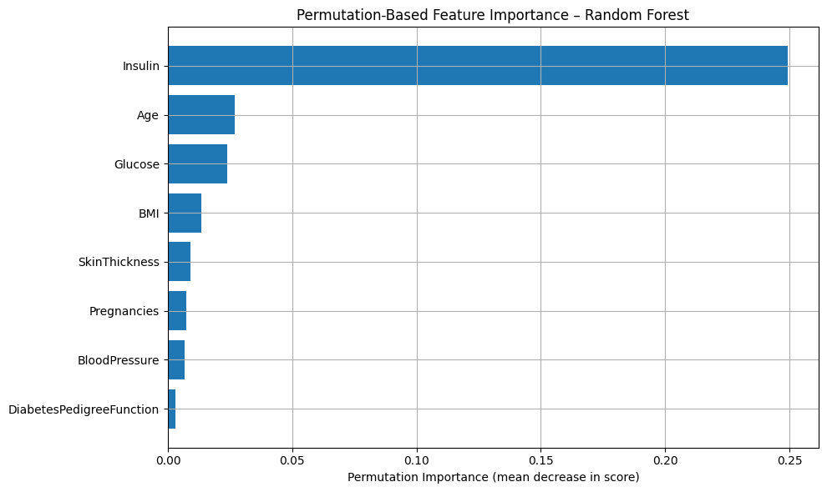
Permutation-based feature importance

Slide 29
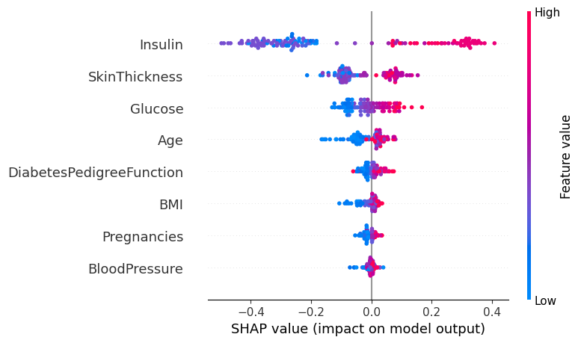
SHAP feature importance

Slide 30
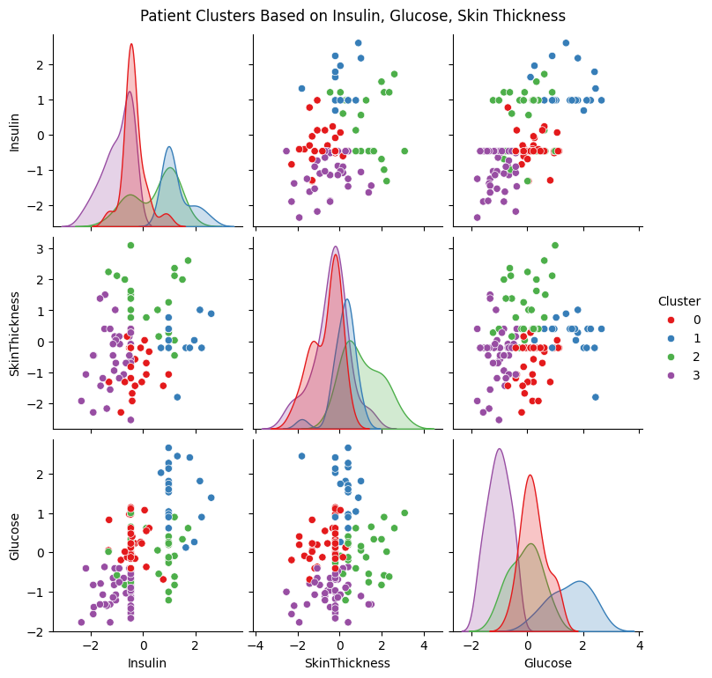
Clustering top features (KMeans)

Slide 31


Clustering top features (KMeans)
Cluster | Count | Diabetes Rate | Interpretation
0 | 37 | 0.135 | Likely non-diabetic cluster with relatively normal metabolic indicators
1 | 22 | 0.864 | Likely diabetic patients with elevated Glucose and Insulin (possibly insulin-resistant group)
2 | 30 | 0.533 | Mixed-risk group, possibly pre-diabetics with elevated Insulin with moderate Glucose.
3 | 45 | 0.067 | Very low-risk cluster, metabolically healthy patients

Slide 32
Insights & Conclusions
Robust preprocessing (outlier removal, scaling, balancing) significantly improved model performance.
The top 3 models were all ensemble-based: AdaBoost, XGBoost, and Random Forest.
Random Forest was chosen for its high recall (0.884), strong F1-score (0.884), and AUC (0.960), making it well-suited for medical prediction.
SHAP and permutation importance identified Insulin, Skin Thickness, and Glucose as key features.
KMeans clustering on these features revealed 4 distinct patient groups, from low-risk to likely diabetic profiles, offering potential for targeted risk stratification.

Slide 33

Thank you
for listening!

Slide 34
References
[1] “DIABETES PERCEPTION REPORT Perceptions of health- screening participants in Singapore 1 in partnership with Diabetes Singapore.” Available: https://ipur.nus.edu.sg/wp-content/uploads/2024/11/Diabetes-Perception-Report-1.pdf

