Slide 1
EGT 309 T1 Team 5
Members:
Nigel Nakajima Ken (241555R)
Jayden Sim Zhong Yi (224546P)
Gua Yihao (242851Z)

Slide 2
Contributions
cleaning.py - Nigel
config.py - Nigel
ingestion.py - Nigel
preprocessing.py - Jayden
synthetic_data_generation.py - Jayden
training.py - Yihao
evaluate.py - Yihao

Slide 3
Null/Error handling methods
Temperature | We assumed that temperature values are in Kelvin and corrected them to be in Celsius.
Humidity | We removed humidity values below 0 and above 100 by setting them to NaN.
Missing values | We used KNN to impute all the missing data.

Slide 4
Visualisations
Scatter plot | Plot data points to see outliers.
Histogram | Visualise the distribution of data.
Heatmap | Visualise correlation between features.

Slide 5
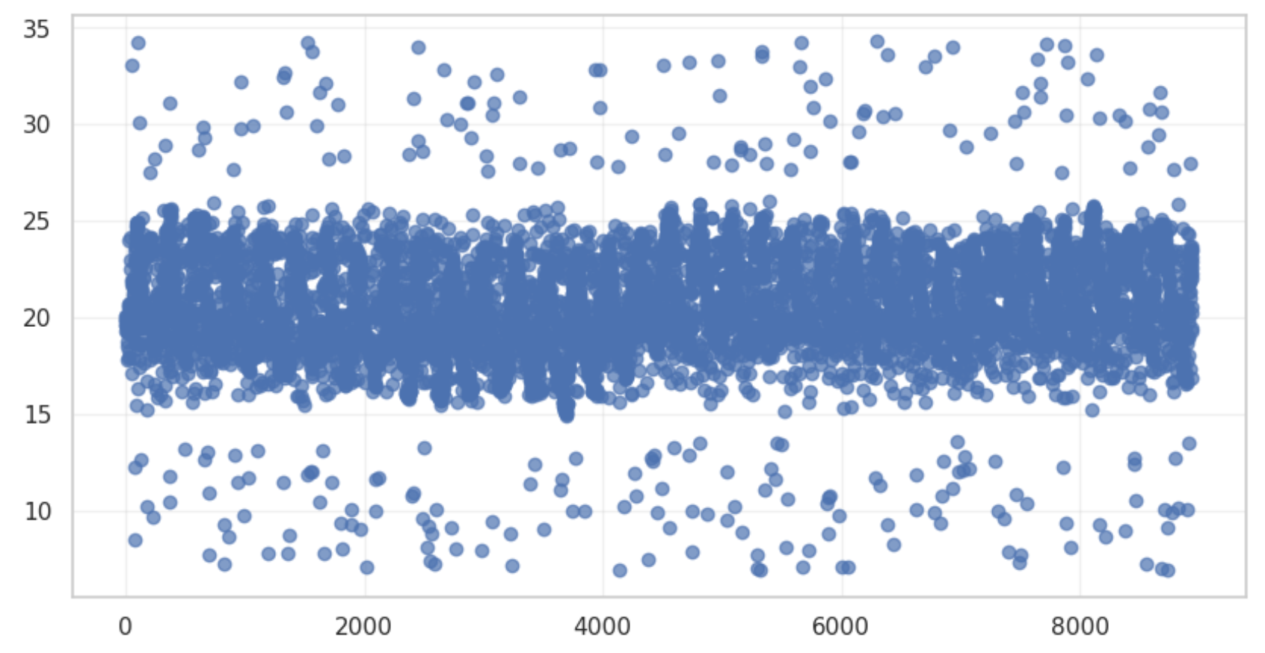
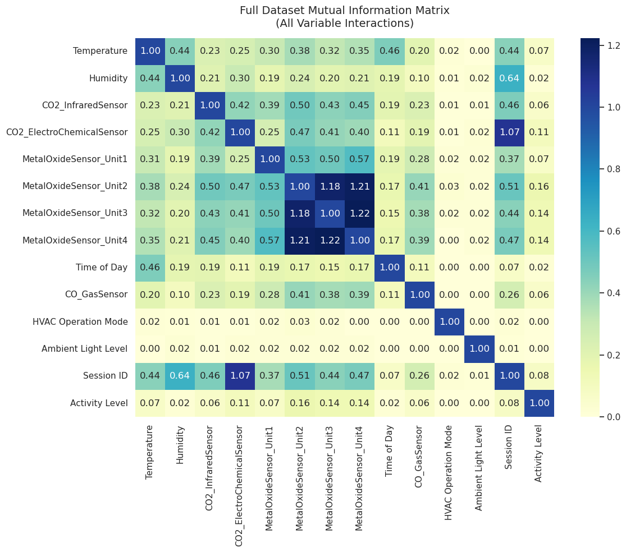
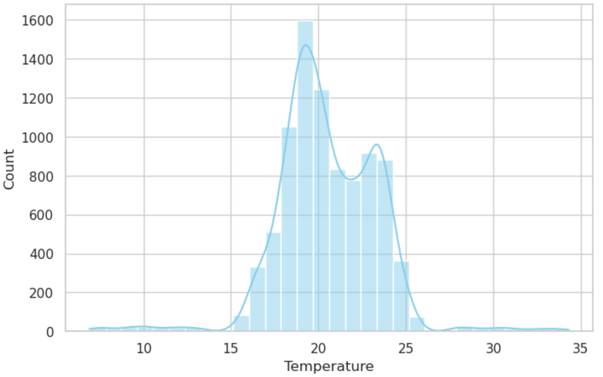
Visualisations

Slide 6
Model choices
Random Forest | Supervised machine learning algorithm that combines the predictions of multiple individual decision trees to generate a single, more accurate, and stable output.
XGBoost | Open-source, highly optimised machine learning library designed to implement gradient-boosted decision trees.
SVM (RBF) | Supervised machine learning algorithm used primarily for classification and regression tasks .

Slide 7
Tuning methods
RandomisedSearchCV | Finds the best hyperparameters by randomly testing hyperparameters within a range.
Stratified K-Fold Cross Validation | Splits data into K-folds with similar distribution of class labels.
Early Stopping | Prevents overfitting by stopping model training when accuracy stops improving.
Class Weighting | Assigns higher importance to minority class by penalising misclassifications severely.

Slide 8
Evaluation methods
Accuracy | Percentage of predictions that are correct.
Precision | Proportion of all the model’s positive classifications that are actually correct .
Recall | Proportion of all actual positives that are classified correctly as positives.
F1-Score | Mean of precision and recall. Measures the tradeoff between precision and recall.
Confusion Matrix | Shows true positives/negatives and false positives/negatives in a table.

Slide 9
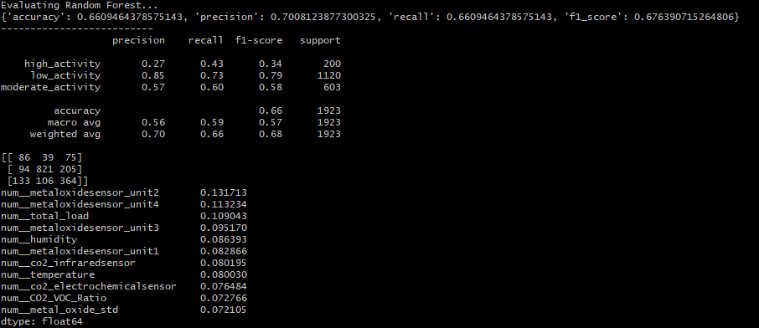
Evaluation results - Random Forest

Slide 10
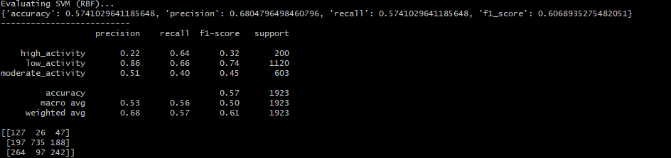
Evaluation results - SVM

Slide 11
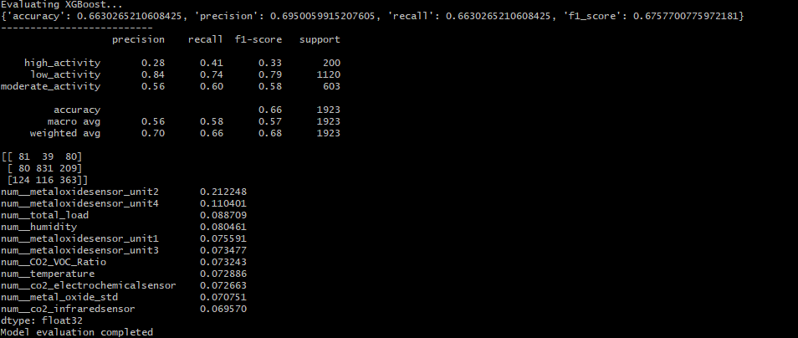
Evaluation results - XGBoost

Slide 12
Thank you

