Slide 1

The Cost-of-Living Crisis In Melbourne
Unpacking the Data Behind the Rising Expenses
Image from Microsoft Powerpoint

Slide 2
Introduction
According to suicide prevention Australia, a record 54% of Victorians reported cost-of-living and personal debt distress beyond normal levels in March.
This is more-than-double all other key economic and social determinants of suicide.

Slide 3
Understanding the cost-of-living crisis
Why It’s Crucial:
• Household Budgets: Impacts affordability of necessities (food, housing, healthcare).
• Mental Health: Links to higher anxiety and depression rates.
• Economic Stability: Reduced consumer spending can slow economic growth.
• Policy Making: Informs effective support and economic policies.
What is CPI?
• CPI Measures average price changes of a basket of consumer goods and services.
• Indicator of Inflation: Reflects cost-of-living changes and purchasing power.
• Importance:
• Economic Insight: Guides businesses, investors, and policymakers.
• Income Adjustments: Used for adjusting wages and pensions.
• Policy Formulation: Helps design fiscal and monetary policies.

Slide 4
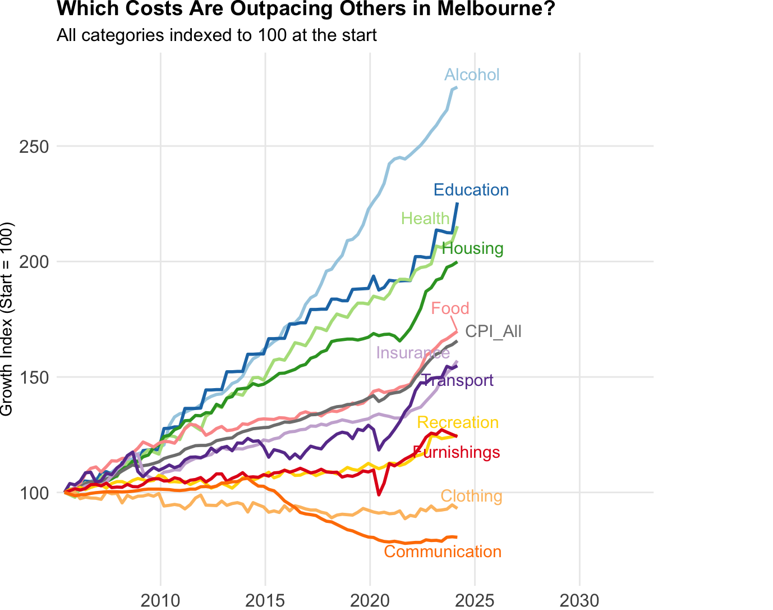
All trending upward except communication and clothing
Top Rising Costs: Alcohol, education, and health and housing
The latest household expenditure survey from ABS suggests that housing is the highest expenditure of households in Australia. Let's explore the rent prices in Melbourne.
Data source: Australian Bureau of Statistics

Slide 5
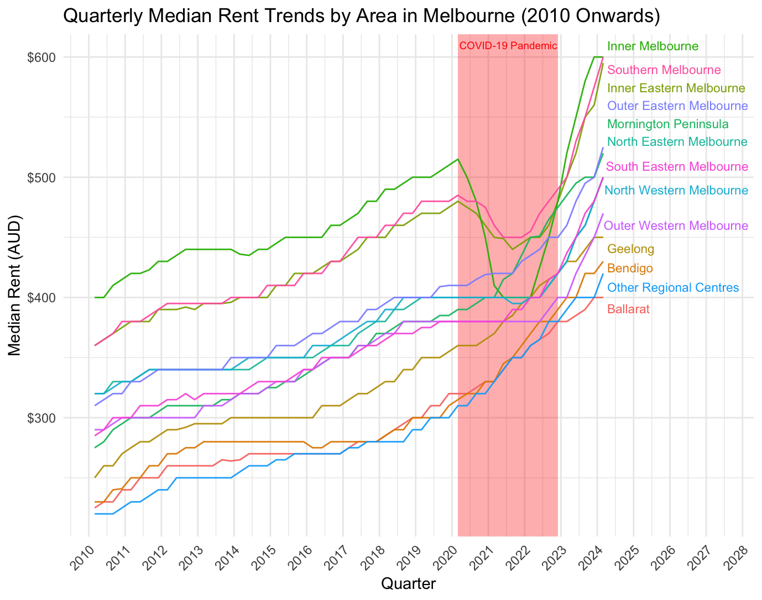
Inner areas dipped during the pandemic
Prices are more expensive closer to the city
Data source: DataVic

Slide 6
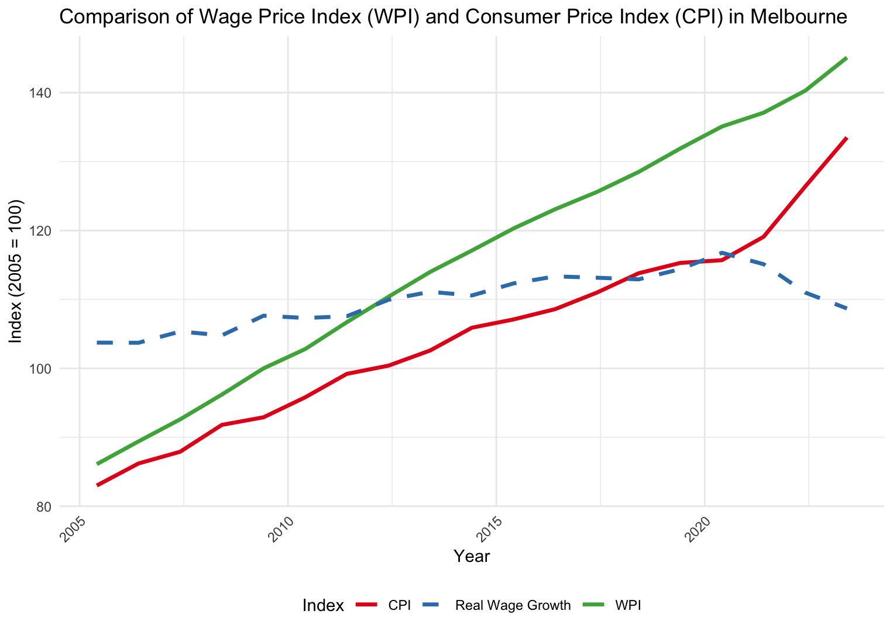
Are the wages keeping up?
CPI and WPI is increasing but real wage growth which measures the change in wages adjusted for inflation
has been decreasing in recent years
Data source: Australian Bureau of Statistics

Slide 7
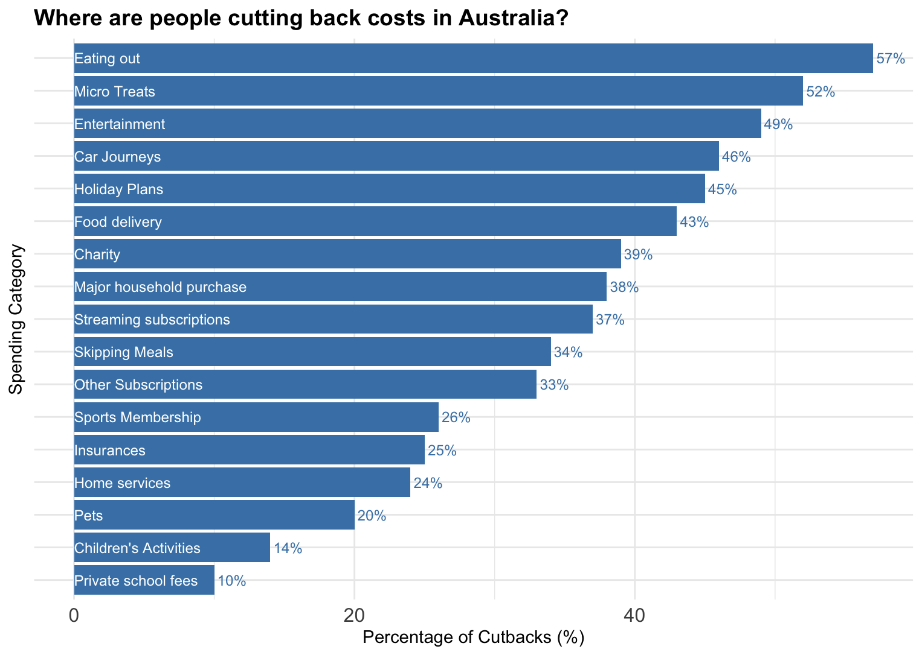
Data source: NAB

Slide 8

Recommendations
Policy changes
Affordable housing initiatives
Wage growth support
Personal Actions
Cut Back on Discretionary Spending
Eating Out: Cook at Home
Micro Treats and Entertainment: Limit Small Purchases
Car Journeys: Use Public Transport
Optimize Essential Spending :
Relocate if Possible
Delay Major Purchases
Review Subscriptions
Image from Microsoft Powerpoint

Slide 9
References
1. The Age. (2024, March 27). Victorians suffer the biggest jump in financial distress as cost of living soars. Retrieved June 11, 2024, from https://www.theage.com.au/politics/victoria/victorians-suffer-the-biggest-jump-in-financial-distress-as-cost-of-living-soars-20240327-p5ffr5.html
2. Data VIC. (2024). Rental report: Quarterly moving annual rents by suburb. Retrieved June 11, 2024, from https://discover.data.vic.gov.au/dataset/rental-report-quarterly-moving-annual-rents-by-suburb
3. National Australia Bank. (2024, April). Consumer Sentiment Survey Q1 2024. Retrieved June 11, 2024, from https://business.nab.com.au/wp-content/uploads/2024/04/NAB-Consumer-Sentiment-Survey-Q1-2024.pdf
4. Australian Bureau of Statistics. (2024). Consumer Price Index, Australia. Retrieved June 11, 2024, from https://www.abs.gov.au/statistics/economy/price-indexes-and-inflation/consumer-price-index-australia/latest-release
5. Australian Bureau of Statistics. (2024). Wage Price Index, Australia. Retrieved June 11, 2024, from https://www.abs.gov.au/statistics/economy/price-indexes-and-inflation/wage-price-index-australia/latest-release#data-downloads

