Slide 1
Microsoft Graph Microsoft Cognitive Services
Sébastien Pertus
@sebastienpertus
Microsoft DX France

Slide 2


Sebastien Pertus
Microsoft Technical Evangelist
OSS Lover
Node.JS & .Net Core advocate
Twitter : @sebastienpertus

Slide 3
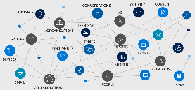
Artificial Intelligence will change the way we work
This challenge is completely open to innovations based on :
Microsoft Graph which allows to access to all the datas of Microsoft users: emails, calendar, documents, contacts, working groups, etc
API Cognitive Services, a series of artificial intelligence algorithms for vision, speech, language and knowledge.

Slide 4
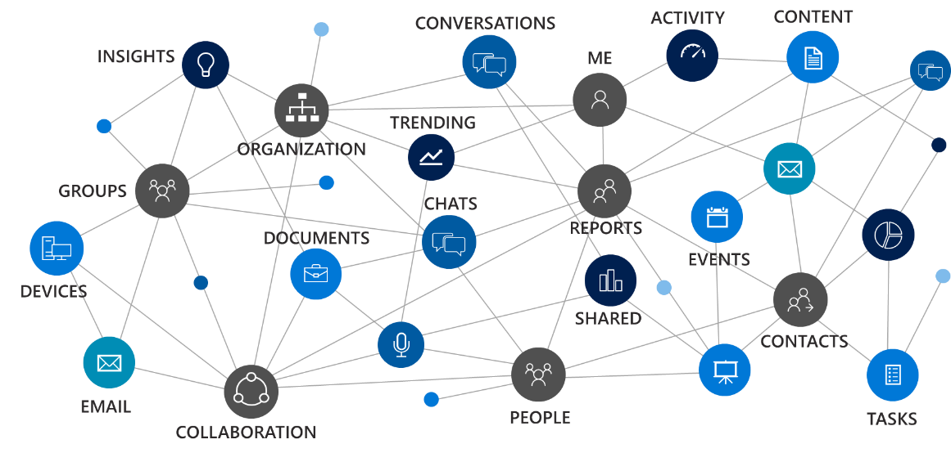








Microsoft Graph
CONVERSATIONS
ACTIVITY
CONTENT
INSIGHTS
ME
TRENDING
ORGANIZATION
GROUPS
CHATS
DOCUMENTS
REPORTS
EVENTS
DEVICES
SHARED
CONTACTS
EMAIL
PEOPLE
TASKS
COLLABORATION

Slide 5
- User, group and organizational
Data
One endpoint
One token
All users
Your app
https://graph.microsoft.com
Users
Groups
Excel
Outlook
Calendar
OneNote
Teams
Planner
Intune
Azure AD
SharePoint

Slide 6

With Microsoft Graph
GET: /users/yina
{
"displayName": "Yina",
"jobTitle": "PRINCIPAL PM MANAGER",
}
GET: /users/yina/photo/…
{}
GET: /users/yina/manager
{"displayName": "Tristan", …}
GET: /users/yina/directReports
"value" : [
{"displayName": "Matt", …},
{"displayName": "Dmitry", …},
]
GET: /me/memberOf/…
"value" : [
{"displayName": "Office engineering", …},
{"displayName": "Women in tech", …},
]
Get the user profile
Tristan
manager
Groups
memberOf
Yina
directReports
Dmitry
Matt
Sudhi

Slide 7
With Microsoft Graph
GET /me/drive/root/…
"value" : [
{"name": "proposal.pptx",… },
{"name": "forecast.xlsx",… }
]
GET /drives/items/{id}/workbook
GET /me/messages
GET /me/events
GET /me/contacts
GET /me/onenote/notebooks
GET /me/planner/tasks
GET /me/devices
GET /sites:/teams/opg:/
GET /sites:/teams/opg:/lists
GET /groups/{id}/conversations
`
Get content for email, calendar, files, tasks, sites, notes & more
Documents
Calendar
Sites
Tasks
Email
Meetings
Contacts

Slide 8

With Microsoft Graph
GET /me/insights/trending
"value" : [
{"name": "presentation.pptx", …},
{"name": "forecast.xlsx", …}
]
GET /me/drive/recent
"value" : [
{"name": "guidelines.pptx", …},
{"name": "budget.xlsx", …}
]
GET people/?$search="topic: planning"
"value" : [
{"displayName": "Dan", …},
{"displayName": "Sean", …},
]
POST: /me/findMeetingTimes
{
"attendees": [
{
"type": "required",
"emailAddress": {
"address": "ana@contoso.com"
}
],
"meetingDuration": "2h"
}
Get insights based on activities
Out of office
Trending Documents
Find me the best time to meet Ana
Search people based on topics
People I’m working with
Recent Documents

Slide 9
Calling the API
HTTP verbs dictate the request intent: GET | POST | PATCH | PUT | DELETE
Version: /v1.0 or /beta
Resource: /users, /groups, /sites, /drives, /devices, more…
Member from collection: /users/AAA
Property: /users/AAA/department
Traverse to related resources via navigations: /users/AAA/events
Query parameters: /users/AAA/events?$top=5
Format results: $select | $orderby
Control results: $filter | $expand
Paging: $top | $skip | $skiptoken
https://graph.microsoft.com
/{version}
/{resource}
/{id}
/{property}
?{query-parameters}

Slide 10
Common queries
Scenario | API - https://graph.microsoft.com/
GET my profile | /v1.0/me
GET my files | /v1.0/me/drive/root/children
GET my photo | /v1.0/me/photo/$value
GET my high importance email | /v1.0/me/messages?$filter=importance eq 'high'
GET my calendar | /v1.0/me/calendar
GET my manager | /v1.0/me/manager
GET last user to modify foo.txt | /v1.0/me/drive/root/children/foo.txt/lastModifiedByUser
GET my recent files | /v1.0/me/drive/recent
GET Office 365 groups I’m member of | /v1.0/me/memberOf/$/?$filter=groupTypes/any(a:a eq 'unified')
GET users in my organization | /v1.0/users
GET group conversations | /v1.0/groups/<id>/conversations
GET people relevant to me | /beta/me/people
GET files trending around me | /beta/me/insights/trending
GET the root SharePoint site | /beta/sharepoint/sites/root
GET my Planner tasks | /beta/me/planner/tasks
GET my notes | /beta/me/onenote/notebooks

Slide 11











SDKs, samples and tooling
GA*
GA
GA
GA
PREVIEW
ASP.NET MVC
JavaScript
Angular
PHP
Python
GA*
GA*
GA*
PREVIEW
PREVIEW
Xamarin
UWP
Android
iOS
Ruby
UPDATED
VS integration

Slide 12
Using Microsoft Graph
Sébastien Pertus
@sebastienpertus

Slide 13

Vision
Computer Vision | Content Moderator | Emotion | Face | Video | Video Indexer | Custom Vision Service
Speech
Bing Speech | Custom Speech Service | Speaker Recognition
Microsoft Cognitive Services
Give your apps a human side
Language
Bing Spell Check | Language Understanding | Linguistic Analysis | Text Analytics | Translator Text & Speech | Web Language Model
Knowledge
Academic Knowledge | Entity Linking | Knowledge Exploration | Recommendations | QnA Maker | Custom Decision Service
Search
Bing Autosuggest | Bing Image Search | Bing News Search | Bing Video Search | Bing Web Search | Bing Custom Search
Labs Project Prague | Project Cuzco | Project Johannesburg | Project Nanjing | Project Abu Dhabi | Project Wollongong

Slide 14
Search
Vision
Speech
Language
Knowledge
Bing Web Search
Computer Vision
Bing Speech
Bing Spell Check
Academic
Knowledge
Bing Custom Search
Custom Vision Service
Custom Speech Service
Linguistic Analysis
Custom Decision Service
Bing Image Search
Emotion
Speaker Recognition
Language Understanding
Knowledge Exploration
Bing Video Search
Face
Translator
Text Analytics
QnA Maker
Bing News Search
Video
WebLM
Recommendations
Bing Autosuggest
Video Indexer
Entity Linking
Content Moderator
microsoft.com/cognitive

Slide 15
Accessing the APIs
/* 1. Obtain an API subscription key from
microsoft.com/cognitive
2. Call REST endpoint, and pass API key via
special header */
GET https://api.cognitive.microsoft.com/bing/v7.0/search?q=nasa
HTTP/1.1
OCP-Apim-Subscription-Key: <API KEY>

Slide 16
Key Code Snippets
internal const string ImageSearchService = "https://api.cognitive.microsoft.com/bing/v7.0/images/details?";
var client = new HttpClient();
client.DefaultRequestHeaders.Add("Ocp-Apim-Subscription-Key", Constants.SearchKey);
client.DefaultRequestHeaders.Accept.Add(
new MediaTypeWithQualityHeaderValue("application/json"));
// Post request additional metadata and process response
var queryString = string.Format(“mkt={0}&setlang={1}&safesearch={2}&modules={3}",
“en-us”, “en”, "strict", “all“);
var uri = Constants.ImageSearchService + queryString;
var response = await client.PostAsync(uri, content);
if (response.StatusCode == HttpStatusCode.OK)
rawResults = await response.Content.ReadAsStringAsync();

Slide 17
Call to action
Get started for free at https://www.microsoft.com/cognitive-services
Documentation portal: https://docs.microsoft.com/en-us/azure/cognitive-services/
Re-visit Build session recordings on Channel 9.
My repository with samples : http://www.github.com/Mimetis
The graph API documentation : http://graph.microsoft.io
The graph explorer : https://developer.microsoft.com/en-us/graph/graph-explorer#
The graph samples & SDK : https://developer.microsoft.com/en-us/graph/code-samples-and-sdks
Azure AD V2 registration portal : https://apps.dev.microsoft.com
Custom Vision API (preview): http://customvision.ai
#MSBuild

