Slide 1
TMS
Layer -1
Pulse characteristics
pulse_waveform = ‘biphasic’
[pulse_shape] – alternative names
stim_id = ‘stim1’
nibs.json
StimID = ‘stim1’
StimDescription = ‘Single pulse condition’
Required:
pulse_duration
pulse_waveform
pulse_intensity
pulse_intensity = 40 %MSO
pulse_duration = 0.002 s
Multiple pulse timing parameters
stim_id = ‘stim2’
nibs.json (if pulse characteristics change per pulse in instance)
StimID = ‘stim2’
StimDescription = ‘Paired pulse SICI condition’
PulseIntensityScalingVector = [30,40]
PulseIntensityScalingMethod = [‘absolute’,’absolute’]
PulseDurationScalingVector = [0.002,0.004]
PulseDurationScalingMethod = [‘absolute’,’absolute’]
pulse_count = 3
[pulses_in_instance]
pulse_count = 2
instance_duration = 0.06 s
Layer 0
Instance [burst, train]
Required:
_count
_repetition_interval
pulse_repetition_interval = 0.02 s
pulse_repetition_interval = 0.02 s
pulse_repetition_frequency = 50 Hz
instance_count = 3
Layer 1
Train [repeat]
train_duration = 0.6 s
See TUS for ITRUSST layer model
Required:
_count
_repetition_interval
instance_repetition_interval = 0.2 s
instance_repetition_frequency = 5 Hz
train_count = 2
Layer 2
Sequence [repeat2]
sequence_duration = 0.36 s
Required:
_count
_repetition_interval
train_repetition_interval = 1 s
train_repetition_frequency = 1 Hz

Slide 2
TMS (stimulus alternative)
Layer -1
Stimulus characteristics
stimulus_waveform = ‘biphasic’
[stimulus_shape] – alternative names
stim_id = ‘stim1’
nibs.json
StimID = ‘stim1’
StimDescription = ‘Single pulse condition’
Required:
stimulus_duration
stimulus_waveform
stimulus_intensity
stimulus_intensity = 40 %MSO
stimulus_duration = 0.002 s
Multiple stimulus timing parameters
stim_id = ‘stim2’
nibs.json (if pulse characteristics change per pulse in instance)
StimID = ‘stim2’
StimDescription = ‘Paired pulse SICI condition’
StimulusIntensityScalingVector = [30,40]
StimulusIntensityScalingMethod = [‘absolute’,’absolute’]
StimulusDurationScalingVector = [0.002,0.004]
StimulusDurationScalingMethod = [‘absolute’,’absolute’]
stimulus_count = 3
[stimuli_in_instance]
stimulus_count = 2
instance_duration = 0.06 s
Layer 0
Instance [burst, train]
Required:
_count
_repetition_interval
stimulus_repetition_interval = 0.02 s
stimulus_repetition_interval = 0.02 s
stimulus_repetition_frequency = 50 Hz
instance_count = 3
Layer 1
Train [repeat]
train_duration = 0.6 s
See TUS for ITRUSST layer model
Required:
_count
_repetition_interval
instance_repetition_interval = 0.2 s
instance_repetition_frequency = 5 Hz
train_count = 2
Layer 2
Sequence [repeat2]
sequence_duration = 0.36 s
Required:
_count
_repetition_interval
train_repetition_interval = 1 s
train_repetition_frequency = 1 Hz

Slide 3
Layer -1
Pulse characteristics
TUS
Required:
pulse_duration
pulse_waveform
pulse_peak_positive_pressure
pulse_peak_negative_pressure
pulse_operating_frequency
pulse_initial_phase
pulse_ramp_duration
pulse_ramp_shape
pulse_waveform = ‘sinusoid’
pulse_initial_phase = 0
pulse_peak_positive_pressure
pulse_operating_frequency= 270 kHz
stim_id = ‘stim1’
nibs.json
StimID = ‘stim1’
StimDescription = ‘Single pulse TUS’
pulse_initial_phase = 0
pulse_peak_negative_pressure = 720 kPa
pulse_duration = 2 s
Multiple pulse timing parameters
pulse_count = 3
[pulses_in_instance]
ITRUSST parameters
pulse_count = 3
instance_duration = 0.06 s
pulse_train_duration = 0.06 s
Layer 0
Instance [burst, train]
Layer 0
Pulse Train
Required:
_duration
_repetition_interval
Required:
pulse_train_duration
pulse_repetition_interval
pulse_repetition_interval = 0.02 s
pulse_repetition_interval = 0.02 s
pulse_repetition_frequency = 50 Hz
pulse_repetition_frequency = 50 Hz
instance_count = 3
Layer 1
Pulse Train Repeat
pulse_train_repeat_duration = 0.6 s
Layer 1
Train [repeat]
train_duration = 0.6 s
Required:
_duration
_repetition_interval
Required:
pulse_train_repeat_duration
pulse_train_repetition_interval
instance_repetition_interval = 0.2 s
pulse_train_repetition_interval = 0.2 s
instance_repetition_frequency = 5 Hz
pulse_train_repetition_frequency = 5 Hz
train_count = 2
Layer 2
Repeat2
repeat2_duration = 0.36 s
Layer 2
Sequence [repeat2]
sequence_duration = 0.36 s
Required:
repeat2_duration
pulse_train_repeat_repetition_interval
Required:
_duration
_repetition_interval
train_repetition_interval = 1 s
pulse_train_repeat_repetition_interval = 1 s
train_repetition_frequency = 1 Hz
pulse_train_repeat_repetition_frequency = 1 Hz

Slide 4
Layer -1
Pulse characteristics (must be described for each electrode)
ANODE
tES
CATHODE
pulse_waveform = ‘rectangle’
stim_id = ‘stim1’
nibs.json
StimID = ‘stim1’
StimDescription = ‘tDCS’
pulse_peak_positive_current = 1 mA
Required:
pulse_duration
pulse_waveform
pulse_peak_positive_current
pulse_peak_negative_current
pulse_operating_frequency
pulse_initial_phase
pulse_ramp_duration
pulse_ramp_shape
pulse_ramp_up_duration = 30s
pulse_ramp_down_duration = 30s
pulse_waveform = ‘rectangle’
pulse_duration = 10 mins
pulse_peak_negative_current = 0 mA
pulse_peak_positive_current = 0 mA
pulse_duration = 10 mins
pulse_ramp_up_duration = 30s
pulse_ramp_down_duration = 30s
pulse_peak_negative_current = -1 mA
Multiple pulse timing parameters
(e.g., tPCS)
pulse_count = 3
tACS
pulse_waveform = ‘sinusoid’
instance_duration = 0.06 s
Required:
pulse_duration
pulse_waveform
pulse_peak_positive_current
pulse_peak_negative_current
pulse_operating_frequency
pulse_initial_phase
pulse_peak_positive_current = 1 mA
Layer 0
Instance [burst, train]
pulse_operating_frequency = 20 Hz
Required:
_duration
_repetition_interval
pulse_initial_phase = 0
pulse_repetition_interval = 0.02 s
pulse_peak_negative_current = -1 mA
pulse_repetition_frequency = 50 Hz
pulse_duration = 10 mins
instance_count = 3
tDCS + tACS
pulse_waveform = ‘sinusoid’
Layer 1
Train [repeat]
train_duration = 0.6 s
Required:
pulse_duration
pulse_waveform
pulse_peak_positive_current
pulse_peak_negative_current
pulse_operating_frequency
pulse_initial_phase
pulse_peak_positive_current = 2 mA
pulse_operating_frequency = 20 Hz
Required:
_duration
_repetition_interval
pulse_initial_phase = 0
instance_repetition_interval = 0.2 s
pulse_peak_negative_current = 0 mA
instance_repetition_frequency = 5 Hz
pulse_duration = 10 mins
train_count = 2
tRNS
pulse_waveform = ‘random noise’
Layer 2
Sequence [repeat2]
sequence_duration = 0.36 s
Required:
_duration
_repetition_interval
train_repetition_interval = 1 s
train_repetition_frequency = 1 Hz

Slide 5
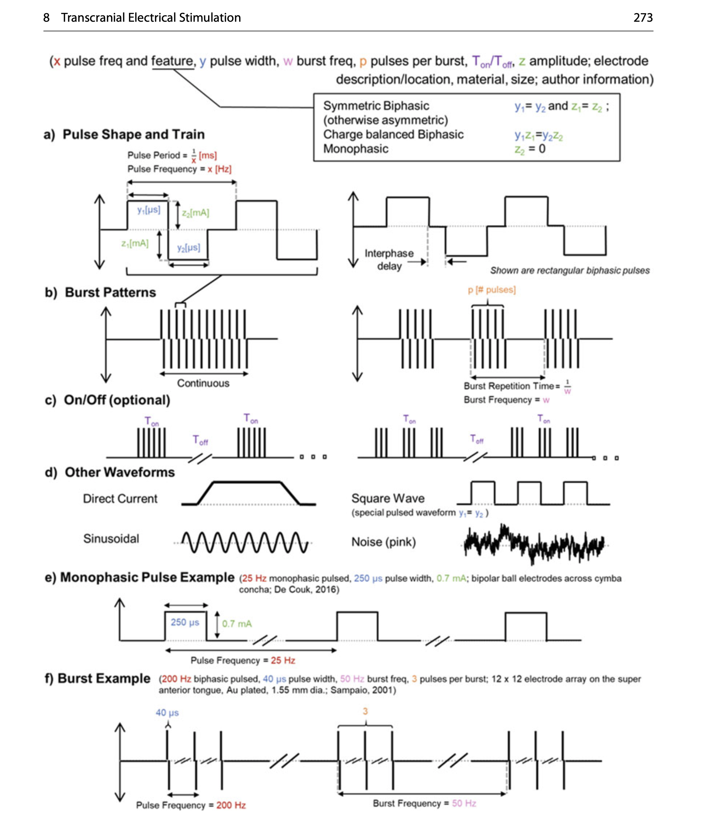
Fundamentals of transcranial electric and magnetic stimulation dose: Definition, selection, and reporting practices
https://www.sciencedirect.com/science/article/pii/S1935861X11001495
Transcranial electrical stimulation nomenclature
https://www.sciencedirect.com/science/article/pii/S1935861X19302943
FIGURE
https://www.neuralengr.org/news/new-chapter-transcranial-electrical-stimulation-in-neural-engineering

Slide 6
Nomenclature for stimulus/pulse (generalise)
Event waveform = time varying signal making up an event.
Event stimulus = individual stimulation unit (might be problematic as stimulus is semantically loaded).
Property | Nigel | Additions | Alternatives
Waveform/shape (Are waveform and shape separate parameters? – stimulus waveform typically describes the entire stimulation so perhaps shape is better) | stimulus_shape | If = ‘sinusoid’: stimulus_operating_frequency stimulus_operating_phase
Duration | stimulus_duration |  | stimulus_width
Amplitude | stimulus_intensity (TMS) stimulus_peak_positive_pressure (TUS) stimulus_peak_negative_pressure (TUS) stimulus_peak_positive_current (tES) stimulus_peak_negative_current (tES) |  | stimulus_amplitude_machine (TMS) stimulus_amplitude_mso (TMS) stimulus_amplitude_didt (TMS) stimulus_amplitude_maximum (TUS, tES) stimulus_amplitude_minimum (TUS, tES)
Amplitude ramp | stimulus_ramp_duration stimulus_ramp_shape |  | stimulus_ramp_up_duration stimulus_ramp_down_duration
Polarity Related to current direction (not sure if this fits here – perhaps fits under coil position for TMS)

Slide 7
Nomenclature for stimulus/pulse (generalise)
Event waveform = time varying signal making up an event.
Event component = individual stimulation unit.
Property | Nigel | Additions | Alternatives
Waveform/shape (Are waveform and shape separate parameters? – stimulus waveform typically describes the entire stimulation so perhaps shape is better) | component_shape = ‘rectangular’, ‘sinusoidal’, | If = ‘sinusoid’: component_operating_frequency component_operating_phase
Duration | component_duration |  | component_width
Amplitude | component_intensity (TMS) component_peak_positive_pressure (TUS) component_peak_negative_pressure (TUS) component_peak_positive_current (tES) component_peak_negative_current (tES) |  | component_amplitude_machine (TMS) component_amplitude_mso (TMS) component_amplitude_didt (TMS) component_amplitude_maximum (TUS, tES) component_amplitude_minimum (TUS, tES)
Amplitude ramp | component_ramp_duration component_ramp_shape |  | component_ramp_up_duration component_ramp_down_duration
Polarity Related to current direction (not sure if this fits here – perhaps fits under coil position for TMS)

Slide 8
Nomenclature for stimulus/pulse (split)
Event_waveform_type = ‘pulse-based’ or ‘continuous’.
If ‘pulse-based’, parameters refer to individual pulses (e.g., TMS, TUS, TPCS). If ‘continuous’, parameters refer to continuous waveform (e.g., tDCS, tACS, tRNS). Need a definition of what constitutes ‘pulse-based’ vs ‘continuous’.
Property | Nigel | Additions | Alternatives
Waveform/shape (Are waveform and shape separate parameters? – stimulus waveform typically describes the entire stimulation so perhaps shape is better) | shape = ‘rectangular’, ‘sinusoidal’ Where does monophasic/biphasic fit? | If = ‘sinusoidal’: operating_frequency operating_phase
Duration | duration |  | width
Amplitude | intensity (TMS) peak_positive_pressure (TUS) peak_negative_pressure (TUS) peak_positive_current (tES) peak_negative_current (tES) |  | amplitude_machine (TMS) amplitude_mso (TMS) amplitude_didt (TMS) amplitude_maximum (TUS, tES) amplitude_minimum (TUS, tES)
Amplitude ramp | ramp_duration ramp_shape |  | ramp_up_duration ramp_down_duration
Polarity Related to current direction (not sure if this fits here – perhaps fits under coil position for TMS)

Slide 9
Nomenclature for timings (generalise or only for ‘pulse-based’)
Nesting layer | Oleg | Nigel (ITRUSST) | Nigel (alt) | Nigel (alt 2)
Layer -1 | Pulse | Pulse | Stimulus | Component
Layer 0 Layer 0.5 (optional) | Stimulus (instance) Burst | Pulse train | Stimulus train | Component train
Layer 1 | Train | Pulse train repeat | Stimulus train repeat | Component train repeat
Layer 2 | Sequence | Repeat 2 | Repeat 2 | Repeat 2
Layer 3 | Meta-protocol | Undefined (could use repeat 3) | Undefined (could use repeat 3) | Undefined (could use repeat 3)

