Slide 1


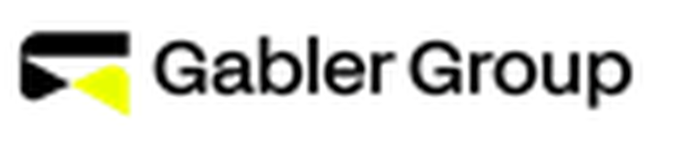


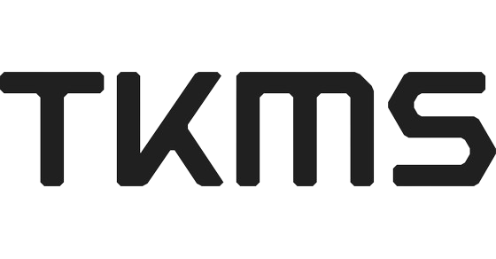




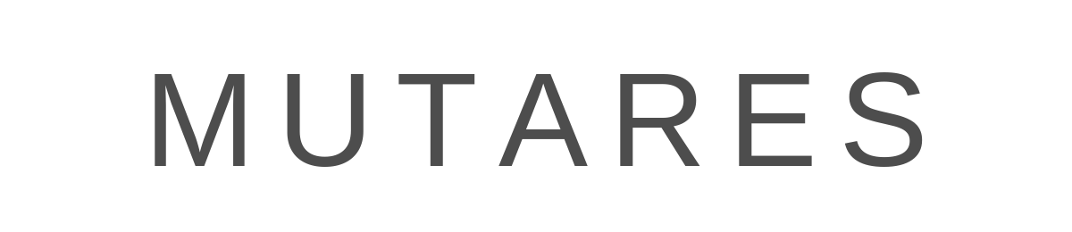


METZLER – Der Blick auf unser Defense Research Team
Defense & Industrials Research Team
Produkte
Sektor Quick Take
Company Note
heads up!
"The cumulation of several developments will make the global defense industry a growth sector over many years, even decades to come: Firstly, European decision makers decided many years ago to replace a multitude of different defense systems to enforce the use of common equipment across all European NATO-member states.
Adding-up only the biggest initiatives, investments into the defense of Europe well exceed EUR 250bn over a period of ten to fifteen years or so. Moreover, it would be naive to consider the above list to be comprehensive, without any further plans and requirements emerging and inflating the shopping list of European governments"
Alexander Neuberger
Senior Analyst
25+ Jahre Research Erfahrung
Rheinmetall Coverage seit 2015
Company Report
Outlook
Stephan Bauer
Senior Analyst
15+ Jahre Research Erfahrung
Industrials Coverage seit 2011
Equity Special
Sector Note
German Top Ten
Sector Report
Defense (bezogene) Coverage
Recommendations & Price targets (PT)
Beitrag im Rahmen eines Börsengangs
Company | Recomm. | PT in EUR | Current Upside¹⁾ | Last Update
Gabler | BUY | 64 | +40% | Apr 21, 2026
Renk | BUY | 75 | +43% | Mar 09, 2026
Rheinmetall | BUY | 2,180 | +81% | May 07, 2026
TKMS | BUY | 105 | +33% | May 12, 2026
Airbus | BUY | 210 | +21% | Apr 29, 2026
Bertrandt | BUY | 26 | +150% | Feb 12, 2026
Jenoptik | BUY | 50 | +9% | May 18, 2026
MTU | BUY | 386 | +28% | May 06, 2026
Mutares | BUY | 34 | +24% | Apr 22, 2026
SFC Energy | BUY | 27 | +22% | May 15, 2026
Siemens | BUY | 295 | +8% | May 20, 2026
Pre-deal
Detaillierter Research Report (Initiation)
Teach-in für das Sales Team und PDIE
Road-
show
Umfassende Investor Education
Tägliches Investorenfeedback
After-
market
Langfristige Research Coverage
Unterstützung bei Management Roadshows, Konferenzen und Events
1) Current Upside = Kurspotenzial des Kursziels gegenüber dem jeweils letzten Schlusskurs; Stand: Datum der letzten Aktualisierung

