Slide 1



OBJECT DETECTION AND LOCALIZATION USING CONVOLUTIONAL NEURAL NETWORK
BY TEAM 2:
LANDON VOLKMANN
TREVOR KLINKENBERG
SHUBHABRATA MUKHERJEE
MURALI KRISHNA SAI CHUKKA
Notes:
Landon

Slide 2
MOTIVATION
Object detection and localization is one of the most fundamental domains in modern machine learning
Object localization was not a subject covered yet in our course
This particular implementation was well documented online giving us plenty of resources to follow
We wanted exposure to transfer learning
We found a model that was ready to genericize
Notes:
Landon

Slide 3
IMPLEMENTATION STRATEGY
Firstly we converted the raw data( images and .txt annotations) to a pascal VOC format which can be directly fed to the model using data_to_pascal_voc.py .
We have done a comparison between two of the most widely used object detection and localization algorithms: YOLO-V3 and Mask R-CNN.
We built and tuned our own CNN model based on YOLO-V3 and trained it with the preprocessed data.
Finally our pre-trained model was used to perform object detection and localization from test samples.
Notes:
Landon

Slide 4
DATASET DESCRIPTION
We initially tried using original Kaggle Imagenet, however due to the colossal size(512 Gb+) and unavailability of labels we switch to the Tiny Imagenet dataset which have almost the same number of images but with smaller size.
This has both the images, annotation boxes for localization 200 different labels, also this is associated another Kaggle competition.
This dataset is comprises of color images of 64 x 64 pixel size and .txt files comprises the specifics of annotation box for the object location inside an image.
Notes:
Shubh

Slide 5
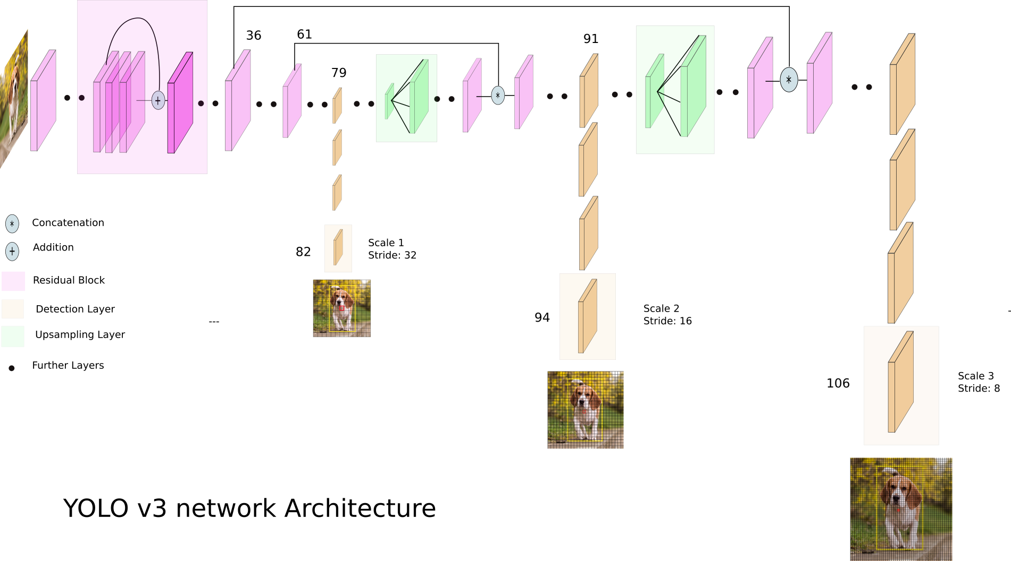
MODEL ARCHITECTURE
YOLO v3 uses a variant of Darknet, 53 more layers are stacked onto it, giving us a 106 layer fully convolutional underlying architecture.
YOLO v3 now performs multilabel classification for objects detected in images.
Since YOLO is a single stage architecture, simpler implementation
Faster inference times also mean faster training times
Notes:
Shubh

Slide 6
DETAILS OF IMPLEMENTATION
Created a virtual environment with the requirements.
Created a training and validation set with the script create_validation_set.sh
Updated the config.json file with our final tuned parameter values.
Used the pre trained backend and generate the anchors for annotation boxes using the gen_anchors.py file.
Used the obtained anchors to update the config.json file.
Used train.py to train the model.
Finally we used predict.py file to generate the prediction boxes inside a test image which encloses an object with the label of the object type in it.
Notes:
Shubh

Slide 7
PERFORMANCE AND ACCURACY
Using the evaluate.py that runs a test accuracy against the validation Images and annotations we set aside when training the model we achieved an accuracy of 76%
n01855672: 0.7673
mAP: 0.7673
Notes:
Trevor

Slide 8


PREDICTION SAMPLE
Using the predict.py that draws the bounding box for an image we can verify the accuracy of the model with a few images:
Notes:
Trevor

Slide 9
Demo
Notes:
Trevor

Slide 10
FUTURE WORK
This model can be used to detect an object inside an image as well as the location of the object inside the image.
This model can also be improvised to detect real object from webcam and smart camera or other static and dynamic sources.
Another similar model can be implemented for other image classification work by means of transfer learning.
We’d also like to explore the MASK-RCNN with this same dataset to see how it might apply segmentation
Extend model to work with multi-label localization
Notes:
Murali

Slide 11
CREDITS & REFERENCE
https://tiny-imagenet.herokuapp.com/
https://ieeexplore.ieee.org/document/7780460
https://github.com/night2wolf/CS490-FinalProject
https://towardsdatascience.com/yolo-v3-object-detection-53fb7d3bfe6b
https://github.com/experiencor/keras-yolo3

