Slide 1
Regression Analysis - MA2142
Multiple linear Regression Model

Slide 2
Outline
DataSet used : Dataset with 2000 data points and 18 regressors
Goal : Predict the cost of a house
→ Fitted the linear model with all regressors
→ Model Selection : forward,backward and step
→ Checking if the residuals are normally distributed
→ Applied BoxCox Transformation
→ Using weights
→ Outlier Analysis

Slide 3
Comparision Table
MODEL | Rsquared | Adj. Rsquared | Regressors excluded | Remarks
Fit | 0.6945 | 0.6919 | None | Co-efficient of X11 is NA (linearly dependent)
Fit1 | 0.6945 | 0.6919 | X11 | -
ForwardP | 0.6932 | 0.6914 | X4,X5,X11,X13,X18 | No improvement in Rsquared compared to Fit1
BackwardP | 0.6939 | 0.6917 | X5,X13,X10
Step | 0.693 | `0.691 | X4,X5,X10,X11,X13,X18

Slide 4
Comparision Table
MODEL | Rsquared | Adj. Rsquared | Regressors excluded | Remarks
Fit | 0.6945 | 0.6919 | None | Co-efficient of X11 is NA (linearly dependent)
Fit1 | 0.6945 | 0.6919 | X11 | -
ForwardAIC | 0.69322 | 0.69121 | X4,X5,X11,X13,X18 | No improvement in Rsquared compared to Fit1
BackwardAIC | 0.69431 | 0.69200 | X5,X13

Slide 5
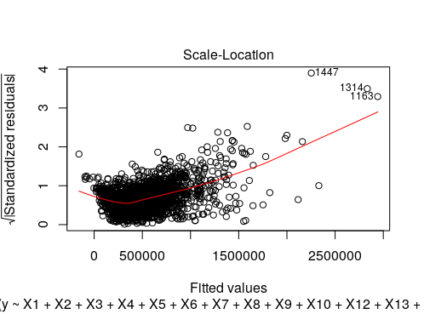
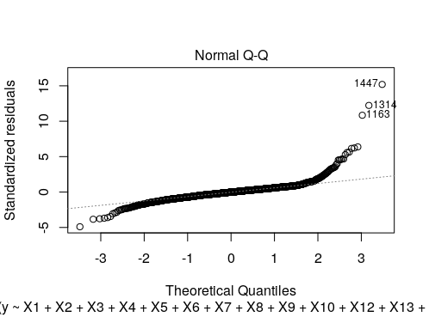
Checking Asumptions
Normalised distribution of residuals:
From the QQ Plot it is clear that residuals donot come from normal distribution
2. Linear relationship between predictor and response variables :
From scale location plot it is clear that they arenot linearly related
SOlution : apply transformation

Slide 6
Comparision Table
MODEL | Rsquared | Adj. Rsquared | Regressors excluded | Remarks
Fit | 0.6945 | 0.6919 | None | Co-efficient of X11 is NA (linearly dependent)
Fit1 | 0.6945 | 0.6919 | X11 | -
BoxCox | 0.7753 | 0.7734 | NOne
Now, apply model selection methods to the transformed data

Slide 7
Comparision Table
MODEL | Rsquared | Adj. Rsquared | Regressors excluded | Remarks
BoxCox | 0.7753 | 0.7734 | NOne
Step | 0.774 | `0.7734 | X1,X10,X11,X18
BackwardAIC | 0.77487 | 0.77328 | X1,X10,X18 | final
ForwardAIC | 0.77487 | 0.77328 | X1,X2,X7,X10,X11
weights | 0.7627 | 0.7611 | X1,X10,X18

Slide 8
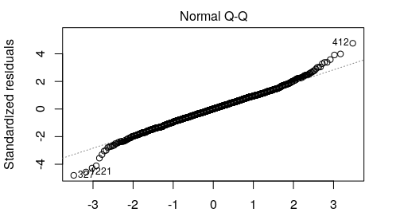
FINAL QQ PLOT

Slide 9
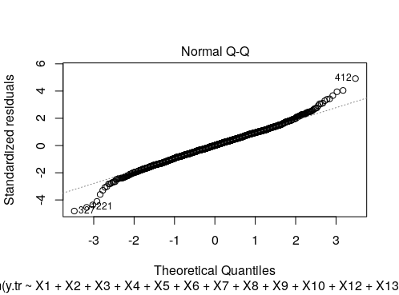
INITIAL QQ PLOT

Slide 10
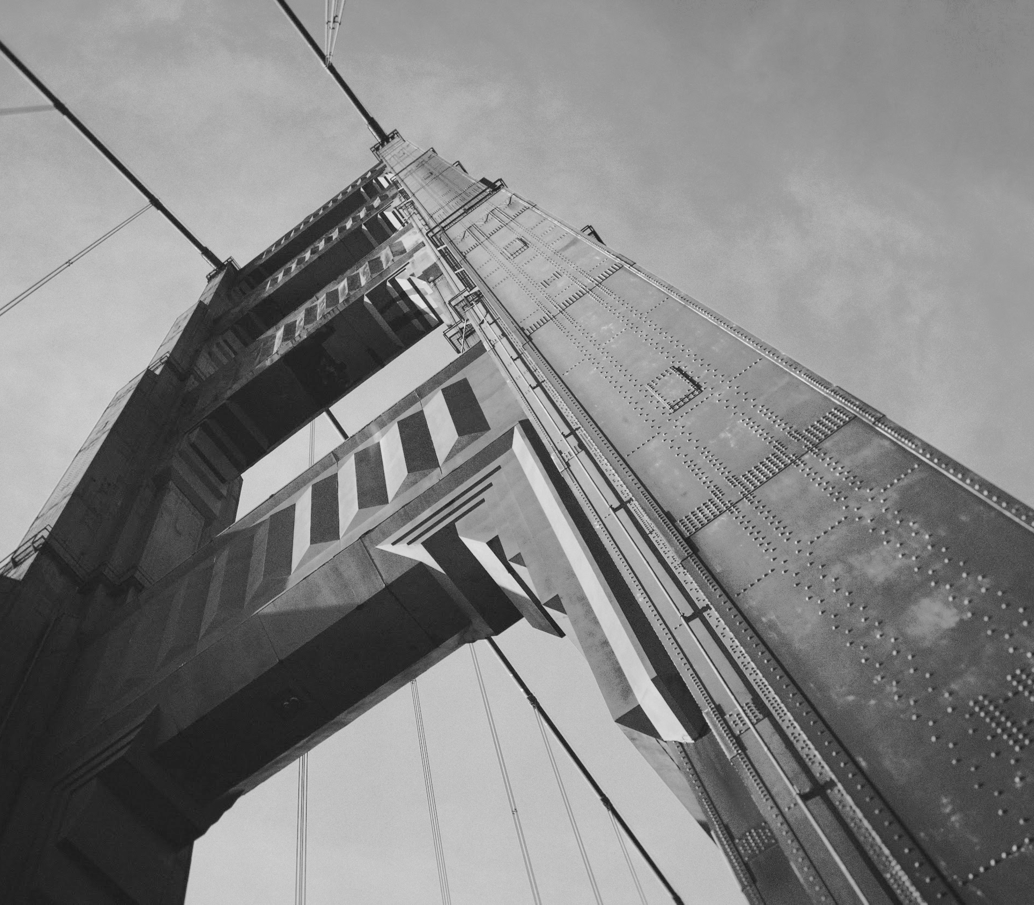
Thanks!
Srujana B
MA17BTECH11001

