Slide 1
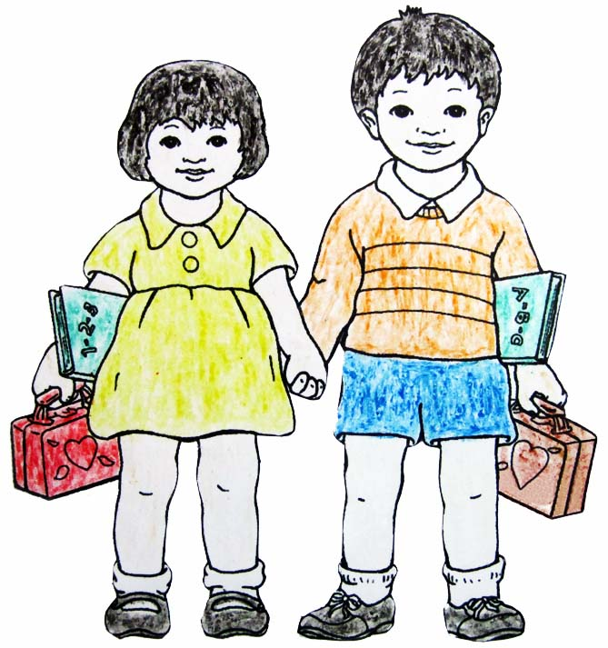
Ang Mag-utod
GINSULAT NI:
ERMA Y. TAYAB
GINLARAGWAY NI:
NONIE F. FALCUNIT
HILIGAYNON STAGE 1
GINBADBAD NI:
JEMA E. BANTULAY
MA. JANET S. GEROSO, PH. D.

Slide 2
Ang Mag-utod
GINSULAT NI:
ERMA Y. TAYAB
GINLARAGWAY NI:
NONIE F. FALCUNIT
GINBADBAD NANDAY:
JEMA E. BANTULAY
MA. JANET S. GEROSO, PH. D.
HILIGAYNON
STAGE 1

Slide 3
Para sa Bata nga Manugbasa:
Ginhimo ini nga libro para sa imo.
Ini nahanungod sa bagay nga makit-an sa imo palibot ukon bata nga subong sa imo.
Maluyagan mo tani ini. Malipayon nga pagbasa!
Ang mga Tag-sulat

Slide 4
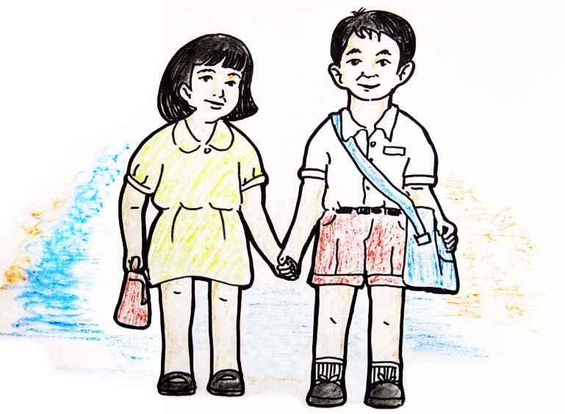
May mag-utod nga ang ila ngalan Toto kag Dayday.
1

Slide 5
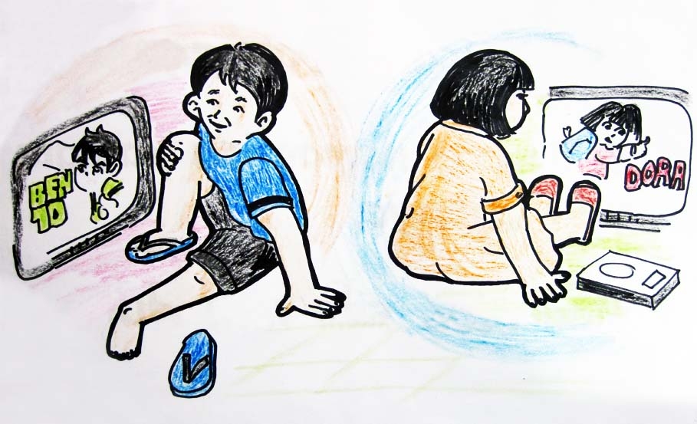
Si Toto luyag maglantaw sang cartoon nga Ben10. Si Dayday naman luyag maglantaw sang cartoon nga Dora.
2

Slide 6
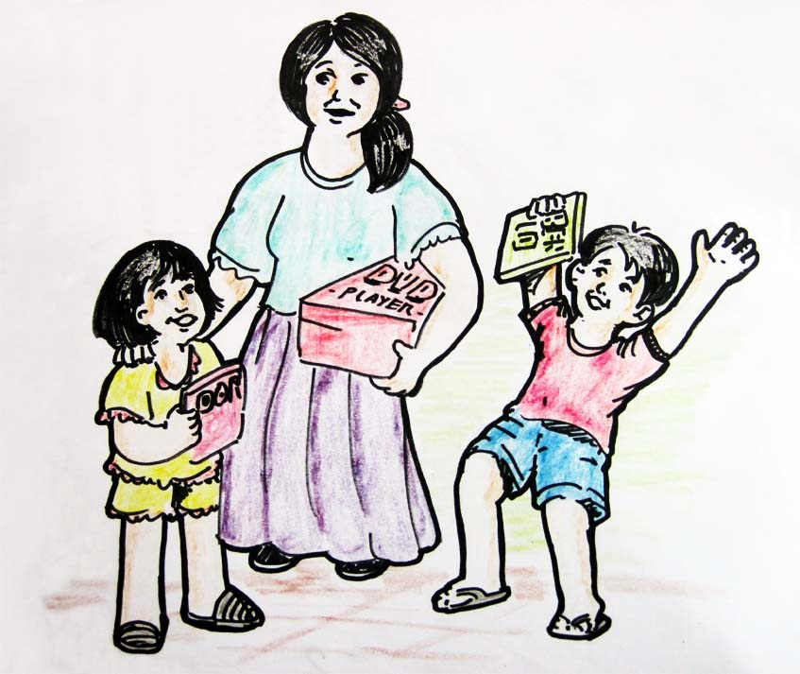
Isa ka adlaw, ginbaklan sila sang portable DVD sang ila nga mama. Ginbaklan pa gid sila sang DVD tape nga Ben10 kag Dora.
3

Slide 7
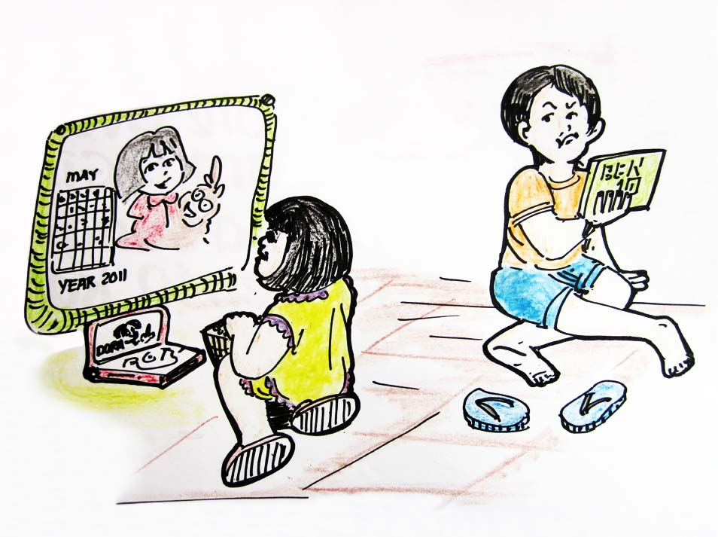
Si Dayday naglantaw sang cartoon nga Dora. Nangakig si Toto kay luyag niya nga Ben10 lang anay ang lantawon.
4

Slide 8
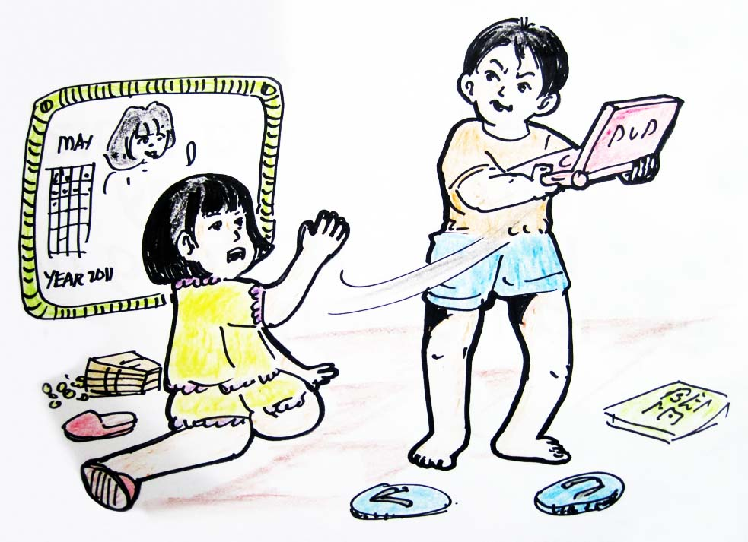
Ginkuha ni Toto ang portable DVD. Nangakig si Dayday, kag nag-agaway sila nga duha.
5

Slide 9
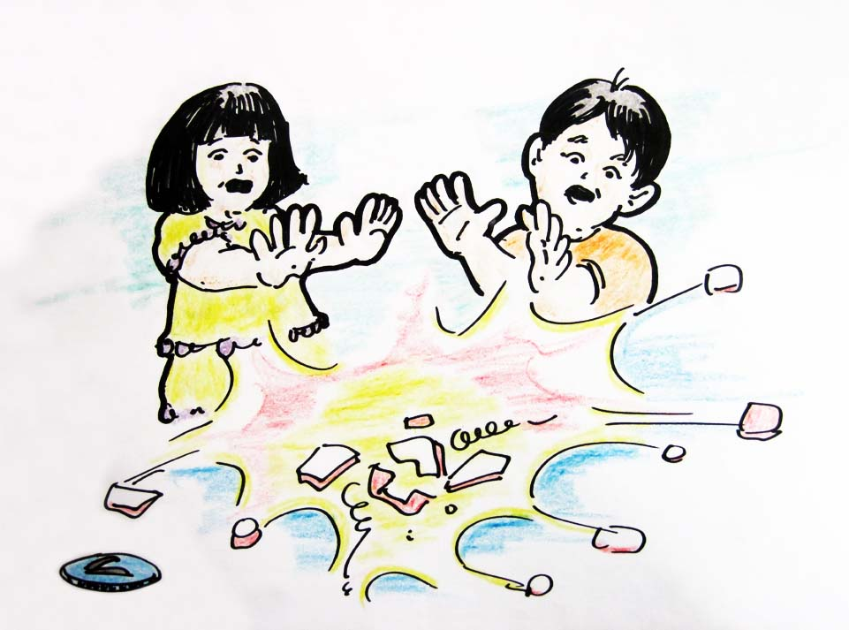
Sang ila pag-agaway, nabuy-an nila ang portable DVD. Nahulog ini kag nawasak.
6

Slide 10
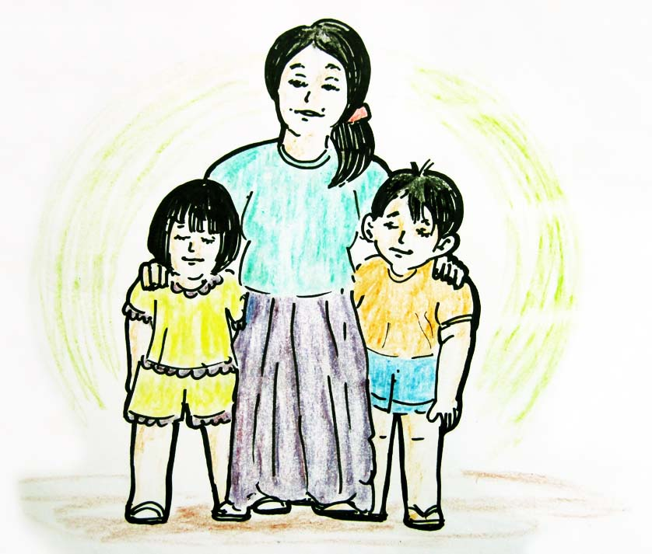
Nakita sila sang ila nga mama. Ginhambalan sila nga indi mag-inaway kag mapalanggaanay gid sila.
7

Slide 11
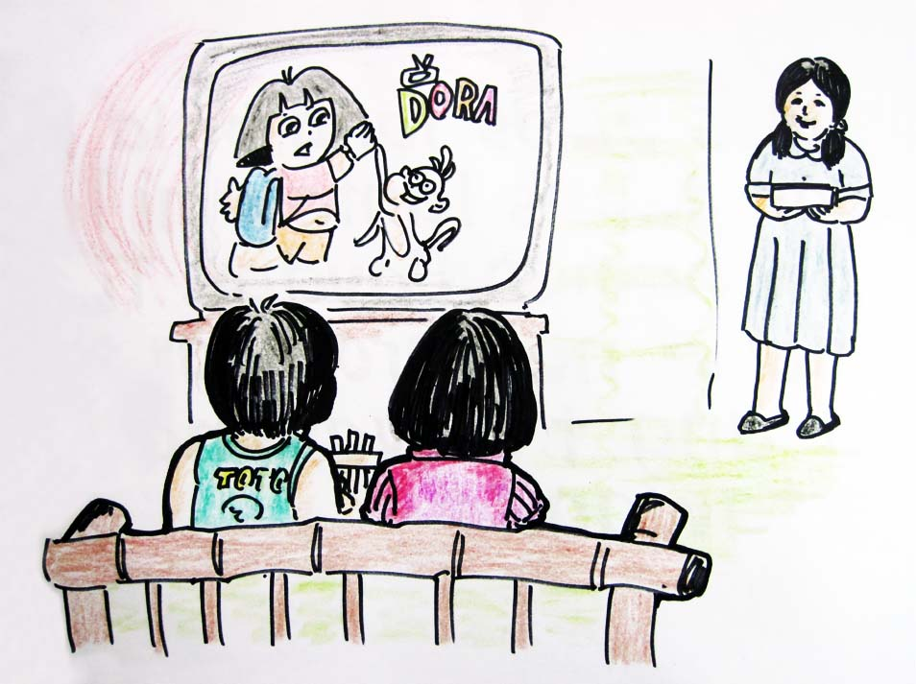
Nangayo pasensya si Toto kag Dayday sa ila nga iloy. Sugod sadto nagahatagay na sila nga duha. Wala na sila naga-away. Nalipay na ang ila nga mama kag papa sa ila nga duha.
8

Slide 12
Ang Mag-Utod
Toto and Dayday are brother and sister.
They want to watch cartoons. Toto likes to watch Ben10 and Dayday likes to watch Dora.
One day, their mother bought them a portable DVD and DVD tapes of Dora and Ben10. They were very happy.
Dayday watched Dora first, but Toto got angry. He wanted to watch Ben10.
Toto got the portable DVD from Dayday, and the two of them quarrelled.
They accidentally dropped the DVD.
Their mother saw what happened, and told Toto and Dayday that as brother and sister they should love each other.
Toto and Dayday asked forgiveness from their mother. From then on, they share and love each other.

Slide 13


Published by the
LEARNING RESOURCES MANAGEMENT AND DEVELOPMENT SYSTEM (LRMDS)
Department of Education
Region VI, Western Visayas
Iloilo City
Copyright 2011
Section 9 of Presidential Decree No. 49 provides:
“No copyright shall subsist in any work of the Government of the Republic of the Philippines. However, prior approval of the government agency of office wherein the work is created shall be necessary for exploitation of such work for profit.”
This material has been developed within the Project in the Mother Tongue-Based Multilingual Education (MTB-MLE) implemented by Curriculum and Learning Management Division (CLMD) of the Department of Education Region VI (DepED RO6). It can be reproduced for educational purposes and the source must be clearly acknowledged. The material may be modified for the purpose of translation into another language but the original work must be acknowledged. Derivatives of the work including creating an edited version, an enhancement or a supplementary work are permitted provided all original work is acknowledged and the copyright is attributed. No work may be derived from this material for commercial purposes and profit.
Ginsulat ni:
Erma Y. Tayab
Ginlaragway ni:
Nonie F. Falcunit
Ginbadbad nanday:
Jema E. Bantulay
Ma. Janet S. Geroso, PH. D.
This first digital edition has been produced for print and online distribution within the Department of Education, Philippines via the Learning Resources Management Development Systems (LRMDS) Portal by Region VI.
http://lrmds.deped.gov.ph

