Slide 1




title_medium_orange
Sample Agent . 2h
Ksh. 250,000
Location A And Some Text
233
Sample Agent . 2h
Ksh. 250,000
Location A And Some Text
233
Notes:
Property listings UI – include fading action bar

Slide 2
User X 2h
Good application blah blah
Archdesign hub replied 1h
Thanks for that!

Slide 3
Sample Agent . 2h
Ksh. 250,000
Location A And Some Text
233

Slide 4




Sample Agent
title_medium_orange
+257485222656
you@mailoneowone.com
www.fookenya.com
6
45
Sample Agent . 2h
Ksh. 250,000
Location A And Some Text
233

Slide 5

Grand Launch Gala
9th Street in two days
233 views . 18 shares
As clipped summary of the event
Another Event Here
9th Street in two days
As clipped summary of the event
Another Event Here
9th Street in two days
Doesn’t have an image, try o make use of space

Slide 6
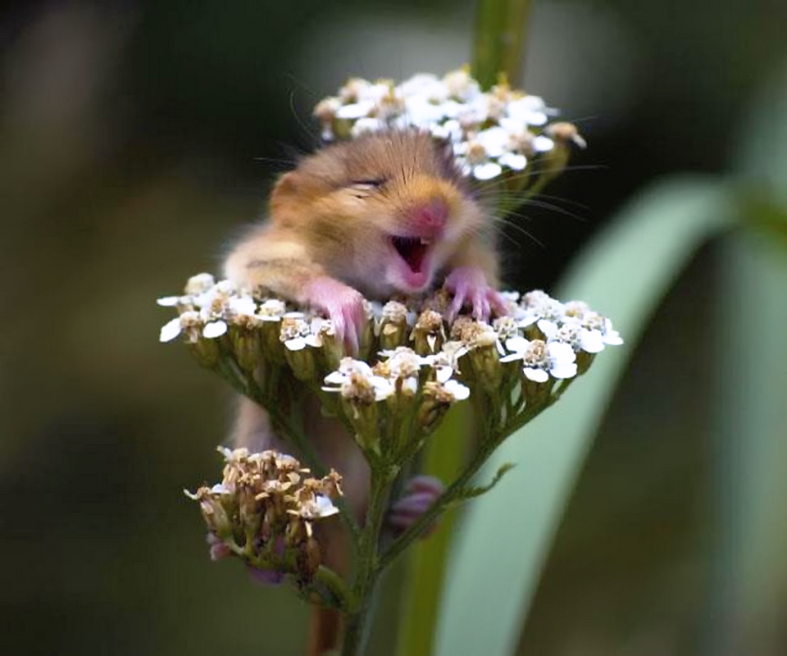
Archdesign Hub

Slide 8
Link to gallery
Seen, liked, large +icons
Ksh. 250,000
location
Agent Name
+2574152566
me@you.com
Map frame
Details below
Some split screen massive icons to break prose monotony – distance from current location

Slide 9


