Slide 1

SMART INDIA HACKATHON 2026
TITLE PAGE
Problem Statement ID – 26075
Problem Statement Title- CAPACITY CONNECT
Theme- Smart Education
PS Category- Software
Team ID- 5043
Team Name - BLUE

Slide 2
IDEA TITLE
BLUE
Problem Description :
Centralized web-based portal for organizational training, competency development, and knowledge sharing.
Secure, multi-role access (Trainee, Trainer, Admin) for course management, assessments, and profile building.
Competency mapping to identify suitable trainers and dashboards for monitoring participation and performance.
Impact → Efficient learning, streamlined administration, and robust organizational capacity building.
Solution :
Unified Portal: A centralized platform (Trainee, Trainer, Admin) for secure course delivery, MCQ assessments, and competency mapping.
Confusion Heatmaps: Tracks video interactions (pauses/rewinds) to visualize exactly where learners struggle, guiding immediate curriculum updates.
Instant Support: Resolves doubts in real-time via AI-powered Q&A (linking to exact video timestamps) and live Peer Rescue chat.
Readiness Dashboards: Uses transparent, rule-based scoring to give leadership clear visibility into organizational skill gaps and workforce readiness.
2

Slide 3
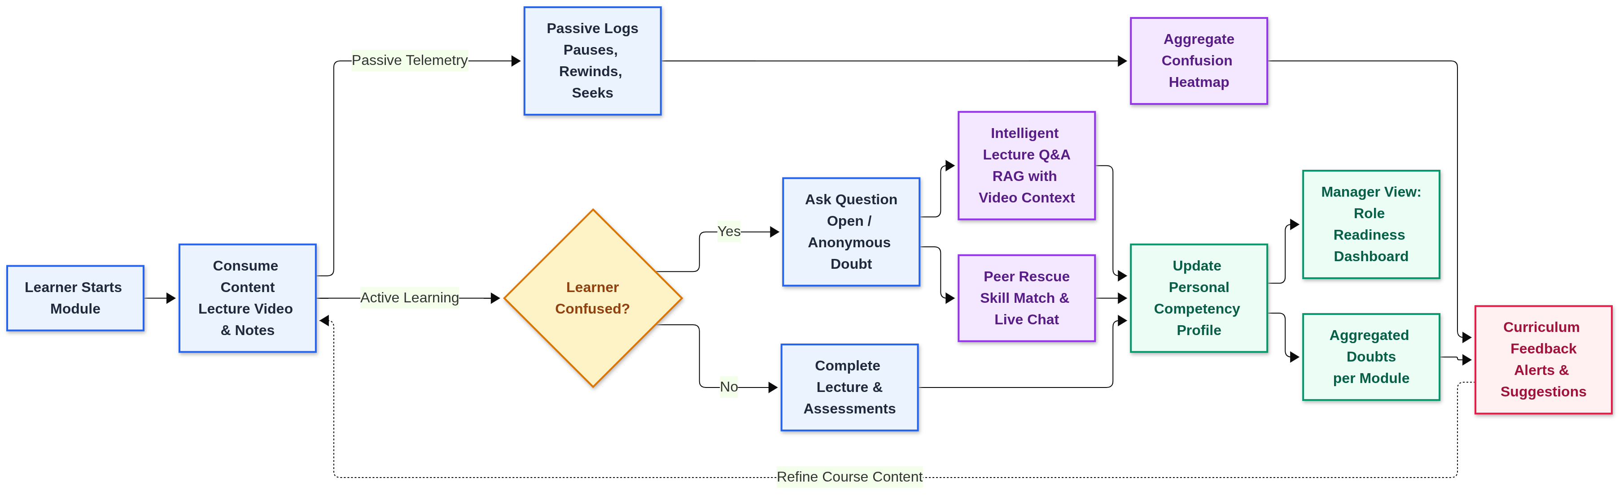
TECHNICAL APPROACH
BLUE
Tech Stack:
AI & LLM: LangChain & LangGraph, Groq & Whisper, FAISS / Chroma
Frontend: HTML5, CSS3, JavaScript, Jinja2
Backend & Database: FastAPI, PostgreSQL & SQLAlchemy, Azure (Cloud Storage)

Slide 4






FEASIBILITY AND VIABILITY
BLUE
Technical Feasibility
Economic Feasibility
Techni
Technology: Built with mature, widely supported web technologies and frameworks.
Scalability: Cloud-based architecture can accommodate increasing users and learning content.
Zero Licensing: Open-source tools eliminate software fees
Reduced Trainer Load: Peer support handles routine interventions
Scalable Infrastructure: Pay-as- you-go cloud hosting adapts to usage
Maintenance and Safety
Maintainability: Modular design simplifies updates and troubleshooting
Security: Role-based permissions restrict sensitive access
Privacy: Anonymous Q&A protects learner identity
Operational Viability
Implementation Viability
Environmental Viability
Training Efficiency: Spots learning gaps before they impact competency.
Decision Support: Competency data reveals actionable training needs.
Content Improvement: Aggregated confusion signals guide course updates.
Deployment: Progressive feature rollout.
Integration: Seamless API and cloud integration.
Adaptability: Flexible across courses, skills, and roles.
Expansion: Supports AI and offline capabilities.
Digital Learning: Cuts reliance on printed materials.
Remote Training: Minimizes the need for physical travel.
Accessibility: Offline support reaches low-connectivity areas.

Slide 5
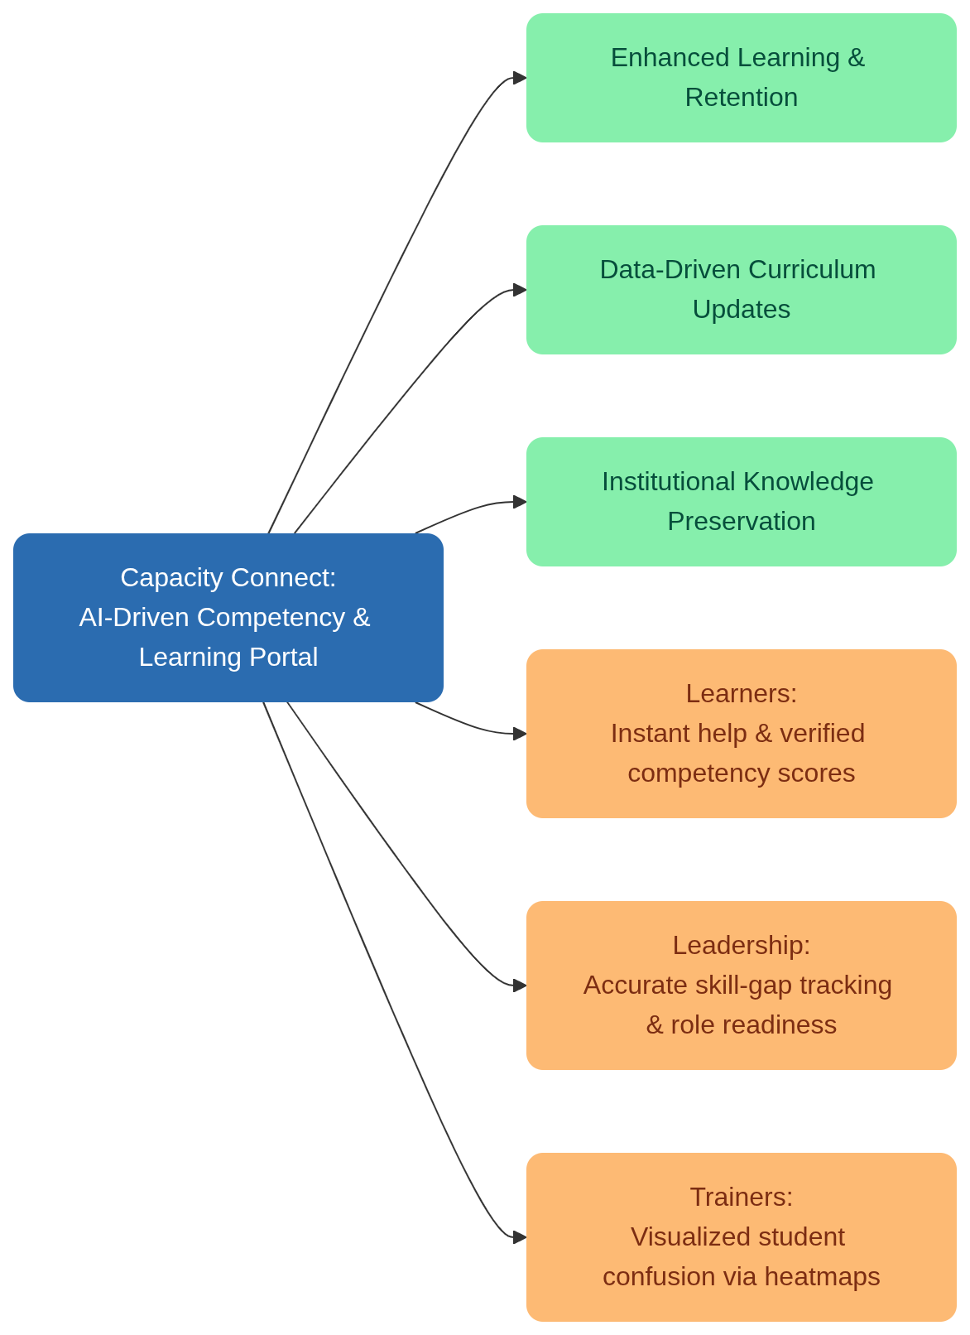
IMPACT AND BENEFITS
BLUE
Target Audience:
Trainees, Trainers, and Leadership at MoES and other technical organizations.
Impact:
●
Transforms passive video consumption into active, measurable competency building by tracking true understanding.
Eliminates blind spots for trainers by visually highlighting the exact minutes where learners struggle.
Captures the nuanced expertise of retiring senior staff and turns it
●
●
into a permanent, searchable database.
Benefits:
●
Instant unblocking of learners via Peer Rescue and Intelligent Q&A.
Automated, AI-driven curriculum feedback saves trainers hours of manual review.
Cost-effective, open-source architecture with offline-first capabilities for remote stations.
●
●
@SIH Idea submission- Template

Slide 6
RESEARCH AND REFERENCES
BLUE
Designing capacity-building in e-learning expertise: challenges and strategies:https://oro.open.ac.uk/12571/1/Capacity_Building_v1b.pdf
A Learning Analytics Model for Competency Mapping in Technical Education:https://www.researchgate.net/publication/396774373_A_LEARNING_ANALYTICS_MODEL_FOR_COMPETENCY_MAPPING_IN_ENGINEERING_EDUCATION_AN_EMPIRICAL_STUDY
Cloud-Based Learning Management Systems: Adoption, Outcomes, and Scalability:https://www.researchgate.net/publication/399792196_Cloud-Based_Learning_Management_Systems_Adoption_and_Outcomes
A Study of Competency Mapping as a Tool for Knowledge Management:https://www.researchgate.net/publication/374158094_A_STUDY_OF_COMPETENCY_MAPPING_AS_A_TOOL_FOR_KNOWLEDGE_MANAGEMENT
IEEE Standard for Learning Technology — Experience API (xAPI) for Analytics:https://standards.ieee.org/ieee/9274.1.1/7350/
The WebSocket Protocol (RFC 6455) for real-time peer communication architecture:https://datatracker.ietf.org/doc/html/rfc6455
@SIH Idea submission- Template

