Slide 1
HTTP, DNS and Web Server Architecture

Slide 2
Web Servers
What is a Web Server?

Slide 3
Web Servers
What is a Web Server?
A web server is a computer program that delivers (serves) content, such as web pages, using the Hypertext Transfer Protocol (HTTP), over the World Wide Web. The term web server can also refer to the computer or virtual machine running the program.
http://en.wikipedia.org/wiki/Web_server

Slide 4
Web Servers
How do they work?

Slide 5
Web Servers
How do they work?
Listen on the network for a request (ie Browser request)
Once they receive a request then validate it
Once validated it determines if the request is for a page or is an application call (ie form data)
If determined to be an application request, it passes the request on to an application (or application server)
Retrieves web page, or receives application response, and formats the response for the client (ie Browser response)

Slide 6
Some terminology...
Host – Computer connected to a network
Port – Endpoint of communication on a host
Protocol – Set of rules for exchanging data. Has its own URI scheme

Slide 7
Uniform Resource Identifier (URI)
Used to identify resources on the Internet
<scheme>:<hierarchical part>[?<query string>] [#fragment]
Browsers will act on the part depending on which scheme is used

Slide 8
Uniform Resource Locator (URL)
A specific type of URI used to locate a resource.
Other types of URIs may be used to simply name them (URNs)
<scheme>://<domain>[:<port>]/<path>[?<query string>][#fragment]
Look familiar yet?
http://example.com:80/first/second/third.ext?a=1&b=2#look-here

Slide 9
Other common URI Schemes
ftp:// - File Transfer Protocol
data:// - BASE64 encoded raw data, most often used with images
mailto: - Identify an email address and default content

Slide 10
IP Address
Internet Protocol Address
32 bits (4 8-bit parts) – IPv4 – 192.168.1.5
64 bits (8 16-bit parts) – IPv6 - fe80::c2ee:fbff:fe20:5f48
Identifies each device connected to a network
Servers
PCs
Smartphones
Printers
VOIP phones
...

Slide 11
IPv6
Address space for IPv4 was depleted in 9/24/2015
IPv6 has enough for everyone – about 5*10²⁸ per person currently on the planet!
64-bit network prefix, 64-bit host address, numerous ways to abbreviate
0000=0
56c7:0:0:0:47ee=56c7::47ee
To simplify things, we'll generally talk about IPv4 in this course
RPI currently rolling out IPv6 – right now supports both.

Slide 12
Domain Name System (DNS)
Directory of domain names
Resolves names to IP addresses
Rpi.edu → 128.113.2.68
Find using a DNS lookup
Records also kept for subdomains, mail servers, etc.

Slide 13
Domain Name System (DNS)
DNS is hierarchical
Labels (parts) of a domain are ordered
Labels (parts) ordered from lowest to highest
Top-level Domain (TLD) at the highest level
www.example.com
Name servers keep track of name->IP mappings
Authoritative Name Servers: Original mappings
Caching Servers: Store authoritative results

Slide 14
127.0.0.1
Special IP, called a “loopback address”
Also referred to as “localhost”
Refers to the same machine

Slide 15
Hosts File
Contains a local mapping of host names (possibly including domain names) to IPs
/etc/hosts on Mac/Unix/Linux
C:/windows/system32/drivers/etc/hosts On Windows

Slide 16
Hosts file format
Comments start with #
<IP> <hostname>
Ex:
127.0.0.1 localhost # loopback address

Slide 17
HTTP
Hypertext Transfer Protocol
http:// scheme
Uses port 80 by default
Most recent (and common) version is HTTP/1.1.

Slide 18
HTTPS
Hypertext Transfer Protocol Secure
https:// scheme
Uses port 443 by default
Combines HTTP with Secure Socket Layer/Transport Layer Security (SSL/TLS) for encryption

Slide 19
SSL Certificates
Browsers come with a series of trusted Certificate Authorities (CAs)
For a fee, CAs will provide site owners with a digitally-signed certificate file, certifying the owner's identity
Web servers automatically send their certificate when responding to a request for an encrypted session
Encryption starts if the browser trusts the certificate
Self-signing is possible, but isn't recognized by default
Users are warned first

Slide 20
HTTP is Stateless
Each request is processed independently of any other request
No concept of a user session is built in
How do Web applications track state?
Good question! You'll see a few ways later on...

Slide 21
Anatomy of an HTTP request
<method (aka verb)> <path> HTTP/1.1
<header name>: <header data>
...
CR/LF
Message (optional)

Slide 22
HTTP Methods
Define what to do with the path and message
“I want to GET the resource at /index.html”
“I want to POST the following to /blog/posts/new: <message>”

Slide 23
HTTP methods
Two most common: GET and POST
Two less common: PUT and DELETE
Others are defined, but used very rarely or not at all

Slide 24
HTTP Get
Retrieve a resource from the server
Information is passed along the query string, not the message body
Starts with “?”, then followed by name=value pairs separated by “&”
http://example.com/index.php?id=1&color=blue
More on using query strings in practice later

Slide 25
HTTP Post
Post information to the server via the request's message body
Can create or update information
Multiple POSTs may have a cumulative effect

Slide 26
HTTP PUT
Puts information on the server via the request's message body
Can only create information
Multiple PUTs have the same effect as one

Slide 27
HTTP DELETE
Remove information from the server via the message body
Can only delete information
Multiple DELETEs have the same effect as one

Slide 28
Idempotence
(eye-dem-po-tens)
The property of an operation to be applied multiple times while yielding the same result.
Refers to the state of the system AFTER the request has completed.
So : an operation is idempotent if the system remains in the same state no matter how many times the operation is called after the 1st time – the result will not change
Ie DELETE unique_record FROM database
Notes:
Moms are idempotent – “no matter how many times you ask me – the answer is still no”

Slide 29
Idempotent Methods
GET – looking shouldn't change anything
PUT – a single representation of data should only be added once
DELETE – however many times you delete something, it's still gone

Slide 30
Non-Idempotent Methods
POST – repeat operations may have a cumulative effect
If your operation is not idempotent, you must use POST to accept input!
This will become important once we get to server-side programming...

Slide 31
Safe Methods
Methods that don't modify anything on the server
GET, other less-used methods for retrieving metadata are safe
POST, PUT and DELETE modify resources, not safe
Only safe methods are used by search engines, etc

Slide 32
HTTP Request Header
Specify additional information about the request
Host: <domain name>
“This is the domain name I'm referring to.” Required in HTTP/1.1.
User-Agent: <string>
“This is the software I'm using to access your site.”
Content-Type: <type>
MIME type of the request body (used with POST/PUT)
Many others

Slide 33
HTTP Message Body
Used by methods that alter information on the server
POST (most common)
PUT
DELETE

Slide 34
Anatomy of an HTTP Response
HTTP/1.1 <status code> <reason>
<header name>: <header data>
…
CR/LF
<response body>

Slide 35
HTTP Status codes
Informs the browser of the resulting status of the request
Three digits
First digit indicates class of response
Custom status codes possible

Slide 36
1xx - Informational
Acknowledges the request was received, and that the server is ready to continue
Used less frequently
Ex: 102 Processing
“I'm still working on that last request, but I don't have an answer for you yet. Hold on.”

Slide 37
2xx - Success
Acknowledges that the request was received and processed successfully
200 OK
“Sure, here you go.”
Most common response

Slide 38
3xx - Redirection
Informs the client that they need to act on the request before it can be carried out
301 Moved Permanently
“This has moved. It now lives here.”
302 Found
“This has moved for now, but keep checking back here.”

Slide 39
4xx – Client Error
Informs the client of an error that is probably on their end
401 Unauthorized
“This request requires authentication. If you want another response, send me your credentials first...”
403 Forbidden
“I'm afraid I can't let you do that, Dave.”
404 Not Found
“I don't know where that is.”

Slide 40
5xx – Server Error
Informs the client of an error when the server knows it is at fault.
Usually due to misconfigured Web server.
500 Internal Server Error
“Something unexpected happened. My fault.”
501 Not Implemented
“I don't know how to do that.”
503 Service Unavailable
“We're currently experiencing some technical difficulties...”

Slide 41
HTTP Response Headers
Provide additional information about the response
Content-Type: <type>
MIME-type of the response
Location: <URL>
Provides the location of a resource, most common in 3xx responses
Many others

Slide 42
HTTP Response Body
The body of a response contains the actual content to be delivered
Could be an HTML page, XML file, image, PDF, etc. depending on the Content-Type

Slide 43
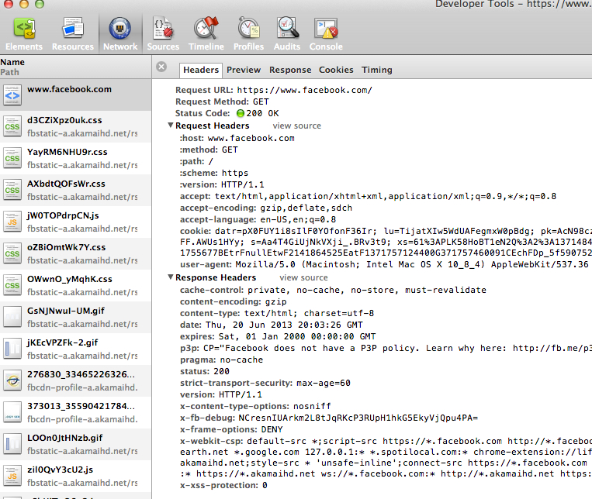
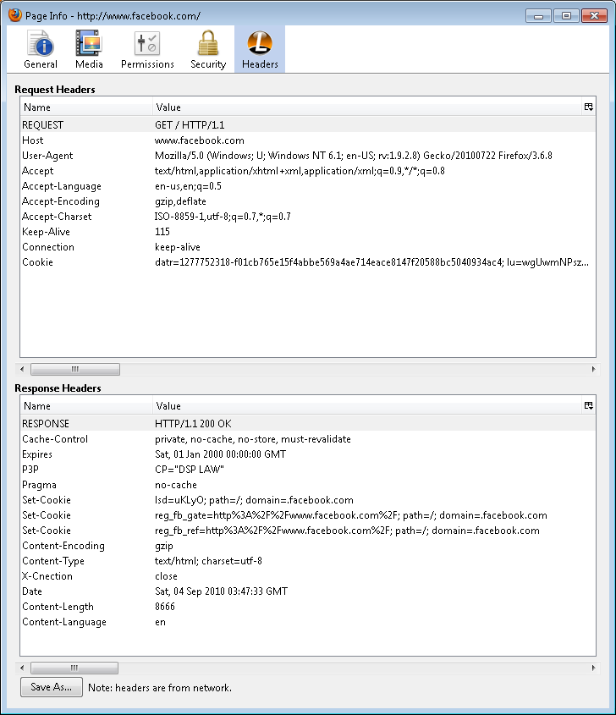
HTTP Protocol
Let’s look at an HTTP request / response cycle:
Open Chrome, and visit http://www.facebook.com (or any site of your choosing)
Select (Hotdog menu) → Tools
→ Developer Tools
Select Network and then select a
page (in this case www.facebook.com)
Select “Headers” to see the Request and Response headers

Slide 44
Telnet
Allows you to send requests and see responses using a command-line interface
telnet <hostname> <port>
Open connection, so you don't get a cursor
Connection may time out if you take too long

Slide 45
Telnet
> telnet www.rpi.edu 80
(connect to the host at www.rpi.edu on port 80)
> GET /index.html HTTP/1.1
GET the resource at /index.html
> Host: www.rpi.edu
Host header is required
> (blank line)
We're done now.

Slide 46
How is a request processed?

Slide 47
Three-Tier model
Presentation Layer (User Interface)
Web Server
Application Layer (processing)
Application Server
Data Layer (database)
Database Server
Not the same as Model-View-Controller (MVC)
Similar – but different.
What is the difference?

Slide 48
Presentation Layer
Where the Web server receives and responds to requests made by the browser
Markup and client-side languages (HTML, CSS, JavaScript, etc)
Front-end, the layer that the end user sees

Slide 49
Application Layer
Business logic, dynamic content
Server-side languages/frameworks
(PHP, Ruby on Rails, .NET, etc)
Colloquially included in back-end when distinguished from front-end, but ties the two together

Slide 50
Data Layer
Persistent data storage
Includes both the database and the data contained within
Back-end, the component furthest from what the user sees

Slide 51
How it works
User Agent
Web Server
GET
/?q=life
HTTP/1,1
Listening
Application Logic
Database
Presentation Layer
Application Layer
Database Layer

Slide 52
How it works
Hey you! Over there at that IP on port 80 – I have to ask you something…
User Agent
Web Server
GET
/?q=life
HTTP/1,1
HTTP
Listening
Application Logic
Database
Presentation Layer
Application Layer
Database Layer

Slide 53
How it works
User Agent
Web Server
GET
/?q=life
HTTP/1,1
HTTP
Processing
Application Logic
Database
Presentation Layer
Application Layer
Database Layer

Slide 54
How it works
Yo App, I found this script you can process. Process it and give me the result
User Agent
Web Server
GET
/?q=life
HTTP/1,1
HTTP
Processing
Application Logic
Database
Presentation Layer
Application Layer
Database Layer

Slide 55
How it works
SELECT answer FROM universe WHERE meaning=‘life’;
User Agent
Web Server
GET
/?q=life
HTTP/1,1
HTTP
Listening
Application Logic
Database
Presentation Layer
Application Layer
Database Layer

Slide 56
How it works
User Agent
Web Server
GET
/?q=life
HTTP/1,1
HTTP
Listening
Application Logic
Database
Got one! Found 1 result: 42
Presentation Layer
Application Layer
Database Layer

Slide 57
How it works
User Agent
Web Server
GET
/?q=life
HTTP/1,1
HTTP
Listening
Application Logic
Database
Done. Here’s how you respond
Presentation Layer
Application Layer
Database Layer

Slide 58
How it works
User Agent
Web Server
GET
/?q=life
HTTP/1,1
HTTP
Processing
Application Logic
Database
Presentation Layer
Application Layer
Database Layer

Slide 59
How it works
User Agent
Web Server
GET
/?q=life
HTTP/1,1
HTTP
Processing
Application Logic
Database
Got your request. Here’s my response: 42
Presentation Layer
Application Layer
Database Layer

Slide 60
How it works
User Agent
Web Server
GET
/?q=life
HTTP/1,1
Listening
Application Logic
Database
Presentation Layer
Application Layer
Database Layer

Slide 61
How it works
A request is received by the Web server
The server determines how to respond to the request, deferring to the application layer if necessary
The application layer retrieves from and/or updates the data layer as necessary, and constructs a response
If a static resource was found, it is simply returned
The response is passed to the presentation layer

Slide 62
How it works
The vast majority of responses request other resources
Images
Stylesheets
Scripts
Etc
Requests should be minimized to improve performance
More on this later...

Slide 63
Why this is a good thing
Loose coupling
Abstraction layers improve interoperability
Promotes data reuse
Between layers
Across systems
Scalable
Layers (Tiers) can run on separate systems
We'll talk about ways to do this to improve performance later on...

Slide 64
We'll be working our way back through the layers as the course progresses
Everything builds on everything covered before
Next up: Apache Web Server Configuration

