Slide 1
Ericsson Logistics Challenge
Come up with a solution that can help and detect fraudulent shipments in supply chains in order to avoid unsustainable and inhumane conditions taking place in production

Slide 2
Objective
Propose a solution for Agenda 2030 goal: Responsible Consumption and Production
To solve a global goal the global population need to strive for change
Increase awareness
Increase transparency
Aim for simplicity

Slide 3
Proposed solution
Fully transparent transaction log including transactions and conversion of materials/products
Data visualization using a graph in order to make the data easily readable
Transactions need to match in order to not raise suspicions about fraud
Should be usable for
Consumers
Manufacturers
Compliance
Should work with existing IT-systems used in the business

Slide 4

Current solution

Slide 5
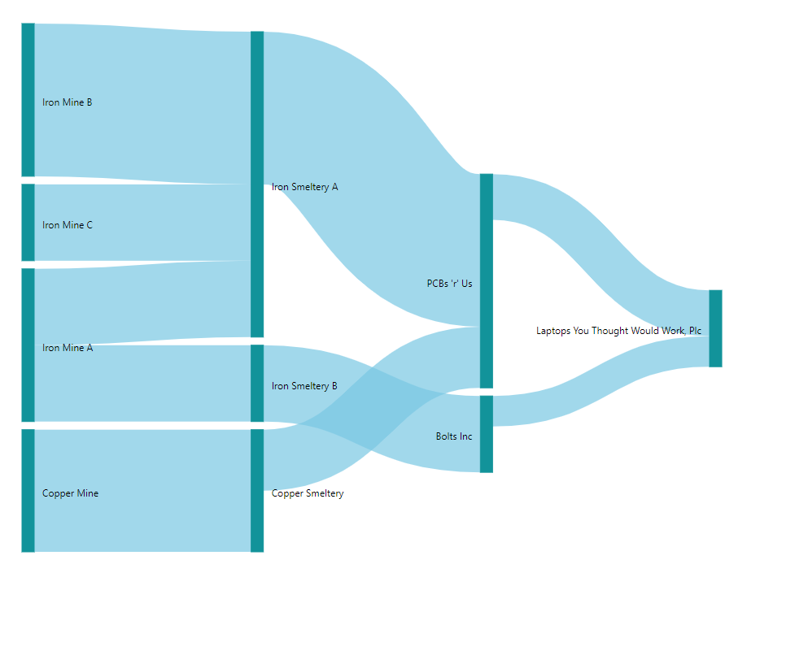
Current solution

Slide 6
Result
Easily usable
Increases awareness
Fully transparent

Slide 7
Questions?

Slide 8
Thank you

